Slide 1
Learn Attention Mechanism For Image Caption Generation
Nguyễn Duy Tuấn: 520K0232
Trịnh Bảo Toàn: 520K0332

Slide 2
Introduction
The attention mechanism is a complex cognitive ability that human beings possess. When people receive information, they can consciously ignore some of the main information while ignoring other secondary information.
This ability of self-selection is called attention. The attention mechanism allows the neural network to have the ability to focus on its subset of inputs to select specific features.
In recent years, neural networks have fueled dramatic advances in image captioning. Researchers are looking for more challenging applications for computer vision and Sequence to Sequence modeling systems. They seek to describe the world in human terms. In the last article we had seen Image Captioning through a Merge architecture, today we’ll be looking at a much more complex yet refined design to tackle this problem.
Attention mechanism has been a go-to methodology for practitioners in the Deep Learning community. It was originally designed in the context of Neural Machine Translation using Seq2Seq Models, but today we’ll take a look at its implementation in Image Captioning

Slide 3

Rather than compressing an entire image into a static representation, the Attention mechanism allows for salient features to dynamically come to the forefront as and when needed. This is especially important when there is a lot of clutter in an image.
Let’s take an example to understand better:

Slide 4
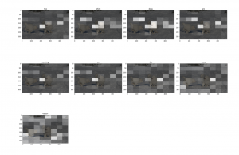
Our aim would be to generate a caption like “two white dogs are running on the snow”. To accomplish this we will see how to implement a specific type of Attention mechanism called Bahdanau’s Attention or Local Attention.
In this way, we can see what parts of the image the model focuses on as it generates a caption. This implementation will require a strong background in deep learning.

Slide 5
Approach to the problem statement
The encoder-decoder image captioning system would encode the image, using a pre-trained Convolutional Neural Network that would produce a hidden state. Then, it would decode this hidden state by using an LSTM and generate a caption.
For each sequence element, outputs from previous elements are used as inputs, in combination with new sequence data. This gives the RNN networks a sort of memory which might make captions more informative and contextaware.
But RNNs tend to be computationally expensive to train and evaluate, so in practice, memory is limited to just a few elements. Attention models can help address this problem by selecting the most relevant elements from an input image.
With an Attention mechanism, the image is first divided into n parts, and we compute an image representation of each When the RNN is generating a new word, the attention mechanism is focusing on the relevant part of the image, so the decoder only uses specific parts of the image.

Slide 6
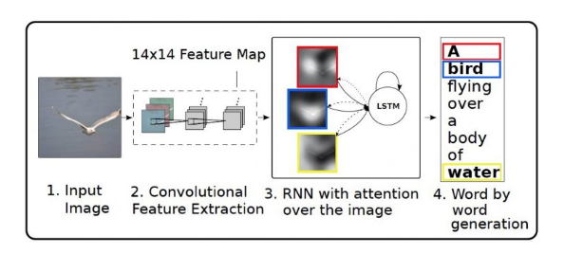

Slide 7
In Bahdanau or Local attention, attention is placed only on a few source positions. As Global attention focuses on all source side words for all target words, it is computationally very expensive. To overcome this deficiency local attention chooses to focus only on a small subset of the hidden states of the encoder per target word.
Local attention first finds an alignment position and then calculates the attention weight in the left and right windows where its position is located and finally weights the context vector. The main advantage of local attention is to reduce the cost of the attention mechanism calculation.
In the calculation, the local attention is not to consider all the words on the source language side, but to predict the position of the source language end to be aligned at the current decoding according to a prediction function and then navigate through the context window, considering only the words within the window.

Slide 8
Design of Bahdanau Attention
All hidden states of the encoder and the decoder are used to generate the context vector. The attention mechanism aligns the input and output sequences, with an alignment score parameterized by a feed-forward network. It helps to pay attention to the most relevant information in the source sequence. The model predicts a target word based on the context vectors associated with the source position and the previously generated target words.
To evaluate our captions in reference to the original caption we make use of an evaluation method called BLEU. It is the most widely used evaluation indicator. It is used to analyze the correlation of n-gram between the translation statement to be evaluated and the reference translation statement.
In this article, multiple images are equivalent to multiple source language sentences in the translation. The advantage of BLEU is that the granularity it considers is an n-gram rather than a word, considering longer matching information. The disadvantage of BLEU is that no matter what kind of n-gram is matched, it will be treated the same.

