Slide 1
Image Captioning Using CNN and LSTM
Nguyễn Duy Tuấn: 520K0232
Trịnh Bảo Toàn: 520K0332

Slide 2
Introduction
Descriptor generator for images related to Computer Vision and Natural Language processing to recognize the context of images and proceed to describe them in natural language. This project uses CNN (Convolutional Neural Networks) and LSTM (Long Short Term Memory) to deploy. The image features will be extracted from Xception-an architectural style of CNN, trained on the imagenet dataset and then put the features into the LSTM model, this model will be responsible for creating the description for the image

Slide 3
Xception
Is a deep convolutional neural network architecture that involves Depthwise Separable Convolutions. This network was introduced Francois Chollet who works at Google, Inc (Fun-Fact: He is the creator of keras)
Also known as “extreme” version of an Inception module. Hence, let us look at the Inception module before delving into Xception.

Slide 4
Inception Network
An inception network is a deep neural network (DNN) with a design that consists of repeating modules referred to as inception modules.
The name Inceptions probably sounds familiar to some readers, especially if you are a fan of the actor Leonardo DiCaprio or movie director, Christopher Nolan. Inception (directed by Christopher Nolan) is a movie released in 2010, and the concepts of embedded dream state were the central premise of the film. This is where the name of the model was taken from.
In general, each layer if DNN is considered to extract some feature, then stacking these layers one above each other is not a great idea. Deep networks are prone to overfitting, and chaining multiple convolutional operations together increases the cost to train the network. Another issue is as each layer type extracts a different kind of information, how do we know which transformation (kernels) provides the most useful information to the DNN?

Slide 5
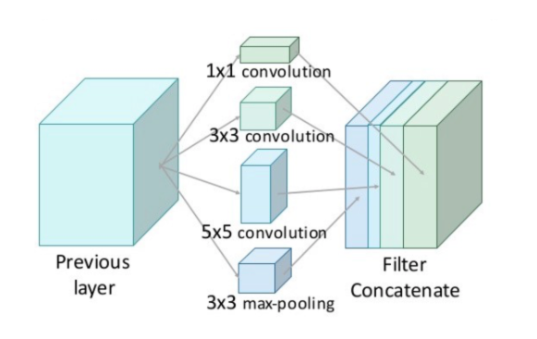

Slide 6
An Inception module computes multiple different transformations (as shown in the figure above) over the same input and then finally combining all the output which lets the model decide what features to take and by how much.
There is one problem. It is still computationally inefficient because of convolutions. These convolutions not only happens spatially, but also across the depth. So, for each additional filter, we have to perform convolution over the input depth to calculate just a single output map, and because of this, the depth becomes a huge bottleneck in the DNN.
How about reduce the depth? This depth can be reeduced by doing 1X1 convolution acroos the depth. This convolution looks acrosss multiple channel's spatial information and compress it down to a lower dimension. For example, using 30 1x1 filters, input of size 128x128x100 (with 100 feature maps) can be compressed down to 128x128x30.
Due to this reduction, the researchers of Inception module were able to concatenate different layer transformations in parallel, resulting in DNN that was wide and deep. The images below shows difference between Inception module without 1X1 filters and one with 1X1 filters.

Slide 7
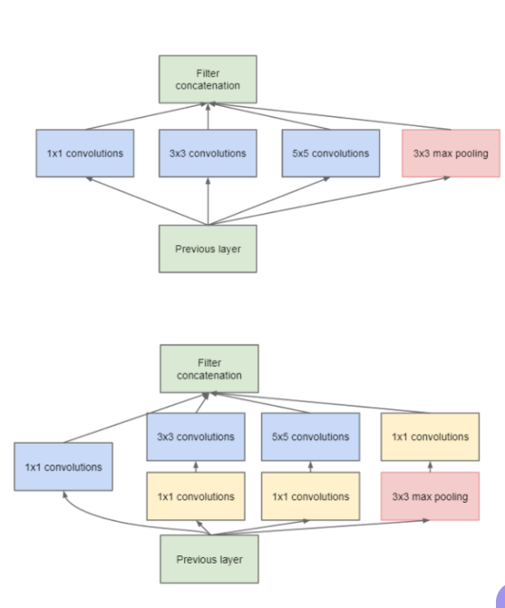

Slide 8
Xception(continue)
Xception stands for “extreme inception”, it takes the principles of Inception to an extreme. In Inception, 1x1 convolutions were used to compress the original input, and from each of those input spaces we used different type of filters on each of the depth space. Xception just reverses this step. Instead, it first applies the filters on each of the depth map and then finally compresses the input space using 1X1 convolution by applying it across the depth. This method is almost identical to a depthwise sepa- rable convolution, an operation that has been used in neural network design as early as 2014. There is one more difference between Inception and Xception. The presence or absence of a non-linearity after the first operation. In Inception model, both operations are followed by a ReLU non-linearity, however Xception doen't introduce any non-linearity.

Slide 9
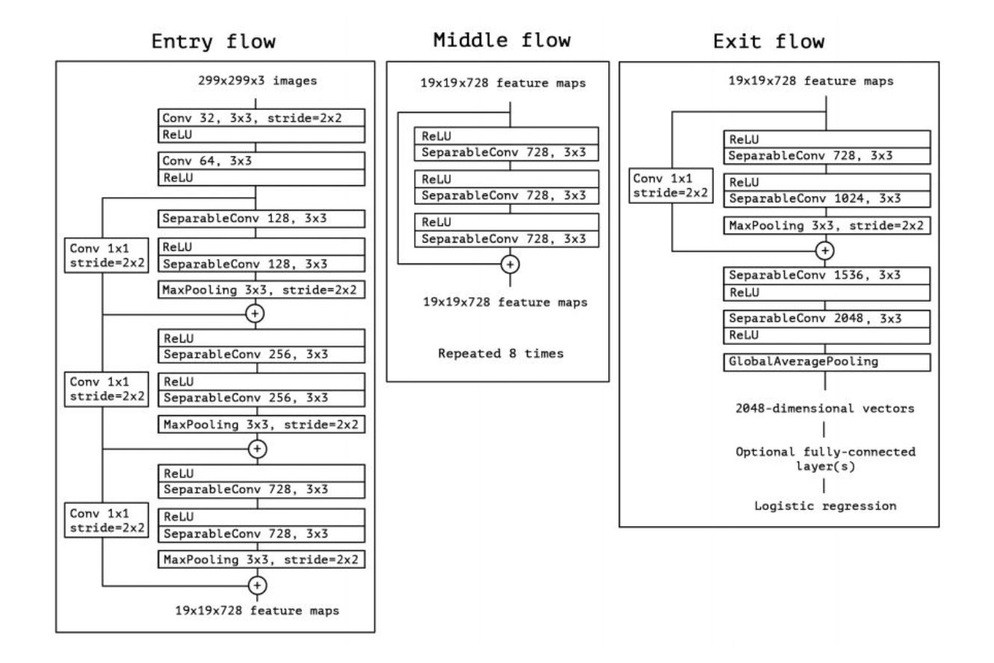
What does Xception look like?

Slide 10
The data first goes through the entry flow, then after than it. goes through the middle flow (repeating itself 8 times in this middle flow), and finally through the exit flow.
Xception implemented using the TensorFlow framework by Google and trained on 60 NVIDIA K80 GPUs each.

Slide 11
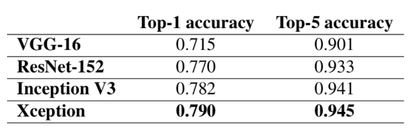
Results
Table below shows that Xception outperforms every model in ImageNet dataset.

Slide 12
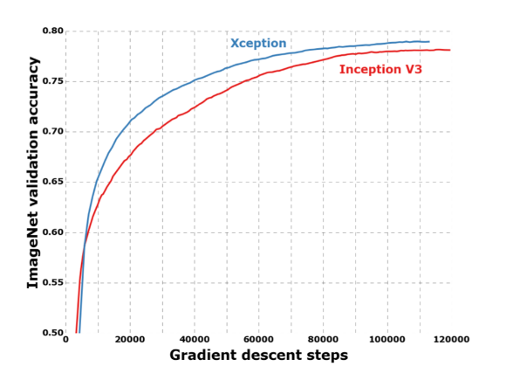
Validation accuracy is also higher for Xception than inception model shown below.

Slide 13
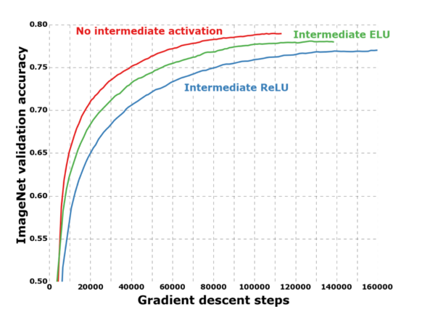
The graph below shows that having no non-linearity in between Xception performs better than having any kind on non-linearity.

Slide 14
Dataset
The Flickr_8K dataset will be used in this project, besides this dataset there are other larger datasets such as Flickr_30K and MSCOCO but it will take many weeks to be able to train on such large datasets, so in this article only use a small dataset is Flickr_8K. The advantage of a large dataset is that it can build better, more optimal models
The Flickr_8k_text folder contains the Flickr8k.token file which is the main file of the dataset, containing image names and corresponding descriptions of the image, separated by newline(“\n”)

Slide 15
Requirement
pip install tensorflow
keras
pillow
numpy
tqdm
jupyterlab

Slide 16
Main Content
CNN (Convolutional Neural networks) - Convolutional neural networks are deep neural networks that can process data with a matrix-like 2D input shape. Image data is very easy to represent as a 2D matrix, which makes CNN useful for working with image data. CNNs are basically used to classify images and identify whether the image is a bird, a plane, or maybe Superman…etc. CNN scans the image from left to right and from top to bottom to extract important features from the image and combine them to classify the image. It can handle images that have been translated, rotated, scaled and changed perspective

Slide 17
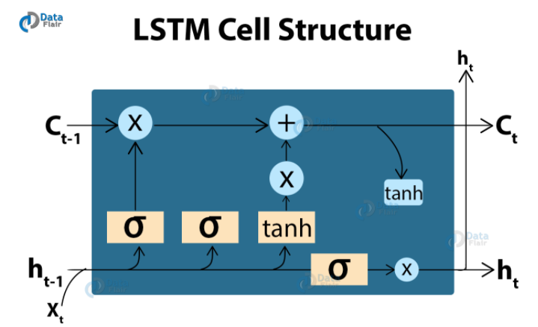
LSTM (Long short term memory) is a type of RNN (Recurrent Neural Network) - a recurrent neural network, very suitable for sequence prediction problems. Based on the previous text, they can predict what the next word is. It has proven its effectiveness from traditional RNNs by overcoming the limitations of RNNs that have short-term memory. LSTM can execute meaningful information throughout the input processing process and with forget gate, it will eliminate any meaningless information.

Slide 18
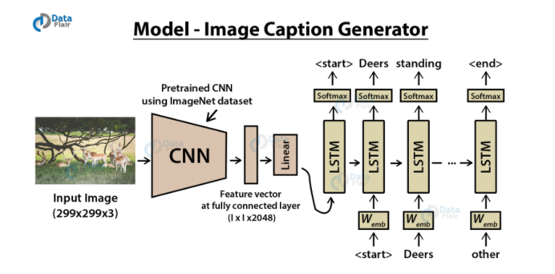
General model
To build a model that creates descriptions for images, we will merge the architectures mentioned above. It is also called a CNN-RNN model.
CNN is used to extract features from images. we will use the pre-trained Xception model. LSTM uses information from CNN to help create descriptions for images.

Slide 19
Flicker8k_Dataset: Contains 8091 images Flickr_8k_text: Contains text files and annotations of images. The following files will be created during the implementation of the project2: Models - Contains training models Descriptions.txt - Contains all image names and their descriptions after preprocessing Features.p - A pickle object containing images and their feature vectors extracted from Xception pre-trained from CNN model Tokenizer.p - contains tokens referenced with an index value Model.png - Visually presents the size of the project Testing_caption_generator.py - Python file to create descriptions for images Training_caption_generator.ipynb - Training model to create descriptions for images

Slide 20
