Slide 1
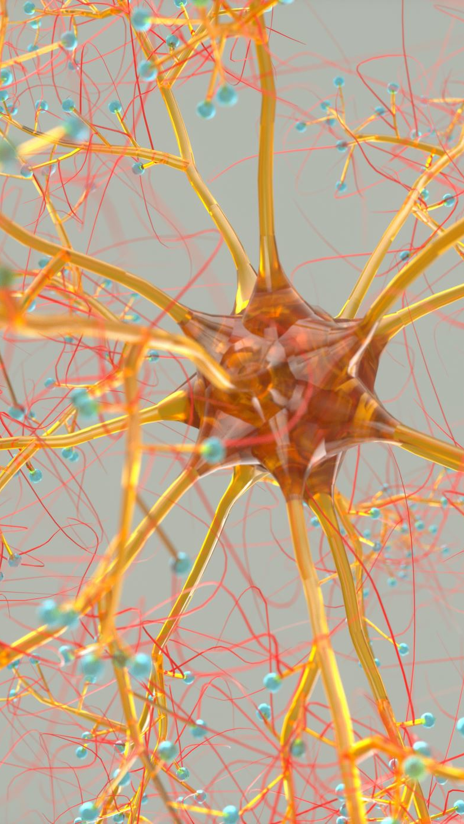
Attention Work in Encoder-Decoder Recurrent Neural Networks
520K0232: Nguyễn Duy Tuấn
520K0332: Trịnh Bảo Toàn

Slide 2
Encoder-Decoder Model
Both developed the technique to address the sequence-to-sequence nature of machine translation where input sequences differ in length from output sequences.
Ilya Sutskever, et al. do so in the paper “Sequence to Sequence Learning with Neural Networks” using LSTMs.
Kyunghyun Cho, et al. do so in the paper “Learning Phrase Representations using RNN Encoder–Decoder for Statistical Machine Translation“. This work, and some of the same authors (Bahdanau, Cho and Bengio) developed their specific model later to develop an attention model. Therefore we will take a quick look at the Encoder-Decoder model as described in this paper.

Slide 3
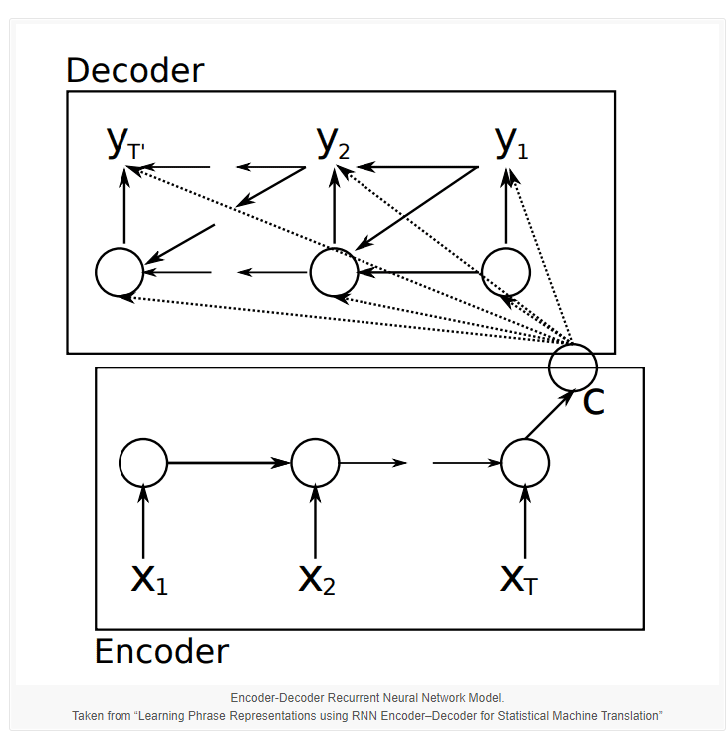
From a high-level, the model is comprised of two sub-models: an encoder and a decoder.
Encoder: The encoder is responsible for stepping through the input time steps and encoding the entire sequence into a fixed length vector called a context vector.
Decoder: The decoder is responsible for stepping through the output time steps while reading from the context vector.

Slide 4
Key to the model is that the entire model, including encoder and decoder, is trained end-to-end, as opposed to training the elements separately.
The model is described generically such that different specific RNN models could be used as the encoder and decoder.
Instead of using the popular Long Short-Term Memory (LSTM) RNN, the authors develop and use their own simple type of RNN, later called the Gated Recurrent Unit, or GRU.
Further, unlike the Sutskever, et al. model, the output of the decoder from the previous time step is fed as an input to decoding the next output time step. You can see this in the image above where the output y2 uses the context vector (C), the hidden state passed from decoding y1 as well as the output y1.

Slide 5
Attention Model
Attention was presented by Dzmitry Bahdanau, et al. in their paper “Neural Machine Translation by Jointly Learning to Align and Translate” that reads as a natural extension of their previous work on the Encoder-Decoder model.
Attention is proposed as a solution to the limitation of the Encoder-Decoder model encoding the input sequence to one fixed length vector from which to decode each output time step. This issue is believed to be more of a problem when decoding long sequences.

Slide 6
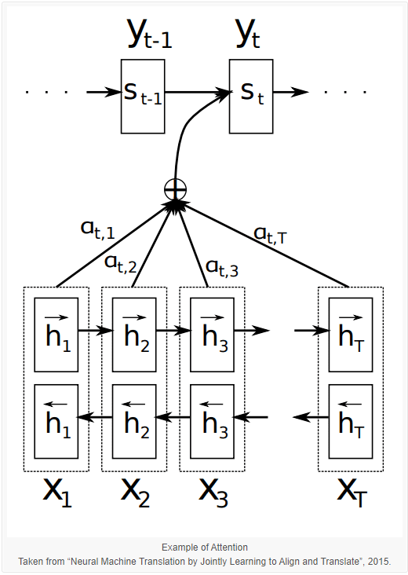
Attention is proposed as a method to both align and translate.
Alignment is the problem in machine translation that identifies which parts of the input sequence are relevant to each word in the output, whereas translation is the process of using the relevant information to select the appropriate output.
Instead of encoding the input sequence into a single fixed context vector, the attention model develops a context vector that is filtered specifically for each output time step.
As with the Encoder-Decoder paper, the technique is applied to a machine translation problem and uses GRU units rather than LSTM memory cells. In this case, a bidirectional input is used where the input sequences are provided both forward and backward, which are then concatenated before being passed on to the decoder.

