Slide 1

Project Title - Seasonal Agriculture Performance Analysis
Name – Surya Dev .A
College Name – Presidency University
AICTE STU ID : STU6a6ad681e26b51785386625

Slide 2

PROBLEM STATEMENT
(Agricultural activities are influenced by seasonal variations in environmental conditions, farming practices, resource availability and market conditions. As a result, agricultural performance may differ from one season to another. However, raw agricultural data does not clearly explain how agricultural performance changes across seasons or what patterns can be observed in different seasonal conditions. The problem is to analyze the given agricultural dataset and investigate seasonal differences in agricultural performance by identifying meaningful patterns, trends, relationships and variations within the available data.

Slide 3
Project Description
This project analyzes seasonal agricultural performance across Kharif, Rabi, and Zaid seasons using data related to crop production, environmental conditions, resource usage, and economic performance.
The analysis focuses on identifying seasonal patterns, variations, relationships, and significant differences in agricultural outcomes. Data cleaning, exploratory data analysis, statistical techniques, and visualizations are used to compare seasons and crops and understand factors associated with yield, resource efficiency, profitability, and agricultural risk.
Key focus areas:
Seasonal crop performance and productivity
Environmental conditions such as rainfall, temperature, and soil moisture
Water, fertilizer, and pesticide usage
Crop-wise yield and profitability
Disease and pest risk
Statistical comparison of seasonal yield
Data-driven insights and recommendations for agricultural planning

Slide 4

WHO ARE THE END USERS?
Farmers – To support crop and seasonal planning decisions.
Agricultural Planners – To analyze seasonal performance and resource requirements.
Government & Agricultural Departments – For data-driven agricultural planning and policy decisions.
Agricultural Analysts & Researchers – To study trends, relationships, and variations in agricultural data
Resource Management Teams – To evaluate water, fertilizer, and pesticide usage.
Agricultural Organizations – To improve crop selection, productivity, and profitability.

Slide 5

Technology Used
Python – Data analysis and statistical analysis
Google Colab – Development and execution environment
Pandas – Data cleaning, preprocessing, and analysis
NumPy – Numerical computations
Matplotlib – Data visualization
Seaborn – Statistical and comparative visualizations
SciPy – Statistical testing such as ANOVA and Kruskal–Wallis tests
CSV Dataset – Primary data source for the analysis

Slide 6
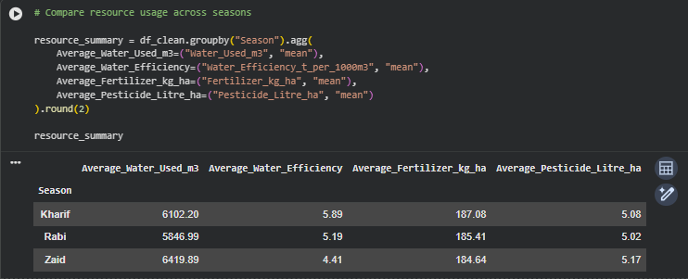
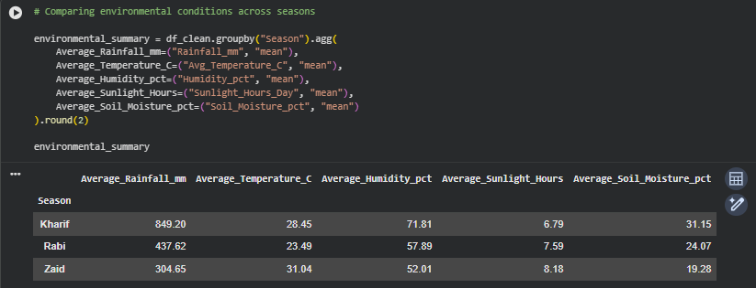
RESULTS

Slide 7
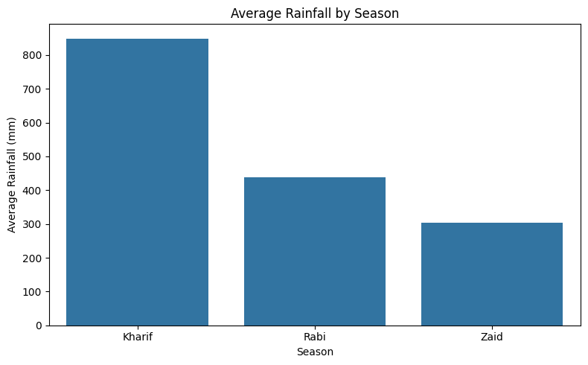
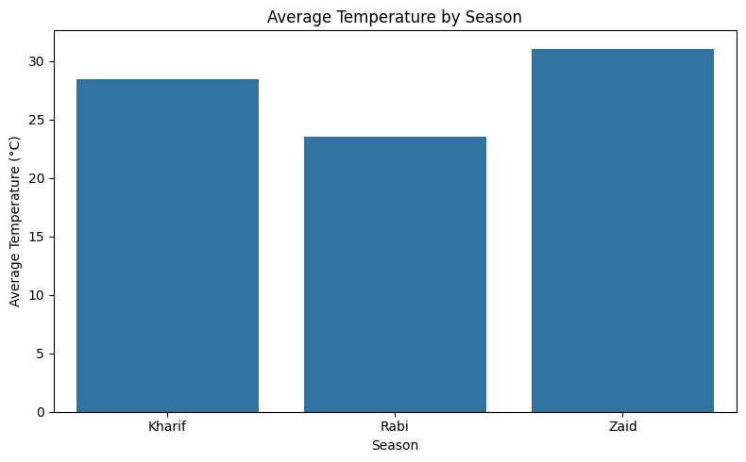
RESULTS

Slide 8
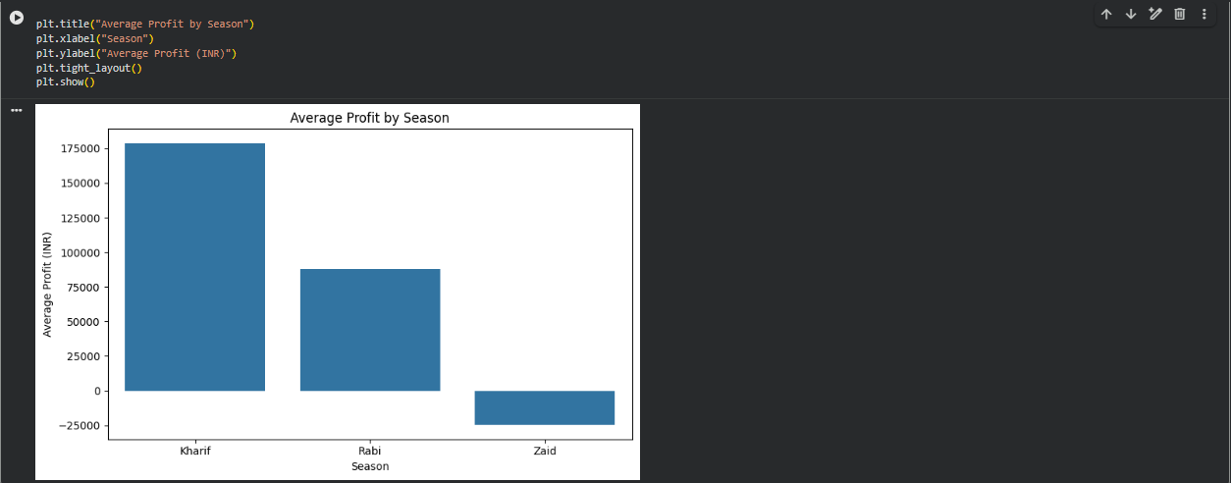
RESULTS
Seasonal Performance Analysis

Slide 9
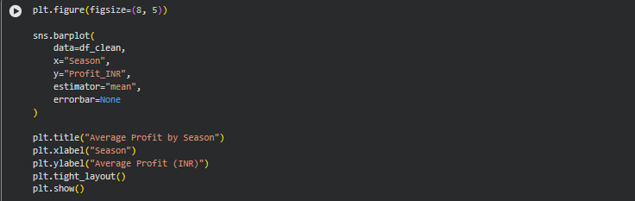
RESULTS
Key Findings
Kharif showed the highest overall economic performance.
Rabi showed moderate performance compared with Kharif.
Zaid recorded
negative average profit, indicating weaker economic performance.
Seasonal performance varies across productivity and economic indicators.

Slide 10
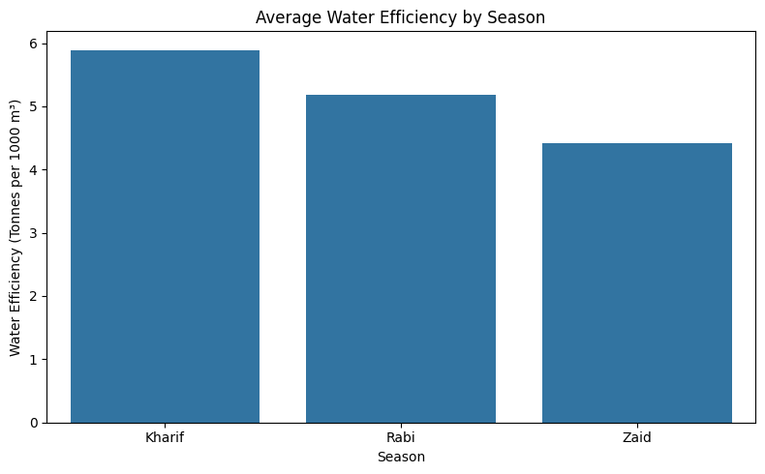
RESULTS
Water Usage / Water Efficiency

Slide 11
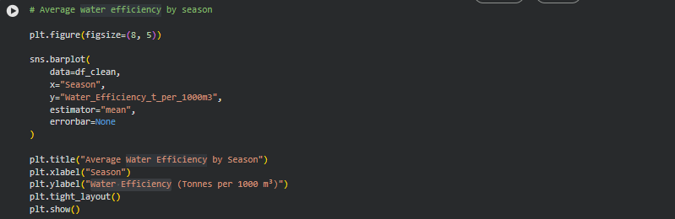
RESULTS

Slide 12
Future scope
Predictive Analysis: Develop models to predict crop yield and profitability for different seasons.
Weather Integration: Incorporate real-time weather data for better seasonal planning.
Crop Recommendation: Build a system to recommend suitable crops based on soil and seasonl conditions.
Resource Optimization: Use data analytics to optimize water, fertilizer, and pesticide usage.
Risk Prediction: Develop models to predict disease and pest risks.
Interactive Dashboard: Create a real-time dashboard for farmers and agricultural planners.
Larger Dataset: Extend the analysis using data from more regions, crops, and years.

Slide 13
GitHub Link
https://github.com/soo6ya/vois-data

Slide 14

VOIS Course completion certificate - Course name- Data Visualization

Slide 15
Thank you
Questions ?
.
.

