Slide 1
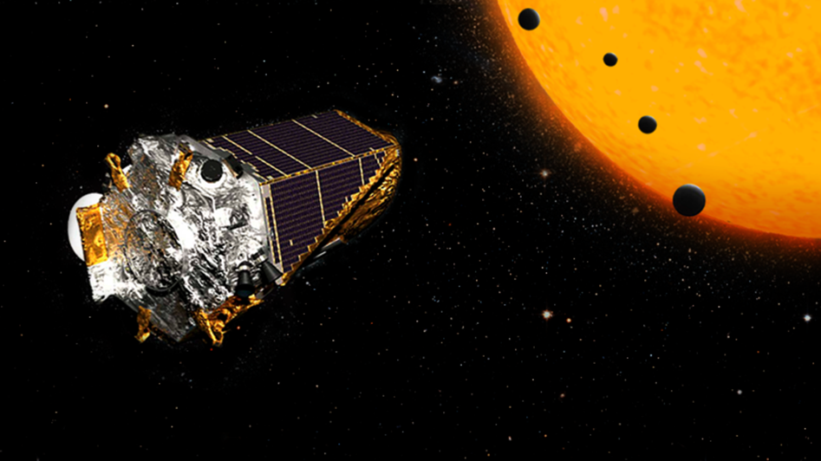
Kepler Telescope Data
Alex Zhang
Shiming Yan
Matthew Bazzo
Soo Hyung Choe

Slide 2
Dataset
9564 Observations
50 Variables
12 categorical
38 numerical
478 200 Data points

Slide 3
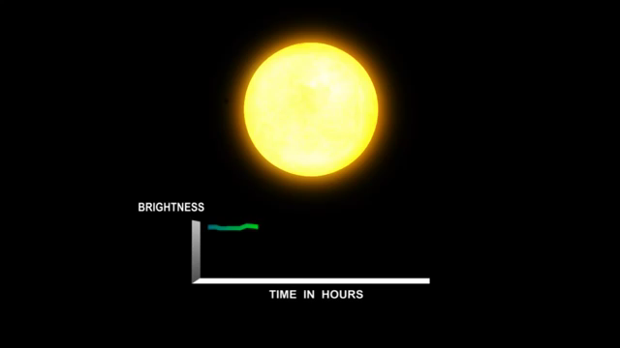
How was the Data Collected?

Slide 4
Initial Analysis of Data
3 Types of Disposition:
Candidate
False positive
Confirmed
Koi Score
4 False Flag Data
Planetary data (period, depth, temperature)
Features of its star (mass, age, temperature)

Slide 5
Questions We Asked?
E.D.A
How many planets could potentially host life?
Supervised
Can we use the data to determine the classification system?
Unsupervised
By analyzing planet characteristics can we determine planet clusters?

Slide 6
Exploratory Data Analysis
What things could we quickly learn from the data just by making some basic plots?
Could we gain a better understanding of our features?
How many planets could potentially host life?

Slide 7
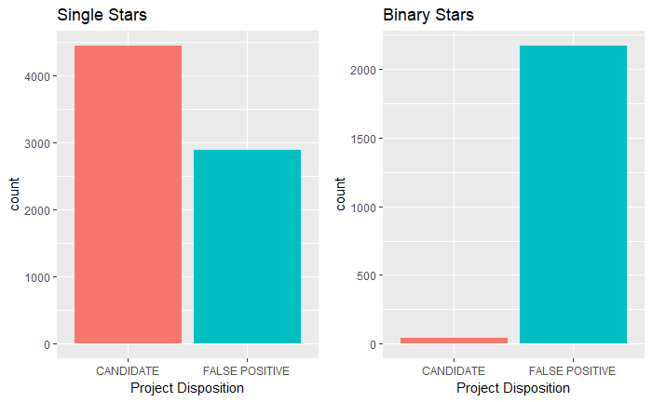
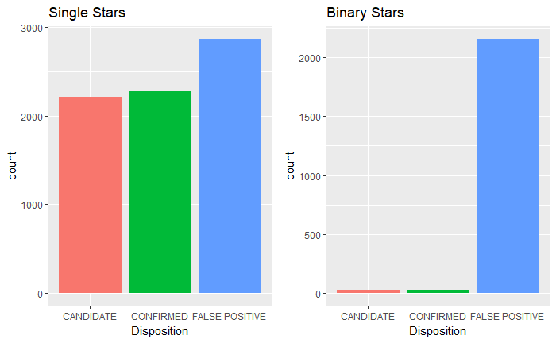
Are Binary Stars More Likely to Host Planets?
Conclusion
It looks like binary stars are less likely to host planets, but this could just be an issue with measurement.

Slide 8
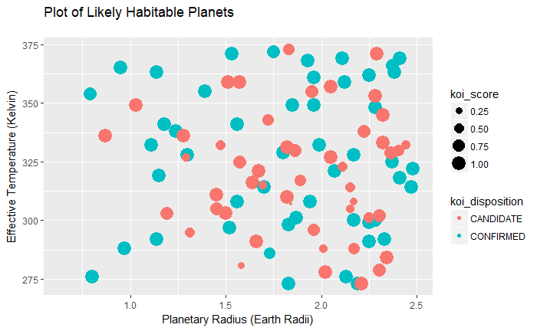
What do the “Goldilocks” Planets Look Like?
Conclusion
They tend to be larger and warmer than the Earth. Also the ‘koi_score’ values seem to show that astronomers are fairly certain that observations within this range are planets.

Slide 9
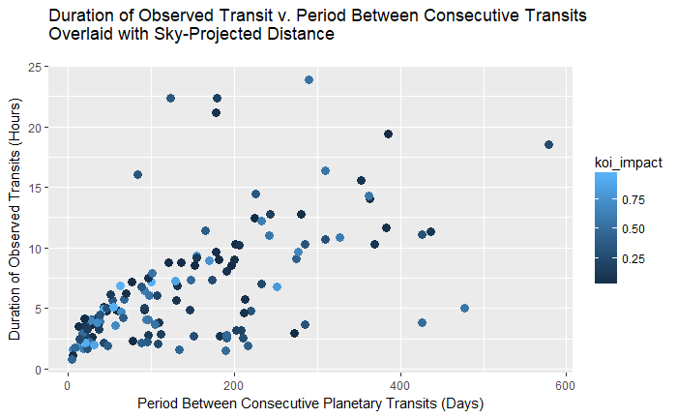
Does “Sky-Projected Distance” Indicate Actual Distance?
NOTE: “koi_impact” = “sky-projected distance”
Conclusion
Assuming longer durations of observed transits and planetary transit periods imply larger planet-star distance, it’s not clear that “sky-projected distance” is an appropriate proxy.

Slide 10
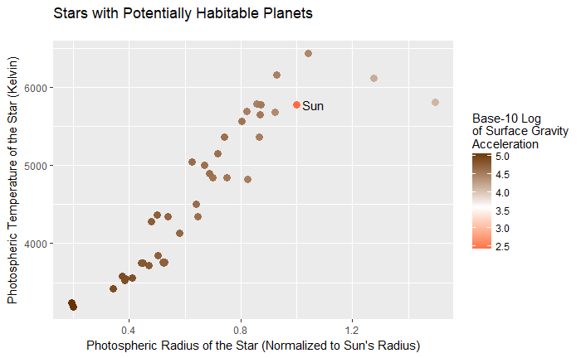
How do Stars in Potentially Habitable Systems Compare to the Sun?
Conclusion
Many of the stars that are likely to host life-supporting planets are cooler, smaller, and denser than our sun.

Slide 11
Supervised Learning
Can we use the data to determine the classification system?

Slide 12
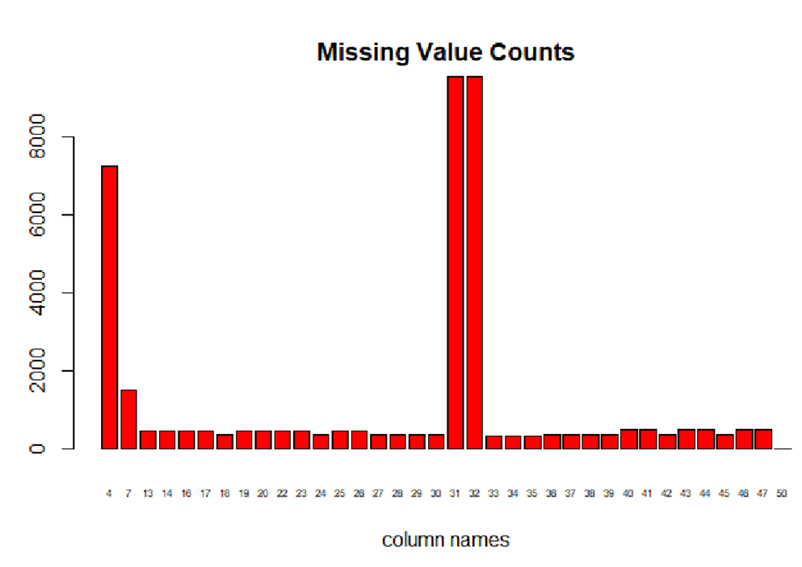
How Did We Clean the Data?
Removed 4 columns
Added mean to missing values in numerical columns
Added mode to missing values in categorical columns
Factored categorical data

Slide 13
Supervised Model and Analysis
Model | Misclassification Rate
Decision Tree | 14.5%
Random Forest | 11.6%
KNN k from 1-30 | 22.5%
SVM Linear cost 15-30 | 24.4%
SVM Polynomial cost 15-30 | 24.4%
SVM Radial cost 15-30 | 24.4%
Neural Networks (20, 12, 4) | 77.2%

Slide 14
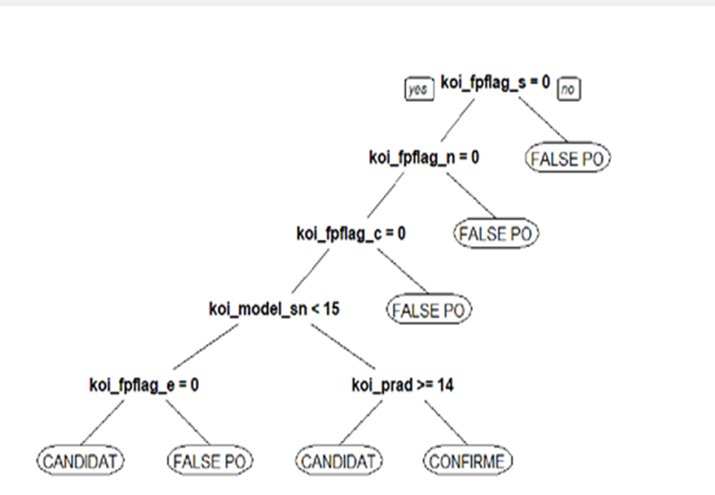
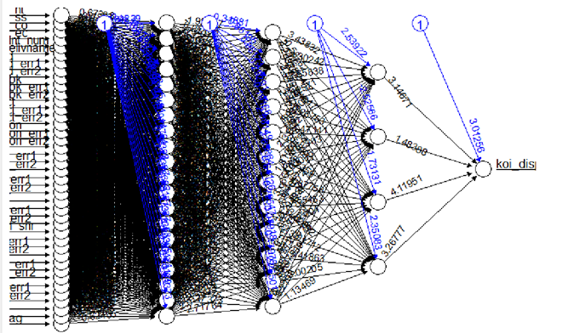
Supervised Model and Analysis

Slide 15
Unsupervised Learning
Could we use CANDIDATE planet data to determine clusters of like planets?
Do the characteristics of the resulting clusters bear any resemblance to the ways astronomers actually classify planets?

Slide 16
Unsupervised Learning
STEPS:
Take all “CANDIDATE” from “koi_pdispositon” (4433 observations).
Isolate for features that only pertain to planet characteristics.
koi_period
koi_impact
koi_duration
koi_depth
koi_prad
koi_teq
Remove any rows containing “NA”.
Normalize data.
Run k-means, choose number of categories.
Use categories to determine most important classification characteristics.
Examine clusters.

Slide 17
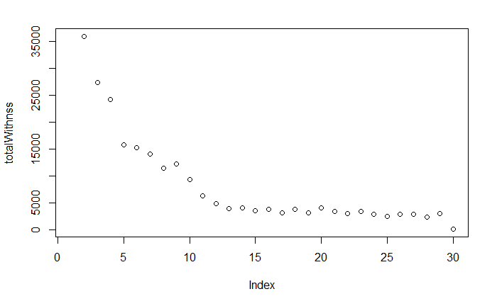
Unsupervised Learning
Ran k-means for between 2-30 centroids. For each index value, totalWithinss was folded to achieve stability in the plot between runs.
Settled on 10 categories…

Slide 18
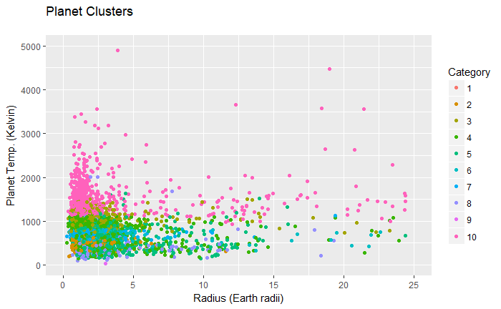
Unsupervised Learning
Applied categories to un-normalized data. Tried to find an appropriate feature space that revealed the clusters…

Slide 19
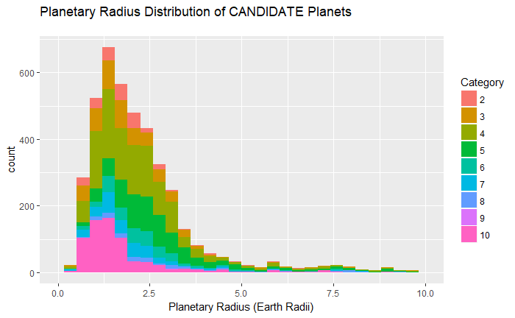
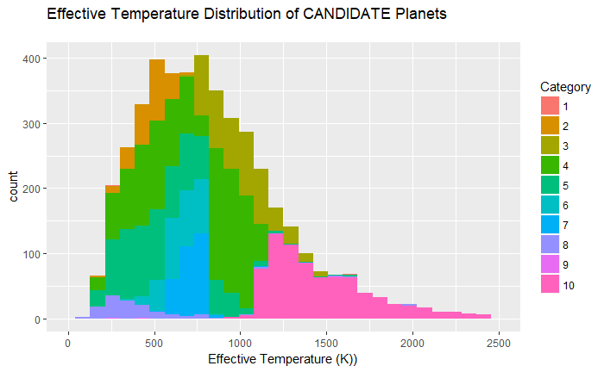
Unsupervised Learning
Planetary radius doesn’t look like a category-defining feature…
Effective temperature looks promising once again…
Need more effective method of identifying the important features: use decision tree.

Slide 20
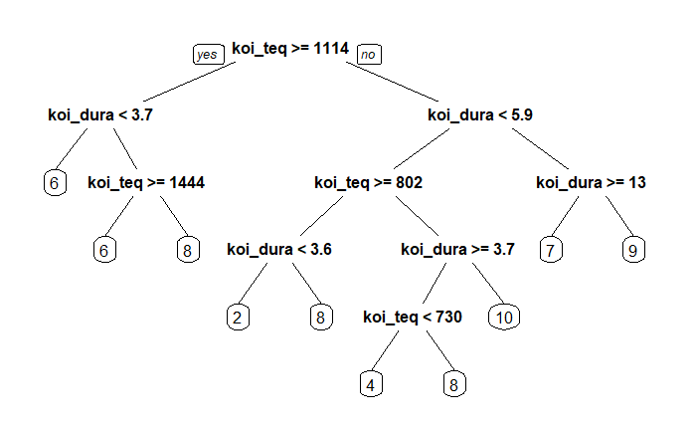
Unsupervised Learning
Train a decision tree model to predict categories based on available planet features. The tree levels will show the most important features in categorizing planets.
In this case, just two.

Slide 21
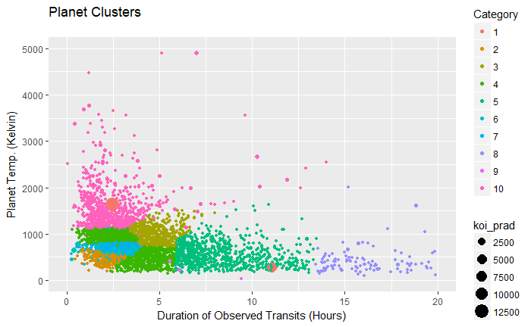
Unsupervised Learning

Slide 22
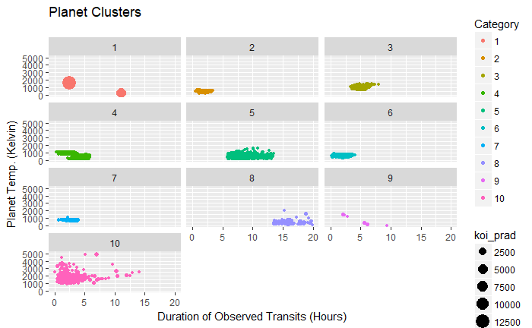
Unsupervised Learning
The two-feature space leads to some decent clustering, but the other features still seem to matter somewhat, especially for some extreme outliers (category 1).

Slide 23
Applications of Analysis?
Applying model may save NASA time and money in confirming planets
Knowing where to look for potential extraterrestrial life
Potential Planets to habit, when Earth becomes uninhabitable

Slide 24
Challenges We Faced
Many missing values
Difficulty understanding the meaning of each variable
Exploratory Analysis: hard to uncover potential relationships
Large database – long process time
3 categorical results for supervised learning
Makes Logistic Regression more complex

Slide 25
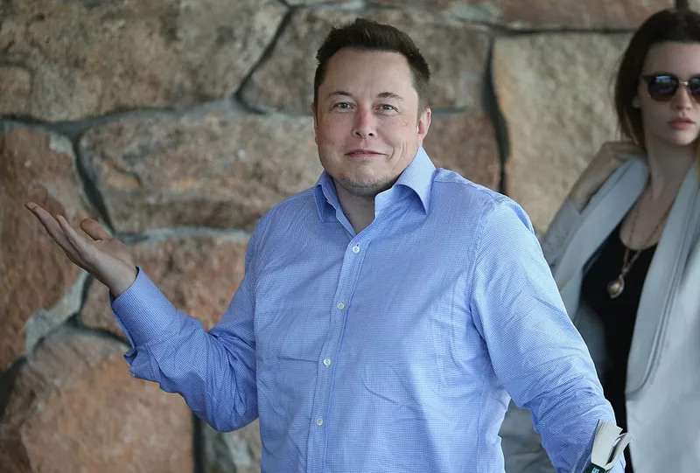
Future Plans
Regression Model for KOI score
Logistic Regression
More detailed analysis of unsupervised learning
K-fold Cross Validation to determine average error

