Slide 1
🔐
CYBER SECURITY INTERNSHIP · WEEK 5 TASK
Vulnerability Assessment &
Penetration Testing
VAPT Tools – Practical Learning | Nmap · Nikto · Burp Suite
SUBMITTED BY
PROGRAM
TARGET SITE
REPORT DATE
Hitesh Sood
DG Interns Hub
testphp.vulnweb.com
17 September 2026

Slide 2
GETTING STARTED
Objective & Tools Used
Hands-on VAPT practice against an authorized, purpose-built vulnerable web application.
OBJECTIVES
TOOLS
Understand VAPT fundamentals — assessment vs. exploitation
NM
Nmap
Get hands-on with Nmap, Nikto, and Burp Suite
Network scanner — discovers hosts, open ports, services & OS.
Scan the network for open ports & running services
NK
Nikto
Detect common web misconfigurations
Web server scanner — flags risky files & missing security headers.
Intercept & analyse live HTTP traffic
BS
Burp Suite
Document at least 3 real security findings
Intercepting proxy — captures & inspects live HTTP requests.
VAPT Week 5 — Hitesh Sood
2

Slide 3
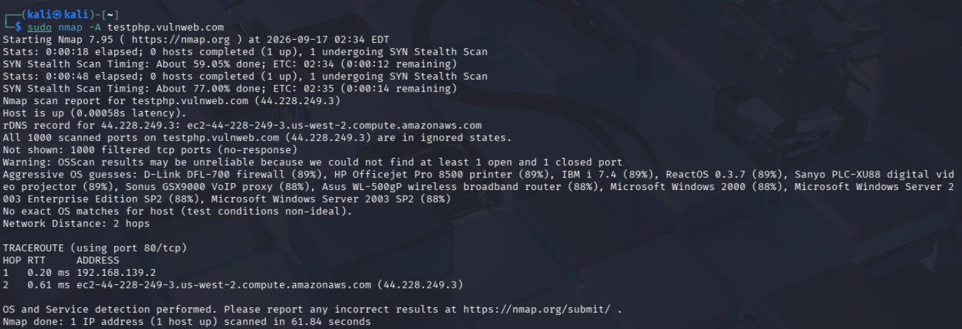
STEP 1 · NETWORK SCANNING
Nmap — Port & Service Discovery
Ran nmap -sS, -sV and -A, plus a ping check, against the authorized target testphp.vulnweb.com.
1000/1000
TCP PORTS FILTERED
100%
ICMP PING PACKET LOSS
2 hops
nmap -A testphp.vulnweb.com — aggressive scan with OS detection & traceroute.
NETWORK DISTANCE (TRACEROUTE)
VAPT Week 5 — Hitesh Sood
3

Slide 4
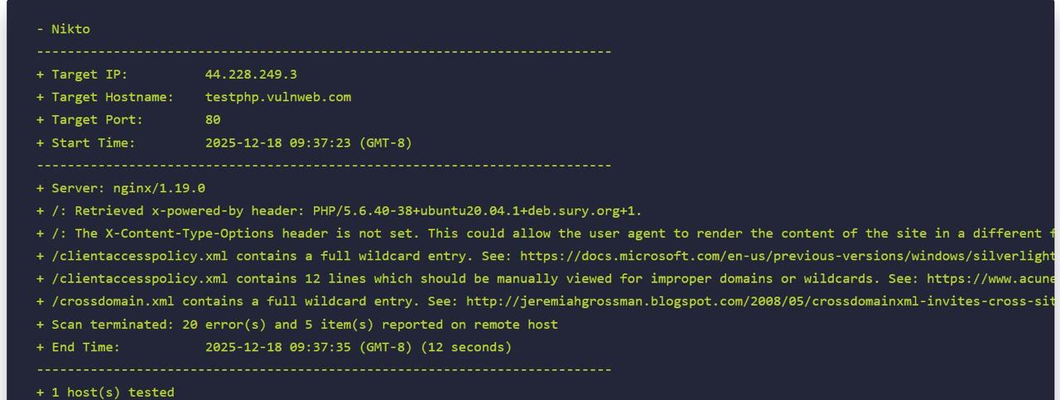
STEP 2 · WEB VULNERABILITY SCAN
Nikto — Server Misconfiguration Scan
Scanned the web server for outdated software, risky files, and missing security headers.
5
NOTABLE FINDINGS
20
INFORMATIONAL ITEMS
12s
TOTAL SCAN DURATION
nikto -h http://testphp.vulnweb.com — server banner, missing header & wildcard policy files.
VAPT Week 5 — Hitesh Sood
4

Slide 5
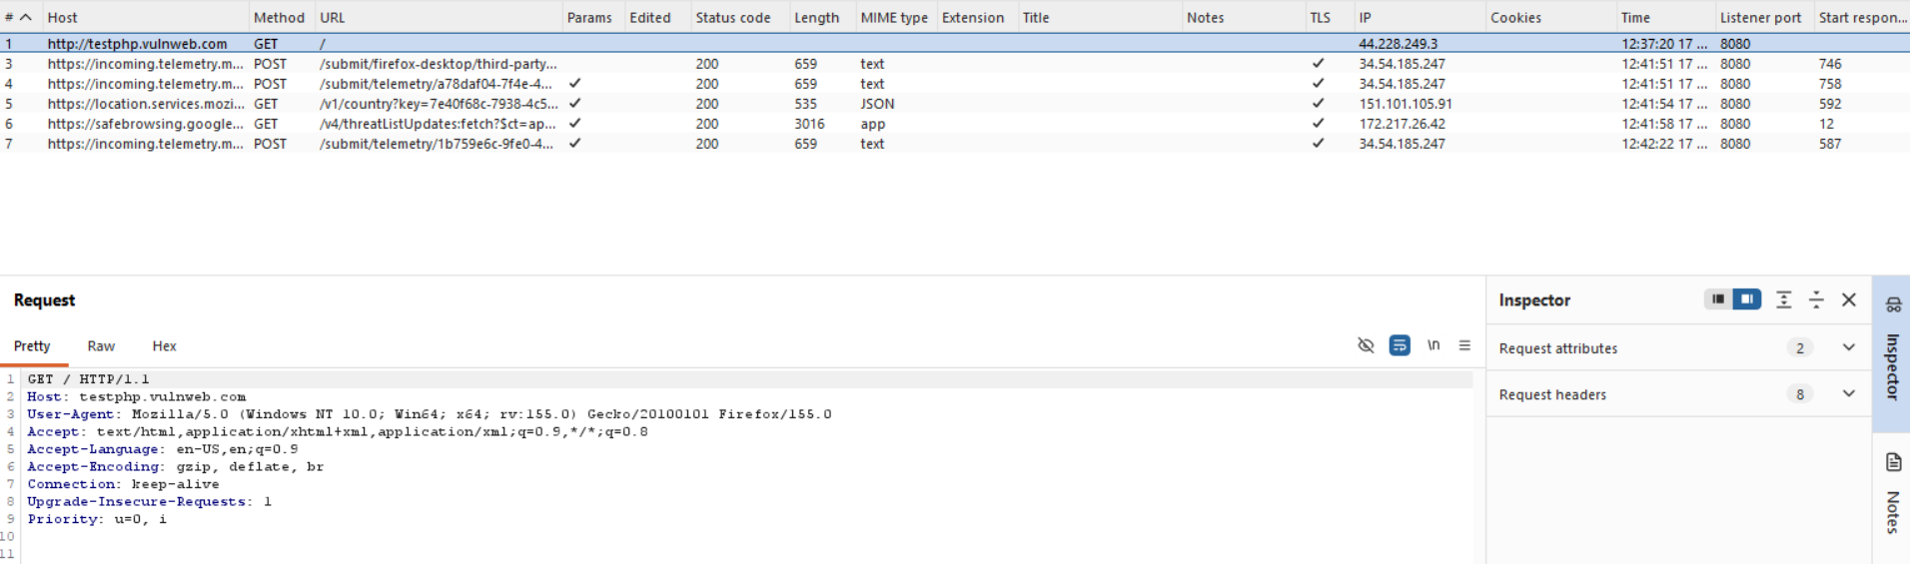
STEP 3 · TRAFFIC INTERCEPTION
Burp Suite — HTTP Request Analysis
Routed browser traffic through Burp's proxy (127.0.0.1:8080) and inspected live requests.
KEY POINTS
Proxy listener configured on 127.0.0.1:8080
Captured GET & POST requests in HTTP history
Inspected headers: User-Agent, Accept, Connection
Proxy → HTTP history: captured GET/POST traffic to testphp.vulnweb.com and third parties.
Studied full request/response anatomy
VAPT Week 5 — Hitesh Sood
5

Slide 6
RESULTS
Findings & Severity
At least 3 issues were required — 5 were identified across the three tools.
1
Missing X-Content-Type-Options header
LOW
Allows the browser to MIME-sniff responses and render content unexpectedly.
2
Wildcard entry in clientaccesspolicy.xml
MEDIUM
Permits cross-domain requests from any untrusted Silverlight/Flash client.
3
Wildcard entry in crossdomain.xml
MEDIUM
Allows any external domain to make cross-domain requests to the site.
4
Server & PHP version disclosed via headers
LOW
X-Powered-By & server banner reveal outdated PHP 5.6 / nginx 1.19.
5
All ports filtered (host hardened)
INFO
Firewall drops unsolicited probes — a positive control, noted for completeness.
VAPT Week 5 — Hitesh Sood
6

Slide 7
WRAP-UP
Conclusion
✓
Full-stack exposure
Practiced network recon (Nmap), automated web scanning (Nikto), and manual traffic analysis (Burp Suite) end-to-end.
✓
Findings across layers
Uncovered issues from network hardening down to header-level and policy-file misconfigurations.
✓
Interpretation over execution
The real skill was reading results correctly — e.g. a filtered port isn't automatically a vulnerability.
“Understand the results, don't just run the commands.”
VAPT Week 5 — Hitesh Sood
7

