Slide 1
Five-Stage Pipeline CPU
Su Qidong

Slide 2
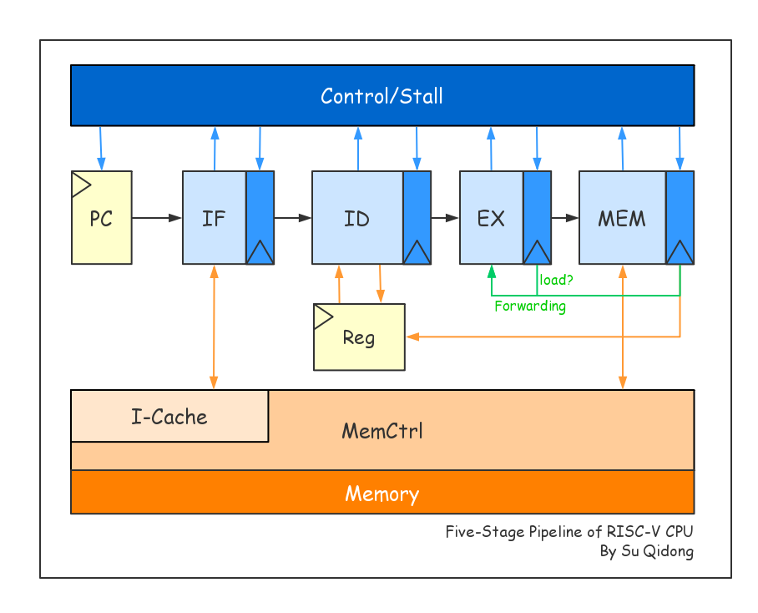
General Design
懒得做
Keep it simple and stupid
A ordinary 5-five pipeline

Slide 3
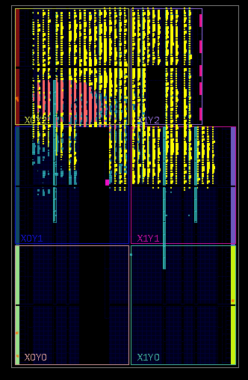
Pipeline
Cache?
Without cache -> 5 cycles to fetch an instruction
Fake pipeline
I-Cache is necessary

Slide 4
Cache
1 KB I-Cache
D-Cache?
Timing fail
Very limited size

Slide 5
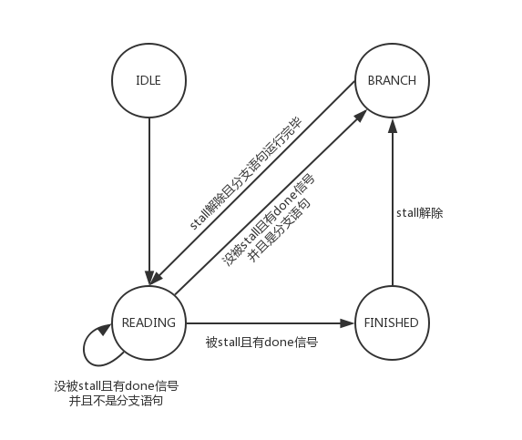
Control
Structural hazard between MEM and IF
Hazard control unit -> MemCtrl
Automata
Avoid useless cycles

Slide 6
Prediction?
Dynamic ?
Too complicated
Static ?
Always take
Require to calculate the address before EX
Always don’t take

Slide 7
Boost!
Eg. Pi
100MHz -> 150MHz
2.4s -> 1.6s
In fact, I didn’t do anything.

Slide 8
Balance
Design
Sophisticated
Simple
High clock rate = Performance?

