Slide 1

DigiPlate
Hack The North 2021
Notes:
Good Morning and welcome to our presentation. Our product is called ‘DigiPlate’. As the name suggested, it is a digital number plate, but it is much more than just that.

Slide 2
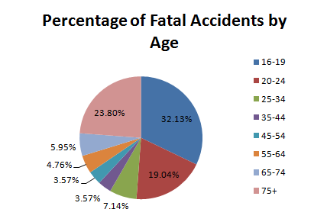
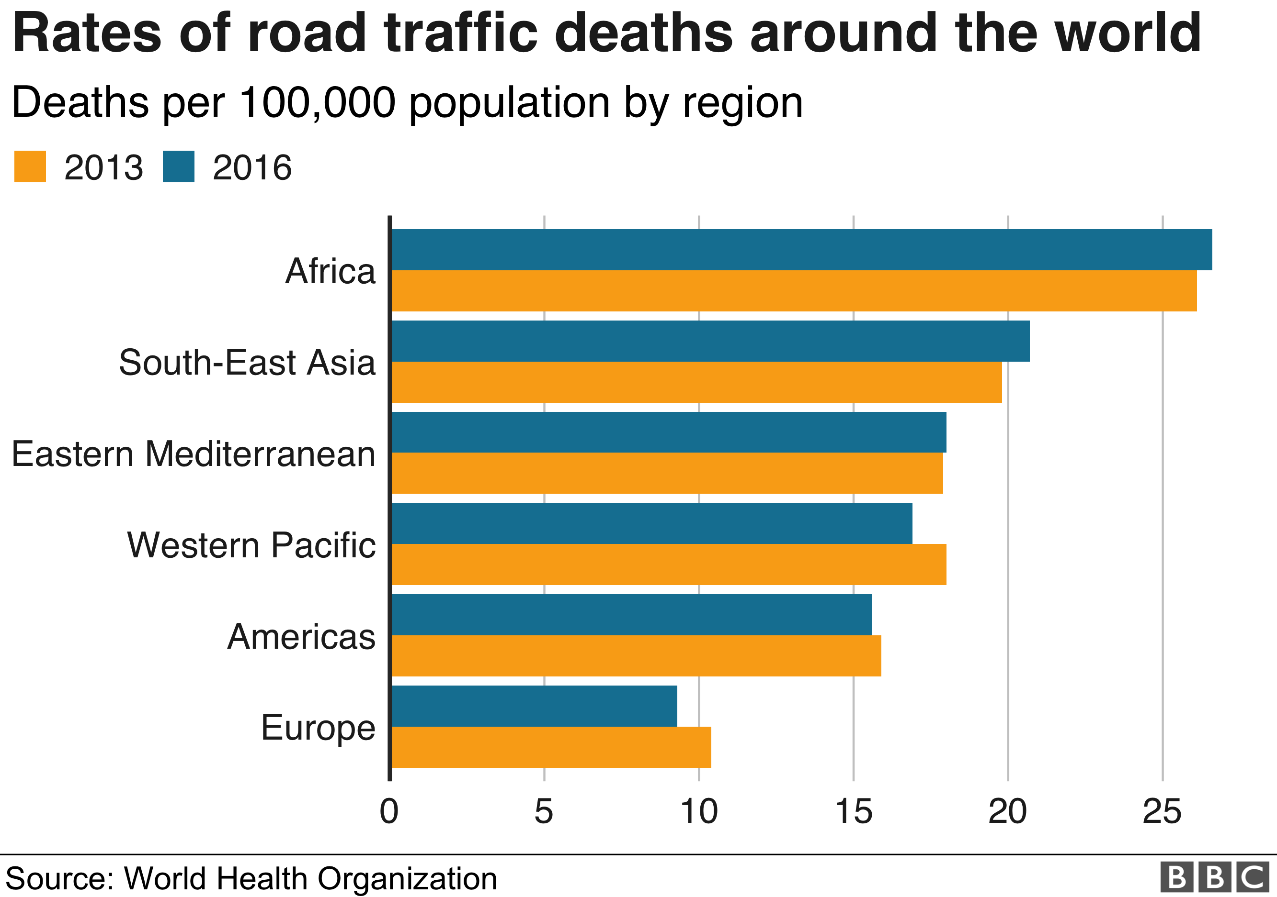
The facts
1.3 million
3%
5-29
Notes:
According to WHO, approximately 1.3 million people die each year as a result of road traffic crashes. Road traffic crashes cost most countries 3% of their gross domestic product (GDP). Road traffic injuries are the leading cause of death for children and young adults aged 5-29 years. Besides the social cost, we also have a strong personal connection to this issue as one of our friends died in a traffic accident last year. Unfortunately, this year too, we lost another 3 of our friends in a road accident. This illustrates that motor accidents affect each and every one of us directly or indirectly and thus it is an issue that needs to be addressed.

