Slide 1
Statistical Learning
Topics in Applied Statistics
Spring 2014
Department of Statistics
Korea University

Slide 2
Statistical Learning
Unsupervised Learning:
  Descriptive analytics
  No specific target variable
  To identify patterns in the data that extend our knowledge and understanding of the world that the data reflects
  To describe how the data are organized or clustered
  Examples: clustering, association rule, …
Supervised Learning:
  Predictive analytics
  Presence of the target variable to guide the learning process
  To predict classes or numeric outcomes
  Examples: regression, decision tree, neural network, …

Slide 3
Unsupervised Learning
Association Analysis and Cluster Analysis
  Association Analysis: identifying items that occur together in a given event (called market basket analysis)
  Cluster Analysis: clustering observations (called segmentation analysis)
Techniques:
  Association rule
  Hierarchical clustering
  K-means clustering
  …
Examples:
  Association analysis: Identify items that are bought together by sufficiently many customers. If a customer buys diaper and milk, then he is very likely to buy beer.
  Cluster analysis: Subdivide a market into distinct subsets of customers where any subset may conceivably be selected as a market target to be reached with a distinct marketing mix.

Slide 4
Supervised Learning
Regression and Classification:
  Regression: interval target variable
  Classification: non-interval target variable
Techniques:
  Regression model
  Decision tree
  Neural network
  …
Example:
  As a marketing analyst at a catalog company, we use logistic regression for a binary target that indicates whether or not a customer will make a purchase. Using the logistic regression model, we develop a mailing list of customers who are likely to make a purchase.

Slide 5
Unsupervised Learning
- Association Analysis -

Slide 6
What is Association Analysis?
Association analysis is to identify items that occur together in a given event or record.
This technique is also known as market basket analysis.
Association rules are based on frequency counts of the number of times items occur alone and in combination in the database.
They are expressed as "if item A is part of an event, then item B is also part of the event X percent of the time."

Slide 7
Some Hypothetical Association Rules
If a customer buys shoes, then 10% of the time he also buys socks.
A grocery chain may find that 80% of all shoppers will buy a jar of salsa when they also purchase a bag of tortilla chips.
When "do-it-yourselfers" buy latex paint, they also buy rollers 85% of the time.
Forty percent of investors holding an equity index fund will have a growth fund in their portfolio.

Slide 8
Evaluation Criteria
The strength of an association is defined by its confidence factor, which is the percentage of cases in which a consequent appears given that the antecedent has occurred.
The level of support is how frequently the combination occurs in the market basket (database).
Lift is a factor by which the likelihood of consequent increases given an antecedent.

Slide 9
Support Factor
Fraction of transactions that contain two items A and B together
Support (A=>B) = Support (B=>A) = Pr(A ∩ B)
Number of transactions that contain two items A and B together
= ----------------------------------------------------------------------------------
Number of total transactions

Slide 10
Confidence Factor
Measuring how often item B appear in transactions that contain item A
Confidence (A=>B) = Pr(B|A) = Pr(A ∩ B)/Pr(A)
Number of transactions that contain two items A and B together
= -----------------------------------------------------------------------------------
Number of transactions that contain item A

Slide 11
Lift Factor
Lift is equal to the confidence factor divided by the expected confidence.
Expected confidence is equal to the number of consequent transactions divided by the total number of transactions.
Lift (A=>B) =Pr(B|A)/Pr(B) =Pr(A ∩ B)/[Pr(A)Pr(B)]
(Number of transactions that contain two items A and B together) x (Number of total transactions)
= -----------------------------------------------------------------------------------------------------------------------------------
(Number of transactions that contain item A) x (Number of transactions that contain item B)

Slide 12
Lift Factor (Cont’d)
Interpretation:
  Lift (A=>B) = 1: no association, i.e., Pr(B|A) = Pr(B)
  Lift (A=>B) > 1: positive association
  Lift (A=>B) < 1: negative association
If confidence is high and lift is 1, then the association is random.
When an association is negative, a negative association rule can be considered. For example, confidence (B&C => A) = 0.33, but confidence (B&C => not A) = 0.67.

Slide 13
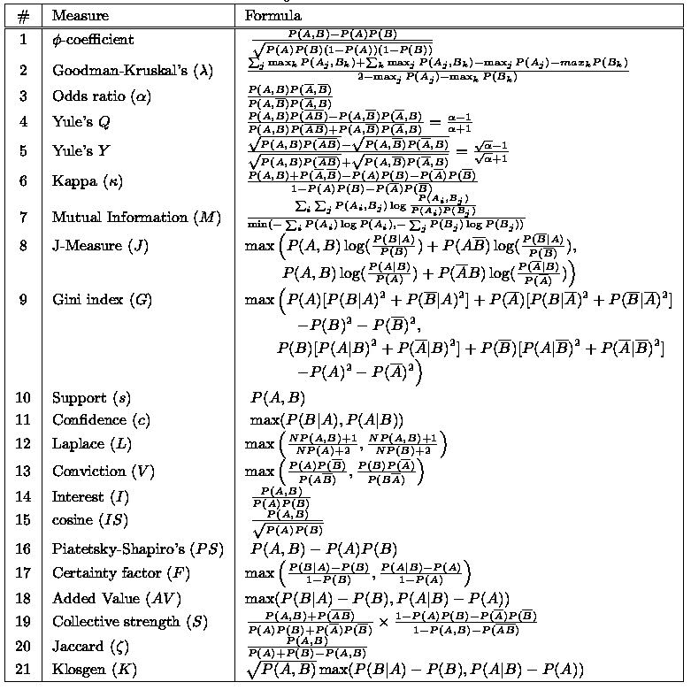
Other Factors

Slide 14
Example: Grocery Chain
Suppose that you are a marketing analyst for a grocery chain.
You want to identify items that are frequently purchased together.
This information may help you make decisions such as when to distribute coupons, when to put a product on sale, or how to present items in store displays.

Slide 15
Example: Grocery Chain (Cont’d)
Costumer | Items
1 2 3 4 5 | Cracker, Heineken, Ham Turkey, Heineken, Ham Heineken, Cracker, Ice Cream Turkey, Ice Cream, Ham Ice Cream, Heineken, Cracker

Slide 16
Example: Grocery Chain (Cont’d)
Hypothetical association rule: If a customer buys heineken, then he/she also buys cracker.
  support = 3/5 = 0.60
  confidence = (3/5)/(4/5) = 3/4 = 0.75
  lift = (3/5) / [(4/5)x(3/5)] = (3x5) / (4x3) = 1.25
Hypothetical association rule: If a customer buys turkey and ham, then he/she also buys ice cream.
  support = 1/5 = 0.20
  confidence = (1/5) / (2/5) = 0.50
  lift = (1/5) /[(2/5)x(3/5)] = (1x5)/(2x3) = 0.83

Slide 17
Example: Artificial Data
Items | N. of transactions | Support
A B C A ∩ B A ∩ C B ∩ C A ∩ B ∩ C etc | 900 850 800 500 400 300 100 550 | 0.450 0.425 0.400 0.250 0.200 0.150 0.050

Slide 18
Example: Artificial Data (Cont’d)
Items | Confidence | Lift
A => B B => A C => B B => C A => C C => A A&B => C B&C => A A&C => B | 0.556 0.588 0.375 0.353 0.444 0.500 0.200 0.333 0.250 | 1.308 1.307 0.882 0.883 1.110 1.111 0.500 0.740 0.588

Slide 19
Association Rule Mining Task
Given a set of transactions T, the goal of association rule mining is to find all rules having
  support ≥ min threshold
  confidence ≥ min threshold
Brute-force approach:
  List all possible association rules
  Compute the support and confidence for each rule
  Prune rules that fail the min thresholds
  ⇒ Computationally prohibitive!

Slide 20
Two-step Approach
Frequent item set generation - generate all item sets whose support ≥ min threshold
Rule generation - generate high confidence rules from each frequent item set, where each rule is a binary partitioning of a frequent item set
  Still computationally expensive!
  Important to select appropriate items!

Slide 21
Sequence Discovery
Sequence discovery goes one step further than association discovery by taking into account the ordering of the relationships among items (the rules additionally imply a timing element).
For example, rule A ==> B implies that event B occurs after event A occurs.
Here are two hypothetical sequence rules:
  Of those customers who currently hold an equity index fund in their portfolio, 15% of them will open an international fund in the next year.
  Of those customers who purchase a new computer, 25% of them will purchase a laser printer in the next month.

Slide 22
Sequence Discovery (Continued)
To perform sequence discovery, you must apply a sequence model role to a time stamp variable.
The sequence variable is used for timing comparisons.
It can have any numeric value including date/time values.
The time or span from observation to observation in the input data set must be on the same scale.

Slide 23
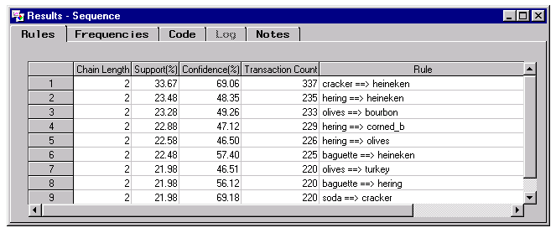
Example: Sequence Discovery
If you were a marketing analyst for a grocery chain, you would want to identify likely product purchase sequences.
This information may help you make decisions such as when to distribute coupons, when to put a product on sale, or how to present items in store displays.

Slide 24
Advantages and Disadvantages of Association Analysis
Easy to understand and apply
Undirected data mining
Computationally expensive when many items exist
Not applicable to items having rare transactions

Slide 25
Unsupervised Learning
- Cluster Analysis -

Slide 26
What is Cluster Analysis?
Multivariate statistical technique which assesses the similarities or dissimilarities among objects to cluster or segment the objects.
Clustering places objects into groups or clusters suggested by the data.
The objects in each cluster tend to be similar to each other in some sense, and objects in different clusters tend to be dissimilar.
If obvious clusters or groupings could be developed prior to the analysis, then the clustering analysis could be performed by simply sorting the data.

Slide 27
What is Cluster Analysis?

Slide 28
Application of Cluster Analysis:
Customer Segmentation
A customer or market segment is a group of people or organizations sharing one or more characteristics that cause them to have similar product and/or service needs.
A true market segment meets all of the following criteria:
  It is distinct from other segments (different segments have different needs).
  It is homogeneous within the segment (exhibits common needs); it responds similarly to a market stimulus.
  It can be reached by a market intervention.

Slide 29
Application of Cluster Analysis:
Customer Segmentation
Variables Used for Segmentation
  Geographic variables: region of the world or country, county size, Density of Area, climate
  Demographic variables: age, gender, family size, family life cycle, education, income, occupation, socioeconomic status, religion, nationality/race, language, Psychographic variables, personality, lifestyle, value, attitude
  Behavioral variables: benefit sought, product usage rate, brand loyalty, product end use, readiness-to-buy stage, buying center, profitability, income status
  Technological segmentation variables: motivations, usage patterns, attitudes about technology, fundamental values, lifestyle perspective, standard of living, profit

Slide 30
Preprocessing
Impute missing values of database observations
Remove outliers, as they often appear as individual clusters, and they may distort other, more important clusters.
Transform the variables so that equal distances are of equal practical importance.
  Variables with large variances tend to have more effect on the resulting clusters than variables with small variances.
  If all variables are measured in the same units (for example, dollars), then standardization may not be necessary.
  Otherwise, some form of standardization is recommended.

Slide 31
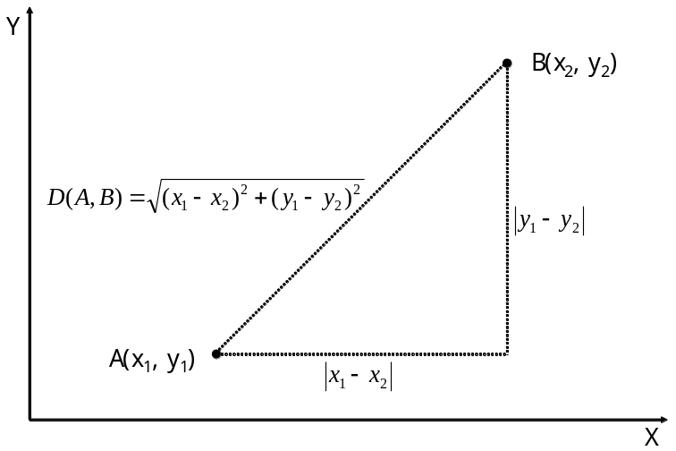
Distance
The distance between x and y, d(x,y), satisfies:
  d(x,y) = 0 => x = y
  d(x,y) ≥0
  d(x,y) = d(y,x)
  d(x,y) ≤ d(x,z)+d(z,y)

Slide 32
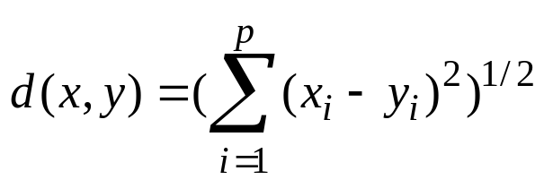
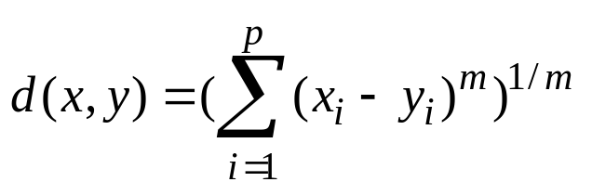
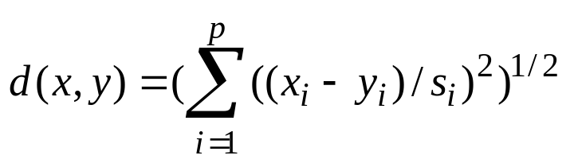

Distance Types
Euclidean distance:
Minkowski distance:
Standardized distance:
Mahalanobis distance:

Slide 33
Distance for Categorical Variables
Example:
Object | Gender | School | Country
A | Male | High school | Korea
B | Female | High school | Japan
C | Male | College | Korea
d(A,B)=2, d(A,C)=1, d(B,C)=3

Slide 34
Clustering Types
Hierarchical Clustering
Non-hierarchical Clustering
  K-means clustering
  Self-organizing maps (SOM)

Slide 35
Hierarchical Clustering
The data are not partitioned into a particular cluster in a single step. Instead, a series of partitions takes place, which may run from a single cluster containing all objects to K clusters each containing a single object.
Agglomerative methods - proceed by series of fusions of the K objects into groups
Divisive methods - separate K objects successively into finer groupings.

Slide 36
Hierarchical Clustering
Single linkage (nearest neighbor) clustering – Distance between groups is defined as the distance between the closest pair of objects, where only pairs consisting of one object from each group are considered.
Complete linkage (farthest neighbor) clustering - Distance between groups is now defined as the distance between the most distant pair of objects, one from each group.
Average linkage clustering - Distance between two clusters is defined as the average of distances between all pairs of objects, where each pair is made up of one object from each group.

Slide 37
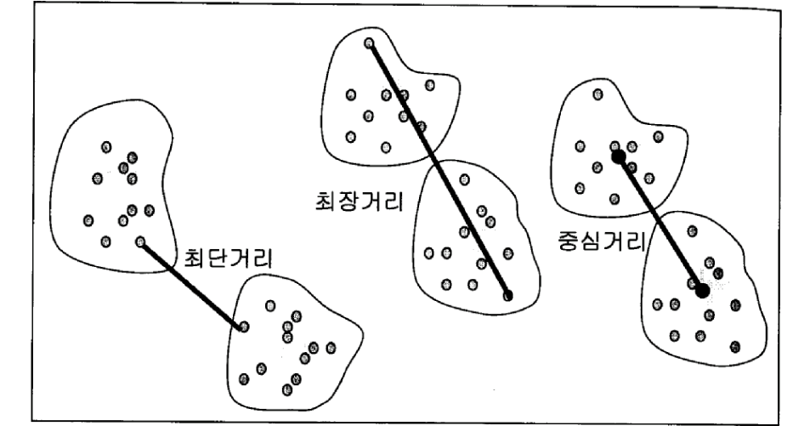
Hierarchical Clustering
Single linkage
Average linkage
Complete linkage

Slide 38
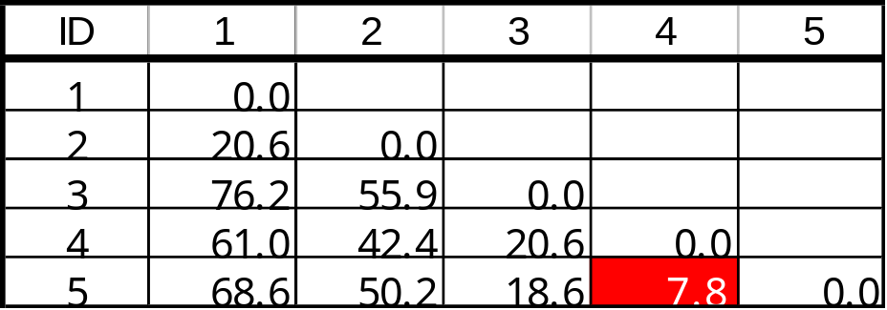
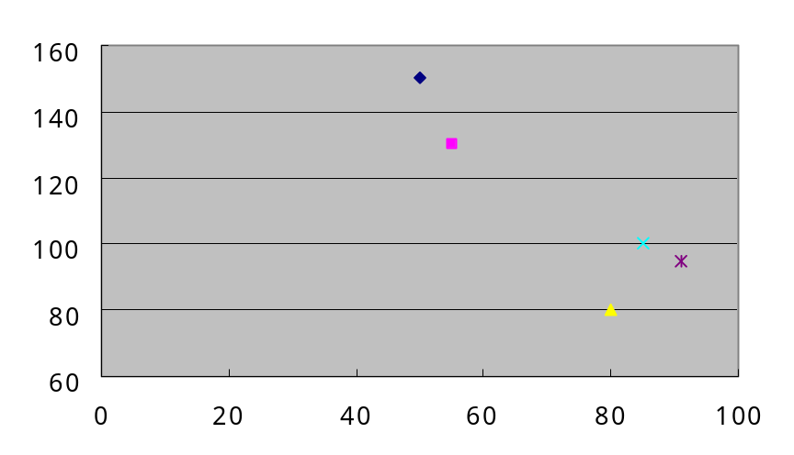
Example: Single Linkage Clustering
1
2
4
5
3

Slide 39
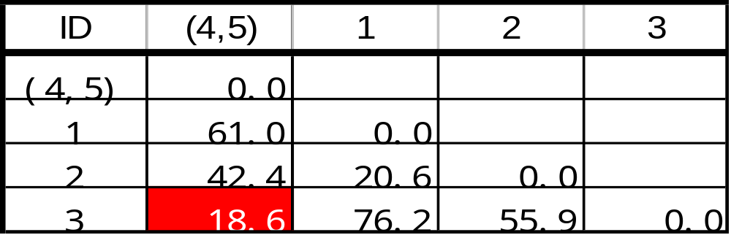
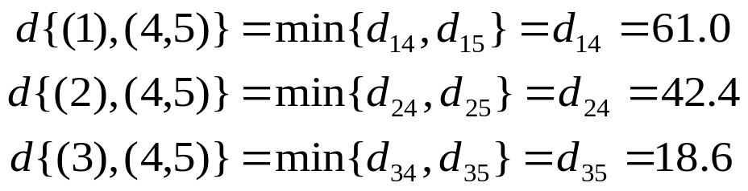
Example: Single Linkage Clustering
1
2
4
5
3

Slide 40
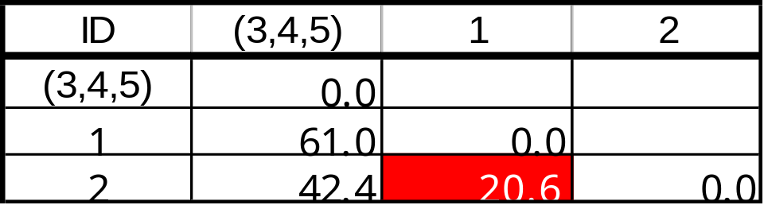
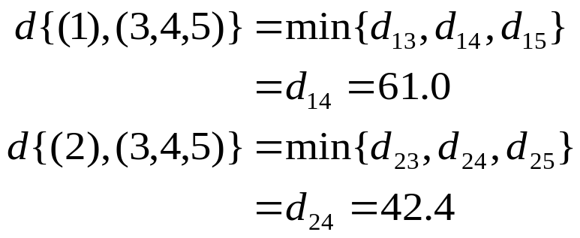
Example: Single Linkage Clustering
1
2
4
5
3
1
2
4
5
3

Slide 41
Example: Single Linkage Clustering
Dendrogram
4
7.8
18.6
5
42.4
3
20.6
1
2

Slide 42
K-means Clustering
A non-hierarchical approach to forming good clusters is to specify a desired number of clusters, say, k, then assign each case (object) to one of k clusters so as to minimize a measure of dispersion within the clusters.
K-means training starts with a single cluster with its center as the mean of the data. This cluster is split into two and the means of the new clusters are iteratively trained. These two clusters are again split and the process continues until the specified number of clusters is obtained.
When the user specifies random start, the algorithm generates the k cluster centers randomly and goes ahead by fitting the data points in those clusters. This process is repeated for as many random starts as the user specifies and the best value of start is found.

Slide 43
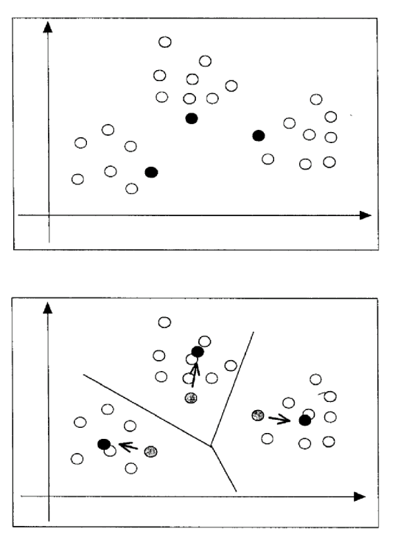
K-means Clustering

Slide 44
K-means Clustering
Determine K : K=5
and initial clusters
Allocate data points into clusters
Reallocate the data points and build new clusters
Step 0
Step 1, 2
Step 3
- <number> -

Slide 45
Pros and Cons of K-means Clustering
Advantages:
  Fast with massive data
Disadvantages:
  Sensitive to initial values and outliers
  Need to specify the number of clusters

