Slide 1
Statistical Learning 2
Topics in Applied Statistics
Spring 2014
Department of Statistics
Korea University

Slide 2
Supervised Learning
- Regression -

Slide 3
Regression Models
Linear Regression Model
  It attempts to predict the value of a continuous (interval) target as a linear function of one or more independent inputs.
  Identity link: g(μ) = μ
Logistic Regression Model
  It attempts to predict the probability that a binary or ordinal (non-interval) target will acquire the event of interest as a function of one or more independent inputs.
  Logit link: g(μ) = log(μ/(1- μ))
  For non-interval target, other link functions can be used, e.g,
  Cloglog link: g(μ) = log(-log(1-μ))
  Probit link: g(μ) = Φ⁻¹(μ)

Slide 4
Example: Catalog Company Data
As a marketing analyst at a catalog company, we would like to develop a mailing list of customers who are like to make a purchase or spend a large amount of money for purchases.
The input data set contains 1,966 customer cases. There are 31 interval inputs and 18 class inputs available for building the model.
We would like to build a model for an interval variable (AMOUNT) that contains the purchase dollar amount.
We would like to build a model for a binary target (PURCHASE) that indicates whether or not a customer will make a purchase.

Slide 5
Linear Regression Model
Input Variables: X=(X₁, X₂, …, X_{p}) ∈ R^{p}
Target Variable: Y ∈ R
Model: Y_{i}= β₀+β₁X_{1i}+ β₂X_{2i}+…+β_{p} X_{pi}+ε_{i},
ε_{i}~ iid N(0, σ²)
Parameters for Regression Coefficients:
(β₀,β₁,β₂,…,β_{p})

Slide 6
Assumptions
Linearity
  The relationship between input and target variables is linear.
  Checking: Use scatter plots between input and target variables or between residuals and target variables.
  If not satisfied, polynomial, nonlinear, or nonparametric regression can be considered.
Constant Variance
  The variance of errors is constant.
  Checking: Use residual plot (residuals vs fitted values).
  If not satisfied, weighted regression can be considered.
Normality
  The distribution of errors is normal.
  Checking: Use Q-Q plot (residuals vs theoretical quantiles).
  If not satisfied, robust regression can be considered.

Slide 7
Parameter Estimation
Data: (x₁,y₁), ..., (x_{n},y_{n}), x_{i} =(x_{1i}, ..., x_{pi})’
The estimates of parameters (b₀,b₁,b₂,…,b_{p}) are minimizing the residual sum of squares:
Σ_{i}(Y_{i}-β₀-β₁X_{1i}-β₂X_{2i}-…-β_{p} X_{pi})².

Slide 8
Least Squares Estimation (LSE)
Y
ε₄
ε₆
ε₂
ε₅
ε₁
ε₃
X
Parameter estimates minimize
ε₁² + ε₂² + ε₃² + ε₄² + ε₅² + ε₆²

Slide 9
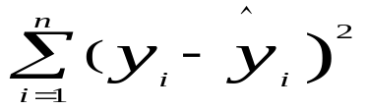
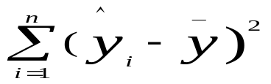
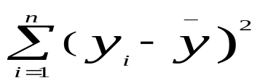
Sum of Squares (SS)
  SSE =
  SSR =
  SST =
  SST = SSR + SSE
  Coefficient of Determination:
  R² = SSR/SST, 0 ≤ R² ≤1
  The values closer to 1 indicate better fits.

Slide 10
ANOVA Table
Source | SS | DF | MS | F
Regression | SSR | p | MSR= SSR/p | F=MSR/MSE
Error | SSE | n-p-1 | MSE= SSE/(n-p-1)
Toal | SST | n-1
If F-value is large, the fitted model is claimed as significant.

Slide 11
Testing Regression Coefficients
Testing whether regression coefficients are significant.
Hypotheses: H₀: β_{j} = 0 vs H₁: β_{j} ≠ 0
Test Statistic: t_{j} = b_{j}/s.e.(b_{j})
If |t_{j}| is large, β_{j} is claimed as significant,
i.e., β_{j} ≠ 0.

Slide 12
Interpretation and Prediction
Interpretation:
  If b_{j} >0, y increases as x_{j} increases.
  If b_{j} <0, y decreases as x_{j} increases.
Prediction:
  Given a new observation x_{k} =(x_{1k}, ..., x_{pk})’, the predicted value of y_{k} is b₀+b₁X_{1k}+ b₂X_{2k}+…+b_{p} X_{pk} .

Slide 13
Variable Selection
Why need variable selection?
  It is not efficient to maintain many input variables.
  Multi-colinearity may inflate variances of estimates.
  Too many input variables may increase prediction error.
  Omitting significant input variables can lose important information, resulting in generating bias.
Find an optimal model by variable selection.

Slide 14
Variable Selection Methods
All Possible Selection: Select the best model based on a criterion among all possible models. It is not practical when there are many candidate effects.
Backward Selection: Begins with all candidate effects in the model and then systematically removes effects that are not significantly associated with the target until no other effect in the model meets the stay significance level or until the stop criterion is met.
Forward Selection: Begins with no candidate effects in the model and then systematically adds effects that are significantly associated with the target until none of the remaining effects meet the entry significance level or until the stop criterion is met.
Stepwise Selection: As in the forward method, stepwise selection begins with no candidate effects in the model and then systematically adds effects that are significantly associated with the target. However, after an effect is added to the model, stepwise may remove any effect already in the model that is not significantly associated with the target.

Slide 15
Model Selection Criteria
Adjusted R² = 1-(n-1)/(n-p)(1- R² ). The model with the largest adjusted R² value is chosen.
AIC (Akaike's Information Criterion) = n ln(SSE/n)+2p , where n is the number of cases, SSE is error sum of squares, and p is the number of model parameters. The AIC criterion penalizes for adding parameters to the model. The model with the smallest AIC value is chosen.
SBC (Schwarz's Bayesian Criterion) = n ln(SSE/n)+p ln(n) . The SBC criterion penalizes for adding parameters to the model. The model with the smallest SBC value is chosen.
BIC (Bayes' Information Criterion) = n ln(SSE/n)+2(p+2)q-2q², where q = σ² (SSE/n) . The model with the smallest BIC value is chosen.
…

Slide 16
Logistic Regression Model
Input Variables: X=(X₁, X₂, …, X_{p}) ∈ R^{p}
Target Variable: Y ∈ {0, 1}
π_{i} = π(x_{i}) = Pr(Y_{i}=1|x_{i})
Model: log(π_{i}/(1-π_{i}))= β₀+β₁X_{1i}+ β₂X_{2i}+…+β_{p} X_{pi}
or π_{i} = exp(β₀+ Σ_{j}β_{j}X_{ji})/(1+ exp(β₀+Σ_{j}β_{j}X_{ji}))
Parameters for Regression Coefficients:
(β₀,β₁,β₂,…,β_{p})

Slide 17
Parameter Estimation
Data: (x₁,y₁), ..., (x_{n},y_{n}), x_{i} =(x_{1i}, ..., x_{pi})’
The estimates of parameters (b₀,b₁,b₂,…,b_{p}) are maximizing the log-likelihood function:
log ∏_{i} π(x_{i})^{yi}[1- π(x_{i})]^{ni-yi}
= Σ_{j}(Σ_{i} y_{i}x_{ij})β_{j}-Σ_{i}n_{i} log[1+exp(Σ_{j} β_{j} x_{ij})]

Slide 18
Testing Regression Coefficients
Testing whether regression coefficients are significant.
Hypotheses: H₀: β_{j} = 0 vs H₁: β_{j} ≠ 0
Test Statistic: Wald or Likelihood Ratio χ²
If χ² is large, β_{j} is claimed as significant,
i.e., β_{j} ≠ 0.

Slide 19
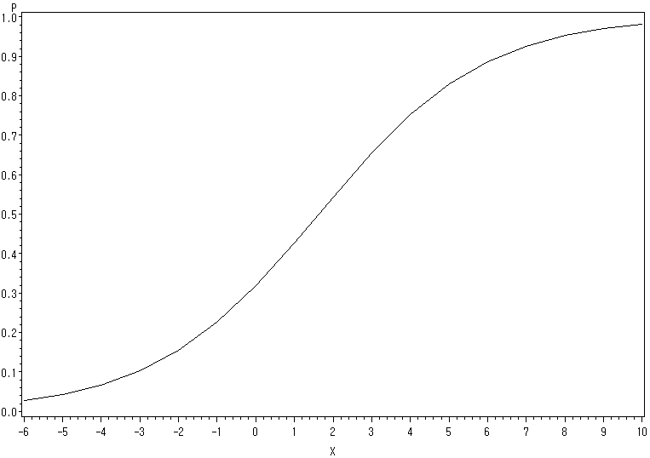
Logistic Curve
Pr(Y=1|X=x)
b₁ > 0
X

Slide 20
Interpretation and Prediction
Interpretation:
  If b_{j} >0, the probability of y=1 increases as x_{j} increases.
  If b_{j} <0, the probability of y=1 decreases as x_{j} increases.
  Odds = π₁/(1-π₁) and Odds Ratio (OR) = π₁/ (1-π₁) / π₂/ (1-π₂).
  The odds increase multiplicatively by exp(b_{j}) for every 1-unit increase in x, i.e., OR = exp(b_{j}) = the odds at x_{j}+1 divided by the odds at x_{j}.
Prediction:
  Given a new observation x_{k} =(x_{1k}, ..., x_{pk})’, the predicted probability of y_{k}=1 is
  π_{i}=exp(b₀+ b₁X_{1i}+ b₂X_{2i}+…+b_{p} X_{pi})/(1+ exp(b₀+ b₁X_{1i}+ b₂X_{2i}+…+b_{p} X_{pi})).

Slide 21
Variable Selection Methods
All Possible Selection: Select the best model based on a criterion among all possible models. It is not practical when there are many candidate effects.
Backward Selection: Begins with all candidate effects in the model and then systematically removes effects that are not significantly associated with the target until no other effect in the model meets the stay significance level or until the stop criterion is met.
Forward Selection: Begins with no candidate effects in the model and then systematically adds effects that are significantly associated with the target until none of the remaining effects meet the entry significance level or until the stop criterion is met.
Stepwise Selection: As in the forward method, stepwise selection begins with no candidate effects in the model and then systematically adds effects that are significantly associated with the target. However, after an effect is added to the model, stepwise may remove any effect already in the model that is not significantly associated with the target.

Slide 22
Classification by Logistic Regression
Given x_{k}, estimate the probability of y_{k}=1,
Pr(y_{k}=1|x_{k}).
Choose a cutoff value (say, c) between 0 and 1.
  Assign Y_{k} = 1 if Pr(y_{k}=1|x_{k}) > c.
  Assign Y_{k} = 0 if Pr(y_{k}=1|x_{k}) < c.

Slide 23
Choosing a cutoff value
Choose a cutoff value by accounting for
  Prior information: the distributions or prior probabilities of categories y=0 and y=1
  Misclassification cost: the costs when misclassified from 0 to 1 and from 1 to 0
  Experts’ opinion

Slide 24
Link Functions
Let μ = E(Y).
Linear Regression Model
  Identity link: g(μ) = μ
Logistic Regression Model
  Logit link: g(μ) = log(μ/(1- μ))
  Cloglog link: g(μ) = log(-log(1-μ))
  Probit link: g(μ) = Φ⁻¹(μ)
Linking versus Transforming

Slide 25
Supervised Learning
- Decision Tree -

Slide 26
What is a Decision Tree?
A decision tree is a logical model represented as a tree that shows how the value of a target variable can be predicted by using the values of a set of predictor (input) variables.
A decision tree recursively partitions the data and sample space to construct the predictive model.
Its name derives from the practice of displaying the partitions as a decision tree, from which the roles of the predictor variables may be inferred.
The idea was first implemented by Morgan and Sonquist in 1963. It is called the AID (Automatic Interaction Detection) algorithm.

Slide 27
Defining a Decision Tree
Let Х denote the domain of x and У the domain of y.
The problem is to find a function h(x) that maps each point in Х to a point in У.
The construction of h(x) requires the existence of a training sample of n observations £ = {(y_{i}, x_{i}), i=1,…,n}.
The criterion for choosing h(x) is usually
  - mean squared prediction error E[h(x)-E(y|x)]² for regression (for interval targets), where E(y|x) is the expected value of y at x, and
  - expected misclassification cost for classification (for non-interval targets).

Slide 28
Defining a Decision Tree
If У contains J distinct values, the classification solution (or classifier) may be written as a partition of Х into J disjoint pieces A_{j}={x: h(x)=j} such that Х = ∪_{j} A_{j} .
A classification tree is a special form of classifier where each A_{j} is itself a union of sets, with the sets being obtained by recursively partitioning the x-space.
A regression tree is similarly a tree-structured solution in which a constant or a relatively simple regression model is fitted to the data in each partition.

Slide 29
Elements of Decision Tree
An empirical tree represents a segmentation of the data that is created by applying a series of split rules. Each split rule assigns an observation to a segment based on the values of inputs.
One rule is applied after another, resulting in a hierarchy of segments within segments. The hierarchy is called a tree, and each segment is called a node.
The original segment contains the entire data set and is called the root node of the tree. A node with all its successors forms a branch of the node that created it.
The nodes that have child nodes are called interior (or internal, intermediate) nodes. The final nodes that do not have child nodes are called leaves (or terminal nodes). For each leaf, a decision is made and applied to all observations in the leaf.
The type of decision depends on the context. In predictive modeling, the decision is simply the predicted value.

Slide 30
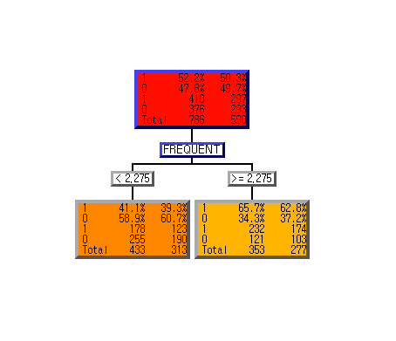
Example: SAS E-Miner Output
Train Validation

Slide 31
Building and Utilizing a Decision Tree
Growing (or Splitting)
  Partition the data and sample space recursively to construct a predictive model.
Stopping (and Pruning)
  Partitioning continues until a criterion is met.
  Prune nodes that cause over-fitting.
Interpretation and Prediction
  Interpret the final predictive model with the significant split variables.
  Predict target values of new data using the final predictive model.

Slide 32
Split Rule
A split rule is a rule for partitioning an intermediate node.
It consists of a split variable, a split point (or split set), and their relationship.
For an interval input variable X, a split rule has the form X ≤c, where c (called a split point) is a numerical value.
For a non-interval input variable X, the split has the form X∈A, where A (called a split set) is a set of values of X.
An observation goes to the left subnode if the split rule is satisfied and goes to the right subnode otherwise.
For a specific node and input, we seek the split rule with maximum worth subject to the limit on the number of branches and the limit on the minimum number of observations assigned to a branch.

Slide 33
Impurity Measure
t
Interval Target
  F-statistic: -log(p),
  where p is a p-value from a F-statistic.
  Variance reduction: I(t)-[I(t_{L})+I(t_{R})],
  where I(t) = ∑_{i}(Y_{i}-Ŷ)²
Non-interval Target
  Chi-square statistic: -log(p),
  where p is a p-value from a Chi-square statistic.
  Entropy index: I(t)-[P_{L}I(t_{L})+P_{R}I(t_{R})],
  where I(node)=-[Pr(class 1)log₂Pr(class 1)+Pr(class 2)log₂Pr(class 2)]
  and P_{L},P_{R} denote the proportions of the observations in the left and right subnodes, respectively.
  Gini index: I(t)-[P_{L}I(t_{L})+P_{R}I(t_{R})],
  where I(node) = 1-[(Pr(class 1))²+(Pr(class 2))²]
X ≤ c
X > c
t_{L}
t_{R}

Slide 34
Stopping Rule
After a node is split, the newly created nodes are considered for splitting.
This recursive process ends when no node can be split.
The reasons a node will not split are as follows:
  The node contains too few observations, as specified (minimum number of observations).
  The number of nodes in the path between the root node and the given node equals the number specified (maximum number of depth).
  No split exceeds the threshold worth requirement specified in the F-test or Chi-square significance level value.

Slide 35
Pruning
After tree construction stops, regardless of why it stops, it creates a sequence of subtrees of the original tree, one subtree for each possible number of leaves.
The subtree chosen with three leaves has the best assessment value of all candidate subtrees with three leaves.
After the sequence of subtrees is established, it uses a method to select which subtree to use for prediction.

Slide 36
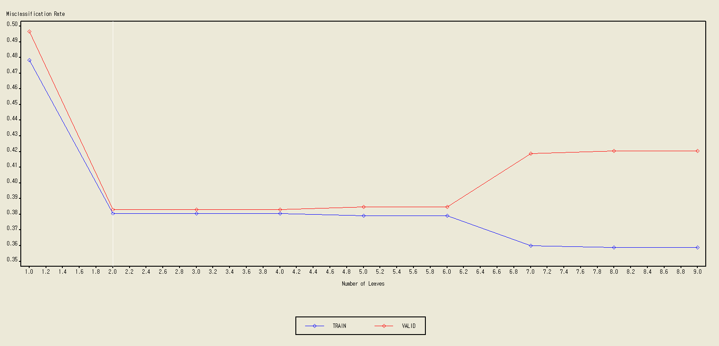
Example: SAS E-Miner Output

Slide 37
Missing Values
Observations in which the target value is missing are ignored when training or validating the tree.
The search for a split on an input uses observations whose values are missing on the inputs.
  For splits on a categorical variable, missing values are treated as a separate category.
  For numerical variables, missing values are treated as having the same unknown non-missing value.

Slide 38
Missing Values (Cont’d)
When a split is applied to an observation in which the required input value is missing, surrogate splitting rules are considered before assigning the observation to the branch for missing values.
  A surrogate splitting rule is a back-up to the main splitting rule.
  For example, the main splitting rule might use COUNTY as input and the surrogate might use REGION. If the COUNTY is unknown and the REGION is known, the surrogate is used.
  If several surrogate rules exist, each surrogate is considered in sequence until one can be applied to the observation.
  If none can be applied, the main rule assigns the observation to the branch that is designated for missing values.

Slide 39
Advantages and Disadvantages of Decision Trees
Advantages
  It produces a model that may represent easily interpretable rules or logic statements.
  It deals with missing data. The search for a splitting rule uses the missing values of an input.
  It handles both interval and non-interval input variables.
  The assumptions such as linearity and constant variance are not strict.
Disadvantages
  It is computationally expensive.
  Its model may have lower prediction accuracy.
  The results are often unstable.

Slide 40
Supervised Learning
- Neural Network -

Slide 41
What is Neural Networking?
Artificial neural networks were originally developed by researchers who were trying to mimic the neurophysiology of the human brain.
By combining many simple computing elements (neurons or units) into a highly interconnected system, these researchers hoped to produce complex phenomena such as intelligence.

Slide 42

Neuron
Cell body
Axon
Dendrites

Slide 43
What is Neural Networking?
Neural networks are a class of flexible nonlinear regression, discriminant, and data reduction models.
By detecting complex nonlinear relationships in data, neural networks can help to make predictions about real-world problems.
Neural networks are especially useful for prediction problems where:
  no mathematical formula is known that relates inputs to outputs.
  prediction is more important than explanation.
  there is lots of training data.

Slide 44
Elements
A neural network consists of units (neurons) and connections between those units.
There are three kinds of units:
  Input units - obtain the values of input variables and optionally standardize those values
  Hidden units - perform internal computations, providing the nonlinearity that makes neural networks powerful.
  Output units - compute predicted values and compare those predicted values with the values of the target variables.
Units pass information to other units through connections
Connections are directional and indicate the flow of computation within the network.

Slide 45
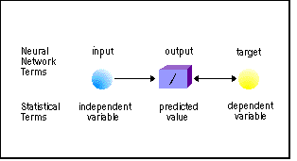
Simple Neural Networks
* Simple linear or logistic regression model

Slide 46
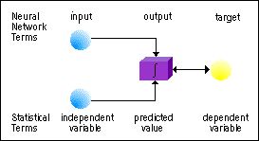
Perceptrons
* Linear or logistic regression model with two independent variables and one dependent variable

Slide 47
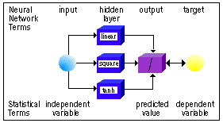
Multilayer Perceptrons (MLPs)
* Nonlinear regression model

Slide 48
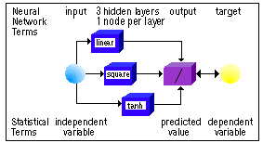
Multilayer Perceptrons (MLPs)
* Nonlinear regression model

Slide 49
MLPs
X
Y
X
Y
X
Y
Input layers
Hidden layers
Output layers

Slide 50



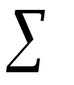





MLPs
1
1
X1
output
X2
X3
Hidden Layer
Output Layer
Input Layer

Slide 51
MLPs
The most popular form of neural network architecture is the multilayer perceptron (MLP).
A multilayer perceptron:
  has any number of inputs.
  has one or more hidden layers with any number of units.
  uses linear combination functions in the hidden and output layers.
  uses sigmoid activation functions in the hidden layers.
  has any number of outputs with any activation function.
  has connections between the input layer and the first hidden layer, between the hidden layers, and between the last hidden layer and the output layer.

Slide 52
Elements (Continued)
Each unit produces a single computed value.
For input and hidden units, this computed value is passed along the connections to other hidden or output units.
For output units, the computed value is what statisticians call a predicted value.
The predicted value is compared with the target value to compute the error function, which the training methods attempt to minimize.
Most connections in a network have an associated numeric value called a weight or parameter estimate.
The training methods attempt to minimize the error function by iteratively adjusting the values of the weights.
Most units also have one or two associated numeric values called the bias and altitude, which are also estimated parameters adjusted by the training methods.
Refer to SAS Help for the comparison of neural network terms and statistical terms.

Slide 53
Combination Functions
All the computed values from previous units feeding into the given unit are combined into a single value using a combination function.
The combination function uses the weights, bias, and altitude.
Two general kinds of combination function are commonly used:
  Linear combination functions - compute a linear combination of the weights and the values feeding into the unit and then add the bias value (the bias acts like an intercept).
  Radial combination functions - compute the squared Euclidean distance between the vector of weights and the vector of values feeding into the unit and then multiply by the squared bias value (the bias acts as a scale factor or inverse width).

Slide 54
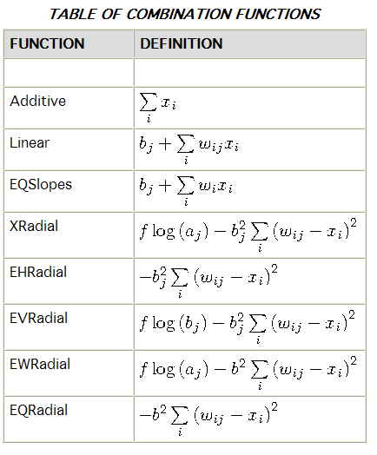

Slide 55
Combination Functions
Example: Linear combination functions
  H₁ = f₁(b₁+w₁₁X₁+w₂₁X₂+…+w_{p1}X_{p})
  H₂ = f₂(b₁+w₁₂X₁+w₂₂X₂+…+w_{p2}X_{p})
  Y = g(b₀+w₁₀H₁+w₂₀H₂)
Refer to SAS Help for the details of combination functions.

Slide 56
Activation Functions
The value produced by the combination function is transformed by an activation function, which involves no weights or other estimated parameters.
Activation function
Inputs
Combinations of
input variables
Outputs

Slide 57


Activation Functions: Sigmoid Functions
1
1
0
x
0.5
0
-1
x
Logistic function
Hyperbolic tangent function

Slide 58
Activation Functions
Several general kinds of activation functions are commonly used:
  The identity function is also called a linear function. It does not change the value of the argument, and its range is potentially is unbounded.
  Sigmoid functions are S-shaped functions such as the logistic and hyperbolic tangent functions that produce bounded values within a range of 0 to 1 or -1 to 1.
  The softmax function is called a multiple logistic function by statisticians and is a generalization of the logistic function that affects several units together, forcing the sum of their values to be one.
  Value functions are bounded bell-shaped functions such as the Gaussian function.
  The exponential and reciprocal functions are bounded below by zero but unbounded above.
Refer to SAS Help for the details of activation functions.

Slide 59
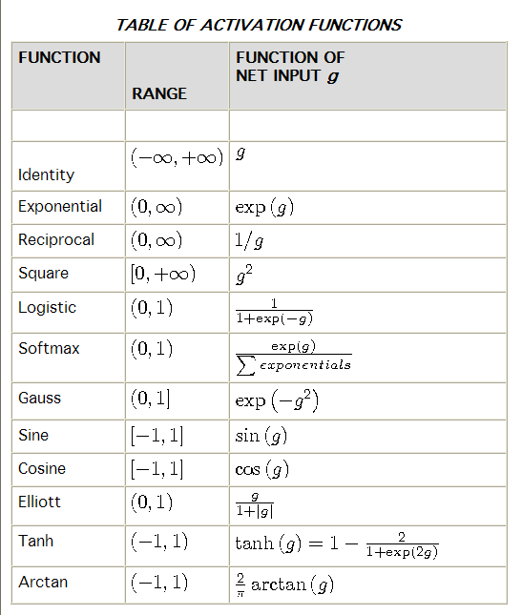

Slide 60
Neural Network is Universal Approximator!
Y
Y=6 + H₁ - 2H₂ +3H₃
H₁
H₂
H₃
X

Slide 61
Objective and Error Functions
The Neural Network trains a network by minimizing an objective function.
The objective function is the sum of a total error function and a penalty function, divided by the total frequency.
The total error function is a summation over all the cases in the training data and all the target variables of an individual error function applied to each target value and corresponding output.
The penalty function is the product of the weight decay constant and the sum of all network weights other than output biases.
The objective function has several different forms depending on the types of error functions used.
Maximum likelihood is the most important of all statistical estimation methods.

Slide 62
Objective and Error Functions
Examples:
  SSE = ∑_{i}(Y_{i}-P_{i})² for interval targets
  Log likelihhod = - ∑_{i}[Y_{i}log(P_{i}) + (1-Y_{i}) log(1-P_{i})]
  for binary targets
Refer to SAS Help for the details.

Slide 63
Back Propagation Algorithm
The back propagation algorithm is commonly used for optimizing the objective function.
Algorithm
  Step 1 – Compute predicted values using given weights.
  Step 2 – Compute errors between observed and predicted values.
  Step 3 – Obtain new weights by back propagation

Slide 64
Choice of Architecture
In developing a neural network, there are many choices to be made:
  the number of inputs to use,
  which basic network architecture to use,
  the number of hidden layers to use,
  the number of units per hidden layer,
  the activation and combination functions to use,
  and so on.
If you have considerable prior information about the function to be learned, you may be able to make some of these choices based on theoretical considerations.
More often, it takes trial and error to find a good architecture. This section will offer some general guidelines.
Since regression and trees are often much faster to train than neural nets, you should try those methods first to provide a baseline for comparing neural network results.
For exploring network architectures, there is no need to use huge data sets.
You can use a representative sample (a stratified sample if you are trying to predict rare events) of the data for exploration and save the weights of the best architecture you find.
Then you can use those weights to initialize training on a larger data set to fine-tune the network.

Slide 65
Advantages and Disadvantages
Advantages
  Universal approximator
  Good prediction accuracy
Disadvantages
  A number of choices
  Often overfitting
  Lots of computing time required
  Difficulty in interpretation
Inputs
Predicted Target
Magic?

Slide 66
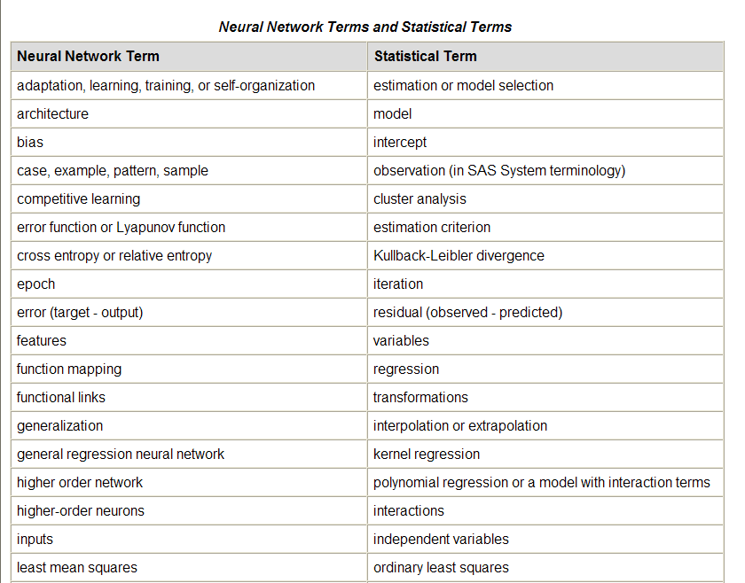

Slide 67
