Slide 1
TCP Throughput Equation
TFRC's t₀
  t₀ = 3 * RTT
t_rtxcur = (t_rttvar * 2³ + t_srtt) / 2³
= (t_rtt * 2 * 2³ + t_rtt * 2³) /2³
= 3 * t_rtt
,where t_rttvar = t_rtt * 2, and t_srtt = t_rtt * 2³

Slide 2
TFWC equation changes
Code Changed
  t₀ = 3 * SRTT
  hence, f(p) = sqrt(2p/3) + 9*p*sqrt(3p/8)*(1+32*p²)

Slide 3
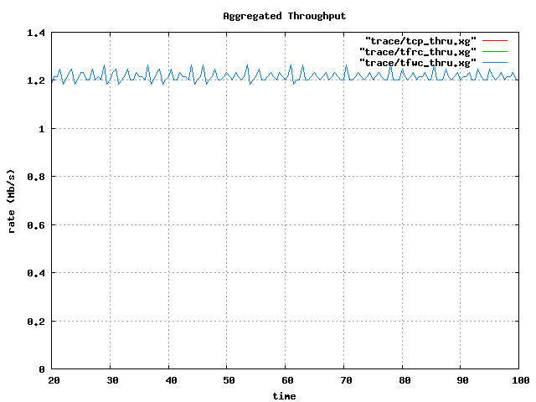
TFWC Throughput

Slide 4
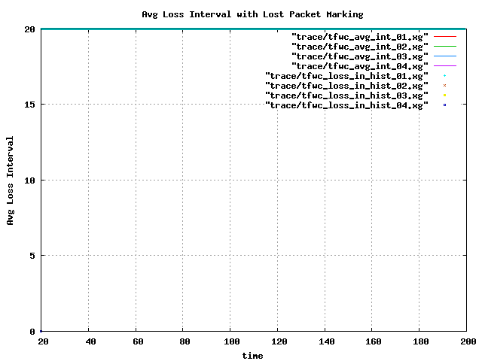
TFWC ALI

Slide 5
TFWC Trace (excerpt)

