Slide 1
TFWCs w/ reverse TCP Sack
2
1
3
50Mbs, random delay
15Mbs, 20ms
TFWCs
RED
TCP
Reverse TCP
• Random FTP start time: 1s ~ 5s
• Random Access Link Delay: 2ms ~ 5ms
• e2e RTT = 44ms ~ 50ms
• Delay x Bandwidth = 20ms x 15Mb/s
= 300 Kbits
• 1 packet = 1000 bytes = 8000 bits
• Delay x BW = 37.5 packets

Slide 2
4 TFWC w/ 4 reverse TCP
Varying Bottleneck (RED) Queue Size (10 ~ 75)
Simulation Time = 200
Random Seed Number = 177
Phase Break = On
Probability = 10%

Slide 3
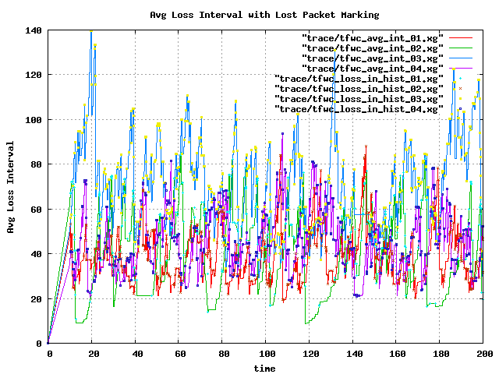
average loss interval (q=10, 4TFWC)

Slide 4
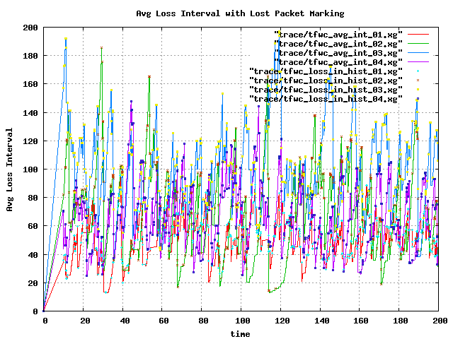
average loss interval (q=15, 4TFWC)

Slide 5
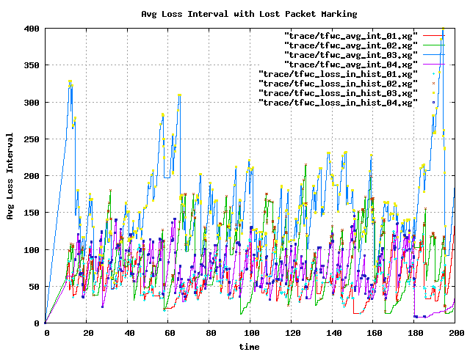
average loss interval (q=20, 4TFWC)

Slide 6
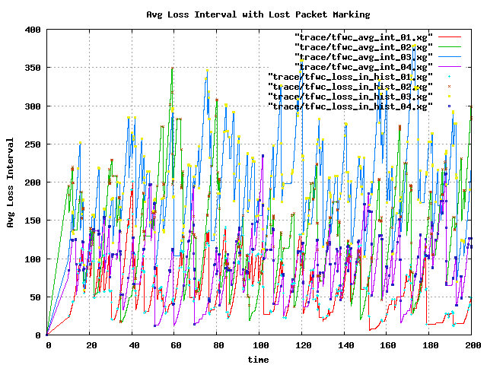
average loss interval (q=25, 4TFWC)

Slide 7
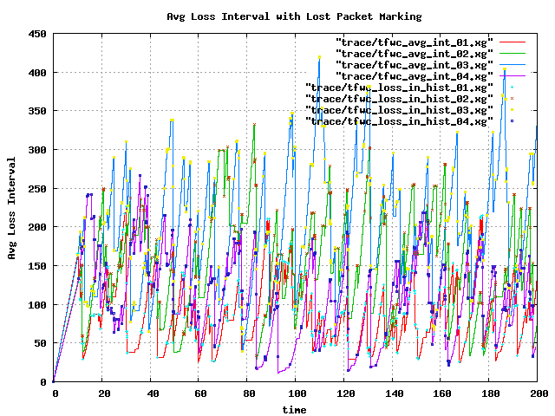
average loss interval (q=30, 4TFWC)

Slide 8
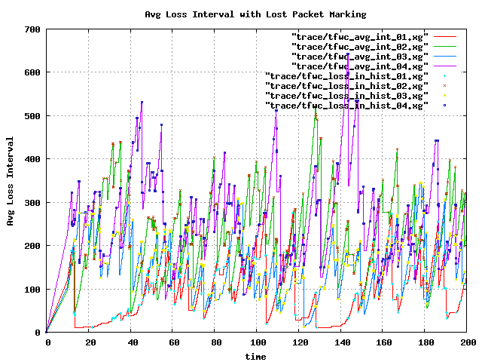
average loss interval (q=35, 4TFWC)

Slide 9
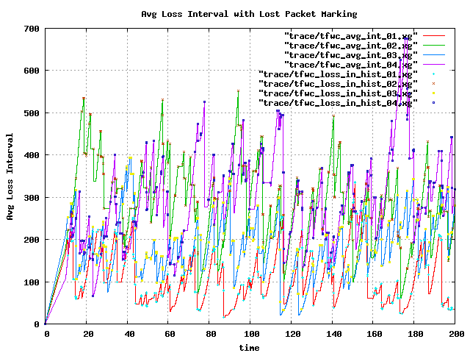
average loss interval (q=40, 4TFWC)

Slide 10
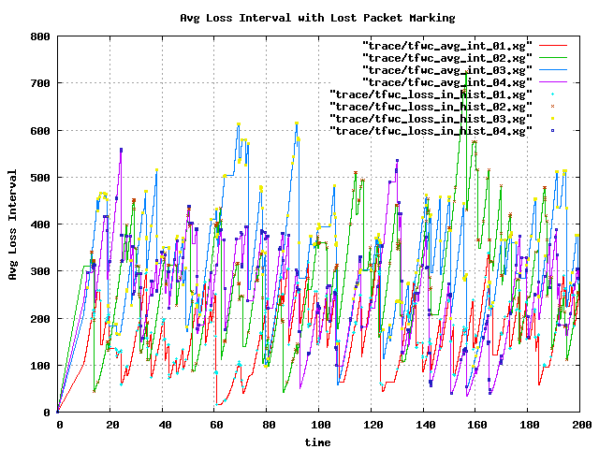
average loss interval (q=45, 4TFWC)

Slide 11
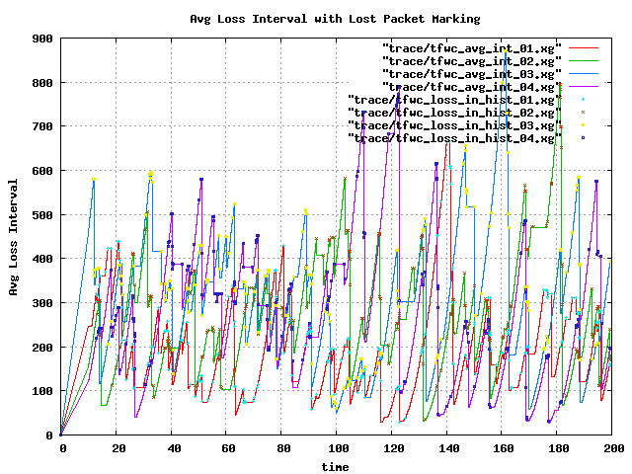
average loss interval (q=50, 4TFWC)

Slide 12
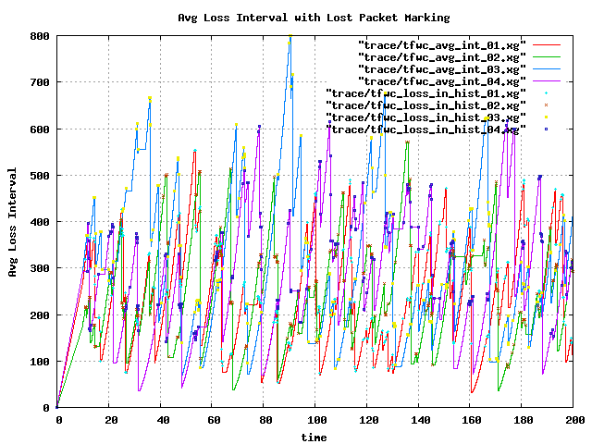
average loss interval (q=55, 4TFWC)

Slide 13
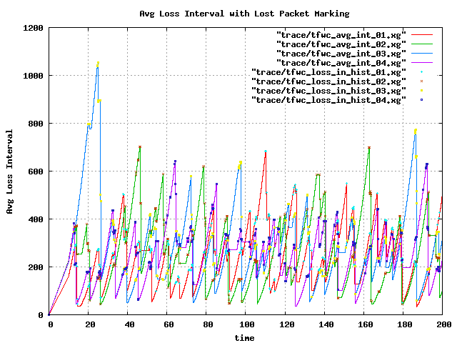
average loss interval (q=60, 4TFWC)

Slide 14
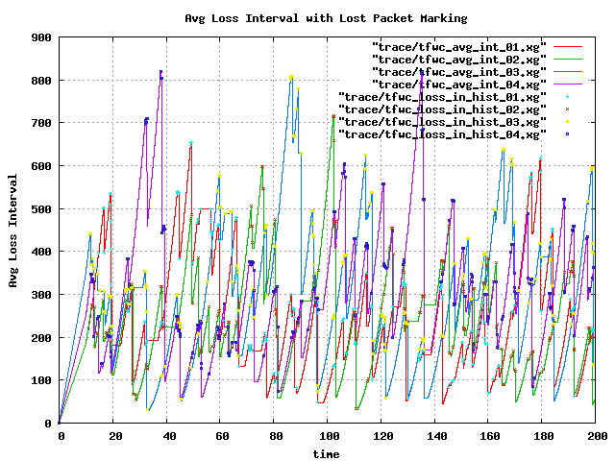
average loss interval (q=65, 4TFWC)

Slide 15
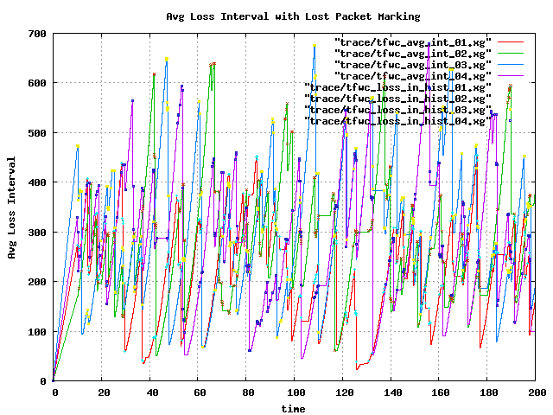
average loss interval (q=70, 4TFWC)

Slide 16
8 TFWC w/ 8 reverse TCP
Varying Bottleneck (RED) Queue Size (10 ~ 75)
Simulation Time = 200
Random Seed Number = 177
Phase Break = On
Probability = 10%

Slide 17
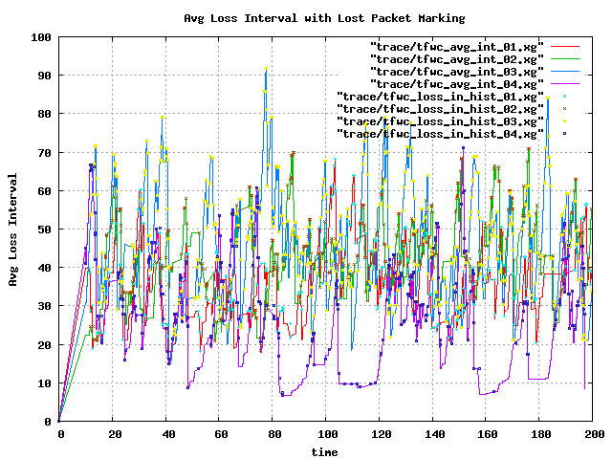
average loss interval (q=10, 8TFWC)

Slide 18
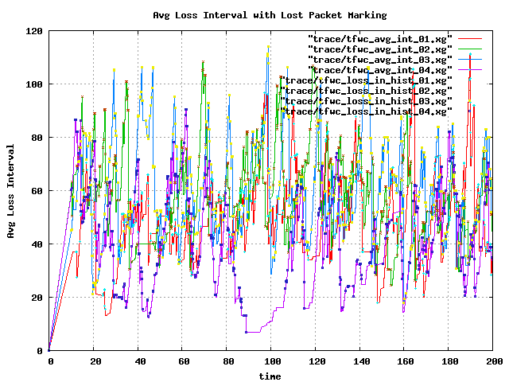
average loss interval (q=15, 8TFWC)

Slide 19
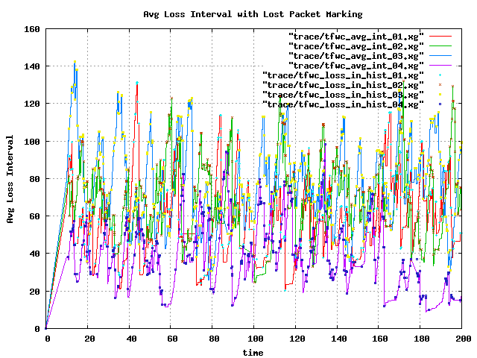
average loss interval (q=20, 8TFWC)

Slide 20
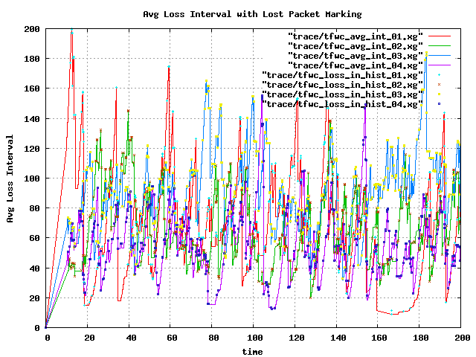
average loss interval (q=25, 8TFWC)

Slide 21
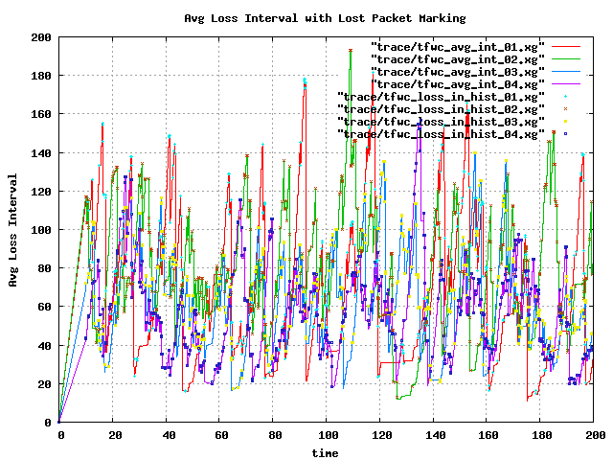
average loss interval (q=30, 8TFWC)

Slide 22
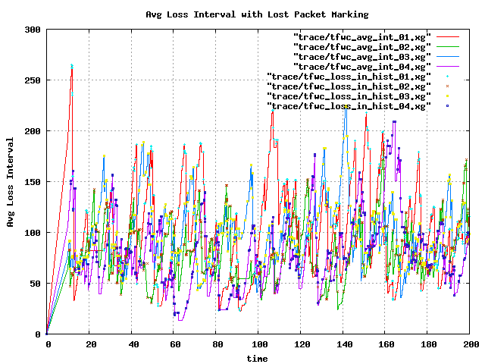
average loss interval (q=35, 8TFWC)

Slide 23
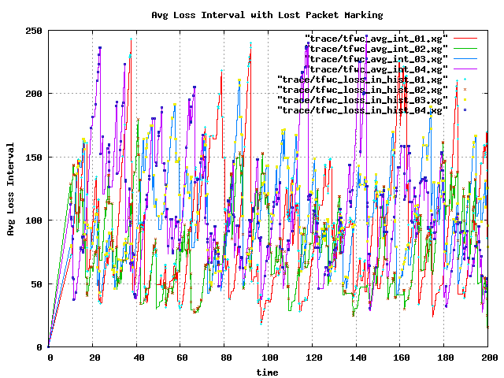
average loss interval (q=40, 8TFWC)

Slide 24
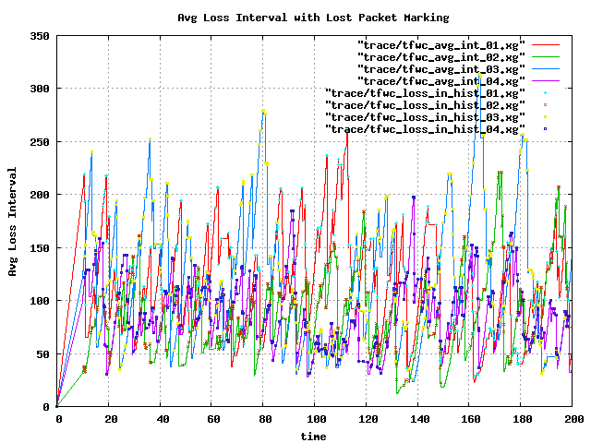
average loss interval (q=45, 8TFWC)

Slide 25
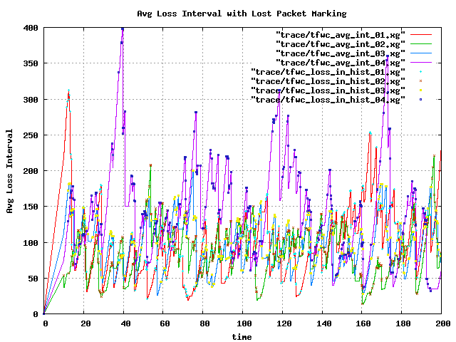
average loss interval (q=50, 8TFWC)

Slide 26
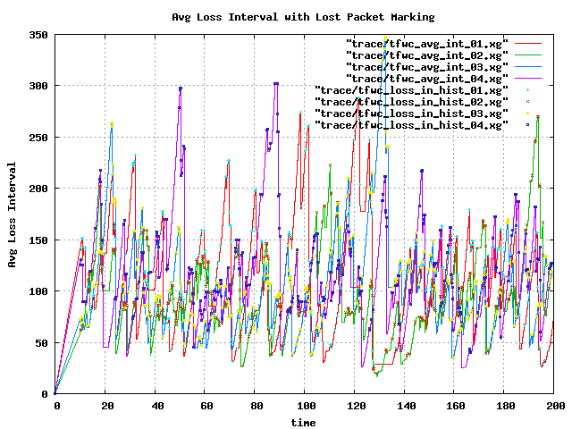
average loss interval (q=55, 8TFWC)

Slide 27
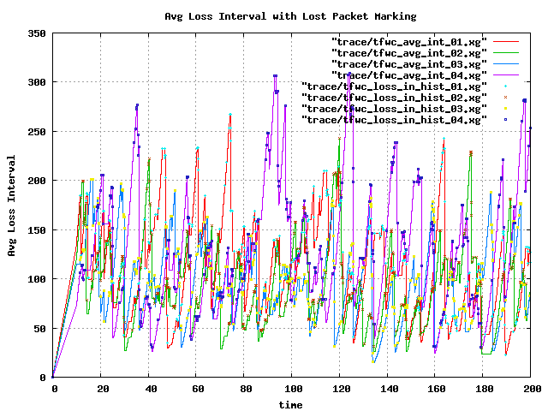
average loss interval (q=60, 8TFWC)

Slide 28
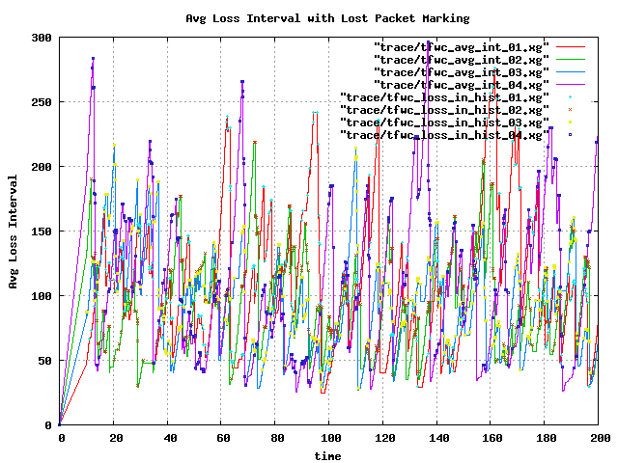
average loss interval (q=65, 8TFWC)

Slide 29
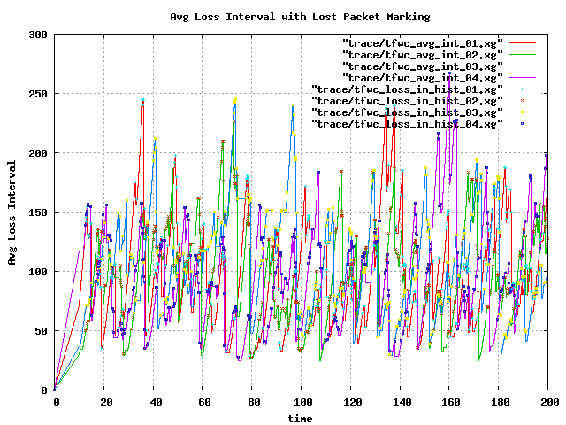
average loss interval (q=70, 8TFWC)

Slide 30
12 TFWC w/ 12 reverse TCP
Varying Bottleneck (RED) Queue Size (10 ~ 75)
Simulation Time = 200
Random Seed Number = 177
Phase Break = On
Probability = 10%

Slide 31
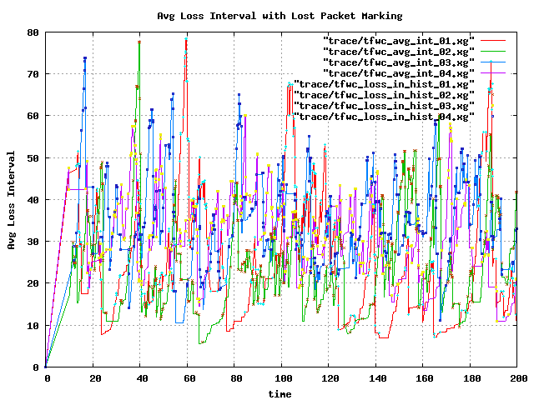
average loss interval (q=10, 12TFWC)

Slide 32
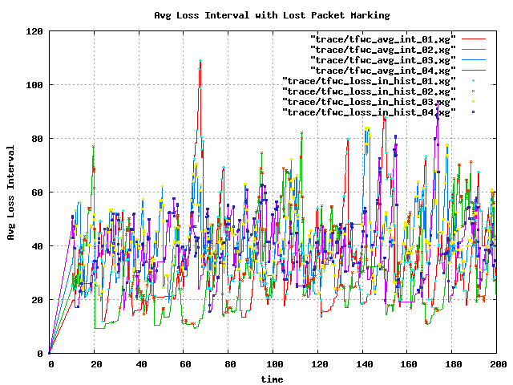
average loss interval (q=15, 12TFWC)

Slide 33
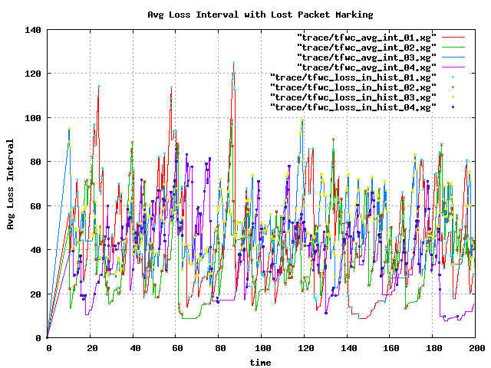
average loss interval (q=20, 12TFWC)

Slide 34
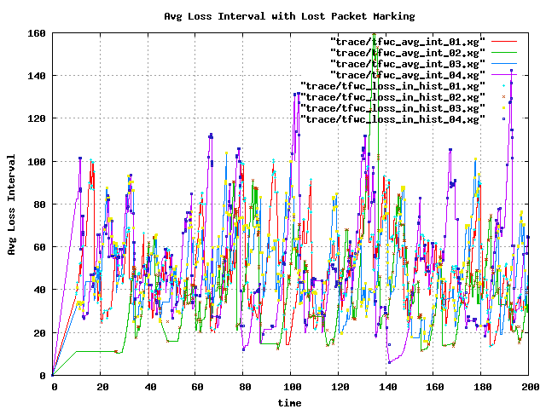
average loss interval (q=25, 12TFWC)

Slide 35
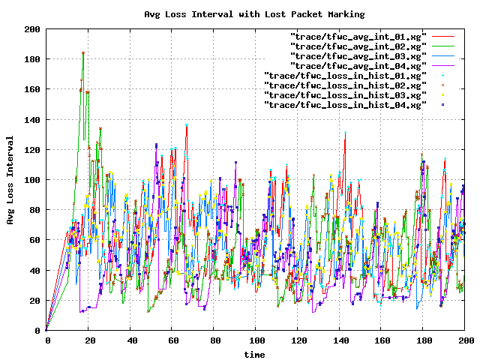
average loss interval (q=30, 12TFWC)

Slide 36
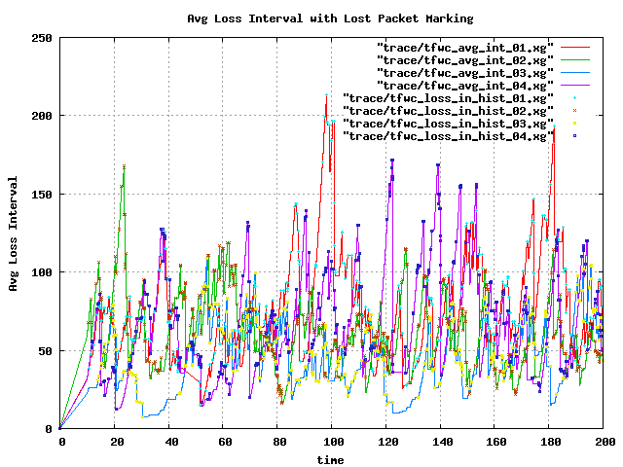
average loss interval (q=35, 12TFWC)

Slide 37
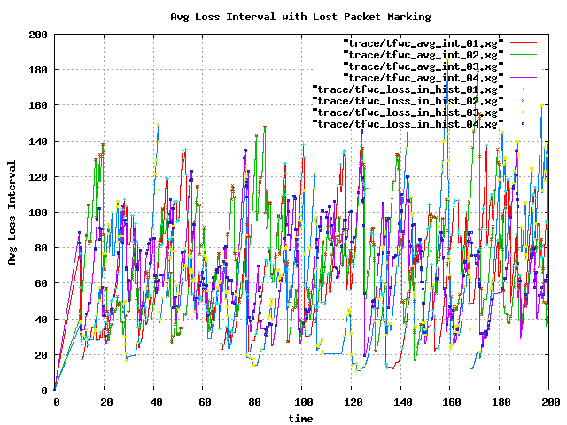
average loss interval (q=40, 12TFWC)

Slide 38
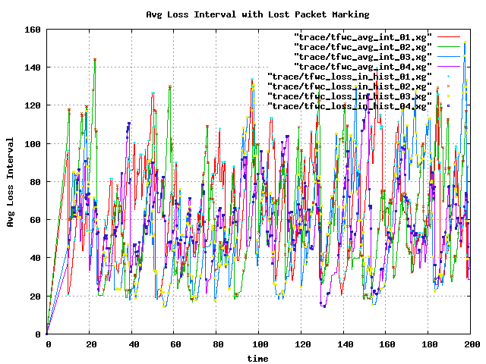
average loss interval (q=45, 12TFWC)

Slide 39
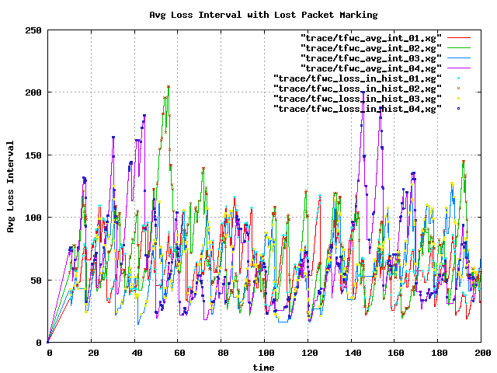
average loss interval (q=50, 12TFWC)

Slide 40
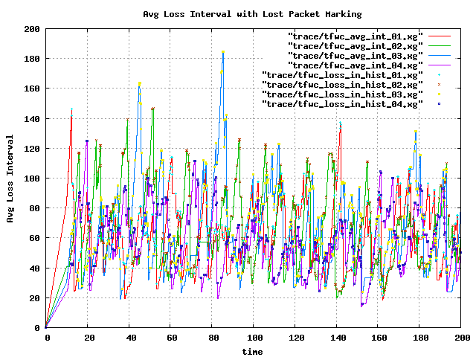
average loss interval (q=55, 12TFWC)

Slide 41
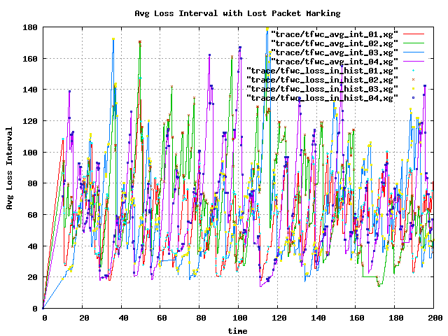
average loss interval (q=60, 12TFWC)

Slide 42
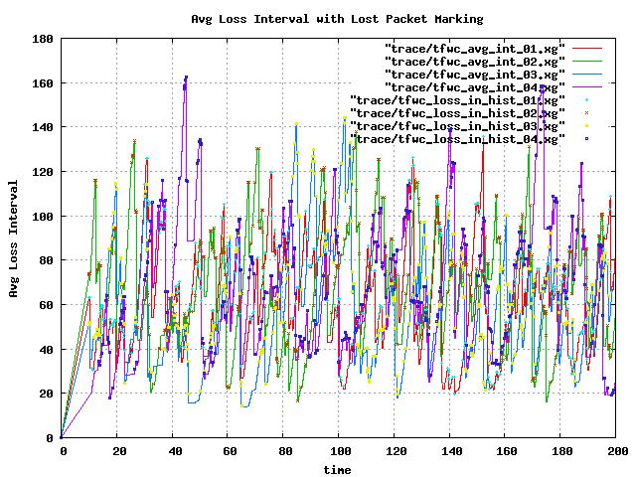
average loss interval (q=65, 12TFWC)

Slide 43
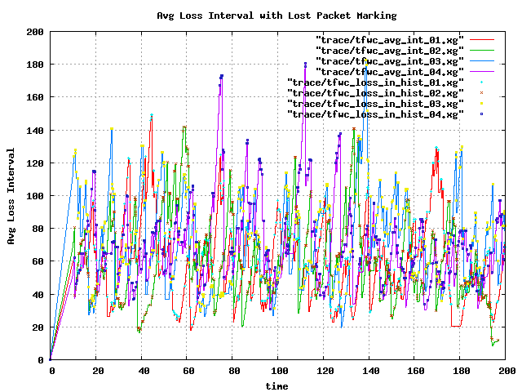
average loss interval (q=70, 12TFWC)

Slide 44
16 TFWC w/ 16 reverse TCP
Varying Bottleneck (RED) Queue Size (10 ~ 75)
Simulation Time = 200
Random Seed Number = 177
Phase Break = On
Probability = 10%

Slide 45
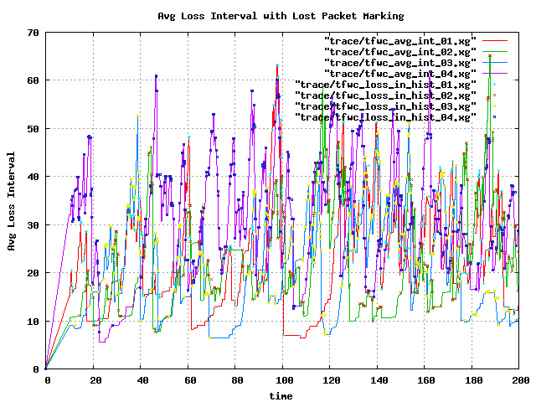
average loss interval (q=10, 16TFWC)

Slide 46
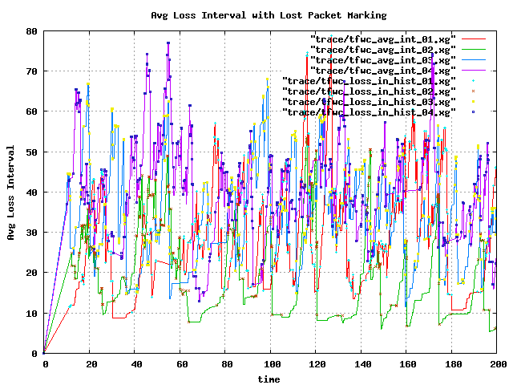
average loss interval (q=15, 16TFWC)

Slide 47
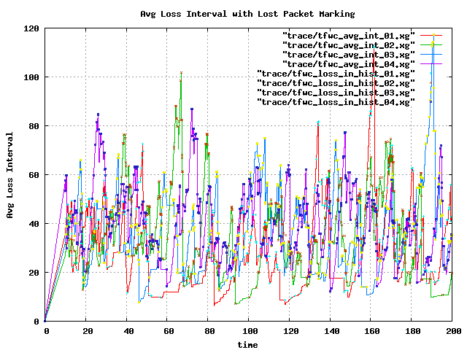
average loss interval (q=20, 16TFWC)

Slide 48
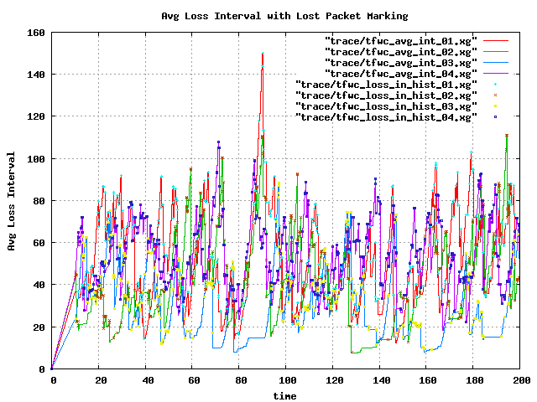
average loss interval (q=25, 16TFWC)

Slide 49
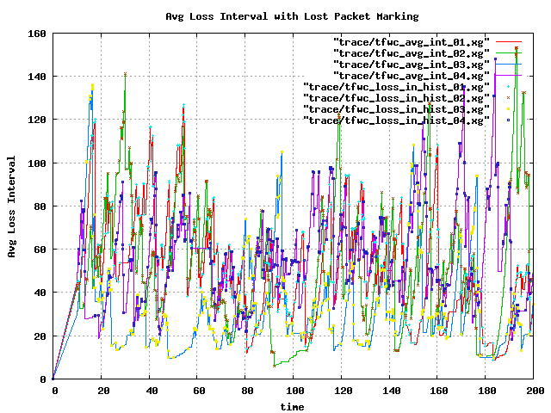
average loss interval (q=30, 16TFWC)

Slide 50
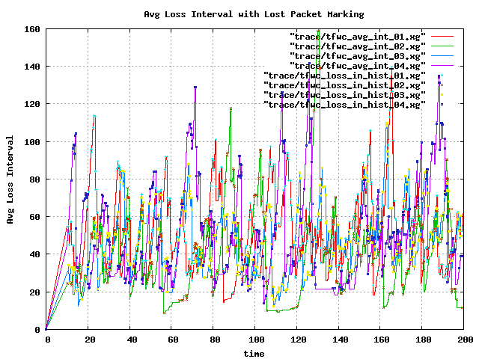
average loss interval (q=35, 16TFWC)

Slide 51
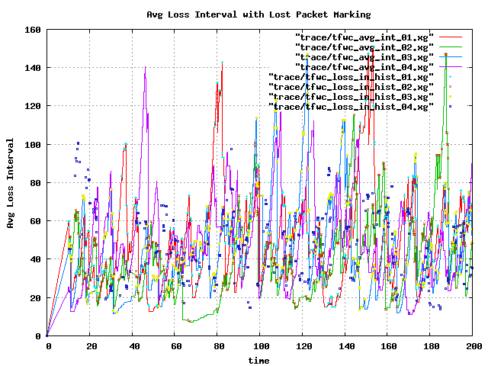
average loss interval (q=40, 16TFWC)

Slide 52
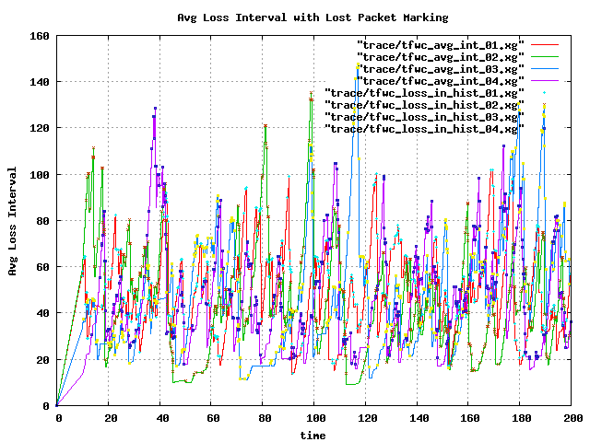
average loss interval (q=45, 16TFWC)

Slide 53
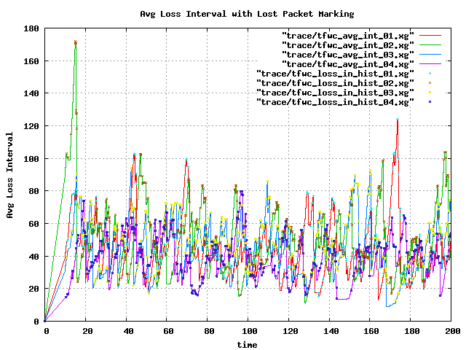
average loss interval (q=50, 16TFWC)

Slide 54
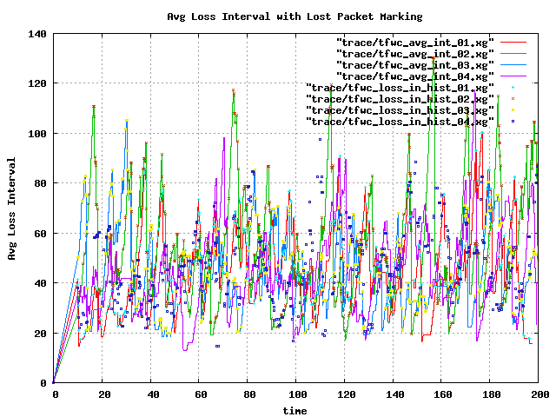
average loss interval (q=55, 16TFWC)

Slide 55
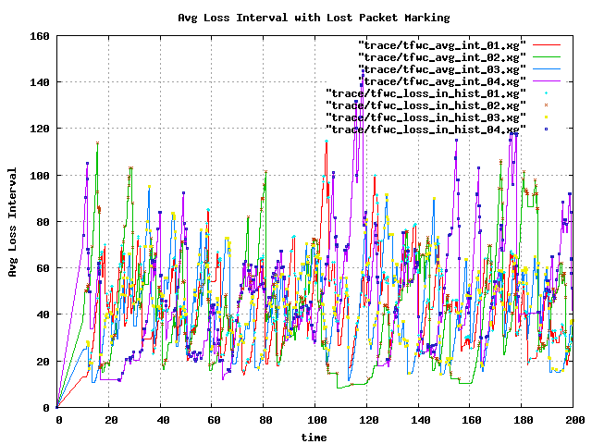
average loss interval (q=60, 16TFWC)

Slide 56

average loss interval (q=65, 16TFWC)

Slide 57

average loss interval (q=70, 16TFWC)

Slide 58
20 TFWC w/ 20 reverse TCP
Varying Bottleneck (RED) Queue Size (10 ~ 75)
Simulation Time = 200
Random Seed Number = 177
Phase Break = On
Probability = 10%

Slide 59

average loss interval (q=10, 20TFWC)

Slide 60

average loss interval (q=15, 20TFWC)

Slide 61

average loss interval (q=20, 20TFWC)

Slide 62

average loss interval (q=25, 20TFWC)

Slide 63

average loss interval (q=30, 20TFWC)

Slide 64

average loss interval (q=35, 20TFWC)

Slide 65

average loss interval (q=40, 20TFWC)

Slide 66

average loss interval (q=45, 20TFWC)

Slide 67

average loss interval (q=50, 20TFWC)

Slide 68

average loss interval (q=55, 20TFWC)

Slide 69
average loss interval (q=60, 20TFWC)

Slide 70

average loss interval (q=65, 20TFWC)

Slide 71

average loss interval (q=70, 20TFWC)

Slide 72
24 TFWC w/ 24 reverse TCP
Varying Bottleneck (RED) Queue Size (10 ~ 75)
Simulation Time = 200
Random Seed Number = 177
Phase Break = On
Probability = 10%

Slide 73

average loss interval (q=10, 24TFWC)

Slide 74

average loss interval (q=15, 24TFWC)

Slide 75

average loss interval (q=20, 24TFWC)

Slide 76

average loss interval (q=25, 24TFWC)

Slide 77

average loss interval (q=30, 24TFWC)

Slide 78

average loss interval (q=35, 24TFWC)

Slide 79

average loss interval (q=40, 24TFWC)

Slide 80

average loss interval (q=45, 24TFWC)

Slide 81

average loss interval (q=50, 24TFWC)

Slide 82

average loss interval (q=55, 24TFWC)

Slide 83

average loss interval (q=60, 24TFWC)

Slide 84

average loss interval (q=65, 24TFWC)

Slide 85

average loss interval (q=70, 24TFWC)

Slide 86
28 TFWC w/ 28 reverse TCP
Varying Bottleneck (RED) Queue Size (10 ~ 75)
Simulation Time = 200
Random Seed Number = 177
Phase Break = On
Probability = 10%

Slide 87

average loss interval (q=10, 28TFWC)

Slide 88

average loss interval (q=15, 28TFWC)

Slide 89

average loss interval (q=20, 28TFWC)

Slide 90

average loss interval (q=25, 28TFWC)

Slide 91

average loss interval (q=30, 28TFWC)

Slide 92

average loss interval (q=35, 28TFWC)

Slide 93

average loss interval (q=40, 28TFWC)

Slide 94

average loss interval (q=45, 28TFWC)

Slide 95

average loss interval (q=50, 28TFWC)

Slide 96

average loss interval (q=55, 28TFWC)

Slide 97

average loss interval (q=60, 28TFWC)

Slide 98

average loss interval (q=65, 28TFWC)

Slide 99

average loss interval (q=70, 28TFWC)

Slide 100
32 TFWC w/ 32 reverse TCP
Varying Bottleneck (RED) Queue Size (10 ~ 75)
Simulation Time = 200
Random Seed Number = 177
Phase Break = On
Probability = 10%

Slide 101

average loss interval (q=10, 32TFWC)

Slide 102

average loss interval (q=15, 32TFWC)

Slide 103

average loss interval (q=20, 32TFWC)

Slide 104

average loss interval (q=25, 32TFWC)

Slide 105

average loss interval (q=30, 32TFWC)

Slide 106

average loss interval (q=35, 32TFWC)

Slide 107

average loss interval (q=40, 32TFWC)

Slide 108

average loss interval (q=45, 32TFWC)

Slide 109

average loss interval (q=50, 32TFWC)

Slide 110

average loss interval (q=55, 32TFWC)

Slide 111

average loss interval (q=60, 32TFWC)

Slide 112

average loss interval (q=65, 32TFWC)

Slide 113

average loss interval (q=70, 32TFWC)

