Slide 1
TFWCs w/ reverse TCP Sack
2
1
3
50Mbs, random delay
15Mbs, 20ms
TFWCs
RED
TCP
Reverse TCP
• Random FTP start time: 1s ~ 5s
• Random Access Link Delay: 2ms ~ 5ms
• e2e RTT = 44ms ~ 50ms
• Delay x Bandwidth = 20ms x 15Mb/s
= 300 Kbits
• 1 packet = 1000 bytes = 8000 bits
• Delay x BW = 37.5 packets

Slide 2
4 TFWC w/ 4 reverse TCP
Varying Bottleneck (RED) Queue Size (10 ~ 75)
Simulation Time = 200
Random Seed Number = 177
Phase Break = On
Probability = 10%

Slide 3
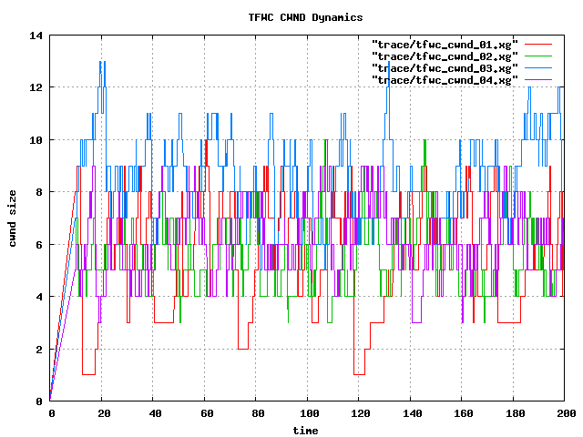
cwnd (q=10, 4TFWC)

Slide 4
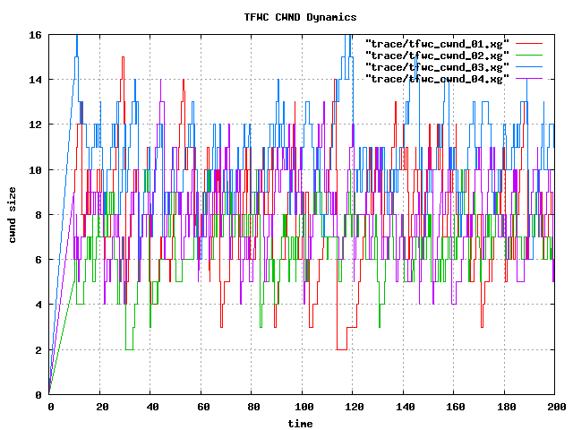
cwnd (q=15, 4TFWC)

Slide 5
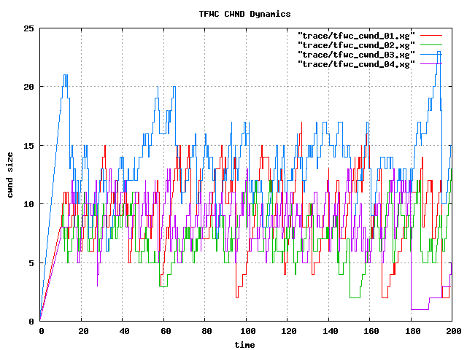
cwnd (q=20, 4TFWC)

Slide 6
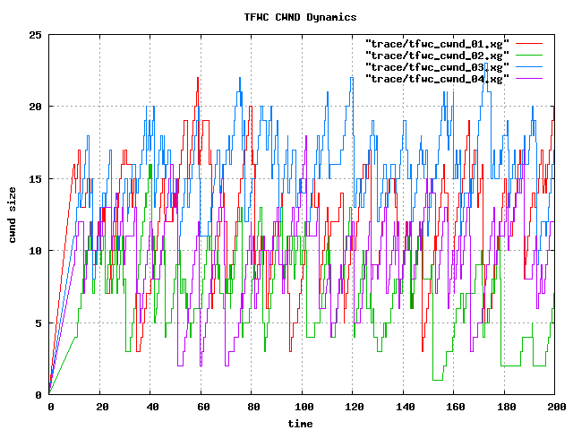
cwnd (q=25, 4TFWC)

Slide 7
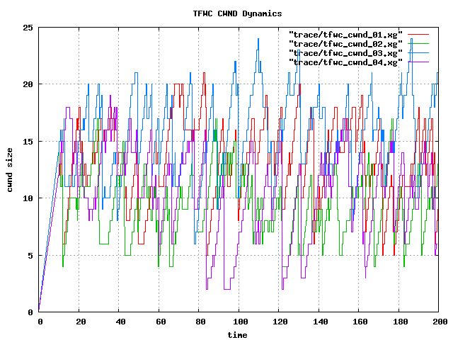
cwnd (q=30, 4TFWC)

Slide 8
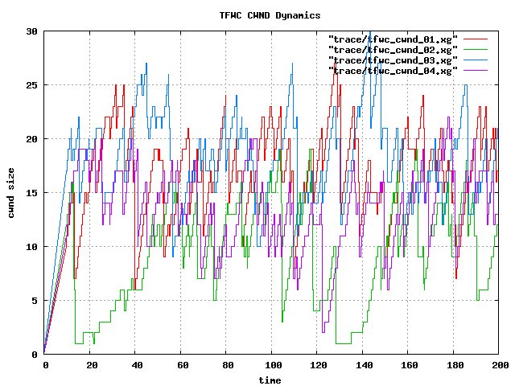
cwnd (q=35, 4TFWC)

Slide 9
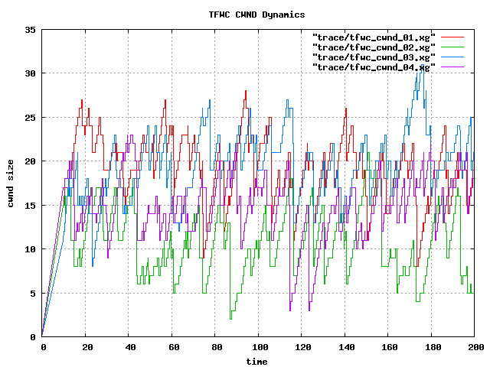
cwnd (q=40, 4TFWC)

Slide 10
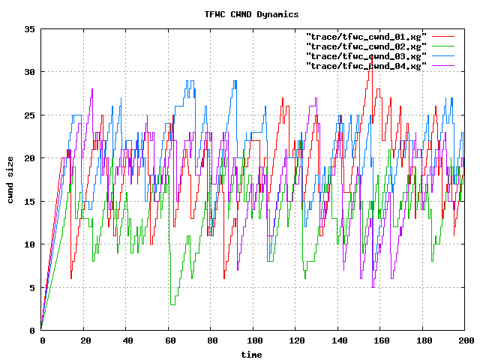
cwnd (q=45, 4TFWC)

Slide 11
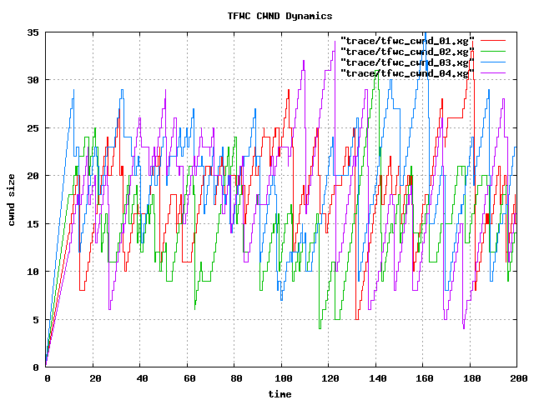
cwnd (q=50, 4TFWC)

Slide 12
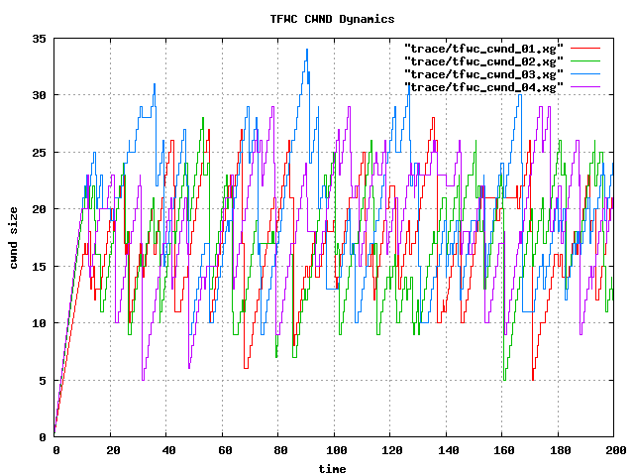
cwnd (q=55, 4TFWC)

Slide 13
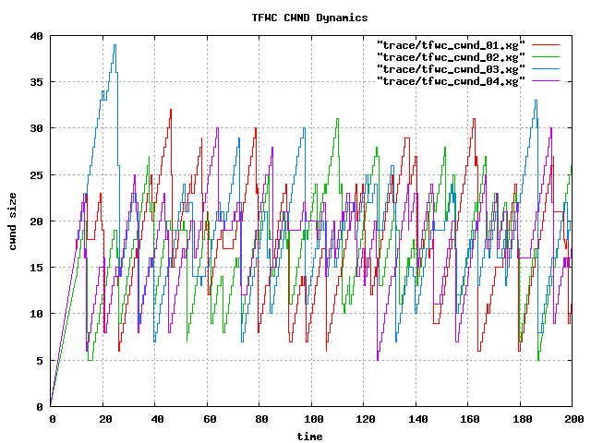
cwnd (q=60, 4TFWC)

Slide 14
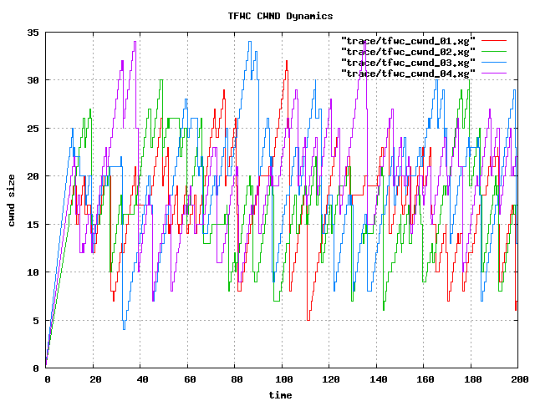
cwnd (q=65, 4TFWC)

Slide 15
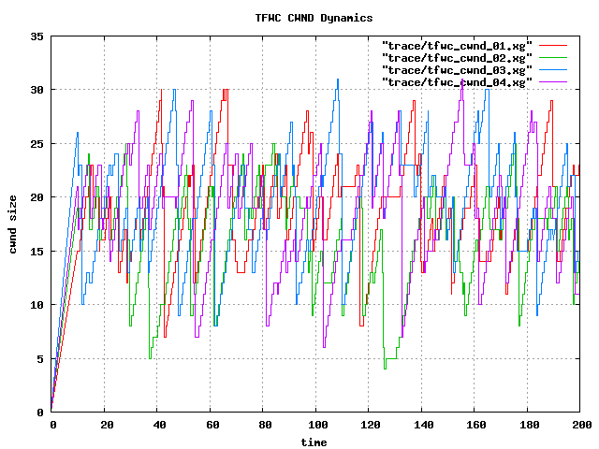
cwnd (q=70, 4TFWC)

Slide 16
8 TFWC w/ 8 reverse TCP
Varying Bottleneck (RED) Queue Size (10 ~ 75)
Simulation Time = 200
Random Seed Number = 177
Phase Break = On
Probability = 10%

Slide 17
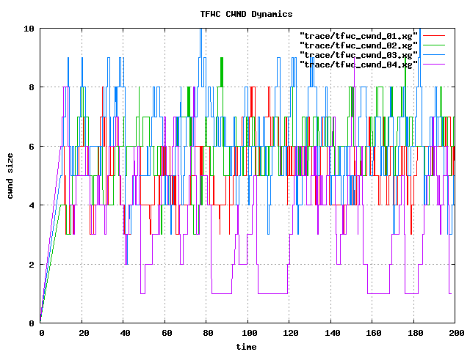
cwnd (q=10, 8TFWC)

Slide 18
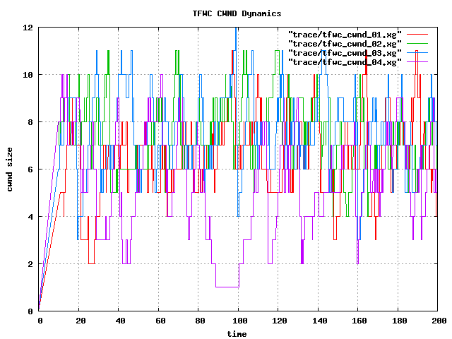
cwnd (q=15, 8TFWC)

Slide 19
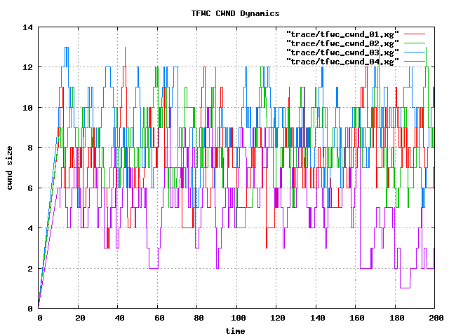
cwnd (q=20, 8TFWC)

Slide 20
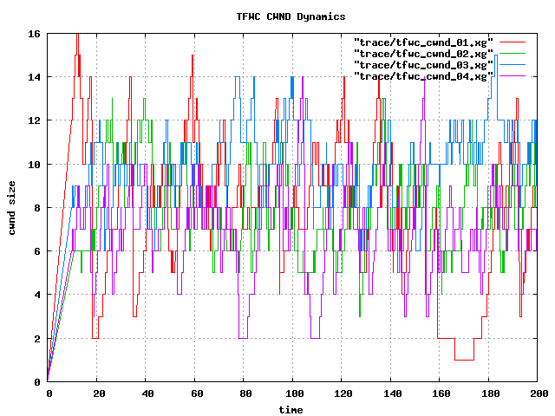
cwnd (q=25, 8TFWC)

Slide 21
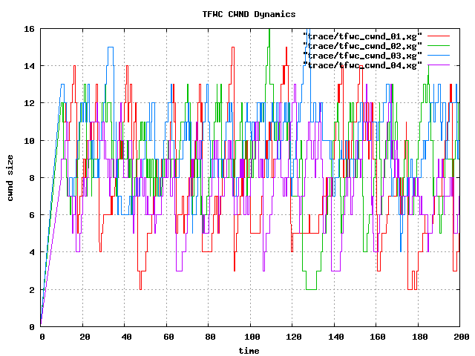
cwnd (q=30, 8TFWC)

Slide 22
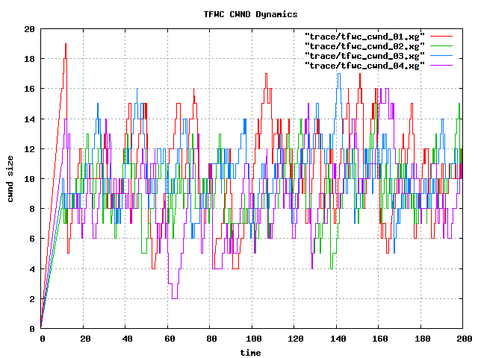
cwnd (q=35, 8TFWC)

Slide 23
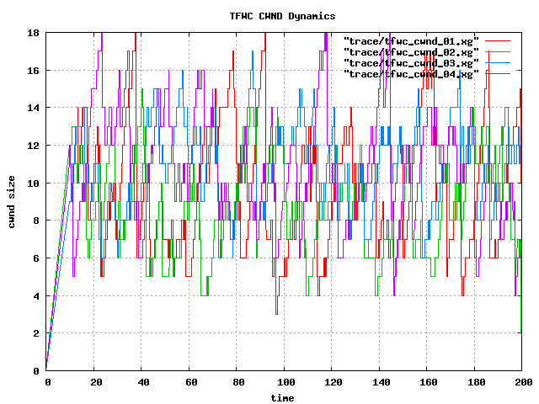
cwnd (q=40, 8TFWC)

Slide 24
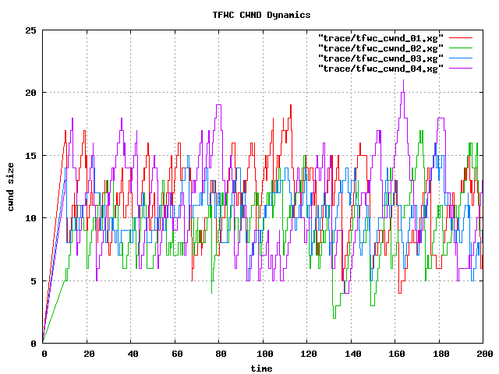
cwnd (q=45, 8TFWC)

Slide 25
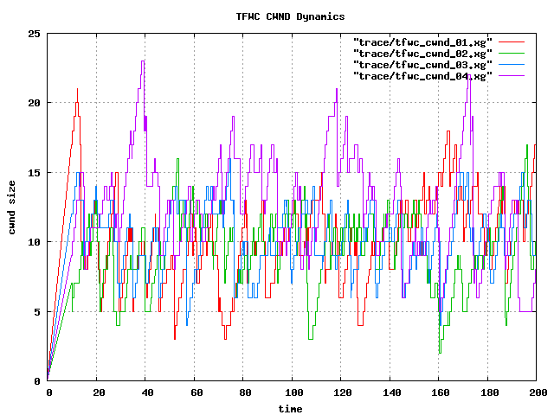
cwnd (q=50, 8TFWC)

Slide 26
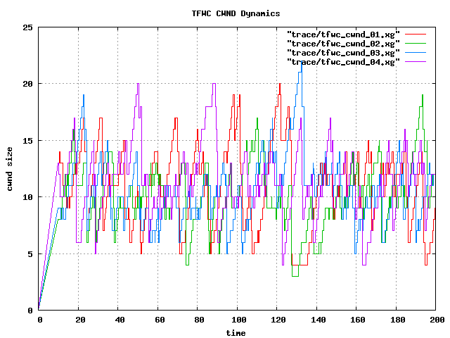
cwnd (q=55, 8TFWC)

Slide 27
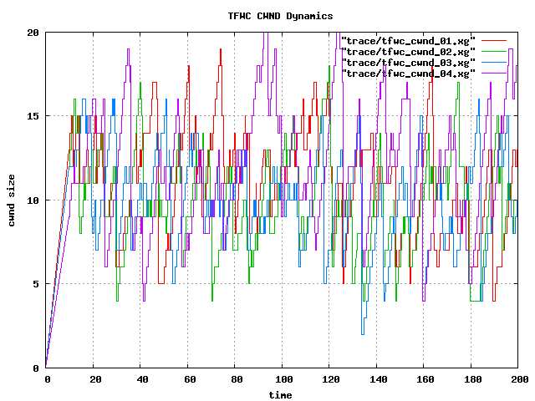
cwnd (q=60, 8TFWC)

Slide 28
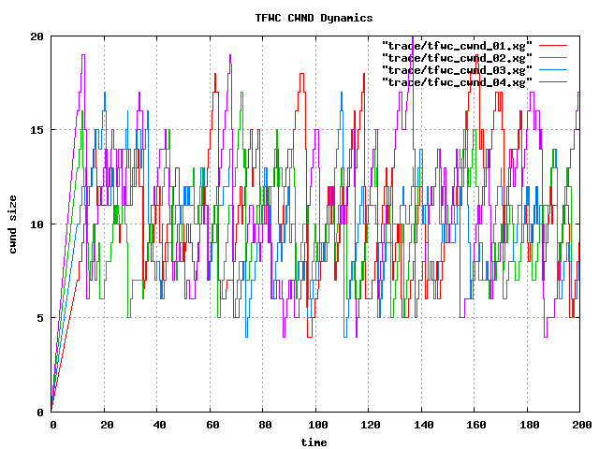
cwnd (q=65, 8TFWC)

Slide 29
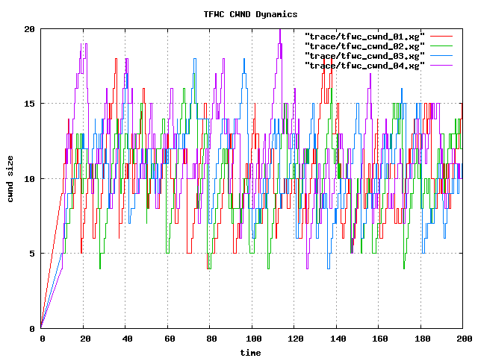
cwnd (q=70, 8TFWC)

Slide 30
16TFWC w/ 16 reverse TCP
Varying Bottleneck (RED) Queue Size (10 ~ 75)
Simulation Time = 200
Random Seed Number = 177
Phase Break = On
Probability = 10%

Slide 31
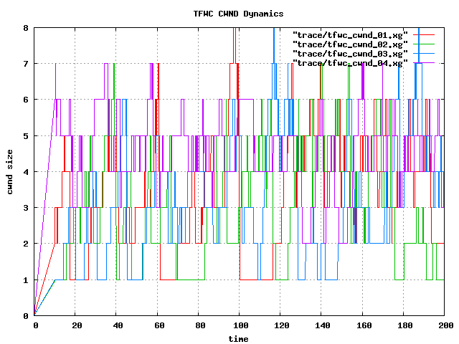
cwnd (q=10, 16TFWC)

Slide 32
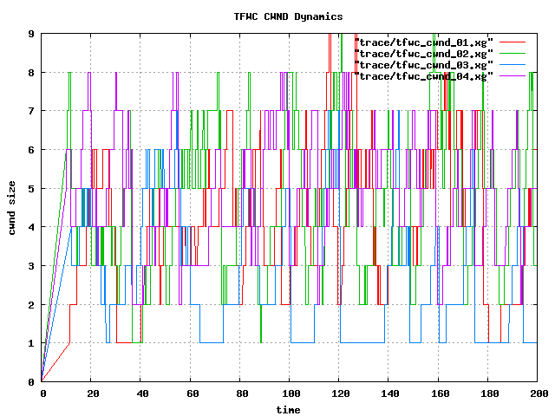
cwnd (q=15, 16TFWC)

Slide 33
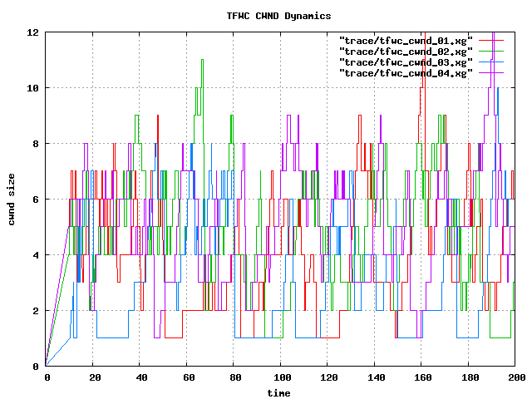
cwnd (q=20, 16TFWC)

Slide 34
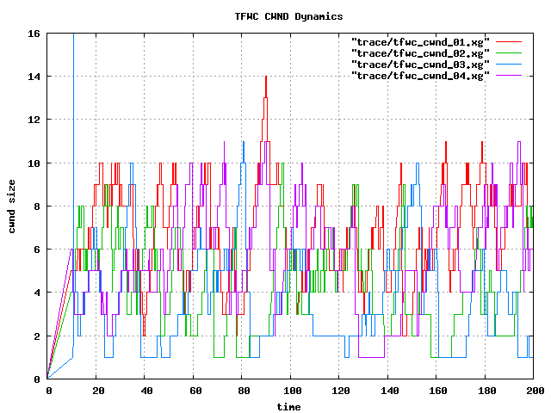
cwnd (q=25, 16TFWC)

Slide 35
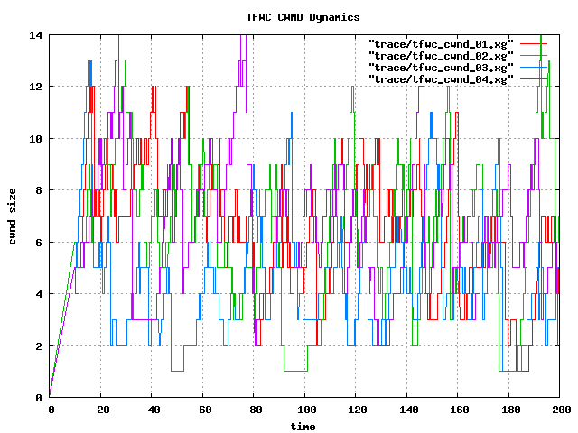
cwnd (q=30, 16TFWC)

Slide 36
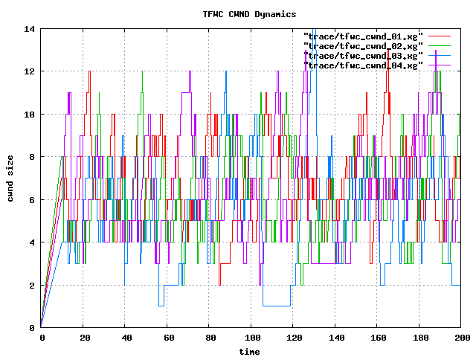
cwnd (q=35, 16TFWC)

Slide 37
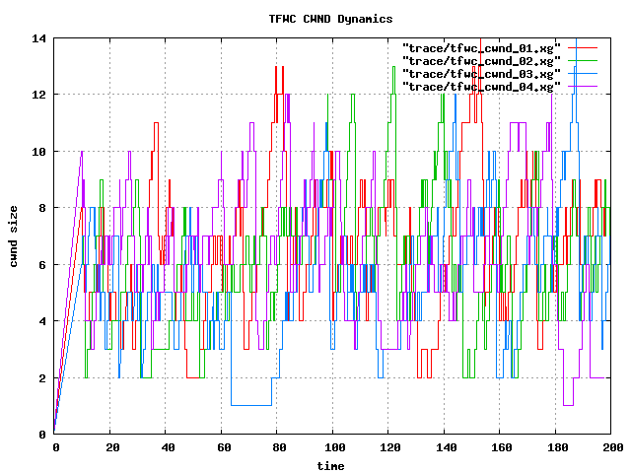
cwnd (q=40, 16TFWC)

Slide 38
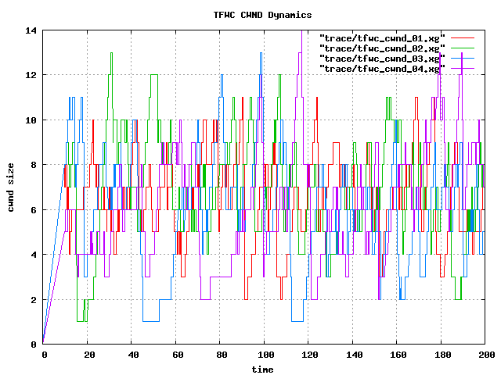
cwnd (q=45, 16TFWC)

Slide 39
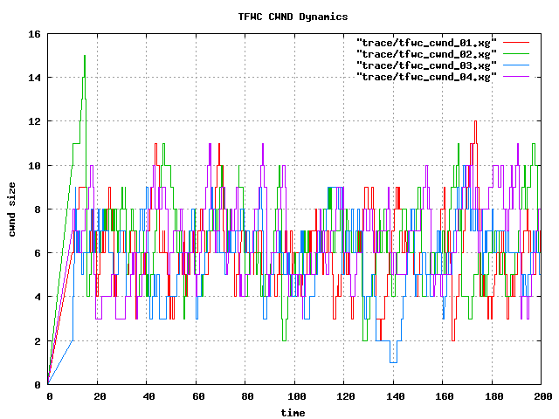
cwnd (q=50, 16TFWC)

Slide 40
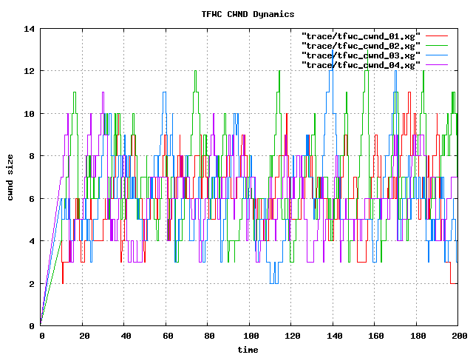
cwnd (q=55, 16TFWC)

Slide 41
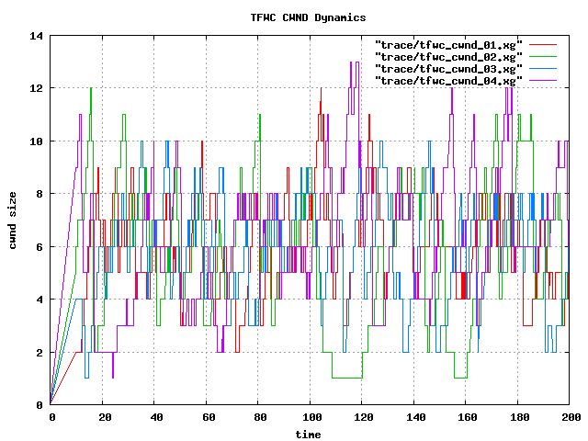
cwnd (q=60, 16TFWC)

Slide 42
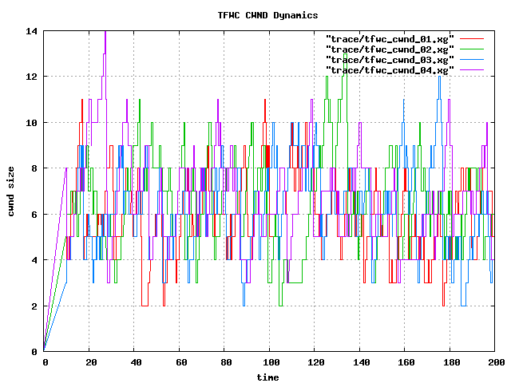
cwnd (q=65, 16TFWC)

Slide 43
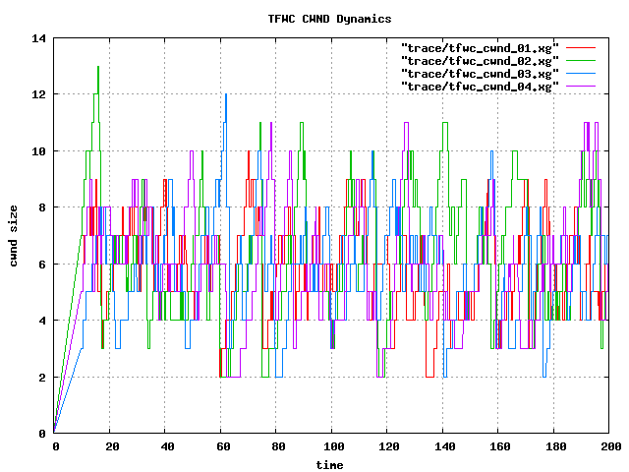
cwnd (q=70, 16TFWC)

Slide 44
32TFWC w/ 32 reverse TCP
Varying Bottleneck (RED) Queue Size (10 ~ 75)
Simulation Time = 200
Random Seed Number = 177
Phase Break = On
Probability = 10%

Slide 45
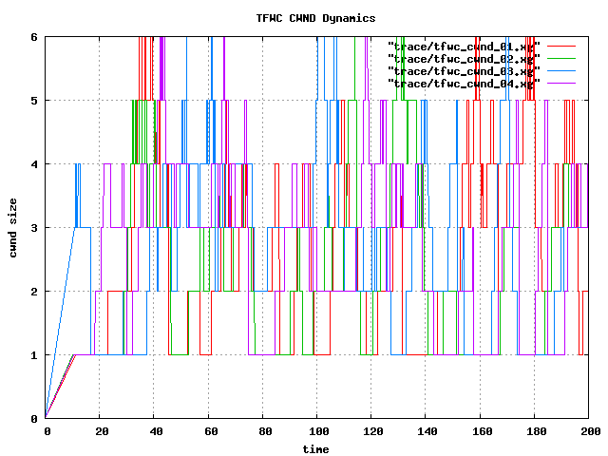
cwnd (q=10, 32TFWC)

Slide 46
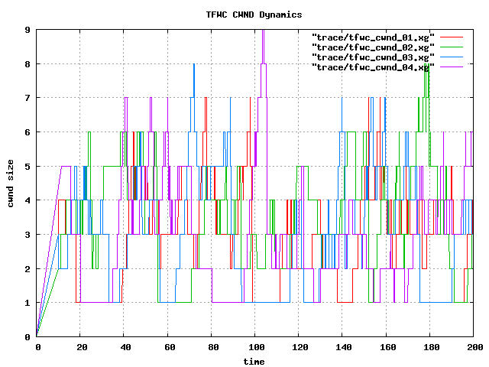
cwnd (q=15, 32TFWC)

Slide 47
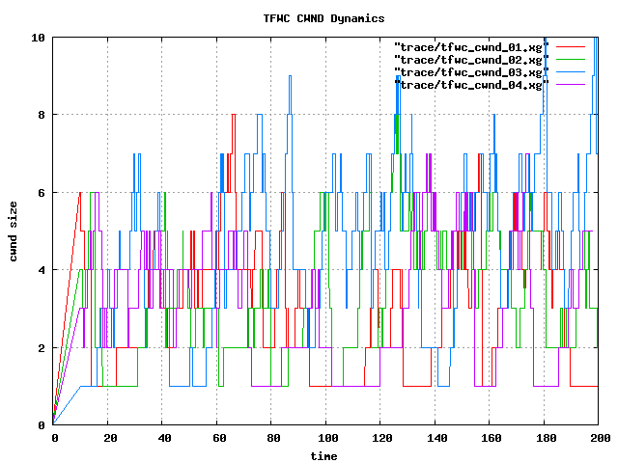
cwnd (q=20, 32TFWC)

Slide 48
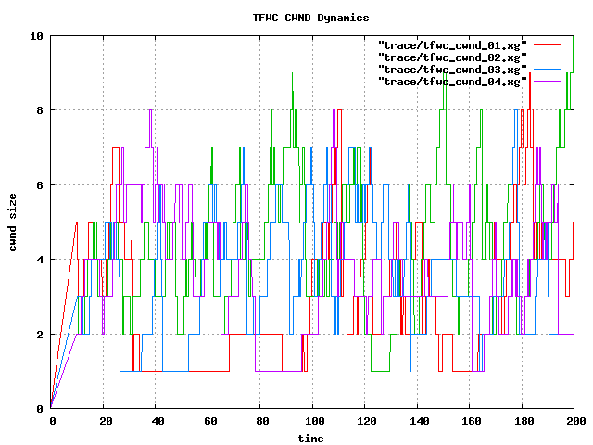
cwnd (q=25, 32TFWC)

Slide 49
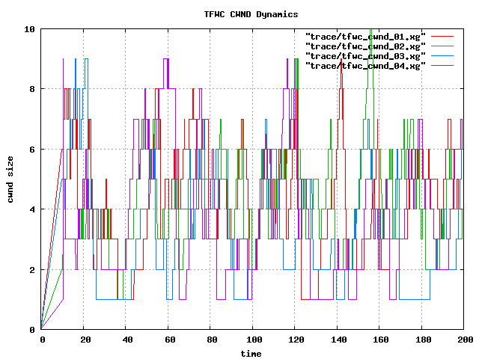
cwnd (q=30, 32TFWC)

Slide 50
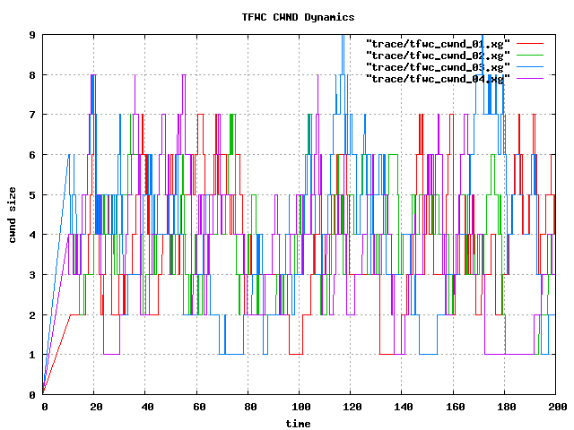
cwnd (q=35, 32TFWC)

Slide 51
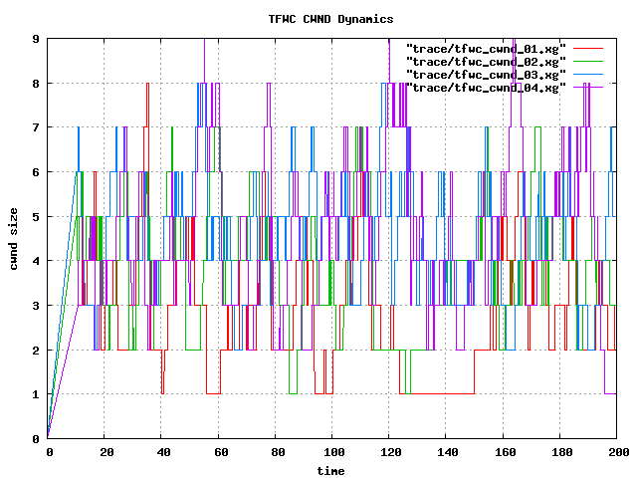
cwnd (q=40, 32TFWC)

Slide 52
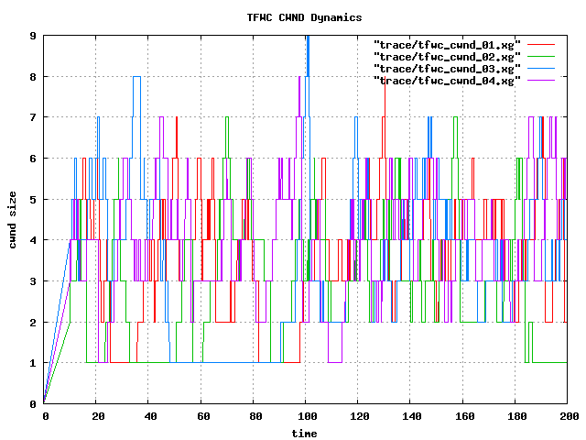
cwnd (q=45, 32TFWC)

Slide 53
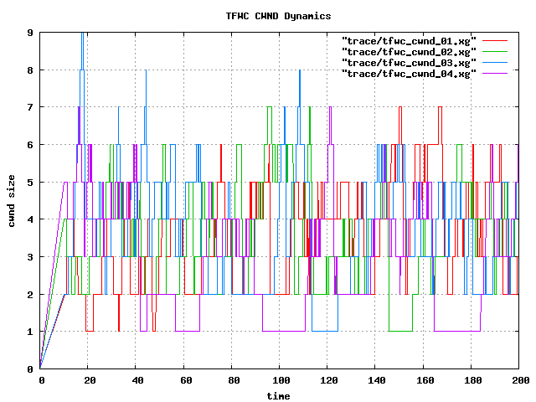
cwnd (q=50, 32TFWC)

Slide 54
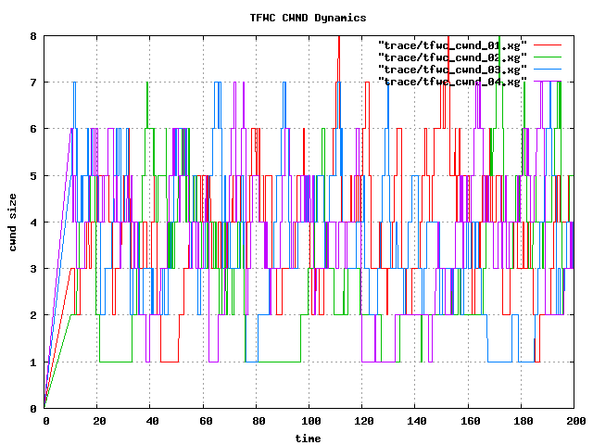
cwnd (q=55, 32TFWC)

Slide 55
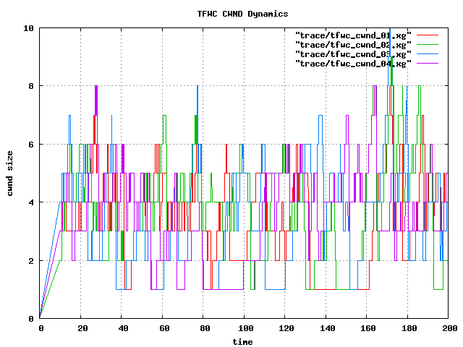
cwnd (q=60, 32TFWC)

Slide 56

cwnd (q=65, 32TFWC)

Slide 57

cwnd (q=70, 32TFWC)

