Slide 1
TFWC rate-based timer test
Manipulate loss rate (periodic)
  1 packet out of 100
Large bottleneck link speed and buffer size
  15Mbps with 50 packets (FIFO)
Always send a packet based on the rate-based timer

Slide 2
Hand Calculation
loss interval = 100
p = 1 / (loss interval) = 1/100 = 0.01
window =~ 1/sqrt(p) =~ 10
  f(p) = sqrt(2/3 * p) + 12 * P * (1 + 32p^2) * sqrt(3/8 * p) =~0.089
  window = 1/f(p) =~ 11

Slide 3
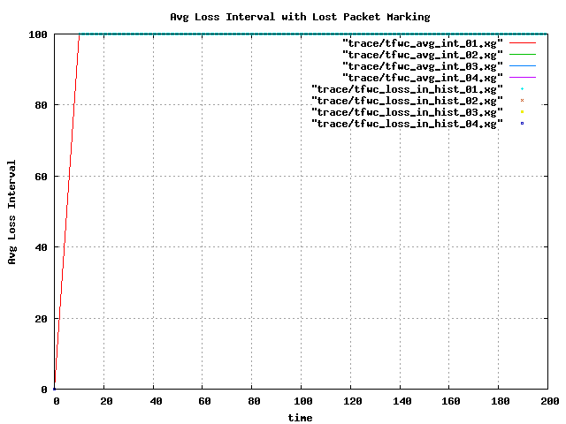
ALI

Slide 4
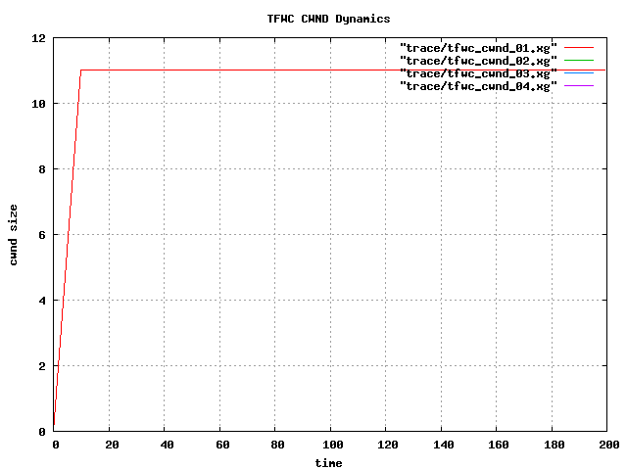
CWND

Slide 5
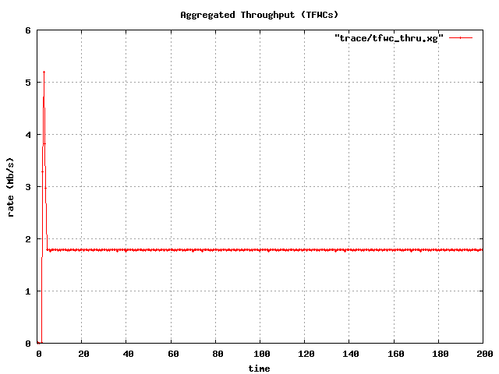
Throughput

