Slide 1
TFWC Validation
The primary purpose of this work is to find out whether TFWC is working fine under the new timer-based mode.
I compare TFWC and TFRC in terms of ALI and X.

Slide 2
Simulation Scenario
Bottleneck Link Speed = 15 Mbps
  Access Link Speed = 50 Mbps
Bottleneck Queue
  FIFO with 50 packets
Loss Rate
  Periodic loss rate = 0.05
  Average Loss Interval = 20
RTT
  RTT=~ 23ms

Slide 3
Back of the envelope calculation
X = s/(R * f(p))
  s: packet size
  R: round trip time
  f(p) = sqrt(p*2/3) + 12*p*sqrt(p*3/8)*(1+32*pow(p,2))
We have
  s = 8000 bits
  R = 0.023 seconds
  p = 0.05
Hence, we get X =~ 1.28 Mbps

Slide 4
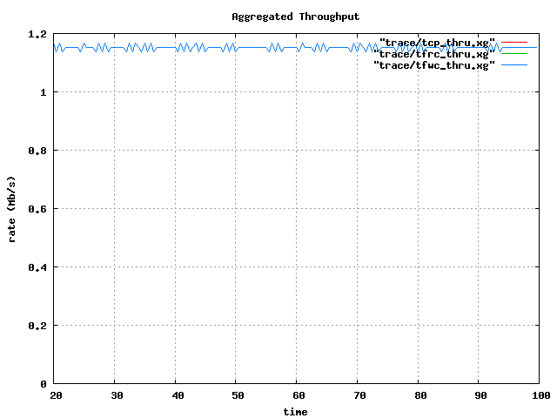
TFWC Throughput

Slide 5
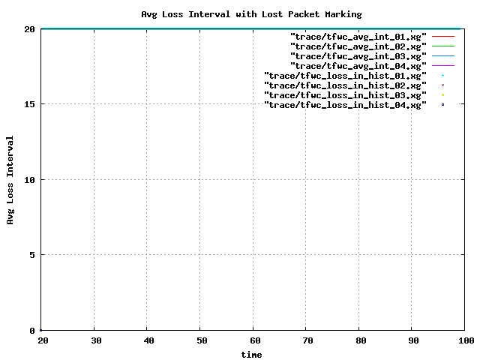
TFWC ALI

Slide 6
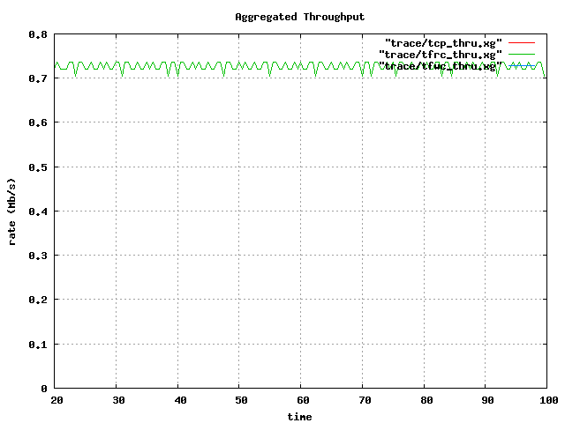
TFRC Throughput

Slide 7
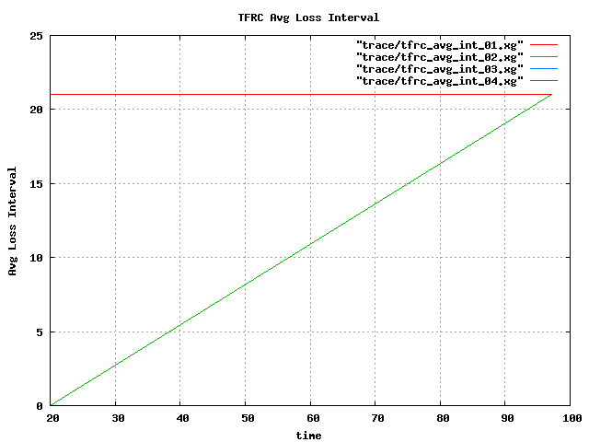
TFRC ALI

