Slide 1




























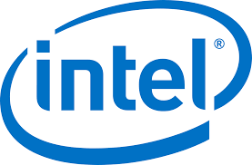

Layer 1. AI Applications
Layer 2. Foundation Models
Layer 3. Software Frameworks (Open Source)
Layer 4. Cloud Infrastructure
Layer 5. Chips (Accelerators)
Layer 6. Chip Components
Layer 7. Silicon Fabrication (Foundry)

