Slide 1
Online Shoppers’ Intention Analysis
BUAN 6359.005 - Group 9
Hongbo Li
Yixio Ji
Jielin Zhang
Nayan Nandkishore Joshi
Paritosh Mishra
Click here to see
presentation video

Slide 2
Motivation
New trend in the past 20 years
Online shopping
E-commerce
Changing demands and behaviors
User purchase habits
Webpage optimization
Boost sales

Slide 3
Background
Various techniques are employed for accurate model creation
Clustering Analysis
Classification Techniques
Decision Tree
Neural Network
Logistic Regression
Evaluation - accuracy rates and area under the curve(AUC)

Slide 4
Dataset Description
Data Origin
Second-hand data
Data Set Information
12,330 sessions
84.5% (10,422) negative class samples
1,908 positive class samples
Number of Instances: | 12,330 | Data Mining Objective: | Classification, Clustering
Number of Attributes: | 18 | Missing Values? | N/A

Slide 5
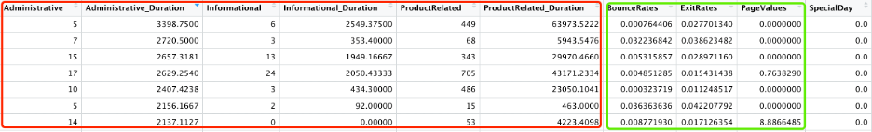
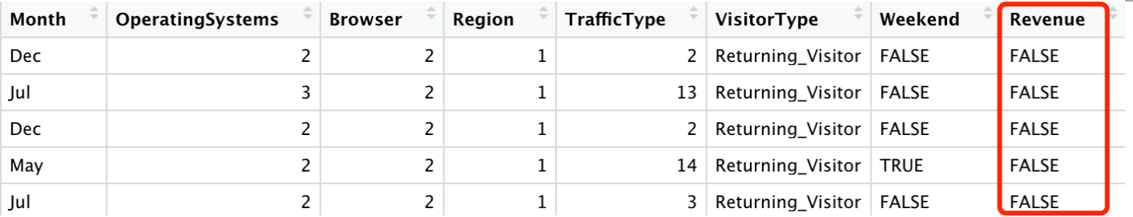
Dataset Description
Numerical attribute samples
Categorical attribute samples

Slide 6
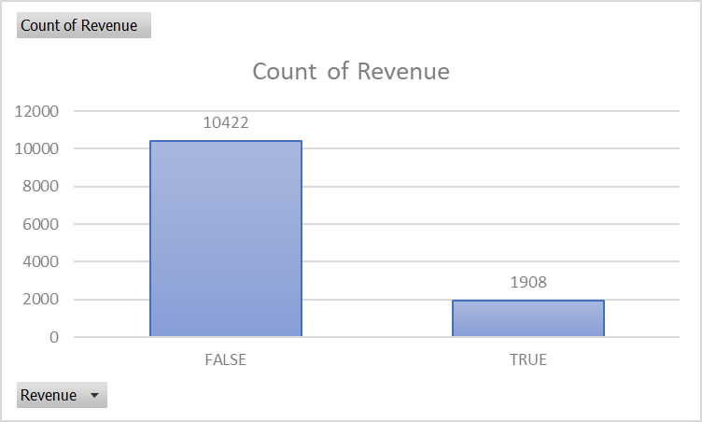
Objective and Data Analysis
Customer behavior key metrics
Accurate predicting model
Imbalanced dataset

Slide 7
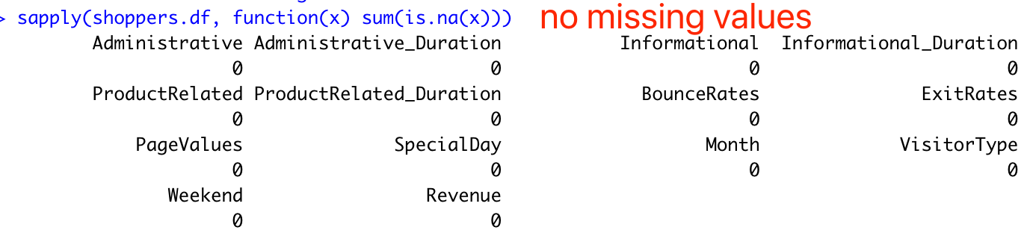
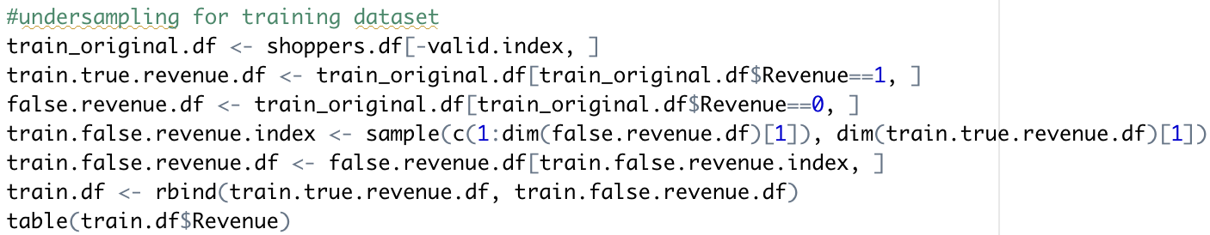
Data Processing and Sampling
Missing values?
Convert logic variables to binary variables
Under-sampling

Slide 8
Clustering analysis: shopper segments
Cluster analysis: K-Means method
3 classification methods:
Decision Tree
Neural Networks
Logistic Regression
Data Mining

Slide 9
Cluster Analysis (K–means)
All categorical values are converted into numerical values
K-means clustering algorithm
Plot for date interpretation

Slide 10
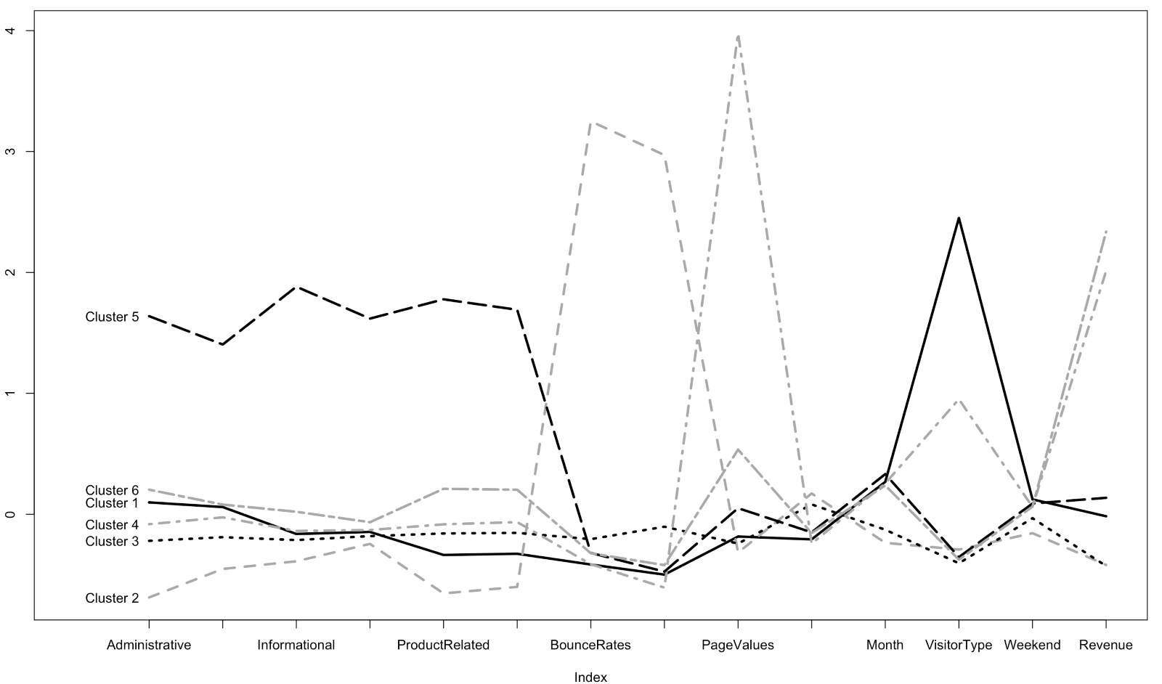
Cluster Analysis (K–means) Continued

Slide 11
Cluster Analysis (K–means) Continued
Interpretation of the graph:
With the highest revenue, Cluster 6 comes out on top
Cluster 6 has higher values for Product Related, Page Values, and Visitor Type attributes than the rest.
Model evaluation:
accuracy rates
AUC

Slide 12
Decision Tree
3 different classification methods
Default Decision Tree
Pruned Decision Tree
Random Forest

Slide 13
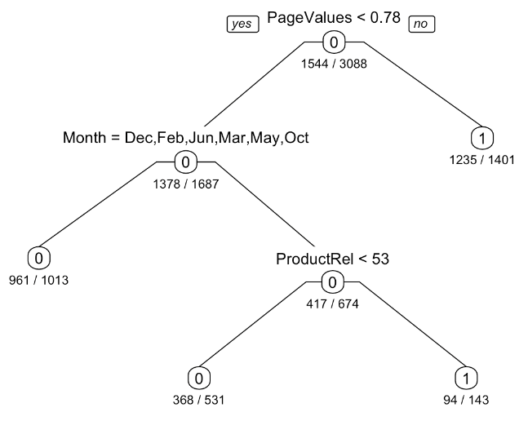
Decision Tree Continued
Default Decision Tree
Yields 4 leaf nodes
3 inputs of the model
Page Values
Few Months of the year
Product Related Pages

Slide 14
Pruned Decision Tree
Manually input the complexity parameter with the lowest misclassification rate to determine the optimal number of leaves
Pruning tree variables:
Page Values
Months
Product Related
Exit Rates
Product Related_Duration
Informational_Duration
Decision Tree Continued

Slide 15
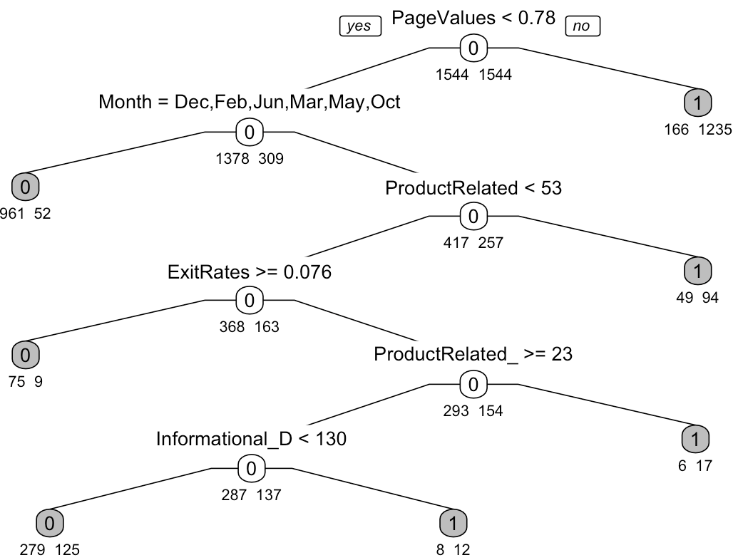
Decision Tree Continued

Slide 16
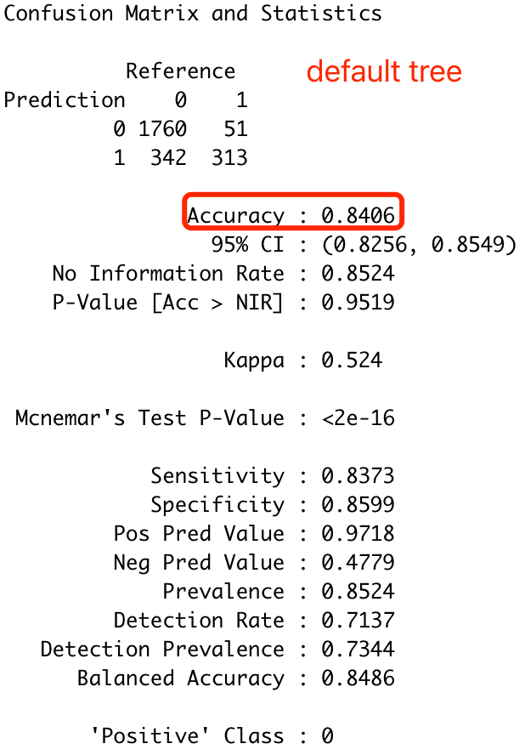
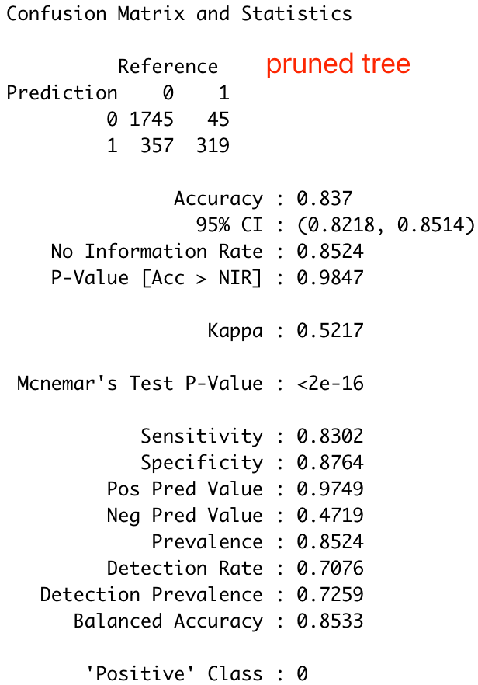
Decision Tree Continued
Compared based on accuracy rates

Slide 17
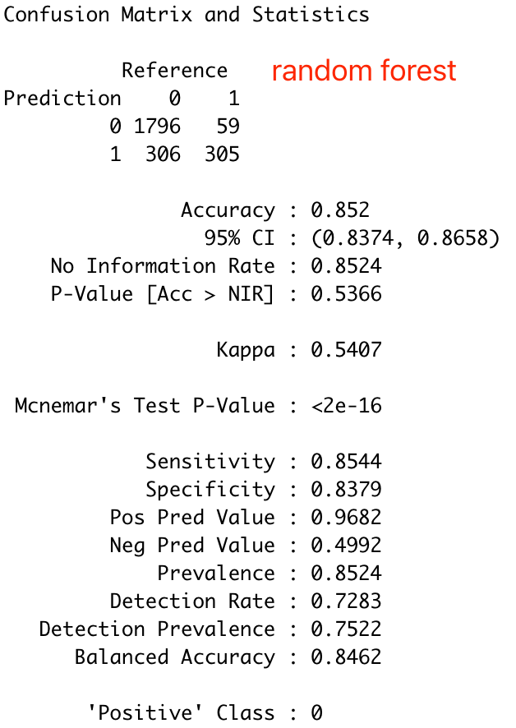
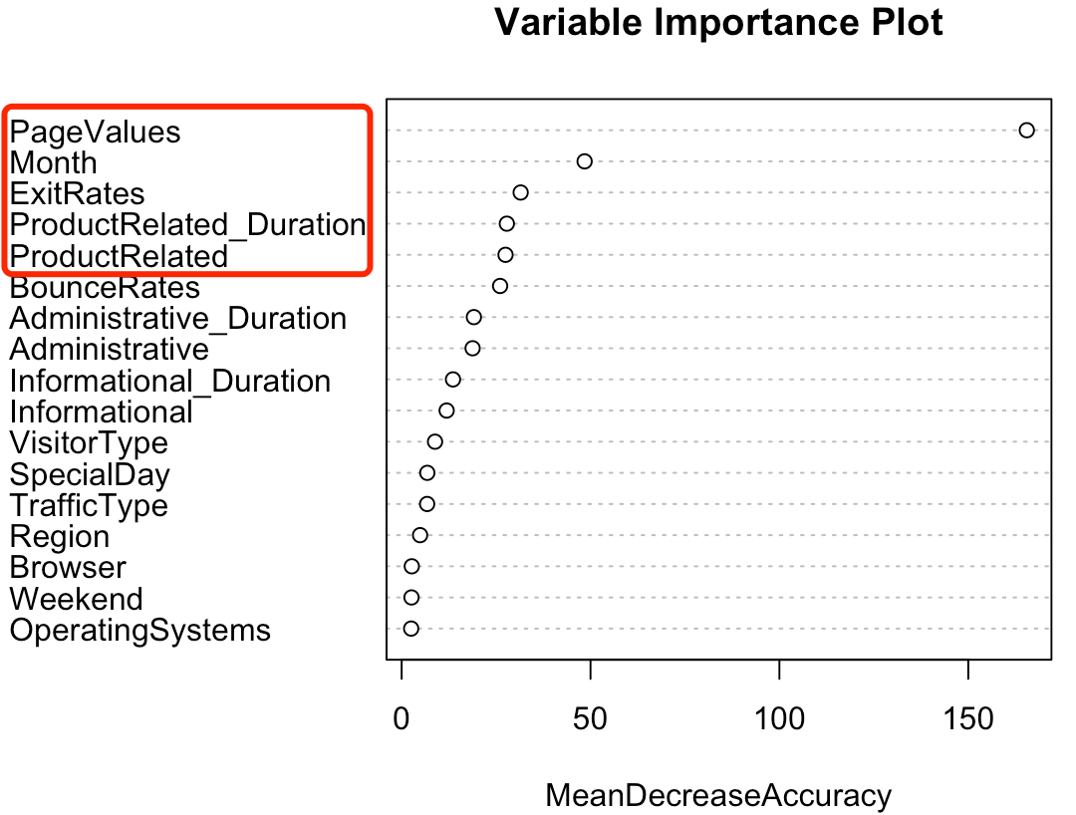
Decision Tree Continued
Random Forest
Check the accuracy using the confusion matrix

Slide 18
Decision Tree Continued
Accuracy rates for the three models
Default Decision Tree – 0.8406
Pruned Decision Tree – 0.837
Random Forest – 0.852
The highest accuracy - Random Forest

Slide 19

Neural Networks
Running decision tree models – first understanding
5 input variables
Model training

Slide 20
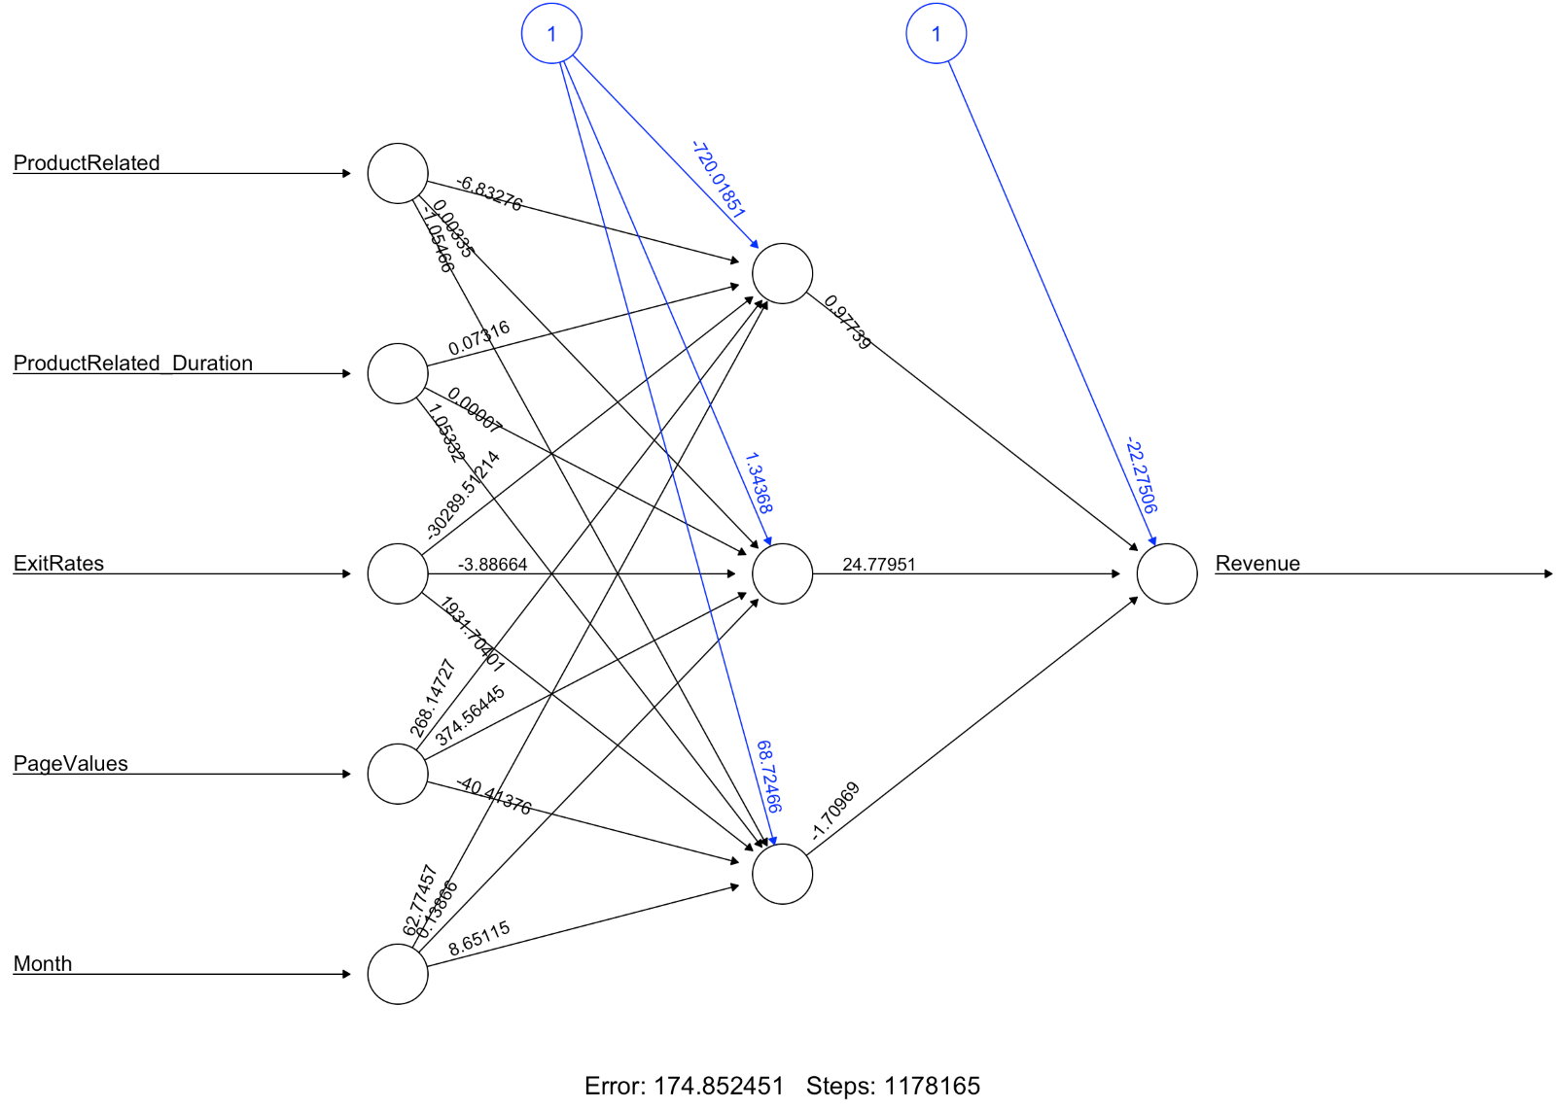
Neural Networks

Slide 21
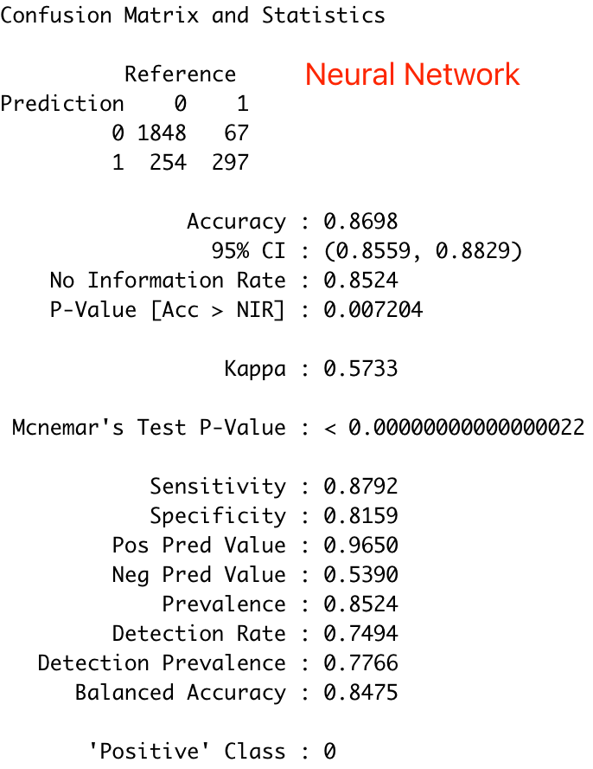
Neural Networks
Accuracy of Neural Network
Confusion matrix
0.8698

Slide 22
Logistic Regression
As the revenue in this dataset represents whether the customer placed an order, logistic regression can also be used
Similar results –
logistic regression and decision tree
Page Values and Month are still significant, but Exit Rates and Bounce Rates are also considered to be important
Partial model –
backward selection process
Accuracy rate check

Slide 23
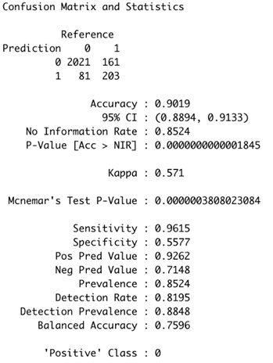
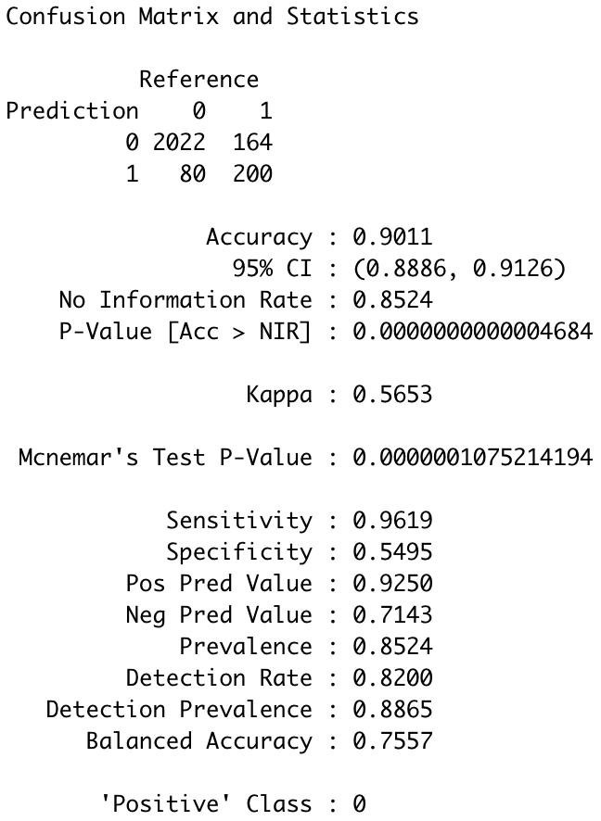
Logistic Regression
We compare the accuracy rates for both the full and the partial models

Slide 24
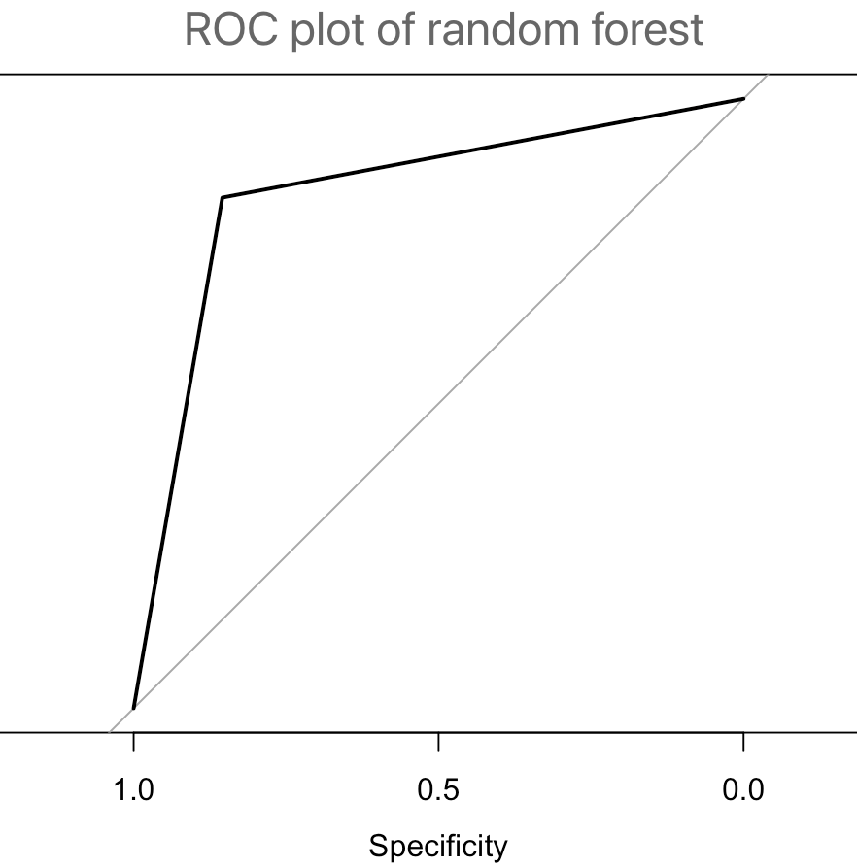
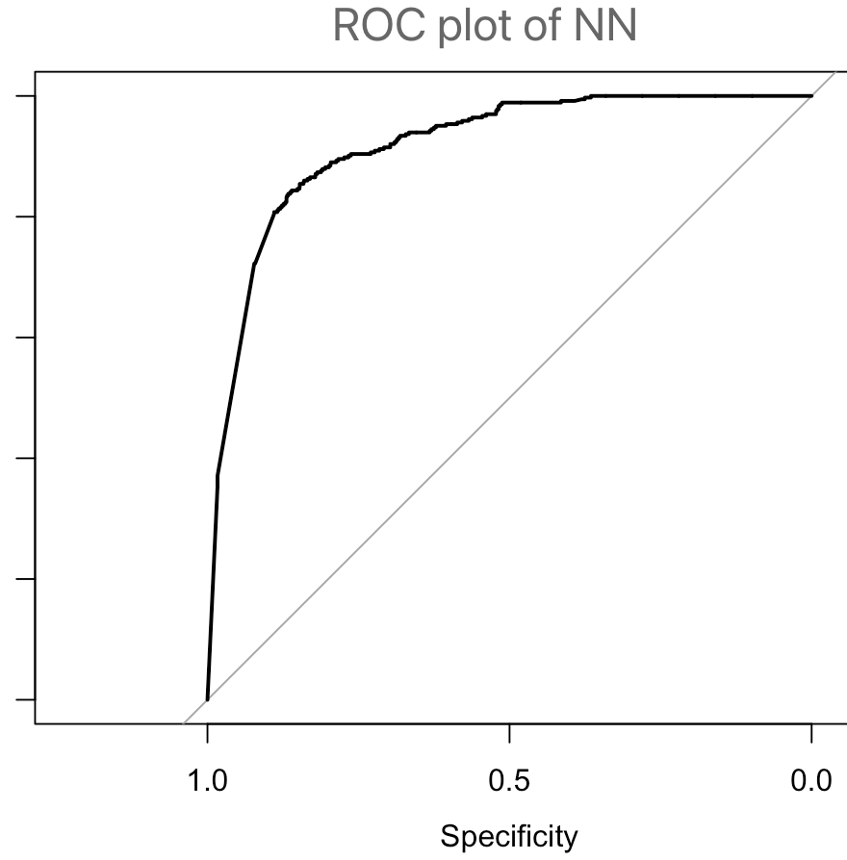
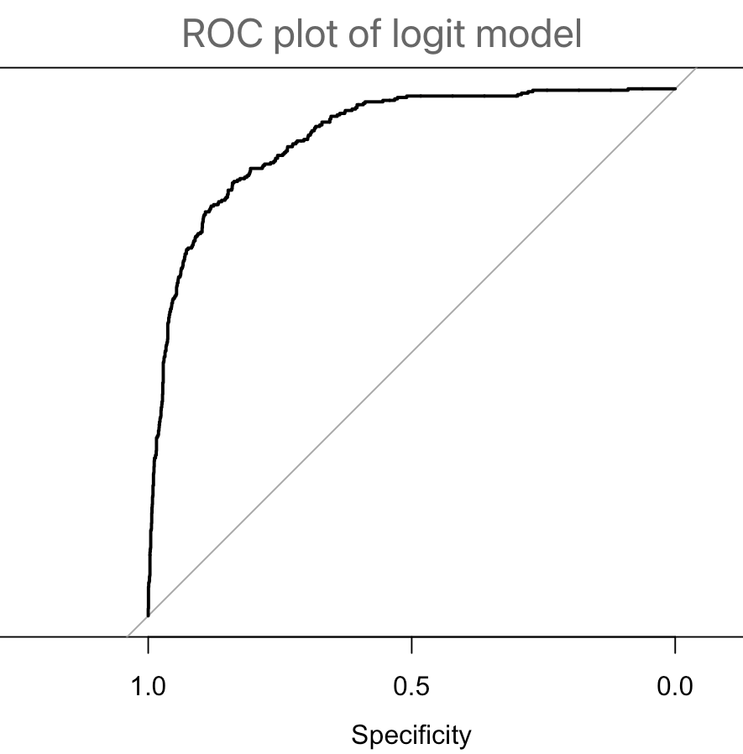
Random Forest
Neural Network
Logistic Regression
ROC Curve
0.846
0.877
0.909

Slide 25
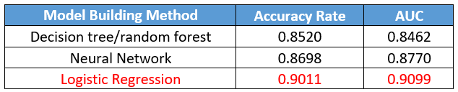
Conclusion
Positive correlations:
Revenue ~ November and Page Values
Negative correlations:
Revenue ~ December, February, June, March and May, Product Related Duration and Exit Rates

