Slide 1
The Smart Thermostat: Using Occupancy Sensors to Save Energy in Homes
Jiakang Lu, Tamim Sookoor, Vijay Srinivasan, Ge Gao, Brian Holben,
John Stankovic, Eric Field, Kamin Whitehouse
SenSys 2010
Zurich, Switzerland

Slide 2
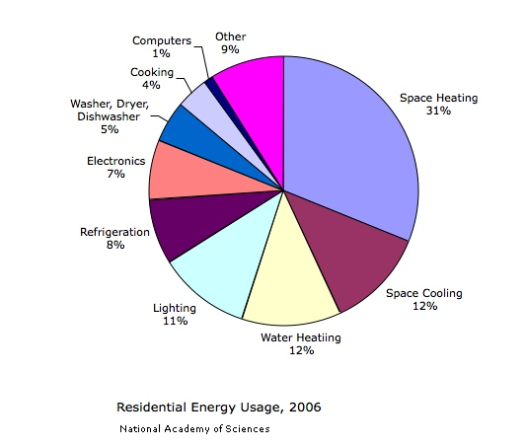
Motivation
43%

Slide 3
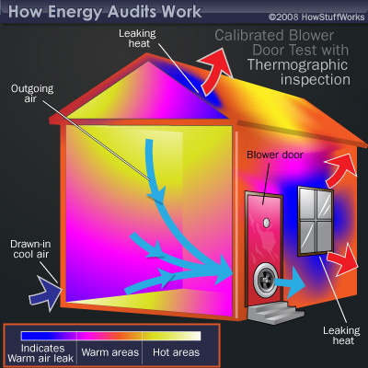
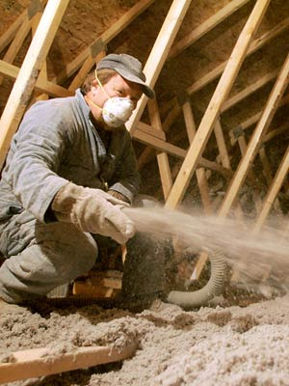
State of the Art
Too much cost!
$5,000 - $25,000

Slide 4
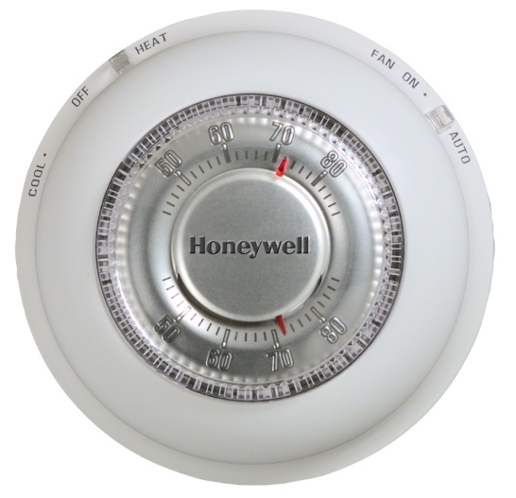
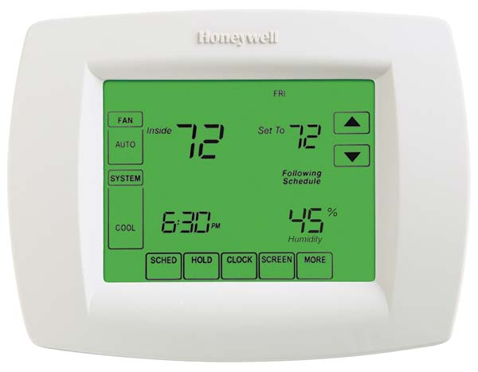
State of the Art
Too much hassle!
Too much hassle!
User discomfort
Energy waste
Temperature (ºF)
75
Setpoint
Setpoint
70
Setback
65
60
55
Home
Home
Home
Home
00:00
08:00
18:00
24:00

Slide 5
“How much energy can be saved
with occupancy sensors?”

Slide 6
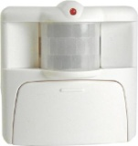
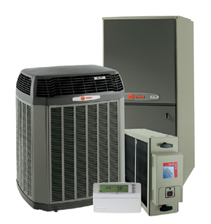
Using Occupancy Sensors
Temperature (ºF)
75
70
65
60
55
Home
Home
Home
Home
00:00
08:00
18:00
24:00

Slide 7
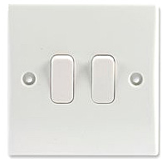
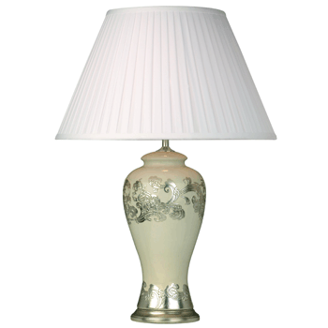

The Wrong Way
“Reactive” Thermostat
Increase energy usage!
Temperature (ºF)
Slow Reaction
Shallow Setback
Inefficient Reaction
75
70
65
60
55
Home
Home
00:00
08:00
18:00
24:00

Slide 8

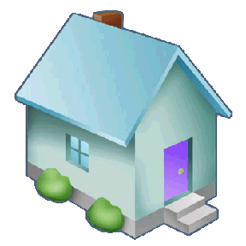

Our Approach
Smart Thermostat
Temperature (ºF)
Fast reaction
Deep setback
Preheating
75
70
65
60
55
Home
Home
00:00
08:00
18:00
24:00
Automatically save energy!

Slide 9
Rest of the talk
System Design
  Fast Reaction
  Preheating
  Deep Setback
Evaluation

Slide 10
1. Fast Reaction
“Reactive" Thermostat
Inactivity detector
Active/Inactive
User discomfort
Energy waste
Temperature (ºF)
75
70
65
60
55
Home
Home
00:00
08:00
18:00
24:00

Slide 11
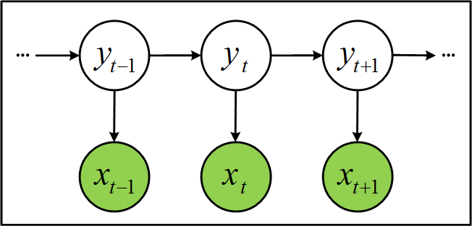
1. Fast Reaction
Smart Thermostat
Pattern detector
Active/Away/Asleep
Temperature (ºF)
Detect within minutes
Without increasing false positives
75
70
65
60
55
Home
Home
00:00
08:00
18:00
24:00

Slide 12
2. Preheating
“Why preheat?”
Preheat – slow but efficient
  Heat pump
React – fast but inefficient
  Electric coils
  Gas furnace
How to decide when to preheat?
Energy waste
Energy waste
Temperature (ºF)
75
70
65
60
55
Home
Home
00:00
08:00
18:00
24:00

Slide 13
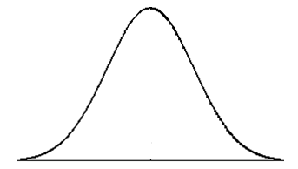


2. Preheating
Arrival Time Distribution
Preheat
React
16:00
18:00
20:00
Optimal Preheat Time
3
Expected Energy Usage (kWh)
2
1
0
16:00
18:00
20:00
Time

Slide 14
3. Deep Setback
Arrival Time Distribution
16:00
18:00
20:00
Earliest expected
arrival time
Optimal preheat time
Shallow setback
Temperature (ºF)
Deep setback
75
70
65
??
60
55
Home
Home
00:00
08:00
18:00
24:00

Slide 15
Rest of the talk
System Design
  Fast Reaction
  Preheating
  Deep Setback
Evaluation

Slide 16
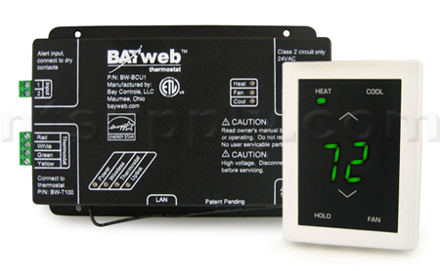
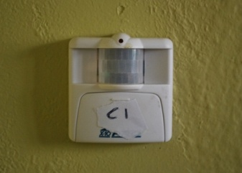
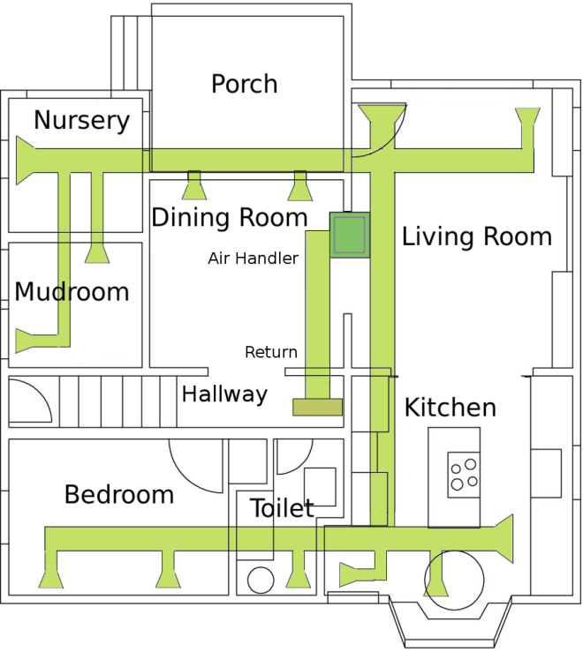
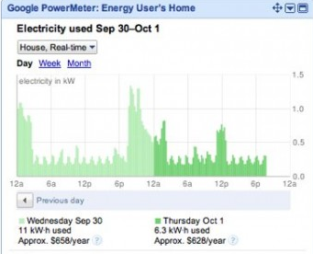
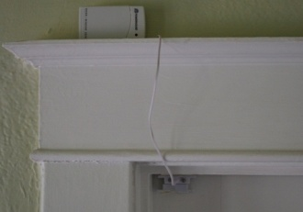

Evaluation
Occupancy Data
Energy Measurements
Home | #Residents | # Motion Sensors | #Door Sensors
A | 1 | 7 | 3
B | 1 | 3 | 2
C | 1 | 4 | 1
D | 1 | 4 | 1
E | 2 | 5 | 1
F | 3 | 5 | 2
G | 3 | 4 | 1
H | 2 | 5 | 2
EnergyPlus Simulator

Slide 17
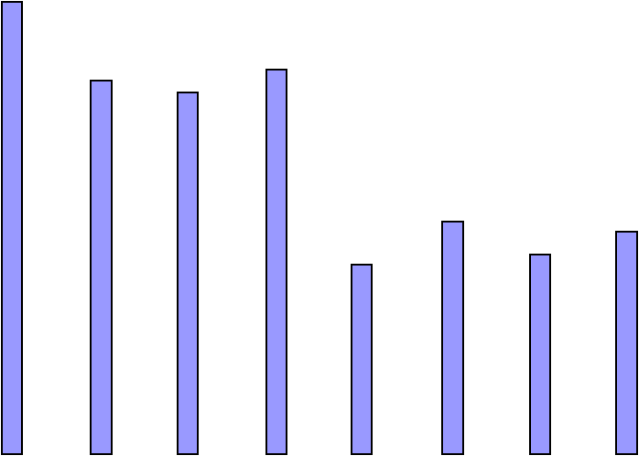
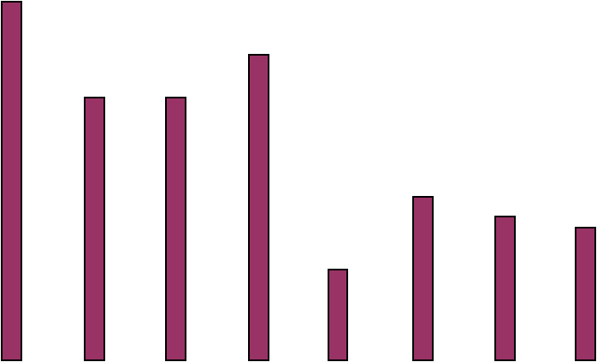
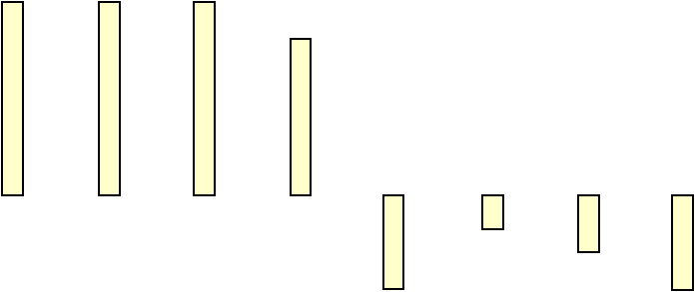
Energy Savings
60
Optimal
50
Reactive
Energy Savings (%)
Smart
40
Optimal: 35.9%
30
Smart: 28.8%
20
10
Reactive: 6.8%
0
-10
A
B
C
D
E
F
G
H
Home Deployments

Slide 18
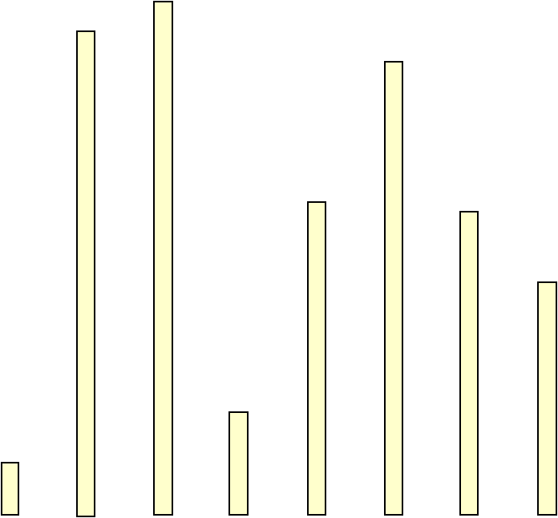
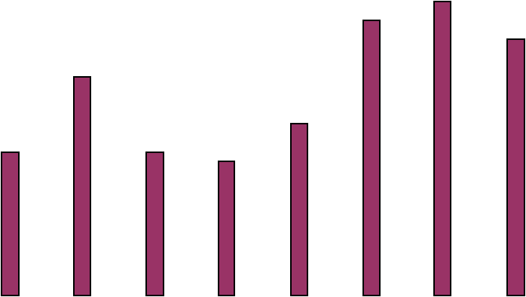
User Comfort
120
Reactive
Smart
Average Daily Miss Time (min)
100
80
Reactive: 60 min
60
40
Smart: 48 min
20
0
A
B
C
D
E
F
G
H
Home Deployments

Slide 19




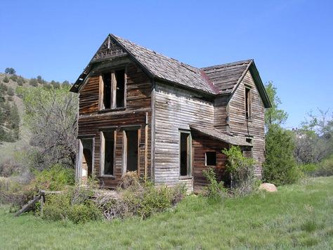
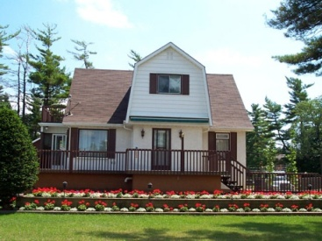
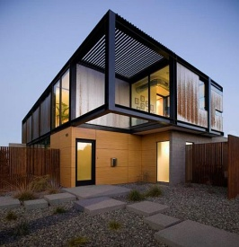
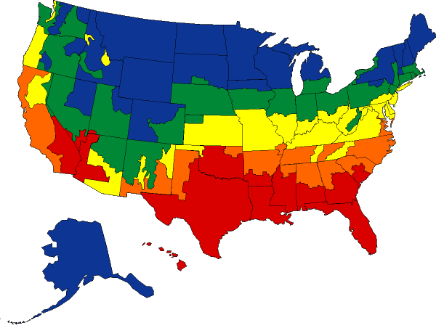
Generalization
Person Types
House Types
Climate Zones
Zone 1 | Minneapolis, MN
Zone 2 | Pittsburg, PA
Zone 3 | Washington, D.C.
Zone 4 | San Francisco, CA
Zone 5 | Houston, TX

Slide 20
Impact
Nationwide Savings
  save over 100 billion kWh per year
  prevent 1.12 billion tons of air pollutants
“Bang for the buck”
  $5 billion for weatherization
  Our technique is ~$25 in sensors per home

Slide 21
Conclusions
Three simple techniques, but able to achieve
  large savings: 28% on average
  low cost: $25 in sensors per home
  low hassle: automatic temperature control
Promising sensing-based solution

Slide 22
Q & A
Thank you!

