Slide 1
T3 Homer: What It Is
Deterministic supervision layer for T3 Code
Runs server-side and monitors live provider/runtime signals.
Goal: keep long tasks stable when sessions drift or fail.
Uses rule-based interventions, not model guesswork.
Every intervention is visible in thread activity (auditable).
Practical use: fewer stuck turns, safer continuation on real work.

Slide 2
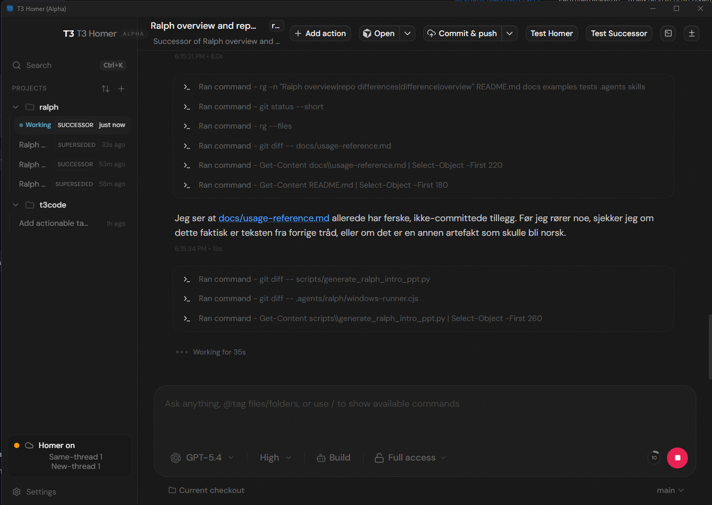
How Homer Handles Sessions and Threads
Session control + thread authority (deterministic rules)
Primary recovery: restart_in_place (fresh session, same thread)
Escalation: spawn_successor_thread after repeated failure/hard triggers
UI example below: activity log + Homer status counters for same-thread/new-thread
Eksempel fra T3 Homer: arbeidslogg, session-tilstand og Homer-metrikker i sidebar.

Slide 3
Memory and Handover Model
Thread-scoped deterministic continuity
No model-written memory summaries; continuity is persisted metadata.
Authoritative task anchor stores objective, source docs, constraints, non-goals, completion contract.
Instruction-delta snapshots and revisioning preserve latest real user intent.
Managed follow-ups (status/progress/continue) are treated as continuation, not new assignment.
Handoff prompts carry objective + deltas + checkpoint context so new sessions continue from the right place.

