Slide 1
SMPlayer<음악플레이어>
2017741019_백수만

Slide 2
시스템 개요
Thread를 이용한 음악재생
UI를 이용한 디자인
Image불러오기를 통한 디자인
Package와 class로 분류를 통한 가독성

Slide 3
시스템 구성(action package)
albumArt
duration
checkString
metadata
(boolean)
fileSelected
Song
genre
songname
Singername
metadata
(int)
Get
action
Get.java
SongFilter
Accept
(File,String)
PlaySong.java
PlaySong
playNext
playPrevious
PlaySong
readySong
Set.java
Set
fixEncode
(String,String)
setList
(String)
song
(Get)
Volume()
Update.java
Update
songInfo
songInfo(String,String)

Slide 4
시스템 구성(design package)
design
AlbumArt.java
SliderUI.java
SongInfo.java
VolumeBar.java
AlbumArt
AlbumArt
ChangeBg
(Image)
SliderUI
SliderUI
(Jslider)
paintThumb
(Fraphics)
paintTrack
(Graphics)
SongInfo
EncodeAction<class>
songInfo
getSongInfo
(String,String)
loadInfoPanel
singerName
songName
VolumeBar
VolumeControl
VolumeBar
getVolumeControl

Slide 5
시스템 구성(process package)
process
FunctionDock.java
ListPanel.java
Mp3Player.java
MusicController.java
MusicPlayer.java
PlayList.java
FunctionDock
LoadBtnAction
<class>
repeatBtnAction
<class>
FunctionDock
makePanel
ListPanel
songBtnAction
<class>
listPanel
loadWaitList
refreshList
Mp3Player
Mp3Player
(InputStream)
Mp3Player
(InputStream,AudioDevice)
Close
Exit
getStatus
Pause
Play
playInternal
Resume
stop
MusicController
nextBtnAction
<class>
onoffBtnAction
<class>
StopBtnAction
<class>
MusicController
buildPanel
makeButtons
Switch_btn
(Boolean)
CloseAction
<class>
MusicPlayer
MinimizeAction
<class>
minimodeBtnACtion
<class>
main
(String[])
MusicPlayer
buildContentPane
makeContents
Paint
(Color)
PlayList
PlayList
showList
previousBtnAction
<class>

Slide 6
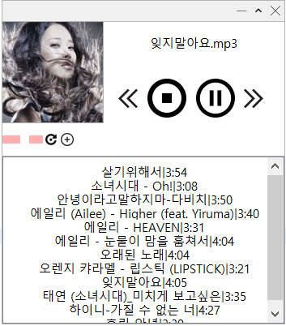
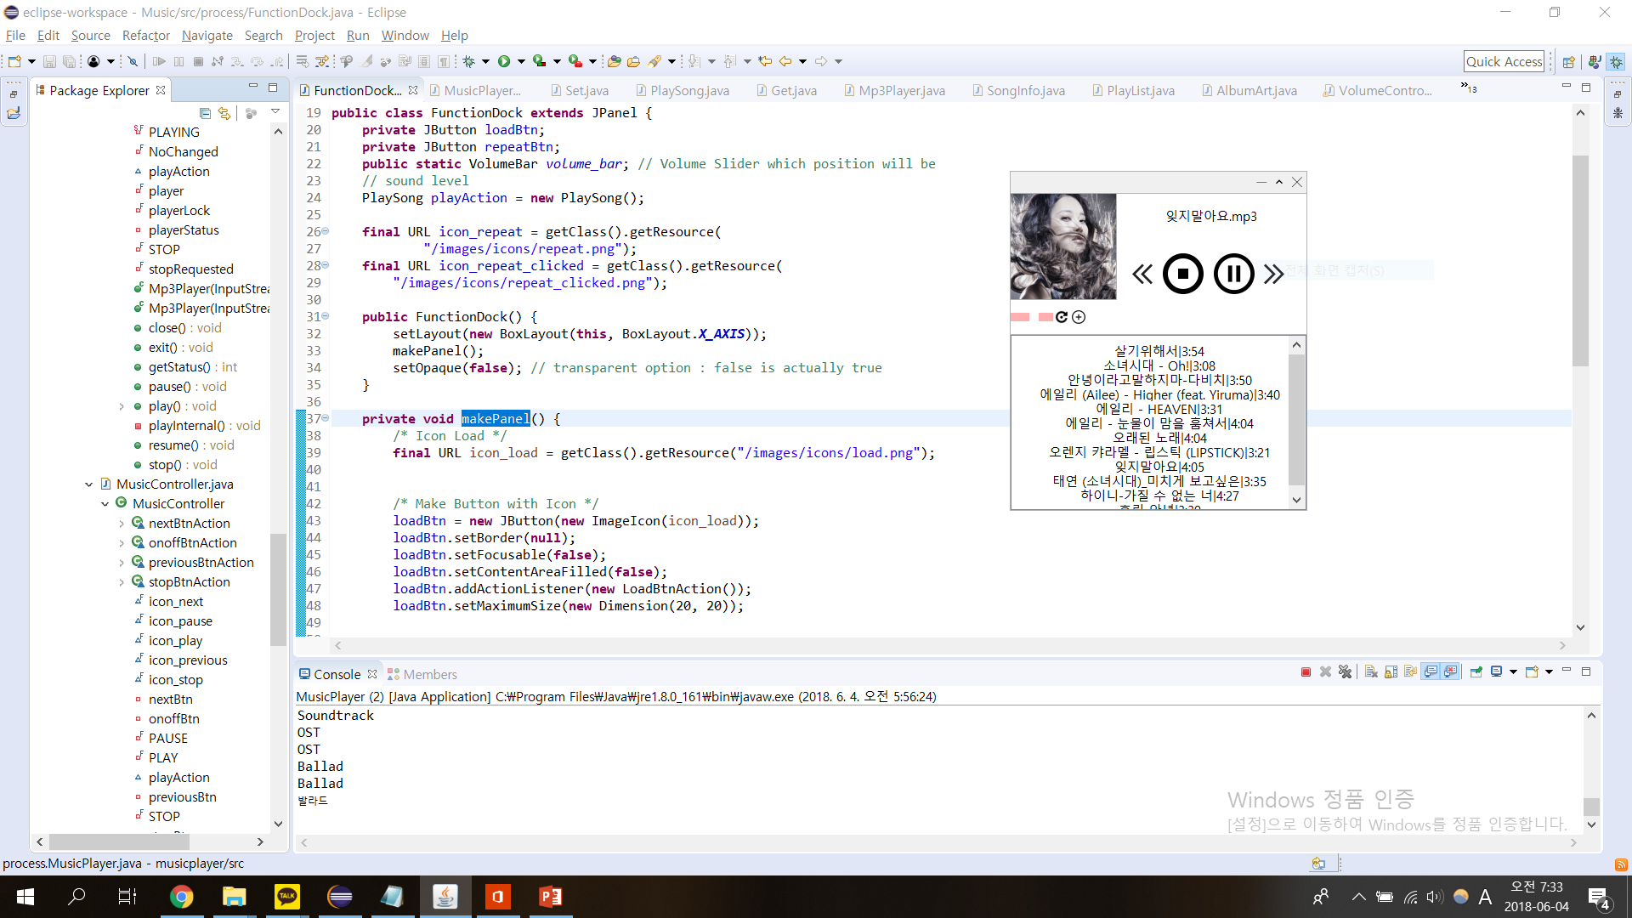
결과 화면

