Slide 1
Mech Inf Div
T-72 Tank Brigade
6th Armour Regiment
8th Mountain Inf Division

Slide 2
17th Infantry Regiment
3rd Inf Division
18th Artilery Regiment
Leh AFS

Slide 3
AD
AD Regiment

Slide 4
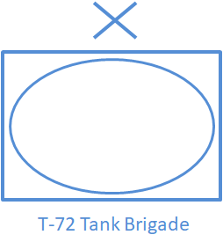
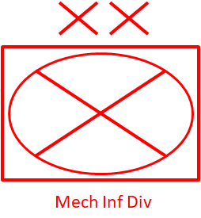
Mi17H

Slide 5
3x Field Rgt-105 mm M101
3x Field Rgt-105 mm M101
3x Field Rgt-105 mm M101

Slide 6
1x Light Rgt-120 mm Mortars
551 Rocket(SMERCH) Rgt
1x Med Rgt-203 mm M-115 or 155 mm Panta

