Slide 1

Volunteers’ Management System
Apollo Group
IT University of Gothenburg

Slide 2

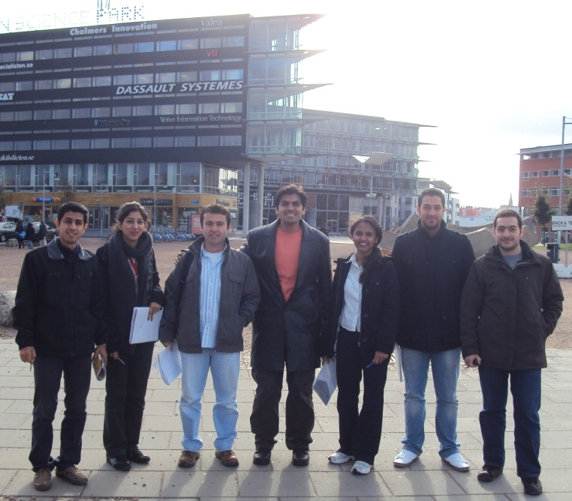
Apollo Group
Abdollah Tabareh
Gilana Ramezani
Abdullah Arslan
Waseem Soomro
Shobha B C
Mustafa Al-Zubaidi
Tigran Harutyunyan

Slide 3
Agenda
Background
Initial Estimation
Baseline Schedule
Project Status
Future Plans
Problems
Tools
VMS in Action
Q&A

Slide 4
Background
Volunteer Management System
Request the citizens for the help
Allow citizens to help with their stuff
Allow crisis manager to organize citizens
Allow to resolve the crisis with the help of the citizens
The users are crisis managers and citizens

Slide 5






















Overall perspective
VMS

Slide 6
Chart

Slide 7
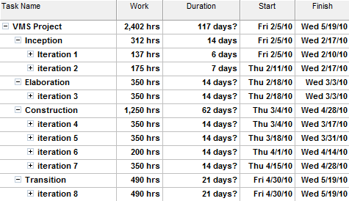
Baseline Schedule

Slide 8
Status of Deliverables
Due date: 28 April 2010
Planed | Status
Project management plan | Completed
QA plan | Completed
SAD and SDD | Completed
65% of functionality developed | 61% is completed
65% of functionality tested | 22% is completed
Test cases for functionality | Completed
1st draft of the User guideline | In progress

Slide 9
Development Progress
%
Iterations

Slide 10
Status Summary
Schedule performance indicators:
SPI < 60%
60 %<= SPI < 85%
SPI >= 85%
Project’s schedule indicator till Monday 26 of April shows:
PV = 420
EV = 386
SPI = PV * 100 / EV
92%

Slide 11
Future Plans
9 May: Beta release, part of user supporting materials
19 May: Final release, all of user supporting materials
And quality and managerial reports for all iterations

Slide 12
Problems
Unavailability of Rational tools
J2ME and mobile technologies problems
Detecting the location from the mobile device
Capturing a video and photo from the mobile device

Slide 13
Tools
Assemla’s Trac
http://trac6.assembla.com/apollogroup/report
ComindWork
http://apollo.comindwork.com/web2.aspx/VMS/PROC/TASK/ACTIVETASKS

Slide 14
VMS in Action
VMS Portal
http://licrp.dnsalias.net/apollo/CrisisBoard.aspx
Mobile Application

Slide 15

Questions

