Slide 1

Volunteers’ Management System
Apollo Group
IT University of Gothenburg

Slide 2

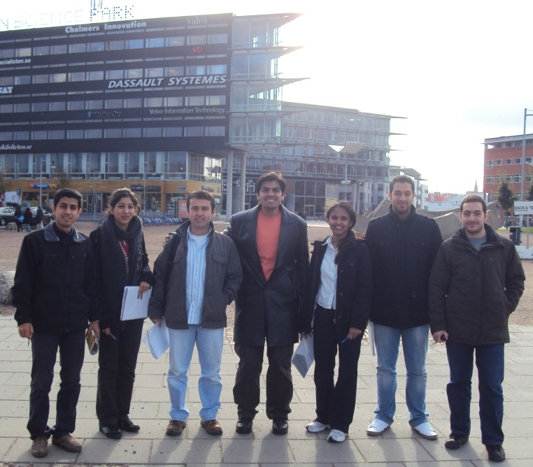
Apollo Group
Abdollah Tabareh
Gilana Ramezani
Abdullah Arslan
Waseem Soomro
Shobha B C
Mustafa Al-Zubaidi
Tigran Harutyunyan

Slide 3
Agenda
Background
Initial Estimation
Baseline Schedule
Phases in Brief
Project Status
Difficulties
Project Portal
Future Plan

Slide 4
Background
Volunteer management system is a system aiming at utilizing the remarkable potential power of civilians in the case of crisis.
It will be a solution consisting of mobile application for civilians that will connect them to a central management center via components of the system between these two.
The system will bring some facilities for both manager and volunteer sides to use as much potential power as possible to help the crisis situation.

Slide 5






















Overall perspective
VMS

Slide 6
Initial Estimations
WBS Headings | Effort (person hours)
Management | 275
Project initiation | 30
Requirement refinement | 25
Analysis and design | 200
Implement | 1,350
Test | 500
Training | 420
Total project estimation: 2,800 person hours

Slide 7
Chart

Slide 8
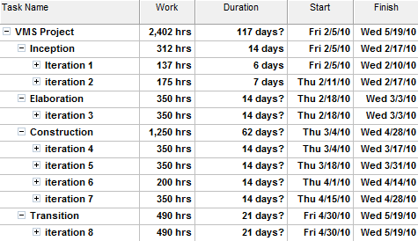
Baseline Schedule

Slide 9
Inception Phase in Brief
End date: 17 February 2010
Project plan (Completed)
Quality assurance plan (Completed)
Project organization (Completed)
Project environment (Completed)
Proof of concept (Completed)
Reading and training (Completed)

Slide 10
Elaboration Phase in Brief
End date: 3 March 2010
Refined SRS (Completed)
Analysis model (Completed)
Software architectural document draft (Completed)
Software design document draft (Completed)
Reading and training (Completed)
Iteration management and quality reports (Completed)

Slide 11

Construction Phase in Brief
End date: 28 April 2010
Refined SAD and SDD
80% of tested functionality (Behind the schedule)
90% of test cases (20% Completed without QC)
50% of user supporting materials.
Iteration management and quality reports

Slide 12
Transition Phase in Brief
End date: 19 May 2010
Remaining functionality
Beta release early
Integration and system test
User supporting materials
Final release
Project close-out

Slide 13
Some Numbers
Till Monday 15 March
Planned: 1012 person hours
Actual: 897 person hours
Earned: 897 person hours
So…
Cost variance | Schedule variance | Cost performance index | Schedule performance index
0 | 115 | 100% | 87%
All numbers based on person hours

Slide 14
Status Summary
Project is behind the internal schedule
Project will meet stakeholder’s deadlines
Schedule indicators:
SPI < 60%
60 %<= SPI < 85%
SPI >= 85%
So the project schedule indicator till Monday 15 March shows:
87%

Slide 15
Problems
Problems till now
Deadlines doesn’t mach with agile processes
Lack of a bug tracking system affects on:
Defect management
Lack of enough quality information
Increases effort and reduces the quality of our project
Future problems
Lack of technical skills may change our estimations and schedule

Slide 16
Project Portal
Visit our project portal at: http://code.google.com/p/apollovms/
You will find there:
All tasks assigned till now and the progress/status
Summary of all our meetings and decisions
All our resulting artifacts and documents
And explore to find more…

Slide 17
Future Plan
31 March: 45% of functionality (35% tested) , 50% of test cases
14 April: 70% of tested functionality, 80% of test cases
28 April: 80% of tested functionality, 100% of test cases
9 May: Beta release, part of user supporting materials
19 May: Final release, all of user supporting materials
And quality and managerial reports for all iterations

Slide 18
Questions

