Slide 1
Vatican Cameos
Robust Voice-Triggered Emergency Detection on Android
Mobile Computing and Its Application, Spring 2026
Kim, Kyoheon

Slide 2
Goal and Usage Scenario
The Gap
Existing emergency solutions fail when the user cannot physically interact with the device.
Wearables require active use
Phone calls require visible interaction
Target Scenarios
Distance Access
User is incapacitated but within voice range of phone
Covert Signaling
Hostile environment where overt phone use is unsafe(robbery, assault)
Solution
Detect pre-designated voice keywords entirely on-device → auto-dispatch emergency alert services

Slide 3
Key Idea: Three-Layer Progressive Activation
DEFAULT
L1 Keyword
IDLE
L2 Keyword
STANDBY
L3 Keyword
📢
Layer | Threshold | Sensor Freq. | Model Size | Role
DEFAULT(L1) | 0.70 | 8 kHz | Smallest | Minimize FN
IDLE(L2) | 0.80 | 16 kHz | Middle | Balanced
STANDBY(L3) | 0.90 | 16 kHz | Biggest | Minimize FP

Slide 4
App Functionality and Architecture
Architecture
MainActivity (front-end)
↓
SafewordService (back-end)
AudioPipeline: Mic → 1 sec PCM → log-mel
KeywordClassifier: Inference per layer
SafewordStateMachine: Transition / Timeouts
EmergencyDispatcher: Auto-dial + SMS + GPS
Key Features
Always-on mic via Foreground Service
Layer-aware audio-pipeline
Per-layer TFLite interpreter with model swap on state transition
HW interrupt (STOP button) at any state
Fully offline — No network required for detection

Slide 5
Model Optimization
Pytorch FP32 ⇨ ONNX ⇨ TFLite
Journey and Lessons
INT8 Attempt
3.8x compression but onnx2tf quantizing made the quantized model’s metadata incompatible with TFLite Android Runtime.
Float16 Attempt
BATCH_MATMUL kernel rejected FP16 (Android limitation)
Float32 Deployed
Stable inference path among given options
Layer | FP32 (trained) | INT8 (attempted) | FP32 (deployed)
L1 | 1.56 MB | 0.44 MB | 1.56 MB
L2 | 2.67 MB | 0.75 MB | 2.67 MB
L3 | 8.53 MB | 2.20 MB | 8.53 MB
Total | 12.8 MB | 3.4 MB | 12.8 MB

Slide 6
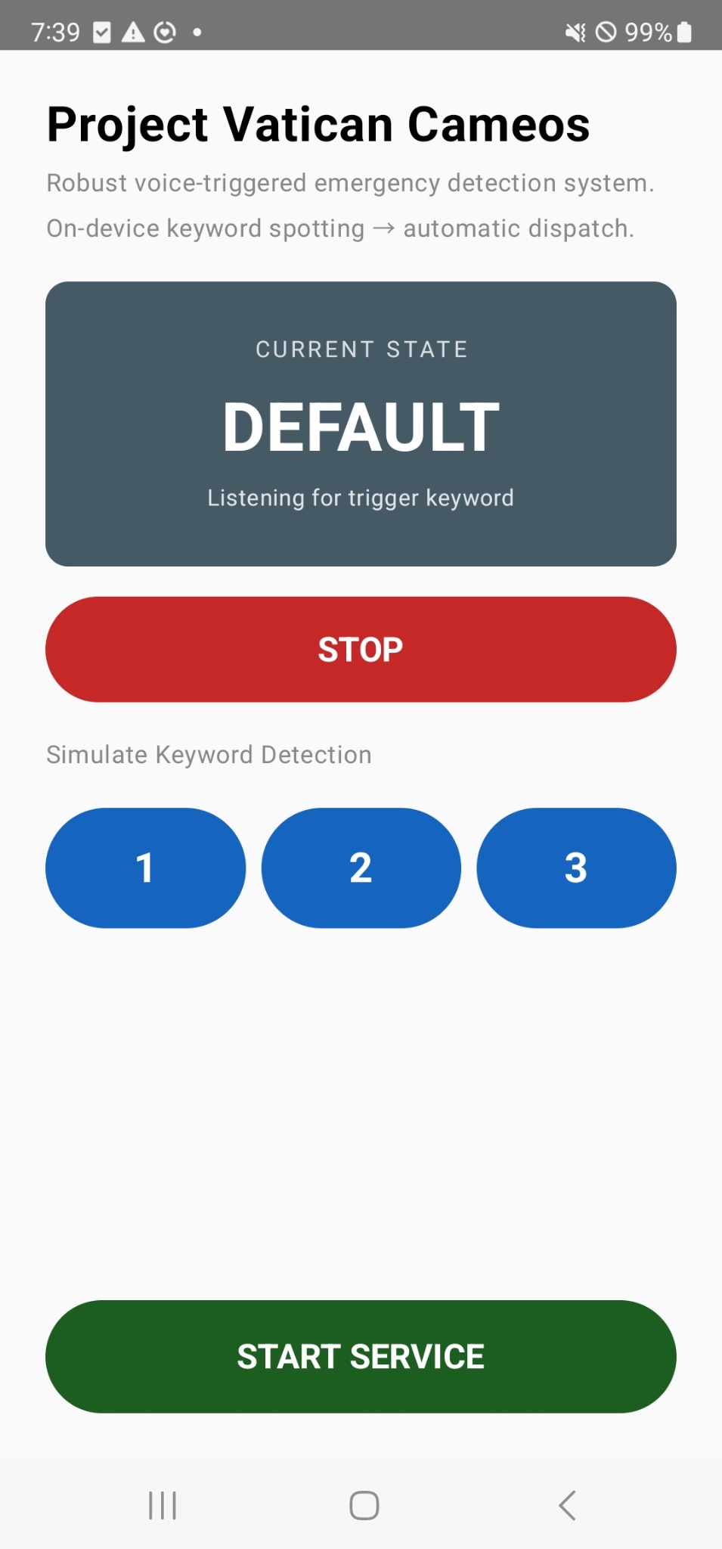
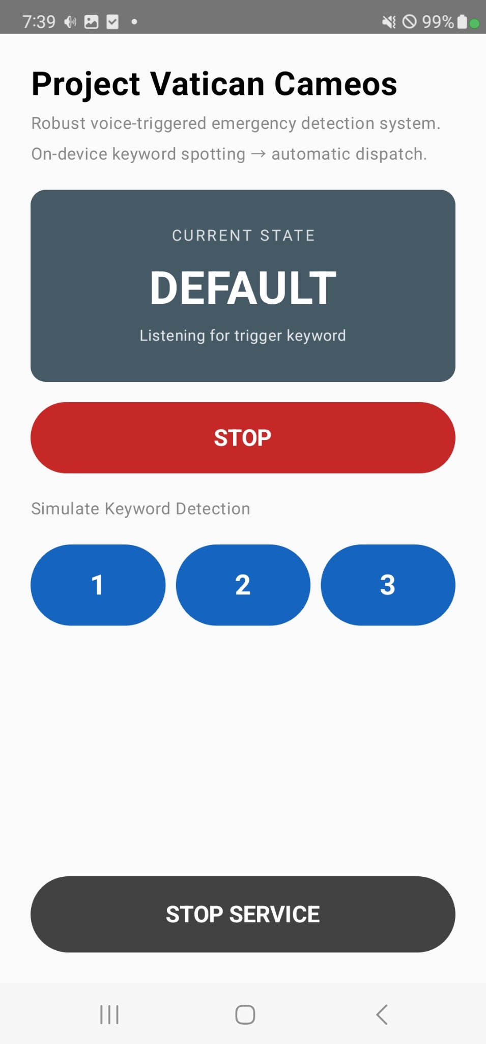
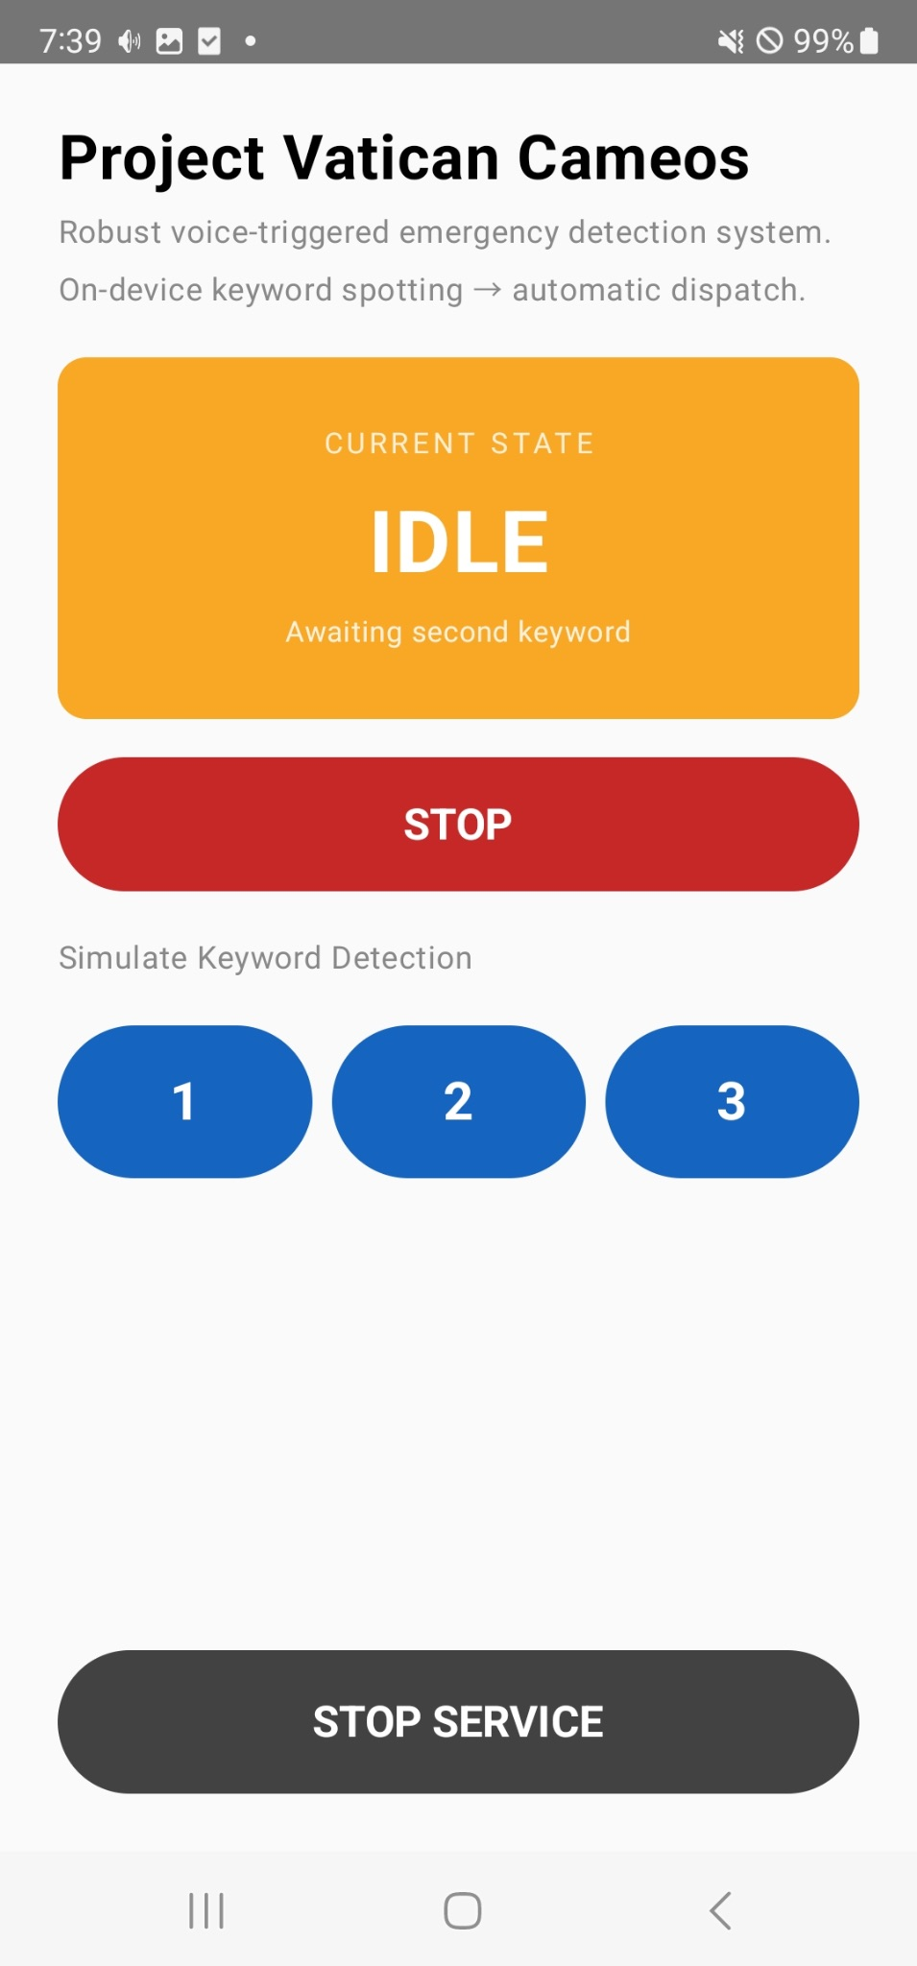
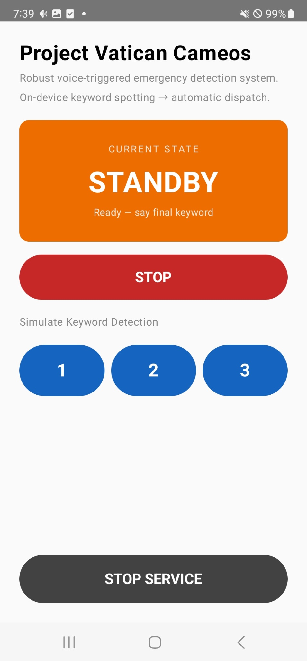
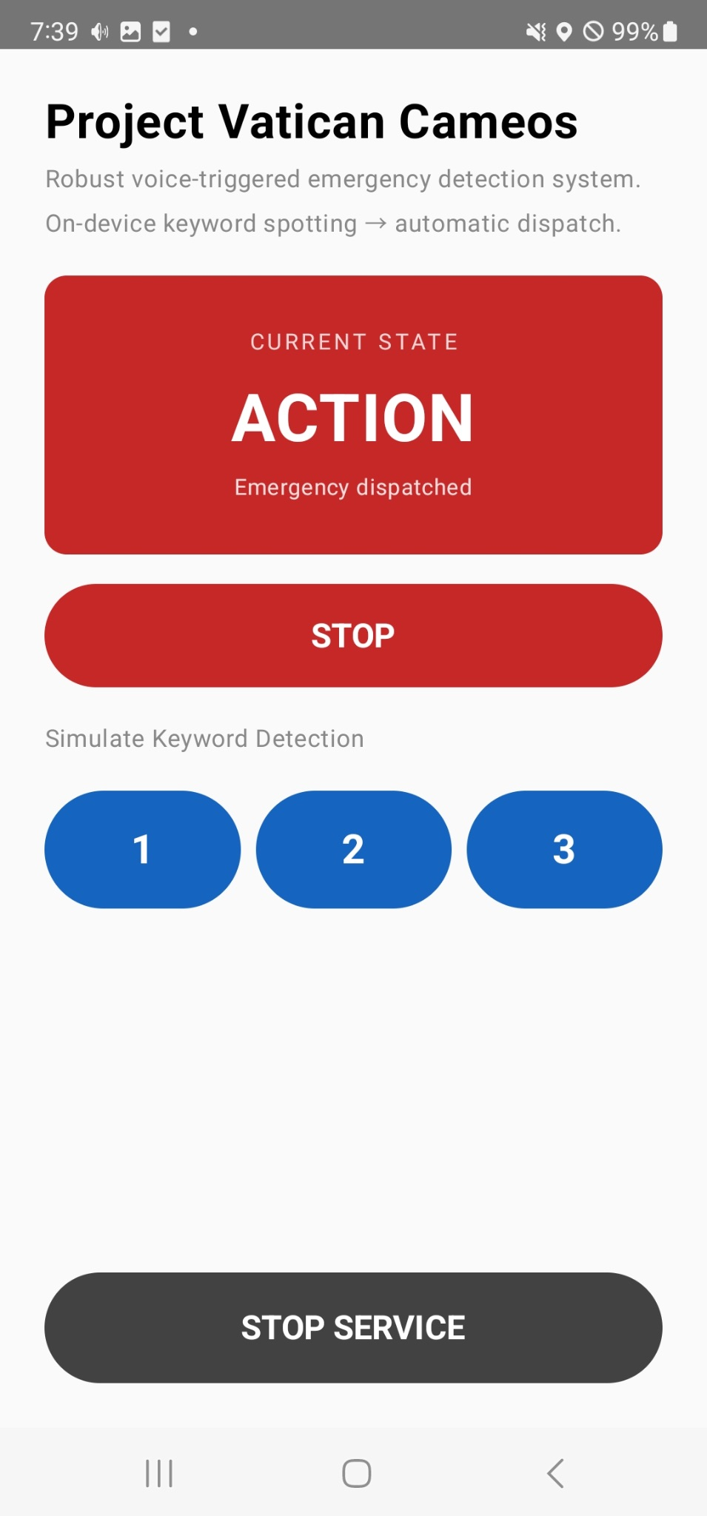
Demo

Slide 7
Accuracy Discussion
End-to-end pipeline is functional
Valid probability distributions generated per frame
But The models biased toward _silence under mic input
Seems It is caused by several reasons like:
Train-Deployment Distribution Shift (Noisy Env.)
Log-Mel Transformation Issue.
I’m still trying to fix it!

Slide 8
Timeline
-5/25: Baseline MobileNet-V2 + App Skeleton
-5/30: Kotlin Mel Extractor + TFLite Exportation + Model Integration
-6/1: Testing + UI Polishing

Slide 9
Thank you!

