Slide 1
Aggressive TCP Slow Start
Soonho Kong, Qinsi Wang, and Gabriel Weisz

Slide 2
TCP Slow Start
During normal operation, TCP achieves good bandwidth utilization through a congestion control mechanism that uses an Additive Increase, Multiplicative Decrease policy
This means that the transfer rate goes up until a packet is dropped, at which point it is halved
TCP Slow Start is meant to help the connection ramp up to the peak transfer rate.
TCP Slow Start increases the transfer rate exponentially until a packet is dropped

Slide 3
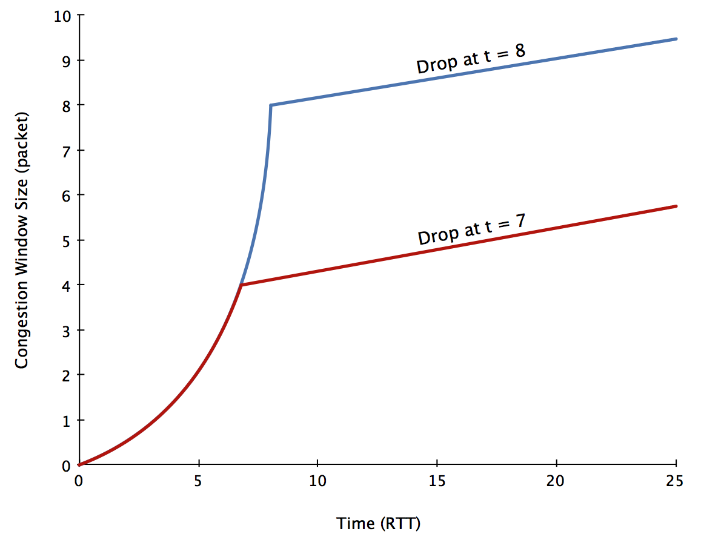
Project Motivation
TCP Slow Start generally works well
But …
If a packet is dropped even one round trip early, the transfer might never hit peak speed.

Slide 4
Reasons for dropped packets
The connection might have exceeded the connection bandwidth (the design is based upon this case)
Some other connection might be hogging the bandwidth (so why should this one suffer?)
The connection might be wireless (which drops packets due to the medium, not just due to congestion control)

Slide 5
The idea
We’d like the connection to have an opportunity to stay in slow start even if a packet was dropped, just in case it was not due to the connection reaching peak bandwidth
What about just randomly sending some packets twice?
Use same sequence #, data, everything, so it does not matter which one gets through
But we’re duplicating packets!
Who cares if it works?
Make sure that we do not negatively impact other clients

Slide 6
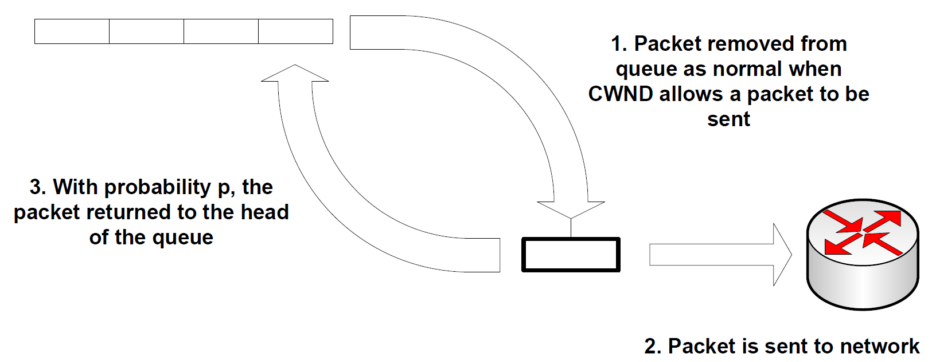
The implementation (Mechanism A)
Connection never has more than # packets allowed by congestion window outstanding

Slide 7
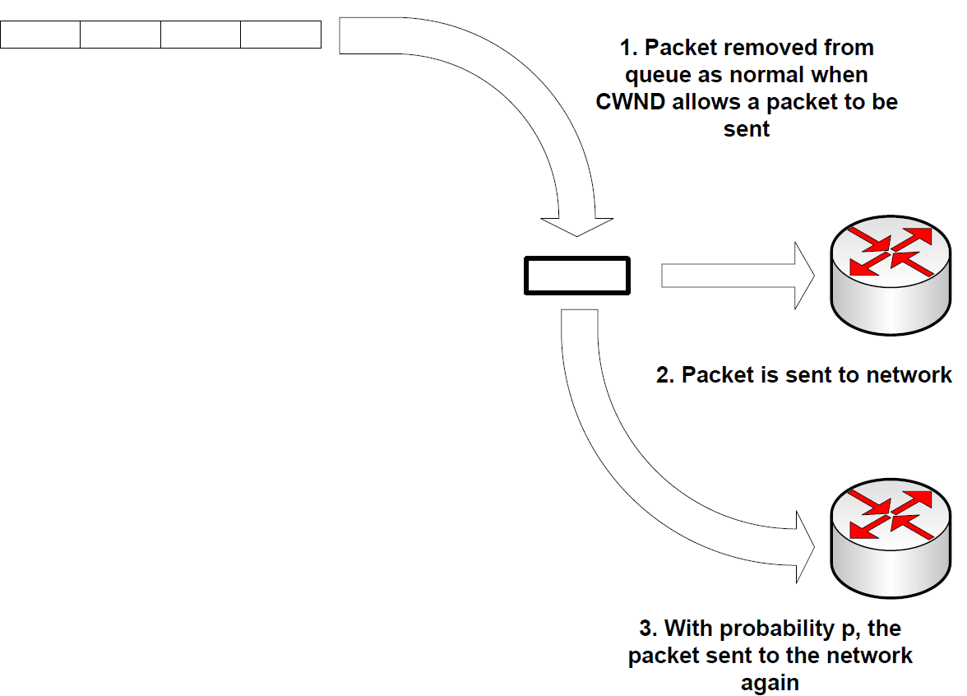
The implementation (Mechanism B)
This mechanism does have more packets than are specified by the congestion window, but still has that many unique packets

Slide 8
More details
Perhaps, instead of always using the same retransmit probability, scale the retransmit probability by the current congestion window size
It is really bad to drop packets …

Slide 9
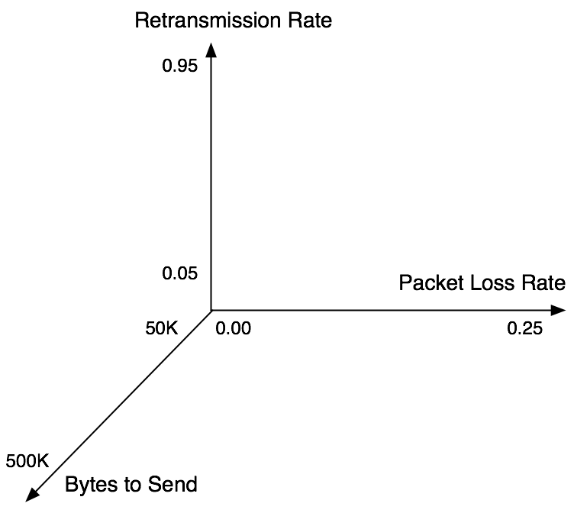
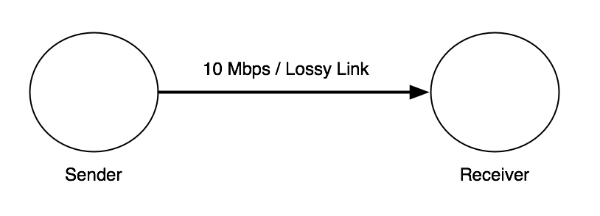
Experiments:
1st Exp: Which mechanism works best?
Method A with Static Retransmission
Method B with Static Retransmission
Method A with Dynamic Retransmission
Method B with Dynamic Retransmission
Network Configuration

Slide 10
Experiments:
2nd Exp: How does it compare to regular TCP?
Normal TCP Sender
Best Retransmission Method
Network Configuration

Slide 11
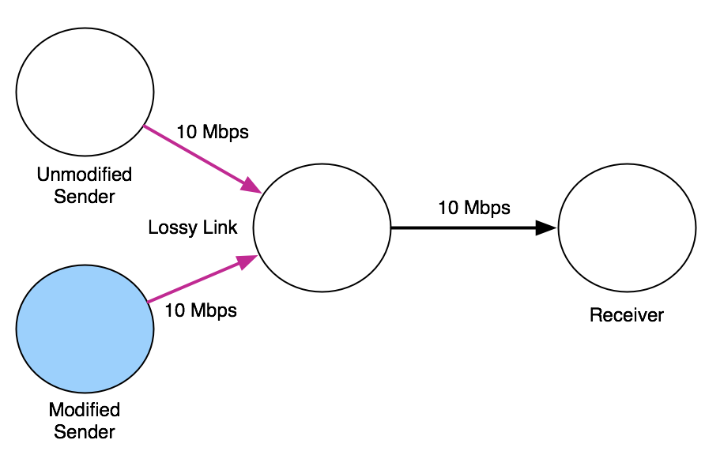
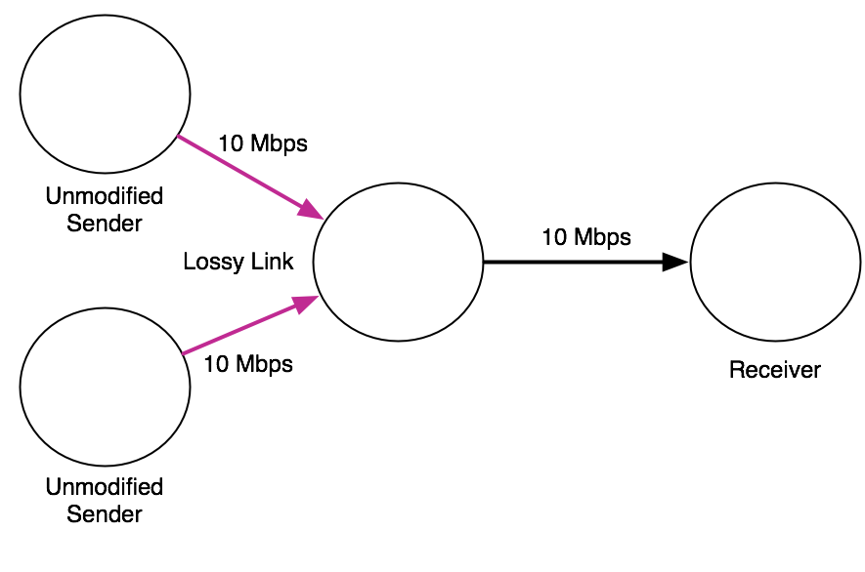
Experiments:
3rd Exp: What’s the overhead? Does it break existing clients?
Two unmodified TCP sender
One modified and One unmodified TCP sender
Network Configuration

Slide 12
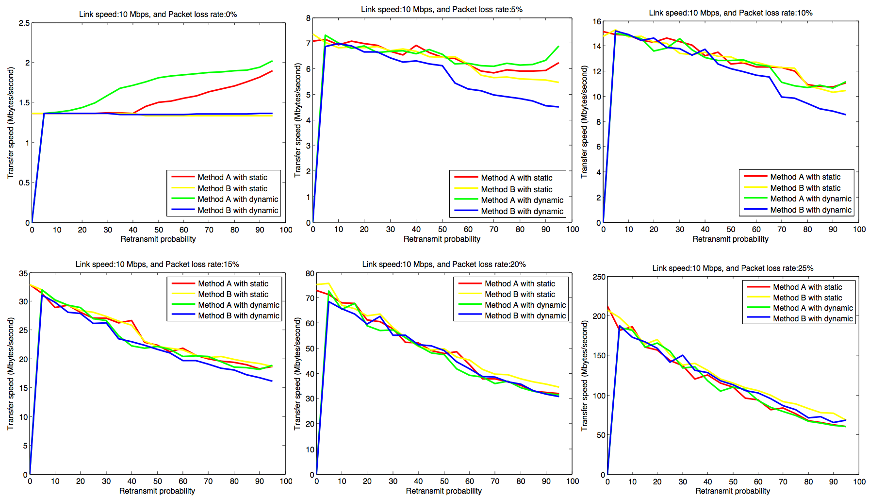
Results: Which mechanism works best?
Dynamic Method B almost always works best

Slide 13
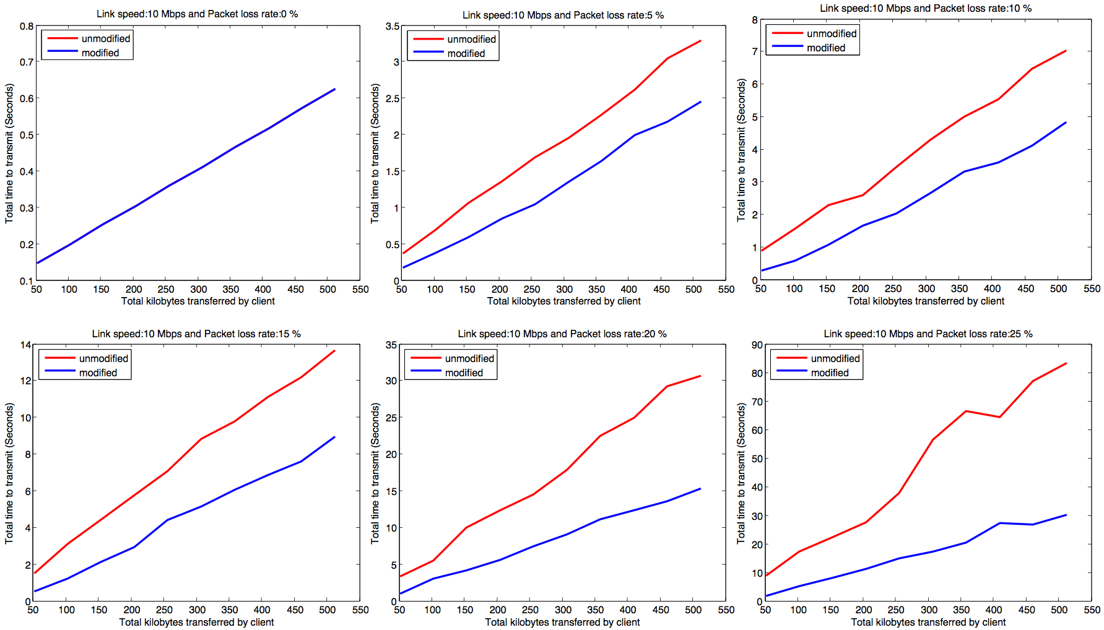
Results: How does it compare to regular TCP?
As expected, this works better than regular TCP

Slide 14
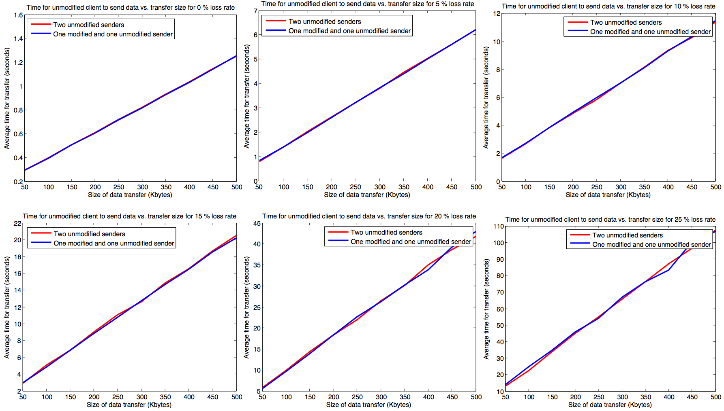
Results: What’s the overhead?
Not only does it work, but it does not starve the standard client
Not only does it not starve the standard client, but the standard client may even see better performance! (more to follow)

Slide 15
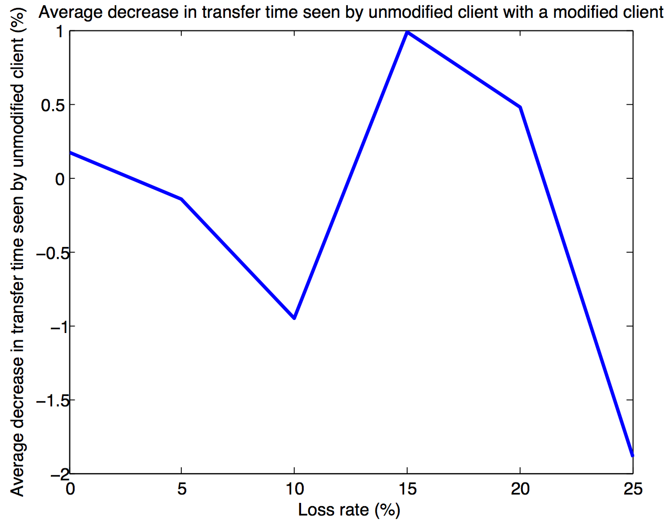
Performance Comparison Summary
Unmodified client does not suffer too much
In some cases, it even improves slightly
We think this is due to the modified sender finishing earlier

Slide 16
Conclusions
It works!
Method B with dynamic retransmit rate works best (base retransmit rate 95%)
Modified client sees better performance
Unmodified client does not suffer, and may even see better performance

