Slide 1
산학 프로젝트
21512071 박순혁

Slide 2
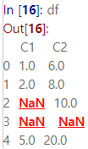
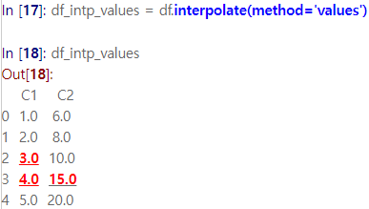
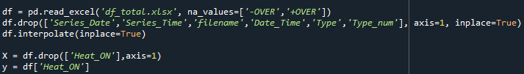
Data preprocessing
interpolate
‘-OVER’, ‘+OVER’ 값 결측치로 처리하고 interpolate 함수로 결측치 보간

Slide 3
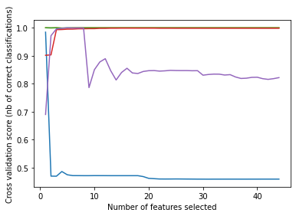

Feature importance
Wrapper(RFECV)
SVC

Slide 4
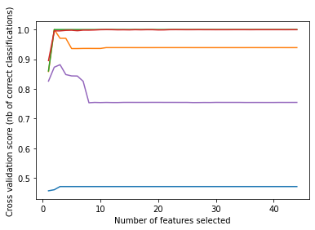

Feature importance
Wrapper(RFECV)
LightGBM

Slide 5
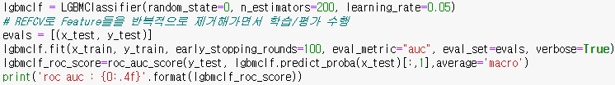
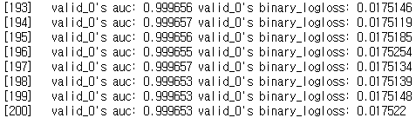
Feature importance
LightGBM
2 feature ['T2_comp out_MIN','inside temp_MIN’] (based on RFECV)
Time cost :
F1_score :

Slide 6
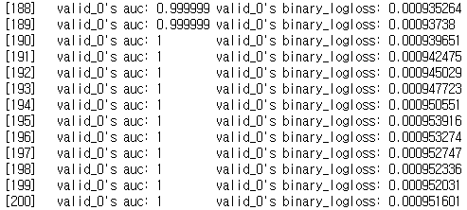
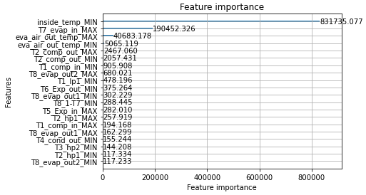
Feature importance
LightGBM
all feature
Time cost :
F1_score :

Slide 7
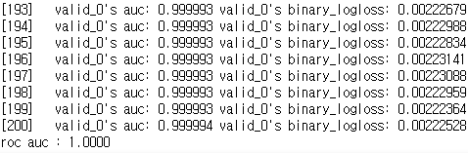
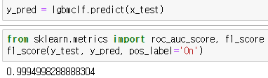
Feature importance
LightGBM
4 feature['T7_evap in_MAX','eva air out temp_MAX','eva air out temp_MIN','inside temp_MIN’] (based on information gain, ppt 6 feature importance 기준)
-> F1_score
Time cost :

Slide 8
Summary
결측치 처리
‘-OVER’, ‘+OVER’ 값 결측치로 처리하고 interpolate 함수로 결측치 보간
Performance(LightGBM(n_estimators=200, learning_rate=0.05))
Feature | AUC(정확도) | F1-score | Time cost
2 feature(wrapper(RFECV)) ['T2_comp out_MIN','inside temp_MIN’] | 0.9997 | 0.9958 | 60.4912
All feature | 1.0000 | 0.9998 | 58.5563
4 feature(based on information gain) ['T7_evap in_MAX','eva air out temp_MAX','eva air out temp_MIN','inside temp_MIN’] | 1.0000 | 0.9994 | 59.1725

