Slide 1
Evaluating the drivers of cost of care Wee Soon Nan

Slide 2
Assignment Pipeline
Data Cleaning
Univariate & Bivariate Analysis
Using Decision Trees Regressor models to evaluate variable importance
Feature Engineering
Assumptions, limitations and conclusion

Slide 3
Data Cleaning
Preprocessing Guidelines
Preprocessing Solutions
bill_amount.csv
Convert to DataFrame for easier processing
Identify null values
Replace null values
demographics.csv
Identify missing values
Impute missing values
Identify duplicated IDs
Remove duplicate IDs
Cleaned datasets
bill_id.csv
clinical_data.csv
Identify categories in categoricals
Identify categories in categoricals
Identify mislabelled categories
Rename mislabelled categories
Identify outliers for continuous variables
Remove samples with outlier data

Slide 4
Feature Engineering
Feature | Method
Inpatient Duration | Date of Discharge – Date of Admission
Number of Medications | SUM(Pre-op Medication)
Number of Medical History | SUM(Medical History)
Number of Symptoms | SUM(Symptoms)
BMI | Weight/ Height²
Age | Date of Admission (clinical_data) - Date of Birth (demographics)
clinical_data
joined
joined
demographics

Slide 5
Processing & Merging
bill_amount
Data Processing
SUM bills for each patient ID on the same date
bill
Keep only first admission for each patient ID
merged
bill_id
~3000 samples
joined

Slide 6
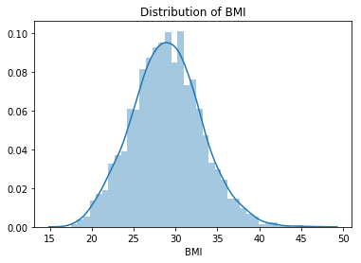
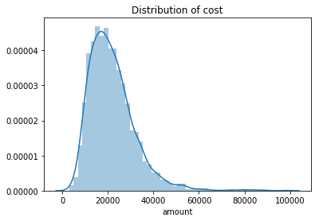
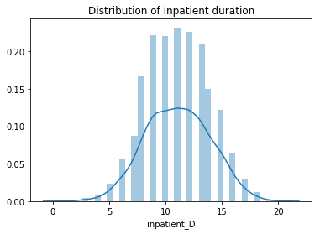
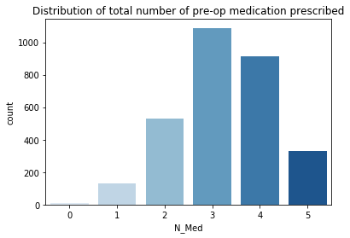
Univariate Analysis

Slide 7
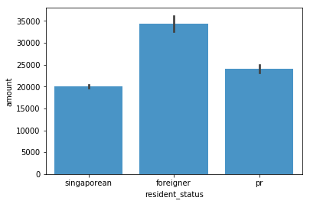
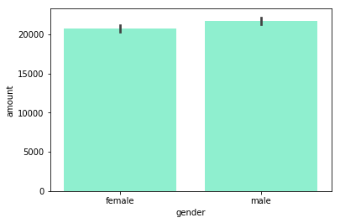
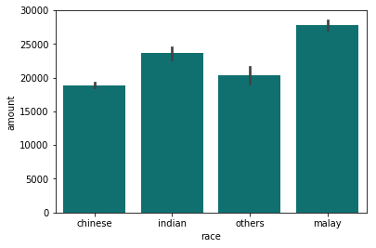
Bivariate Analysis

Slide 8
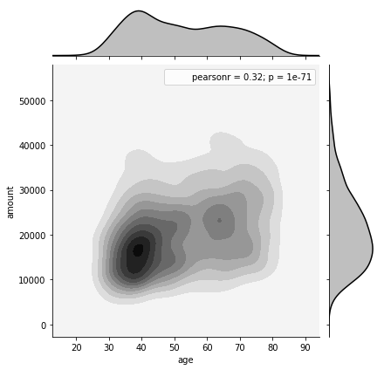
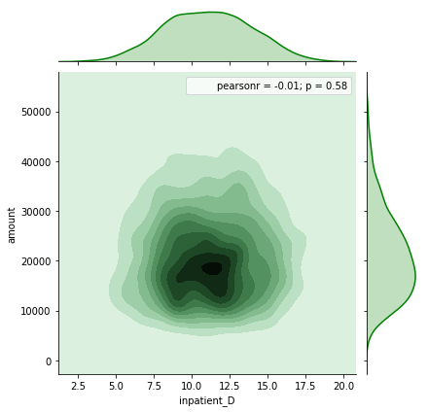
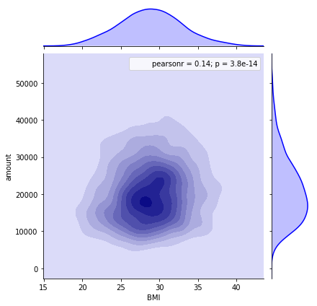
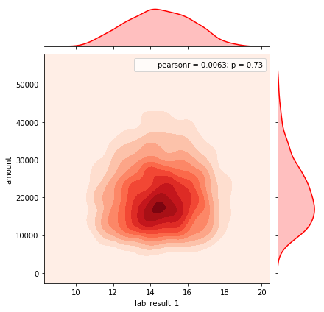
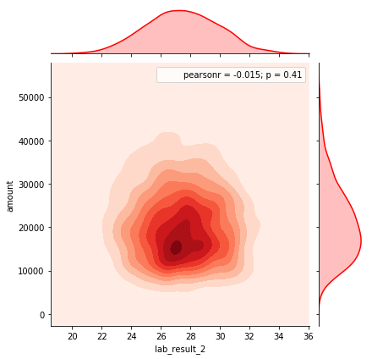
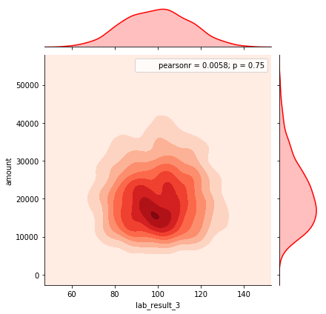
Bivariate Analysis
Feature | Pearson R-score (against cost)
Age | 0.32
Inpatient Duration | -0.01
BMI | 0.14
Lab Result 1 | 0.0063
Lab Result 2 | -0.015
Lab Result 3 | 0.0058

Slide 9
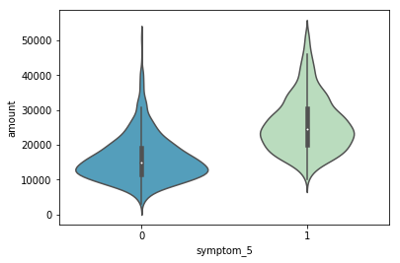
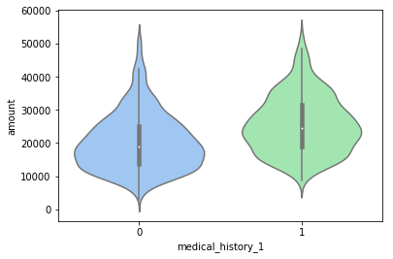
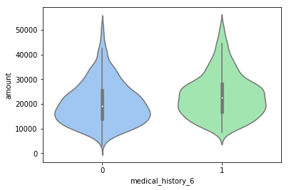
Bivariate Analysis
Violin plots were plotted for all indicator categoricals:
→Symptom
→Medical History
→Preop Medication
Out of 5 symptoms, 7 medical history and 6 preop medication prescription, only 3 categories showed a slight increase in patient bill cost when present:
Symptom 5
Medical History 1 Mediacal History 6

Slide 10
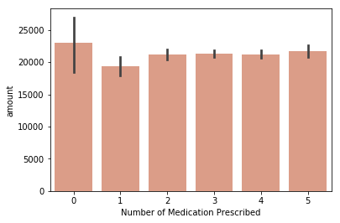
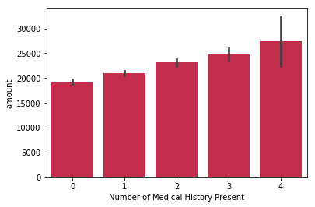
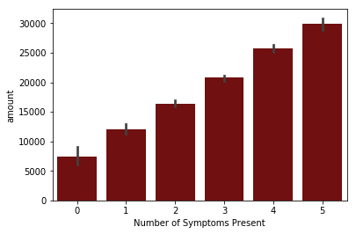
Bivariate Analysis
Barplots for engineered features showed interesting insights:
Cost does not increase linearly with number of medications prescribed (preop_medication).
Cost increases in a linear trend when the number of medical history and symptoms present increase

Slide 11
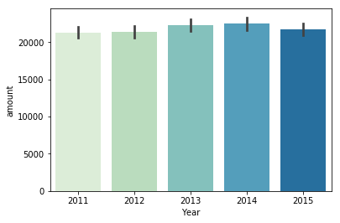
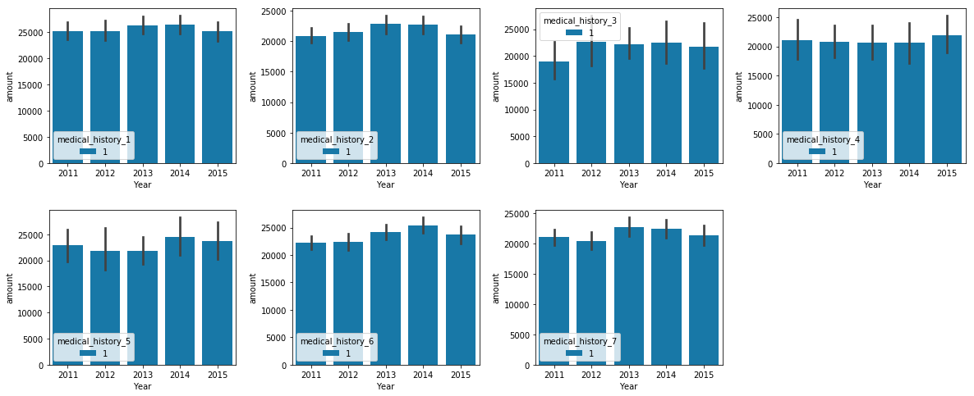
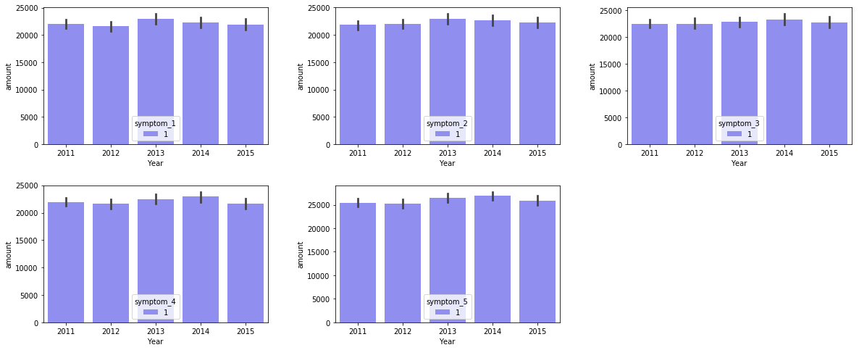
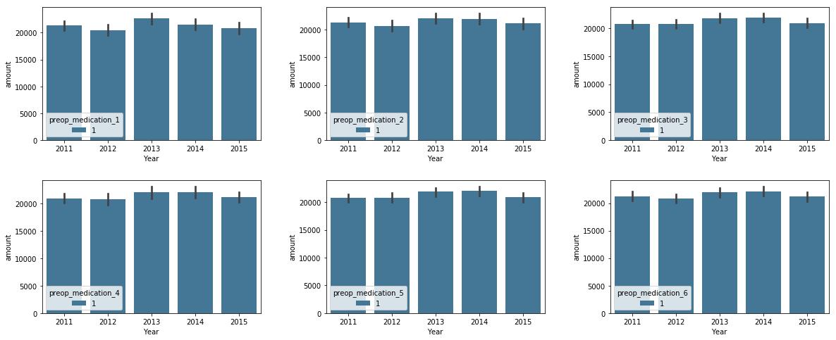
YOY Analysis
A Year-on-year (YOY) analysis was also conducted on the dataset.
To determine if rising costs were attributed to general inflation or potentially rising costs of drugs/treatments.
No obvious increasing trend with each year for total amount, Preop medication, symptoms or medical history.

Slide 12
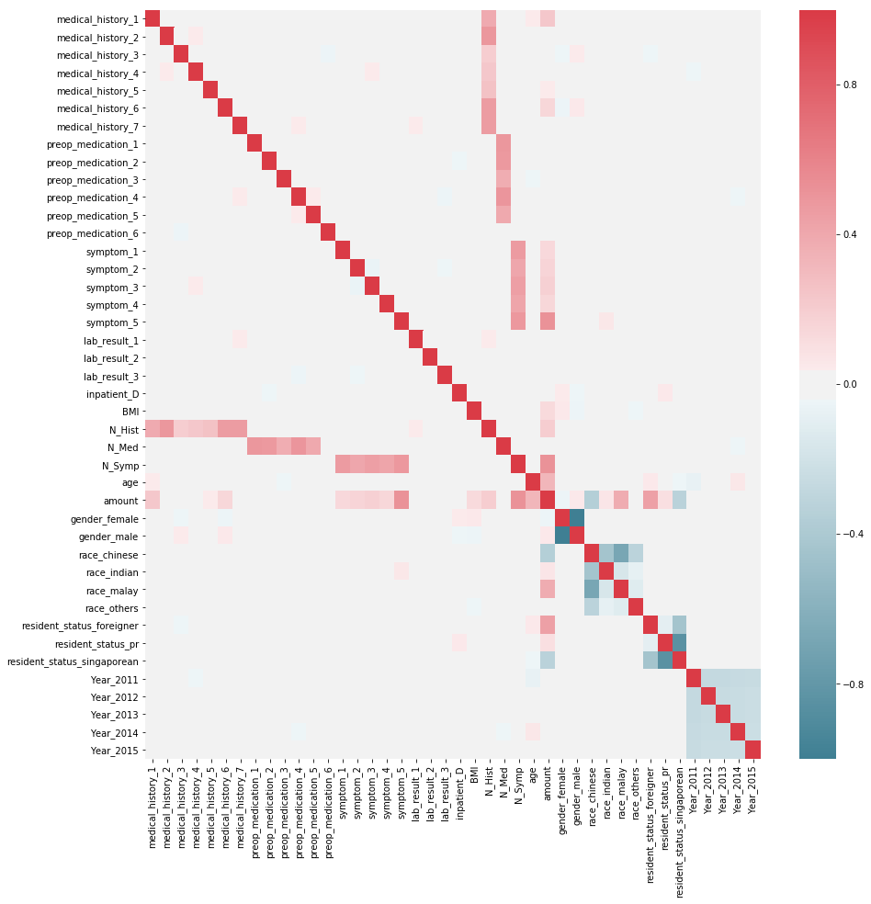
Correlation heatmap

Slide 13
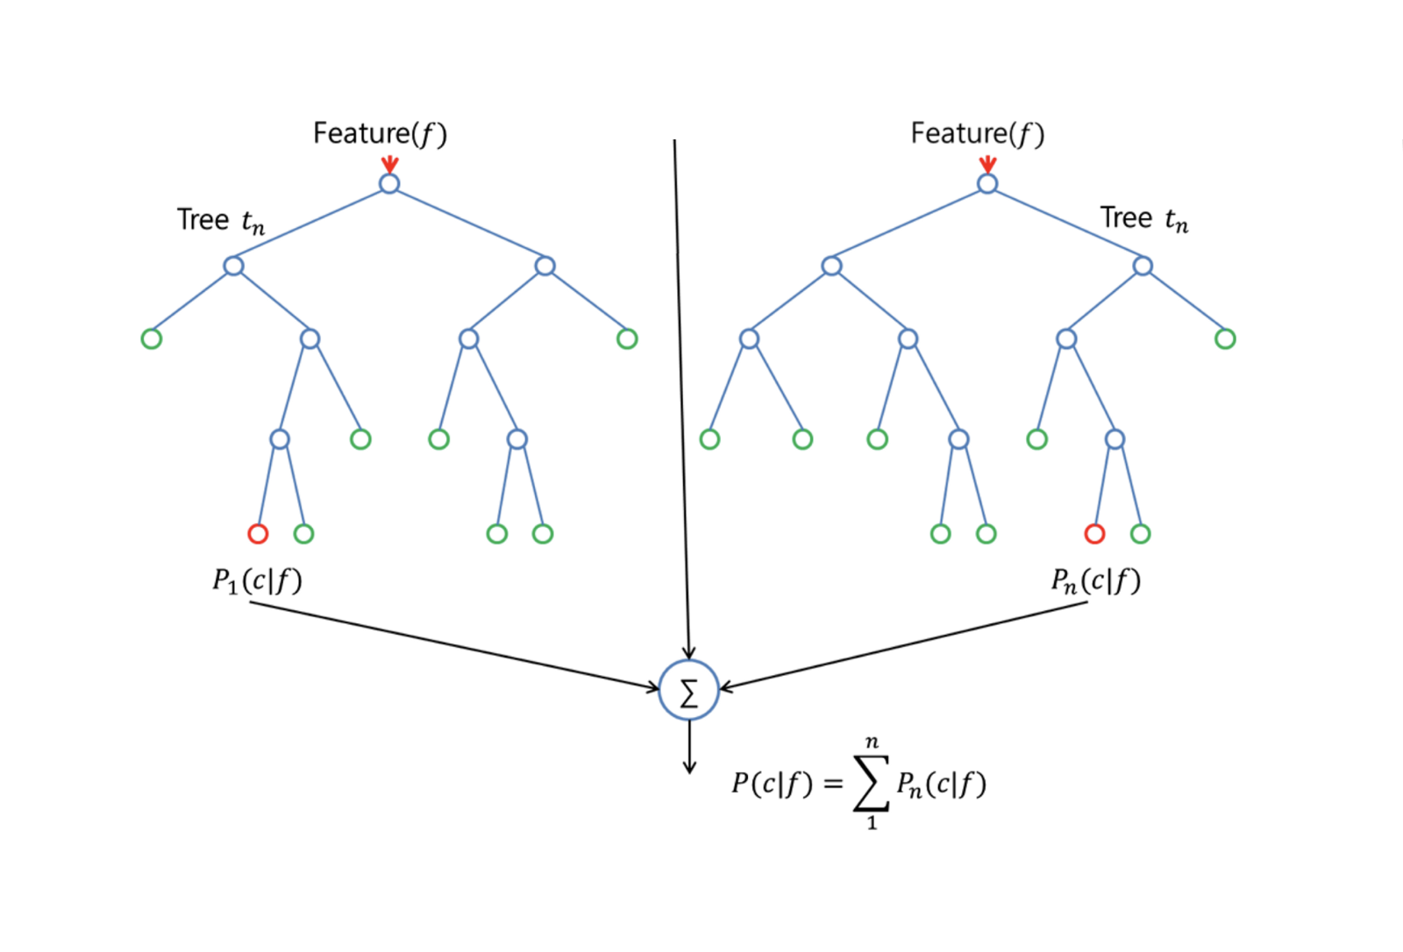
Random Forest Regressor

Slide 14
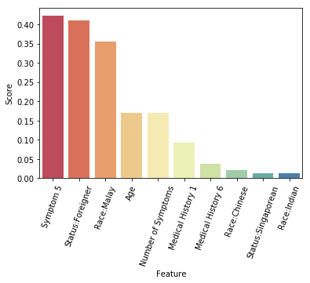
Feature Selection

Slide 15
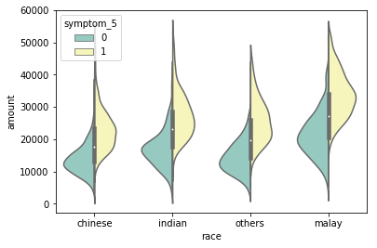
Feature Selection

Slide 16
Assumptions & Limitations

Slide 17
Conclusion

