Slide 1



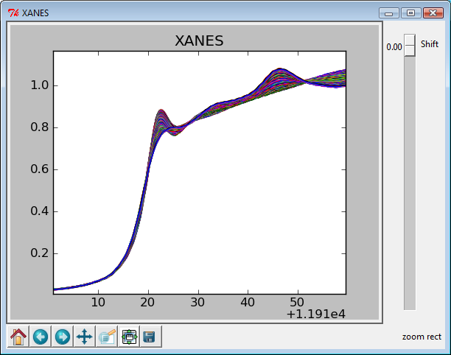
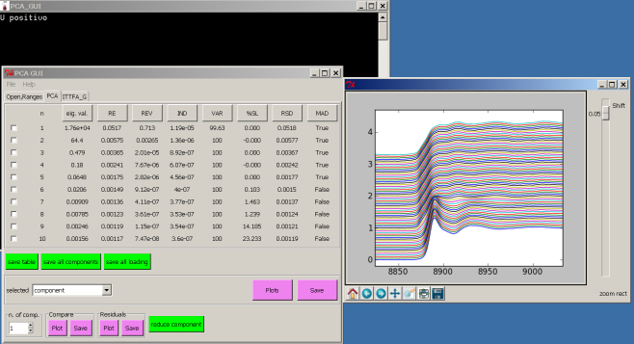
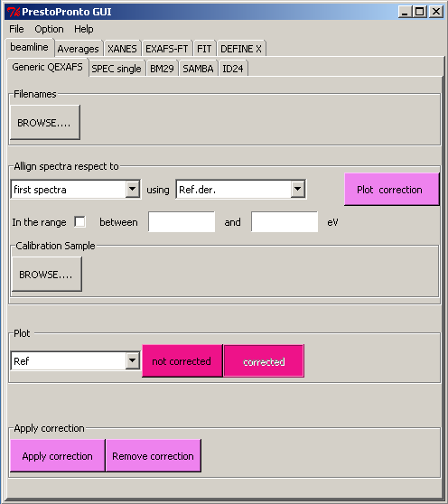
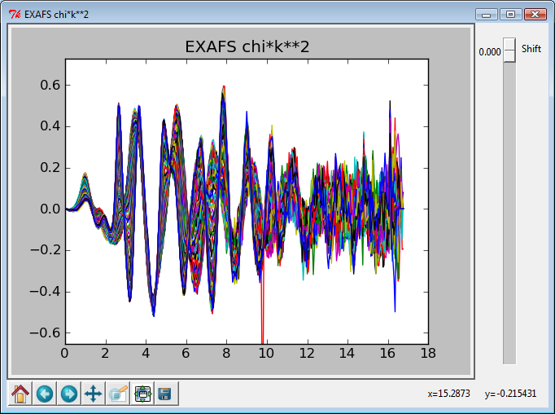
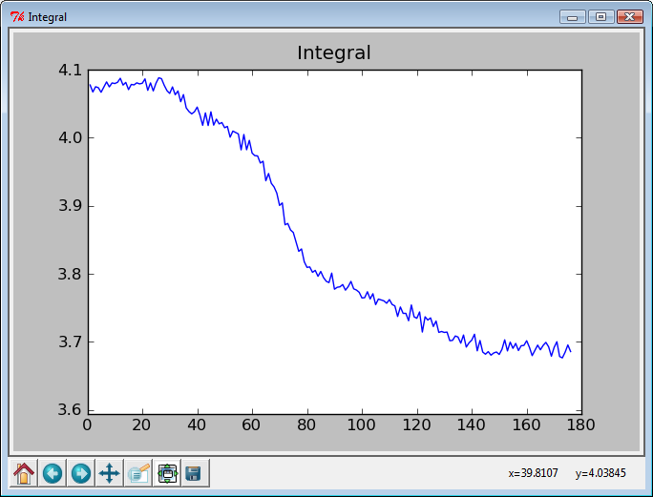
Ad hoc full interface software developed to treat large amount of Data
http://code.google.com/p/prestopronto/
Principal Component Analysis and Linear
Combination Fits
Automatic XANES normalization
Recursive EXAFS extraction
Peak intensity evaluation along the set

