Slide 1
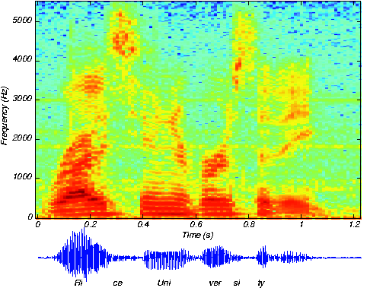
3. SPEECH RECOGNITION, ANALYSIS, AND SYNTHESIS
MUSIC 318 MINI-COURSE ON SPEECH AND SINGING
Science of Sound, Chapter 16
The Speech Chain, Chapters 7, 8

Slide 2
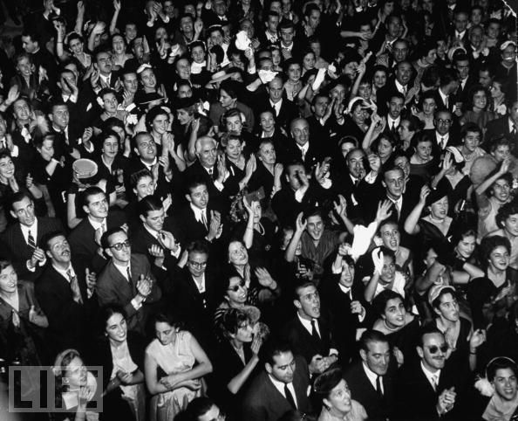

SPEECH RECOGNITION
OUR ABILITY TO RECOGNIZE THE SOUNDS OF LANGUAGE IS TRULY PHENOMENAL. WE CAN RECOGNIZE MORE THAN 30 PHONEMES PER SECOND
SPEECH CAN BE UNDERSTOOD
AT RATES AS HIGH AS
400 WORDS PER MINUTE.

Slide 3
ARTICULATION TESTS
A SET OF SPOKEN WORDS IS PRESENTED AND A LISTENER OR GROUP OF LISTENERS WRITES DOWN WHAT THEY HEAR. THE PERCENTAGE OF WORDS CORRECTLY HEARD IS CALLED THE ARTICULATION SCORE.
ARTICULATION SCORES DEPEND UPON THE TEST WORDS USED. ONE TYPE OF WORD LIST CONSISTS OF SINGLE SYLLABLE WORDS SELECTED SO THAT SPEECH SOUNDS IN THE LISTS OCCUR WITH THE SAME RELATIVE FREQUENCY AS THEY DO IN SPOKEN ENGLISH. THESE ARE THE SO-CALLED PHONETICALLY BALANCED OR PB LISTS.
ANOTHER TYPE OF WORD LIST IS MADE UP OF TWO-SYLLABLE WORDS LIKE “ARMCHAIR,” “SHOTGUN,” OR “RAILROAD” IN WHICH EACH WORD IS PRONOUNCED WITH EQUAL STRESS ON BOTH SYLLABLES.

Slide 4
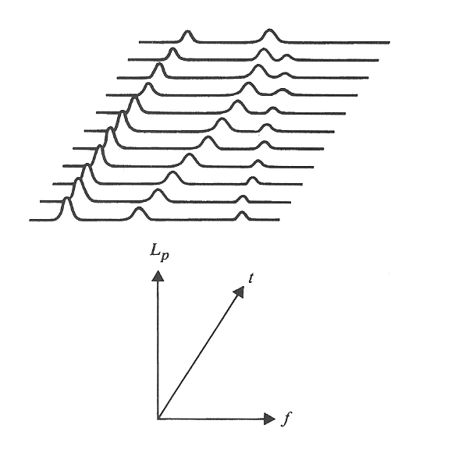
ANALYSIS OF SPEECH
THREE-DIMENSIONAL DISPLAY OF SOUND LEVEL VERSUS FREQUENCY AND TIME

Slide 5
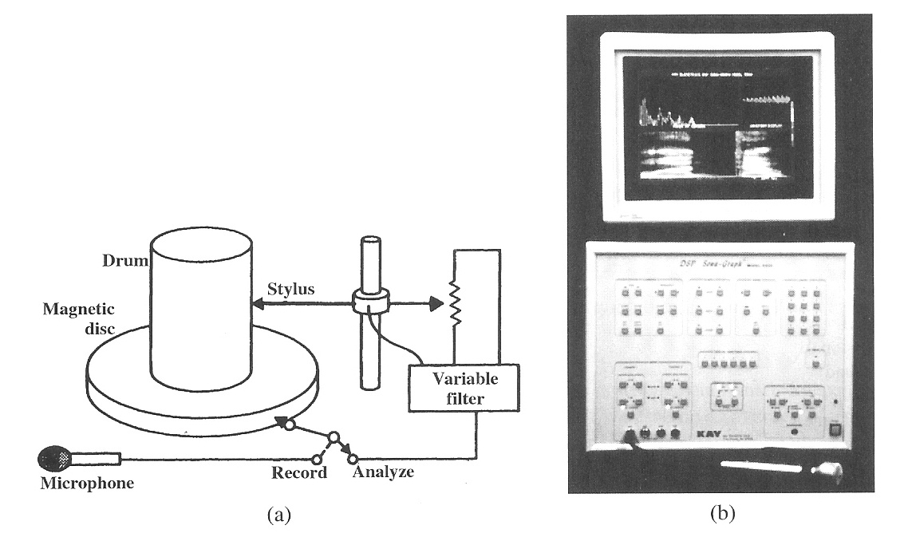
SPEECH SPECTROGRAPH
AS DEVELOPED AT BELL LABORATORIES (1945)
DIGITAL VERSION

Slide 6
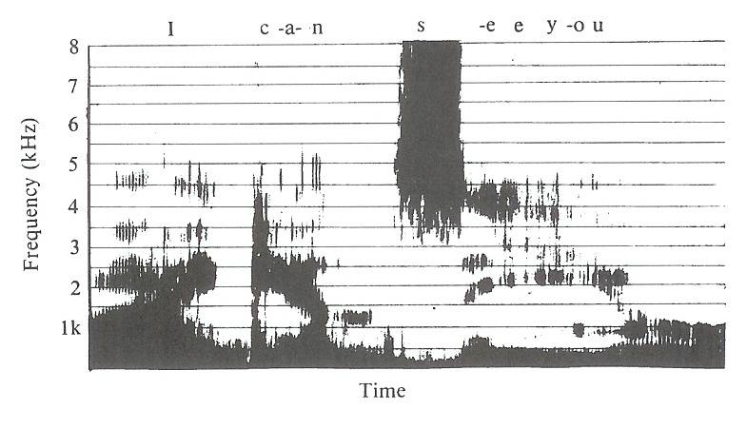
SPEECH SPECTROGRAM

Slide 7
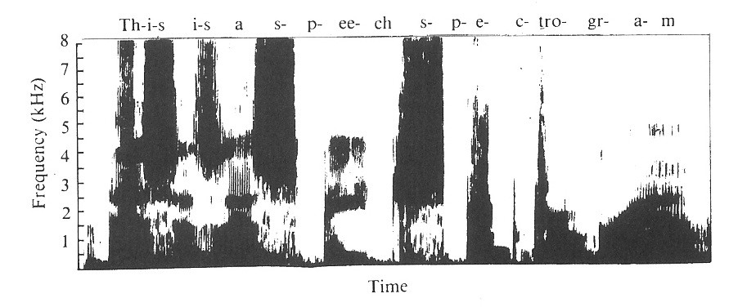
SPEECH SPECTROGRAM OF A SENTENCE: This is a speech spectrogram

Slide 8
SPEECH SPECTROGRAM WITH COLOR
ADDING COLOR ADDS ADDITIONAL INFORMATION

Slide 9
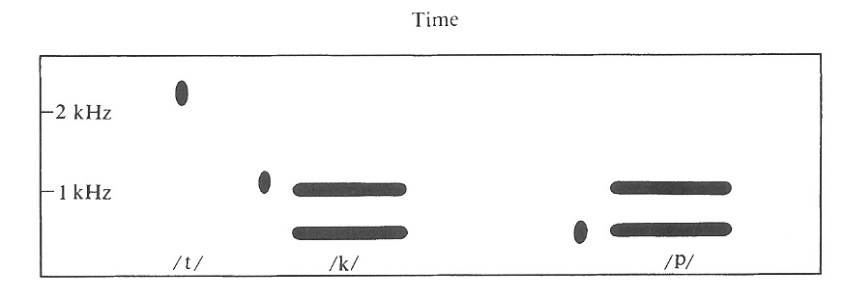
PATTERN PLAYBACK MACHINE
CONSONANT SOUNDS, CHANGE VERY RAPIDLY, ARE DIFFICULT TO ANALYZE.
THE SOUND CUES, BY WHICH THEY ARE RECOGNIZED, OFTEN OCCUR IN THE FIRST FEW MILLISECONDS.
MUCH EARLY KNOWLEDGE ABOUT THE RECOGNITION OF CONSONANTS RESULTED FROM THE PATTERN PLAYBACK MACHINE, DEVELOPED AT THE HASKINS LABORATORY, WHICH WORKS LIKE A SPEECH SPECTROGRAPH IN REVERSE.
PATTERNS MAY BE PRINTED ON PLASTIC BELTS IN ORDER TO STUDY THE EFFECTS OF VARYING THE FEATURES OF SPEECH ONE BY ONE.
A DOT PRODUCES A “POP” LIKE A PLOSIVE CONSTANT
STIMULUS PATTERN FOR PRODUCING /t/, /k/, AND /p/ SOUNDS

Slide 10
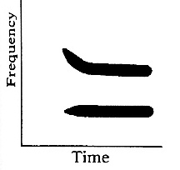
TRANSITIONS MAY OCCUR IN EITHER THE FIRST OR SECOND FORMANT
A FORMANT TRANSITION WHICH MAY PRODUCE /t/, /p/, OR /k/ DEPENDING ON THE VOWEL WHICH FOLLOWS

Slide 11
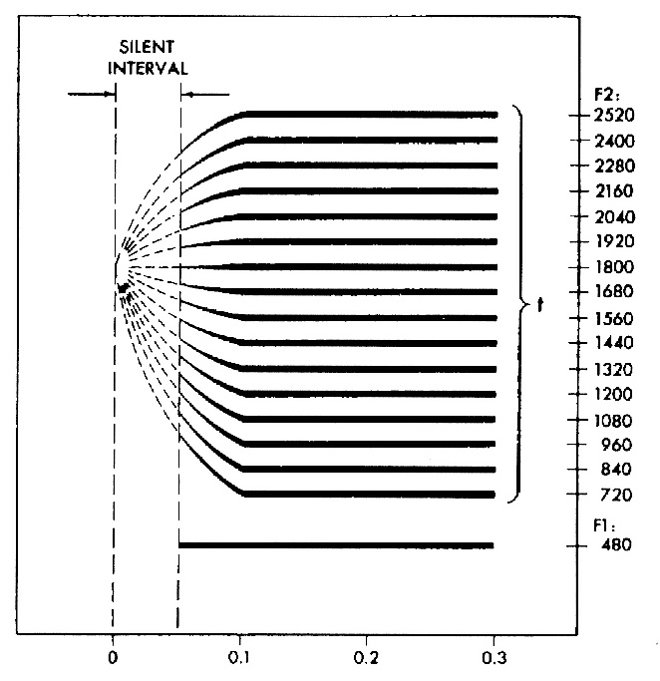
TRANSITIONS THAT APPEAR TO ORIGINATE FROM 1800 Hz
SECOND-FORMANT TRANSITIONS PERCEIVED AS THE SAME PLOSIVE CONSONANT /t/ (after Delattre, Liberman, and Cooper, 1955)

Slide 12
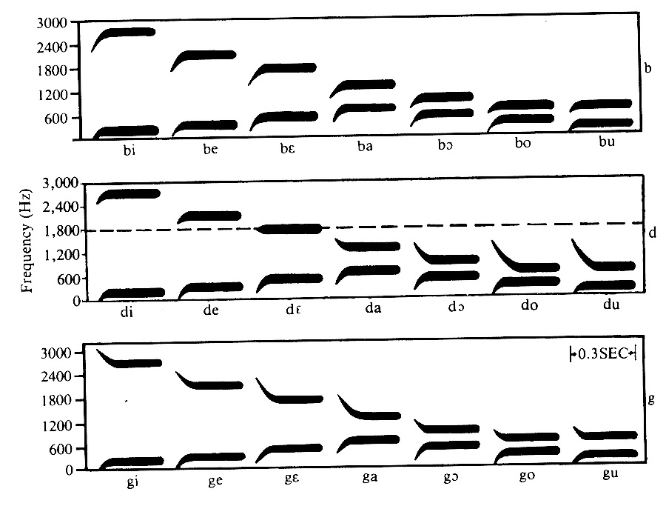
PATTERNS FOR SYNTHESIS OF /b/, /d/, /g/
PATTERNS FFOR THE SYNTHESIS OF /b/, /d/, AND /g/ BEFORE VOWELS
(THE DASHED LINE SHOWS THE LOCUS FOR /d/)

Slide 13
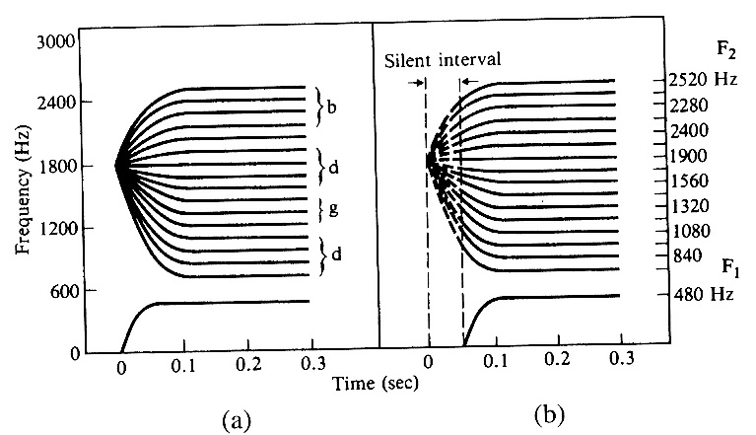
PATTERNS FOR SYNTHESIZING /d/
(a) SECOND FORMANT TRANSITIONS THAT START AT THE /d/-LOCUS
(b) COMPARABLE TRANSITIONS THAT MERELY “POINT” AT THE /d/-LOCUS
TRANSITIONS IN (a) PRODUCE SYLLABLES BEGINNING WITH /b/, /d/, OR /g/ DEPENDING ON THE FREQUENCY LEVEL OF THE FORMANT;
THOSE IN (b) PRODUCE ONLY SYLLABLES BEGINNING WITH /d/

Slide 14
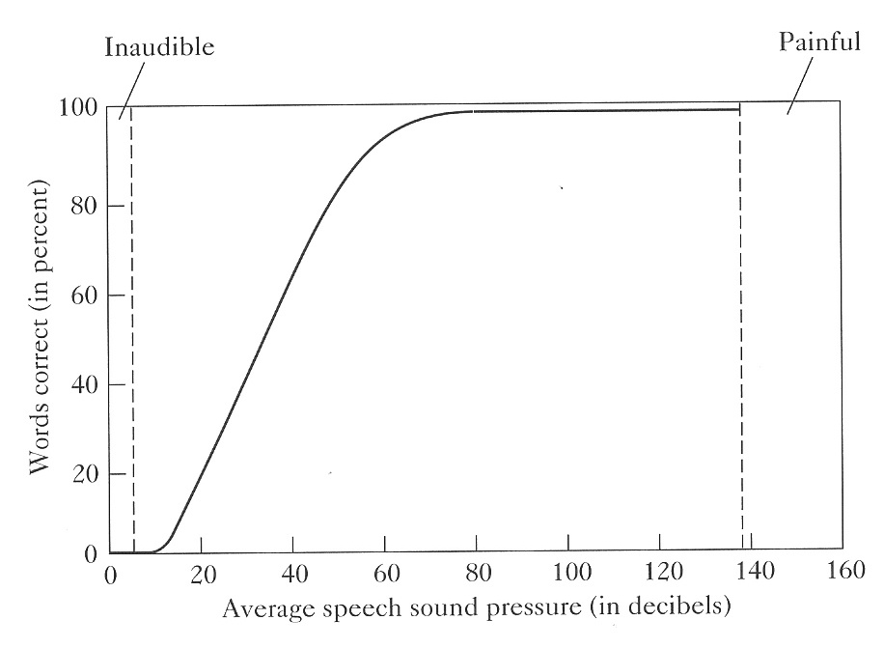
SPEECH INTELLIGIBILITY vs SPL

Slide 15
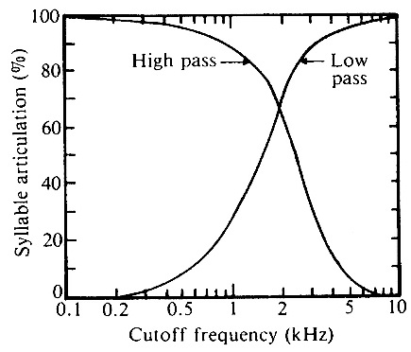
FILTERED SPEECH
FILTERS MAY HAVE HIGH-PASS, LOW-PASS, BAND-PASS, OR BAND-REJECT CHARACTERISTICS.
SPEECH INTELLIGIBILITY IS USUALLY MEASURED BY ARTICULATION TESTS IN WHICH A SET OF WORDS IS SPOKEN AND LISTENERS ARE ASKED TO IDENTIFY THEM.
ARTICULATION SCORES FOR SPEECH FILTERED WITH HIGH-PASS AND LOW-PASS FILTERS. THE CURVES CROSS OVER AT 1800 Hz WHERE THE ARTICULATION SCORES FOR BOTH ARE 67%. NORMAL SPEECH IS INTELLIGIBLE WITH BOTH TYPES OF FILTERS ALTHOUGH THE QUALITY CHANGES.

Slide 16
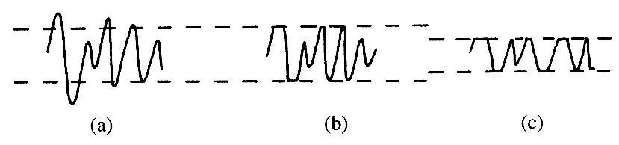
WAVEFORM DISTORTION
PEAK CLIPPING IS A TYPE OF DISTORTION THAT RESULTS FROM OVERDRIVING AN AUDIO AMPLIFIER. IT IS SOMETIMES USED DELIBERATELY TO REDUCE BANDWIDTH
ORIGINAL SPEECH MODERATE CLIPPING SEVERE CLIPPING
EVEN AFTER SEVERE CLIPPING IN (c) THE INTELLIGIBILITY REMAINS 50-90% DEPENDING ON THE LISTENER

Slide 17
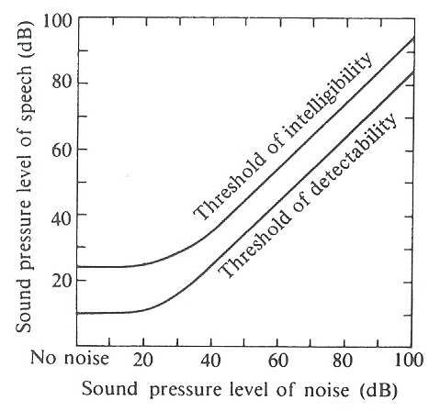
EFFECT OF NOISE ON SPEECH INTELLIGIBILITY
THE THRESHOLDS OF INTELLIGIBILITY AND DETECTABILITY AS FUNCTIONS OF NOISE LEVEL

Slide 18
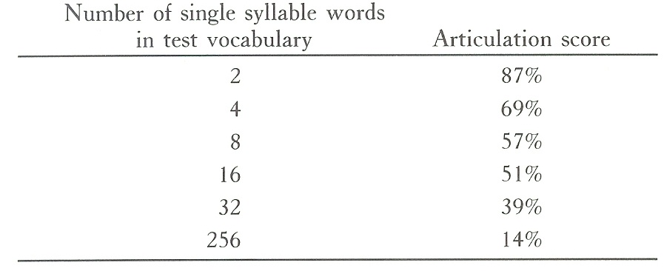
CATEGORICAL PERCEPTION
OUR EXPECTATIONS INFLUENCE OUR ABILITY TO PERCEIVE SPEECH. EXPECTATIONS ARE STRONGER WHEN THE TEST VOCABULARY HAS FEWER WORDS

Slide 19
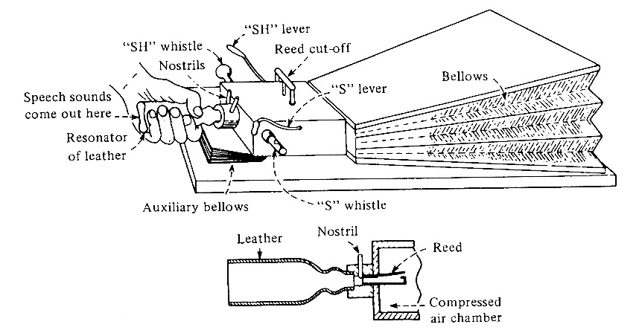
SYNTHESIS OF SPEECH
AN EARLY ATTEMPT (1791) TO SYNTHESIZE SPEECH WAS VON KEMPELEN’S “TALKING MACHINE.” A BELLOWS SUPPLIES AIR TO A REED WHICH SERVES AS THE VOICE SOURCE.
A LEATHER “VOCAL TRACT” IS SHAPED BY THE FINGERS OF ONE HAND.
CONSONANTS ARE SIMULATED BY FOUR CONSTRICTED PASSAGES CONTROLLED BY THE FINGERS OF THE OTHEER HAND.
WHEATSTONE’S RECONSTRUCTION OF KEMPELEN’S TALKING MACHINE

Slide 20
SPEECH SYNTHESIS
ACOUSTIC SYNTHESIZERS—MECHANICAL DEVICES BY VON KEMPELEN, WHEATSTONE, KRATZENSTEIN, VON HELMHOLTZ, etc.
CHANNEL VOCODERS (voice coders)---CHANGES IN INTENSITY IN NARROW BANDS IS TRANSMITTED AND USED TO REGENERATE SPEECH SPECTRA IN THESE BANDS.
FORMANT SYNTHESIZERS---USES A BUZZ GENERATOR (FOR VOICED SOUNDS) AND A HISS GENERATOR (FOR UNVOICED SOUNDS) ALONG WITH A SERIES OF ELECTRICAL RESONATORS (TO SIMULATE FORMANTS).
LINEAR PREDICTIVE CODING (LPC)---TEN OR TWELVE COEFFICIENTS ARE CALCULATED FROM SHORT SEGMENTS OF SPEECH AND USED TO PREDICT NEW SPEECH SAMPLES USING A DIGITAL COMPUTER
HMM-BASED SYNTHESIS OR STATISTICAL PARAMETRIC SYNTHESIS---BASED ON HIDDEN MARKOV MODELS. USES MAXIMUM LIKELIHOOD TO COMPUTE WAVEFORMS

Slide 21
AUTOMATIC SPEECH RECOGNITION BY COMPUTER
AUTOMATIC SPEECH RECOGNITION IS THE “HOLY GRAIL” OF COMPUTER SPEECH RESEARCH
HUMAN LISTENERS HAVE LEARNED TO UNDERSTAND DIFFERENT DIALECTS, ACCENTS, VOICE INFLECTIONS, AND EVEN SPEECH OF RATHER LOW QUALITY FROM TALKING COMPUTERS. IT IS STILL DIFFICULT FOR COMPUTERS TO DO THIS.
A COMMON STRATEGY FOR RECOGNIZING INDIVIDUAL WORDS IS TEMPLATE MATCHING. TEMPLATES ARE CREATED FOR THE WORDS IN THE DESIRED VOCABULARY AS SPOKEN BY SELECTED SPEAKERS. SPOKEN WORDS ARE THEN MATCHED TO THESE TEMPLATES, AND THE CLOSEST MATCH IS ASSUMED TO BE THE WORD SPOKEN.
CONTINUOUS SPEECH RECOGNITION IS MUCH MORE DIFFICULT THAN INDIVIDUAL WORDS BECAUSE IT IS DIFFICULT TO RECOGNIZE THE BEGINNING AND END OF WORDS, SYLLABLES, AND PHONEMES.

Slide 22
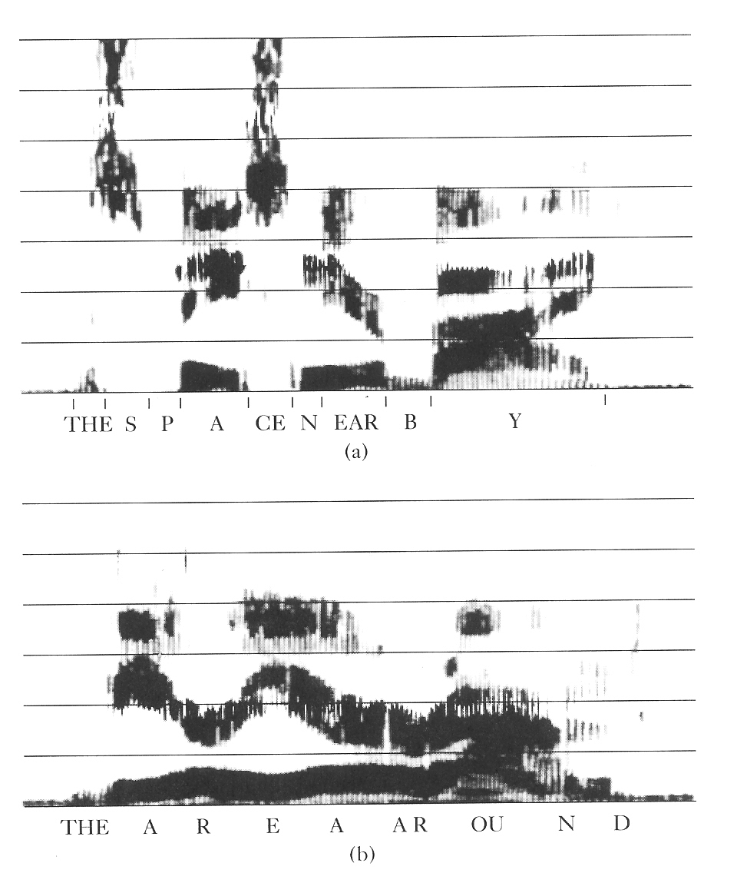
RECOGNIZING WORD BOUNDARIES
“THE SPACE NEARBY”
WORD BOUNDARIES CAN BE LOCATED BY THE INITIAL OR FINAL CONSONANTS
“THE AREA AROUND”
WORD BOUNDARIES ARE DIFFICULT TO LOCATE

Slide 23
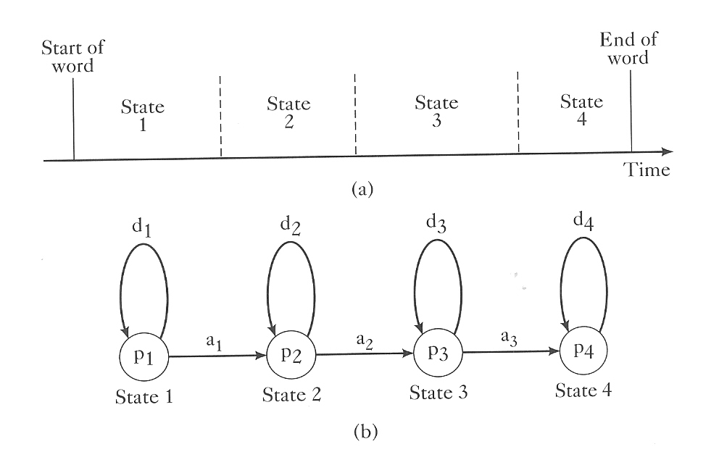
HIDDEN MARKOV MODELS (HMMs)
INVENTED (IN THE EARLY 1900s) BY RUSSIAN MATHEMATICIAN A.A. MARKOV DURING HIS STUDIES OF WORD STATISTICS IN LITERARY TEXTS. DURING THE 1980s HMMs BECAME THE MOST POPULAR SPEECH RECOGNITION METHOD.
HIDDEN MARKOV MODEL REFPRESENTATION. (a) Example of a word represented by four internal states 1,2,3,4. (b) Abstract representation of (a) snowing states 1-4 sequential transition probabilites a_{1.} . . .a_{4;} self-transition probabilities d₁ ….d₄; and within-state probability distribution p₁ . . .p₄ (DENES et al.)

Slide 24
SPEAKER IDENTIFICATION: VOICEPRINTS
SPEECH SPECTROGRAMS PORTRAY SHORT-TERM VARIATIONS IN INTENSITY AND FREQUENCY IN GRAPHICAL FORM. THUS THEY GIVE MUCH USEFUL INFORMATION ABOUT SPEECH ARTICULATION.
WHEN TWO PERSONS SPEAK THE SAME WORD, THEIR ARTICULATION IS SIMILAR BUT NOT IDENTICAL. THUS SPECTROGRAMS OF THEIR SPEECH WILL SHOW SIMILARITIES BUT ALSO DIFFERENCES.

Slide 25
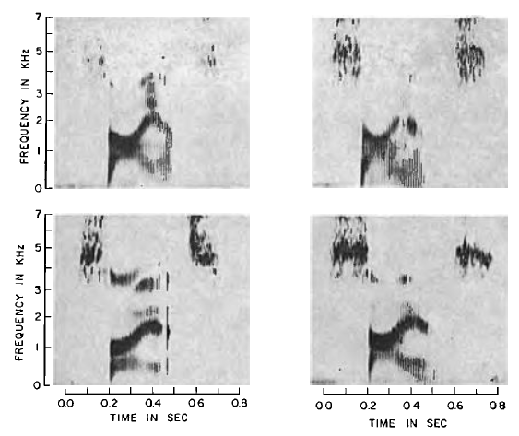
SPECTROGRAMS OF THE SPOKEN WORD “SCIENCE.” WHICH TWO SPECTROGRAMS WERE MADE BY THE SAME SPEAKER?

Slide 26
THE TWO SPECTROGRAMS AT THE TOP WERE MADE BY THE SAME SPEAKER.
THE TWO SPECTROGRAMS AT THE BOTTOM WERE MADE BY TWO OTHER SPEAKERS

Slide 27
FROM THE WINTER 2010 ISSUE OF ECHOES
SPEECH RECOGNITION CAN BE IMPOROVED BY JOINT ANALYSIS OF THROAT AND ACOUSTIC MICROPHONE RECORDINGS, ACCORDING TO A PAPER IN THE SEPTEMBER ISSUE OF IEEE TRANSACTION ON AUDIO. SPEECH, AND LANGUAGE PROCESSING. A PROPOSED MULTIMODAL SYSTEM IMPROVES PHONEME RECOGNITION RATE.
A PAPER IN THE NOVEMBER 2010 ISSUE OF NATURE PROPOSES THAT THE AMINO ACID COMPOSITION IN THE GENE FOXP2 HAS UNDERGONE ACCELERATED EVOLUTION,, AND THIS TWO-AMINO-ACID CHANGE OCCURRED AROUND THE TIME OF LANGUAGE EMERGENCE IN HUMANS AND MAY HAVE PLAYED AN IMPORTANT ROLE.
HUMANS USE TACTILE INFORMATION DURING AUDITORY SPEECH PERCEPTION, ACCORDING TO A PAPER IN THE 26TH NOVEMBER ISSUE OF NATURE. APPLYING TINY BURSTS OF ASPIRATION (SUCH AS WOULD BE PRODUCED BY PLOSIVE CONSONANT <p> TO THE RIGHT HAND OR THE NECK MADE THE SYLLABLES MORE APT TO BE HEARD AS SPIRATED (<p> RATHER THAN <b>, FOR EXAMPLE).

