Slide 1
Lecture 1: Introduction
Chapter 1: Fundamentals of Quantitative Design and Analysis, Computer Architecture: A Quantitative Approach (Sixth Edition).

Slide 2
Computer Technology
Introduction
Performance improvements:
Improvements in semiconductor technology
Feature size, clock speed
Improvements in computer architectures
Enabled by HLL compilers, UNIX
Lead to RISC architectures
Together have enabled:
Lightweight computers
Productivity-based managed/interpreted programming languages

Slide 3
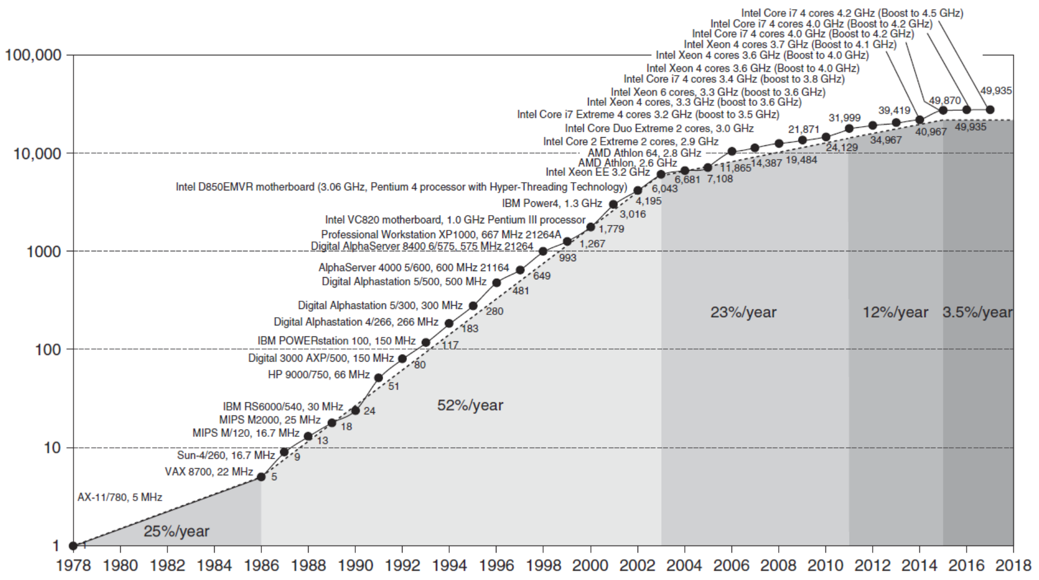
Single Processor Performance
Introduction

Slide 4
Current Trends in Architecture
Introduction
Cannot continue to leverage Instruction-Level parallelism (ILP)
Single processor performance improvement ended in 2003
New models for performance:
Data-level parallelism (DLP)
Thread-level parallelism (TLP)
Request-level parallelism (RLP)
These require explicit restructuring of the application

Slide 5
Classes of Computers
Personal Mobile Device (PMD)
e.g. start phones, tablet computers
Emphasis on energy efficiency and real-time
Desktop Computing
Emphasis on price-performance
Servers
Emphasis on availability, scalability, throughput
Clusters / Warehouse Scale Computers
Used for “Software as a Service (SaaS)”
Emphasis on availability and price-performance
Sub-class: Supercomputers, emphasis: floating-point performance and fast internal networks
Internet of Things/Embedded Computers
Emphasis: price
Classes of Computers

Slide 6
Parallelism
Classes of parallelism in applications:
Data-Level Parallelism (DLP)
Task-Level Parallelism (TLP)
Classes of architectural parallelism:
Instruction-Level Parallelism (ILP)
Vector architectures/Graphic Processor Units (GPUs)
Thread-Level Parallelism
Request-Level Parallelism
Classes of Computers

Slide 7
Flynn’s Taxonomy
Single instruction stream, single data stream (SISD)
Single instruction stream, multiple data streams (SIMD)
Vector architectures
Multimedia extensions
Graphics processor units
Multiple instruction streams, single data stream (MISD)
No commercial implementation
Multiple instruction streams, multiple data streams (MIMD)
Tightly-coupled MIMD
Loosely-coupled MIMD
Classes of Computers

Slide 8
Defining Computer Architecture
“Old” view of computer architecture:
Instruction Set Architecture (ISA) design
i.e. decisions regarding:
registers, memory addressing, addressing modes, instruction operands, available operations, control flow instructions, instruction encoding
“Real” computer architecture:
Specific requirements of the target machine
Design to maximize performance within constraints: cost, power, and availability
Includes ISA, microarchitecture, hardware
Defining Computer Architecture

Slide 9
Instruction Set Architecture
Class of ISA
General-purpose registers
Register-memory vs load-store
RISC-V registers
32 g.p., 32 f.p.
Defining Computer Architecture
Register | Name | Use | Saver
x9 | s1 | saved | callee
x10-x17 | a0-a7 | arguments | caller
x18-x27 | s2-s11 | saved | callee
x28-x31 | t3-t6 | temporaries | caller
f0-f7 | ft0-ft7 | FP temps | caller
f8-f9 | fs0-fs1 | FP saved | callee
f10-f17 | fa0-fa7 | FP arguments | callee
f18-f27 | fs2-fs21 | FP saved | callee
f28-f31 | ft8-ft11 | FP temps | caller
Register | Name | Use | Saver
x0 | zero | constant 0 | n/a
x1 | ra | return addr | caller
x2 | sp | stack ptr | callee
x3 | gp | gbl ptr
x4 | tp | thread ptr
x5-x7 | t0-t2 | temporaries | caller
x8 | s0/fp | saved/ frame ptr | callee

Slide 10
Instruction Set Architecture
Memory addressing
RISC-V: byte addressed, aligned accesses faster
Addressing modes
RISC-V: Register, immediate, displacement (base+offset)
Other examples: autoincrement, indexed, PC-relative
Types and size of operands
RISC-V: 8-bit, 32-bit, 64-bit
Defining Computer Architecture

Slide 11
Instruction Set Architecture
Operations
RISC-V: data transfer, arithmetic, logical, control, floating point
Control flow instructions
Use content of registers (RISC-V) vs. status bits (x86, ARMv7, ARMv8)
Return address in register (RISC-V, ARMv7, ARMv8) vs. on stack (x86)
Encoding
Fixed (RISC-V, ARMv7/v8 except compact instruction set) vs. variable length (x86)
Defining Computer Architecture

Slide 12
Trends in Technology
Integrated circuit technology (Moore’s Law)
Transistor density: 35%/year
Die size: 10-20%/year
Integration overall: 40-55%/year
DRAM capacity: 25-40%/year (slowing)
8 Gb (2014), 16 Gb (2019), possibly no 32 Gb
Flash capacity: 50-60%/year
8-10X cheaper/bit than DRAM
Magnetic disk capacity: recently slowed to 5%/year
Density increases may no longer be possible, maybe increase from 7 to 9 platters
8-10X cheaper/bit then Flash
200-300X cheaper/bit than DRAM
Trends in Technology

Slide 13
Bandwidth and Latency
Bandwidth or throughput
Total work done in a given time
32,000-40,000X improvement for processors
300-1200X improvement for memory and disks
Latency or response time
Time between start and completion of an event
50-90X improvement for processors
6-8X improvement for memory and disks
Trends in Technology

Slide 14
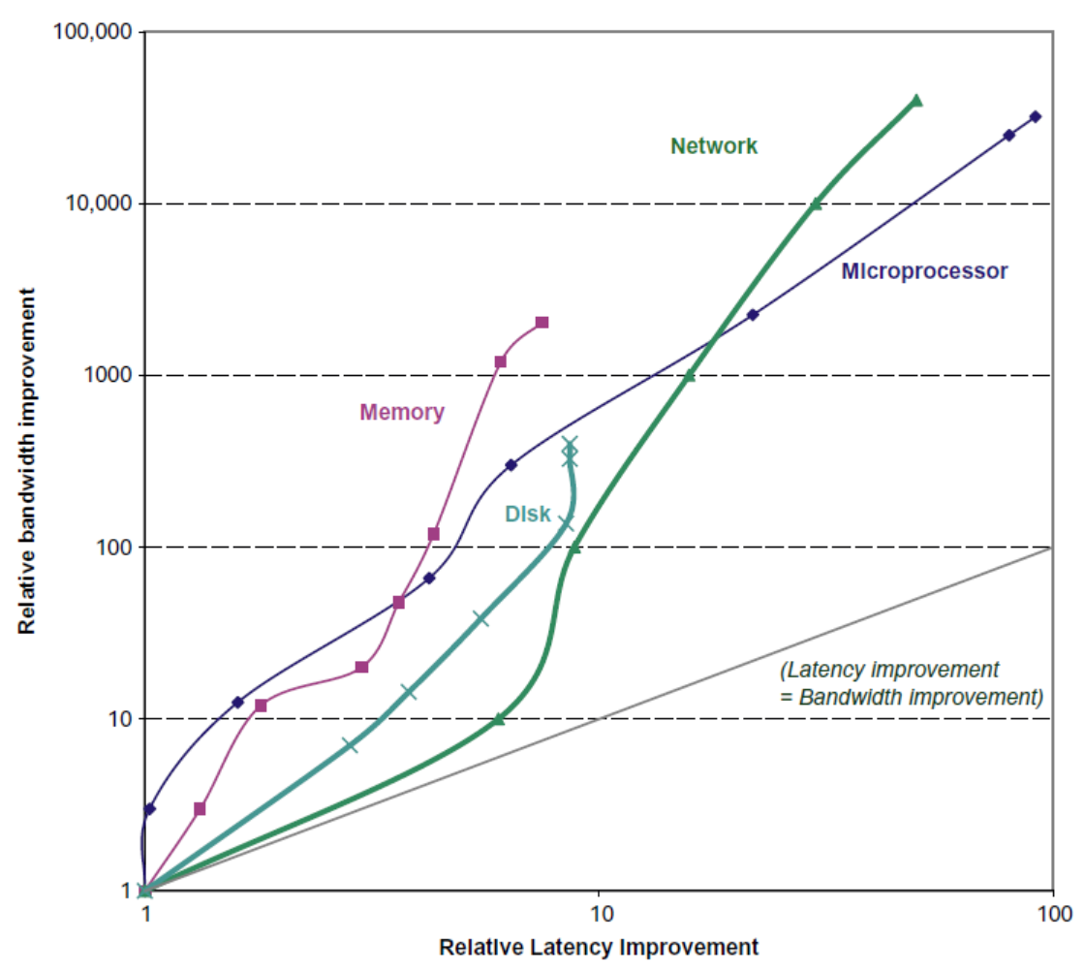
Bandwidth and Latency
Trends in Technology
Log-log plot of bandwidth and latency milestones

Slide 15
Transistors and Wires
Feature size
Minimum size of transistor or wire in x or y dimension
10 microns in 1971 to .011 microns in 2017
Transistor performance scales linearly
Wire delay does not improve with feature size!
Integration density scales quadratically
Trends in Technology

Slide 16
Processor

Slide 17
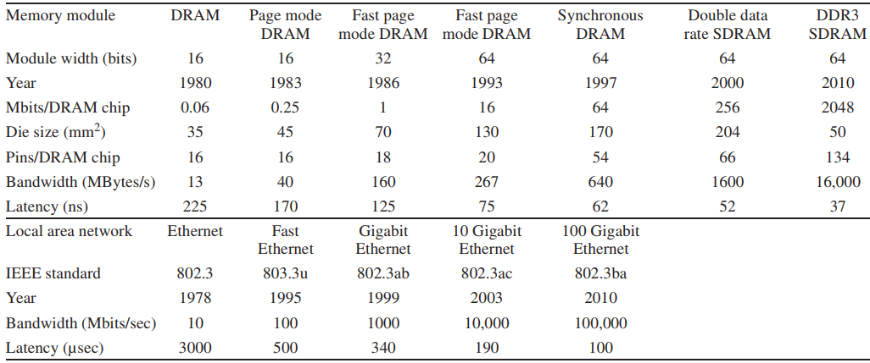
Memory/Network

Slide 18
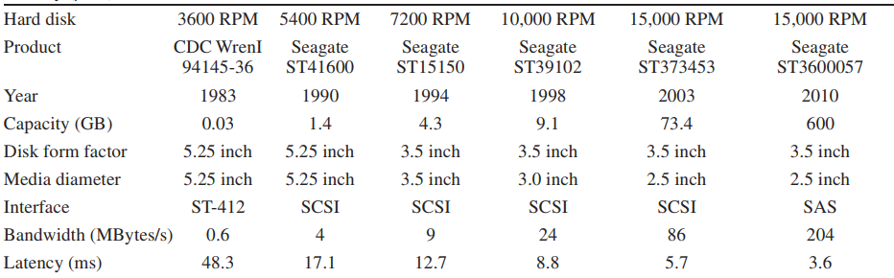
Hard disk

Slide 19
Power and Energy
Problem: Get power in, get power out
Thermal Design Power (TDP)
Characterizes sustained power consumption
Used as target for power supply and cooling system
Lower than peak power (1.5X higher), higher than average power consumption
Clock rate can be reduced dynamically to limit power consumption
Energy per task is often a better measurement
Trends in Power and Energy

Slide 20
Dynamic Energy and Power
Dynamic energy
Transistor switch from 0 -> 1 or 1 -> 0
½ x Capacitive load x Voltage²
Dynamic power
½ x Capacitive load x Voltage² x Frequency switched
Reducing clock rate reduces power, not energy
Trends in Power and Energy

Slide 21
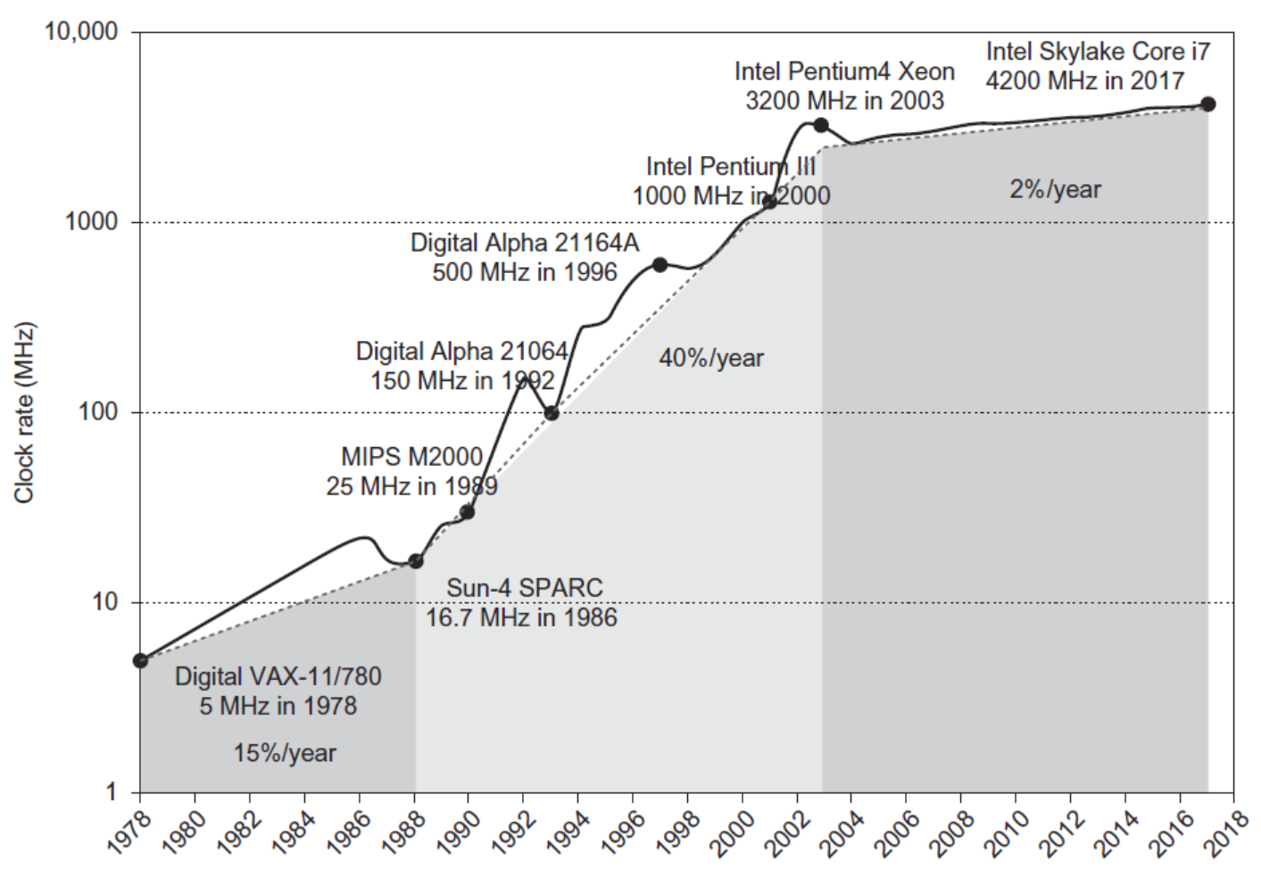
Power
Intel 80386 consumed ~ 2 W
3.3 GHz Intel Core i7 consumes 130 W
Heat must be dissipated from 1.5 x 1.5 cm chip
This is the limit of what can be cooled by air
Trends in Power and Energy

Slide 22
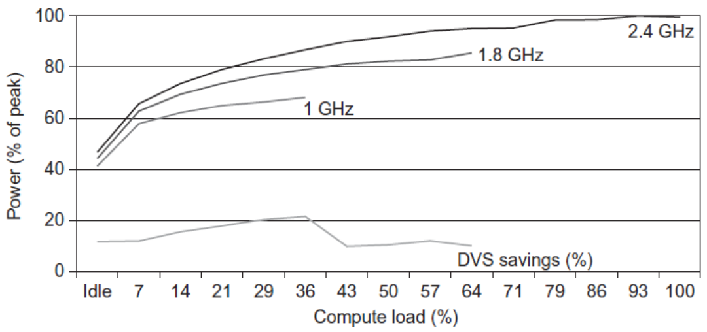
Reducing Power
Techniques for reducing power:
Do nothing well
Dynamic Voltage-Frequency Scaling
Low power state for DRAM, disks
Overclocking, turning off cores
Trends in Power and Energy

Slide 23
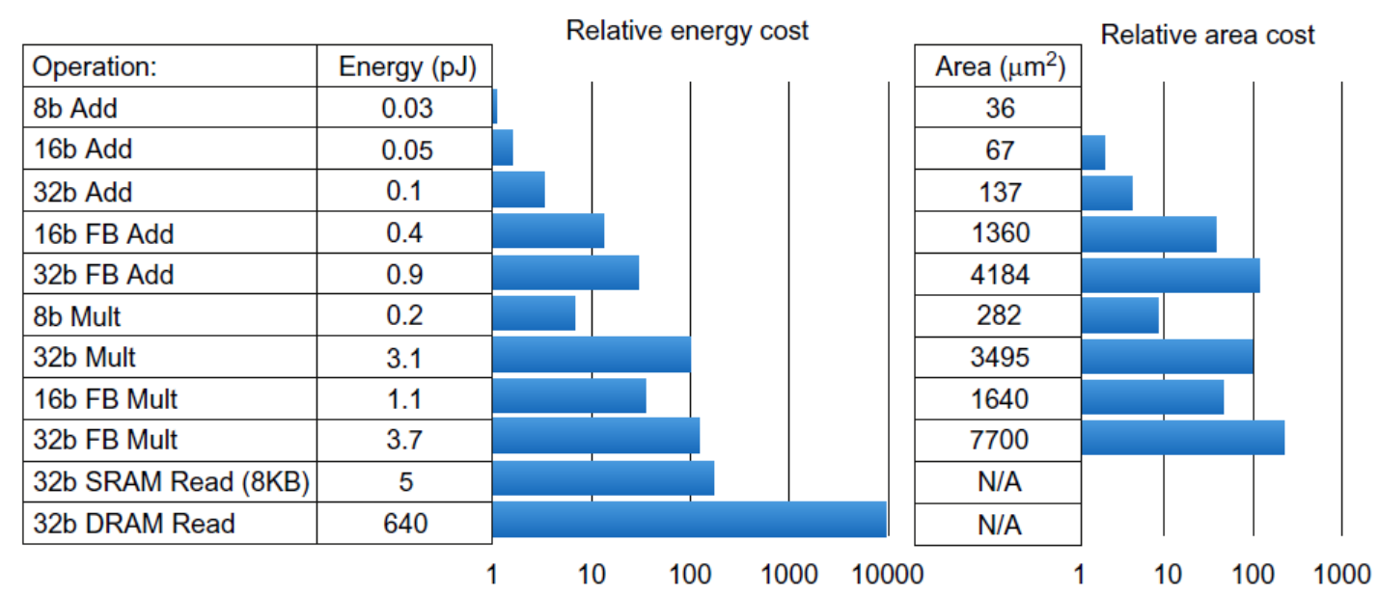
Static Power
Static power consumption
25-50% of total power
Current_{static} x Voltage
Scales with number of transistors
To reduce: power gating
Trends in Power and Energy

Slide 24
Trends in Cost
Trends in Cost
Cost driven down by learning curve
Yield
DRAM: price closely tracks cost
Microprocessors: price depends on volume
10% less for each doubling of volume

Slide 25

Integrated Circuit Cost
Trends in Cost
Integrated circuit
Bose-Einstein formula:
Defects per unit area = 0.016-0.057 defects per square cm (2010)
N = process-complexity factor = 11.5-15.5 (40 nm, 2010)

Slide 26
Dependability
Dependability
Module reliability
Mean time to failure (MTTF)
Mean time to repair (MTTR)
Mean time between failures (MTBF) = MTTF + MTTR
Availability = MTTF / MTBF

Slide 27
Measuring Performance
Typical performance metrics:
Response time
Throughput
Speedup of X relative to Y
Execution time_{Y} / Execution time_{X}
Execution time
Wall clock time: includes all system overheads
CPU time: only computation time
Benchmarks
Kernels (e.g. matrix multiply)
Toy programs (e.g. sorting)
Synthetic benchmarks (e.g. Dhrystone)
Benchmark suites (e.g. SPEC06fp, TPC-C)
Measuring Performance

Slide 28

Principles of Computer Design
Principles
Take Advantage of Parallelism
e.g. multiple processors, disks, memory banks, pipelining, multiple functional units
Principle of Locality
Reuse of data and instructions
Focus on the Common Case
Amdahl’s Law

Slide 29


Principles of Computer Design
Principles
The Processor Performance Equation

Slide 30


Principles of Computer Design
Principles
Different instruction types having different CPIs

Slide 31
Fallacies and Pitfalls
All exponential laws must come to an end
Dennard scaling (constant power density)
Stopped by threshold voltage
Disk capacity
30-100% per year to 5% per year
Moore’s Law
Most visible with DRAM capacity
ITRS disbanded
Only four foundries left producing state-of-the-art logic chips
11 nm, 3 nm might be the limit

Slide 32
Fallacies and Pitfalls
Multiprocessors are a silver bullet
Performance is now a programmer’s burden
Falling prey to Amdahl’s Law
A single point of failure
Hardware enhancements that increase performance also improve energy efficiency, or are at worst energy neutral
Benchmarks remain valid indefinitely
Compiler optimizations target benchmarks

Slide 33
Fallacies and Pitfalls
The rated mean time to failure of disks is 1,200,000 hours or almost 140 years, so disks practically never fail
MTTF value from manufacturers assume regular replacement
Peak performance tracks observed performance
Fault detection can lower availability
Not all operations are needed for correct execution

