Slide 1
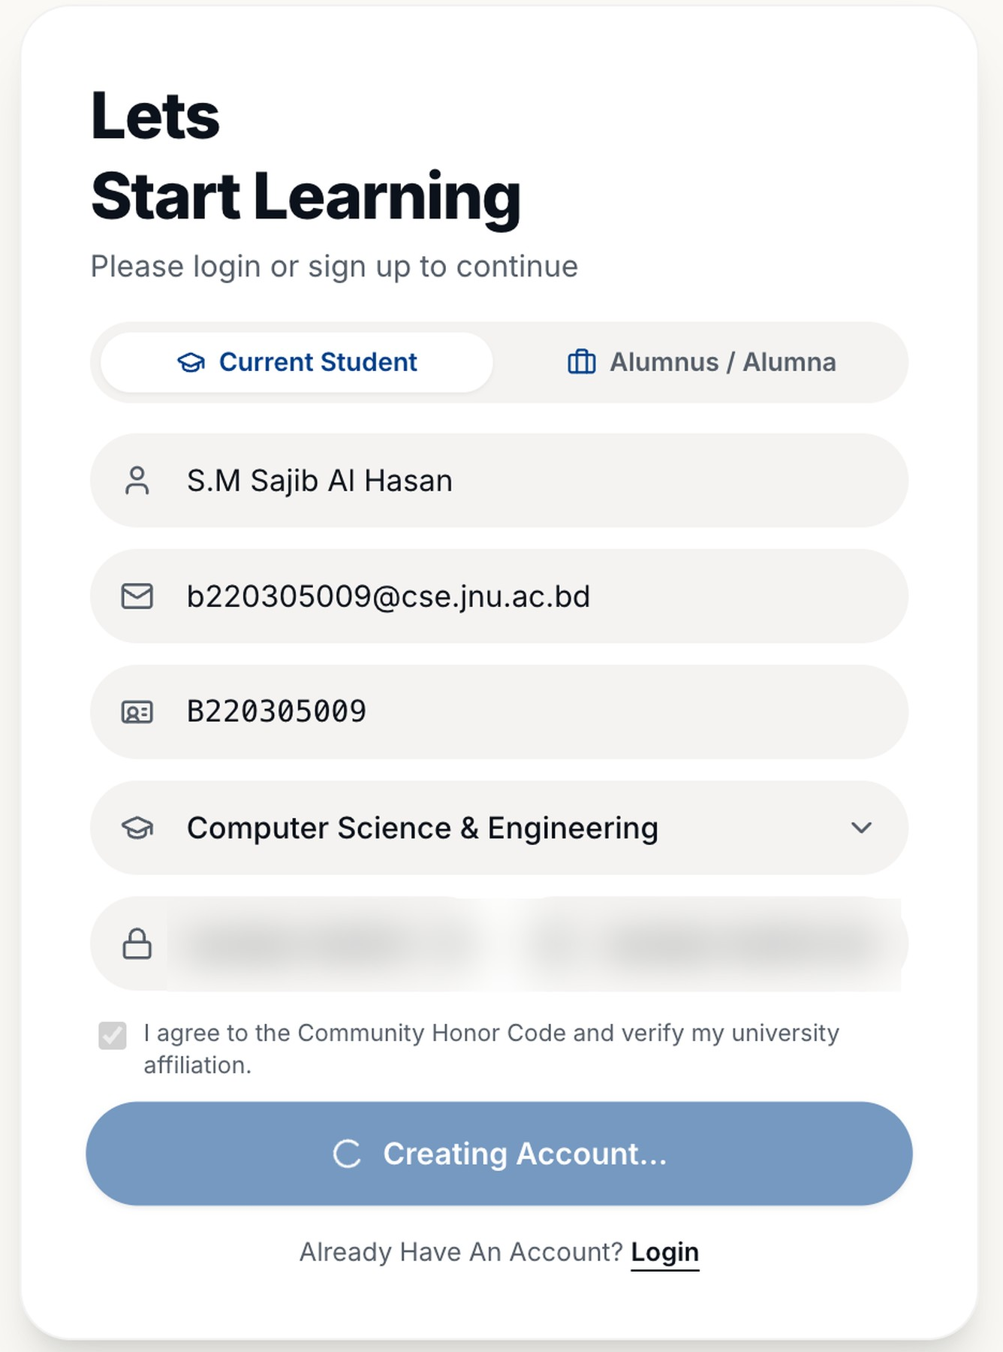
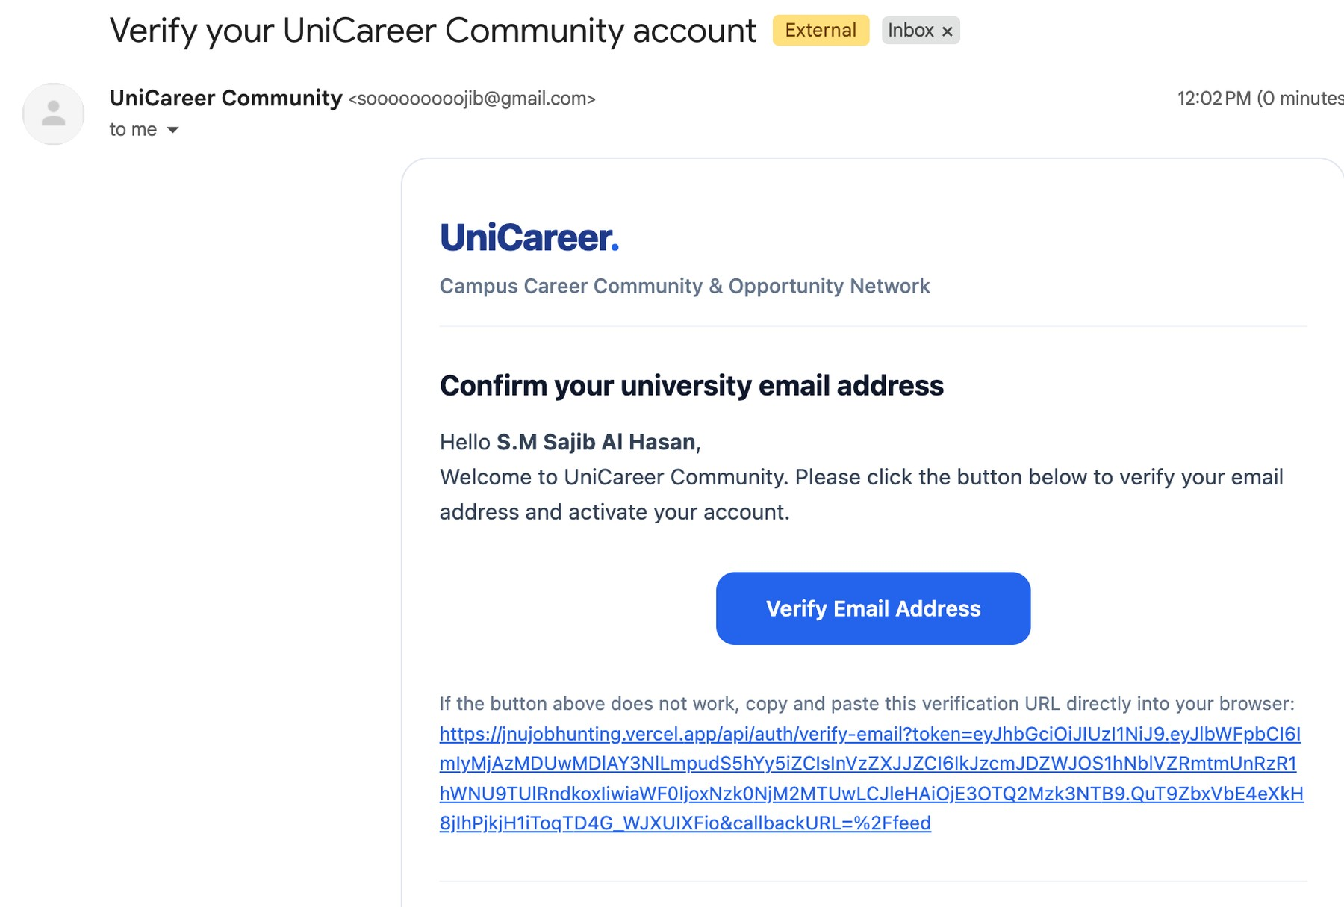
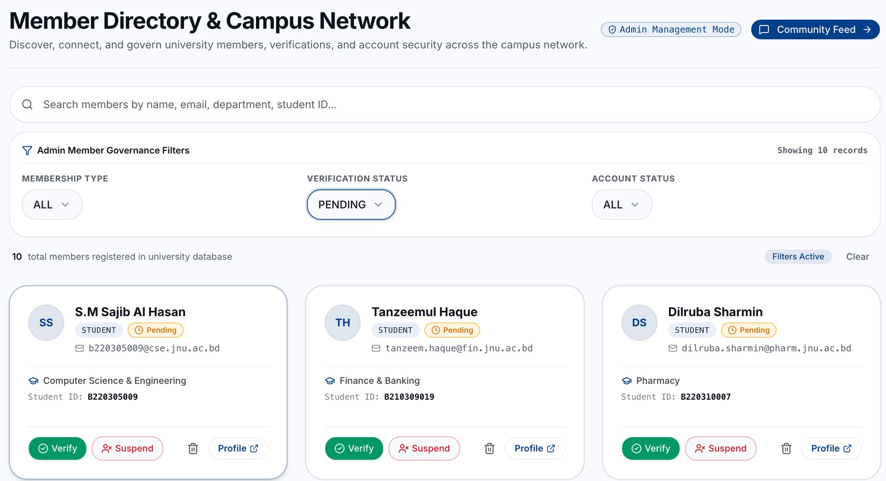
Create your account
Joining
What you enter
Then
What you get
You do: fill the form, then click the email link
You get: a request waiting for admin approval
Notes:
Screens: (1) /register — 'Let's Start Learning': choose Current Student or Alumnus / Alumna, enter name, university email, University/Student ID, department and a strong password, then 'Create Account'. The app then opens /verify-email ('Verify Your Email', with 'Resend Verification Link'). (2) The real email sent through Gmail SMTP: subject 'Verify your UniCareer Community account', heading 'Confirm your university email address'. Clicking the link confirms the email and shows 'What happens next' with 'Return to Sign In'; the user is NOT logged in (autoSignInAfterVerification: false). (3) At sign-up, /api/auth/register-details saves the locked ID and department. Only when the email link is clicked does Better Auth's afterEmailVerification hook create the PENDING membership request. The admin then sees the new member as 'Pending' in Member Network ('Member Directory & Campus Network', Admin Management Mode, Verification Status filter = PENDING) with Verify, Suspend, Delete and Profile buttons. The same request also appears in Admin Command → Verification Requests. Note: the password fields in screenshot 1 are blurred on purpose.

Slide 2
Create your account
Joining
What you enter
Then
What you get
You do: fill the form, then click the email link
You get: a request waiting for admin approval
Notes:
Zoomed view: Sign-up form. Click to continue.
Screens: (1) /register — 'Let's Start Learning': choose Current Student or Alumnus / Alumna, enter name, university email, University/Student ID, department and a strong password, then 'Create Account'. The app then opens /verify-email ('Verify Your Email', with 'Resend Verification Link'). (2) The real email sent through Gmail SMTP: subject 'Verify your UniCareer Community account', heading 'Confirm your university email address'. Clicking the link confirms the email and shows 'What happens next' with 'Return to Sign In'; the user is NOT logged in (autoSignInAfterVerification: false). (3) At sign-up, /api/auth/register-details saves the locked ID and department. Only when the email link is clicked does Better Auth's afterEmailVerification hook create the PENDING membership request. The admin then sees the new member as 'Pending' in Member Network ('Member Directory & Campus Network', Admin Management Mode, Verification Status filter = PENDING) with Verify, Suspend, Delete and Profile buttons. The same request also appears in Admin Command → Verification Requests. Note: the password fields in screenshot 1 are blurred on purpose.

Slide 3
Create your account
Joining
What you enter
Then
What you get
You do: fill the form, then click the email link
You get: a request waiting for admin approval
Notes:
Zoomed view: Verification email. Click to continue.
Screens: (1) /register — 'Let's Start Learning': choose Current Student or Alumnus / Alumna, enter name, university email, University/Student ID, department and a strong password, then 'Create Account'. The app then opens /verify-email ('Verify Your Email', with 'Resend Verification Link'). (2) The real email sent through Gmail SMTP: subject 'Verify your UniCareer Community account', heading 'Confirm your university email address'. Clicking the link confirms the email and shows 'What happens next' with 'Return to Sign In'; the user is NOT logged in (autoSignInAfterVerification: false). (3) At sign-up, /api/auth/register-details saves the locked ID and department. Only when the email link is clicked does Better Auth's afterEmailVerification hook create the PENDING membership request. The admin then sees the new member as 'Pending' in Member Network ('Member Directory & Campus Network', Admin Management Mode, Verification Status filter = PENDING) with Verify, Suspend, Delete and Profile buttons. The same request also appears in Admin Command → Verification Requests. Note: the password fields in screenshot 1 are blurred on purpose.

Slide 4
Create your account
Joining
What you enter
Then
What you get
You do: fill the form, then click the email link
You get: a request waiting for admin approval
Notes:
Zoomed view: Pending in admin's Member Network. Click to continue.
Screens: (1) /register — 'Let's Start Learning': choose Current Student or Alumnus / Alumna, enter name, university email, University/Student ID, department and a strong password, then 'Create Account'. The app then opens /verify-email ('Verify Your Email', with 'Resend Verification Link'). (2) The real email sent through Gmail SMTP: subject 'Verify your UniCareer Community account', heading 'Confirm your university email address'. Clicking the link confirms the email and shows 'What happens next' with 'Return to Sign In'; the user is NOT logged in (autoSignInAfterVerification: false). (3) At sign-up, /api/auth/register-details saves the locked ID and department. Only when the email link is clicked does Better Auth's afterEmailVerification hook create the PENDING membership request. The admin then sees the new member as 'Pending' in Member Network ('Member Directory & Campus Network', Admin Management Mode, Verification Status filter = PENDING) with Verify, Suspend, Delete and Profile buttons. The same request also appears in Admin Command → Verification Requests. Note: the password fields in screenshot 1 are blurred on purpose.

Slide 5
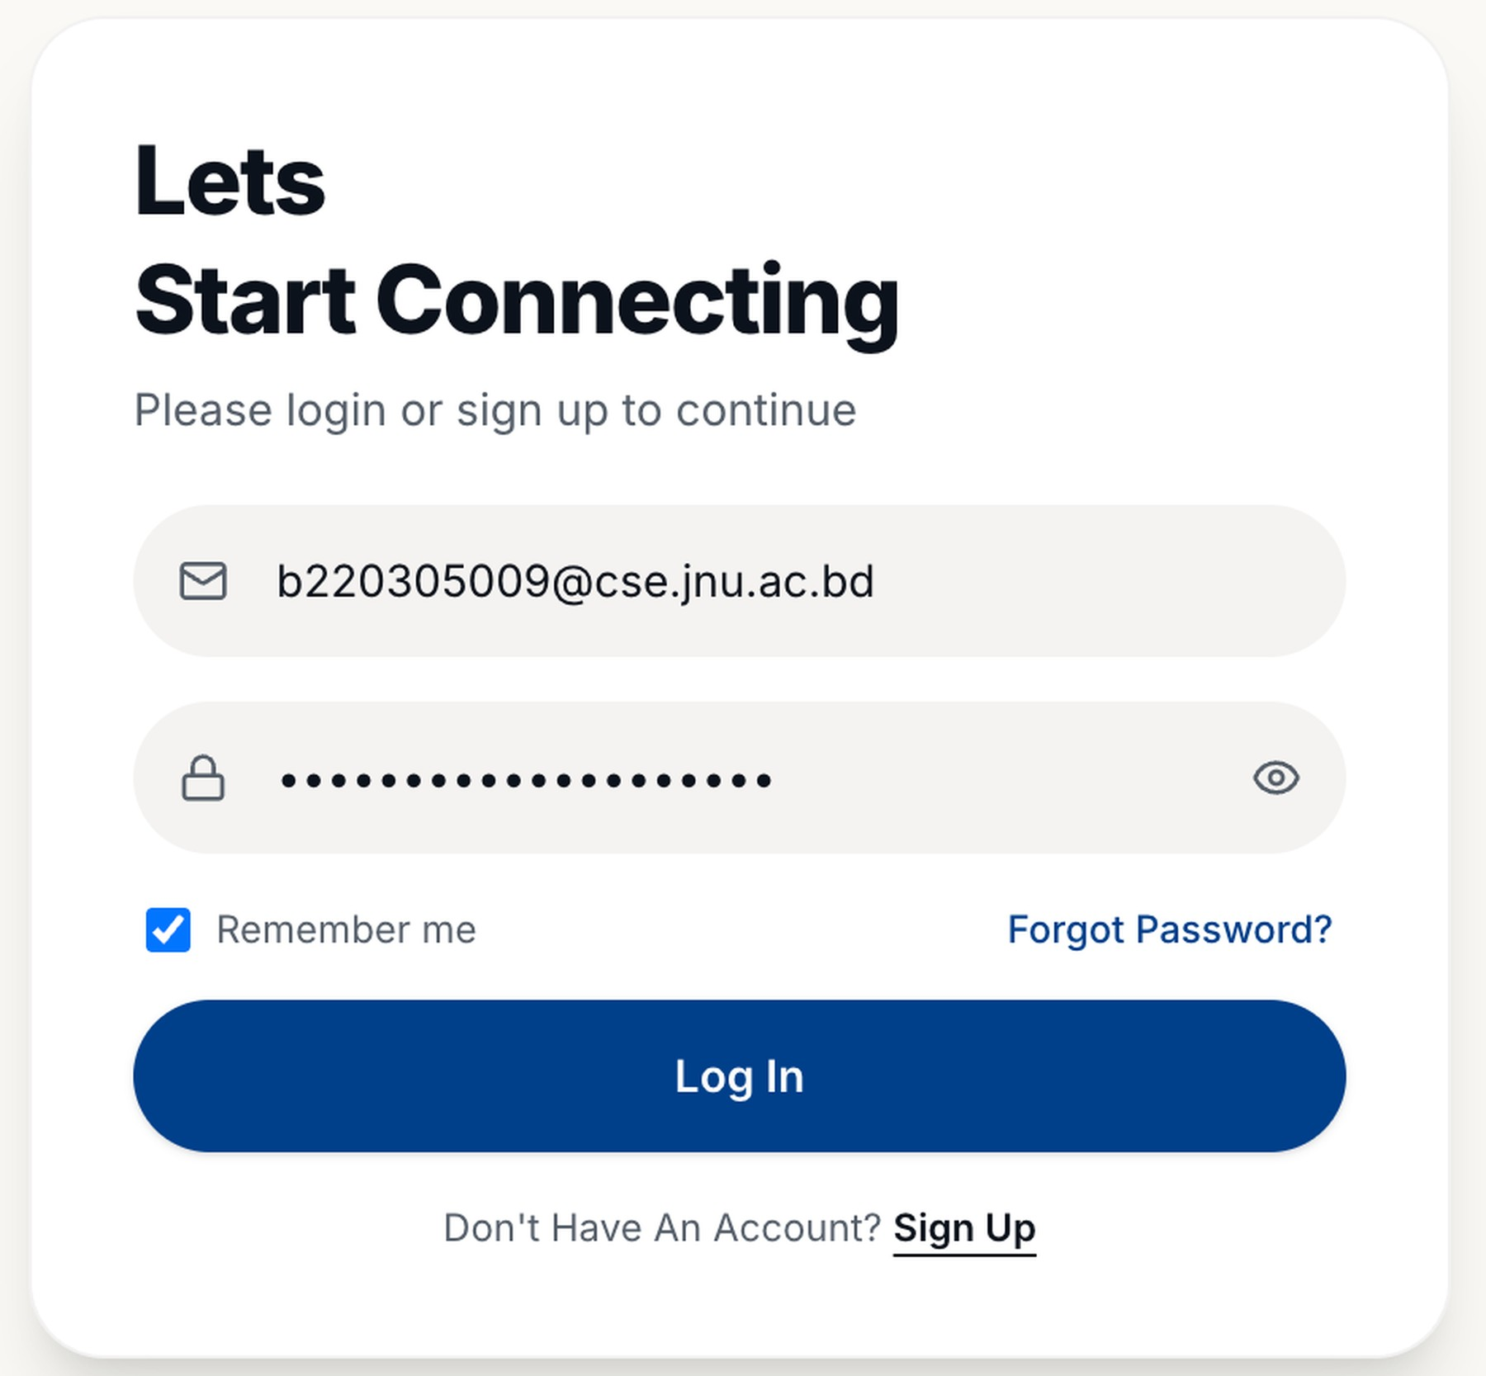
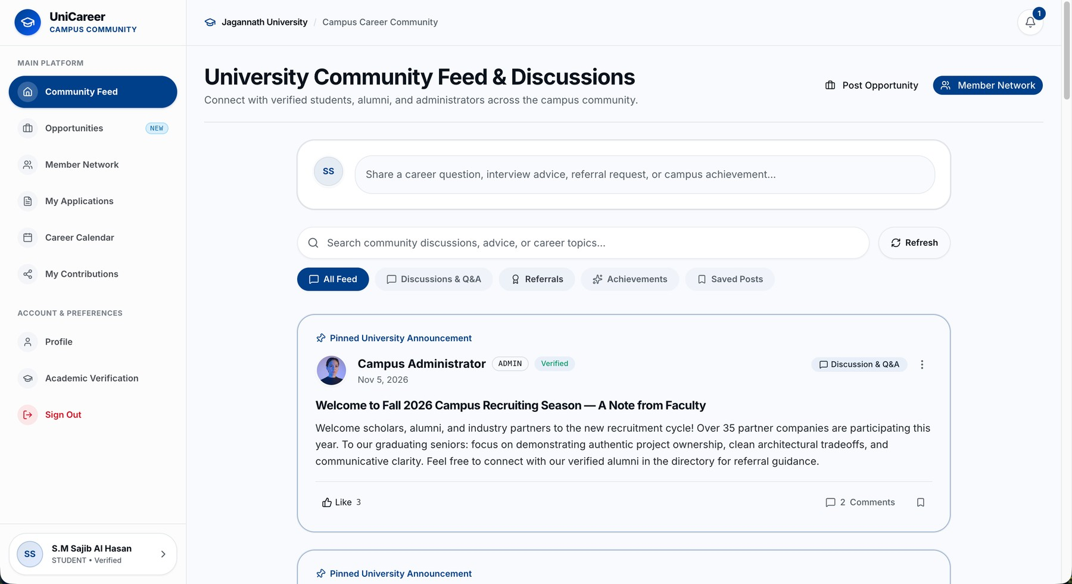
Log in to your dashboard
Joining
What you enter
What you get
You do: log in after the approval email
You get: your home feed: jobs, people, posts
Notes:
Screens: (1) /login — 'Let's Start Connecting': Email and Your Password fields, 'Remember me', and 'Check Status & Resend Verification Link'. Login works only after the admin approves: before the email is confirmed it is refused (EMAIL_NOT_VERIFIED, HTTP 403); after confirming but before approval the page shows 'Awaiting Administrator Approval' and every member page redirects back to /login?error=pending_admin_approval. (2) After login the app goes to /feed (the /dashboard route also redirects there) — 'Community Feed & Discussions' with shortcuts to Browse Opportunities, Member Network and Post Opportunity.

Slide 6
Log in to your dashboard
Joining
What you enter
What you get
You do: log in after the approval email
You get: your home feed: jobs, people, posts
Notes:
Zoomed view: Login page. Click to continue.
Screens: (1) /login — 'Let's Start Connecting': Email and Your Password fields, 'Remember me', and 'Check Status & Resend Verification Link'. Login works only after the admin approves: before the email is confirmed it is refused (EMAIL_NOT_VERIFIED, HTTP 403); after confirming but before approval the page shows 'Awaiting Administrator Approval' and every member page redirects back to /login?error=pending_admin_approval. (2) After login the app goes to /feed (the /dashboard route also redirects there) — 'Community Feed & Discussions' with shortcuts to Browse Opportunities, Member Network and Post Opportunity.

Slide 7
Log in to your dashboard
Joining
What you enter
What you get
You do: log in after the approval email
You get: your home feed: jobs, people, posts
Notes:
Zoomed view: Dashboard: community feed. Click to continue.
Screens: (1) /login — 'Let's Start Connecting': Email and Your Password fields, 'Remember me', and 'Check Status & Resend Verification Link'. Login works only after the admin approves: before the email is confirmed it is refused (EMAIL_NOT_VERIFIED, HTTP 403); after confirming but before approval the page shows 'Awaiting Administrator Approval' and every member page redirects back to /login?error=pending_admin_approval. (2) After login the app goes to /feed (the /dashboard route also redirects there) — 'Community Feed & Discussions' with shortcuts to Browse Opportunities, Member Network and Post Opportunity.

Slide 8
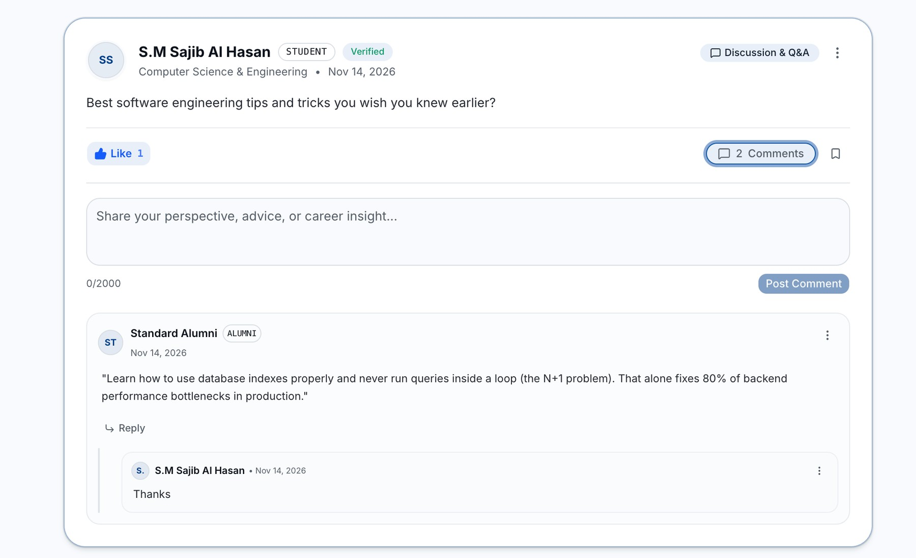
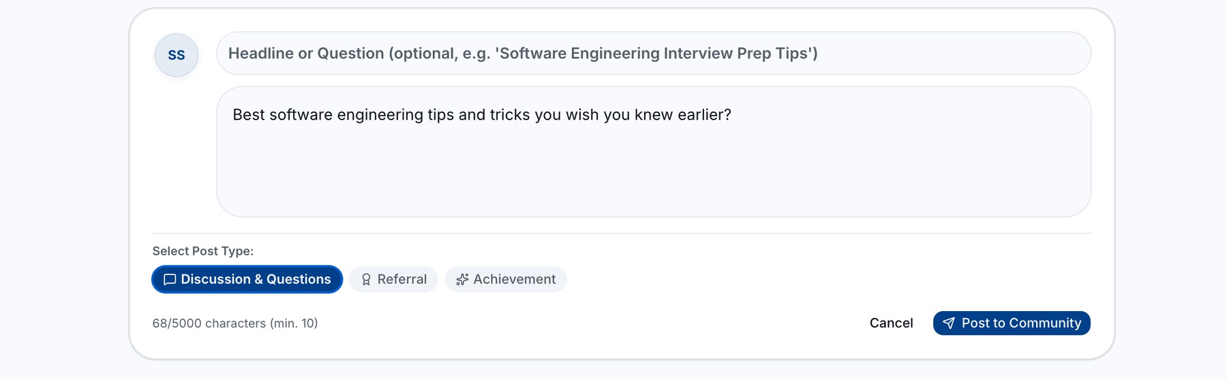
Share in the community feed
Community
What you get
What you enter
You do: a discussion, referral or achievement
You get: likes, comments and replies
Notes:
Screens: (1) The post box on /feed — optional 'Headline or Question', the message, 'Select Post Type': Discussion & Questions, Referral or Achievement; 10 to 5,000 characters ('68/5000 characters (min. 10)'); 'Cancel' or 'Post to Community'. (2) The published post with the author's role badge (STUDENT, Verified), department and date, the post type tag, 'Like' with a counter, comments, and the save (bookmark) button. Comments allow up to 2,000 characters ('Post Comment') and replies are threaded under the comment (here an alumnus answers and the student replies). The menu (three dots) lets members report a post or comment. Feed tabs: All Feed, Discussions & Q&A, Referrals, Achievements, Saved Posts.

Slide 9
Share in the community feed
Community
What you get
What you enter
You do: a discussion, referral or achievement
You get: likes, comments and replies
Notes:
Zoomed view: Write a post. Click to continue.
Screens: (1) The post box on /feed — optional 'Headline or Question', the message, 'Select Post Type': Discussion & Questions, Referral or Achievement; 10 to 5,000 characters ('68/5000 characters (min. 10)'); 'Cancel' or 'Post to Community'. (2) The published post with the author's role badge (STUDENT, Verified), department and date, the post type tag, 'Like' with a counter, comments, and the save (bookmark) button. Comments allow up to 2,000 characters ('Post Comment') and replies are threaded under the comment (here an alumnus answers and the student replies). The menu (three dots) lets members report a post or comment. Feed tabs: All Feed, Discussions & Q&A, Referrals, Achievements, Saved Posts.

Slide 10
Share in the community feed
Community
What you get
What you enter
You do: a discussion, referral or achievement
You get: likes, comments and replies
Notes:
Zoomed view: Post with likes and comments. Click to continue.
Screens: (1) The post box on /feed — optional 'Headline or Question', the message, 'Select Post Type': Discussion & Questions, Referral or Achievement; 10 to 5,000 characters ('68/5000 characters (min. 10)'); 'Cancel' or 'Post to Community'. (2) The published post with the author's role badge (STUDENT, Verified), department and date, the post type tag, 'Like' with a counter, comments, and the save (bookmark) button. Comments allow up to 2,000 characters ('Post Comment') and replies are threaded under the comment (here an alumnus answers and the student replies). The menu (three dots) lets members report a post or comment. Feed tabs: All Feed, Discussions & Q&A, Referrals, Achievements, Saved Posts.

Slide 11
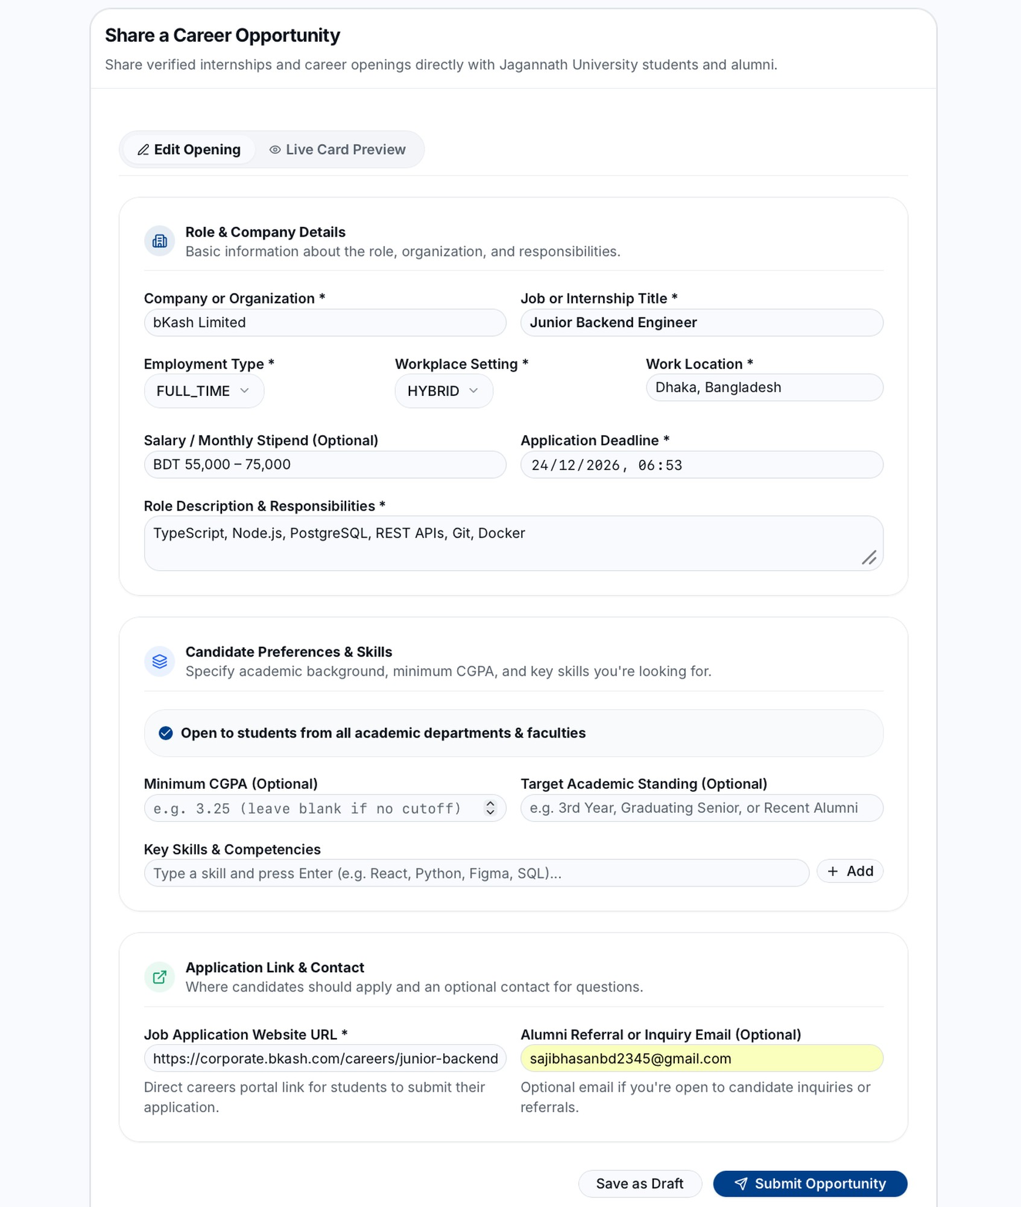
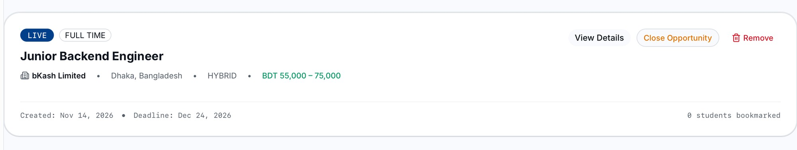
Share a job
Jobs
What you enter
What you get
You do: the job, deadline and company link
You get: a live post you can close or remove
Notes:
Screens: (1) /opportunities/post — 'Share a Career Opportunity' with tabs 'Edit Opening' and 'Live Card Preview'. Role & Company Details: company, job title, employment type, workplace setting, location, optional salary, application deadline, role description. Candidate Preferences & Skills: open to all departments, optional minimum CGPA, target academic standing, key skills. Application Link & Contact: the official job application URL (required) and an optional alumni referral/inquiry email. Buttons: 'Save as Draft' and 'Submit Opportunity'. (2) /opportunities/my — the post shows LIVE right away, with type, company, location, workplace, salary, created date, deadline and how many students bookmarked it; actions 'View Details', 'Close Opportunity' and 'Remove'. Only verified students and alumni can post (canPostOpportunity); admins can close misleading posts.

Slide 12
Share a job
Jobs
What you enter
What you get
You do: the job, deadline and company link
You get: a live post you can close or remove
Notes:
Zoomed view: Share a Career Opportunity form. Click to continue.
Screens: (1) /opportunities/post — 'Share a Career Opportunity' with tabs 'Edit Opening' and 'Live Card Preview'. Role & Company Details: company, job title, employment type, workplace setting, location, optional salary, application deadline, role description. Candidate Preferences & Skills: open to all departments, optional minimum CGPA, target academic standing, key skills. Application Link & Contact: the official job application URL (required) and an optional alumni referral/inquiry email. Buttons: 'Save as Draft' and 'Submit Opportunity'. (2) /opportunities/my — the post shows LIVE right away, with type, company, location, workplace, salary, created date, deadline and how many students bookmarked it; actions 'View Details', 'Close Opportunity' and 'Remove'. Only verified students and alumni can post (canPostOpportunity); admins can close misleading posts.

Slide 13
Share a job
Jobs
What you enter
What you get
You do: the job, deadline and company link
You get: a live post you can close or remove
Notes:
Zoomed view: Your live job post. Click to continue.
Screens: (1) /opportunities/post — 'Share a Career Opportunity' with tabs 'Edit Opening' and 'Live Card Preview'. Role & Company Details: company, job title, employment type, workplace setting, location, optional salary, application deadline, role description. Candidate Preferences & Skills: open to all departments, optional minimum CGPA, target academic standing, key skills. Application Link & Contact: the official job application URL (required) and an optional alumni referral/inquiry email. Buttons: 'Save as Draft' and 'Submit Opportunity'. (2) /opportunities/my — the post shows LIVE right away, with type, company, location, workplace, salary, created date, deadline and how many students bookmarked it; actions 'View Details', 'Close Opportunity' and 'Remove'. Only verified students and alumni can post (canPostOpportunity); admins can close misleading posts.

Slide 14
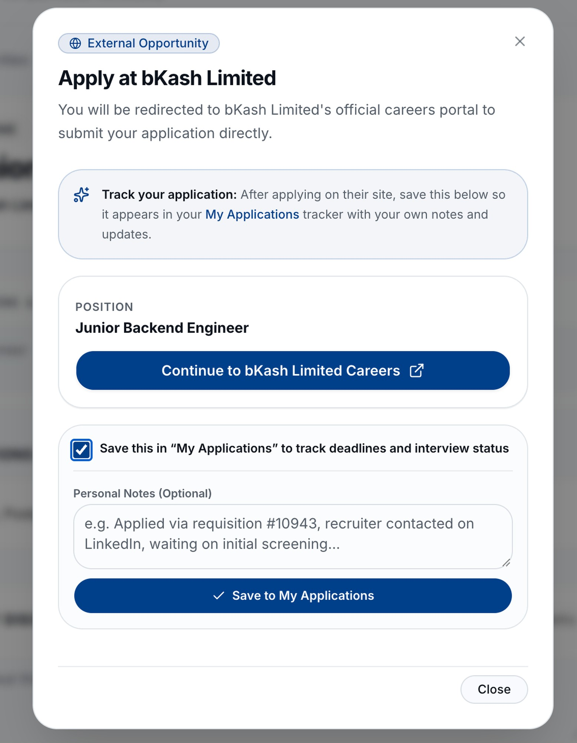
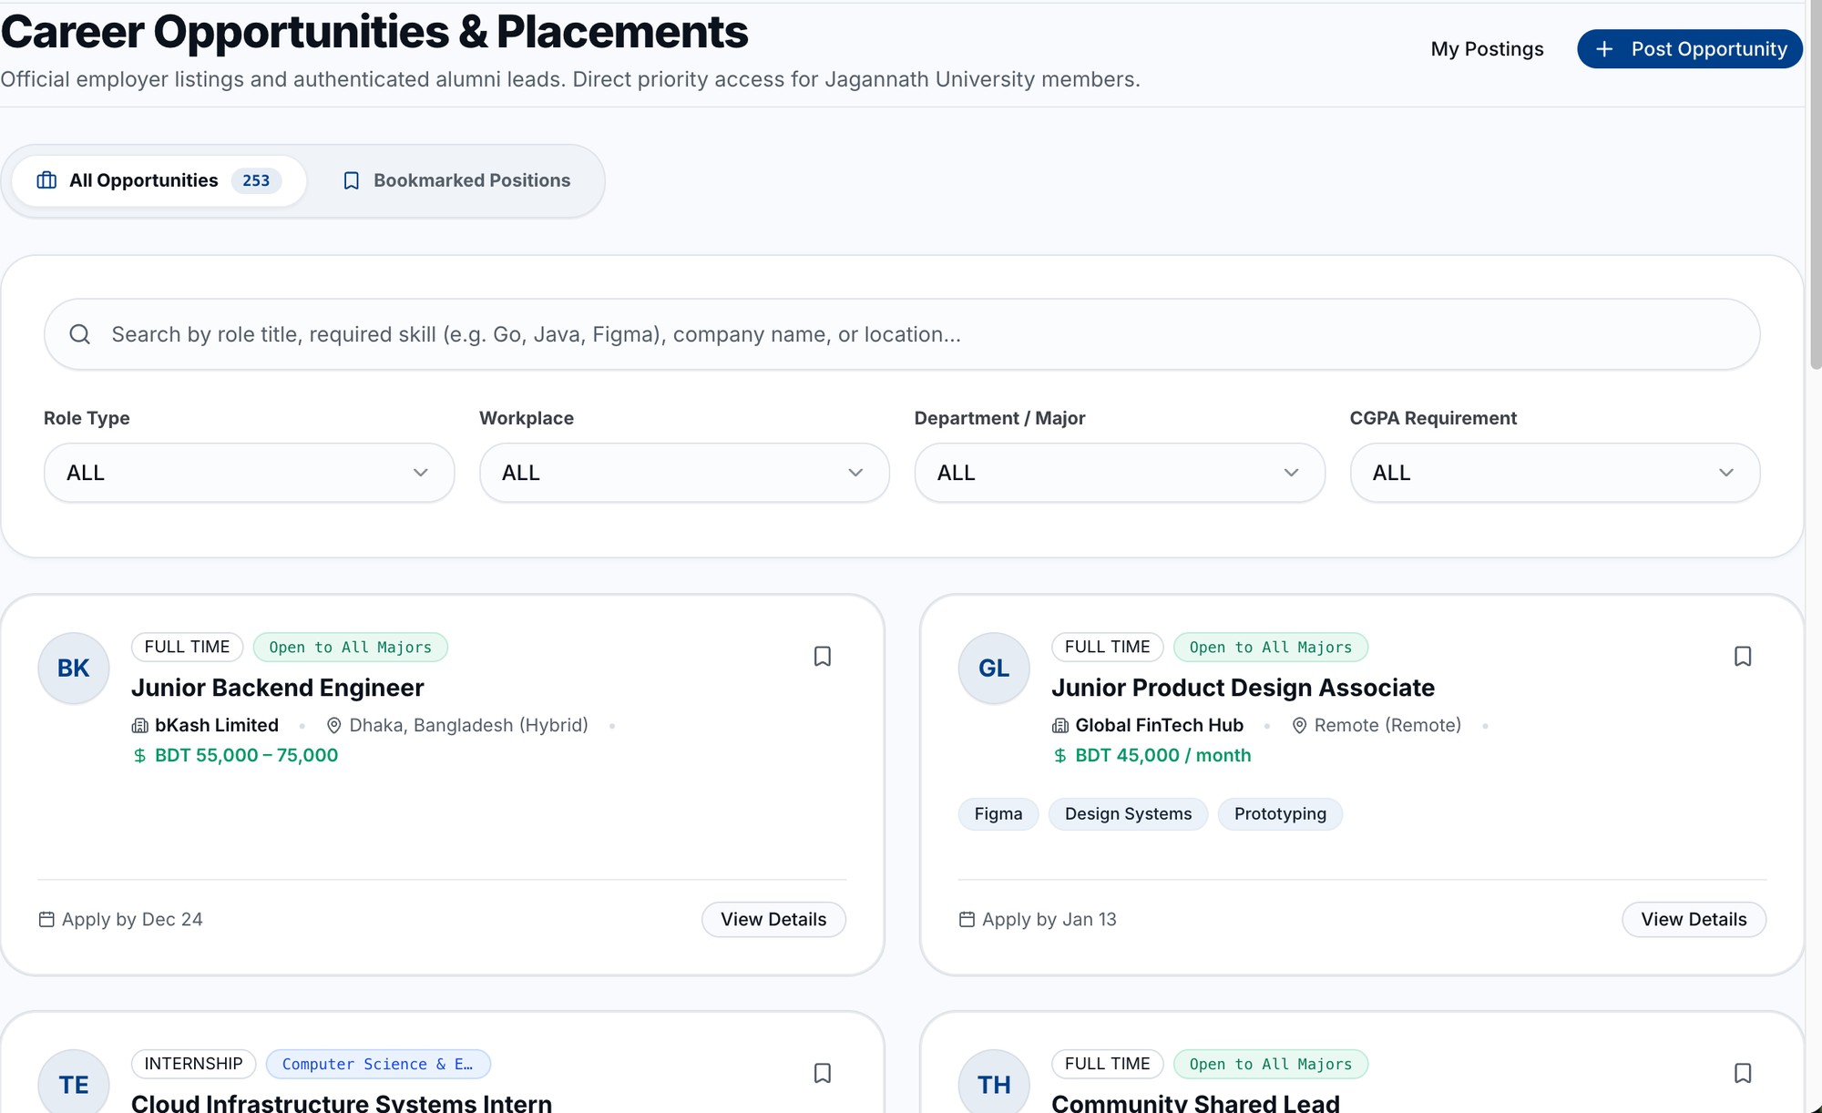
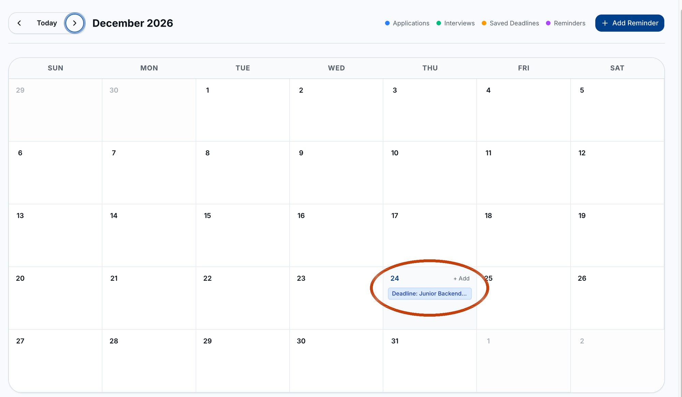
Find, apply and track
Jobs
Then
What you enter
What you get
You do: search, apply, then save it
You get: the deadline on your calendar
Notes:
Screens: (1) /opportunities — 'Career Opportunities & Placements' with tabs 'All Opportunities' and 'Bookmarked Positions', a search box (role, skill, company or location) and filters Role Type, Workplace, Department / Major and CGPA Requirement. Each card shows type, 'Open to All Majors' or a department, company, location, salary, skills, 'Apply by' date, a bookmark button and 'View Details'. (2) 'External Opportunity — Apply at bKash Limited': 'Continue to bKash Limited Careers' opens the company's own site; tick 'Save this in My Applications', add optional notes, then 'Save to My Applications'. One record per job (unique opportunityId + applicantId); at most 30 per hour. (3) /calendar — the saved job's deadline appears on 24 December (circled). Legend: Applications, Interviews, Saved Deadlines, Reminders; 'Add Reminder'. The reminder job also alerts you when a saved or applied job closes within 72 hours.

Slide 15
Find, apply and track
Jobs
Then
What you enter
What you get
You do: search, apply, then save it
You get: the deadline on your calendar
Notes:
Zoomed view: Find a job. Click to continue.
Screens: (1) /opportunities — 'Career Opportunities & Placements' with tabs 'All Opportunities' and 'Bookmarked Positions', a search box (role, skill, company or location) and filters Role Type, Workplace, Department / Major and CGPA Requirement. Each card shows type, 'Open to All Majors' or a department, company, location, salary, skills, 'Apply by' date, a bookmark button and 'View Details'. (2) 'External Opportunity — Apply at bKash Limited': 'Continue to bKash Limited Careers' opens the company's own site; tick 'Save this in My Applications', add optional notes, then 'Save to My Applications'. One record per job (unique opportunityId + applicantId); at most 30 per hour. (3) /calendar — the saved job's deadline appears on 24 December (circled). Legend: Applications, Interviews, Saved Deadlines, Reminders; 'Add Reminder'. The reminder job also alerts you when a saved or applied job closes within 72 hours.

Slide 16
Find, apply and track
Jobs
Then
What you enter
What you get
You do: search, apply, then save it
You get: the deadline on your calendar
Notes:
Zoomed view: Apply on the company site. Click to continue.
Screens: (1) /opportunities — 'Career Opportunities & Placements' with tabs 'All Opportunities' and 'Bookmarked Positions', a search box (role, skill, company or location) and filters Role Type, Workplace, Department / Major and CGPA Requirement. Each card shows type, 'Open to All Majors' or a department, company, location, salary, skills, 'Apply by' date, a bookmark button and 'View Details'. (2) 'External Opportunity — Apply at bKash Limited': 'Continue to bKash Limited Careers' opens the company's own site; tick 'Save this in My Applications', add optional notes, then 'Save to My Applications'. One record per job (unique opportunityId + applicantId); at most 30 per hour. (3) /calendar — the saved job's deadline appears on 24 December (circled). Legend: Applications, Interviews, Saved Deadlines, Reminders; 'Add Reminder'. The reminder job also alerts you when a saved or applied job closes within 72 hours.

Slide 17
Find, apply and track
Jobs
Then
What you enter
What you get
You do: search, apply, then save it
You get: the deadline on your calendar
Notes:
Zoomed view: Deadline on your calendar. Click to continue.
Screens: (1) /opportunities — 'Career Opportunities & Placements' with tabs 'All Opportunities' and 'Bookmarked Positions', a search box (role, skill, company or location) and filters Role Type, Workplace, Department / Major and CGPA Requirement. Each card shows type, 'Open to All Majors' or a department, company, location, salary, skills, 'Apply by' date, a bookmark button and 'View Details'. (2) 'External Opportunity — Apply at bKash Limited': 'Continue to bKash Limited Careers' opens the company's own site; tick 'Save this in My Applications', add optional notes, then 'Save to My Applications'. One record per job (unique opportunityId + applicantId); at most 30 per hour. (3) /calendar — the saved job's deadline appears on 24 December (circled). Legend: Applications, Interviews, Saved Deadlines, Reminders; 'Add Reminder'. The reminder job also alerts you when a saved or applied job closes within 72 hours.

Slide 18
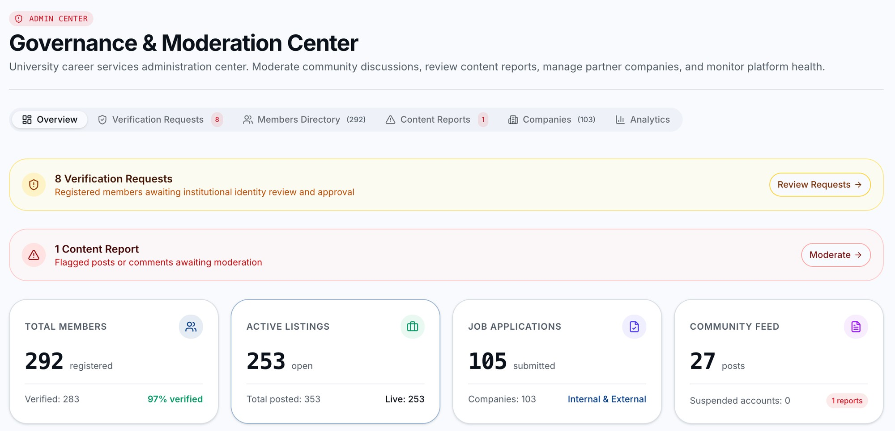
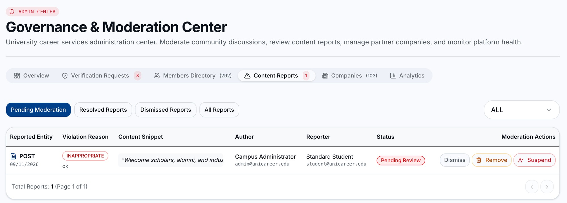
Admin: keep it safe
Admin
What you enter
What you get
You do: check the numbers, act on reports
You get: a safe site, every step logged
Notes:
Screens: (1) Admin Command → 'Governance & Moderation Center', Overview tab. Alert cards: '8 Verification Requests' (Review Requests) and '1 Content Report' (Moderate). Live counts from the database: Total Members 292 (283 verified, 97%), Active Listings 253 (353 posted in total), Job Applications 105, Community Feed 27 posts, 0 suspended accounts. Other tabs: Verification Requests, Members Directory, Content Reports, Companies, Analytics. (2) Content Reports tab — filters Pending Moderation, Resolved, Dismissed, All. Each report shows what was reported (post or comment), the reason (e.g. INAPPROPRIATE), a snippet, author, reporter and status, with actions Dismiss, Remove and Suspend. A post with 3 or more reports is flagged automatically. Every admin action is written to the audit log; admins can't suspend themselves.

Slide 19
Admin: keep it safe
Admin
What you enter
What you get
You do: check the numbers, act on reports
You get: a safe site, every step logged
Notes:
Zoomed view: Admin Center overview. Click to continue.
Screens: (1) Admin Command → 'Governance & Moderation Center', Overview tab. Alert cards: '8 Verification Requests' (Review Requests) and '1 Content Report' (Moderate). Live counts from the database: Total Members 292 (283 verified, 97%), Active Listings 253 (353 posted in total), Job Applications 105, Community Feed 27 posts, 0 suspended accounts. Other tabs: Verification Requests, Members Directory, Content Reports, Companies, Analytics. (2) Content Reports tab — filters Pending Moderation, Resolved, Dismissed, All. Each report shows what was reported (post or comment), the reason (e.g. INAPPROPRIATE), a snippet, author, reporter and status, with actions Dismiss, Remove and Suspend. A post with 3 or more reports is flagged automatically. Every admin action is written to the audit log; admins can't suspend themselves.

Slide 20
Admin: keep it safe
Admin
What you enter
What you get
You do: check the numbers, act on reports
You get: a safe site, every step logged
Notes:
Zoomed view: Content reports. Click to continue.
Screens: (1) Admin Command → 'Governance & Moderation Center', Overview tab. Alert cards: '8 Verification Requests' (Review Requests) and '1 Content Report' (Moderate). Live counts from the database: Total Members 292 (283 verified, 97%), Active Listings 253 (353 posted in total), Job Applications 105, Community Feed 27 posts, 0 suspended accounts. Other tabs: Verification Requests, Members Directory, Content Reports, Companies, Analytics. (2) Content Reports tab — filters Pending Moderation, Resolved, Dismissed, All. Each report shows what was reported (post or comment), the reason (e.g. INAPPROPRIATE), a snippet, author, reporter and status, with actions Dismiss, Remove and Suspend. A post with 3 or more reports is flagged automatically. Every admin action is written to the audit log; admins can't suspend themselves.

