Slide 1
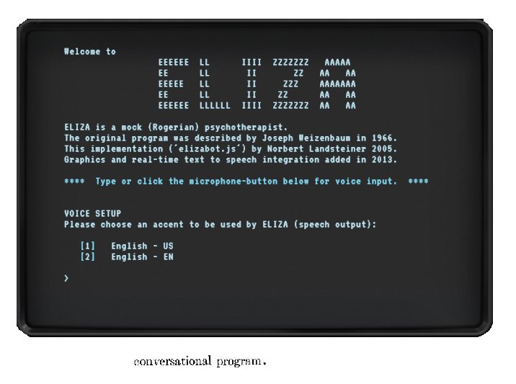
bevel
title
my prompt text
>_ and input box, accent color
ASCII
zork

