Slide 1
CS 544: Shift-Reduce Parsing
Ulf Hermjakob
USC Information Sciences Institute
ulf@isi.edu
February 9, 2010

Slide 2
What is Parsing?
Syntactic analysis of text to determine the grammatical structure
with respect to a grammar formalism.
Input: a tokenized sentence of phrase such as “ I bought a book . ”
Output: often a parse tree such as
S
NP
VP
.
PRP
VBD
NP
DT
NN
I
bought
a
book

Slide 3
What is Parsing?
Syntactic analysis of text to determine its grammatical structure
with respect to a grammar formalism.
Input: a tokenized sentence of phrase such as “ I bought a book . ”
Output: often a parse tree such as
S
Grammar formalism includes information on
Tagset
e.g. PRP for personal pronoun
Bracketing guidelines
e.g. VP covers verb, objects, ...
Level of annotation
e.g. head of phrase,
roles of arguments
NP
VP
.
PRP
VBD
NP
DT
NN
I
bought
a
book

Slide 4
Applications of Parsing
and the practical challenges they impose on parsing
  Question answering
    Question: Who is the leader of France?
    Text: Henri Hadjenberg, who is the leader of France’s Jewish community, endorsed confronting the ...
    Bush met with French President Nicolas Sarkozy.
  Machine translation
  Language training
  ...

Slide 5
Types of Parsers
Types of output
  Parse trees (or parse forests), Dependency structures

Slide 6
Types of Parsers
Types of output
  Parse trees (or parse forests), Dependency structures
S
NP
John
VP
NP
John
VB
loves
NP
Mary
VB
loves
NP
Mary
S
NP
John
VB
loves
NP
Mary

Slide 7
Types of Parsers
Types of output
  Parse trees (or parse forests), Dependency structures
Provenance of rules
  Hand-built; Empirical, incl. Statistical
Direction
  Top-down, Bottom-up
Context-free/Context-sensitive
Deterministic/Non-deterministic
Examples:
Shift-reduce parser, CKY, Chart parsers (e.g. Earley)

Slide 8
Overview of Shift-Reduce Parsing
Shift-reduce parser mechanism
  Basic operations; casting parsing as machine learning problem
  Original framework in NLP (Marcus 1980); CONTEX parser (Hermjakob 1997)
Resources
  Treebank, lexicon, ontology, subcategorization tables
Challenges of a deterministic parser
  Perils of “early” attachments, POS-tagging

Slide 9
General Idea
View parsing as a decision making problem
  How do we tag the word left?
  Where do we attach this prepositional phrase to New York?
  What is the proper antecedent for this pronoun?
Learn how to make these decisions from examples,
using machine learning techniques (decision trees).
Train a deterministic parser (non-statistical) using
  Examples derived from treebank
  Background knowledge
    Lexicon
    Ontology
    Subcategorization table
  Feature set (which describes the context)

Slide 10
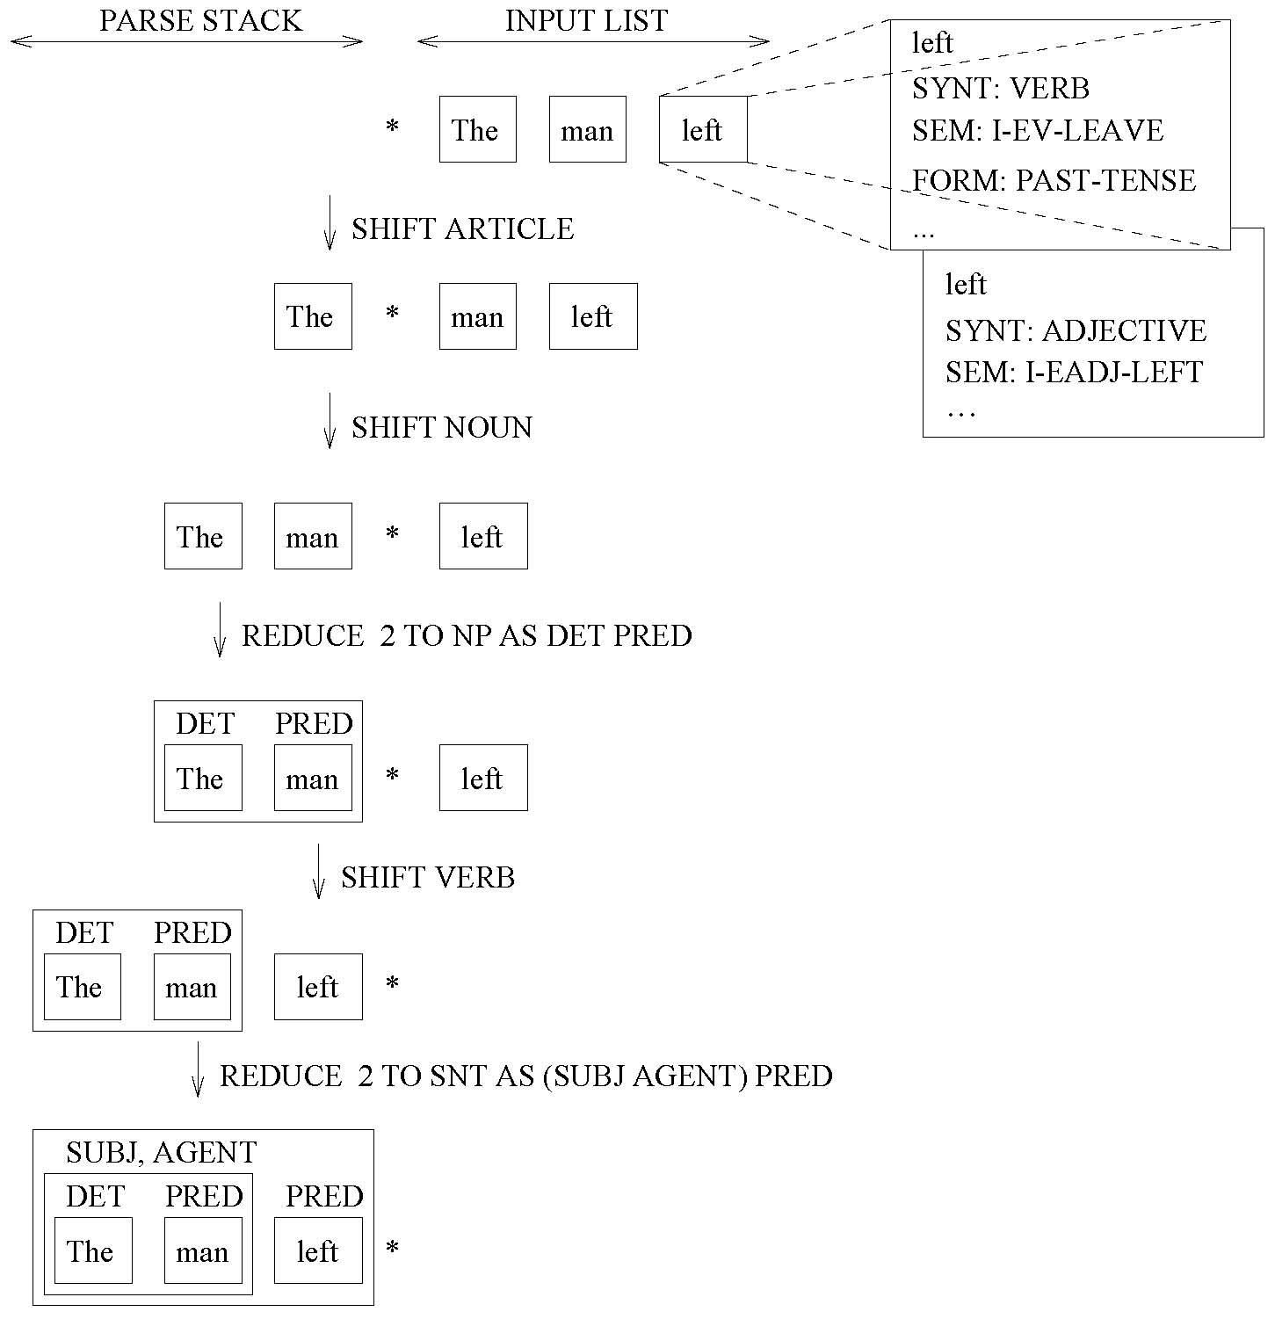
Example

Slide 11
Date Structure for Shift-Reduce Parsing
Input list
  Initialized with list of words of sentence to be parsed
  Gradually empties as items are shifted onto parse stack
  Empty after parsing is complete
Parse stack
  Stack of parse trees corresponding to (partially) parsed sentence chunks
  Top of stack (“right” end in diagram below) is “active” part of sentence
  Contains final parse tree after parsing is complete
PP
NP
On
Tuesday
my
ADJP
friend
*
bought
a
new
car
.
best
top
of stack
parse stack
input list

Slide 12
Shift-Reduce Operations
Two major types of operations:
SHIFT VERB
  Shifts element from input list onto stack
  Argument to specify part-of-speech (for possibly ambiguous word, e.g. left)
REDUCE 2 TO SNT AS (SUBJ AGENT) PRED
  Combines elements on the parse stack
  Arguments to specify number of elements, target POS, syntactic/semantic roles
Optional additional “minor” operations
  EMTPY-CAT, CO-INDEX, SPLIT, ADD-INTO, SHIFT-BACK, ...
Pseudo operation for “done/success” (and optionally failure)
  Typically done when input list empty and one element on stack with final syntactic category
Safe-guards against inapplicable operations, premature end, endless loops

Slide 13
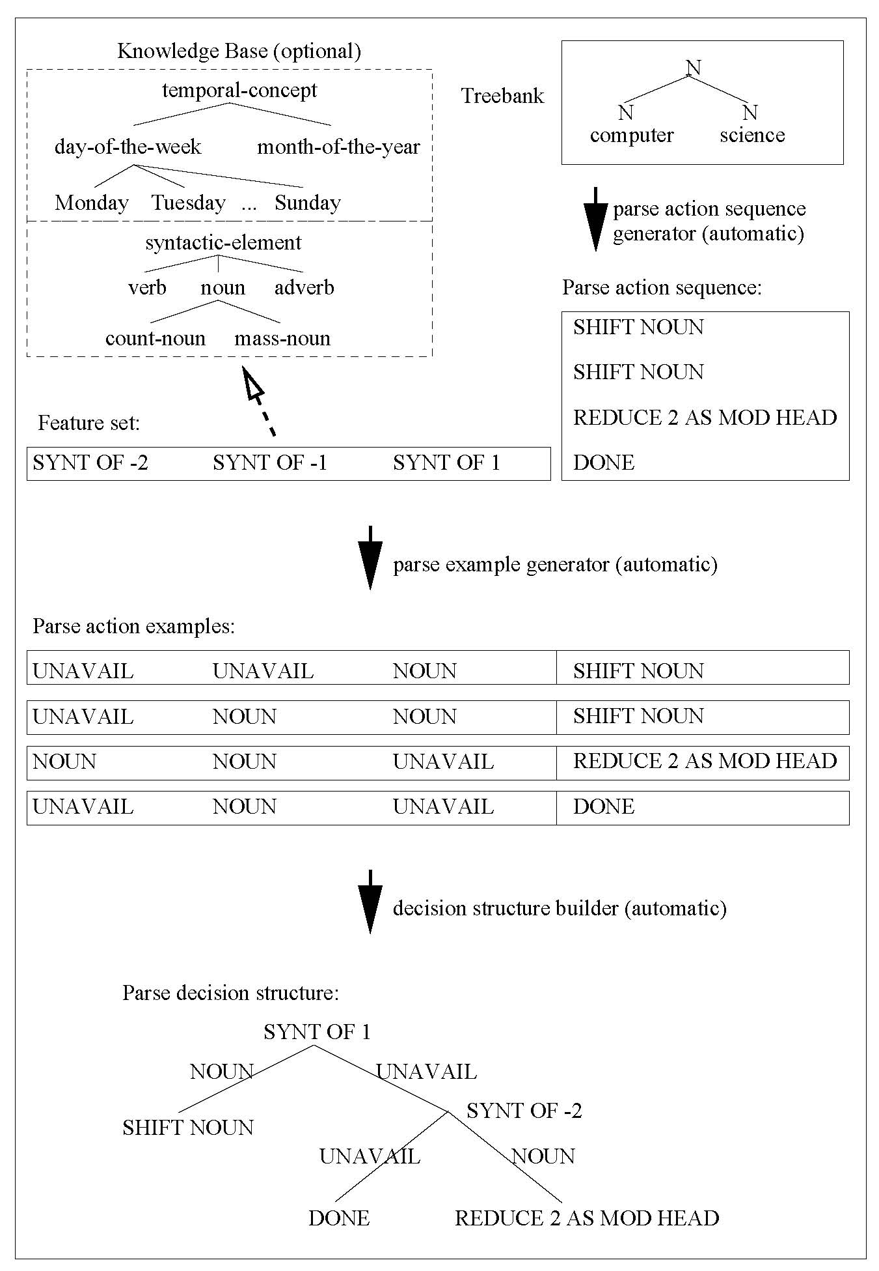
Flowchart

Slide 14
Parse Tree
The president has already been told that Osama bin Laden left Afghanistan at 3pm. [SNT]
forms: (PERF-TENSE 3RD-PERSON SINGULAR PASSIVE DECL) of `to tell'
(SUBJ LOG-OBJ) The president [NP,PERSON] forms: (3RD-PERSON SINGULAR) of `president'
(DET) The [DEF-ART]
(HEAD) president [COUNT-NOUN,PERSON]
(MOD) already [ADV]
(HEAD) has been told [VERB]
(AUX) has been [AUX]
(AUX) has [AUX]
(HEAD) been [AUX]
(HEAD) told [VERB]
(COMPL) that Osama bin Laden left Afghanistan at 3pm [SUB-CLAUSE]
(CONJ) that [SUBORD-CONJ]
(HEAD) Osama bin Laden left Afghanistan at 3pm [SNT] forms: (PAST-TENSE 3RD-PERSON SINGULAR DECL) of 'to leave'
(SUBJ) Osama bin Laden [NP,PERSON]
(HEAD) Osama bin Laden [PROPER-NAME,PERSON]
(MOD) Osama [PROPER-NAME]
(MOD) bin [PROPER-NAME]
(HEAD) Laden [PROPER-NAME]
(HEAD) left [VERB]
(OBJ) Afghanistan [NP,COUNTRY]
(HEAD) Afghanistan [PROPER-NAME,COUNTRY]
(TIME) at 3pm [PP,TIME]
(P) at [PREP]
(HEAD) 3pm [NP,TIME]
(HEAD) 3pm [NOUN,TIME]
(HEAD) 3 [CARDINAL]
(MOD) pm [ADV]
(DUMMY) . [PERIOD]

Slide 15
Parse Tree
The president has already been told that Osama bin Laden left Afghanistan at 3pm. [SNT]
forms: (PERF-TENSE 3RD-PERSON SINGULAR PASSIVE DECL) of `to tell'
(SUBJ LOG-OBJ) The president [NP,PERSON] forms: (3RD-PERSON SINGULAR) of `president'
(DET) The [DEF-ART]
(HEAD) president [COUNT-NOUN,PERSON]
(MOD) already [ADV]
(HEAD) has been told [VERB]
(AUX) has been [AUX]
(AUX) has [AUX]
(HEAD) been [AUX]
(HEAD) told [VERB]
(COMPL) that Osama bin Laden left Afghanistan at 3pm [SUB-CLAUSE]
(CONJ) that [SUBORD-CONJ]
(HEAD) Osama bin Laden left Afghanistan at 3pm [SNT] forms: (PAST-TENSE 3RD-PERSON SINGULAR DECL) of 'to leave'
(SUBJ) Osama bin Laden [NP,PERSON]
(HEAD) Osama bin Laden [PROPER-NAME,PERSON]
(MOD) Osama [PROPER-NAME]
(MOD) bin [PROPER-NAME]
(HEAD) Laden [PROPER-NAME]
(HEAD) left [VERB]
(OBJ) Afghanistan [NP,COUNTRY]
(HEAD) Afghanistan [PROPER-NAME,COUNTRY]
(TIME) at 3pm [PP,TIME]
(P) at [PREP]
(HEAD) 3pm [NP,TIME]
(HEAD) 3pm [NOUN,TIME]
(HEAD) 3 [CARDINAL]
(MOD) pm [ADV]
(DUMMY) . [PERIOD]

Slide 16
Background Knowledge
Monolingual lexicon (83,000+ entries for English)
entries include POS and link to semantic concept
Ontology (33,000+ concepts) for both semantic and syntactic concepts [Knight, Hovy, Whitney; Hermjakob, Gerber, Ticrea]
Subcategorization Table 12,298/53,703 English entries derived from Penn treebank
  The president will be sending two telegrams to Japan.
    SEND VERB CLAUSE 1
    immediate left arg: (SUBJ) - NP/PERSON 1
    immediate right arg: (OBJ) - NP/telegram 1
    other right arg: (DIR) to NP/COUNTRY 1
  John sent a letter to China.
Segmentation and Morphology Module
  Internal for English, German
  External for Japanese (Juman) and Korean (kma/ktag)

Slide 17
Features
To make good parse decisions,
A wide range of features (currently 390) are considered
Examples:
  Syntactic or semantic class
  Tense, number, voice, case of constituents
  Agreement between constituents
Some features and values for the partially parsed sentence
At various degree of abstraction:
  adjp, interr-adjp
  quantity, monetary-quantity
He (spent $150) * yesterday.
Feature stem | Value
syntactic class of item at position 1 | noun
semantic class of item at position 1 | relative-temporal-interval
semantic class of object of item at position -1 | monetary-quantity
tense of item at position -1 | past tense
np-vp agreement of items at position -2 and -1 | true
subcat affinity of 1 to -1 relative to -2 | positive

Slide 18
Flowchart
(duplicate)

Slide 19
Learning From Mistakes
Example: preposition vs. conjunction
(Feelings) (have overwhelmed) (the people) * since the Berlin Wall opening last Nov. 9.
(Feelings) (have overwhelmed) (the people) * since the Berlin Wall opened last Nov. 9.
(Feelings) (have overwhelmed) (the people) (since/PREP) (the Berlin Wall opened last Nov. 9/SNT) * .
Action: RETAG -2 TO SUBORD-CONJ
Example:
(John) (passed) (the exam) (his professor said) * .
Action: SHIFT -1
Key idea
Train parser on part of training data
Parse sentences from withheld training data
Allow mistake - look for correction opportunity – record
12% lower error rate through simple retagging, shift-back correction actions

Slide 20
Postponing Some Decisions
Postpone decisions until we can really make good ones.
Example
  John ate pasta * with a red sauce.
  John ate pasta * with a red fork.
  John ate pasta (with a red fork) * .
  John ate pasta * (with a red fork) .
  John (ate pasta) * (with a red fork) .
Prepositional phrase attachment
Late subject attachment
Avoid dangling right conjunctions (“research and”)
Use intermediary VP

Slide 21
Unknown Words
Tagging is naturally integrated into parsing
Key: do not use lexical info from parse-tree for initial POS alternatives
Example: ... found (an asbestos fiber) called * crocidolite(?) and ...
General tagging accuracy: 98.2%
  For unknown words: 95.0% (1% “harmful errors”)
Frequently used features:
  Capitalization
  POS of surrounding words/constituents
  Give-away word endings (“ized”, “ocracy”')

Slide 22
Parsing Results
For English (2001 results)
Trained on 5% of Penn Treebank
Number of training sentences | 2048
Labeled precision | 88.9%
Labeled recall | 89.8%
Tagging accuracy | 98.2%
Words/sentence | 24.8
Sent. with no crossings | 41.4%
Crossings per sentence | 1.6

Slide 23
CONTEX Parser Characteristics
Developed at UT Austin, USC/ISI
Machine-learning based
Deterministic (→ linear time complexity → fast) even though in Lisp
Parse trees have explicit roles for all constituents
Semantically motivated structure, heads
Separate syntactic categories from information such as tense
Group semantically related words, even if they are non-contiguous at surface level
Built-in treebanking mode

Slide 24
Upgrading the Parser for Question Answering
Treebanked 1153 question
  Highly crucial: Question parse tree accuracy
    Used to build Qtargets
    Often one question, but several answer candidates
  Problem: Questions severely underrepresented in Penn treebank (Wall Street Journal)
    Only 0.5% of sentences are questions, many rhetorical
    No questions starting with interrogatives When or How much
  Result of question treebanking
    Labeled precision: 84.6% → 95.4%
Identify target answer types (“qtargets”)
In-house preprocessor for dates, quantities, zip code, ...
Use BBN named entity tagger (Bikel '99) for
  person, location, organization
Post-BBN refinement
  location → proper-city, proper-country, proper-mountain, proper-island, proper-star-constellation, ...
  organization → government-agency, proper-company, proper-airline, proper-university, proper-sports-team, proper-american-football-sports-team, ...

Slide 25
Better matching with Semantic Trees
Question and answer in CONTEX format (top level):
[1] When was the Berlin Wall opened? [SNT,PAST,PASSIVE,WH-QUESTION]
(TIME) [2] When [INTERR-ADV]
(SUBJ LOG-OBJ) [3] the Berlin Wall [NP]
(PRED) [8] was opened [VERB,PAST,PASSIVE]
(DUMMY) [11] ? [QUESTION-MARK]
[12] On November 11, 1989, East Germany opened the Berlin Wall. [SNT,PAST]
(TIME) [13] On November 11, 1989, [PP,DATE-WITH-YEAR]
(SUBJ LOG-SUBJ) [14] East Germany [NP,PROPER-COUNTRY]
(PRED) [15] opened [VERB,PAST]
(OBJ LOG-OBJ) [16] the Berlin Wall [NP]
(DUMMY) [17] . [PERIOD]

Slide 26
For Comparison: Syntactic Trees
Same question and answer in Penn treebank format:
[18] When was the Berlin Wall opened? [SBARQ]
[19] When [WHADVP-1]
[20] was the Berlin Wall opened [SQ]
[21] was [VBD]
[22] the Berlin Wall [NP-SBJ-2]
[23] opened [VP]
[24] opened [VBN]
[25] -NONE- [NP]
[26] -NONE- [*-2]
[27] -NONE- [ADVP-TMP]
[28] -NONE- [*T*-1]
[29] ? [.]
[30] On November 11, 1989, East Germany opened the Berlin Wall. [S]
[31] On November 11, 1989, [PP-TMP]
[32] East Germany [NP-SBJ]
[33] opened the Berlin Wall [VP]
[34] opened [VBD]
[35] the Berlin Wall [NP]
[36] . [.]

Slide 27
Rapid Parser Building (Korean)
Given
  ISI's Contex parser, developed for English, Japanese
  Limited Korean resources (segmenter, morph. analyzer)
Technique: Machine Learning using new
  Treebank (1187 sentences from Chosun)
  Feature set (133 context features)
  Background knowledge (ontology with about 1000 entries)
Effort: 3 people, 9 person months (1 researcher, 2 Korean graduate students)
Output: Deterministic Korean parser with 89.8% recall and 91.0% precision

Slide 28
Applications at ISI
Machine Translation
  Pre-process source language text
  Parse target language text (to learn rules; to evaluate candidates)
  Word alignment (more on following slide)
Question Answering
  Who is the leader of France? Who was Vlad the Impaler?
  Determine question type and arguments
  Match question and answer candidates
    Henri Hadjenberg, who is the leader of France’s Jewish community, endorsed confronting the specter of the Vichy past. (NO MATCH!)
Tactical Language Training
  Computer program to teach foreign languages
  Iraqi Arabic, Pashto, French
  Now continued at spin-off company http://www.alelo.com
WordNet Extension Project
  Parse definition for subsequent rendering in logical form

Slide 29
Word Alignment: A Badly Aligned Verb
Ar: ... وتحدث العديد من الكمبوديين مع الممثل الخاص
Ar: spoke many from the·cambodians with the·representative the·special ...
En: many cambodians have told the special representative ...
Problem: Single-word Arabic verb in very different position.
Idea: Model sentence-initial verbs in Arabic using English parse trees.
Traditional treebank structure:
(NP many cambodians) (VP have (VP told (NP the special representative)))
NLP application-friendly structure:
(NP many cambodians) (V have told) (NP the special representative)
Reorder to mimic Arabic (one alternative):
(V have told) (NP many cambodians) (NP the representative special)

Slide 30
Alignment of Prepositions: 2 Styles
Ar: مدينة زامبوانغا
Ar: city Zamboanga
En: the city of Zamboanga
Ar: ويستطيعون الدفاع عن انفسهم
Ar: and·capable defending on themselves
En: and capable of defending themselves
Experimental result: MT-style alignment produces better MT.
Gold standard/syntax-style MT-style Both

Slide 31
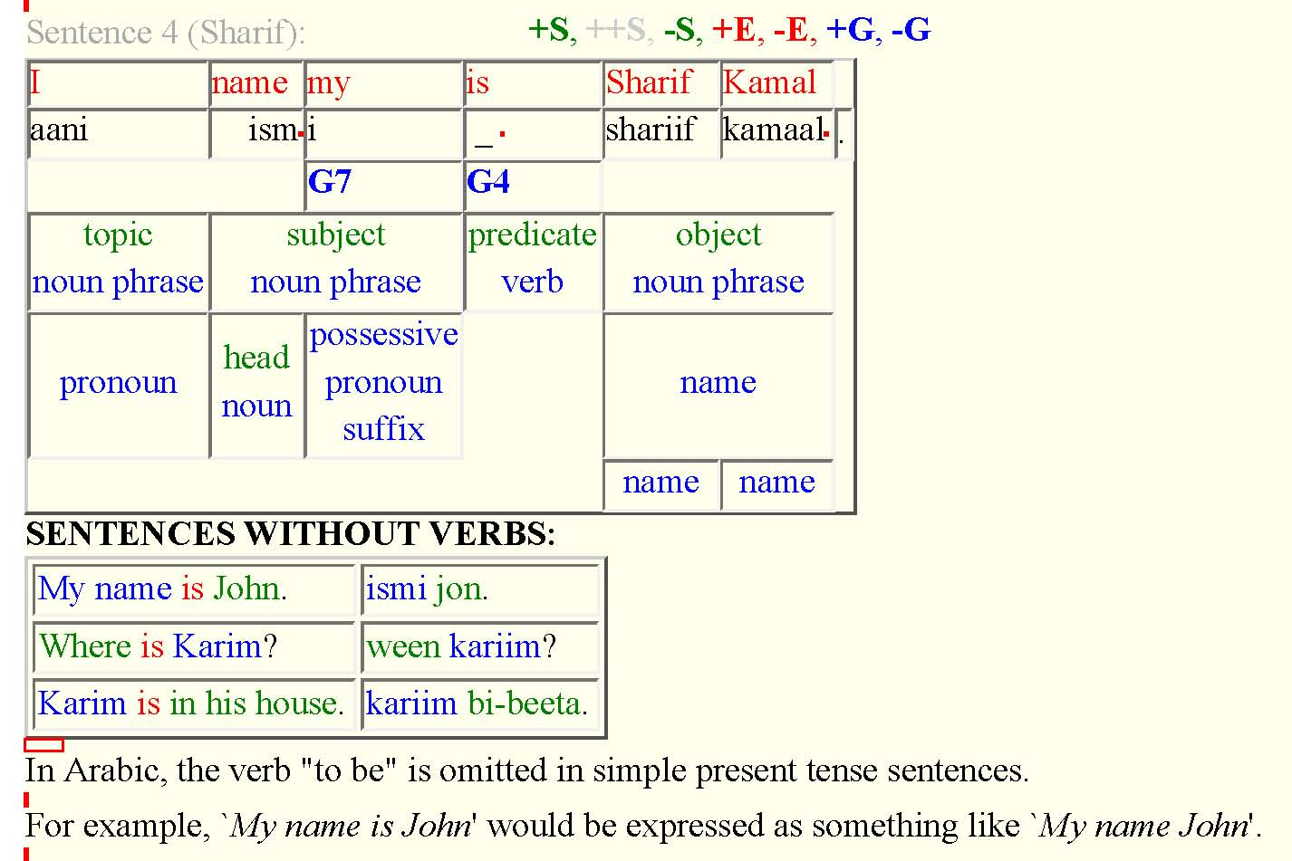
Tactical Language Web Wizard

