Slide 1
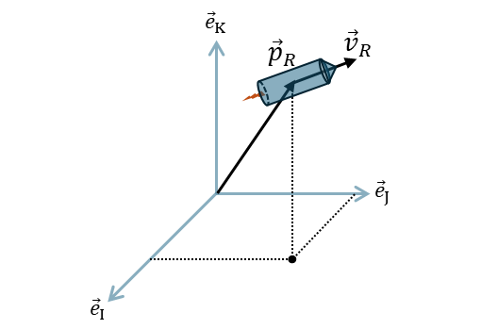
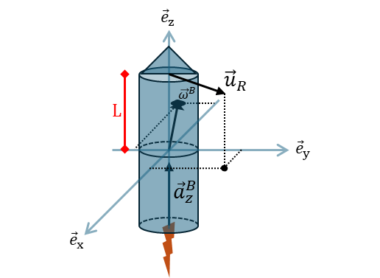












$${\vec{e}}_{K}$$
$${\vec{v}}_{R}$$
$${\vec{e}}_{z}$$
$${\vec{p}}_{R}$$
$${\vec{u}}_{R}$$
$$L$$
$${\vec{ω}}^{B}$$
$${\vec{e}}_{J}$$
$${\vec{e}}_{y}$$
$${\vec{a}}_{z}^{B}$$
$${\vec{e}}_{I}$$
$${\vec{e}}_{x}$$

Slide 3
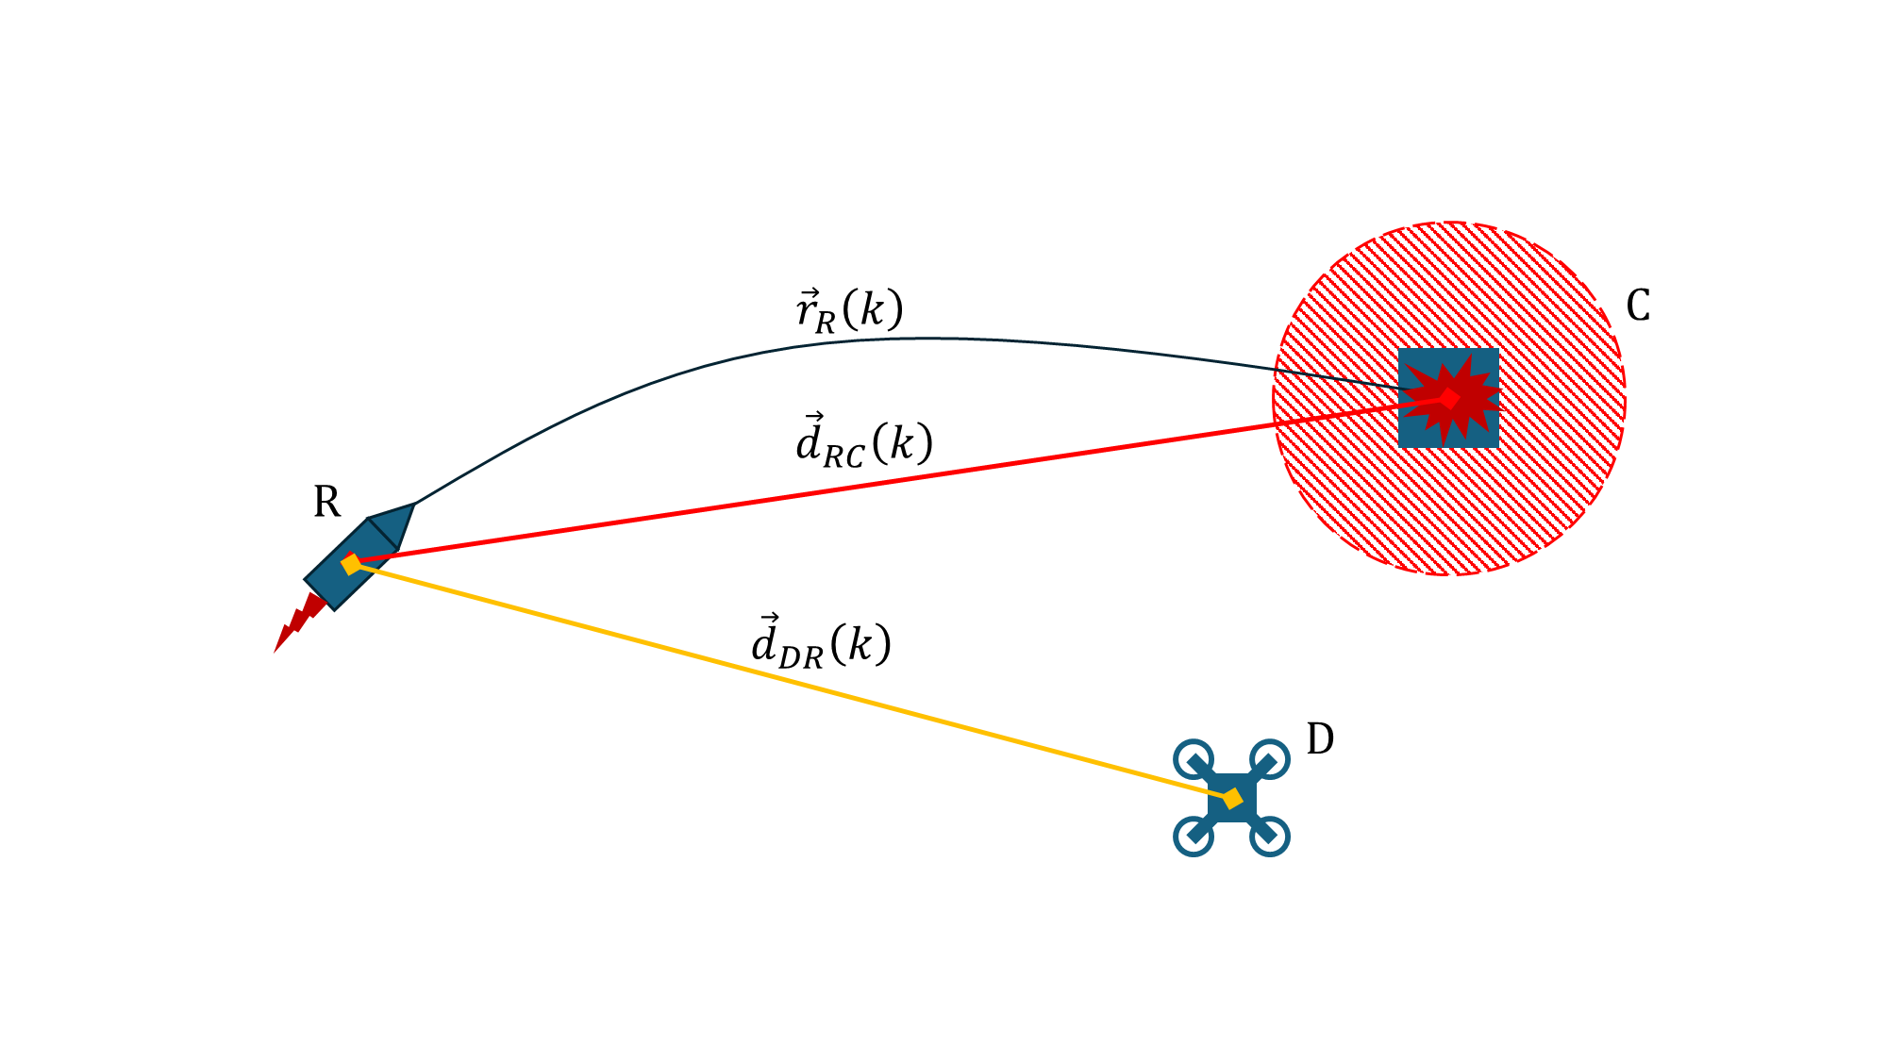



$${\vec{r}}_{R}\left(k\right)$$
C
$${\vec{d}}_{RC}\left(k\right)$$
R
$${\vec{d}}_{DR}\left(k\right)$$
D

Slide 4
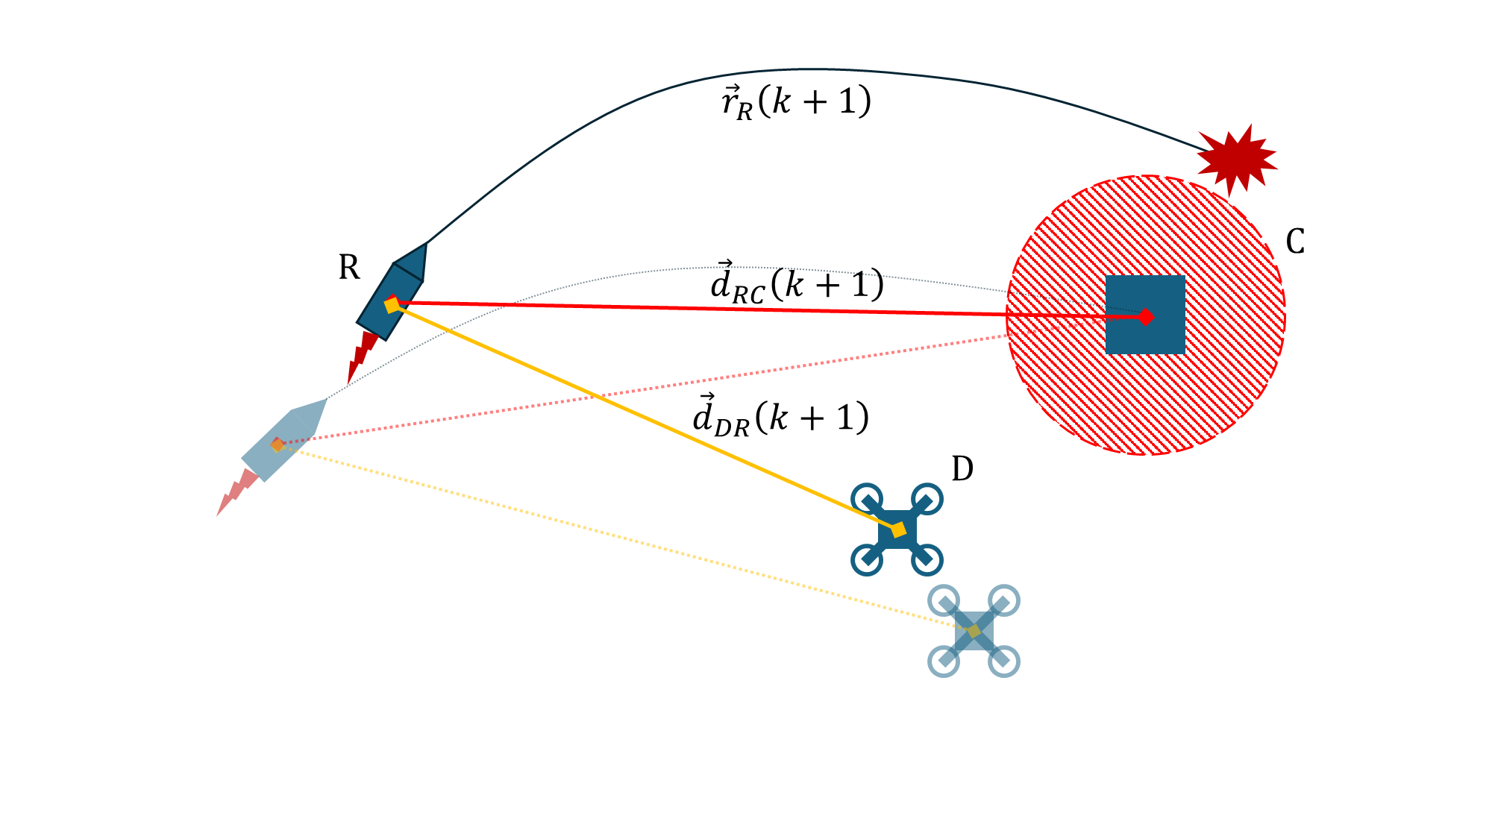



$${\vec{r}}_{R}\left(k+1\right)$$
R
$${\vec{d}}_{RC}\left(k+1\right)$$
C
$${\vec{d}}_{DR}\left(k+1\right)$$
D

Slide 5
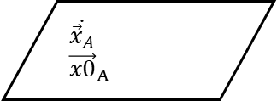
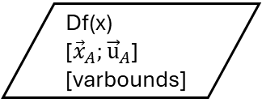
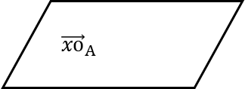
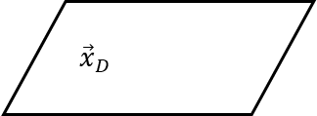
calcAlpha0
$$\dot{{\vec{x}}_{A}}$$
$${\vec{x0}}_{A}$$
${\vec{x}}_{D}$
trajectory
${\vec{xo}}_{A}$
Df(x)
[${\vec{x}}_{A};{\vec{u}}_{A}$]
[varbounds]
initRangeStruct
R_strct
Propagate Parametope

