Slide 1
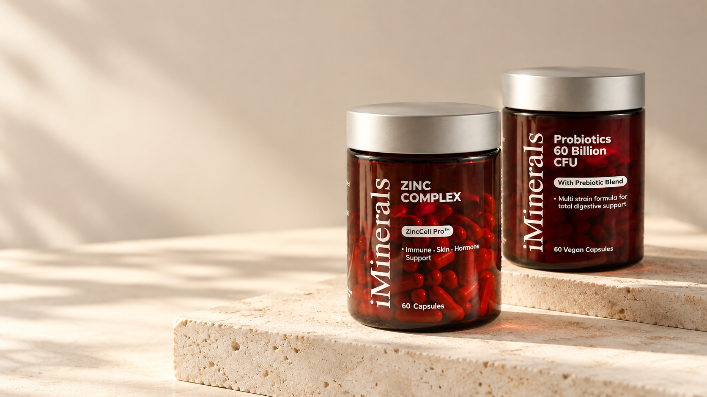
BRAND IDENTITY / PACKAGING / ART DIRECTION
iMinerals
Everyday wellness,
clearly expressed.
A branding case study by Sooraj Somarajan
Notes:
Original brand and packaging references supplied by the designer: zinc.png and Frame 23.png. Cover scene is a newly created AI concept mockup based on those references. Presentation narrative is drafted from the supplied design work, not from documented research or performance data.

Slide 2
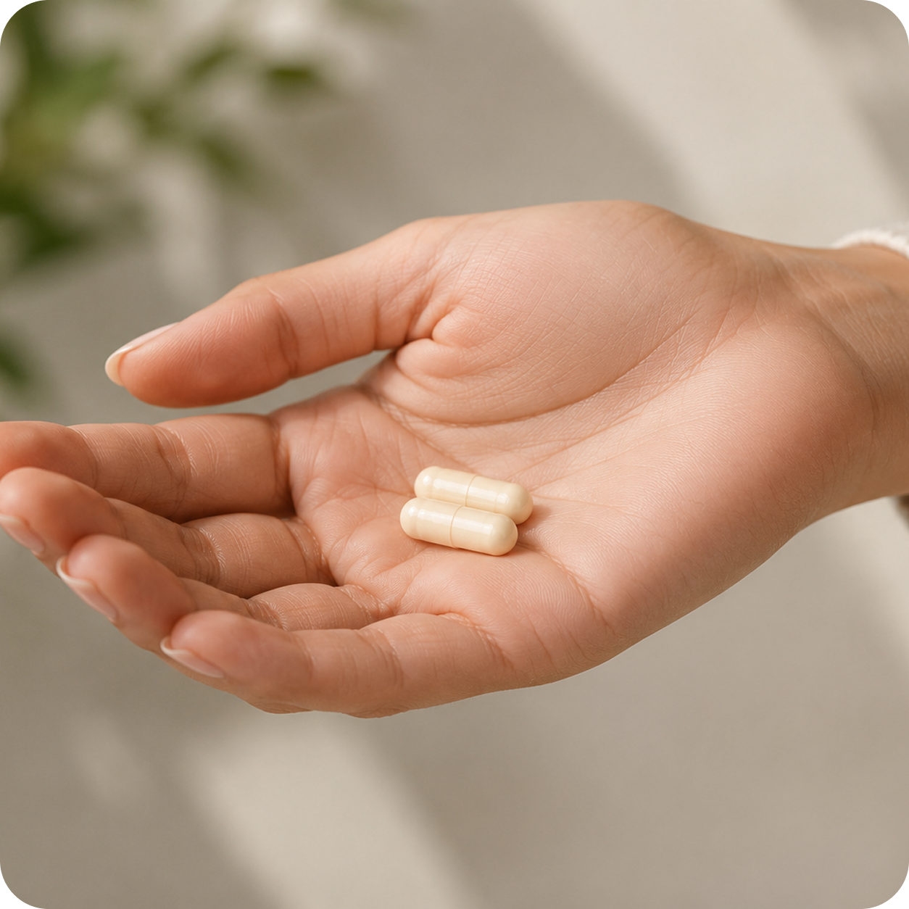
THE DESIGN CHALLENGE
02
Make the range
feel clear.
Make the brand
feel human.
The design problem
Communicate a supplement range with warmth and clarity, while giving every product a recognizable place within one brand.
SOORAJ SOMARAJAN / BRAND IDENTITY & PACKAGING
Notes:
Design problem is a portfolio framing inferred from the supplied artwork. No interviews, market research, client brief, medical outcomes, or usability findings were supplied. Source visual: Frame 24.png.

Slide 3
THE DESIGN RESPONSE
03
A warm identity.
A clear system.
01
02
03
Recognizable
Readable
Approachable
Deep burgundy and a prominent wordmark create a consistent visual signature.
A clear type hierarchy separates the brand, product name, and supporting information.
Natural light, tactile surfaces, and everyday imagery soften the product presentation.
Notes:
Interpretive description of visible design choices in zinc.png, Frame 23.png, Frame 24.png, and iminerals.pdf. These are design intentions rather than tested effects.

Slide 4
COLOUR DIRECTION
04
Warmth. Contrast. Clarity.
A presentation palette drawn from the supplied artwork.
Burgundy
Warm ivory
Silver
Ink
#600707
#F5F0E6
#BDBBB6
#211C19
Notes:
Hex colours are proposed presentation tokens sampled/visually interpreted from the provided artwork, not verified official brand specifications. Burgundy, warm ivory, silver, and ink reflect the supplied scenes and packaging.

Slide 5
TYPOGRAPHY & HIERARCHY
05
Character meets clarity.
Aa
Aa
Expressive serif
Direct sans serif
Brings character to the brand name
and editorial moments.
Keeps product names, supporting details,
and navigation easy to scan.
Notes:
The supplied packaging combines a serif brand wordmark with sans serif product information. This slide illustrates that contrast using Nimbus Roman and Nimbus Sans, chosen for this presentation; it does not assert the original font families.

Slide 6
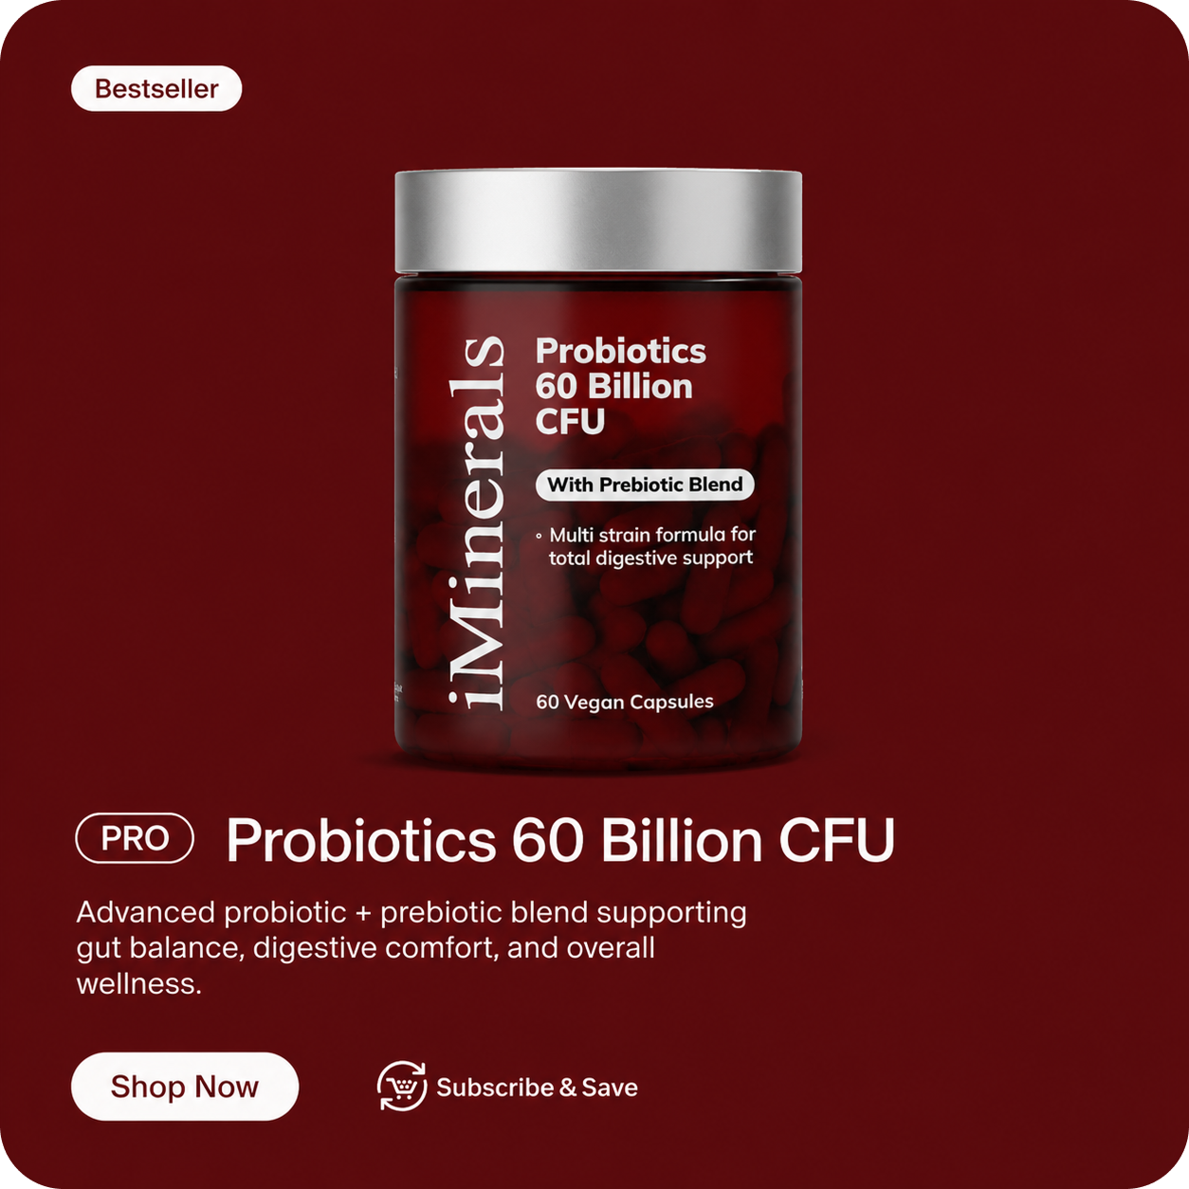
PACKAGING SYSTEM
06
One system.
Distinct products.
A consistent hierarchy
The vertical brand name anchors the pack. The product name takes priority, followed by the formula descriptor and capsule count.
BRAND / PRODUCT / DETAILS
Notes:
Supplied artwork: Frame 23.png. Product claims shown within the original artwork are reproduced as design content, not independently verified medical statements. No production-ready dielines or print specifications were supplied.

Slide 7
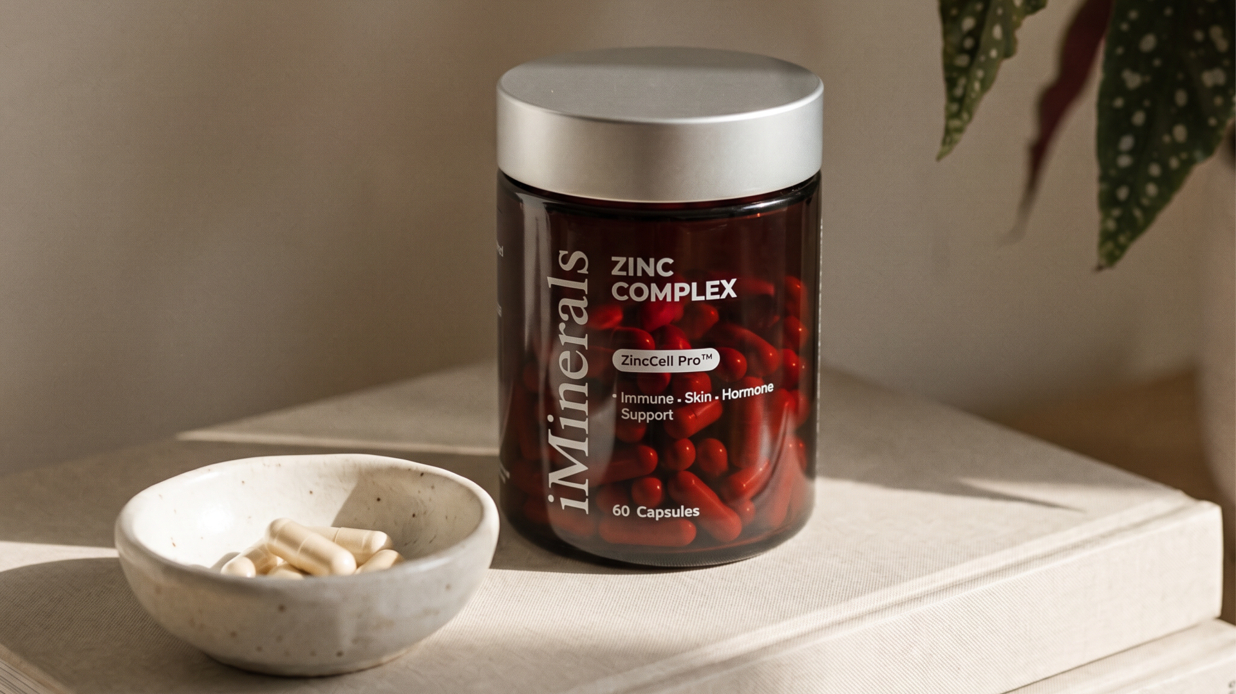
Art direction
Natural light. Tactile surfaces. A product-led composition.
Notes:
Supplied original asset: zinc.png. The portfolio caption describes the visual qualities of the artwork only.

Slide 8
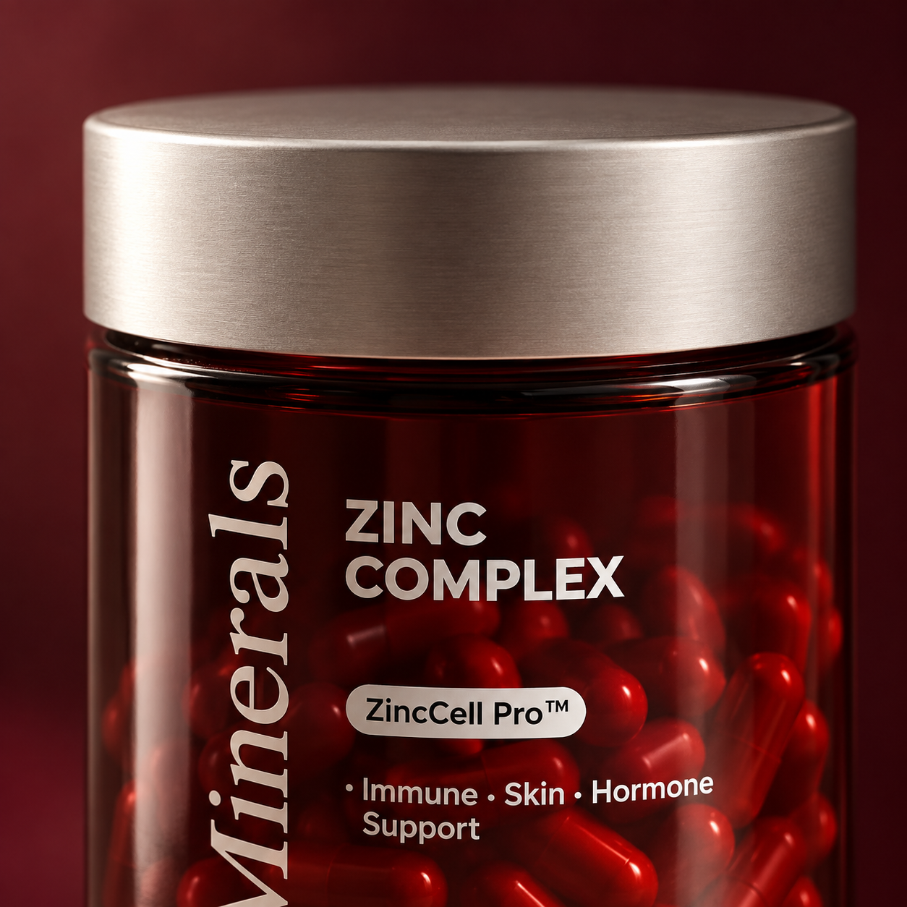
MATERIAL & DETAIL
08
The detail
builds the feel.
Translucent burgundy glass and a brushed silver lid bring depth and contrast to the packaging presentation.
PRODUCT VISUALIZATION CONCEPT
Notes:
New AI-generated portfolio mockup using zinc.png as the packaging reference. This is a product visualization concept, not a record of a manufactured object.

Slide 9
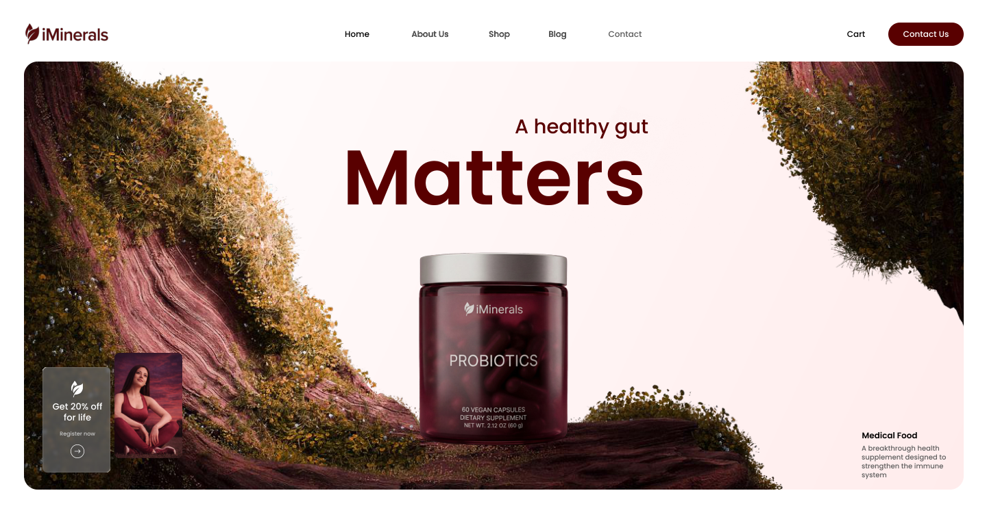
DIGITAL EXTENSION
09
The same identity, online.
Burgundy typography and product imagery carry the visual system into the homepage.
Notes:
Source: iminerals.pdf, page 1, top 740 points. This is a supplied website design mockup, not a claim of a live implemented shop. Existing health and promotional copy is part of the original artwork.

Slide 10
DESIGN OUTCOME
10
A recognizable
world for iMinerals.
The visual system
A consistent colour palette, expressive typography, structured packaging, and warm imagery connect the brand across print and digital touchpoints.
IDENTITY / PACKAGING / ART DIRECTION / DIGITAL DESIGN
Notes:
Outcome refers to the visible design system and presentation deliverables. No commercial launch, sales, conversion, or brand-awareness results are claimed. Case study prepared for Sooraj Somarajan from supplied work.

