Slide 1
Photography basics
Phase : 1

Slide 2
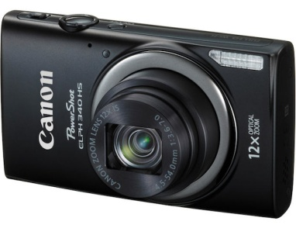
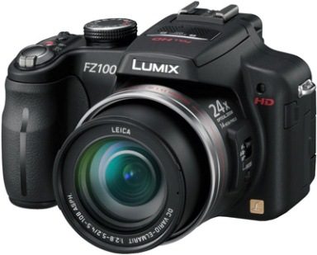
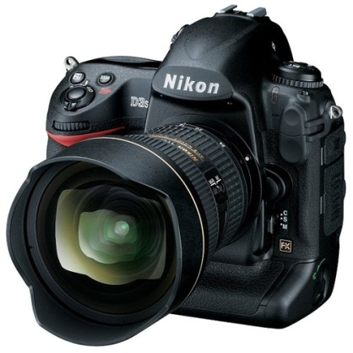
Camera Classifications
Point & Shoot
Prosumer
Digital SLR (DSLR)

Slide 3
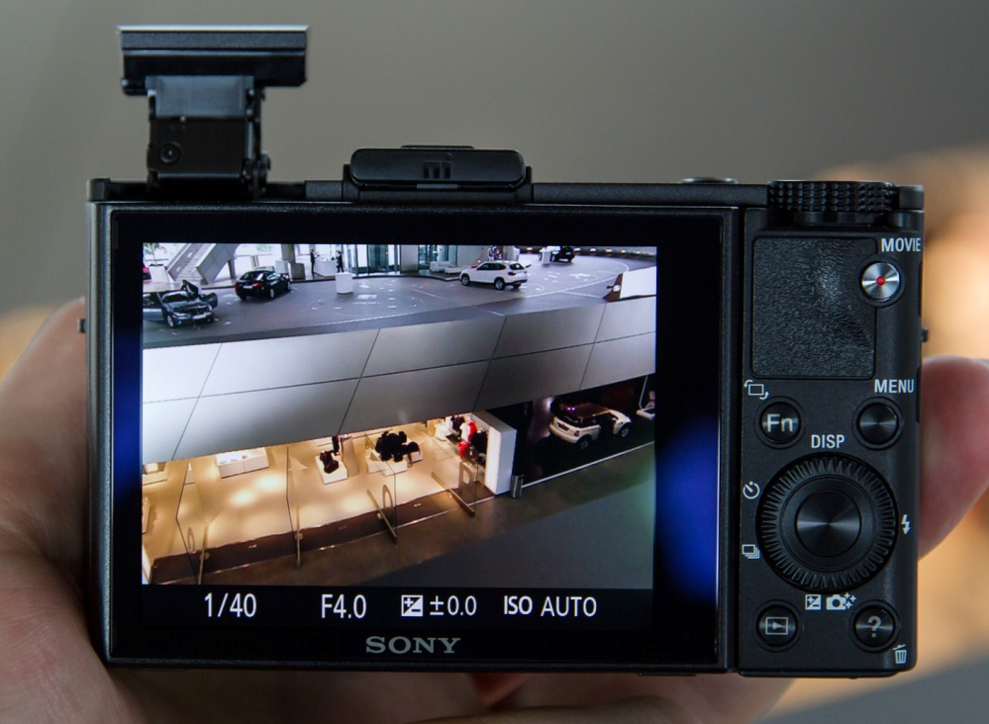
How camera clicks the shot we see?
Backend process taking place while we press the shutter button.
How camera judges for the correct exposure.

Slide 4

What Exposure Means?
  Brightness or darkness of the photo
  Has proper light and dark areas
Automatic
Manual

Slide 5
Exposure Control
Three Basic Tools
  Aperture
  Shutter Speed
  ISO

Slide 6

Aperture
Defined as a hole or opening through which light is admitted
Controls the entry of light to sensor
Mechanical blades that form an octagonal shape
f#

Slide 7
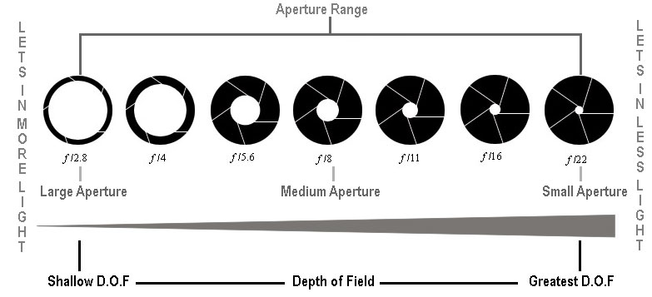

Slide 8
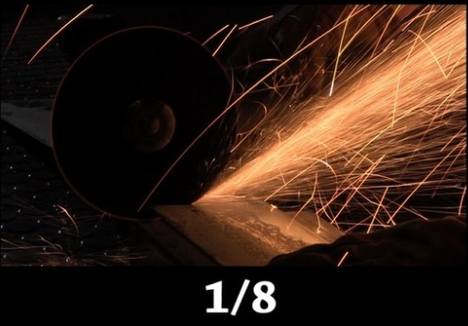

Shutter Speed
How long the shutter is open
Measured in seconds
Fast Shutter speed – Motion Freeze(>=1/600)
Slow Shutter speed – Portray movement or speed(<=1/60)

Slide 9
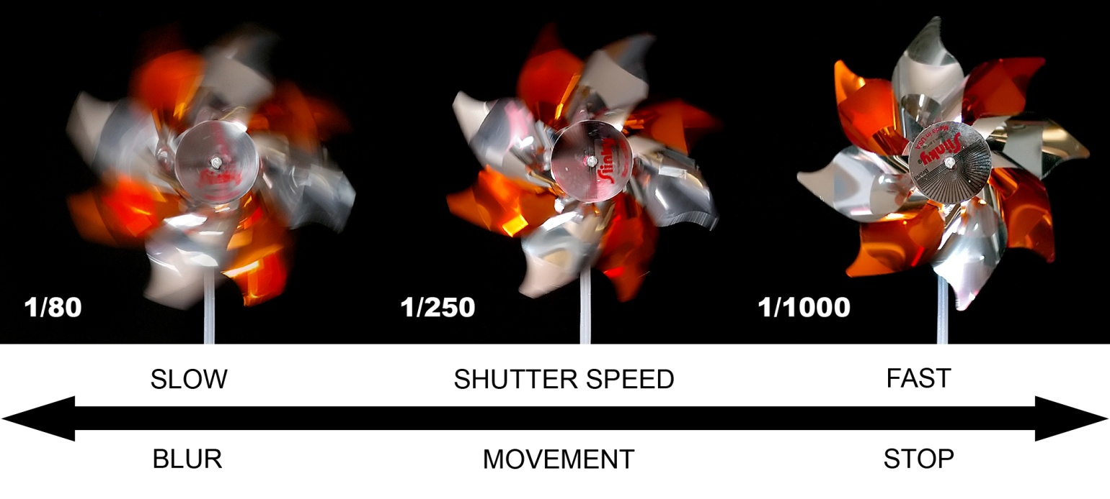

Slide 10
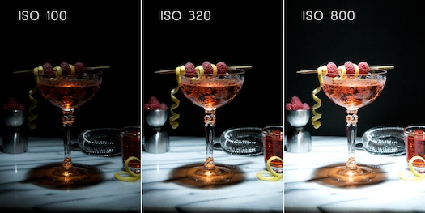
ISO
Sensitivity of Sensor towards light
Software controlled

Slide 11
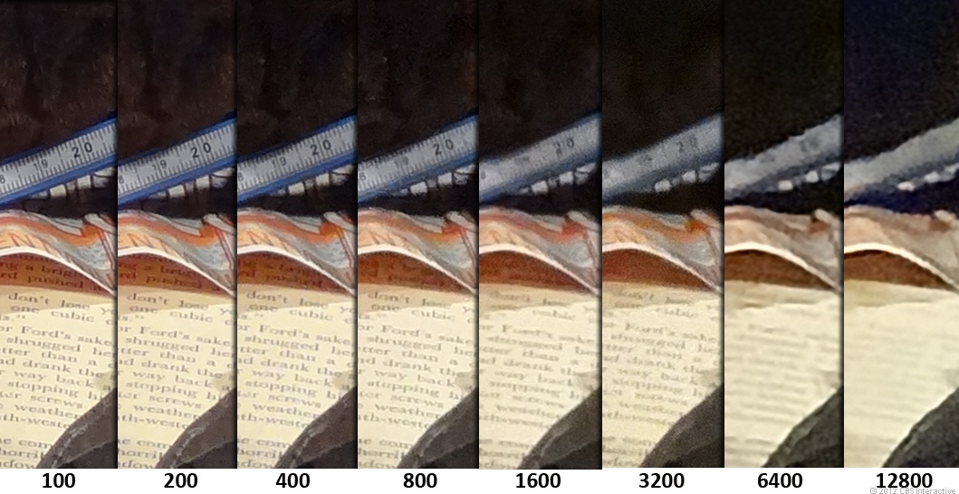

Slide 12
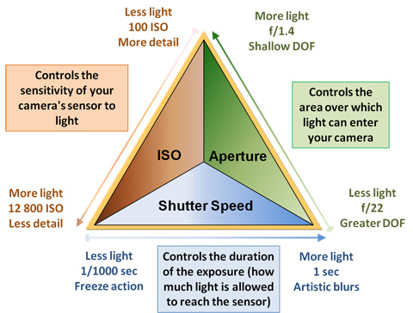
Exposure Triangle
These three tools decides the exposure.
Whether over exposed or under exposed

Slide 13
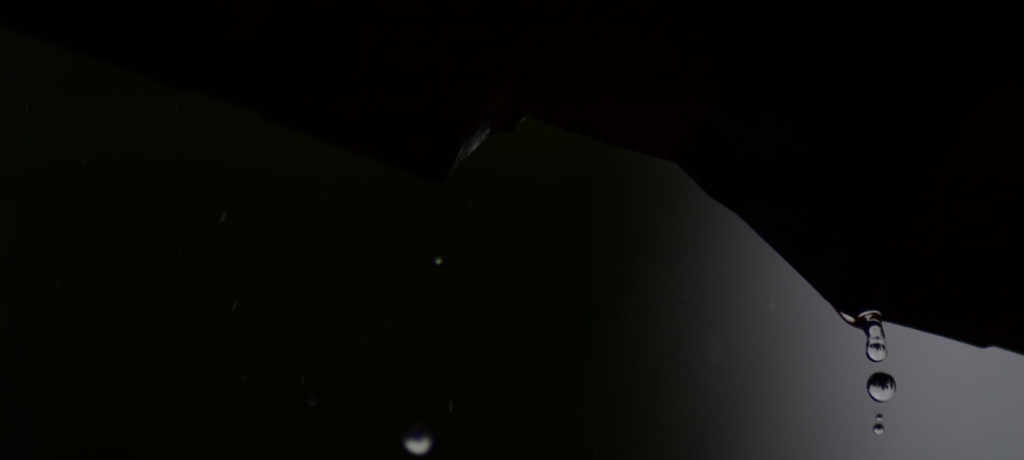
Higher Shutter Speed
1/1000s
f/5.6
ISO: 100

Slide 14
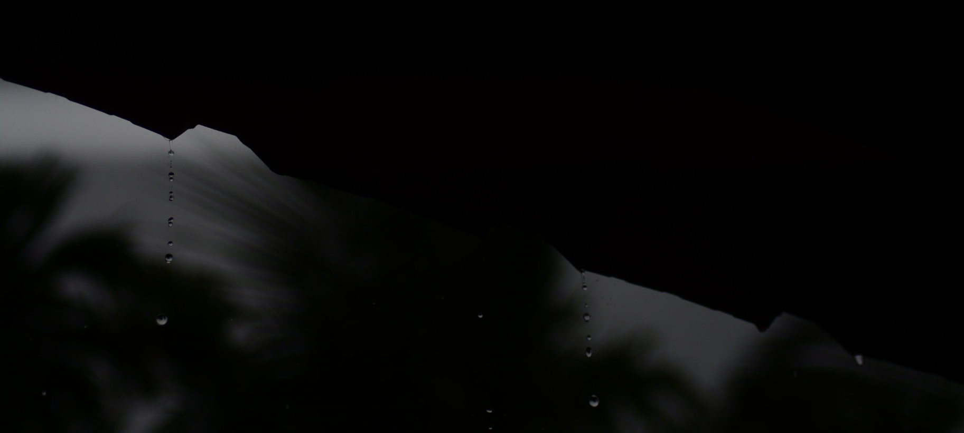
1/4000s
f/4.0
ISO: 100

Slide 15

Slower Shutter Speed
1/25s
f/4.0
ISO: 400

