Slide 1

MRA Project – Milestone 2
Soorej Kunnool BALAN
PGDSBA–Jun(B) ’22 BATCH

Slide 2
Agenda[Table of Contents]
Problem Statement
Tools Used
Exploratory Analysis
Executive Summary
EDA (Exploratory Data Analysis)
Trends
Inferences
Market Basket Analysis (MBA)
Association Rules
KNIME workflow
Threshold – Support & Confidence
Association & Recommendation

Slide 3
Problem Statement
A Grocery Store shared the transactional data with you. Your job is to identify the most popular combos that can be suggested to the Grocery Store chain after a thorough analysis of the most commonly occurring sets of menu items in the customer orders. The Store doesn’t have any combo meals. Can you suggest the best combo meals?
Store Transactional Data →
Data Dictionary
Excel Column Name | Definition
Date | Order Number
Order_id | Quantity Ordered
Product | Price of Each Item

Slide 4
Tools Used
We will be analyzing the data using python, KNIME analytics platform and Tableau software.
The link for the Tableau workbook is given below:
https://public.tableau.com/app/profile/soorej.balan/viz/MRA_Milestone2_16513377691420/Product-Barplot
The Jupyter(python) notebook and KNIME workflow is attached with this ppt for submission.

Slide 5
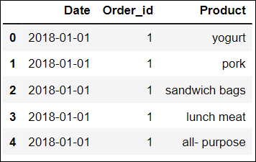
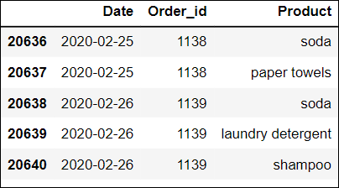
Executive Summary of Data
Tool – Used python to determine executive summary of data.
Data Head (First 5 rows) Data Tail (Last 5 rows)
Dataset Shape – Data has 20641 rows and 3 columns.
Null Values - There are no null/missing values in the dataset.
Duplicate Records – There are 4730 duplicate records in the dataset.

Slide 6
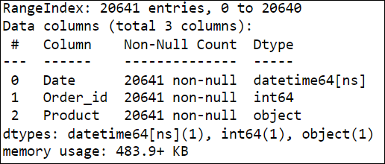
Executive Summary of Data (contd..)
Concise Data Summary:
The concise data summary shows the presence of
20641 rows and 3 columns.
We can see that the data columns are of the following
data types.
Datetime datatype: DATE
Integer Datatype: Order_id
Object Datatype: Product

Slide 7
Executive Summary of Data (contd..)
Assumptions
Since there are no nulls, it seems the data is accurate.
There are 4730 duplicate records, but since we don’t have price, quantity or any other sales information we can assume that duplicate product records indicate multiple quantities bought or variation of products under the product group.
Duplicate records won’t affect Market Basket Analysis as we will be considering only unique products under each basket, in this scenario order_id.
We can perform univariate, bivariate and multivariate analysis on the data.
Order date information can give us weekly, monthly and yearly trends on number of orders and products chosen by customers.
We have data to perform Market Basket Analysis and derive association rules.

Slide 8
Exploratory Analysis
For exploratory data analysis we will use Tableau for the visual charts with the input dataset.
We will start with univariate analysis of the input dataset columns using python. This will be followed by bivariate analysis via graphs in Tableau.
Then we will move onto the order trends.
We will wrap the EDA section with inference gained through the above steps.

Slide 9
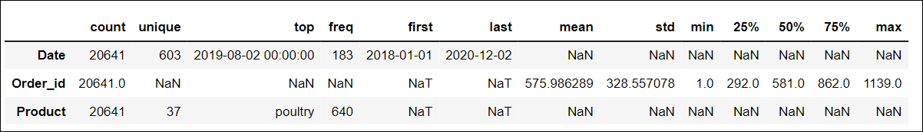
EDA – Univariate Analysis
Using python, we describe the table to get the information in the below chart:
Date column ranges from 2018-01-01 to 2020-12-02. Highest frequency in date column is 2019-08-02 with 183 occurrences.
Order_id, though an integer column, is a nominal column. Order id ranges from 1 to 1139.
Product is an object column, and the dataset consists of 37 unique products. Poultry has the highest frequency of 640 occurrences and seems to be the favourite product among the customer transactions.

Slide 10
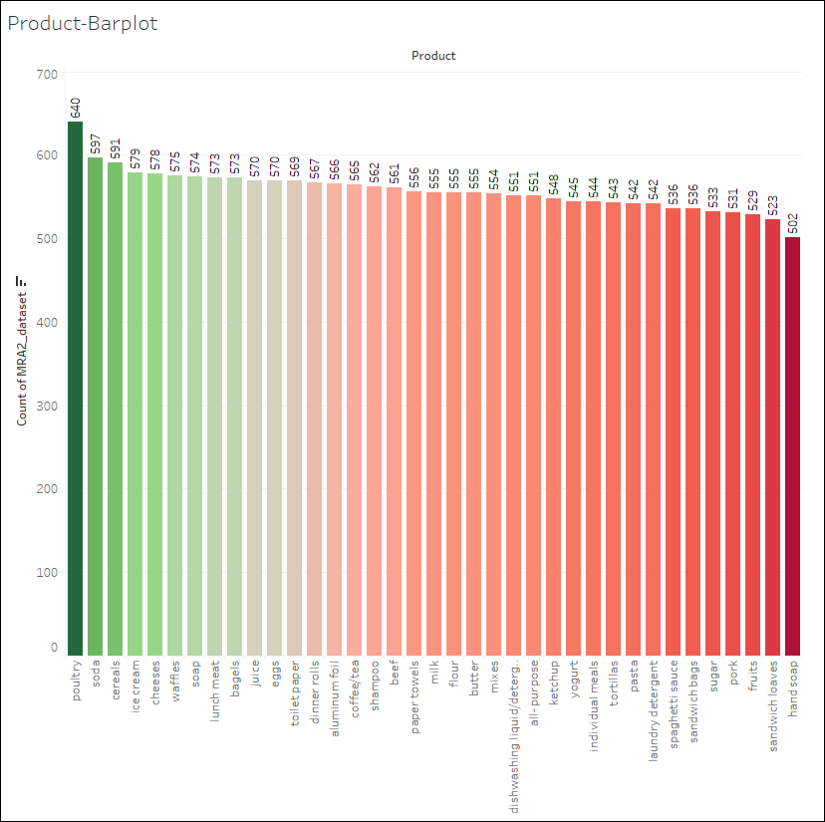
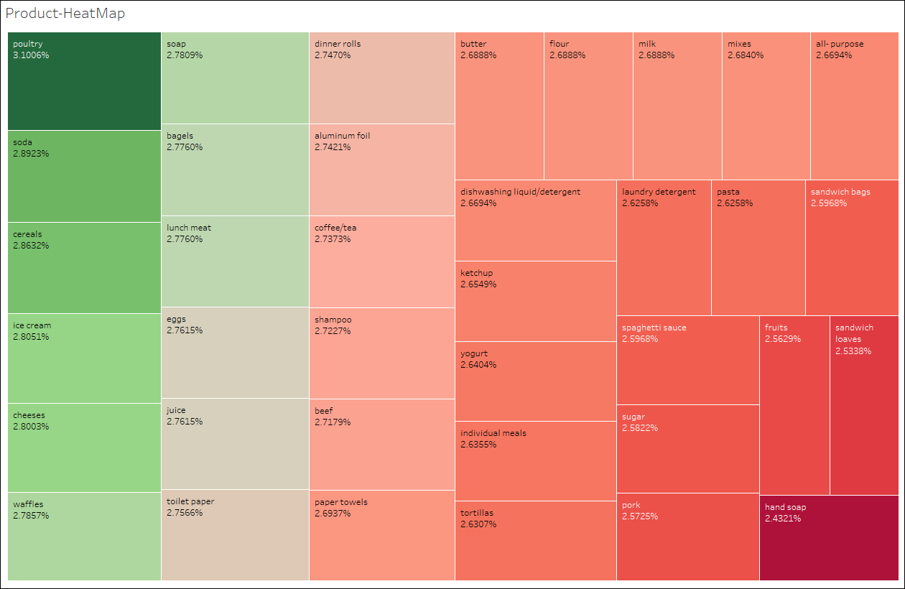
EDA–Univariate Analysis -Product
From tableau, we can see that Poultry is the product with highest frequency among the products in the dataset at 640 (3.1%) and the
Product with least frequency is “Hand soap” with 502 (2.4%).
The % difference between the lowest 502 and highest frequency, 640 is 27.5% over a period of 3 years from Jan-2018 to Dec-2020.
10

Slide 11
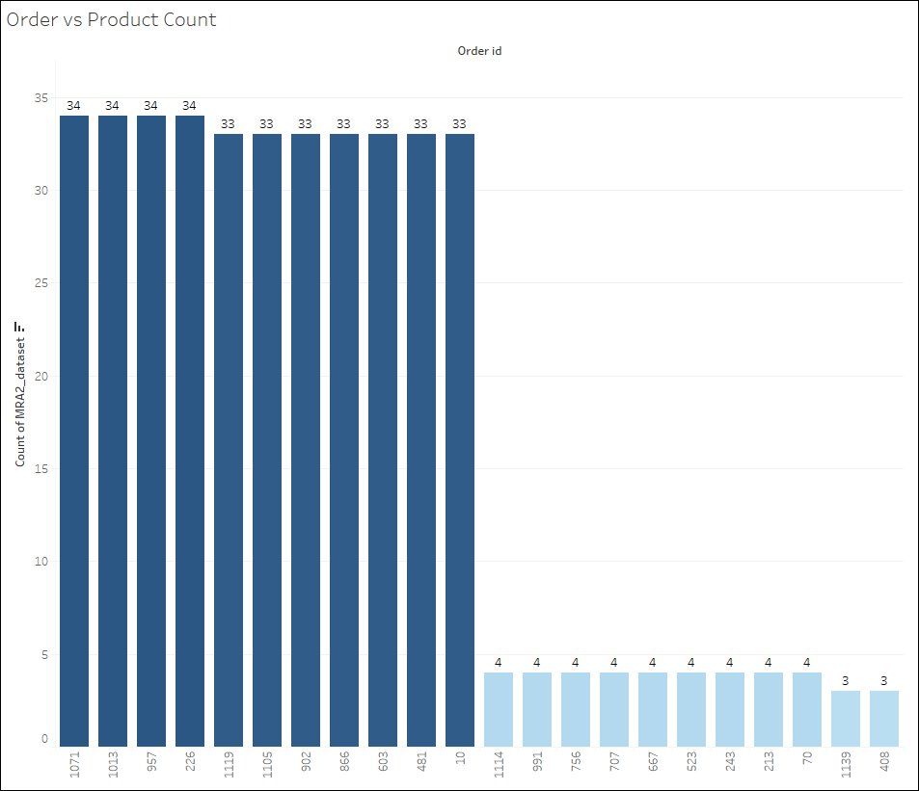
EDA–BV/MV Analysis-Order vs Product Count
Using tableau, we get the top 10 and bottom 10 product counts against individual order.
We can see that the highest number of product types among a single order is 34 and the lowest is at 3.
11

Slide 12
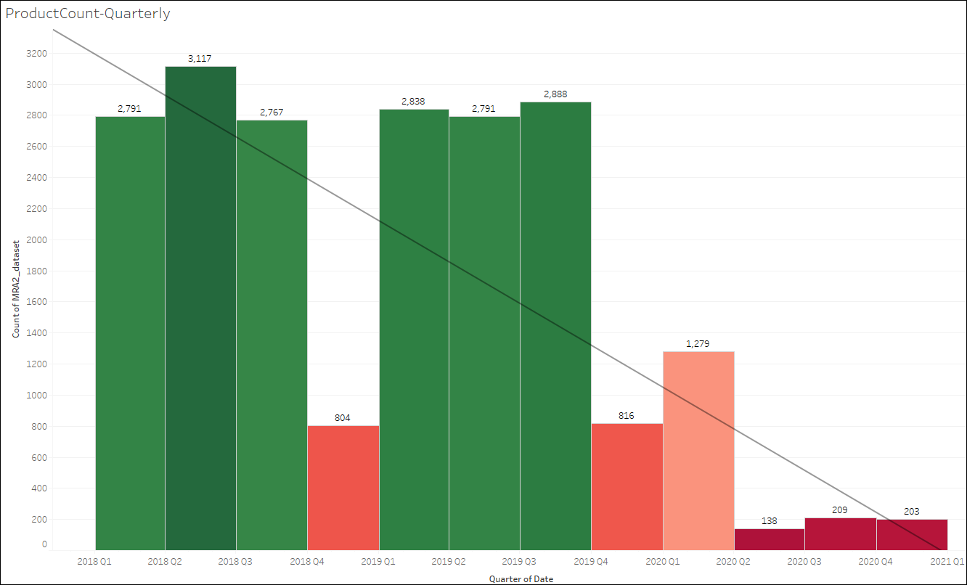
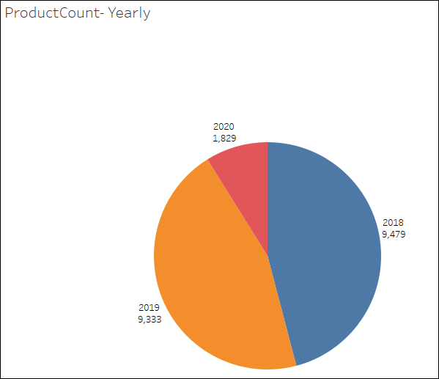
TRENDS- Product Count –Yearly & Quarterly
Using Tableau, we derive the number of product counts ordered across the years and quarter.
Though we don’t have the sales information, it looks like the business is waning based on the number of product counts. In 2018 we have the number of product count at 9479 which decreases to 9333 and then 1829 in 2019 and 2020 respectively. The quarterly plot doesn’t show any obvious seasonality, except for the years 2018 and 2019, we have Q4 performing at almost 30% to the other quarters. 2020 all quarters show much reduced orders. The quarterly average product count value has fallen from 2018 Q1 (3100) to 2020 Q4 (200).
12

Slide 13
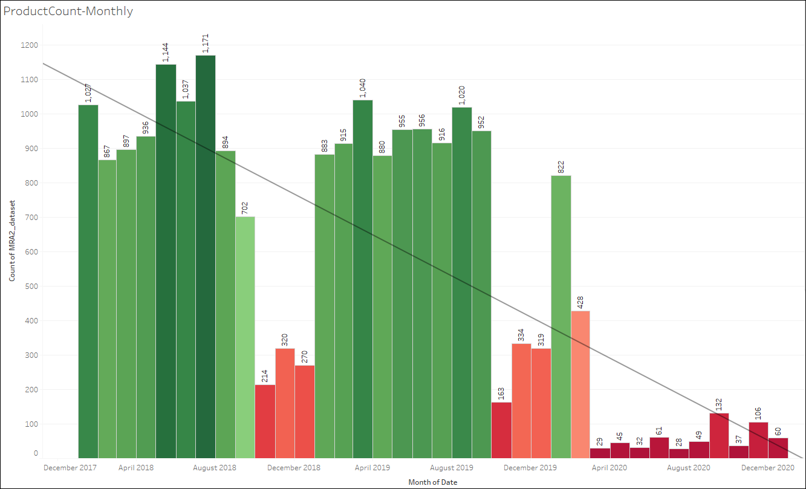
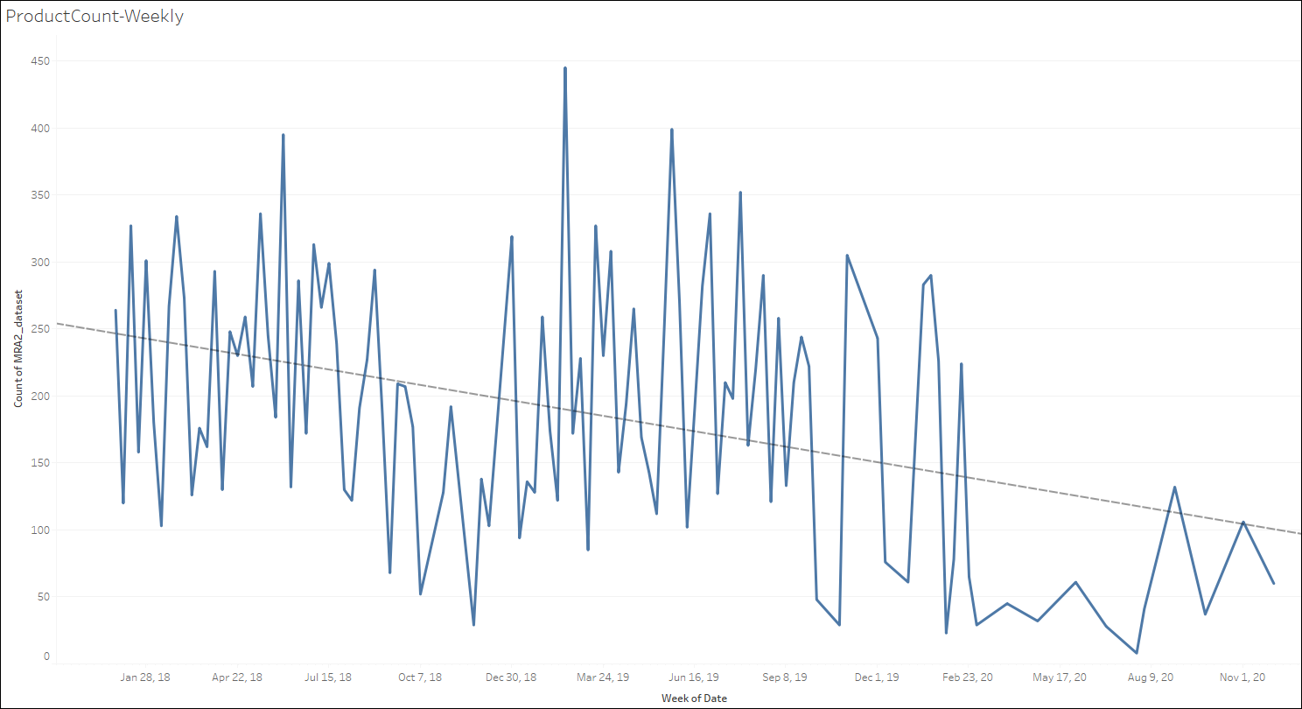
TRENDS- Product Count –Monthly & Weekly
Using Tableau, we derive the number of product counts ordered across the months and weeks.
In 2018 and 2019 we can see comparable figures, though the rate is falling. The months October, November & December shows very least orders.
The average monthly product count decreases from 1100 to 60 across the duration, and the weekly average fall is from 250 to 80.
13

Slide 14
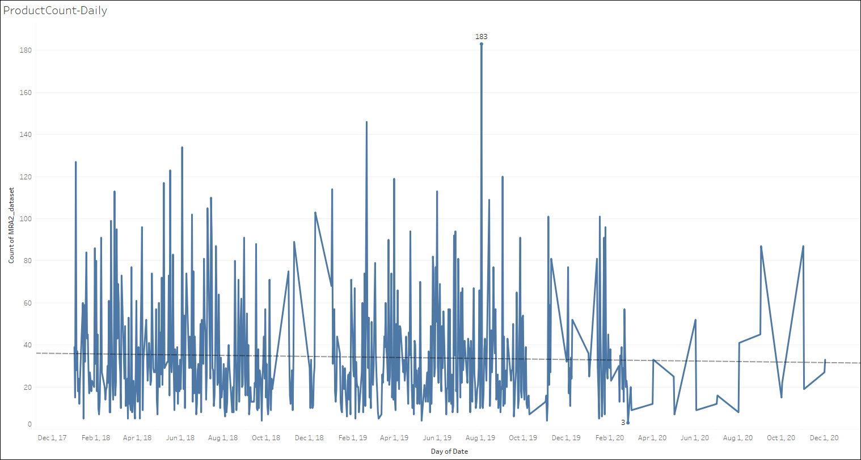
TRENDS- Product Count –Daily
Using Tableau, we derive the number of product counts ordered across days.
There is no discernible seasonality. The highest number of products types ordered on a daily basis is 183 in the month of August and lowest is 3 in the month of March 2020.
14

Slide 15
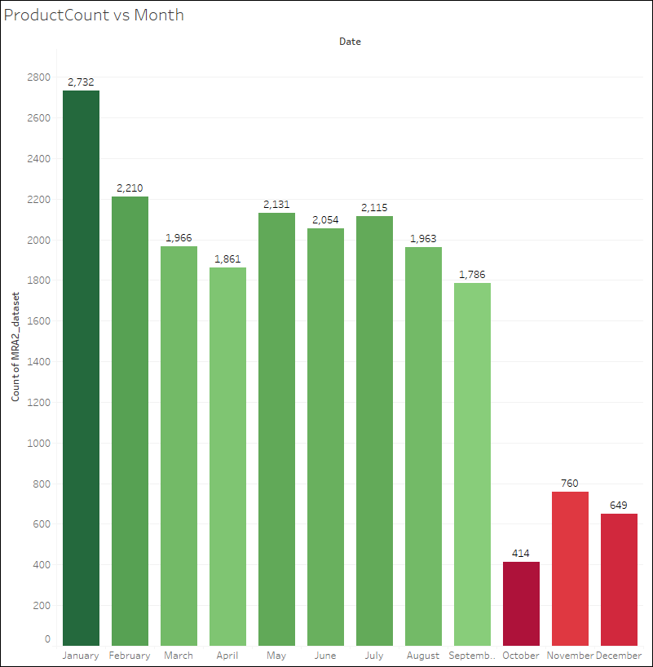
TRENDS- Product Count vs Month
Using Tableau, we derive the number of product count behavior across month.
We can see that product count is lowest in months of quarter 4. The trend shows that max product count in Jan which declines until April, then follows a small rise across July and falls slightly until September and then drastically reduces in October to December.
15

Slide 16
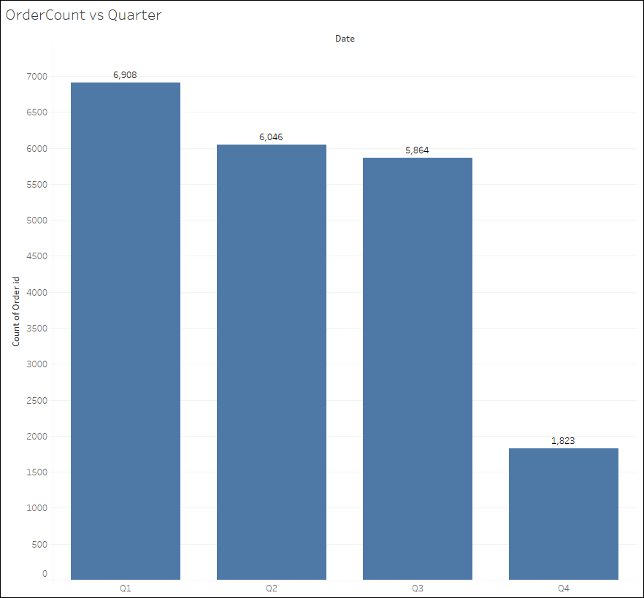
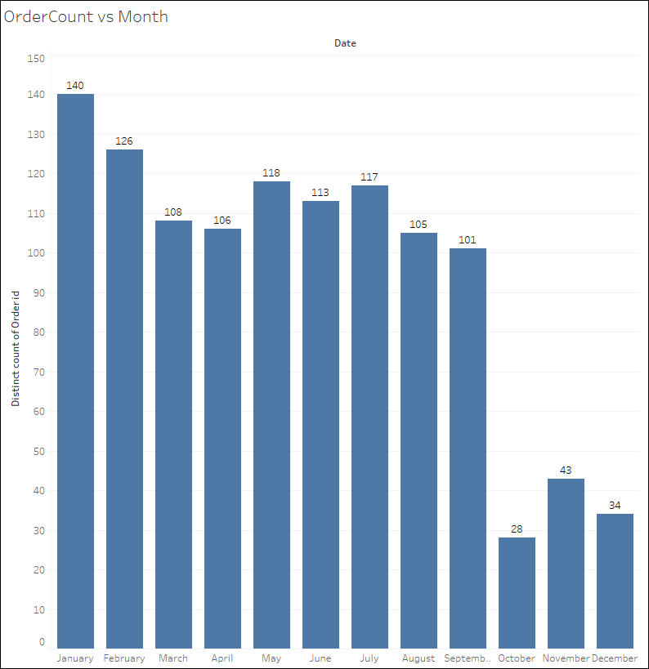
TRENDS- Order Count vs Quarter/Month
Using Tableau, we derive the number of orders placed in different quarters and months.
We can see that orders placed follows the product count across months. The sales progressively declines from quarter 1 to 4.
16

Slide 17
EDA - Inferences
Lets look at the inferences derived from the given dataset.
The transaction dataset consists of 20641 product level transactions.
The transactions range from 2018-01-01 to 2020-12-02.
Order id ranges from 1 to 1139.
There are 37 unique product groups in the given dataset.
We can see that both number of orders and number of product types ordered progressively reducing across the years from 2018 to 2020.
2018 and 2019 orders show a seasonality where Q4 orders and number of products ordered have reduced to 30% of the average order/product count in the other 3 quarters.
2020 is a lean period where business seems to be struggling with overall orders and number of product types in orders.
We can see that product count is lowest in months of quarter 4. The trend shows that max product count in Jan which declines until April, then follows a small rise across July and falls slightly until September and then drastically reduces in October to December.
17

Slide 18
Market Basket Analysis (MBA)
What is Market Basket Analysis?
Market Basket Analysis is a technique to identify patterns in the purchases of customers in any retail setting.
The technique attempts to identify relationship among items in each customer’s order purchase and quantitatively group items which are highly correlated from a purchase perspective.
For example a person who purchases bread is more likely to buy jam than lets say deodorant. So MBA will quantitatively establish that there is a relationship between bread and jam than bread and deodorant.
Market basket analysis is modeled on Association rule mining, which goes as per the if- then construct, which is represented as, e,g, IF customer buys bread THEN he is likely to buy jam as well.
MBA helps to optimize operations in the store and optimal placement of goods with high relationship.
It helps to understand customer’s behaviour and purchase patterns thus helping with individual promotions/suggestions.

Slide 19
MBA – Association Rules
In this given dataset we can see that business is dwindling in the year 2020. We can use MBA on the given dataset and understand the association that exists between different purchase items. This will help customer to provide combo offers and subsequently lead to rise in sales.
Let us consider an association rule which says {A} -> {B}, i.e. IF ‘A’ THEN ‘B’
The 3 main metrics in association data mining are as follows:
Support – This is the ratio of transactions involving A to the total number of transactions. This metric is important as it identifies the item most involved in transactions that could lead to a greater impact.
Confidence – This indicates the percentage of time B was purchased given A. This value ranges from 0 to 1 and indicates the confidence of the rule. i.e. a confidence level of 0.75 in {A} -> {B}, tells us that in 75% of the cases when ‘A’ occurred, ‘B’ also occurred.
Lift – This indicates the increase in sale of ‘A’, given ‘B’. Lift is derived as Confidence/Support for B. This valu indicates the likeliness of ‘A’ and ‘B’ occurring together. If lift value is greater than 1, it indicates positive correlation between A and B and hence its likely that ‘A’ and ‘B’ will occur together and if lift is lesser than 1, its unlikely that ‘A’ and ‘B’ occurs together.

Slide 20
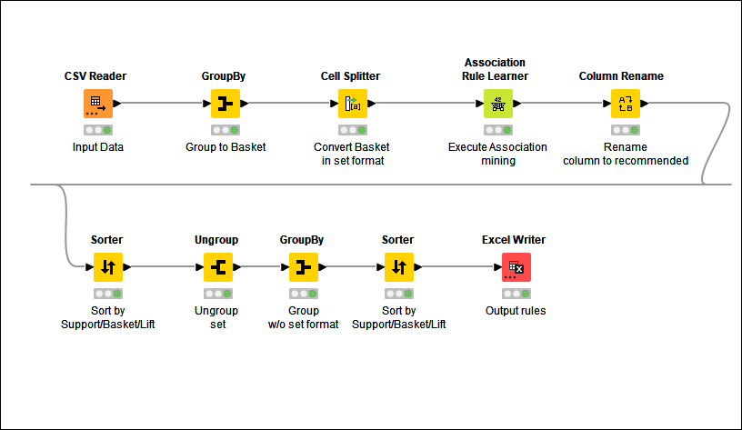
MBA – KNIME Workflow Image
The KNIME workflow image is provided.
On running the workflow, the output data with association rules are generated and is attached below.

Slide 21
MBA – Threshold
When running MBA on the given dataset the threshold set for Support and confidence are :
Support – 0.05. We want to look at all the basket combination which exists in at least 5% of the orders. This will give us association rules for pretty much all the 37 unique product combinations the customers have been placing order on.
Confidence – 0.5. We have set confidence at 50% level as we want to identify rules where the association exists in at least 50% of the order id’s, so that implementation of the rule will have an impact.

Slide 22
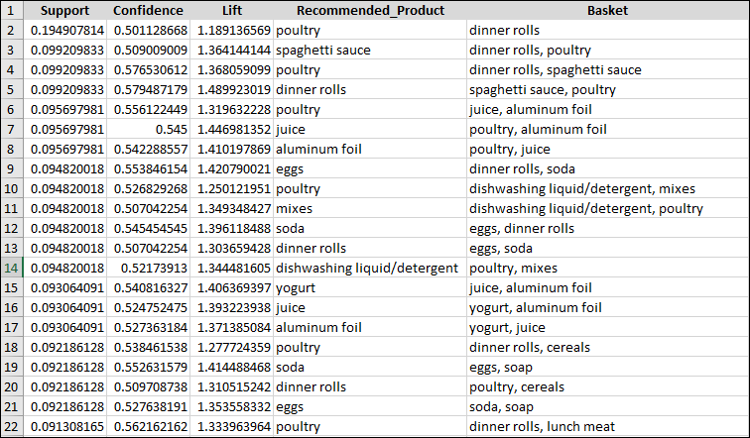
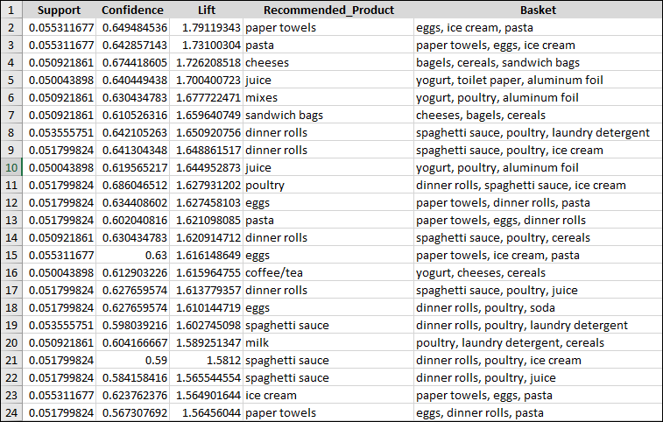
Association & Recommendation
The MBA analysis on the given dataset with thresholds of Support(0.05) and confidence 0.5 has yielded 1109 association rules. Please find below some of the rules with high support (LHS) and some with high lift(RHS).

Slide 23
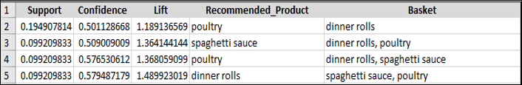
Association & Recommendation (contd..)
High support indicates the likelihood of the rule being enforced and high lift indicates the increase in sales of the basket w.r.t recommended product.
Let’s first look at the rules where support is highest.
From row 1 we can see that there is 19.5% chance that
A customer buys dinner rolls and the recommended
Product is poultry with lift 1.18931, i.e. likelihood is high.
So we should have some discount on poultry for customers
Who buy dinner rolls alone.
Similarly, the next three rows gives associations, such as:
basket {dinner rolls, poultry} recommendation is spaghetti sauce,
basket {dinner rolls, spaghetti sauce} recommendation is poultry,
basket {spaghetti sauce, poultry} recommendation is dinner rolls,
Considering the scenarios, a combo deal for dinner rolls, spaghetti sauce & poultry in the form of a percentage off or in the form of buy 2 each and get one free should increase the sales. The appropriate campaign can be decided based on price and margin on the items.

Slide 24
Association & Recommendation (contd..)
Similarly, from the next 3 row of highest support,
We can see that poultry, aluminum foil and juice has
Interdependent association rules.
Considering the scenarios, a combo deal for poultry, aluminum foil and juice in the form of a percentage off or in the form of buy 2 each and get one free should increase the sales. The appropriate campaign can be decided based on price and margin on the items.
Higher lift indicates that sale of recommended product will increase the sales of the basket. Since lift considers confidence of rule among the overall dataset, it can
provide good insights.
Lets look at some of the first rows:
We can see association rule {eggs,ice cream,pasta} -> {paper towels}, hence this recommendation can be suggested with customers having basket of eggs, ice cream pasta.
Similarly the case for {paper towels, eggs, ice cream} -> {pasta}.
Considering the scenarios, a combo deal for paper towels, eggs, ice cream & pasta in the form of a percentage off or in the form of buy 3 and get one free should increase the sales. The appropriate campaign can be decided based on price and margin of the items involved.

Slide 25
Association & Recommendation (contd..)
Similarly, we can see the rows 12 and 13 where eggs,
Paper towels, dinner rolls and pasta have interdependent
association rules.
Considering the scenarios, a combo deal for eggs, paper towels, dinner rolls and pasta in the form of a percentage off or in the form of buy 2 each and get one free should increase the sales. The appropriate campaign can be decided based on price and margin on the items.
Similarly, we can have many more associations and combo items generated from the association rules.

Slide 26


