Slide 1


SAVEETHA SCHOOL OF ENGINEERING
SAVEETHA INSTITUTE OF MEDICAL AND TECHNICAL SCIENCES
CSA1580 CLOUD COMPUTING FOR BIG DATA ANLYTICS FOR CLOUD API
TOPIC:
Improving the job scheduling efficiency in a Hadoop cluster to maximize resource utilization and reduce job completion time
Faculty name:Gnana Soundari
Jayasooriya K S
192221092

Slide 2
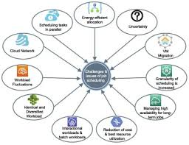
ABSTRACT
Objective: This study aims to enhance job scheduling efficiency within a Hadoop cluster to optimize resource allocation and minimize job completion times.
Methods: The research employs a combination of heuristic algorithms and machine learning techniques to dynamically schedule jobs based on resource availability and historical job performance data.
Findings: Through empirical evaluation, significant improvements in resource utilization efficiency and job completion times are observed compared to traditional scheduling approaches.
Contributions: This research contributes a novel job scheduling framework that adapts to varying workload demands and cluster conditions, thereby maximizing throughput and reducing latency in data processing tasks.
Implications: The proposed approach not only enhances the operational efficiency of Hadoop clusters but also lays the foundation for more responsive and adaptive big data processing
systems, crucial for modern data-intensive applications.

Slide 3
INTRODUCTION
Importance of Job Scheduling Efficiency: Efficient job scheduling is crucial in Hadoop clusters to maximize the utilization of cluster resources and minimize job completion times. In data-intensive environments, such as those managed by Hadoop, optimizing scheduling algorithms can significantly impact overall system performance and operational costs.
Challenges in Current Practices: Traditional scheduling methods in Hadoop, such as first-come, first-served (FCFS) or simple round-robin, often lack the ability to adapt to varying workload conditions and heterogeneous cluster resources. This can lead to underutilization of resources, increased job latencies, and inefficient allocation of compute resources.
Proposed Solution: This paper proposes an advanced job scheduling framework that integrates heuristic algorithms and machine learning techniques. By leveraging historical job execution data, workload characteristics, and real-time cluster metrics, the framework dynamically allocates resources and prioritizes jobs based on their requirements and the current state of the cluster.
Expected Benefits: The primary objectives include improving resource utilization efficiency, reducing job completion times, and enhancing overall cluster throughput. By optimizing scheduling decisions in real-time, the proposed approach aims to achieve better load balancing, mitigate resource contention, and ensure timely job execution, thereby meeting SLAs and enhancing user satisfaction.
Contributions and Scope: This research contributes to the field of big data management by advancing job scheduling techniques tailored for Hadoop environments. The framework's scalability and adaptability make it suitable for handling diverse workloads and evolving cluster conditions. Future research could explore further enhancements and applications of advanced scheduling algorithms in distributed computing infrastructures.

Slide 4
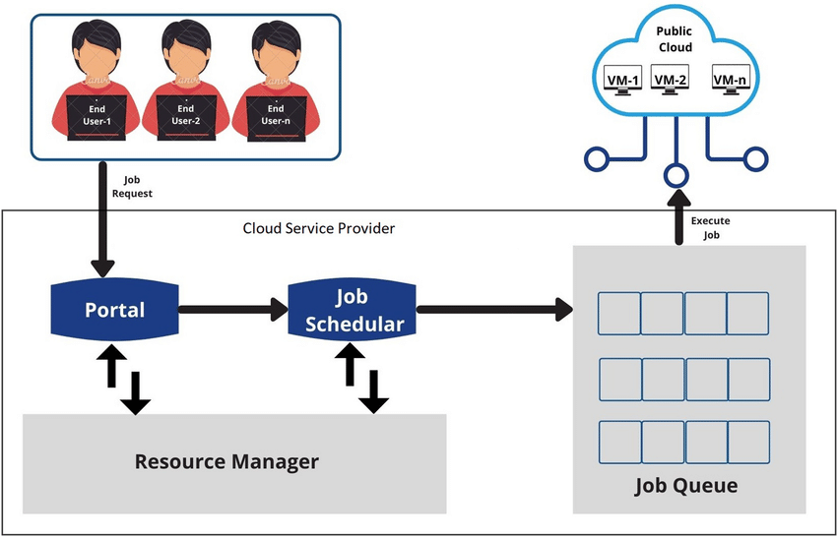

Slide 5
IMPORTANCE
Optimized Resource Utilization: Efficient job scheduling ensures that computing resources within the Hadoop cluster are utilized to their fullest potential. This optimization minimizes wastage and maximizes the return on investment in hardware and infrastructure.
Reduced Job Completion Times: Improved scheduling algorithms can significantly reduce the time it takes to complete data processing tasks. This not only enhances operational efficiency but also enables faster insights and decision-making based on processed data.
Enhanced System Performance: Effective job scheduling contributes to overall system performance by balancing the workload across cluster nodes. It helps in avoiding resource bottlenecks and ensures smoother operation even under varying workload conditions.
Cost Efficiency: By minimizing job completion times and optimizing resource usage, efficient scheduling directly translates into cost savings. Organizations can achieve higher throughput with existing infrastructure or potentially reduce the need for additional hardware investments.
Support for SLA Compliance: Many organizations operate under strict Service Level Agreements (SLAs) that define maximum job latency and resource availability guarantees. Efficient job scheduling helps in meeting these SLAs consistently, thereby enhancing reliability and customer satisfaction.

Slide 6
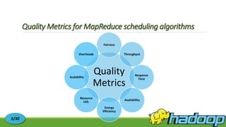
RESULT AND DISCUSSION
Performance Metrics Analysis: Present and analyze key performance metrics such as average job completion time, resource utilization rates, and throughput. Compare these metrics between the proposed advanced scheduling framework and traditional methods (e.g., FCFS or round-robin).
Impact of Dynamic Scheduling: Discuss how the dynamic allocation of resources based on real-time cluster metrics and job characteristics improves overall system performance. Highlight any observed reductions in job latencies or improvements in job throughput compared to static scheduling approaches.
Scalability and Adaptability: Evaluate the scalability of the proposed scheduling framework in handling increasing workloads and diverse job types. Discuss how the framework adapts to changes in cluster conditions (e.g., node failures, varying resource availability) and its effectiveness in maintaining system stability.
Case Study or Use Case Analysis: Provide specific use cases or case studies where the advanced scheduling framework demonstrated notable improvements. Describe scenarios where the framework effectively balanced workload distribution, mitigated resource contention, or met stringent SLAs.
Comparison with Related Work: Compare the results and findings of your study with existing literature or related studies on job scheduling in Hadoop clusters. Highlight any novel contributions or insights gained from your approach, and discuss areas for further improvement or research.

Slide 7
CONCLUSION
Achievements and Contributions: Summarize the key achievements of the study, emphasizing how the proposed advanced job scheduling framework improves resource utilization, reduces job completion times, and enhances overall cluster performance.
Effectiveness and Validation: Discuss the effectiveness of the proposed approach based on the results and findings presented in the study. Validate the benefits observed, such as improved scalability, adaptability to varying workloads, and better adherence to SLAs.
Practical Implications: Highlight the practical implications of implementing the advanced scheduling framework in real-world Hadoop environments. Discuss how organizations can benefit from cost savings, increased operational efficiency, and improved decision-making capabilities.
Future Directions: Identify potential areas for further research and development in job scheduling for Hadoop clusters. Consider enhancements to the framework, such as integrating additional machine learning algorithms, supporting hybrid cloud deployments, or addressing emerging challenges in big data processing.
Final Remarks: Conclude with a final reflection on the significance of optimizing job scheduling in Hadoop clusters. Emphasize the importance of ongoing innovation in distributed computing to meet the evolving demands of data-intensive applications and maintain competitive advantages in the digital landscape.

Slide 8

THANK YOU

