Slide 1
Blinkit Sales Analysis
Excel project
Submitted by: S P Soorya Deva

Slide 2
INTRODUCTION
•This project focuses on analyzing Blinkit customer orders and purchasing behavior using Microsoft Excel.
•The dashboard provides insights into customer segmentation, regional order distribution, registration trends, and average order values.
•Interactive visualizations help identify customer engagement patterns and operational performance across different areas.

Slide 3
OBJECTIVES OF THE STUDY
•To analyze total orders and customer activity across regions.
•To study customer segmentation patterns such as New, Premium, Regular, and Inactive customers.
•To compare average order values among different customer segments.
•To monitor registration trends over time.
•To build an interactive dashboard for business decision-making.

Slide 4
DATASET OVERVIEW
•Customer information including customer_id and customer segment.
•Order details such as total orders and average order value.
•Area-wise order distribution data.
•Customer registration date and trend information.
•Data cleaned and transformed using Microsoft Excel.

Slide 5
KEY PERFORMANCE INDICATORS (KPIs)
•Total Orders: 10,573
•Total Customers: 1,001
•Average Order Value: ₹1086.83
•Top Area by Orders: Orai
•Highest Customer Segment Participation: Inactive Segment

Slide 6
VISUALIZATIONS USED
•Pie Chart – Customer by Segment
•Bar Chart – Average Order Value by Customer Segment
•Horizontal Bar Chart – Total Orders by Area
•Line Chart – Registration Trend
•Cards – KPI Metrics
•Tables – Area-wise and Segment-wise Analysis

Slide 7
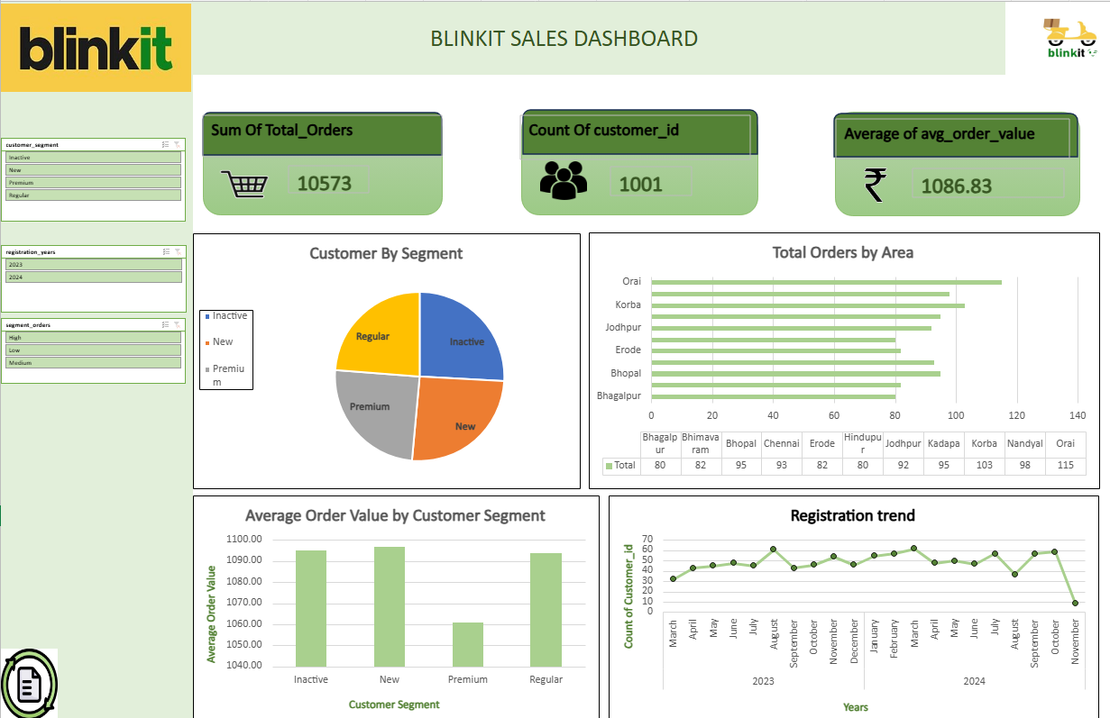

Slide 8
CONCLUSION
•The Blinkit Excel dashboard successfully transforms raw transactional data into meaningful business insights.
•The dashboard helps understand customer behavior, regional performance, and sales trends.
•Interactive visuals improve analytical capabilities and support better business decisions.
•This project demonstrates the effectiveness of Microsoft Excel in retail and customer analytics.

Slide 9


References:

Slide 10
Suggestions :
•Implement predictive analytics to forecast future order trends.
•Track customer retention and repeat purchases.
•Create product-level and category-level analysis dashboards.
•Develop mobile-friendly reports for business users.
•Integrate real-time order data for live monitoring.

Slide 11
THANKYOU

