Slide 1
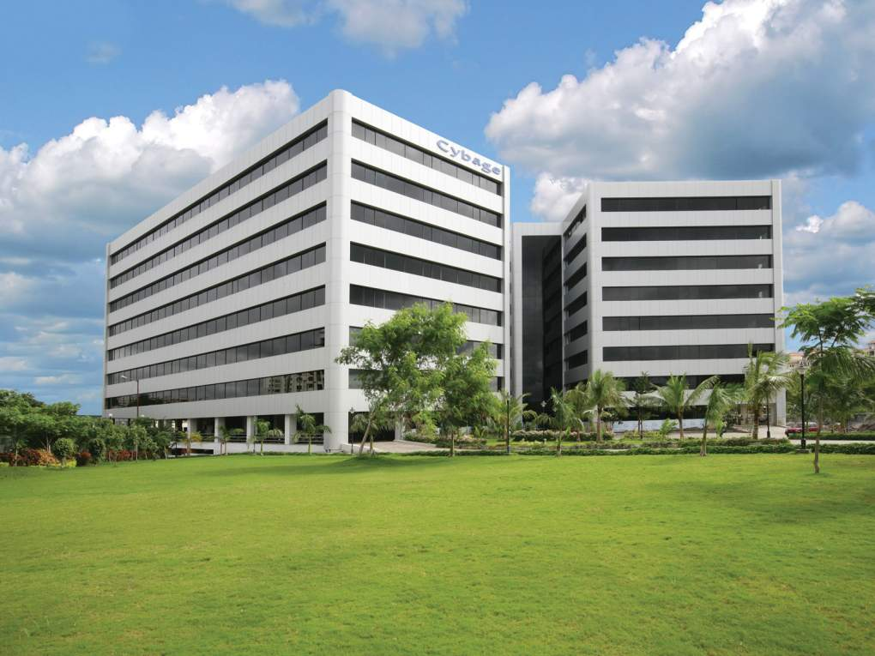

Process, Framework & Jenkins Integration for CI
This document and all its contents contain information from Cybage Software Private Limited which may be privileged, confidential,
or otherwise protected from disclosure. The information is intended to be for the addressee(s) only. Any unauthorized disclosure,
copy, distribution, or use of the contents of this message is strictly prohibited.

Slide 2
Agenda
RATA Framework Overview
RATA Process
Integrating SoapUI project in Jenkins
Sample Project Integrated in Jenkins

Slide 3
What is RATA Framework
RATA (RMSg APIs Test Automation) Framework aims at automating the RMSg APIs that are based on RESTful services
SoapUI - SOAP UI is a powerful and easy to use open source tool for automating different types of web services like SOAP, REST etc. It provides a UI for creating test cases,assertions making it easier to develop test cases rapidly.

Slide 4
What is RATA Framework
RATA Framework Features:
Consists of library files (written in Groovy) for:
  Creating the files for test data & assertion
  Setting up the data
  Comparing the actual response with expected response (in JSON)
Test Data, Properties & library files are stored outside the SoapUI’s project.xml

Slide 5
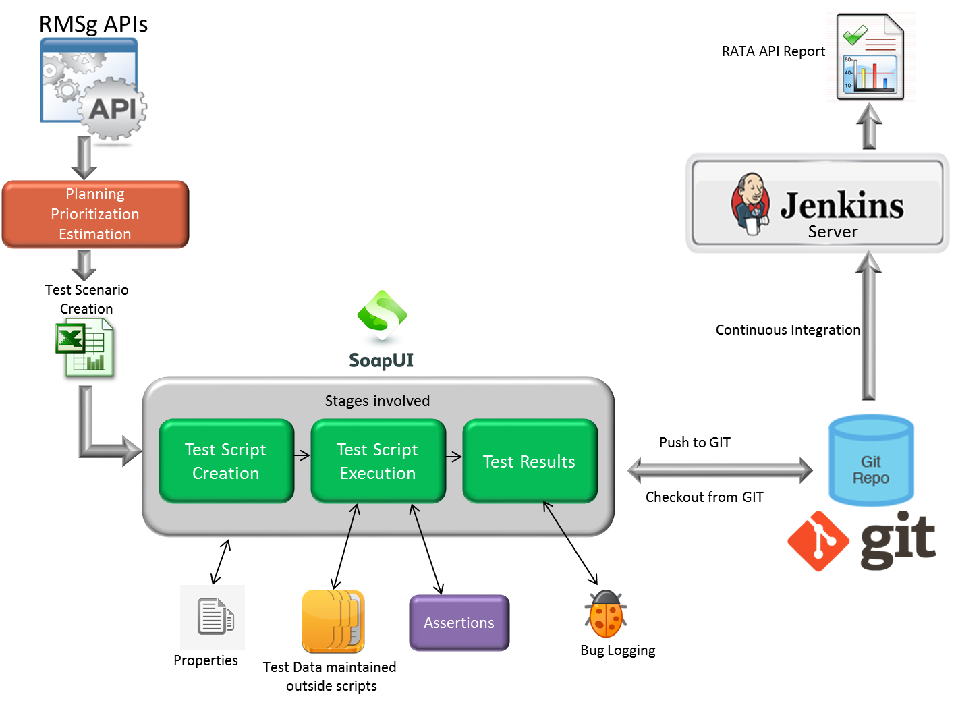
What is RATA Framework

Slide 6
RATA Process
Planning
Deciding priorities of APIs
Estimations
Estimation of IFs
Scenarios Identification
Analyzing IFs
Script creation and execution
API testing request from Dev team
Defining Timelines
Query resolution
Scenarios creation
Scenarios review
Decide approach
Test script creation
Defect logging
Test script review
Jenkins Integration
Upload project to GIT
Configure Jenkins to add SoapUI project

Slide 7
RATA Process (for Release changes)
Plan changes for new release
Identify changes in Automated APIs from ”API development plan”
Estimations
Estimation for changes
Scenarios Identification
Analyzing IFs
Script creation /modification and execution
Defining Timelines
Query resolution
Scenarios creation
Scenarios review
Decide automation approach
Test script creation/modification
Defect logging
Test script review
Upload project to GIT

Slide 8
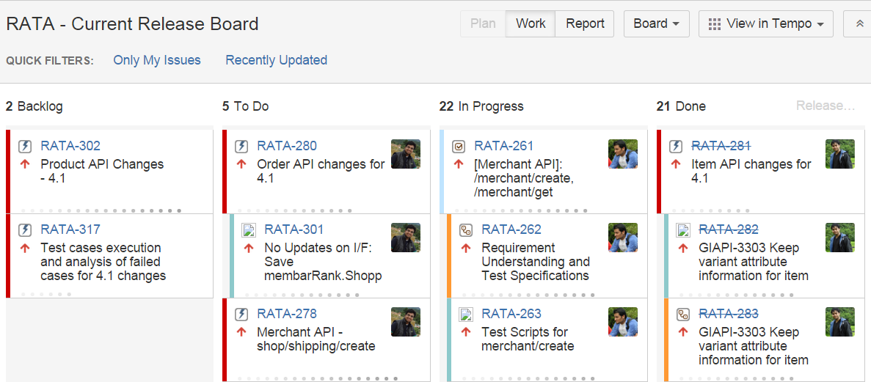
RATA Process – Kanban Board

Slide 9
Jenkins Integration
Automated Build Deployment
Immediate bug detection
Generate test reports
Notes:
9

Slide 10
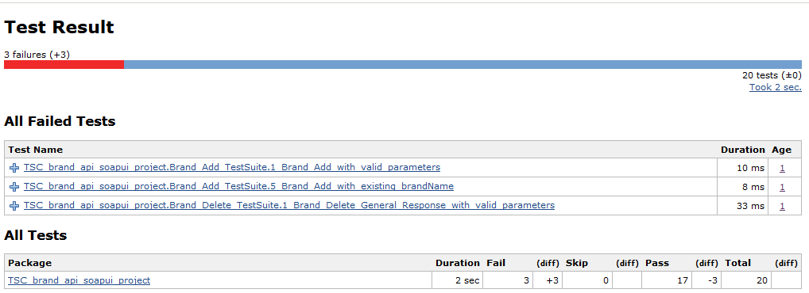
Jenkins Integration - Reporting

Slide 11
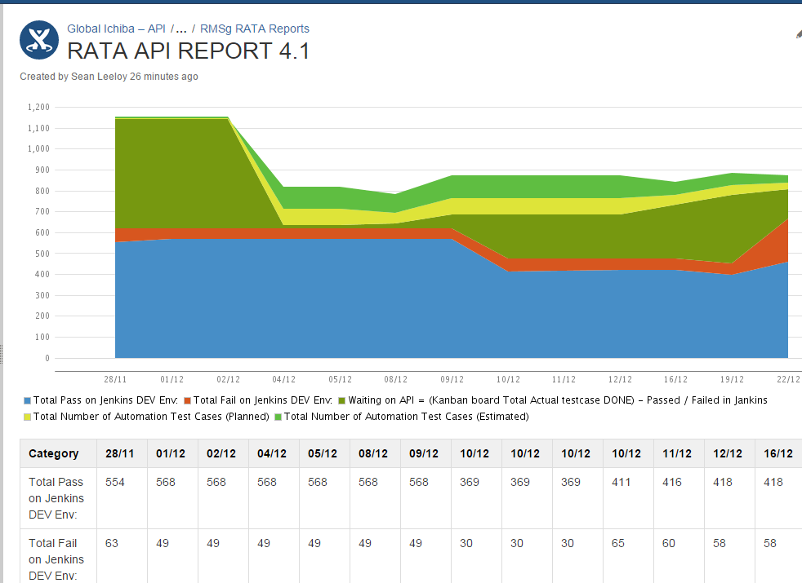
Release-wise Report
Notes:
11

Slide 12


Summary
Overview of RATA Framework
RATA Process
Jenkins Integration

Slide 13
Guidelines for RATA Project
https://rakuten.atlassian.net/wiki/display/GIAPI/API+Automation+-+Guideline

Slide 14
References:
http://www.soapui.org/
http://en.wikipedia.org/wiki/SoapUI
https://github.com/redfish4ktc/maven-soapui-extension-plugin
https://github.com/redfish4ktc/maven-soapui-extension-plugin/wiki/Goals
http://jenkins-ci.org/
http://maven.apache.org/
Notes:
14

Slide 15
Thank You!

Slide 16
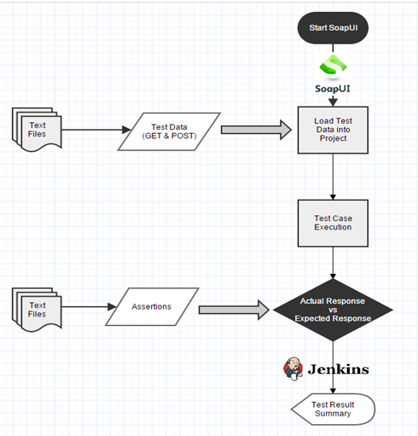
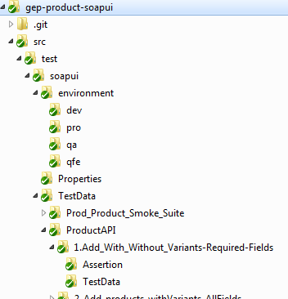
RATA Folder Structure
Git repo name
Project.xml
Properties Folder
Test Suite Name
Test Case Name
Assertion
Test Data

