Slide 1
Introducing Git version control into your team
Mark Groves
mgroves@microsoft.com
@mgroves84

Slide 2
Abstract
Over the last several years one of the biggest changes in how developers collaborate with each other has come through, of all things, their source control system. The adoption of Git has changed many of the patterns of software development. In this talk I will introduce you to the core concepts of using Git within a team, how it can improve your agility and communication.

Slide 3
Agenda
Introduction
What is Git?
Git 101
Enabling Team Development
Short vs. Long Lived Branches
Deploying with Git
Your Org uses TFS?
Tools/Resources
Notes:
Today we I’m going to talk through several core concepts within Git. How you can take advantage of it within your team. And a few powerful scenarios such as using git to handle deployments.

Slide 4
WHO AM I?
Mark Groves
Principal Program Manager
Developer Division
Notes:
My name is Mark Groves and I am a Program manager within Developer Division

Slide 5
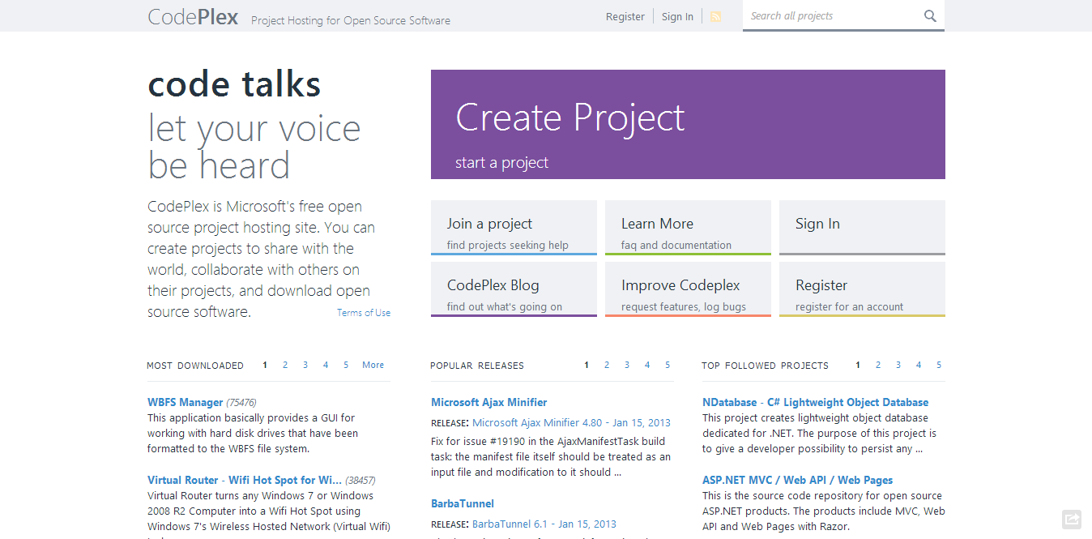
Notes:
On CodePlex. I’m pretty sure this audience is familiar with CodePlex. Before working on CodePlex, I worked on several parts of the Visual Studio product, including the UML and architectural discovery features. And in VS 2012 I worked on the Code Review and the My work Features.
So developer productivity has been something that has been close to my heart for several years.

Slide 6
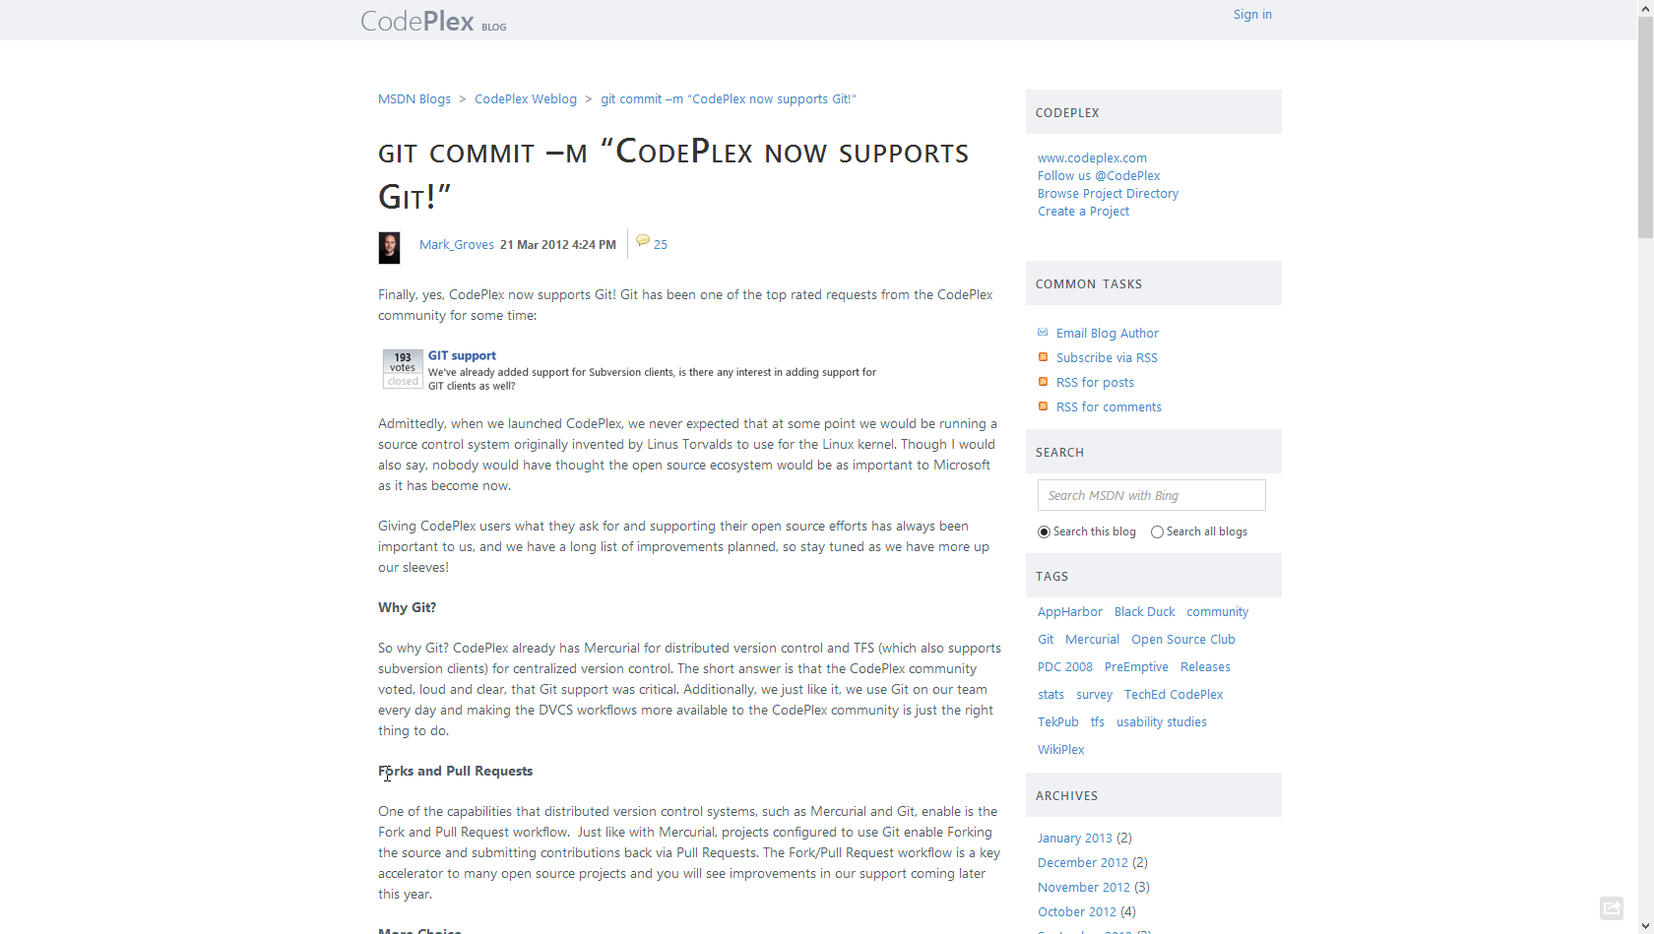
Notes:
By in March of last year, CodePlex added Git Support. You may have heard about announcement.
We now have several teams within the company using git on a daily basis. The ASP.Net Web Stack team, Entity Framework, the Typescript team, and several others. Including the CodePlex team.
I had been playing with Git on personal projects for about a year, but this was the first time I had to chance to work with a development team on a real project.

Slide 7
History

Slide 8
History
Created by Linus Torvalds for work on the Linux kernel ~2005
Notes:
Git was originally created by Linus for work on the Linux kernel right around 2005.
Although git has its origins in the Open source community, git is being used within close source projects also.

Slide 9





History
Created by Linus Torvalds for work on the Linux kernel ~2005
Some of the companies that use git:
Notes:
Git was originally created by Linus for work on the Linux kernel right around 2005.
Although git has its origins in the Open source community, git is being used within close source projects also.
This is just some of the many companies that are using git for both oss and closed sourced projects.

Slide 10
What is Git?

Slide 11
Git is a
Distributed
Version Control System
Notes:
Git is a distributed version control system.

Slide 12
OR
Notes:
Or you can think of it as

Slide 13
Git is a
Directory
Content Management System
Notes:
A directory content management system

Slide 14
Git is a
Tree
history storage system
Notes:
A tree based history storage system

Slide 15
Git is a
Stupid
content tracker
Notes:
Or How git is described on the Git Man page a Stupid content tracker.

Slide 16
How ever you think about it…

Slide 17
How ever you think about it…
Git is SUPER cool
Notes:
Git is super cool.

Slide 18
Distributed
Everyone has the complete history
Notes:
So what does it really mean to have a distributed version control system?
Everyone on your team has a complete history of the code locally.

Slide 19
Distributed
Everyone has the complete history
Everything is done offline
…except push/pull
Notes:
Just about everything in Git can be done offline.
Not just that the system works well when it is offline. It is design from the beginning to have no real dependencies on a specific server.
The only actions you do in git where you need a server is when you push or pull changes from other team members.

Slide 20
Distributed
Everyone has the complete history
Everything is done offline
No central authority
…except by convention
Notes:
In git there is no central server required. So the authority is really determined by the conventions your team puts in place.

Slide 21
Distributed
Everyone has the complete history
Everything is done offline
No central authority
Changes can be shared without a server
Notes:
Given Git’s nature you can even share changes in a peer-to –peer nature.
This does not happen often but Git does enable this ability. If your server is offline for some reason your team can still work.

Slide 22
Centralized VC vs. Distributed VC
Central Server
Remote Server
Notes:
This is over simplifying the story, but the basics are that centralized version control system define a central authority.
I am not saying one system is better that the other, it is just that each model that its benefits.
In the distributed model by definition everything is expected to be off line. To have a system that expects everything to be offline, you have to build in several local capabilities that are not required in a centralized model.
Such as local branching. And to make branching fast and lightweight you better make merging great also.
I won’t go into the guts of git that enables some of this capability in this talk, but if you are interested I will highlight some resources at the end of the talk where you can go deeper.

Slide 23
Branching
Notes:
Ok lets get into branching.

Slide 24
Branching
Forget what you know from Central VC
(…TFS, SVN, Perforce...)
Notes:
For this you need to forget what your experiences with branching in centralized version control systems.

Slide 25
Branching
Forget what you know from Central VC
Git branch is “Sticky Note” on a graph node
Notes:
A Git branch is just a sticky note on the graph.

Slide 26
Branching
Forget what you know from Central VC
Git branch is “Sticky Note” on a graph node
All branch work takes place within the same folder within your file system.
Notes:
All work happens within this one location.
When I first started using Git, it really freaked me out when I switched branches for the first time and things just disappeared.
It took me awhile to really trust what was happening. So don’t freak out it is ok.

Slide 27
Branching
Forget what you know from Central VC
Git branch is “Sticky Note” on the graph
All branch work takes place within the same folder within your file system.
When you switch branches you are moving the “Sticky Note”
Notes:
Switching between branches is just moving the sticky note around.

Slide 28
Initialization
C:\> mkdir CoolProject
C:\> cd CoolProject
C:\CoolProject > git init
Initialized empty Git repository in C:/CoolProject/.git
C:\CoolProject > notepad README.txt
C:\CoolProject > git add .
C:\CoolProject > git commit -m 'my first commit'
[master (root-commit) 7106a52] my first commit
1 file changed, 1 insertion(+)
create mode 100644 README.txt
Notes:
After you install git on your machine to get started you will need to initialize a repository.
You can do this by going into your file system, creating a folder and doing git init within the folder.
All the magic happens in the Dot Git folder. This folder IS GIT. You can copy this folder to another machine and it will work.
When I first started playing with git, I had setup a new machine, and was having a hell of a time trying to figure out how I should move my git projects over to the new machine. It was kind of embarrassing. Eventually I just tried to copy it over and it worked.
At this point you really don’t have much. You need to do your first commit to make this light up.
You create a file. When then stage it, but telling git the track this file. In this case I told git to add all files.
Then I was able to commit with a message say this is my first commit.

Slide 29
Branches Illustrated
master
A
> git commit –m ‘my first commit’
Notes:
Now lets see what this visually looks like.
On my first commit I have A.
The default branch that gets created with git is a branch names Master.
This is just a default name. As I mentioned before, most everything in git is done by convention. Master does not mean anything special to git.

Slide 30
Branches Illustrated
master
A
B
C
> git commit (x2)
Notes:
We make a set of commits, moving master and our current pointer (*) along

Slide 31
Branches Illustrated
master
A
B
C
bug123
> git checkout –b bug123
Notes:
Suppose we want to work on a bug. We start by creating a local “story branch” for this work.
Notice that the new branch is really just a pointer to the same commit (C) but our current pointer (*) is moved.

Slide 32
Branches Illustrated
master
A
B
C
D
E
bug123
> git commit (x2)
Notes:
Now we make commits and they move along, with the branch and current pointer following along.

Slide 33
Branches Illustrated
master
A
B
C
D
E
bug123
> git checkout master
Notes:
We can “checkout” to go back to the master branch.
This is where I was freaked out the first time I did this. My IDE removed the changes I just made. It can be pretty startling, but don’t worry you didn’t lose anything.

Slide 34
Branches Illustrated
master
A
B
C
D
E
bug123
> git merge bug123
Notes:
And then merge from the story branch, bringing those change histories together.

Slide 35
Branches Illustrated
master
A
B
C
D
E
> git branch -d bug123
Notes:
And since we’re done with the story branch, we can delete it. This all happened locally, without affecting anyone upstream.

Slide 36
Branches Illustrated
master
A
B
C
D
E
F
G
bug456
Notes:
Let’s consider another scenario. Here we created our bug story branch back off of (C). But some changes have happened in master (bug 123 which we just merged) since then.
And we made a couple of commits in bug 456.

Slide 37
Branches Illustrated
master
A
B
C
D
E
F
G
bug456
> git checkout master
Notes:
Again, to merge, we checkout back to master which moves our (*) pointer.

Slide 38
Branches Illustrated
master
A
B
C
D
E
H
F
G
bug456
> git merge bug456
Notes:
And now we merge, connecting the new (H) to both (E) and (G). Note that this merge, especially if there are conflicts, can be unpleasant to perform.

Slide 39
Branches Illustrated
master
A
B
C
D
E
H
F
G
> git branch -d bug456
Notes:
Now we delete the branch pointer.
But notice the structure we have now. This is very non-linear. That will make it challenging to see the changes independently. And it can get very messy over time.

Slide 40
Branches Illustrated
master
A
B
C
D
E
F
G
bug456
Notes:
Rebase flow - Let’s go back in time and look at another approach that git enables. So here we are ready to merge.

Slide 41
Branches Illustrated
master
A
B
C
D
E
F’
G’
bug456
> git rebase master
Notes:
Instead of merging, we “rebase”.
What this means is something like this:
1. Take the changes we had made against (C) and undo them, but remember what they were
2. Re-apply them on (E) instead

Slide 42
Branches Illustrated
master
A
B
C
D
E
F’
G’
bug456
> git checkout master
> git merge bug456
Notes:
Now when we merge them, we get a nice linear flow.
Also, the actual changeset ordering in the repository mirrors what actually happened. (F’) and (G’) come after E rather than in parallel to it. Also, there is one fewer snapshots in the repository.

Slide 43
Branching Review

Slide 44
Branching Review
Quick and Easy to create ‘Feature’ Branches

Slide 45
Branching Review
Quick and Easy to create ‘Feature’ Branches
Local branches are very powerful

Slide 46
Branching Review
Quick and Easy to create ‘Feature’ Branches
Local branches are very powerful
Rebase is not scary

Slide 47
Software is a Team Sport
Notes:
But of course, most of you work on software with other people.

Slide 48
Sharing commits
Tom’s Repo
Matt’s Repo
A
B
C
A
B
C
My Local Repo
Tracey’s Repo
A
B
C
A
B
C
Notes:
Since everyone on the team has a complete copy of the repository you can do things like this.
But no one wants to keep track of changes this way.

Slide 49
Adding a Remote
Notes:
This is where you add in a remote server.

Slide 50
Sharing commits
Tom’s Repo
Matt’s Repo
A
B
C
D
A
B
C
D
Remote Repo
A
B
C
D
My Local Repo
Tracey’s Repo
A
B
C
D
A
B
C
D
Notes:
There really is nothing special about the remote server. You can have more than one. But it enables a nice integration location, just like you are used to in the centralized version control

Slide 51
Setting up a Remote
Notes:
There are two ways to configure a remote within your local machine.

Slide 52
Setting up a Remote
Adding a remote to an existing local repo
C:\CoolProject > git remote add origin https://git01.codeplex.com/coolproject
C:\CoolProject > git remote -v
origin https://git01.codeplex.com/coolproject (fetch)
origin https://git01.codeplex.com/coolproject (push)
Notes:
If you have an existing repository you can just add a git remote using
Git remote add NAME. Origin is not a special name, it is just a common convention that gets used. You can name this anything you want.

Slide 53
Setting up a Remote
Clone will auto setup the remote
C:\> git clone https://git01.codeplex.com/coolproject
Cloning into 'coolproject'...
remote: Counting objects: 3, done.
remote: Total 3 (delta 0), reused 0 (delta 0)
Unpacking objects: 100% (3/3), done.
C:\> cd .\coolproject
C:\CoolProject> git remote -v
origin https://git01.codeplex.com/coolproject (fetch)
origin https://git01.codeplex.com/coolproject (push)
Notes:
If you don’t have a local copy of the repository you can clone the repository from the remote.
Doing this pulls the full repository locally, and sets up the remote connection information.

Slide 54
Setting up a Remote
Name remotes what you want

Slide 55
Setting up a Remote
Name remotes what you want
Origin is only a convention

Slide 56
Branches Illustrated
master
A
B
C
D
E
bug123
Notes:
Suppose we are here. We cloned master on (A) and have been fixing bug 123 in our story branch.

Slide 57
Branches Illustrated
origin/master
master
A
B
C
D
E
bug123
Notes:
I’ll use the orange box to indicate where the master pointer is on the remote server.
Here we are as before with our local master branch and the remote master branch both pointing at (A)

Slide 58
Branches Illustrated
origin/master
master
A
B
C
D
E
bug123
Notes:
The changes on the Bug123 branch are only known to my local machine the remote server does not have these changes. Or the bug123 branch for that matter.

Slide 59
Branches Illustrated
origin/master
master
origin/master
A
F
G
B
C
D
E
bug123
Notes:
But in fact there are two versions of the orange master pointer. One is what we last know about the upstream master and the other is what is actually up there (which we don’t know about).

Slide 60
Branches Illustrated
origin/master
master
A
B
C
D
E
bug123
> git checkout master
Notes:
So if this is what we know, we can update our master to catch up.
First we checkout master which moves our current (*) to there. Note that we are actually on our master, not the upstream one. That is always true. But the tracking branch is also pointing to (A) at this point.

Slide 61
Branches Illustrated
origin/master
master
A
F
G
B
C
D
E
bug123
> git pull origin
Notes:
Now we can do a pull on the origin (our source remote) and move both along to their new place.

Slide 62
Pull = Fetch + Merge
Fetch - updates your local copy of the remote branch
Pull essentially does a fetch and then runs the merge in one step.
Notes:
I have not talked about Pull before. The pull command is combination of a fetch from the remote server and a merge of the changes.
You can do these steps separately, but if you are not working on the branch you are pulling down, pull is just a nice way to get up to date.

Slide 63
Branches Illustrated
origin/master
master
A
F
G
B
C
D
E
bug123
Notes:
Now we can do a pull on the origin (our source remote) and move both along to their new place.

Slide 64
Branches Illustrated
origin/master
master
A
F
G
B
C
D
E
bug123
> git checkout bug123
Notes:
Returning to our bug fix now by checkout on that, we have a similar problem to what we saw before. B-C-D-E all come before F and G. Merging would create issues, right?

Slide 65
Branches Illustrated
origin/master
master
A
F
G
B’
C’
D’
E’
bug123
> git rebase master
Notes:
So we use rebase to rewind and replay B-C-D-E after G.

Slide 66
Branches Illustrated
origin/master
master
A
F
G
B’
C’
D’
E’
bug123
> git checkout master
Notes:
Then we checkout back to master

Slide 67
Branches Illustrated
origin/master
master
A
F
G
B’
C’
D’
E’
bug123
> git merge bug123
Notes:
And merge. Note that the orange (upstream) pointer is still “back there”.

Slide 68
Branches Illustrated
origin/master
master
A
F
G
B’
C’
D’
E’
bug123
> git push origin
Notes:
And finally, because we want to publish these changes, we push to the origin, moving the orange pointer along.

Slide 69
Push
Pushes your changes upstream
Git will reject pushes if newer changes exist on remote.
Good practice: Pull then Push
Notes:
Push will update the remote server.
If you are out of date, Git will reject that push.
Git will require you to merge locally, then push the results.

Slide 70
Branches Illustrated
origin/master
master
A
F
G
B’
C’
D’
E’
bug123
Notes:
And finally, because we want to publish these changes, we push to the origin, moving the orange pointer along.

Slide 71
Branches Illustrated
origin/master
master
A
F
G
B’
C’
D’
E’
> git branch -d bug123
Notes:
Delete the story branch and we’re good to go

Slide 72
Adding a Remote Review
Adding a remote makes it easy to share
Pulling from the remote often helps keep you up to date
Notes:
Suggestion, update your local repository at least once a day. Makes it easier to see what is going on upstream.

Slide 73
Short vs. Long-Lived Branches
Local branches are short lived

Slide 74
Short vs. Long-Lived Branches
Local branches are short lived
Staying off master keeps merges simple

Slide 75
Short vs. Long-Lived Branches
Local branches are short lived
Staying off master keeps merges simple
Enables working on several changes at once

Slide 76
Short vs. Long-Lived Branches
Local branches are short lived
Staying off master keeps merges simple
Enables working on several changes at once
Create
Commit
Merge
Delete
Notes:
The process of Creating a local branch, commit your changes, merge it into the shared branch and then deleting the branch…

Slide 77
Short vs. Long-Lived Branches
Great for multi-version work
Notes:
Define branches for the next version of the product.

Slide 78
Short vs. Long-Lived Branches
Great for multi-version work
Follow same rules as Master

Slide 79
Short vs. Long-Lived Branches
Great for multi-version work
Follow same rules as Master…Story branches

Slide 80
Short vs. Long-Lived Branches
Great for multi-version work
Follow same rules as Master…Story branches
Integrate frequently

Slide 81
Short vs. Long-Lived Branches
Great for multi-version work
Follow same rules as Master…Story branches
Integrate frequently
Pushed to Remotes

Slide 82
Branches Illustrated
origin/master
master
E
Notes:
Say we want to start working on the next version of our Cool Project

Slide 83
Branches Illustrated
origin/master
master
E
develop
> git branch develop
Notes:
Say we want to start working on the next version of our Cool Project. We will want to create a develop branch

Slide 84
Branches Illustrated
origin/master
master
E
develop
origin/develop
> git push origin develop
Notes:
To share this with the team we need to push it up to the remote

Slide 85
Branches Illustrated
origin/master
master
E
develop
origin/develop
> git checkout develop
Notes:
To share this with the team we need to push it up to the remote

Slide 86
Branches Illustrated
origin/master
master
E
F
G
develop
origin/develop
Notes:
Lets say there are some changes on develop from other team members. Until we do a pull we won’t see these changes locally

Slide 87
Branches Illustrated
origin/master
master
E
F
G
develop
origin/develop
> git pull origin develop
Notes:
Pull some changes from other team members… you should be doing this at least once a day.

Slide 88
Branches Illustrated
origin/master
master
E
F
G
develop
origin/develop
idea
> git checkout –b idea
Notes:
Now we have an idea. We create a working branch off of development

Slide 89
Branches Illustrated
origin/master
master
E
F
G
H
develop
origin/develop
idea
> git commit
Notes:
Now we have an idea. We create a working branch off of development

Slide 90
Branches Illustrated
origin/master
master
E
I
F
G
H
develop
origin/develop
idea
Notes:
One of your teammates did a hotfix in production

Slide 91
Branches Illustrated
origin/master
master
E
I
F
G
H
develop
origin/develop
idea
> git pull (at least daily)
Notes:
Since we are keeping up to date. Just doing a pull or fetch now and then is a good idea.

Slide 92
Branches Illustrated
origin/master
master
E
I
F
G
H
develop
origin/develop
idea
> git checkout develop
Notes:
Merge Idea into Develop. First we want to checkout develop

Slide 93
Branches Illustrated
origin/master
master
E
I
F
G
H
develop
origin/develop
idea
> git merge idea (fast forward merge)
Notes:
Since there was not any additional changes on develop we could easily merge idea into develop. – This is call a fast forward merge since git is really just moving the pointer to H

Slide 94
Branches Illustrated
origin/master
master
E
I
F
G
H
develop
origin/develop
> git branch –d idea
Notes:
We can delete idea now

Slide 95
Branches Illustrated
origin/master
master
E
I
F
G
H
develop
origin/develop
> git push origin develop
Notes:
We now need to share develop with the rest of the team.

Slide 96
Merge Flow vs. Rebase Flow
origin/master
master
E
I
F
G
H
develop
origin/develop
> git push origin develop
Notes:
When we are ready to move the develop branch to production (master) we have two choices. We can go through the merge flow, or a rebase flow.

Slide 97
Branches Illustrated – Merge Flow
origin/master
master
E
I
F
G
H
develop
origin/develop
> git checkout master
Notes:
Move onto master

Slide 98
Branches Illustrated – Merge Flow
origin/master
master
E
I
J
F
G
H
develop
origin/develop
> git merge develop
Notes:
Move onto master

Slide 99
Branches Illustrated – Merge Flow
origin/master
master
E
I
J
F
G
H
develop
origin/develop
> git push origin
Notes:
Move onto master

Slide 100
Branches Illustrated – Rebase Flow
origin/master
master
E
I
F
G
H
develop
origin/develop
> git checkout master
Notes:
Rebase flow - Move onto master

Slide 101
Branches Illustrated – Rebase Flow
origin/master
I
master
E
F
G
H
I’
develop
origin/develop
> git rebase develop
Notes:
Rebase flow - Move onto master

Slide 102
Branches Illustrated – Rebase Flow
origin/master
master
E
F
G
H
I’
develop
origin/develop
> git push origin
Notes:
Rebase flow – Get Origin up to date

Slide 103
Rebase Flow
origin/master
master
E
F
G
H
I’
develop
origin/master
origin/develop
master
E
I
J
F
G
H
Merge Flow
develop
origin/develop
Notes:
As with most things with Git, there are multiple ways to do something. Using a Merge flow verse a Rebase flow is a matter of taste, but as you can see the rebase flow looks cleaner and as you get into large projects the number of branches can get pretty messy.
This is a simple example of rewriting history in git.

Slide 104
Short vs. Long-Lived Branches
Great for multi-version work
Follow same rules as Master
…use Story branches
Define your conventions
What branches do you want to share?
Branch per environment?
Notes:
Git is really powerful, but when you start working with a team it is best to come up with a few conventions that you can agree upon.
Are you going to treat master as a production branch.
No work happen in master, everything happens in a combination of shared feature branches and personal local branches.

Slide 105
Deploying with Git
Notes:
As we have seen git is pretty powerful to enable sharing of code between team members. But git can also be used to deploy to several services.

Slide 106
Deploying with Git
Developer “FTP”
Notes:
You can almost think of git as a protocol.

Slide 107
Deploying with Git
Developer “FTP”
Additional Branches pointing at:
Notes:
You can almost think of git as a protocol.

Slide 108
Deploying with Git
Developer FTP
Additional Branches pointing at:
Test, Staging , Production
Notes:
You can setup multiple remotes, each pointing at a specific environment.

Slide 109
Deploying with Git
Developer FTP
Additional Branches pointing at:
Test, Staging , Production
Post Commit Hooks Automate deployments
Notes:
Adding Post Commit hooks can automate deployments on changes.

Slide 110
Cloud Providers – Git Support
AppHarbor
Heroku
Nodejitsu
Windows Azure
… to name a few
Notes:
Adding Post Commit hooks can automate deployments on changes.

Slide 111
Simple Azure Deploy

Slide 112
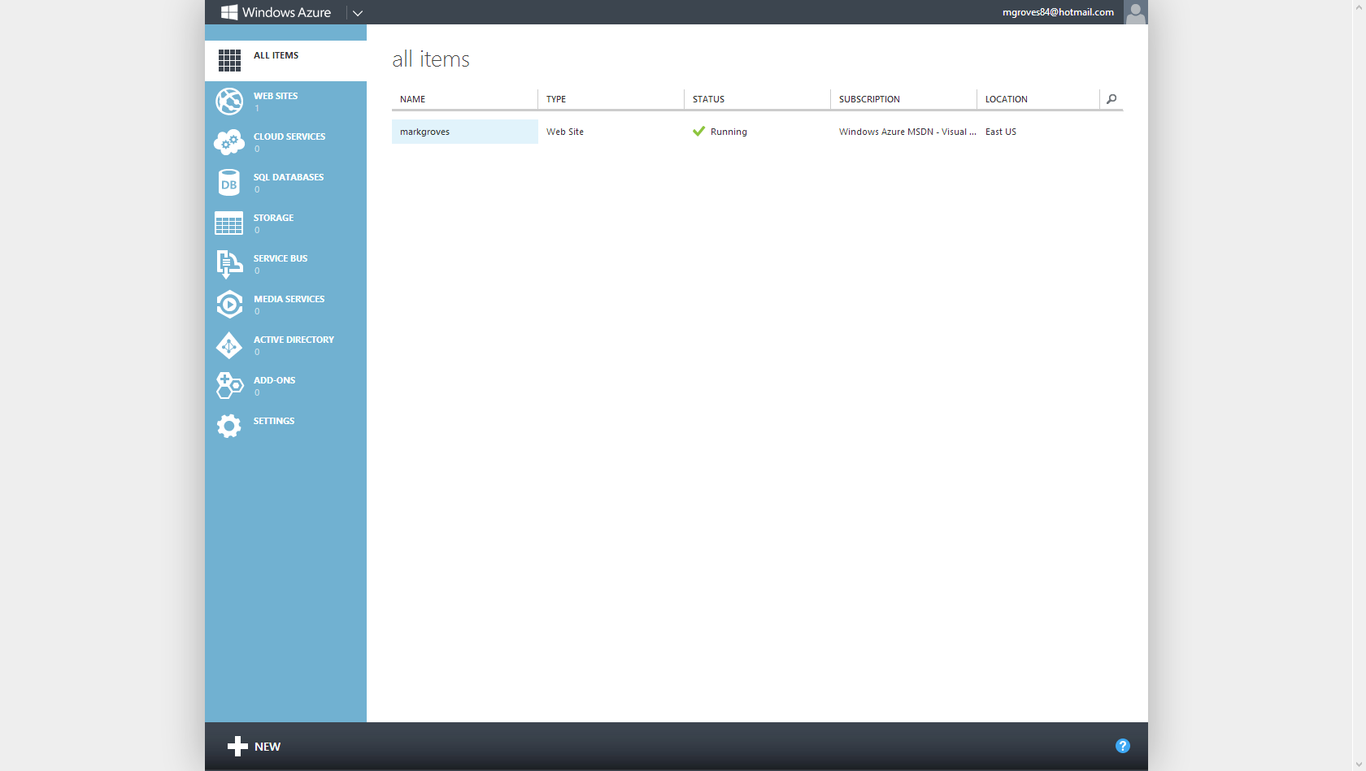

Slide 113
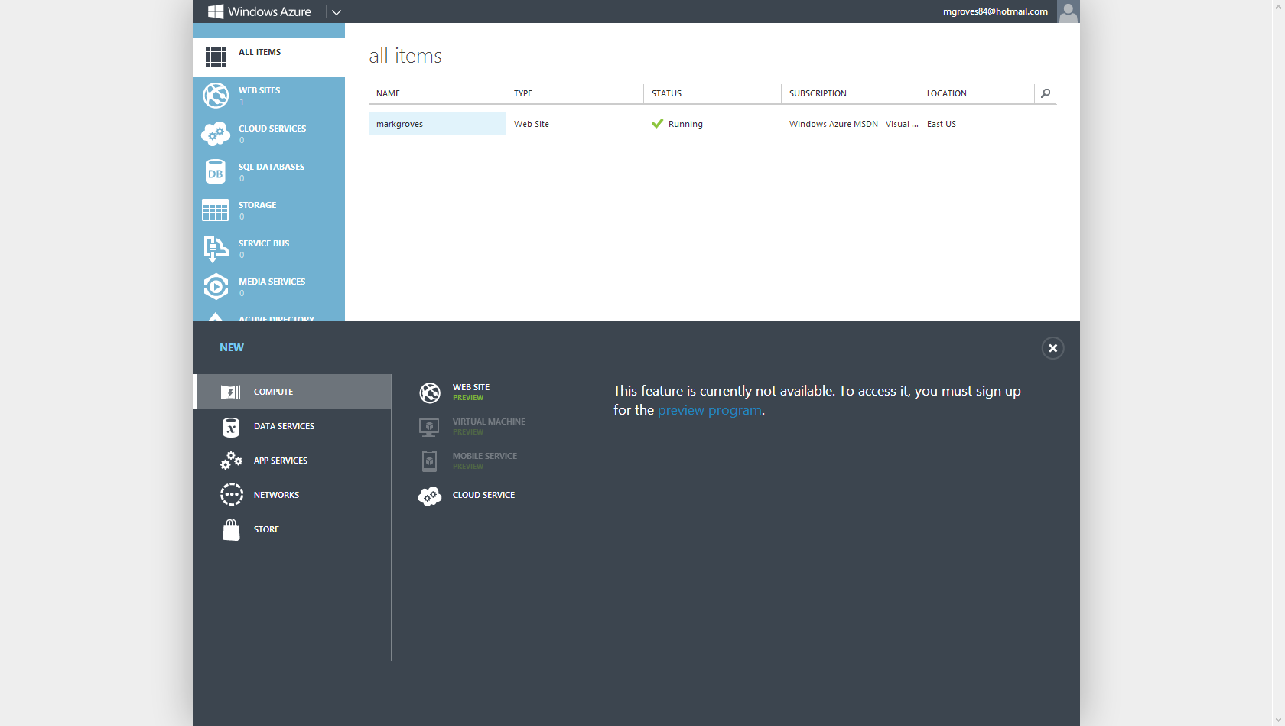

Slide 114
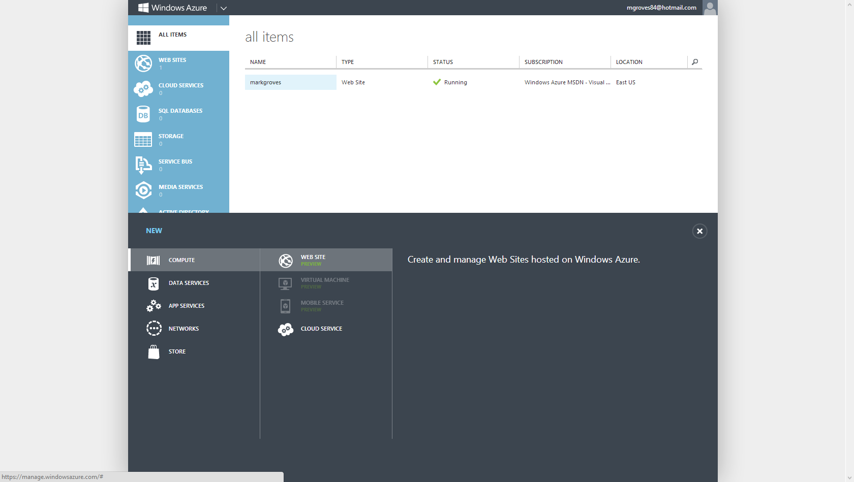

Slide 115
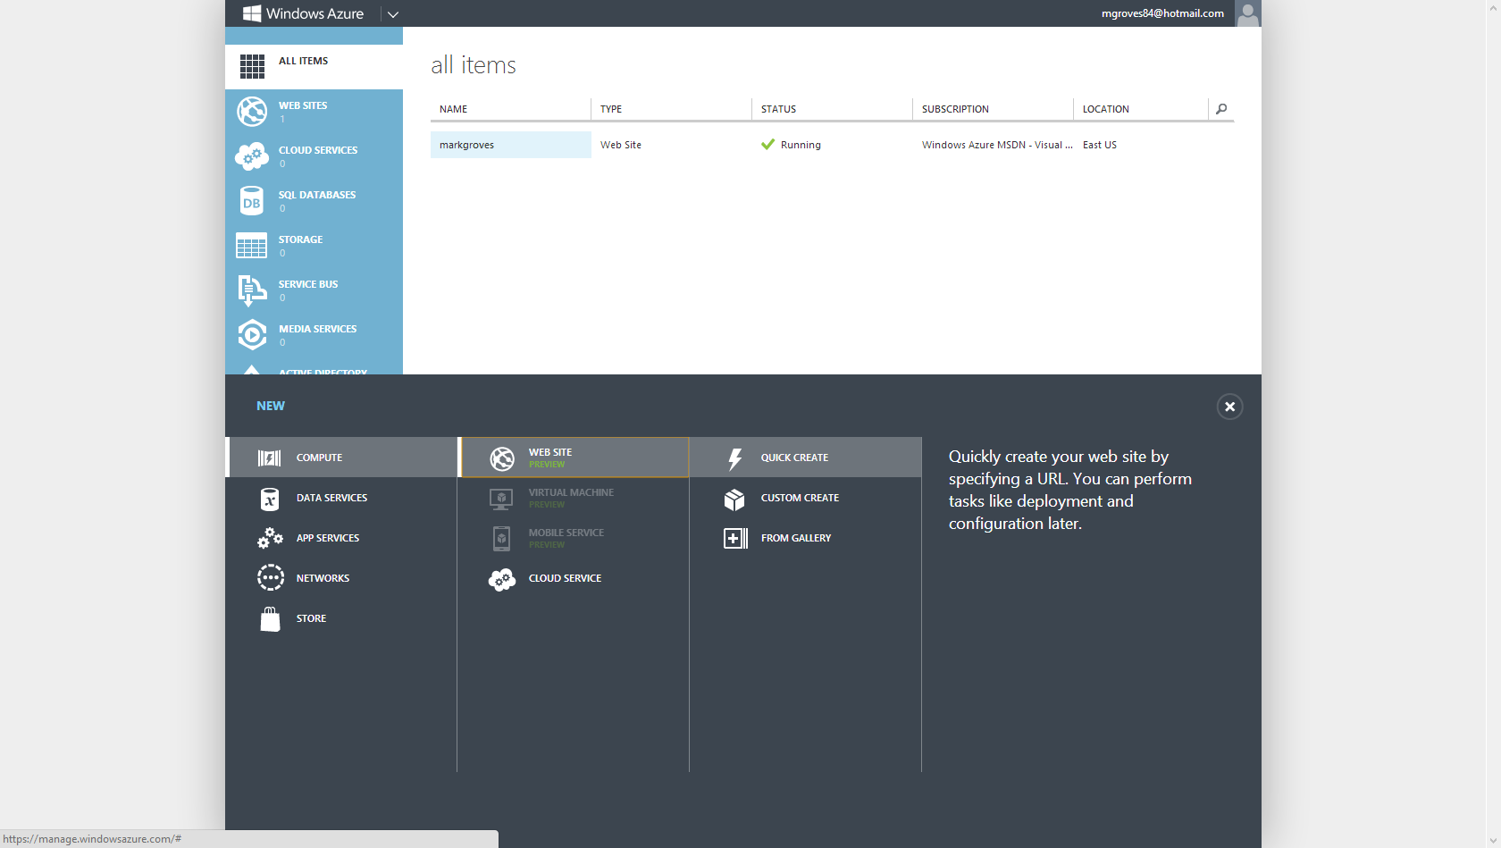

Slide 116
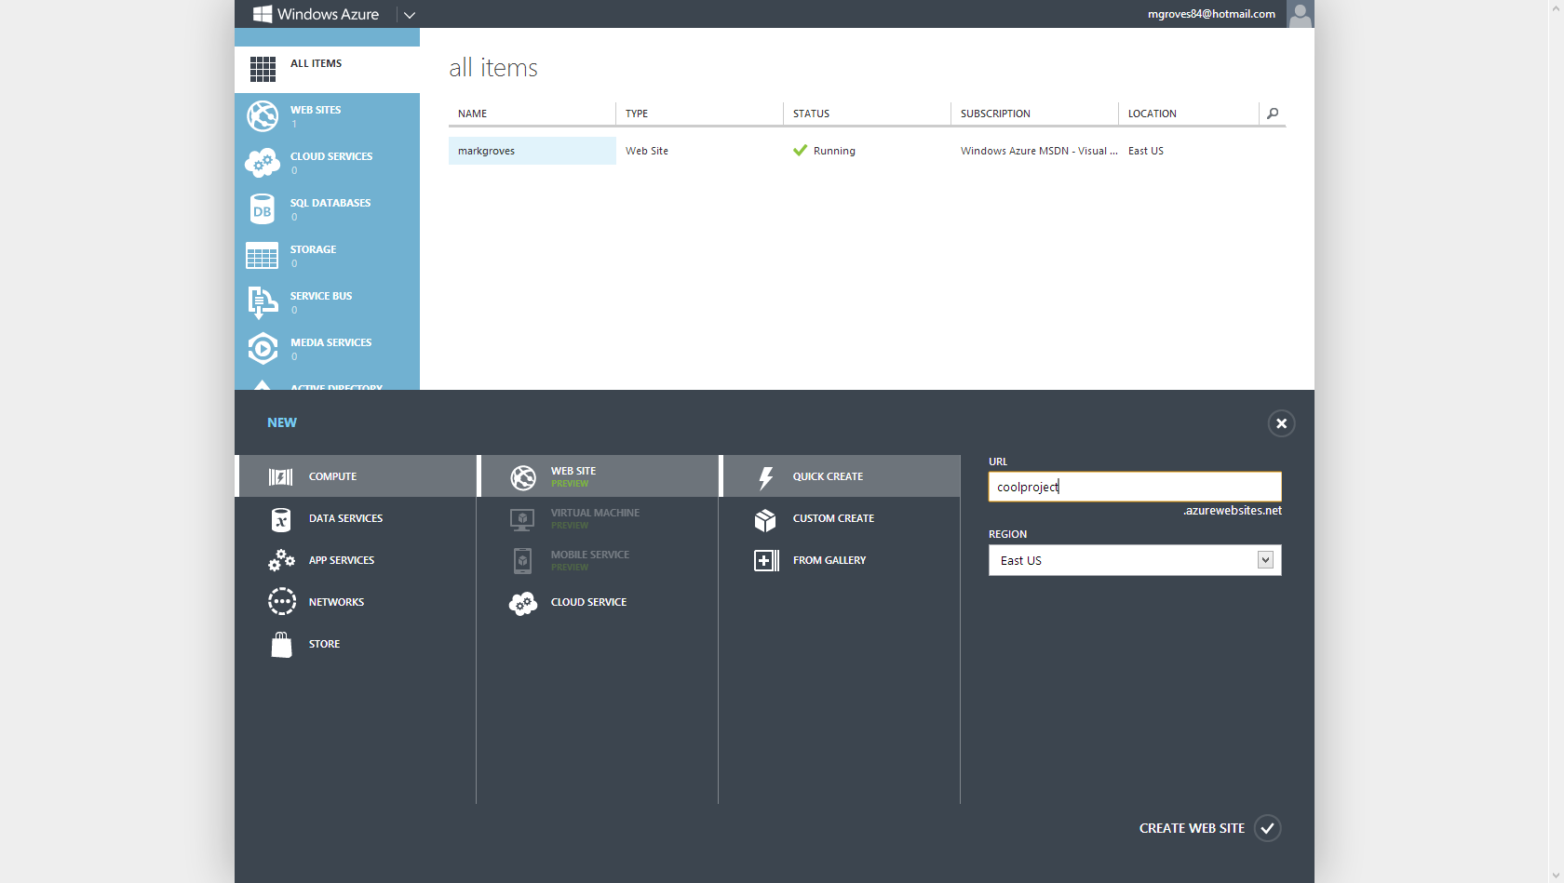

Slide 117
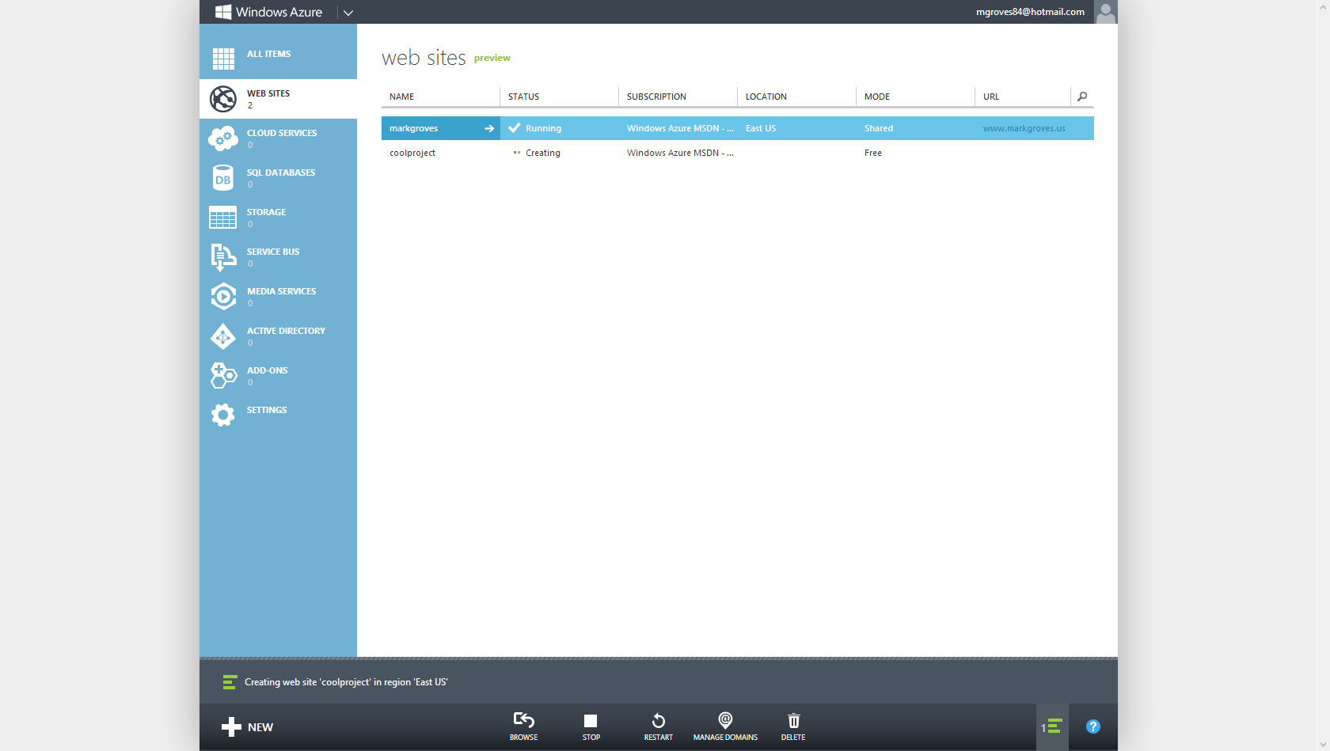

Slide 119
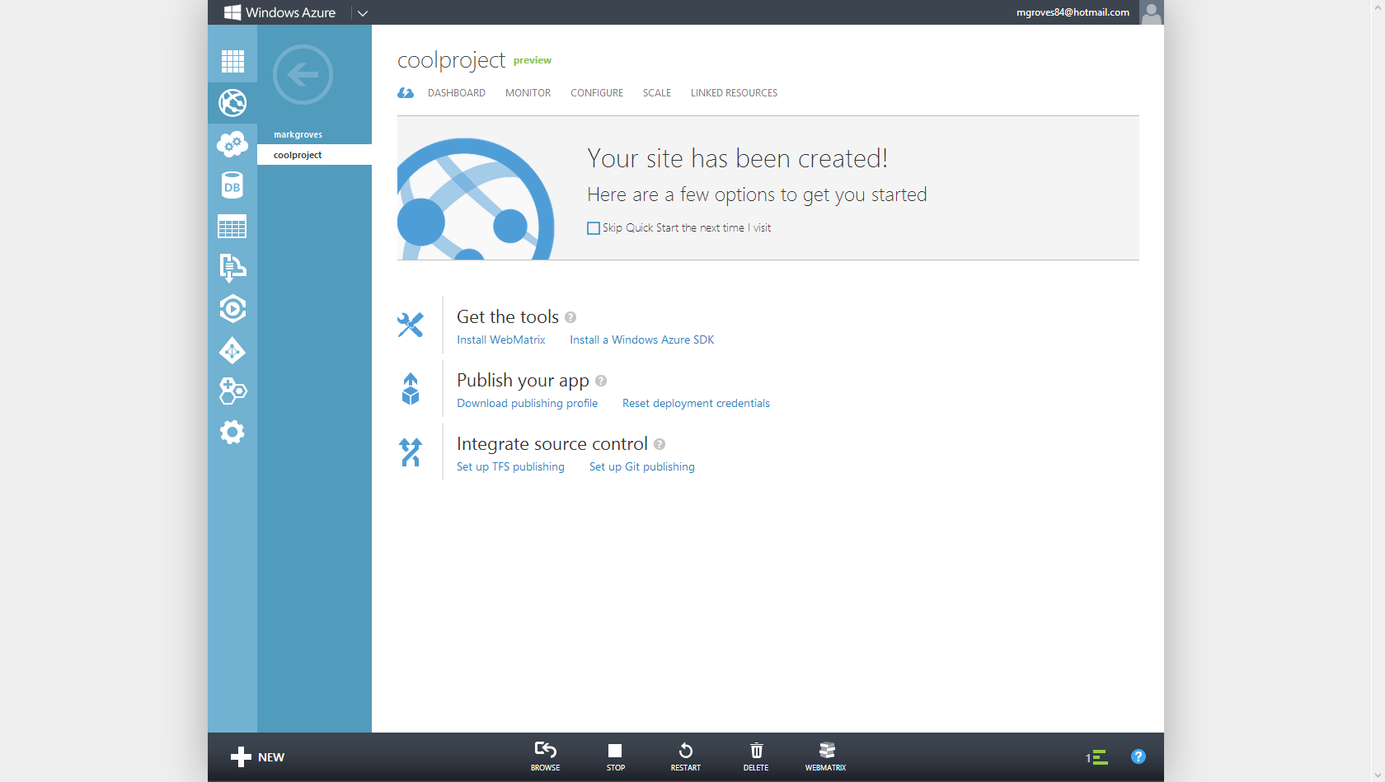

Slide 120
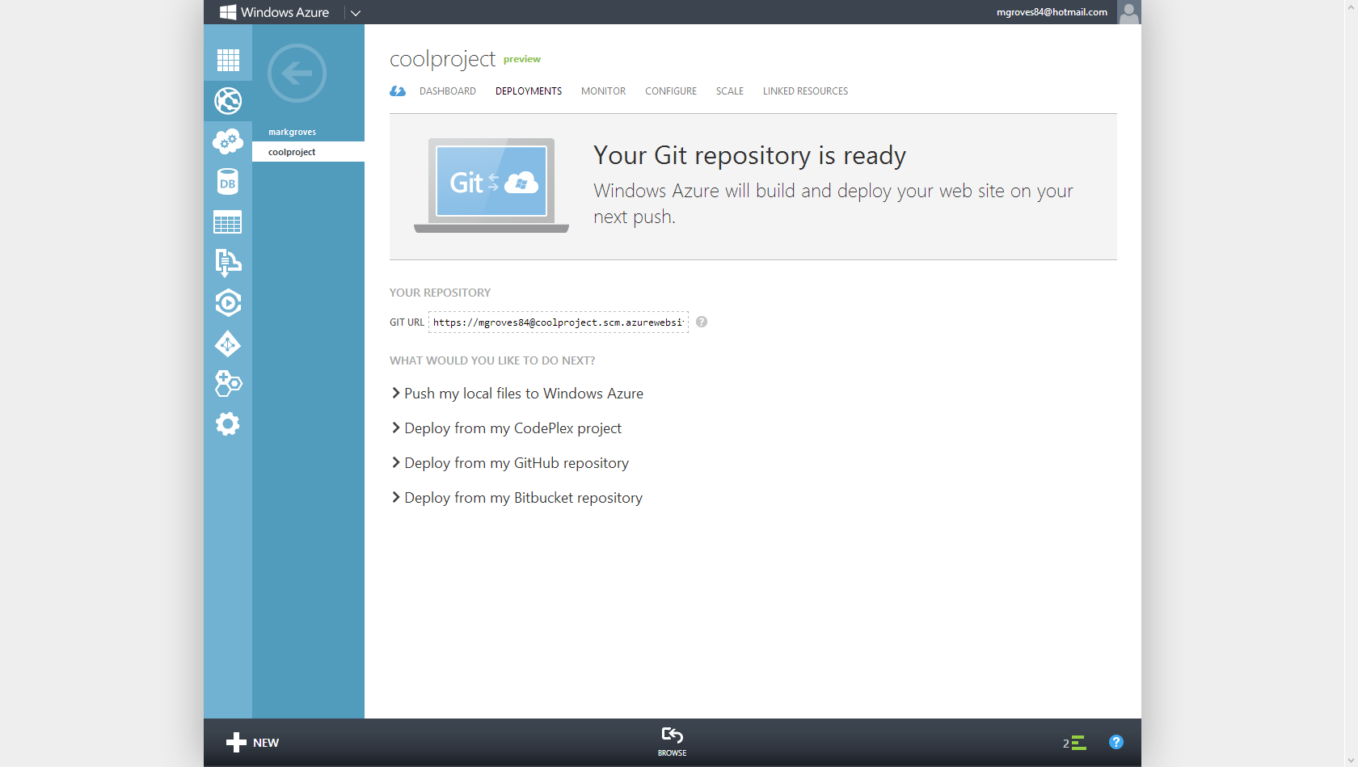

Slide 121
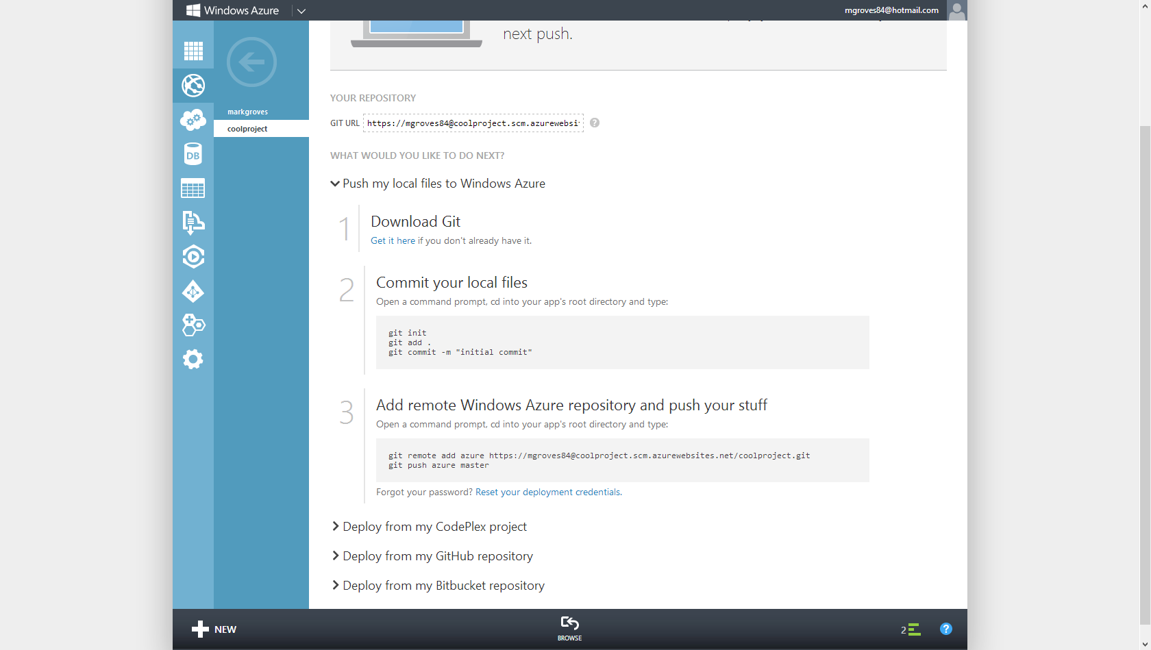

Slide 122
C:\CoolProject > git remote add azure https://mgroves84@coolproject.scm.azurewebsites.net/coolproject.git
C:\CoolProject > git remote -v
azure https://mgroves84@coolproject.scm.azurewebsites.net/coolproject.git (fetch)
azure https://mgroves84@coolproject.scm.azurewebsites.net/coolproject.git (push)
origin https://git01.codeplex.com/coolproject (fetch)
origin https://git01.codeplex.com/coolproject (push)
C:\CoolProject > git push azure master
Counting objects: 3, done.
Writing objects: 100% (3/3), 226 bytes, done.
Total 3 (delta 0), reused 0 (delta 0)
remote: New deployment received.
remote: Updating branch 'master'.
remote: Updating submodules.
remote: Preparing deployment for commit id '7106a52771'.
remote: Preparing files for deployment.
remote: Deployment successful.
To https://mgroves84@coolproject.scm.azurewebsites.net/coolproject.git
* [new branch] master -> master

Slide 123
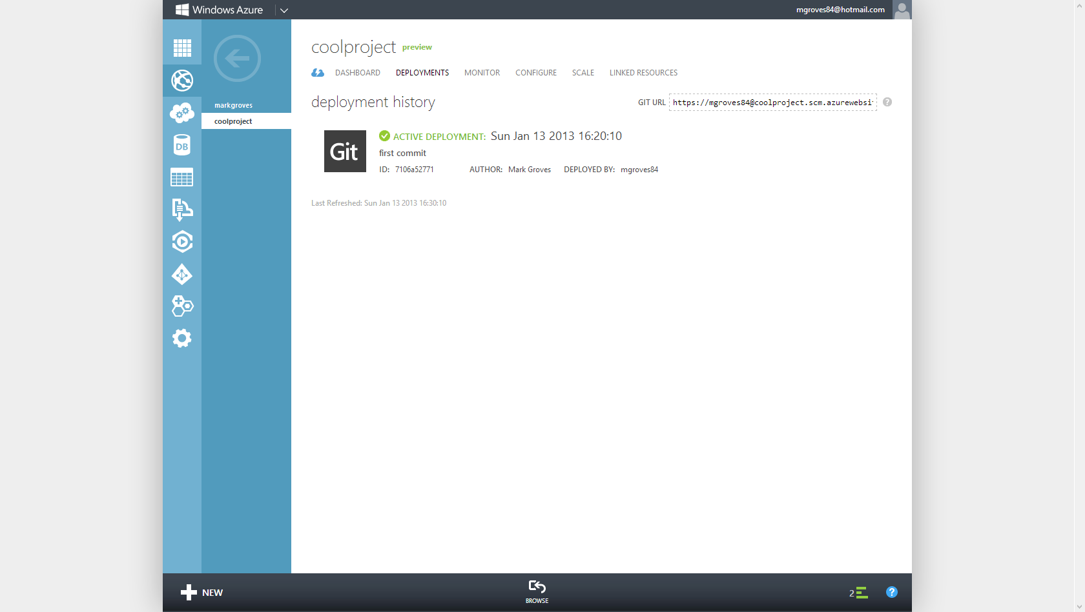

Slide 124
Git Deployment
Simple workflow
Notes:
Adding Post Commit hooks can automate deployments on changes.

Slide 125
Git Deployment
Simple workflow
Add Hooks to deploy on Commit
Notes:
Adding Post Commit hooks can automate deployments on changes.

Slide 126
Git Deployment
Simple workflow
Add Hooks to deploy on Commit
Can get more advanced
Notes:
Adding Post Commit hooks can automate deployments on changes.

Slide 127
Git Deployment
Simple workflow
Add Hooks to deploy on Commit
Can get more advanced
Add Build machines, push on success
Notes:
Adding Post Commit hooks can automate deployments on changes.

Slide 128
Your Org uses TFS?
Notes:
What if your organization uses TFS? Can this git stuff be used at all?

Slide 129
Your Org uses TFS? Sure Use Git-TF
Local workflow with Git
Notes:
What if your organization uses TFS? Can this git stuff be used at all?

Slide 130
Your Org uses TFS? Sure Use Git-TF
Local workflow with Git
Push to TFS as a Remote
Notes:
What if your organization uses TFS? Can this git stuff be used at all?

Slide 131
Your Org uses TFS? Sure Use Git-TF
Local workflow with Git
Push to TFS as a Remote
Multi-Platform and Open Source
Notes:
Git TF is multi-platform. If you have a team working on OSX they can use Git Locally and push to a central TFS server.

Slide 132
Your Org uses TFS? Sure Use Git-TF
Local workflow with Git
Push to TFS as a Remote
Multi-Platform and Open Source
http://gittf.codeplex.com
Notes:
Git TF is multi-platform. If you have a team working on OSX they can use Git Locally and push to a central TFS server.

Slide 133
Individual Developer Workflow
C:\CoolProject > git tf clone http://myserver:8080/tfs $/TeamProjectA/Main
Make changes to the file in the Git repo
C:\CoolProject > git commit -a -m "commit one" (commit changes locally)
Make more changes
C:\CoolProject > git commit -a -m "commit two"
C:\CoolProject > git tf pull --rebase
C:\CoolProject > git tf checkin

Slide 134
Git-TF for larger teams
TFS
Shared Git Repo
A
B
C
git push
git tf clone
git clone
git clone
Tom’s Repo
Matt’s Repo
Tracey’s Repo
A
B
C
A
B
C
A
B
C
Notes:
For larger teams, it is not recommended to share changes directly between each using Git (Git push/pull)
If development teams want to share changes in git then using a single authority model works best.
This pattern works well for teams that don’t share code with others using TFS often. For example the iOS team.

Slide 135
Git-TF
Local workflow with Git
Push to TFS as a Remote
Multi-Platform and Open Source
http://gittf.codeplex.com
Notes:
Git TF is multi-platform. If you have a team working on OSX they can use Git Locally and push to a central TFS server.

Slide 136
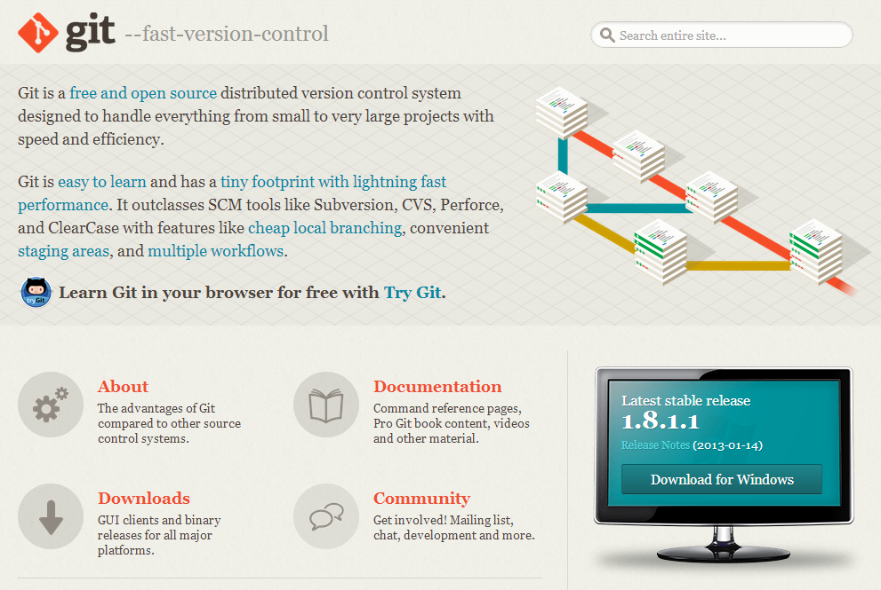
http://Git-SCM.com

Slide 137
Tools / Resources
Pro Git (Book) http://www.git-scm.com/book
TortoiseGit (with TortoiseMerge) http://code.google.com/p/tortoisegit
Msysgit (includes git-bash) http://code.google.com/p/msysgit
Posh-Git (for PowerShell users) http://github.com/dahlbyk/posh-git
GitScc (Visual Studio integration) http://gitscc.codeplex.com/
Windows Git Credential Store http://gitcredentialstore.codeplex.com/
GitHub for Windows http://windows.github.com/

Slide 138
Thanks!
mgroves@microsoft.com
@mgroves84

