Slide 1
MRIM 1.5T CMRtools

Slide 2
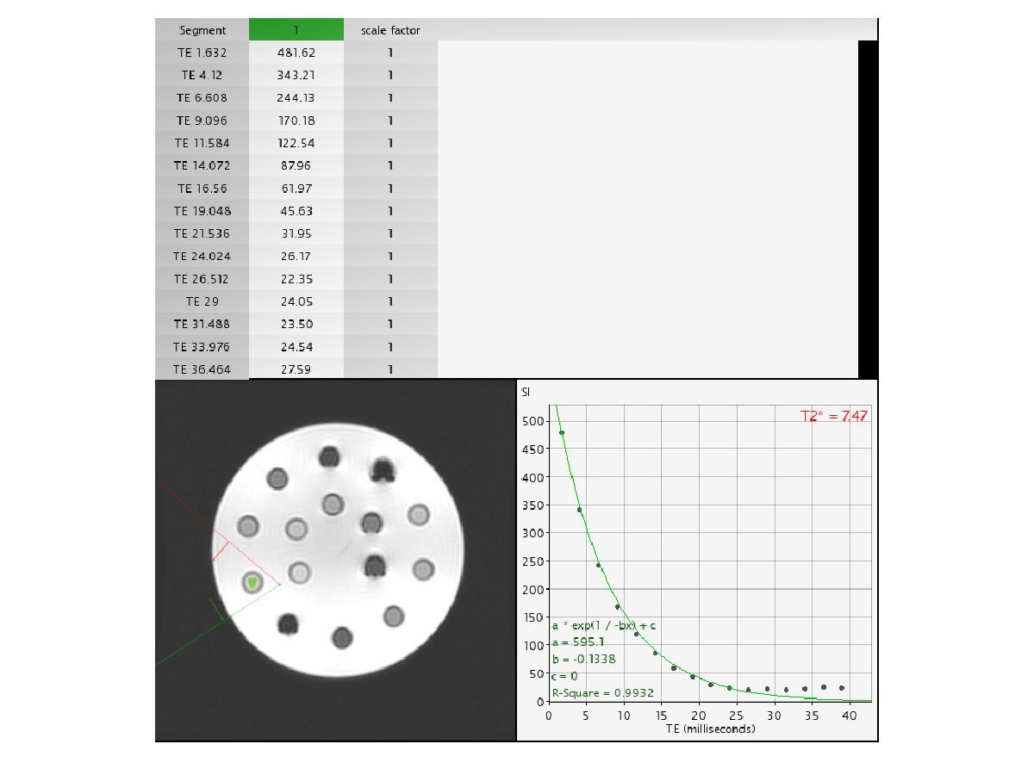
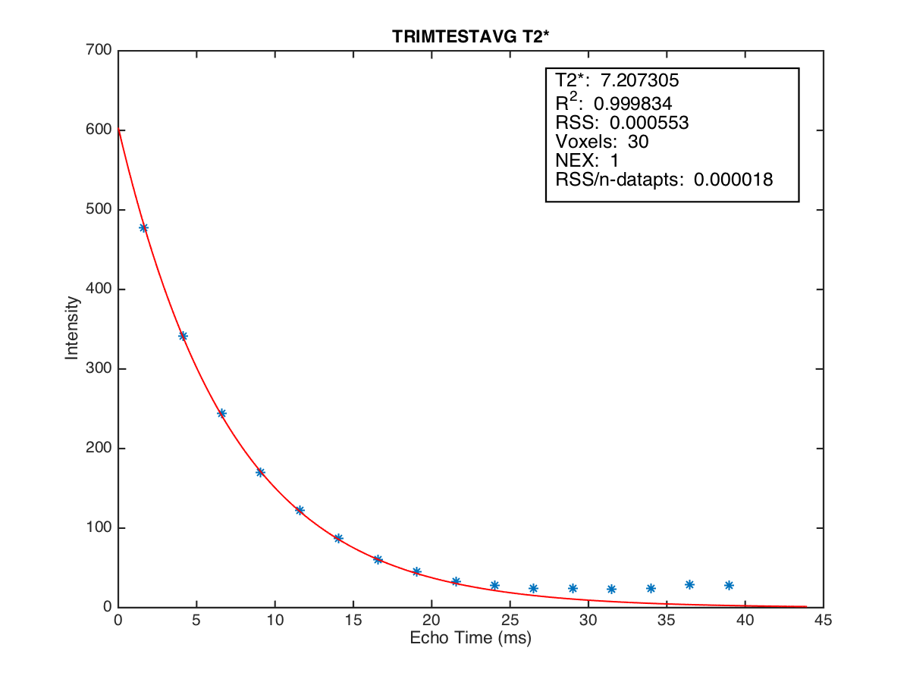

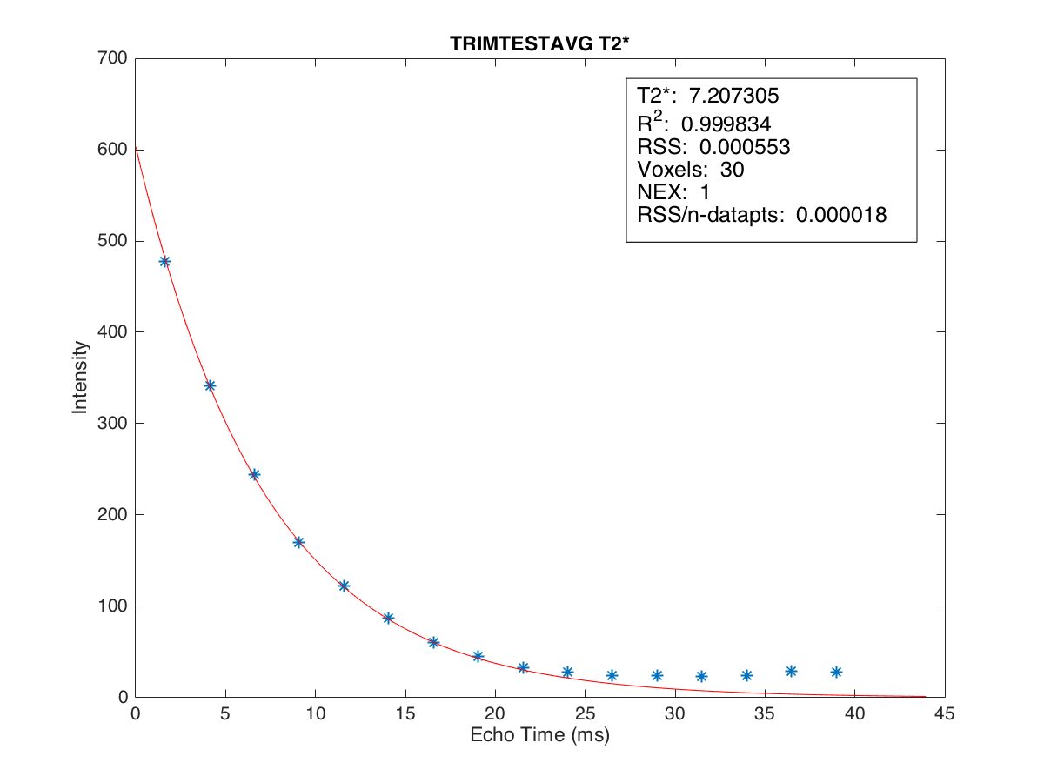

no point condition
CMRtools
T2*=7.207
position1
Conc. 0.504737
2014-09-30
3 point condition
4 point condition
T2*=7.207
T2*=7.207

Slide 3
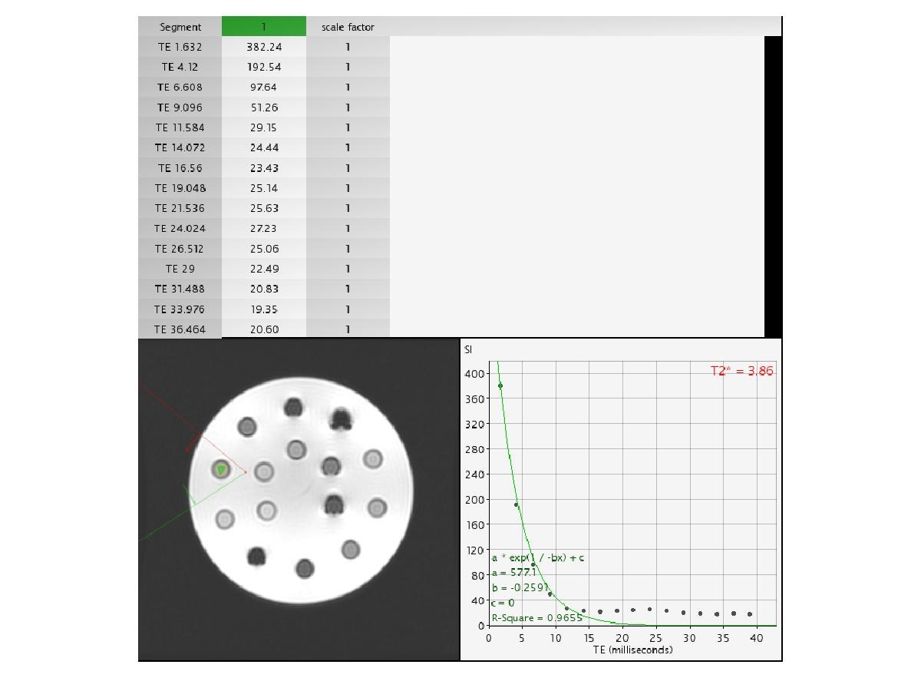
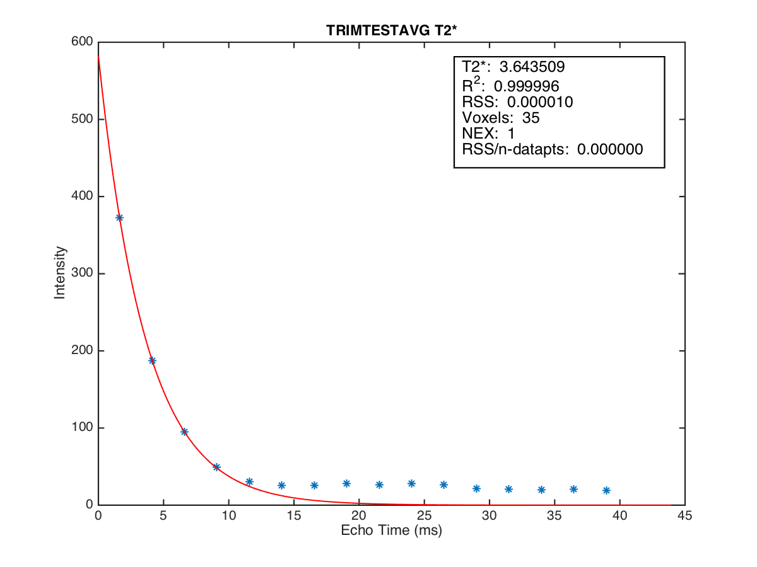
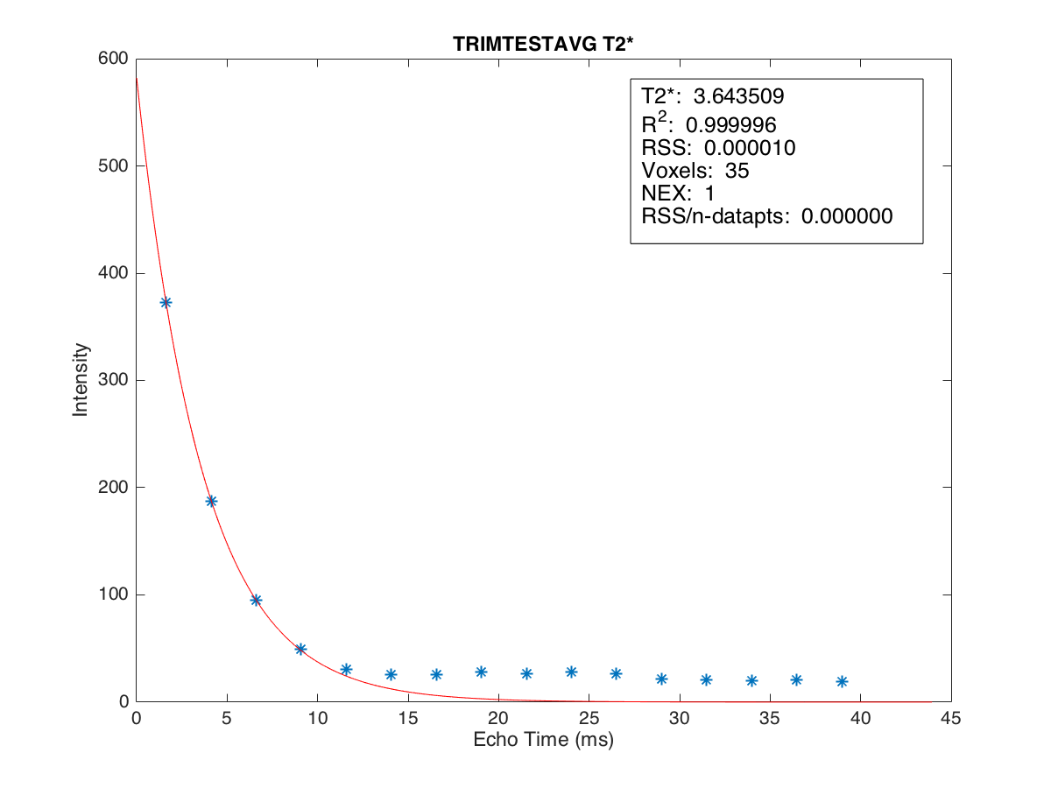
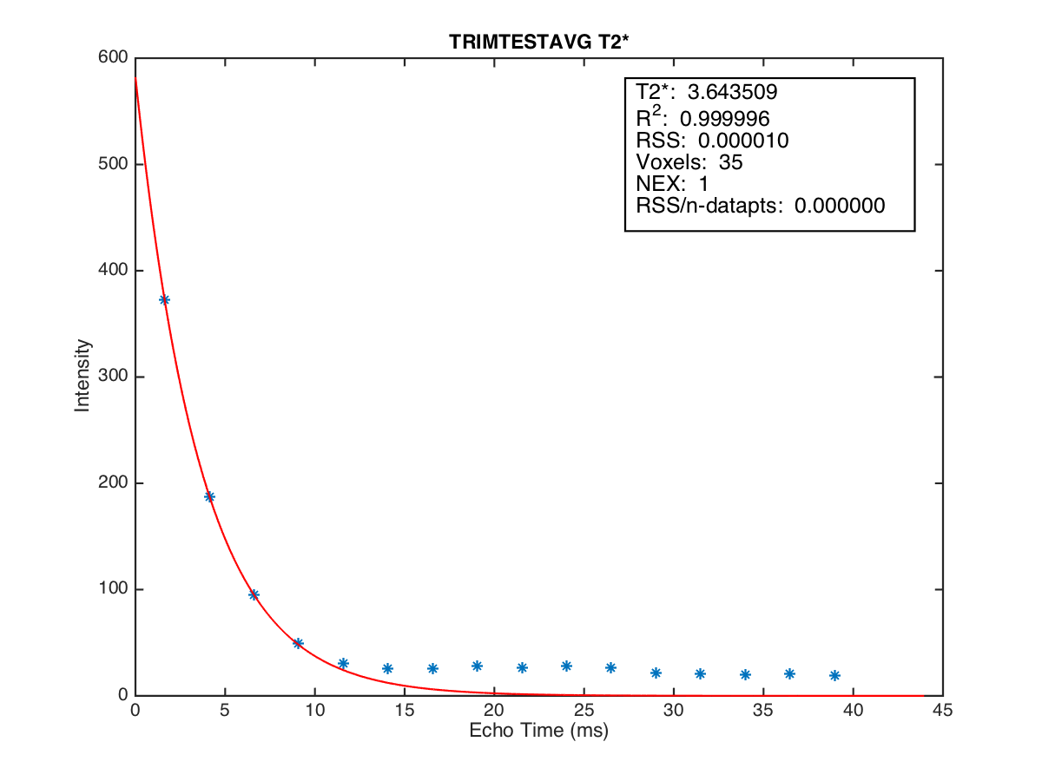
no point condition
T2*=3.644
position2
Conc. 0.78872
2014-09-30
3 point condition
4 point condition
T2*=3.644
T2*=3.644

Slide 4

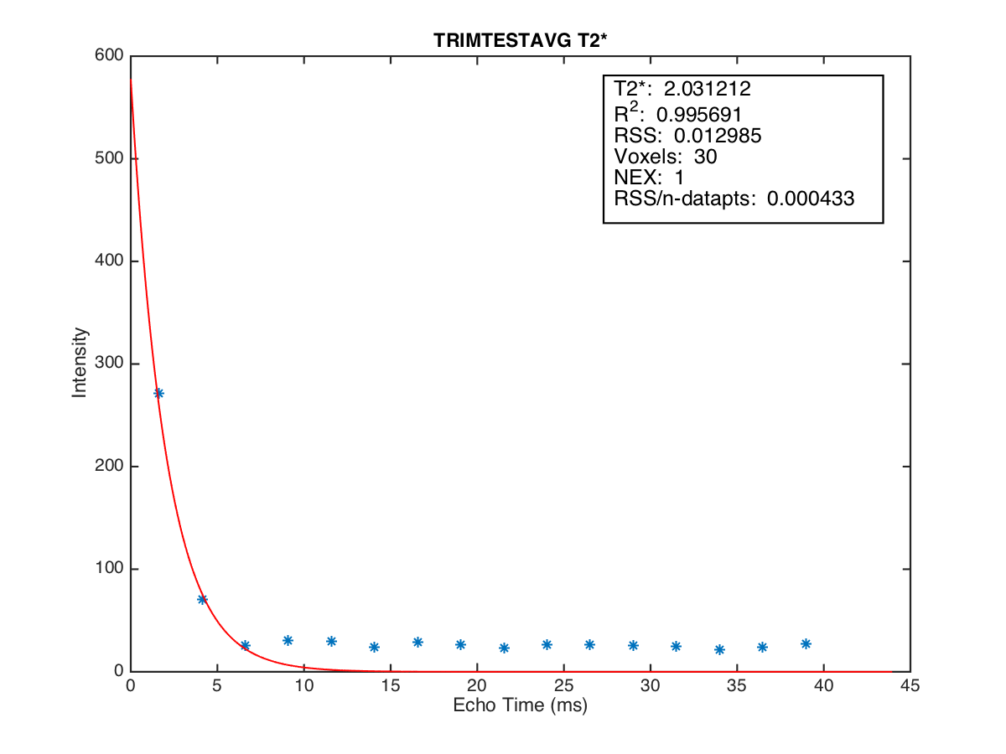
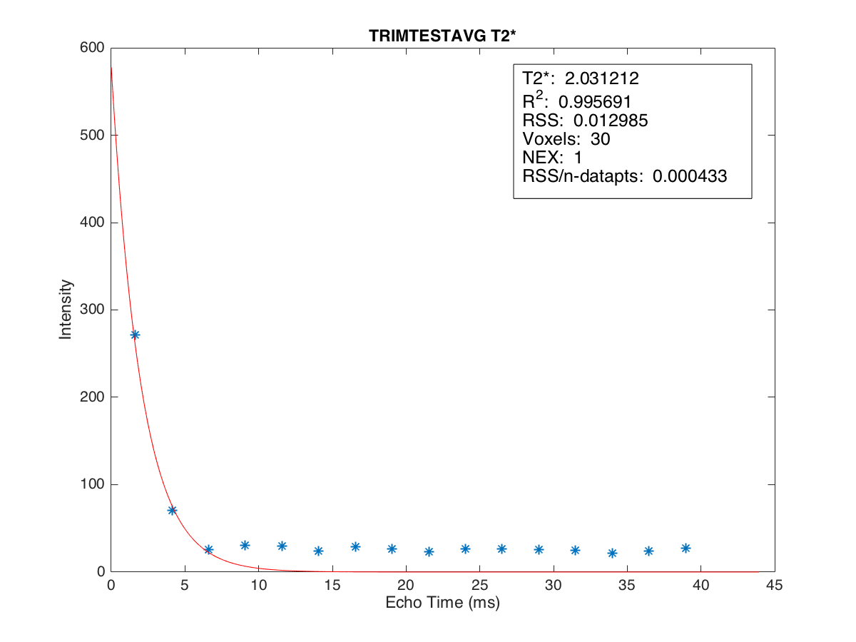
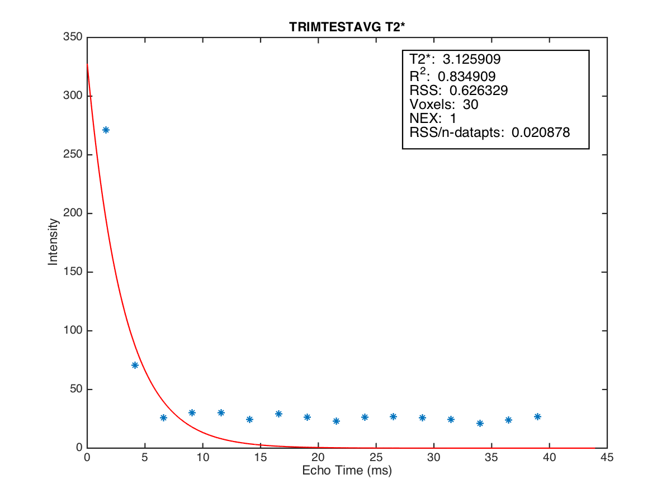
no point condition
T2*=2.031
position3
Conc. 1.413272
2014-09-30
3 point condition
4 point condition
T2*=2.031
T2*=3.126

Slide 5
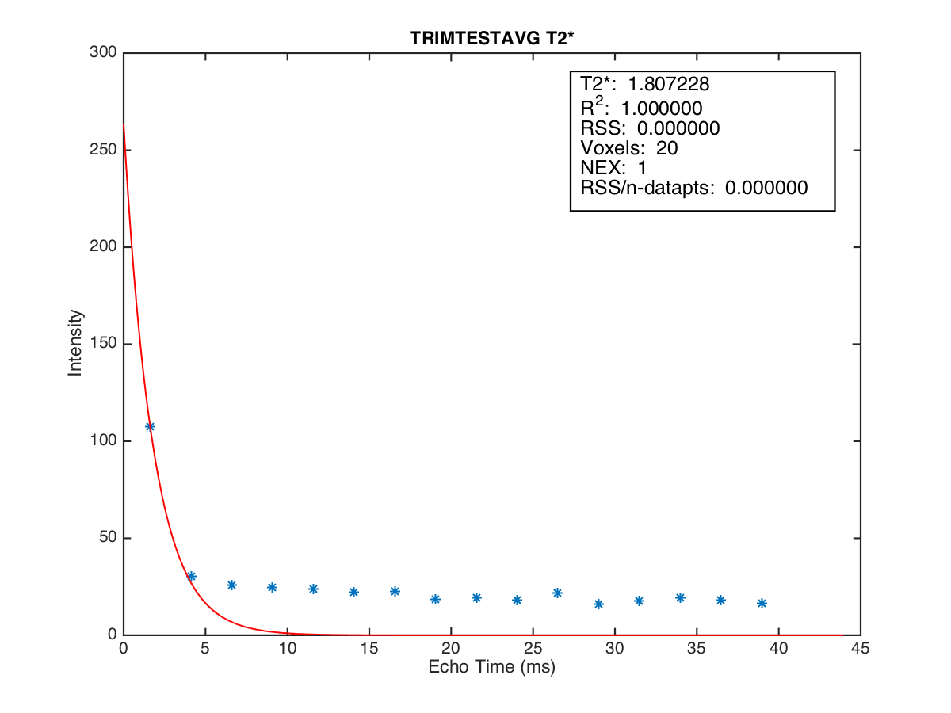

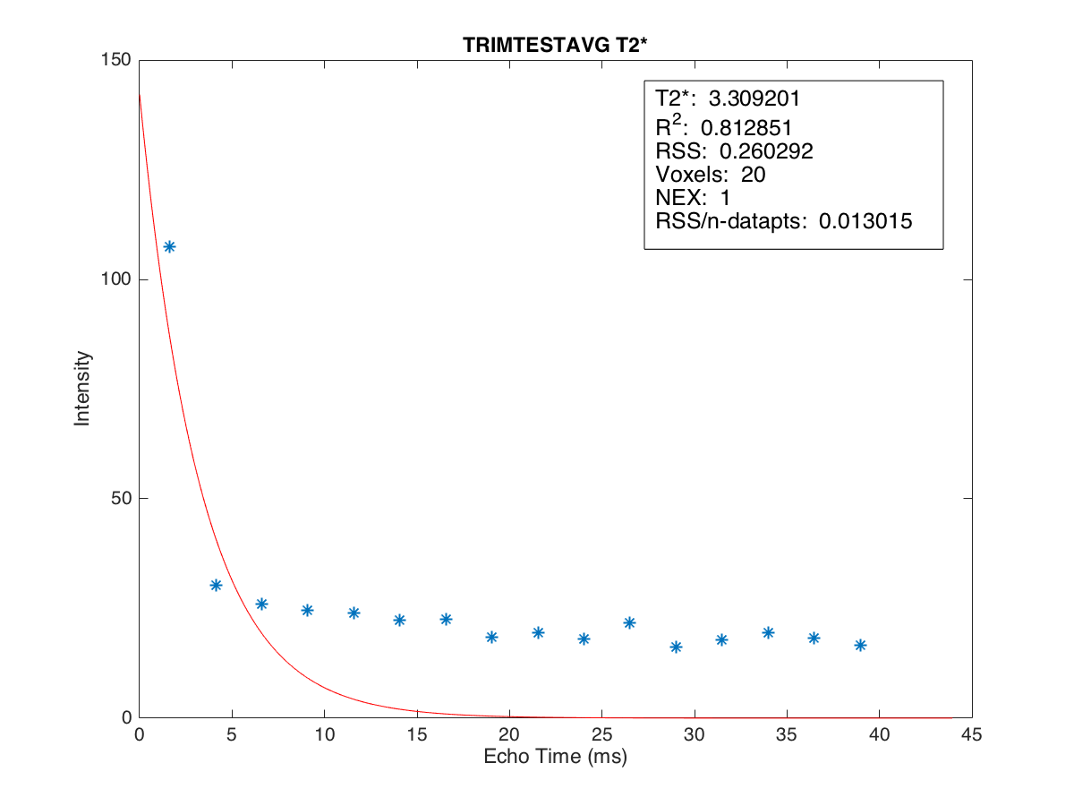
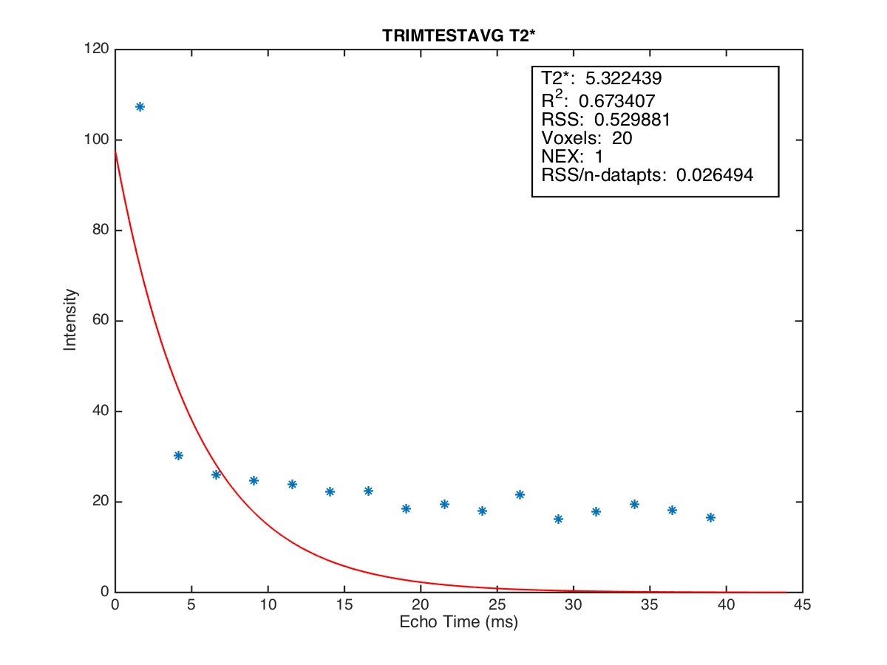
no point condition
T2*=1.807
position4
Conc. 2.470457
2014-09-30
3 point condition
4 point condition
T2*=3.309
T2*=5.322

Slide 6
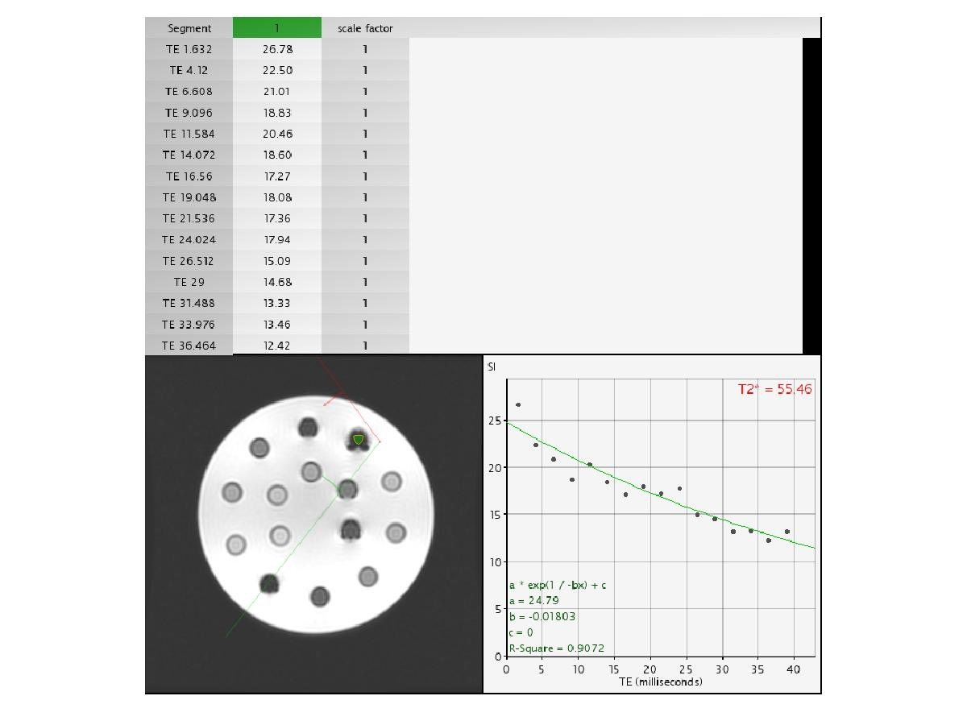
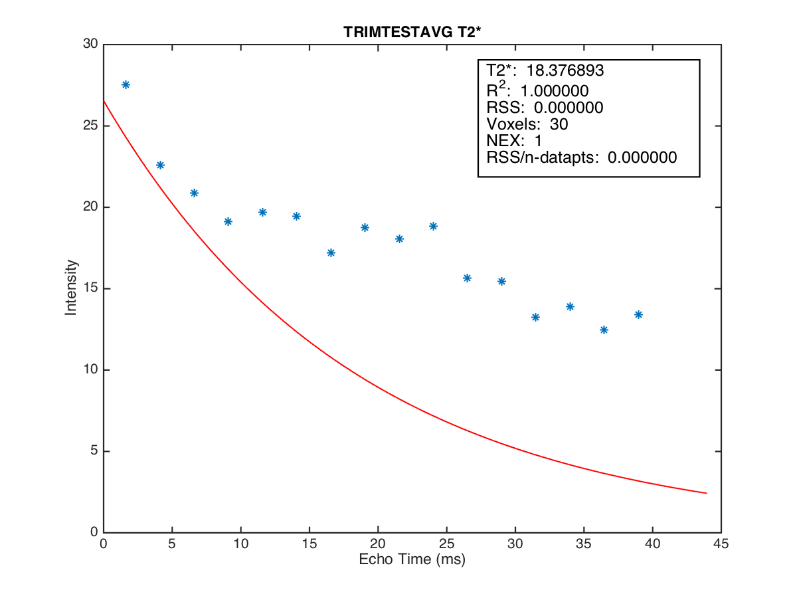
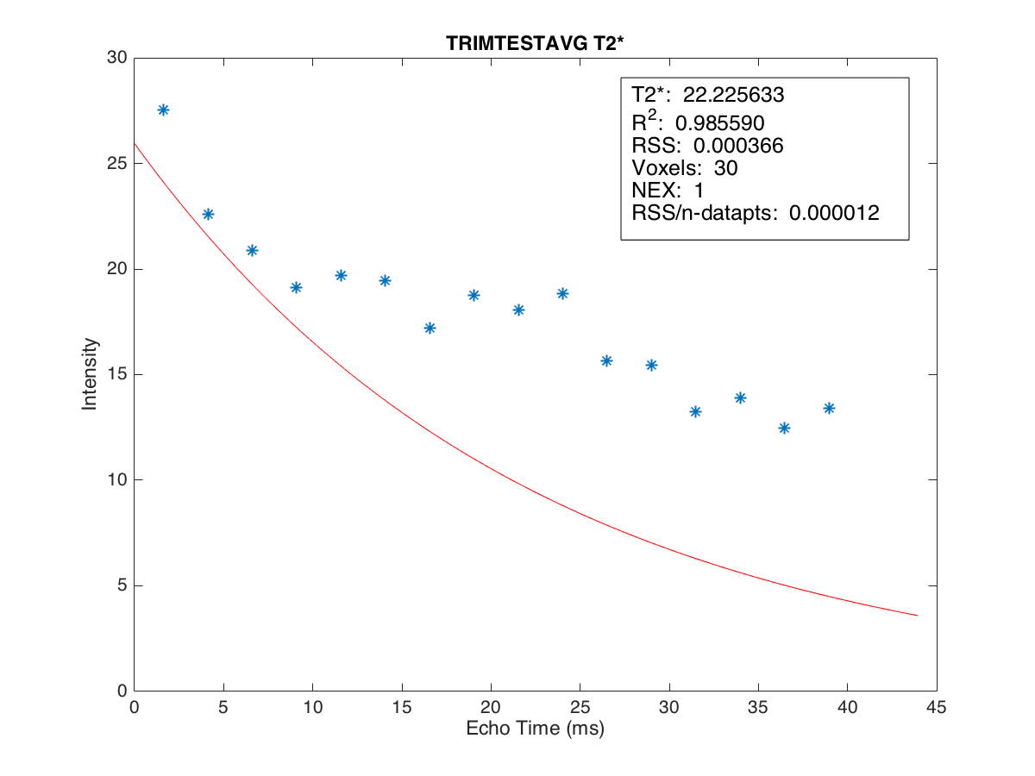
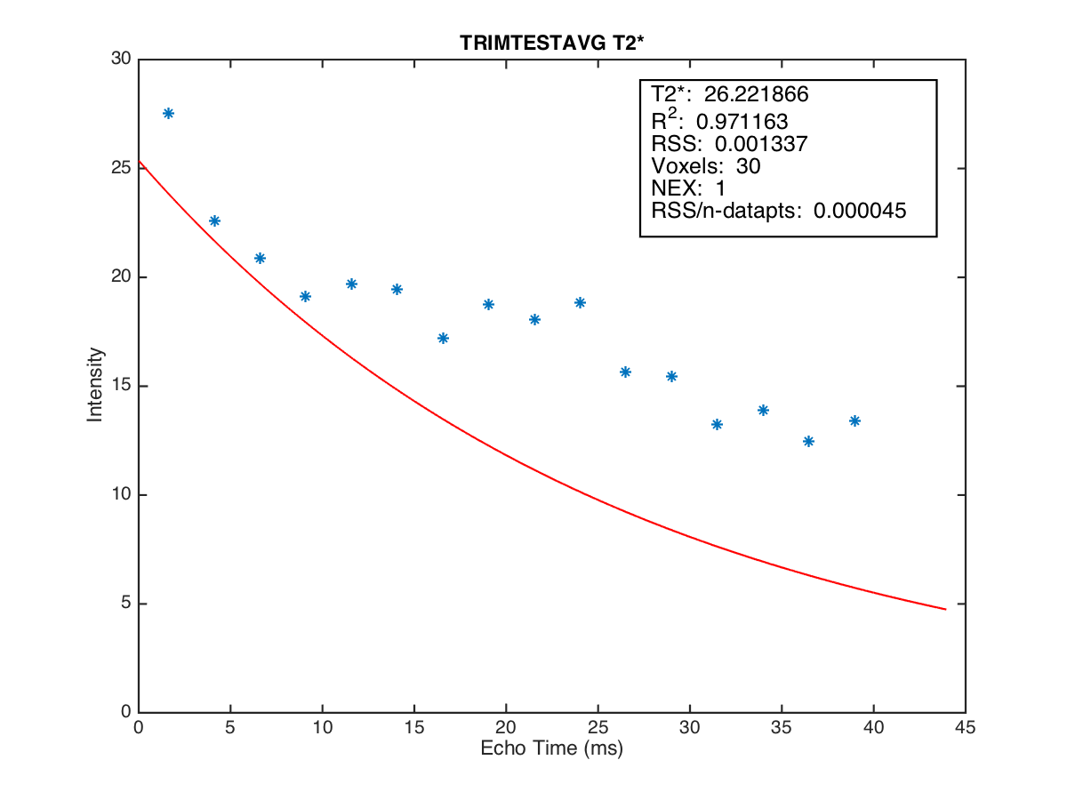
no point condition
T2*=18.377
position5
Conc. 5.058639
2014-09-30
3 point condition
4 point condition
T2*=26.222
T2*=26.222

Slide 7
กราฟความสัมพันธ์ระหว่างค่า T2* ในแต่ละหลุมกับเงื่อนไขต่างๆของ phantom 1.5 Tesla 2014-09-30

Slide 8
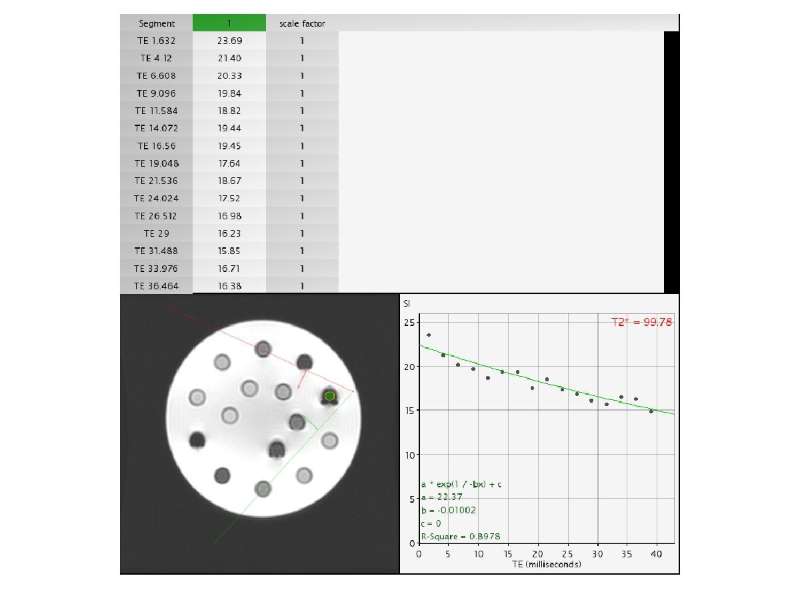
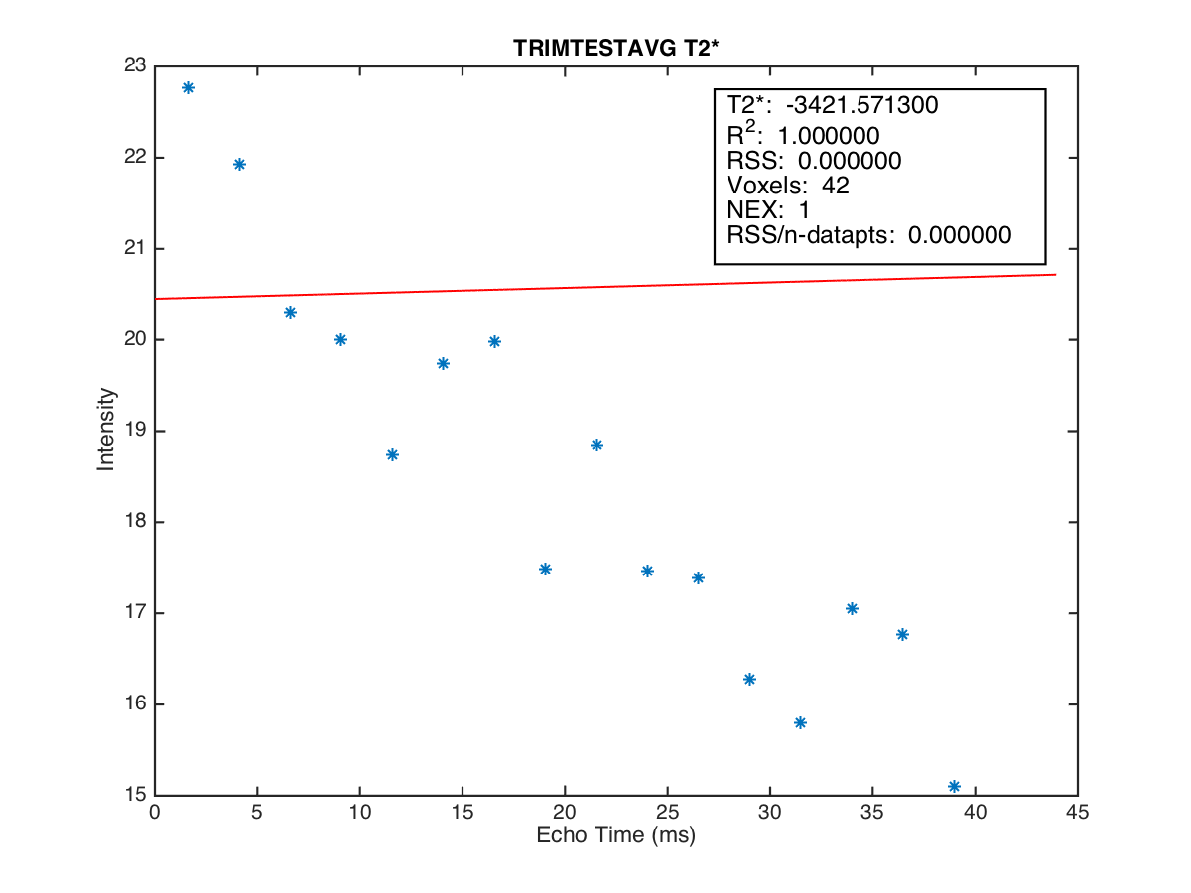
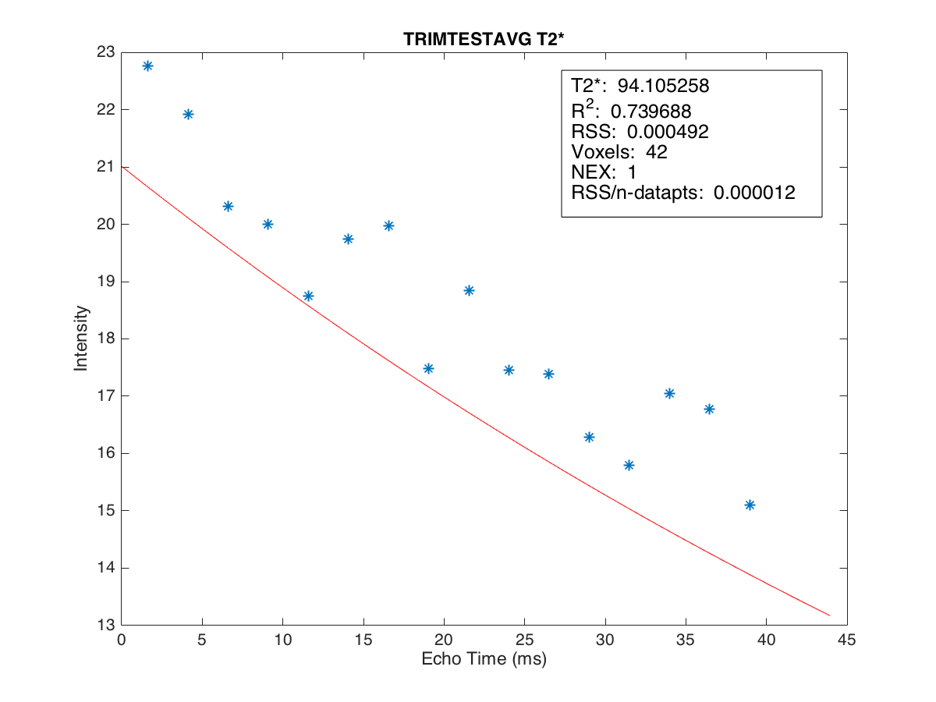
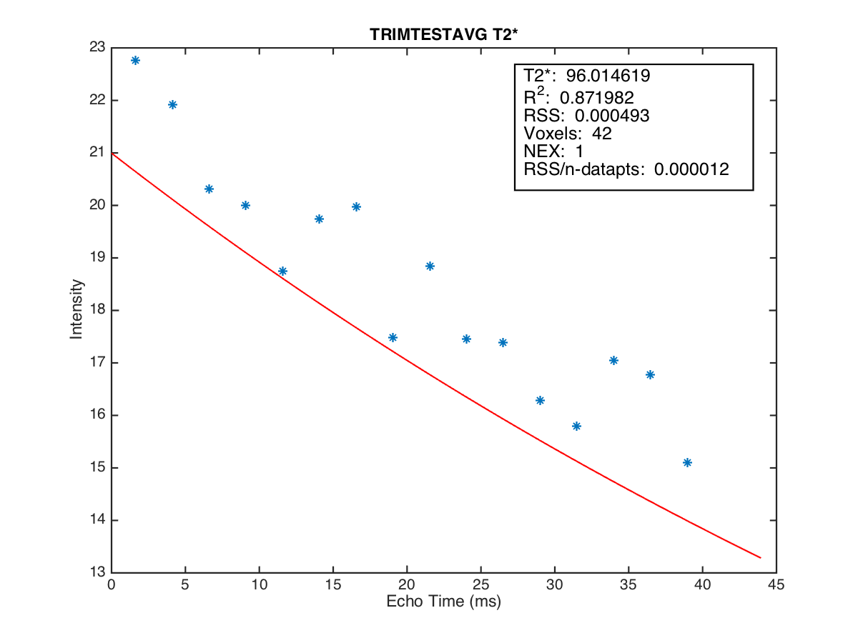
no point condition
position5
Conc. 5.058639
2014-10-22
3 point condition
4 point condition

Slide 9
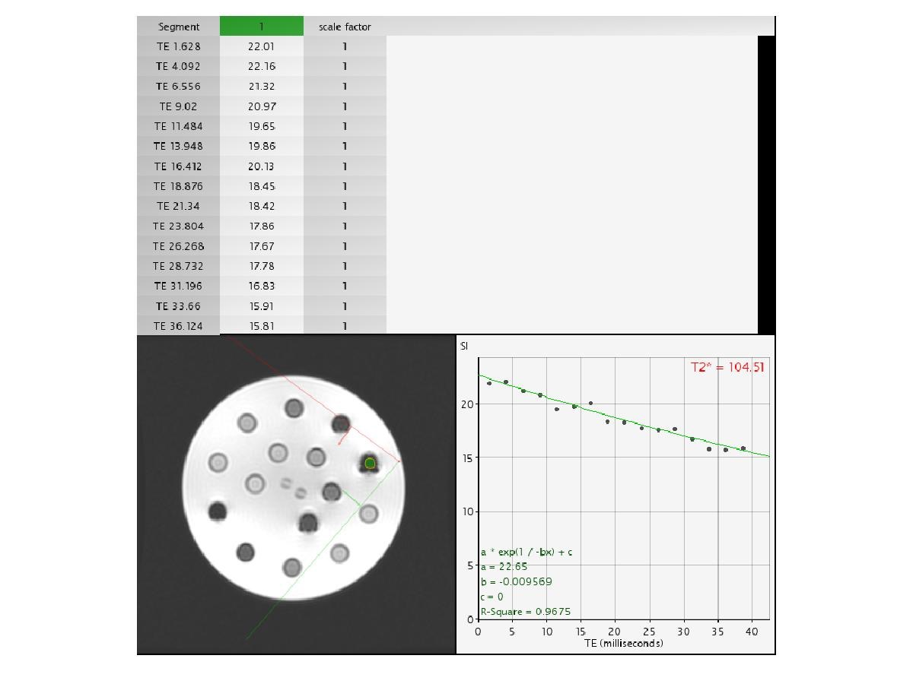
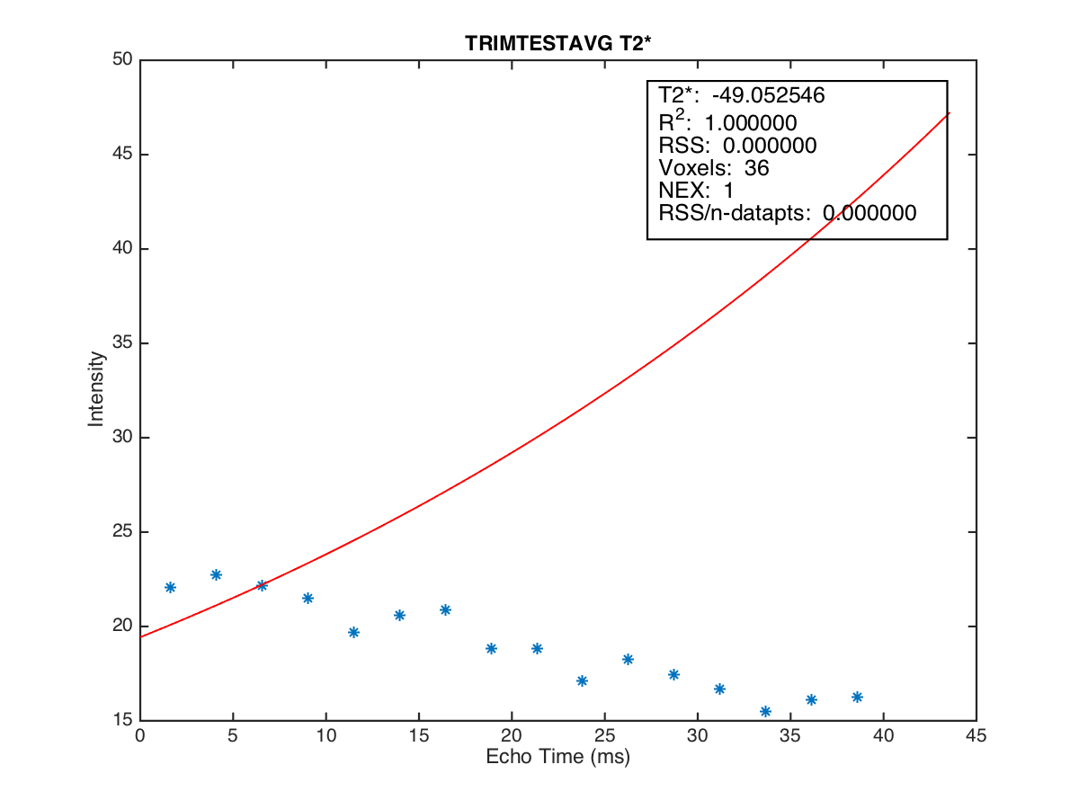
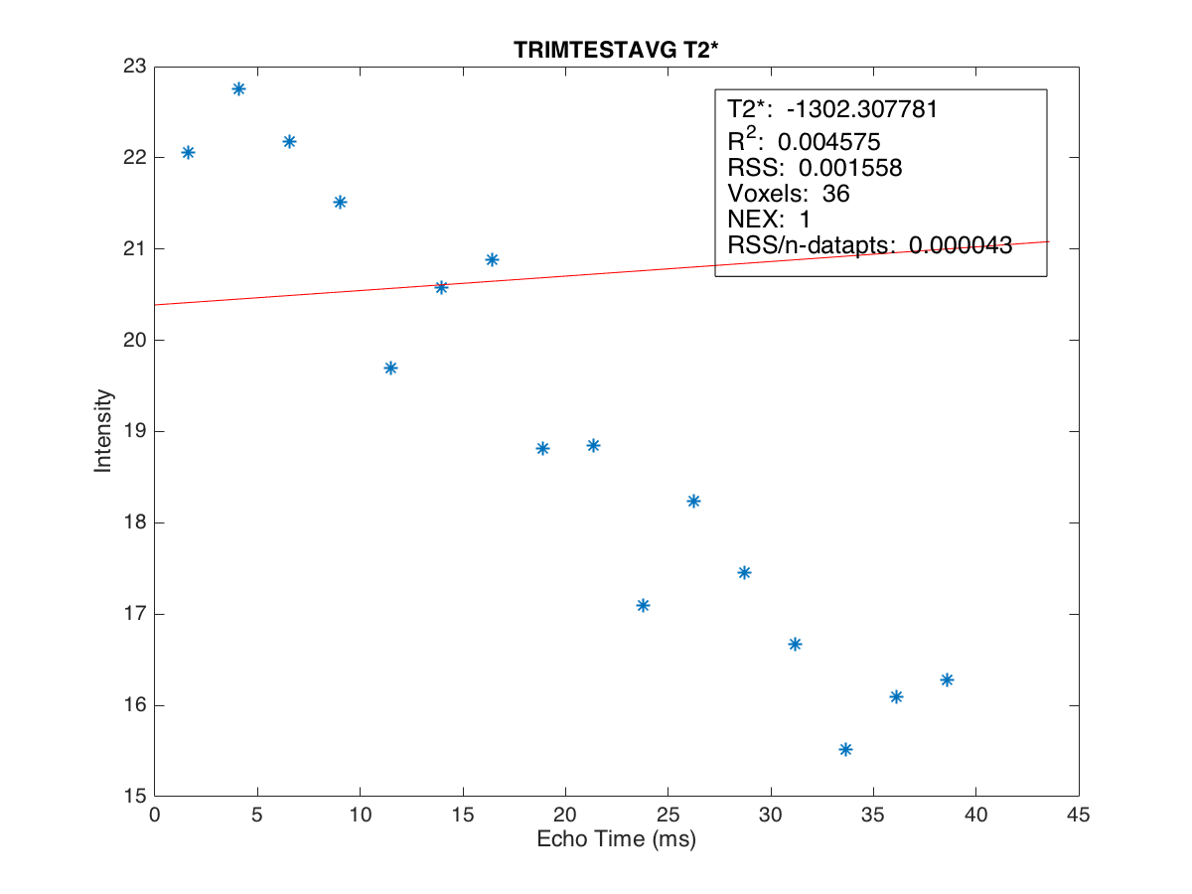
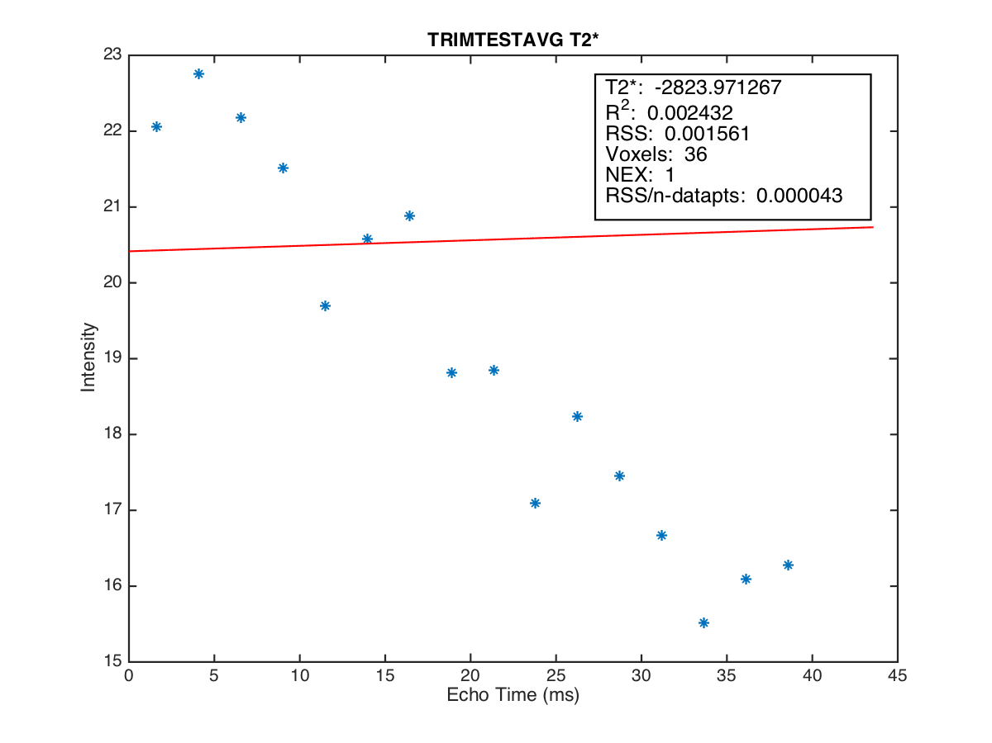
no point condition
position5
Conc. 5.058639
2014-11-12
3 point condition
4 point condition

Slide 10

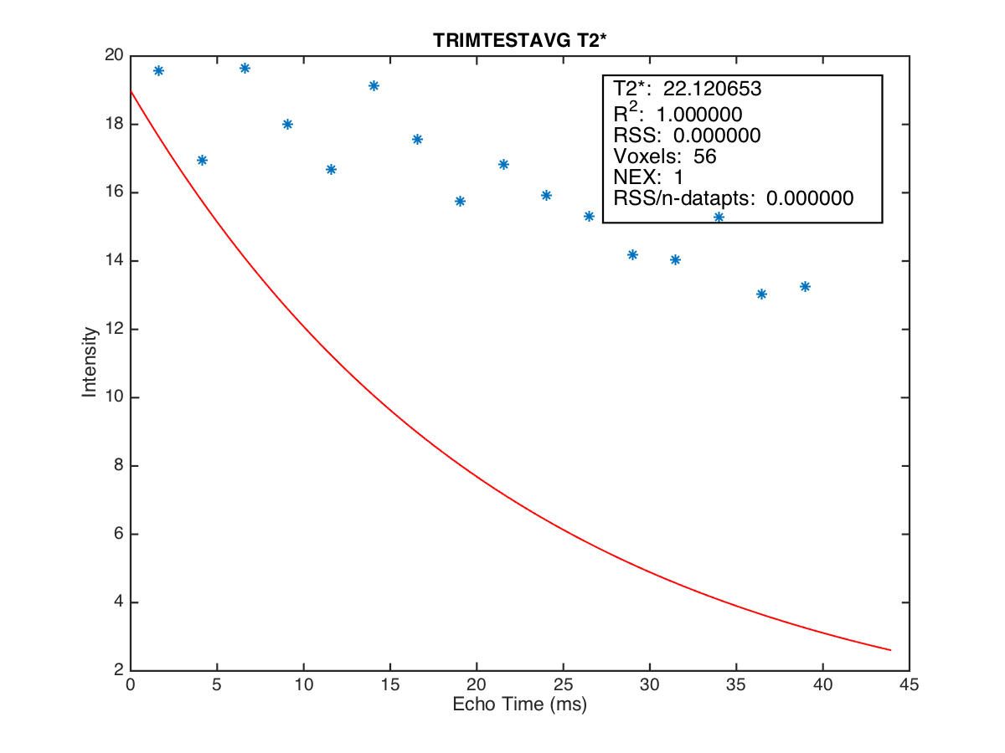
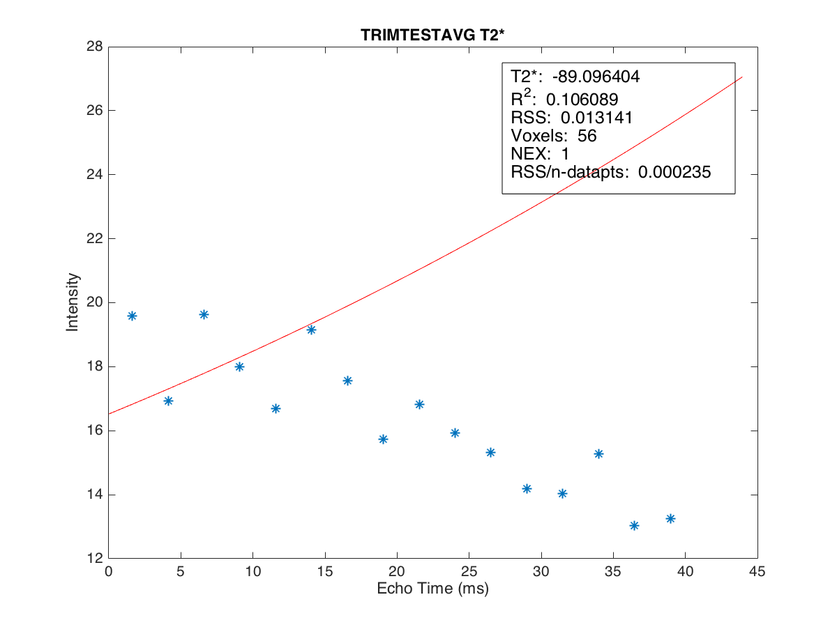
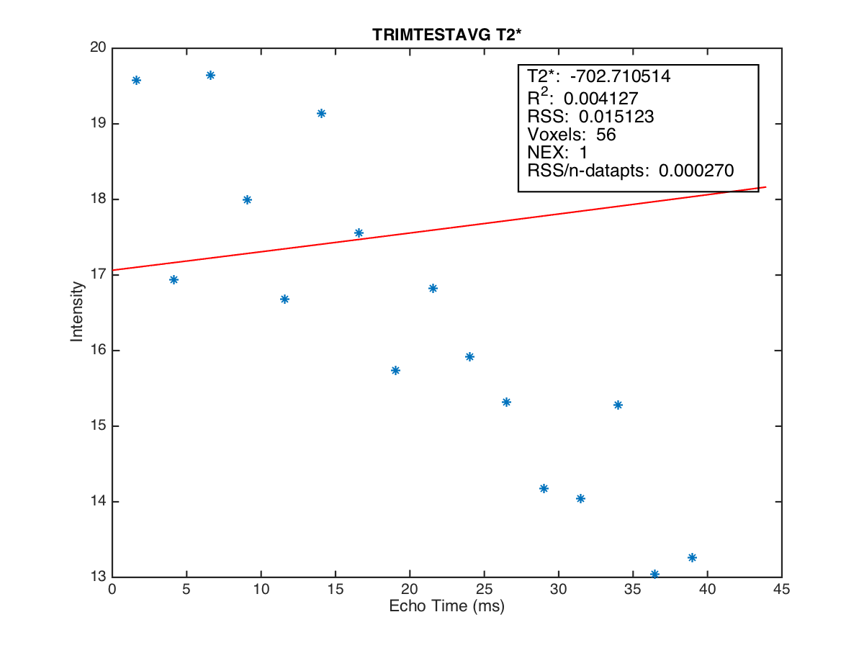
no point condition
position5
Conc. 5.058639
2015-02-04
3 point condition
4 point condition

Slide 11
ตารางค่า T2* ของแต่ละสัปดาห์
position | 1 | 2 | 3 | 4 | 5
2014-9-30 | 7.207 | 3.644 | 2.031 | 1.807 | 18.377
2014-10-8 | 7.440 | 3.686 | 1.868 | 1.494 | 19.221
2014-10-15 | 7.741 | 3.705 | 1.826 | 1.620 | 22.273
2014-10-22 | 7.449 | 3.685 | 2.054 | 1.691 | -3421.571
2014-11-05 | 7.494 | 3.679 | 1.936 | 1.637 | 16.790
2014-11-12 | 7.420 | 3.680 | 2.020 | 1.773 | -49.053
2014-11-19 | 7.795 | 3.904 | 1.906 | 1.564 | 10.464
2014-11-26 | 8.149 | 4.043 | 2.040 | 1.434 | 8.665
2014-12-3 | 8.297 | 4.070 | 2.028 | 1.422 | 7.836
2014-12-10 | 7.919 | 3.933 | 1.910 | 1.312 | 8.676
2014-12-17 | 7.670 | 3.858 | 1.889 | 1.332 | 8.540
2014-12-24 | 7.901 | 3.911 | 1.907 | 1.264 | 5.507
2015-1-21 | 7.647 | 3.970 | 2.091 | 1.286 | 7.316
2015-1-28 | 7.934 | 3.952 | 2.072 | 1.489 | 8.893
2015-2-4 | 7.360 | 3.680 | 2.011 | 1.643 | 22.121
1 | 2 | 3 | 4 | 5
7.207 | 3.644 | 3.126 | 5.322 | 26.222
7.440 | 3.686 | 2.911 | 5.167 | 646.896
7.741 | 3.705 | 2.936 | 5.386 | 428.635
7.449 | 3.709 | 2.900 | 5.395 | 96.015
7.494 | 3.741 | 2.847 | 5.492 | 83.146
7.420 | 3.697 | 2.973 | 5.691 | -2823.971
7.795 | 3.904 | 2.873 | 5.228 | 37.152
8.149 | 4.043 | 2.857 | 5.260 | 21.599
8.297 | 4.070 | 2.830 | 4.837 | 27.135
7.919 | 3.933 | 2.548 | 4.358 | 20.352
7.670 | 3.858 | 2.628 | 4.113 | 19.171
7.901 | 3.911 | 2.587 | 4.307 | 16.412
7.647 | 3.970 | 2.650 | 4.250 | 24.103
7.934 | 3.952 | 2.731 | 5.336 | 28.572
7.360 | 3.680 | 2.852 | 5.801 | -702.711
1 | 2 | 3 | 4 | 5
7.207 | 3.644 | 2.031 | 3.309 | 22.226
7.440 | 3.686 | 1.868 | 3.412 | 163.555
7.741 | 3.705 | 2.015 | 3.452 | 91.189
7.449 | 3.685 | 2.054 | 3.534 | 94.105
7.494 | 3.679 | 2.091 | 3.361 | 67.675
7.420 | 3.680 | 2.020 | 3.713 | -1302.308
7.795 | 3.904 | 1.906 | 3.314 | 22.846
8.149 | 4.043 | 2.040 | 3.212 | 14.706
8.297 | 4.070 | 2.028 | 2.953 | 16.182
7.919 | 3.933 | 1.910 | 2.888 | 18.610
7.670 | 3.858 | 2.006 | 2.879 | 13.238
7.901 | 3.911 | 1.907 | 2.827 | 10.943
7.647 | 3.970 | 2.091 | 2.670 | 13.318
7.934 | 3.952 | 2.072 | 3.146 | 17.026
7.360 | 3.680 | 2.011 | 3.155 | -89.096
no point condition
4 point condition
3 point condition

Slide 12
MRIM 3T

Slide 13
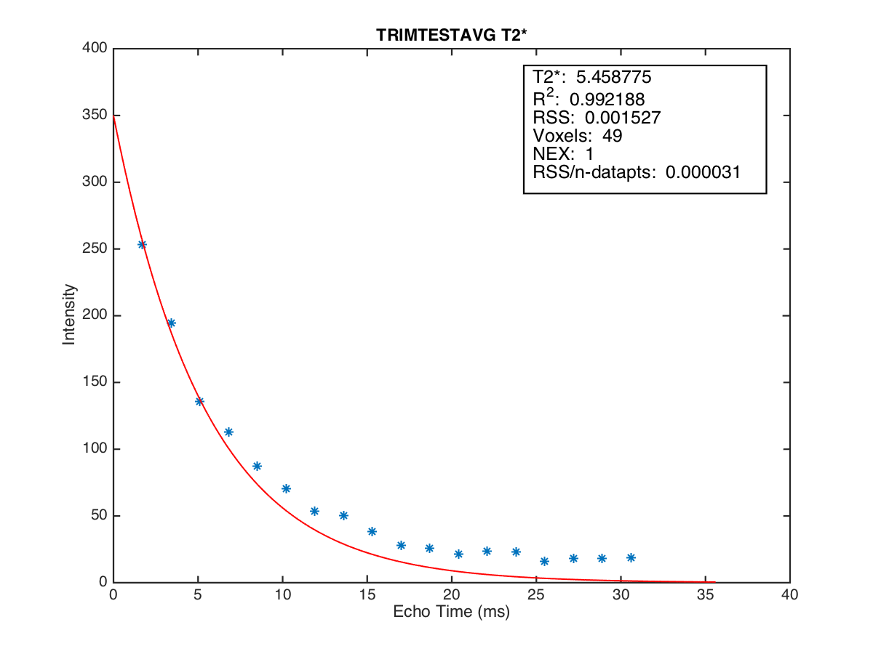
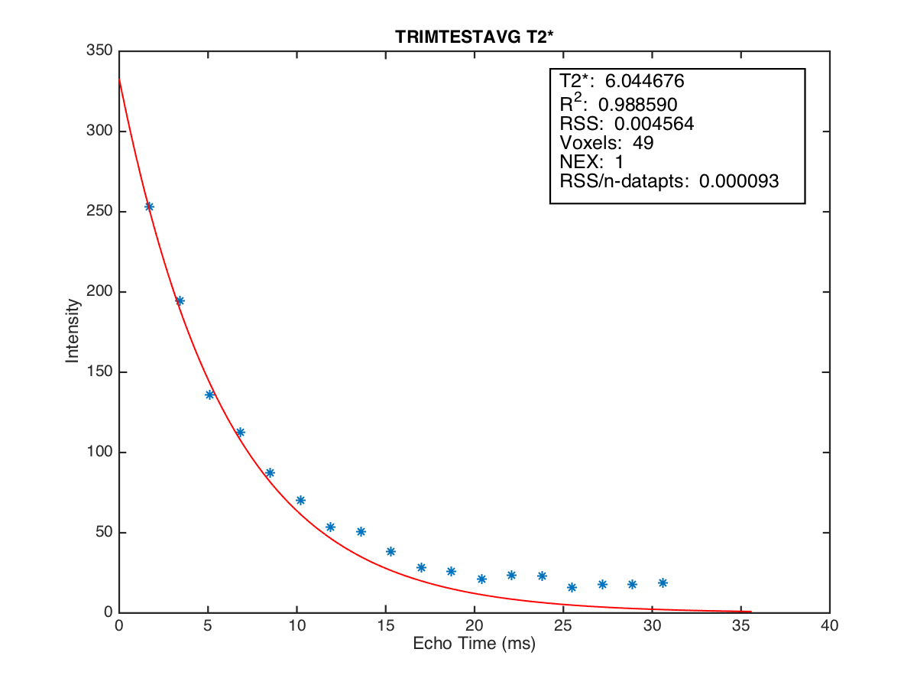
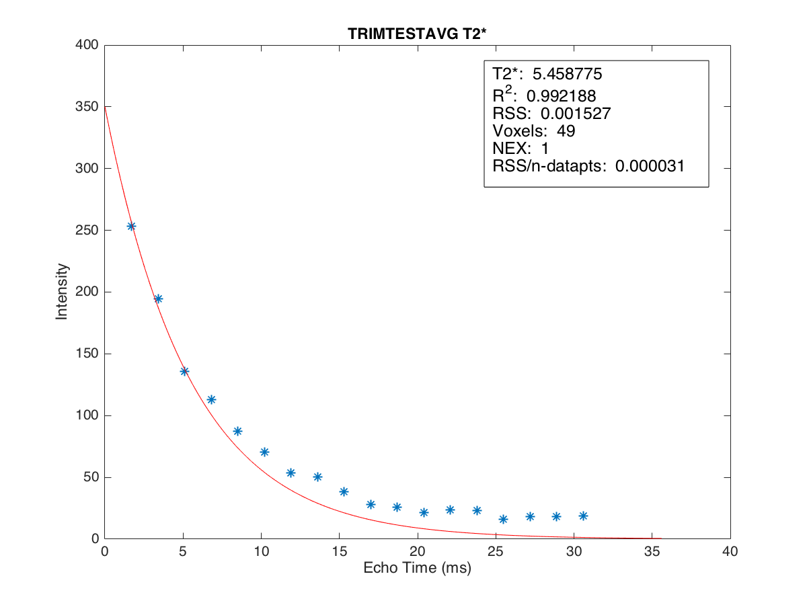
no 4 point condition
position1
4 point condition

Slide 14
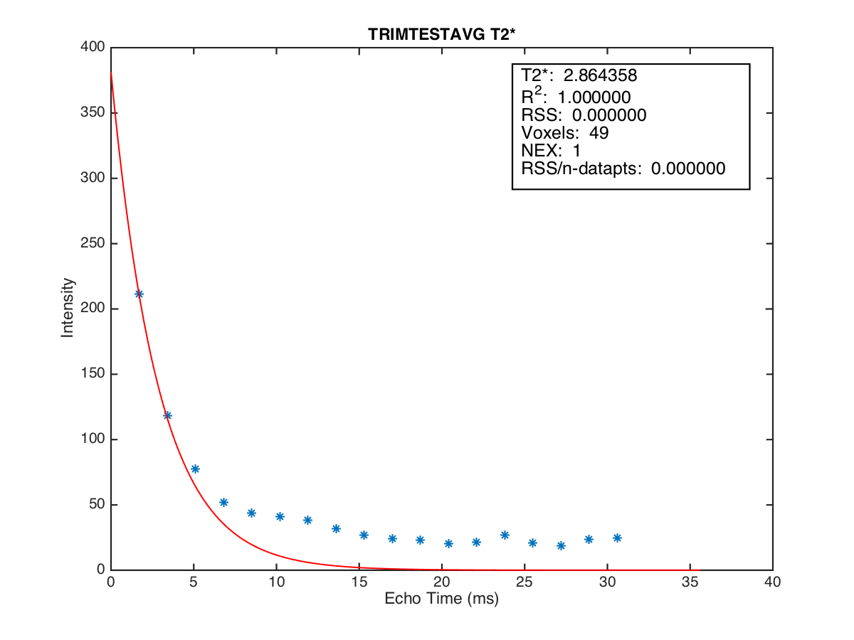
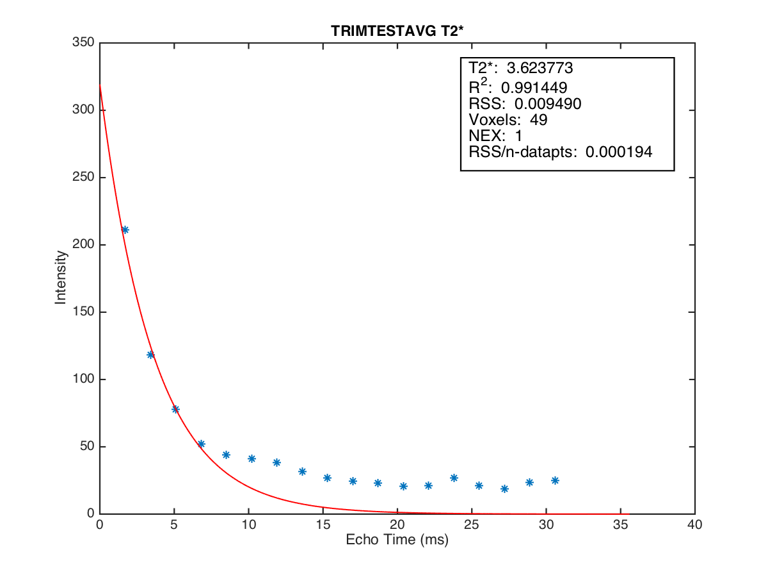
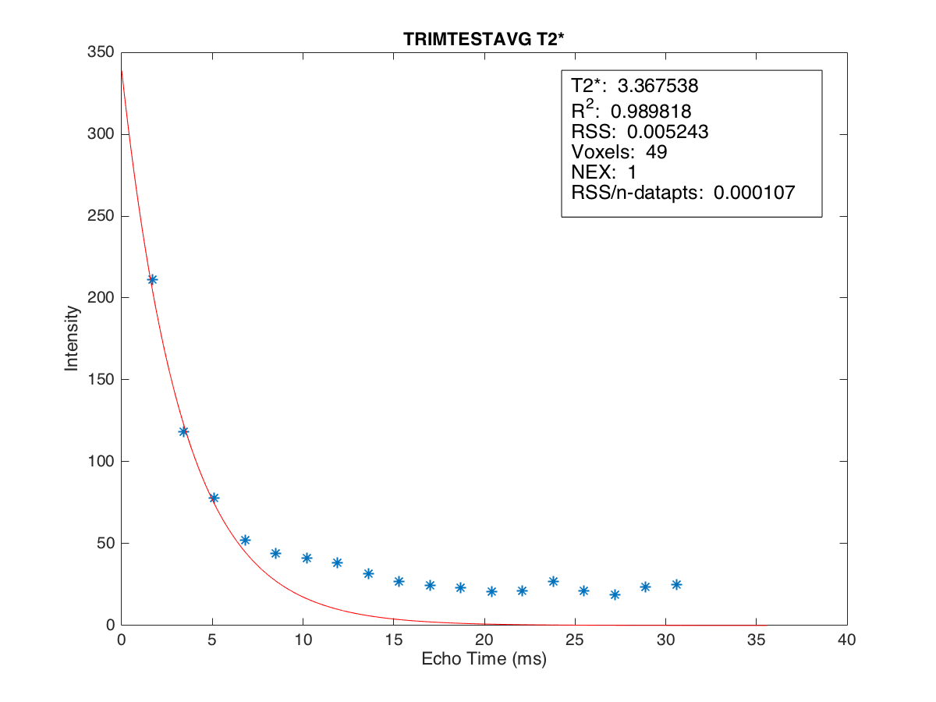
no 4 point condition
position2
4 point condition

Slide 15
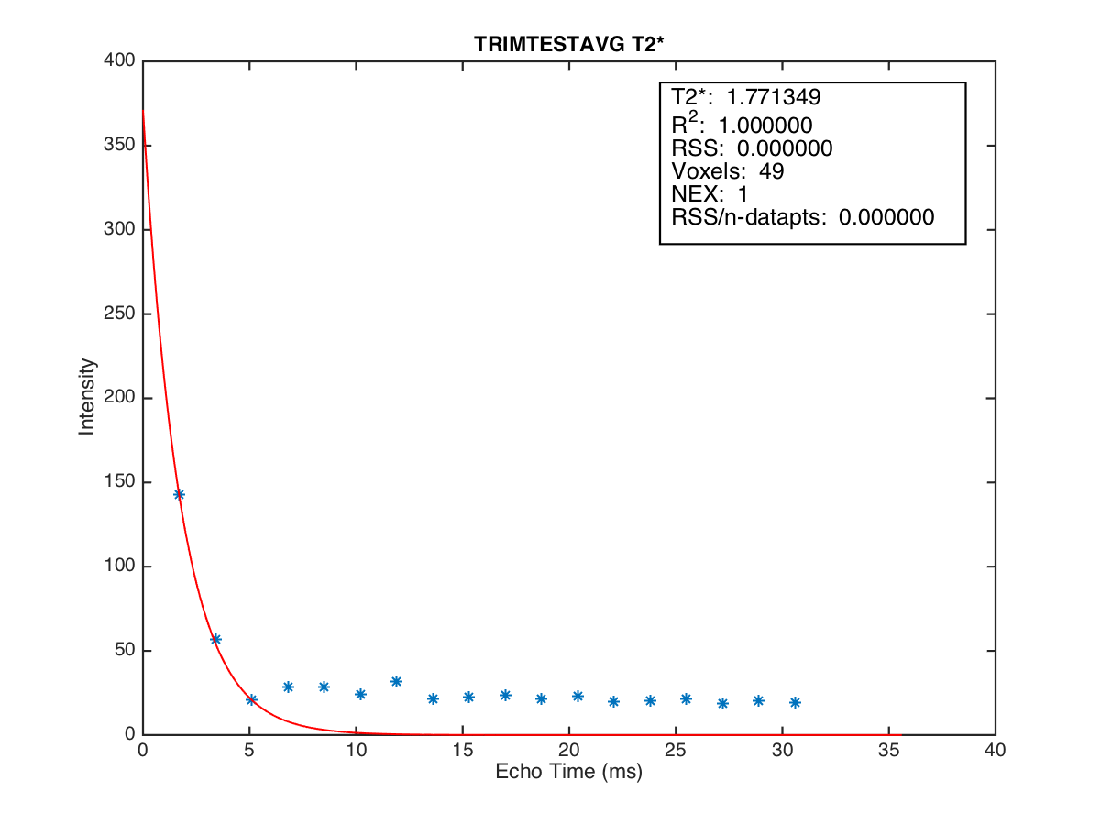
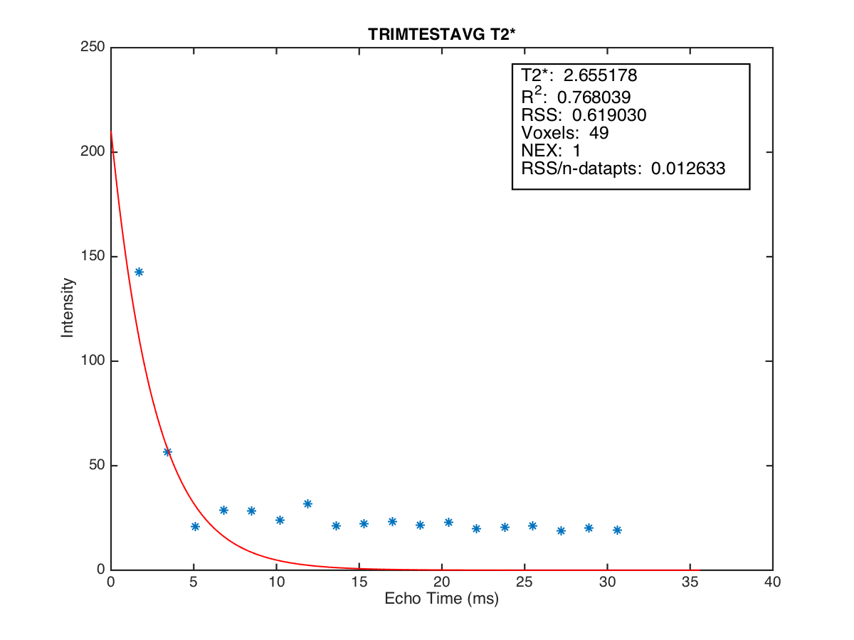
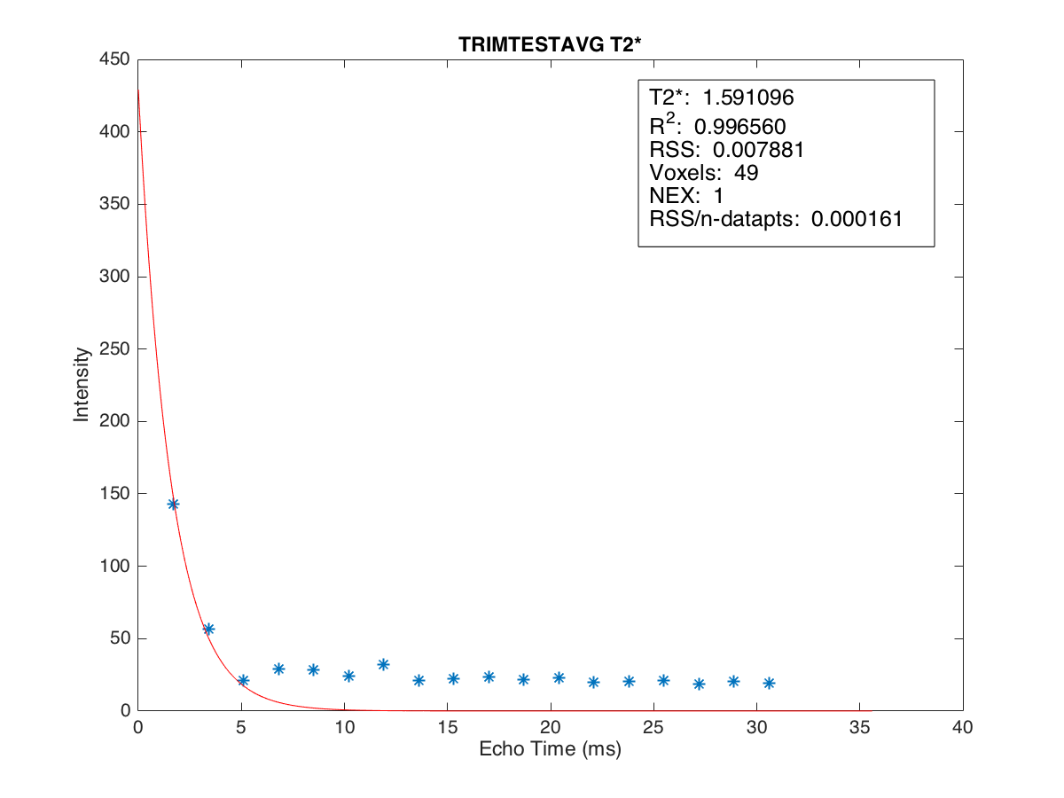
no 4 point condition
position3
4 point condition

Slide 16
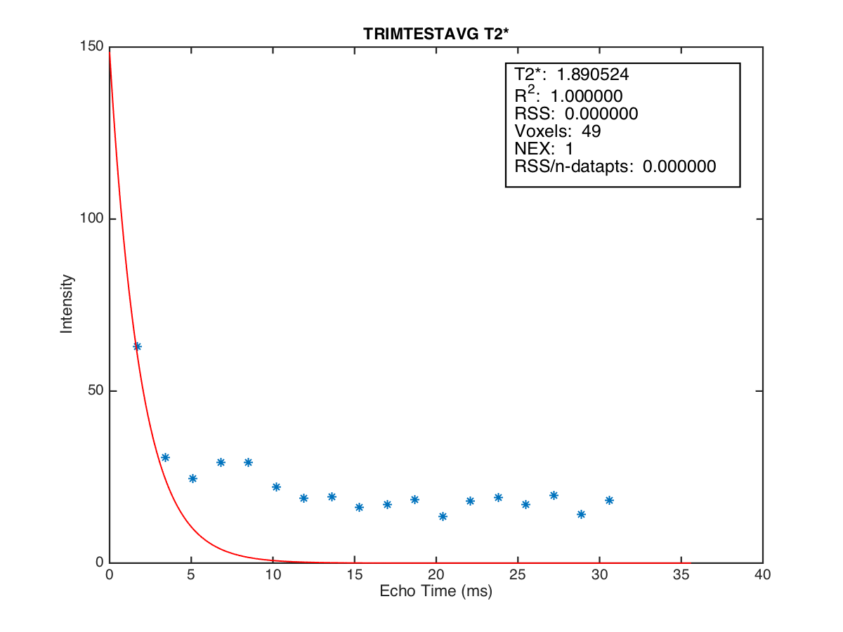
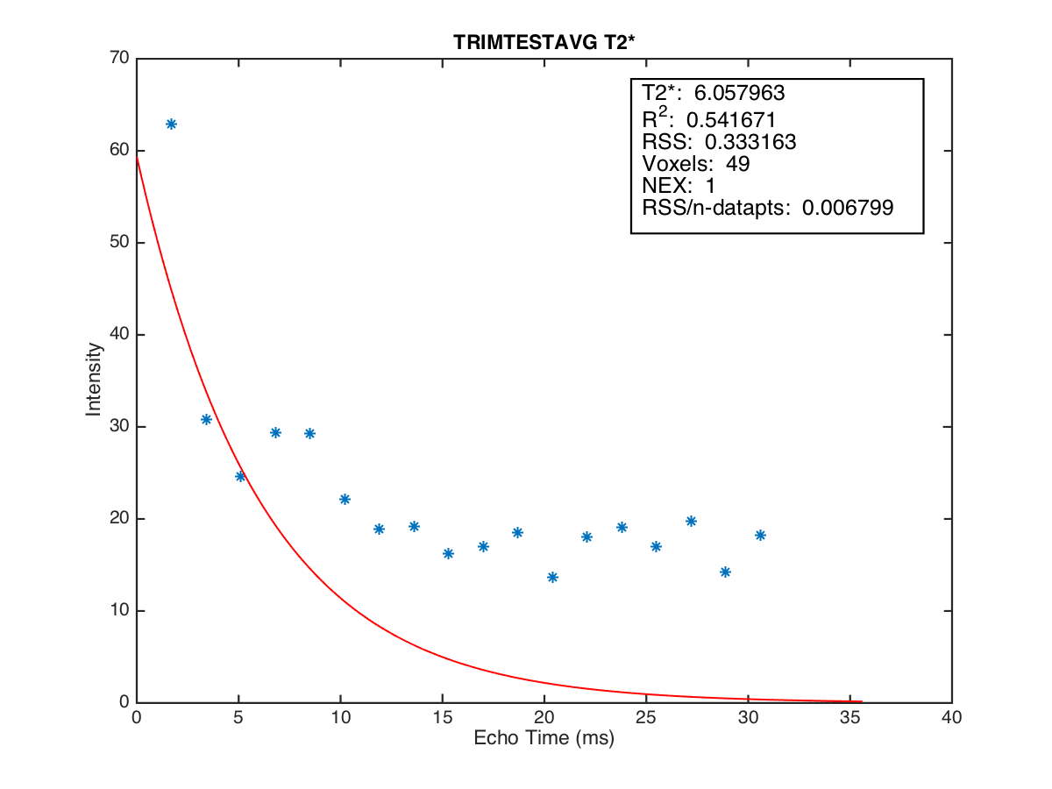
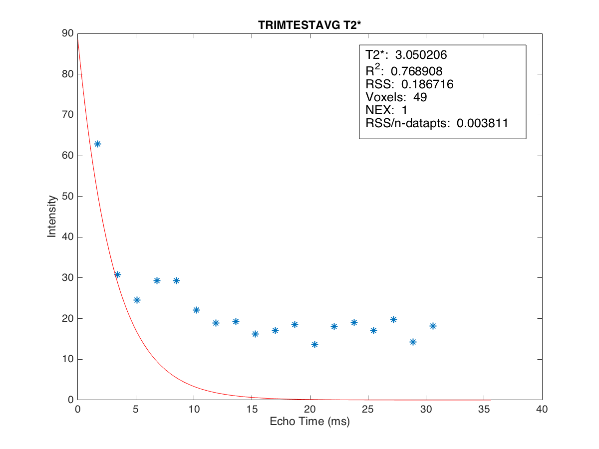
no 4 point condition
position4
4 point condition

Slide 17
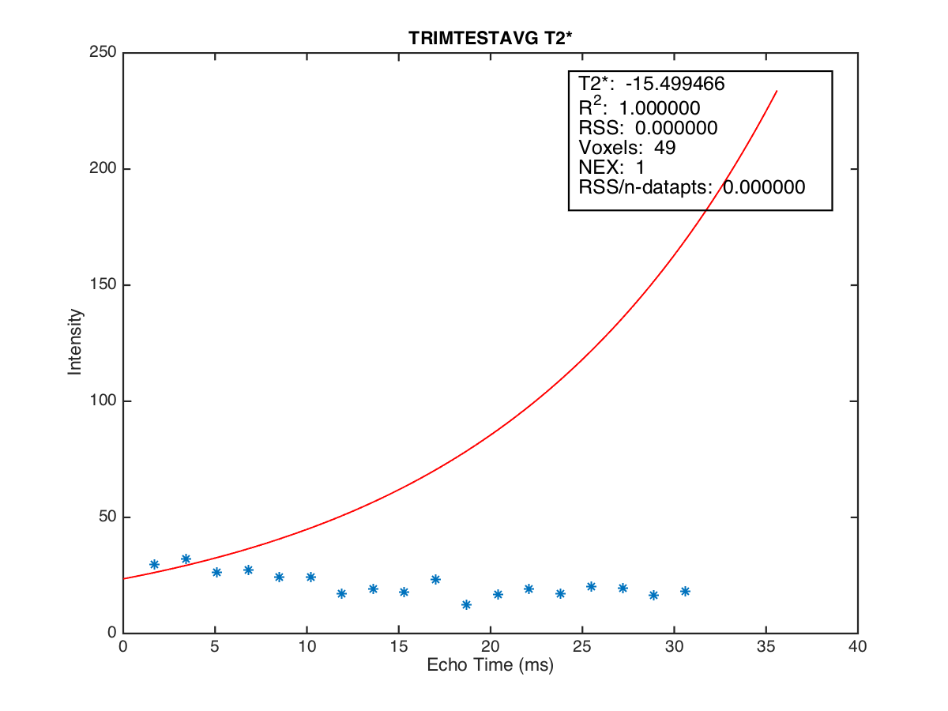
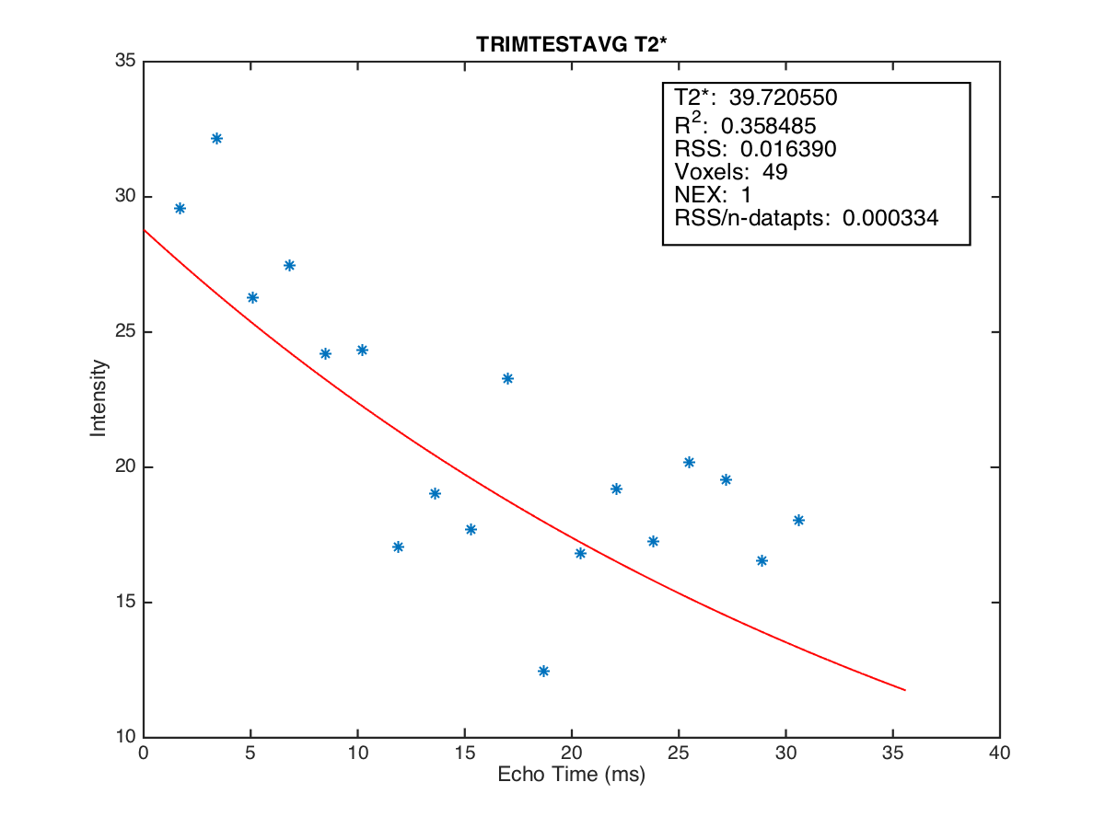
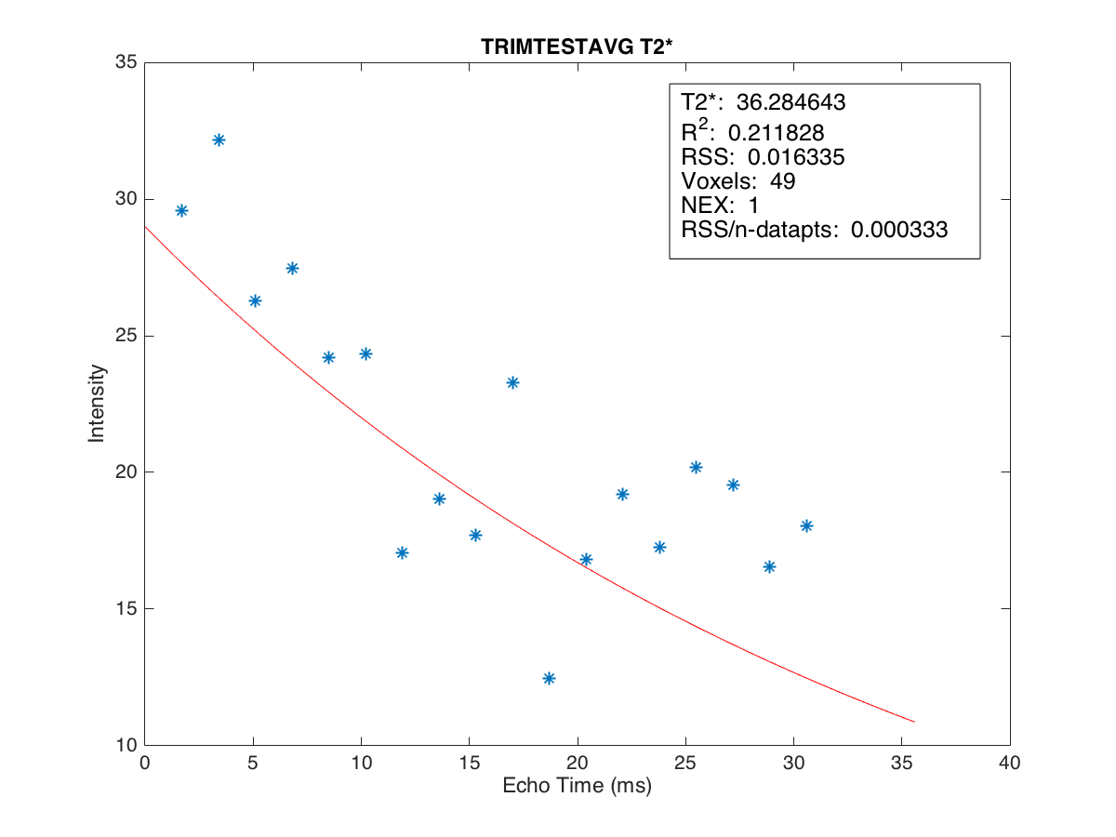
no 4 point condition
position5
4 point condition

Slide 18
กราฟความสัมพันธ์ระหว่างค่า T2* ในแต่ละหลุมกับเงื่อนไขต่างๆของ phantom 3 Tesla 2014-09-30

