Slide 1
MRIM
Phantom

Slide 2

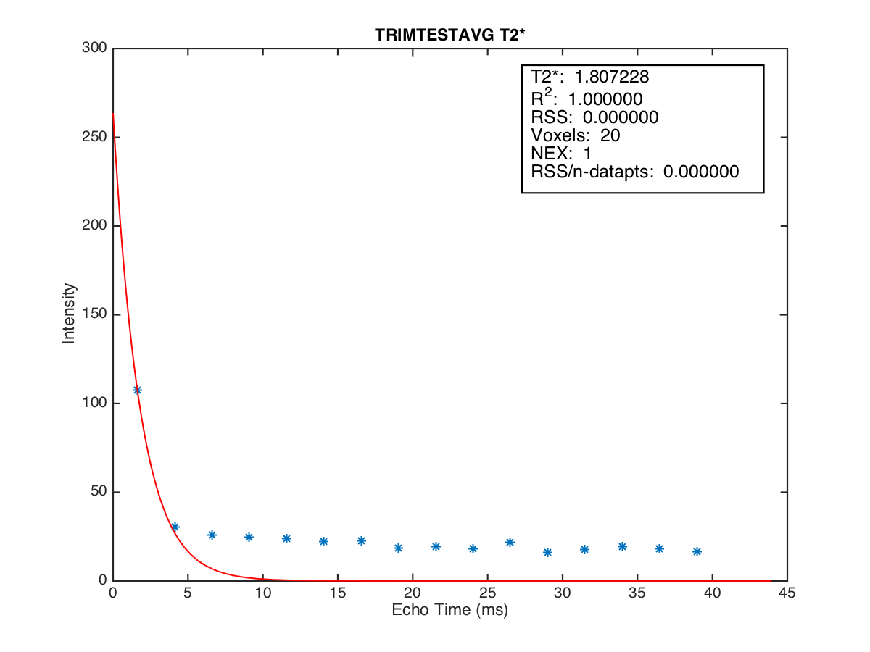
week 1 position 4
T2*=1.807
Conc. = 2.470457

Slide 3
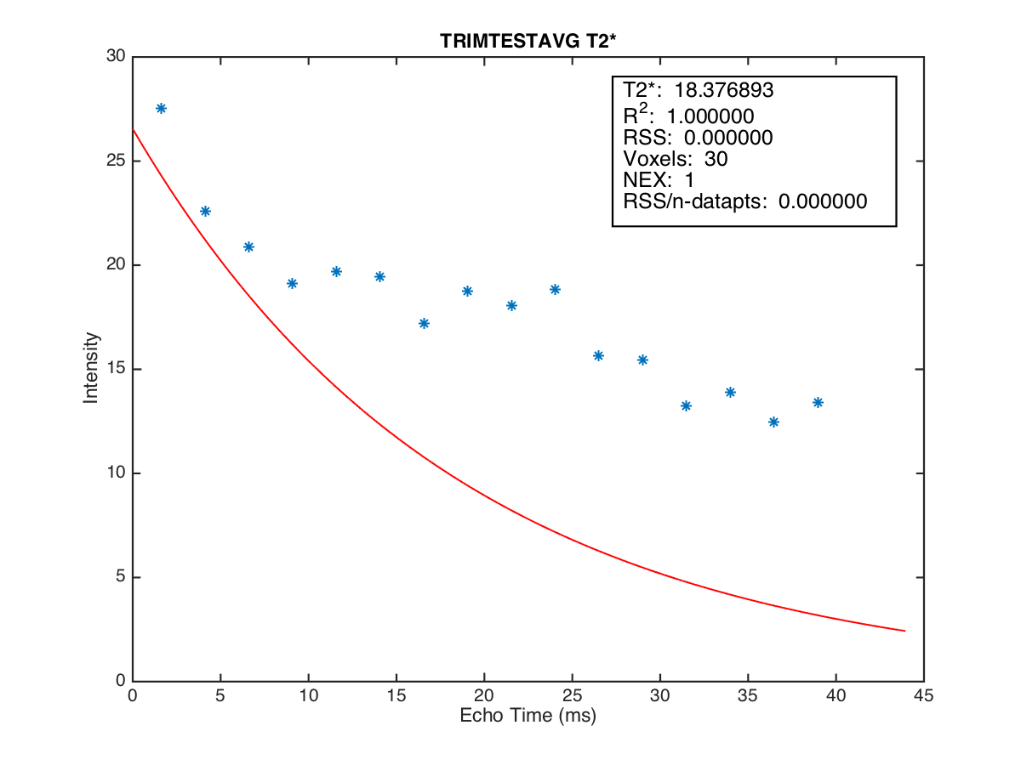
week 1 position 5
T2*=18.377
Conc.=5.058639

Slide 4
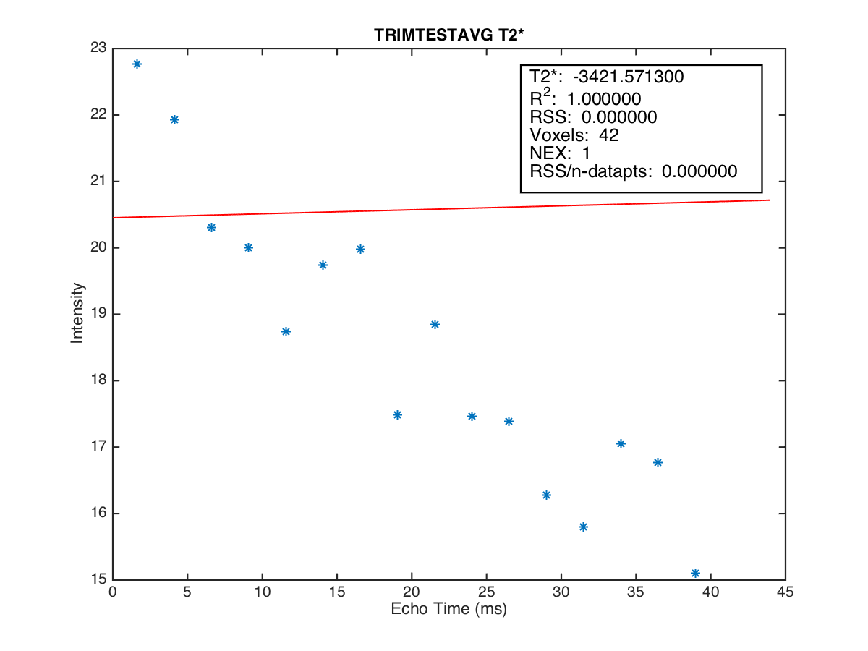
week 3 position 5
T2*=-3421
Conc.=5.058639

Slide 5
max
min
min
Ratio =
max

Slide 6


T2* value and Ratio of Phantom 1.5Tesla Group 1
week/position | T2* value |  |  |  |  | Ratio
 | 1 | 2 | 3 | 4 | 5 | 1 | 2 | 3 | 4 | 5
2014-09-30' | 7.207 | 3.644 | 2.031 | 1.807 | 18.377 | 0.049 | 0.052 | 0.078 | 0.151 | 0.453
2014-10-08' | 7.440 | 3.686 | 1.868 | 1.494 | 19.221 | 0.047 | 0.052 | 0.068 | 0.156 | 0.644
2014-10-15' | 7.741 | 3.705 | 1.826 | 1.620 | 22.273 | 0.047 | 0.050 | 0.074 | 0.151 | 0.596
2014-10-22' | 7.449 | 3.685 | 2.054 | 1.691 | -3422 | 0.041 | 0.051 | 0.068 | 0.143 | 0.663
2014-11-05' | 7.494 | 3.679 | 1.936 | 1.637 | 16.790 | 0.045 | 0.054 | 0.071 | 0.173 | 0.630
2014-11-12' | 7.420 | 3.680 | 2.020 | 1.773 | -49.053 | 0.045 | 0.050 | 0.065 | 0.170 | 0.682
2014-11-19' | 7.795 | 3.904 | 1.906 | 1.564 | 10.464 | 0.045 | 0.056 | 0.072 | 0.140 | 0.563
2014-11-26' | 8.149 | 4.043 | 2.040 | 1.434 | 8.665 | 0.046 | 0.050 | 0.072 | 0.145 | 0.548
2014-12-03' | 8.297 | 4.070 | 2.028 | 1.422 | 7.836 | 0.047 | 0.051 | 0.075 | 0.126 | 0.516
2014-12-10' | 7.919 | 3.933 | 1.910 | 1.312 | 8.676 | 0.049 | 0.055 | 0.078 | 0.134 | 0.544
2014-12-17' | 7.670 | 3.858 | 1.889 | 1.332 | 8.540 | 0.047 | 0.054 | 0.068 | 0.134 | 0.561
2014-12-24' | 7.901 | 3.911 | 1.907 | 1.264 | 5.507 | 0.047 | 0.052 | 0.073 | 0.137 | 0.470
2015-01-21' | 7.647 | 3.970 | 2.091 | 1.286 | 7.316 | 0.046 | 0.049 | 0.076 | 0.135 | 0.473
2015-01-28' | 7.934 | 3.952 | 2.072 | 1.489 | 8.893 | 0.042 | 0.046 | 0.071 | 0.133 | 0.613
2015-02-04' | 7.360 | 3.680 | 2.011 | 1.643 | 22.121 | 0.043 | 0.051 | 0.077 | 0.165 | 0.664
position | 1 | 2 | 3 | 4 | 5
Conc. | 0.505 | 0.789 | 1.413 | 2.470 | 5.059
T2* min = 1.264
Ratio max = 0.170
Ratio min = 0.453

Slide 7
T2* value and Ratio of Phantom 1.5Tesla Group 2
week/position | T2* value |  |  |  |  | Ratio
 | 6 | 7 | 8 | 9 | 10 | 6 | 7 | 8 | 9 | 10
2014-09-30' | 8.906 | 4.248 | 2.207 | 1.316 | 4.602 | 0.041 | 0.048 | 0.064 | 0.121 | 0.373
2014-10-08' | 9.271 | 4.253 | 2.245 | 1.242 | 4.795 | 0.043 | 0.048 | 0.058 | 0.137 | 0.453
2014-10-15' | 10.015 | 4.431 | 2.333 | 1.209 | 4.595 | 0.045 | 0.050 | 0.066 | 0.136 | 0.434
2014-10-22' | 9.890 | 4.370 | 2.294 | 1.110 | 4.035 | 0.061 | 0.057 | 0.062 | 0.121 | 0.430
2014-11-05' | 9.629 | 4.454 | 2.337 | 1.158 | 3.930 | 0.054 | 0.049 | 0.058 | 0.130 | 0.440
2014-11-12' | 9.539 | 4.556 | 2.339 | 1.136 | 3.653 | 0.056 | 0.048 | 0.064 | 0.127 | 0.457
2014-11-19' | 9.954 | 4.456 | 2.297 | 1.212 | 4.250 | 0.045 | 0.052 | 0.059 | 0.138 | 0.449
2014-11-26' | 10.152 | 4.545 | 2.374 | 1.247 | 2.707 | 0.055 | 0.054 | 0.059 | 0.124 | 0.356
2014-12-03' | 10.086 | 4.861 | 2.437 | 1.205 | 2.707 | 0.042 | 0.051 | 0.063 | 0.130 | 0.355
2014-12-10' | 9.950 | 4.529 | 2.388 | 1.174 | 2.176 | 0.059 | 0.047 | 0.061 | 0.120 | 0.326
2014-12-17' | 9.997 | 4.486 | 2.430 | 1.184 | 2.053 | 0.050 | 0.047 | 0.060 | 0.111 | 0.329
2014-12-24' | 9.937 | 4.445 | 2.397 | 1.206 | 2.037 | 0.067 | 0.049 | 0.059 | 0.112 | 0.313
2015-01-21' | 10.280 | 4.693 | 2.647 | 1.332 | 1.867 | 0.053 | 0.044 | 0.059 | 0.096 | 0.250
2015-01-28' | 10.348 | 4.700 | 2.542 | 1.353 | 2.500 | 0.049 | 0.051 | 0.063 | 0.109 | 0.320
2015-02-04' | 9.854 | 4.478 | 2.440 | 1.258 | 3.085 | 0.047 | 0.050 | 0.063 | 0.108 | 0.346
position | 6 | 7 | 8 | 9 | 10
Conc. | 0.871 | 1.761 | 3.584 | 6.387 | 12.421
T2* min = 1.110
Ratio max = 0.137
Ratio min = 0.250

Slide 8
T2* value and Ratio of Phantom 1.5Tesla Group 3
week/position | T2* value |  |  |  |  | Ratio
 | 11 | 12 | 13 | 14 | 15 | 11 | 12 | 13 | 14 | 15
2014-09-30' | 13.905 | 7.425 | 3.701 | 1.891 | 1.487 | 0.082 | 0.045 | 0.046 | 0.075 | 0.115
2014-10-08' | 14.382 | 7.053 | 3.633 | 2.431 | 1.636 | 0.084 | 0.043 | 0.053 | 0.067 | 0.119
2014-10-15' | 15.131 | 7.572 | 3.778 | 2.394 | 1.628 | 0.100 | 0.042 | 0.044 | 0.070 | 0.129
2014-10-22' | 14.322 | 7.463 | 3.910 | 1.869 | 1.514 | 0.082 | 0.039 | 0.049 | 0.065 | 0.129
2014-11-05' | 14.522 | 7.408 | 3.651 | 1.896 | 1.580 | 0.095 | 0.046 | 0.050 | 0.070 | 0.128
2014-11-12' | 14.363 | 7.281 | 3.583 | 2.443 | 1.600 | 0.088 | 0.039 | 0.056 | 0.065 | 0.137
2014-11-19' | 14.953 | 7.803 | 3.924 | 1.975 | 1.536 | 0.092 | 0.040 | 0.044 | 0.064 | 0.125
2014-11-26' | 15.928 | 8.268 | 4.098 | 2.402 | 1.507 | 0.099 | 0.042 | 0.046 | 0.059 | 0.104
2014-12-03' | 16.331 | 8.506 | 4.224 | 2.376 | 1.407 | 0.112 | 0.041 | 0.048 | 0.056 | 0.103
2014-12-10' | 14.711 | 7.678 | 3.809 | 2.144 | 1.370 | 0.108 | 0.048 | 0.052 | 0.065 | 0.110
2014-12-17' | 14.873 | 7.730 | 3.954 | 2.128 | 1.395 | 0.111 | 0.045 | 0.051 | 0.064 | 0.102
2014-12-24' | 14.909 | 7.770 | 4.026 | 2.163 | 1.448 | 0.102 | 0.045 | 0.049 | 0.059 | 0.112
2015-01-21' | 14.823 | 7.585 | 3.968 | 2.198 | 1.396 | 0.112 | 0.050 | 0.047 | 0.070 | 0.124
2015-01-28' | 15.234 | 7.839 | 3.932 | 1.935 | 1.503 | 0.096 | 0.041 | 0.045 | 0.062 | 0.117
2015-02-04' | 14.090 | 7.040 | 3.472 | 1.807 | 1.568 | 0.074 | 0.046 | 0.046 | 0.073 | 0.141
position | 11 | 12 | 13 | 14 | 15
Conc. | 1.060 | 1.682 | 3.375 | 6.956 | 9.698
T2* min = 1.370
Ratio max = 0.141
Ratio min = -

Slide 9
T2* value and Ratio of Phantom 3Tesla Group 1
week/position | T2* value |  |  |  |  | Ratio
 | 1 | 2 | 3 | 4 | 5 | 1 | 2 | 3 | 4 | 5
2014-09-30' | 5.459 | 2.864 | 1.771 | 1.565 | -15.499 | 0.062 | 0.088 | 0.132 | 0.217 | 0.387
2014-10-08' | 6.507 | 3.523 | 1.473 | 1.668 | 87.846 | 0.077 | 0.079 | 0.103 | 0.287 | 0.677
2014-10-15' | 6.835 | 3.586 | 1.500 | 1.635 | -4.179 | 0.070 | 0.087 | 0.092 | 0.254 | 0.638
2014-10-22' | 6.872 | 3.590 | 1.692 | 1.606 | -7 | 0.078 | 0.080 | 0.100 | 0.171 | 0.582
2014-11-05' | 7.808 | 3.479 | 1.372 | 2.410 | -3.725 | 0.069 | 0.094 | 0.087 | 0.350 | 0.741
2014-11-12' | 6.508 | 3.240 | 0.992 | 0.989 | 26.902 | 0.084 | 0.097 | 0.113 | 0.380 | 0.626
2014-11-19' | 7.081 | 3.449 | 1.341 | 1.388 | -2.361 | 0.059 | 0.101 | 0.104 | 0.285 | 0.517
2014-11-26' | 8.647 | 3.762 | 1.487 | 1.051 | 12.183 | 0.060 | 0.076 | 0.084 | 0.213 | 0.597
2014-12-03' | 7.376 | 3.595 | 1.374 | 1.054 | 7.045 | 0.103 | 0.077 | 0.099 | 0.246 | 0.584
2014-12-10' | 5.453 | 3.291 | 1.083 | 2.139 | -5.550 | 0.062 | 0.071 | 0.095 | 0.249 | 0.510
2014-12-17' | 6.116 | 3.445 | 1.362 | 0.916 | 5.468 | 0.067 | 0.068 | 0.079 | 0.200 | 0.596
2014-12-24' | 6.615 | 3.417 | 1.217 | 1.280 | 21.171 | 0.062 | 0.085 | 0.084 | 0.273 | 0.655
2015-01-21' | 7.199 | 3.438 | 1.342 | 1.338 | -3.972 | 0.065 | 0.064 | 0.091 | 0.254 | 0.603
2015-01-28' | 6.797 | 3.418 | 1.250 | 0.801 | 3.377 | 0.041 | 0.063 | 0.063 | 0.138 | 0.707
2015-02-04' | 5.430 | 3.816 | 1.472 | 1.620 | -4.199 | 0.063 | 0.097 | 0.095 | 0.361 | 0.668
position | 1 | 2 | 3 | 4 | 5
Conc. | 0.505 | 0.789 | 1.413 | 2.470 | 5.059
T2* min = 0.801
Ratio max = 0.380
Ratio min = 0.249

Slide 10
T2* value and Ratio of Phantom 3Tesla Group 2
week/position | T2* value |  |  |  |  | Ratio
 | 6 | 7 | 8 | 9 | 10 | 6 | 7 | 8 | 9 | 10
2014-09-30' | 6.624 | 2.949 | 2.036 | 1.094 | -5.837 | 0.067 | 0.098 | 0.122 | 0.186 | 0.522
2014-10-08' | 9.287 | 3.907 | 2.196 | 1.134 | 1351 | 0.107 | 0.093 | 0.131 | 0.344 | 0.629
2014-10-15' | 8.497 | 4.231 | 2.183 | 1.175 | -4.243 | 0.092 | 0.097 | 0.119 | 0.247 | 0.579
2014-10-22' | 8.660 | 3.623 | 2.074 | 1.128 | -2.379 | 0.084 | 0.069 | 0.103 | 0.214 | 0.616
2014-11-05' | 10.816 | 4.965 | 1.849 | 1.210 | -3.716 | 0.087 | 0.092 | 0.127 | 0.276 | 0.604
2014-11-12' | 8.857 | 5.048 | 1.926 | 1.262 | -3.516 | 0.083 | 0.090 | 0.109 | 0.285 | 0.625
2014-11-19' | 8.231 | 3.930 | 2.170 | 0.921 | 11.169 | 0.099 | 0.074 | 0.127 | 0.193 | 0.523
2014-11-26' | 11.591 | 4.985 | 1.600 | 1.139 | 18.259 | 0.126 | 0.088 | 0.105 | 0.208 | 0.621
2014-12-03' | 6.210 | 3.464 | 1.662 | 0.927 | 1.853 | 0.104 | 0.071 | 0.095 | 0.171 | 0.470
2014-12-10' | 8.525 | 3.233 | 1.549 | 1.175 | 98.037 | 0.066 | 0.074 | 0.078 | 0.148 | 0.482
2014-12-17' | 12.673 | 3.281 | 1.619 | 0.856 | 2.889 | 0.074 | 0.072 | 0.101 | 0.143 | 0.509
2014-12-24' | 10.846 | 4.021 | 1.917 | 1.173 | -5.957 | 0.078 | 0.066 | 0.125 | 0.255 | 0.603
2015-01-21' | 11.279 | 4.105 | 1.766 | 1.018 | -8.839 | 0.077 | 0.079 | 0.094 | 0.204 | 0.573
2015-01-28' | 8.200 | 3.441 | 1.702 | 1.065 | 0.868 | 0.066 | 0.043 | 0.064 | 0.128 | 0.250
2015-02-04' | 11.056 | 3.157 | 2.054 | 1.183 | -1.727 | 0.089 | 0.081 | 0.091 | 0.209 | 0.564
position | 6 | 7 | 8 | 9 | 10
Conc. | 0.871 | 1.761 | 3.584 | 6.387 | 12.421
T2* min = 0.856
Ratio max = 0.344
Ratio min = 0.470

Slide 11
T2* value and Ratio of Phantom 3Tesla Group 3
week/position | T2* value |  |  |  |  | Ratio
 | 11 | 12 | 13 | 14 | 15 | 11 | 12 | 13 | 14 | 15
2014-09-30' | 17.389 | 5.914 | 2.998 | 1.643 | 1.146 | 0.118 | 0.062 | 0.061 | 0.101 | 0.195
2014-10-08' | 11.171 | 6.314 | 3.987 | 1.089 | 1.140 | 0.180 | 0.061 | 0.063 | 0.131 | 0.191
2014-10-15' | 15.874 | 6.909 | 3.780 | 1.196 | 1.184 | 0.178 | 0.067 | 0.055 | 0.125 | 0.189
2014-10-22' | 12.666 | 6.640 | 3.965 | 1.421 | 0.967 | 0.103 | 0.066 | 0.060 | 0.104 | 0.167
2014-11-05' | 13.094 | 6.346 | 3.833 | 1.617 | 1.606 | 0.105 | 0.056 | 0.065 | 0.114 | 0.199
2014-11-12' | 9.919 | 5.560 | 3.227 | 1.476 | 1.542 | 0.086 | 0.050 | 0.056 | 0.127 | 0.223
2014-11-19' | 10.281 | 6.108 | 3.762 | 1.428 | 1.488 | 0.100 | 0.059 | 0.057 | 0.094 | 0.186
2014-11-26' | 17.732 | 6.961 | 3.986 | 1.752 | 1.064 | 0.147 | 0.064 | 0.055 | 0.107 | 0.175
2014-12-03' | 9.666 | 6.228 | 3.389 | 1.631 | 1.049 | 0.115 | 0.055 | 0.048 | 0.110 | 0.144
2014-12-10' | 7.174 | 5.065 | 2.655 | 1.741 | 1.792 | 0.041 | 0.038 | 0.041 | 0.074 | 0.134
2014-12-17' | 10.074 | 6.209 | 3.380 | 1.407 | 1.129 | 0.052 | 0.048 | 0.039 | 0.076 | 0.096
2014-12-24' | 10.913 | 6.507 | 3.741 | 1.446 | 1.434 | 0.122 | 0.060 | 0.048 | 0.117 | 0.210
2015-01-21' | 12.445 | 6.544 | 3.459 | 1.589 | 1.121 | 0.126 | 0.056 | 0.059 | 0.103 | 0.174
2015-01-28' | 12.581 | 6.258 | 3.443 | 1.745 | 0.913 | 0.084 | 0.024 | 0.028 | 0.054 | 0.107
2015-02-04' | 10.160 | 6.081 | 3.768 | 1.334 | 1.297 | 0.103 | 0.061 | 0.060 | 0.105 | 0.230
position | 11 | 12 | 13 | 14 | 15
Conc. | 1.060 | 1.682 | 3.375 | 6.956 | 9.698
T2* min = 0.913
Ratio max = 0.230
Ratio min = 0.134

