Slide 1
Phantom
transfer function

Slide 2
เพิ่มเงื่อนไขตรวจสอบค่า T2*
การตรวขสอบว่าค่า T2* ที่ได้ถูกต้องหรือไม่
1. ค่า ratio ต้องมีค่าต่ำกว่า 0.317
2. ค่า T2* ต้องไม่ติดลบ
ถ้าไม่ถูกต้องจะกำหนดให้ค่า T2* มีค่าต่ำกว่า 1.097 โดยกำหนดให้มีค่าเท่ากับ 0.549 เพื่อง่ายแก่การ plot chart

Slide 3
Result
1.5Tesla CMRtools Result
date | T2* value
 | position1 | position2 | position3 | position4 | position5 | position6 | position7 | position8 | position9 | position10 | position11 | position12 | position13 | position14 | position15
2014-09-30' | 7.472 | 3.860 | 2.094 | 12.325 | 55.463 | 8.954 | 4.320 | 2.377 | 1.683 | 51.289 | 14.185 | 7.781 | 4.056 | 2.160 | 2.079
2014-10-08' | 7.617 | 3.926 | 1.958 | 17.812 | 88.170 | 9.677 | 4.505 | 2.350 | 1.802 | 63.018 | 14.653 | 7.503 | 3.959 | 2.077 | 2.714
2014-10-15' | 8.033 | 4.015 | 2.069 | 17.659 | 82.364 | 10.235 | 4.758 | 2.418 | 1.638 | 55.377 | 15.233 | 7.933 | 4.152 | 2.170 | 2.612
2014-10-22' | 7.733 | 3.981 | 2.103 | 16.333 | 99.779 | 10.323 | 4.708 | 2.386 | 1.673 | 64.793 | 14.631 | 7.857 | 4.067 | 2.199 | 2.391
2014-11-05' | 7.672 | 3.933 | 2.198 | 19.128 | 98.721 | 10.082 | 4.626 | 2.408 | 1.727 | 58.036 | 14.813 | 7.833 | 4.088 | 2.328 | 2.294
2014-11-12' | 7.579 | 3.885 | 2.129 | 19.123 | 104.508 | 9.946 | 4.633 | 2.417 | 1.575 | 69.908 | 14.425 | 7.528 | 3.844 | 2.228 | 2.726
2014-11-19' | 7.957 | 4.128 | 2.162 | 14.417 | 90.513 | 10.242 | 4.753 | 2.462 | 1.727 | 62.562 | 15.178 | 8.150 | 4.178 | 2.299 | 2.309
2014-11-26' | 8.363 | 4.320 | 2.316 | 13.467 | 89.903 | 10.683 | 4.893 | 2.554 | 1.668 | 49.213 | 16.303 | 8.689 | 4.442 | 2.444 | 2.114
2014-12-03' | 8.453 | 4.375 | 2.384 | 11.064 | 83.863 | 10.372 | 5.004 | 2.571 | 1.617 | 49.300 | 16.338 | 8.792 | 4.517 | 2.456 | 1.910
2014-12-10' | 8.037 | 4.180 | 2.196 | 8.043 | 79.613 | 10.233 | 4.773 | 2.530 | 1.490 | 42.714 | 14.799 | 8.030 | 4.195 | 2.248 | 1.818
2014-12-17' | 7.981 | 4.110 | 2.192 | 2.392 | 88.821 | 10.259 | 4.673 | 2.466 | 1.487 | 40.002 | 14.936 | 8.020 | 4.148 | 2.187 | 1.769
2014-12-24' | 8.146 | 4.167 | 2.197 | 12.296 | 70.749 | 10.327 | 4.750 | 2.466 | 1.527 | 36.942 | 15.194 | 8.184 | 4.206 | 2.260 | 1.919
2015-01-21' | 7.914 | 4.166 | 2.260 | 9.619 | 60.496 | 10.507 | 4.804 | 2.636 | 1.609 | 27.603 | 15.063 | 8.042 | 4.184 | 2.257 | 1.819
2015-01-28' | 7.981 | 4.216 | 2.304 | 14.208 | 112.086 | 10.664 | 4.980 | 2.663 | 1.671 | 40.998 | 15.403 | 8.218 | 4.290 | 2.334 | 2.053
2015-02-04' | 7.421 | 3.892 | 2.169 | 18.980 | 101.124 | 10.182 | 4.718 | 2.596 | 1.597 | 46.076 | 14.100 | 7.394 | 3.805 | 2.185 | 2.540
mean | 7.891 | 4.077 | 2.182 | 13.791 | 87.078 | 10.179 | 4.727 | 2.487 | 1.633 | 50.522 | 15.017 | 7.997 | 4.142 | 2.256 | 2.205

Slide 4
Result
1.5Tesla MRIM Result
date | T2* value
 | position1 | position2 | position3 | position4 | position5 | position6 | position7 | position8 | position9 | position10 | position11 | position12 | position13 | position14 | position15
2014-09-30' | 7.207 | 3.644 | 2.031 | 1.807 | 0.549 | 8.906 | 4.248 | 2.207 | 1.316 | 0.549 | 13.905 | 7.425 | 3.701 | 1.891 | 1.487
2014-10-08' | 7.440 | 3.686 | 1.868 | 1.494 | 0.549 | 9.271 | 4.253 | 2.245 | 1.242 | 0.549 | 14.382 | 7.053 | 3.633 | 2.431 | 1.636
2014-10-15' | 7.741 | 3.705 | 1.826 | 1.620 | 0.549 | 10.015 | 4.431 | 2.333 | 1.209 | 0.549 | 15.131 | 7.572 | 3.778 | 2.394 | 1.628
2014-10-22' | 7.449 | 3.685 | 2.054 | 1.691 | 0.549 | 9.890 | 4.370 | 2.294 | 1.110 | 0.549 | 14.322 | 7.463 | 3.910 | 1.869 | 1.514
2014-11-05' | 7.494 | 3.679 | 1.936 | 1.637 | 0.549 | 9.629 | 4.454 | 2.337 | 1.158 | 0.549 | 14.522 | 7.408 | 3.651 | 1.896 | 1.580
2014-11-12' | 7.420 | 3.680 | 2.020 | 1.773 | 0.549 | 9.539 | 4.556 | 2.339 | 1.136 | 0.549 | 14.363 | 7.281 | 3.583 | 2.443 | 1.600
2014-11-19' | 7.795 | 3.904 | 1.906 | 1.564 | 0.549 | 9.954 | 4.456 | 2.297 | 1.212 | 0.549 | 14.953 | 7.803 | 3.924 | 1.975 | 1.536
2014-11-26' | 8.149 | 4.043 | 2.040 | 1.434 | 0.549 | 10.152 | 4.545 | 2.374 | 1.247 | 0.549 | 15.928 | 8.268 | 4.098 | 2.402 | 1.507
2014-12-03' | 8.297 | 4.070 | 2.028 | 1.422 | 0.549 | 10.086 | 4.861 | 2.437 | 1.205 | 0.549 | 16.331 | 8.506 | 4.224 | 2.376 | 1.407
2014-12-10' | 7.919 | 3.933 | 1.910 | 1.312 | 0.549 | 9.950 | 4.529 | 2.388 | 1.174 | 0.549 | 14.711 | 7.678 | 3.809 | 2.144 | 1.370
2014-12-17' | 7.670 | 3.858 | 1.889 | 1.332 | 0.549 | 9.997 | 4.486 | 2.430 | 1.184 | 0.549 | 14.873 | 7.730 | 3.954 | 2.128 | 1.395
2014-12-24' | 7.901 | 3.911 | 1.907 | 1.264 | 0.549 | 9.937 | 4.445 | 2.397 | 1.206 | 2.037 | 14.909 | 7.770 | 4.026 | 2.163 | 1.448
2015-01-21' | 7.647 | 3.970 | 2.091 | 1.286 | 0.549 | 10.280 | 4.693 | 2.647 | 1.332 | 1.867 | 14.823 | 7.585 | 3.968 | 2.198 | 1.396
2015-01-28' | 7.934 | 3.952 | 2.072 | 1.489 | 0.549 | 10.348 | 4.700 | 2.542 | 1.353 | 0.549 | 15.234 | 7.839 | 3.932 | 1.935 | 1.503
2015-02-04' | 7.360 | 3.680 | 2.011 | 1.643 | 0.549 | 9.854 | 4.478 | 2.440 | 1.258 | 0.549 | 14.090 | 7.040 | 3.472 | 1.807 | 1.568
mean | 7.695 | 3.827 | 1.973 | 1.518 | 0.549 | 9.854 | 4.500 | 2.380 | 1.223 | 0.736 | 14.832 | 7.628 | 3.844 | 2.137 | 1.505
T2* value on table = 0.549 mean T2* value less than 1.097

Slide 5
Result
3Tesla MRIM Result
date | T2* value
 | position1 | position2 | position3 | position4 | position5 | position6 | position7 | position8 | position9 | position10 | position11 | position12 | position13 | position14 | position15
2014-09-30' | 5.459 | 2.864 | 1.771 | 1.565 | 0.549 | 6.624 | 2.949 | 2.036 | 1.094 | 0.549 | 17.389 | 5.914 | 2.998 | 1.643 | 1.146
2014-10-08' | 6.507 | 3.523 | 1.473 | 1.668 | 0.549 | 9.287 | 3.907 | 2.196 | 0.549 | 0.549 | 11.171 | 6.314 | 3.987 | 1.089 | 1.140
2014-10-15' | 6.835 | 3.586 | 1.500 | 1.635 | 0.549 | 8.497 | 4.231 | 2.183 | 1.175 | 0.549 | 15.874 | 6.909 | 3.780 | 1.196 | 1.184
2014-10-22' | 6.872 | 3.590 | 1.692 | 1.606 | 0.549 | 8.660 | 3.623 | 2.074 | 1.128 | 0.549 | 12.666 | 6.640 | 3.965 | 1.421 | 0.967
2014-11-05' | 7.808 | 3.479 | 1.372 | 0.549 | 0.549 | 10.816 | 4.965 | 1.849 | 1.210 | 0.549 | 13.094 | 6.346 | 3.833 | 1.617 | 1.606
2014-11-12' | 6.508 | 3.240 | 0.992 | 0.549 | 0.549 | 8.857 | 5.048 | 1.926 | 1.262 | 0.549 | 9.919 | 5.560 | 3.227 | 1.476 | 1.542
2014-11-19' | 7.081 | 3.449 | 1.341 | 1.388 | 0.549 | 8.231 | 3.930 | 2.170 | 0.921 | 0.549 | 10.281 | 6.108 | 3.762 | 1.428 | 1.488
2014-11-26' | 8.647 | 3.762 | 1.487 | 1.051 | 0.549 | 11.591 | 4.985 | 1.600 | 1.139 | 0.549 | 17.732 | 6.961 | 3.986 | 1.752 | 1.064
2014-12-03' | 7.376 | 3.595 | 1.374 | 1.054 | 0.549 | 6.210 | 3.464 | 1.662 | 0.927 | 0.549 | 9.666 | 6.228 | 3.389 | 1.631 | 1.049
2014-12-10' | 5.453 | 3.291 | 1.083 | 2.139 | 0.549 | 8.525 | 3.233 | 1.549 | 1.175 | 0.549 | 7.174 | 5.065 | 2.655 | 1.741 | 1.792
2014-12-17' | 6.116 | 3.445 | 1.362 | 0.916 | 0.549 | 12.673 | 3.281 | 1.619 | 0.856 | 0.549 | 10.074 | 6.209 | 3.380 | 1.407 | 1.129
2014-12-24' | 6.615 | 3.417 | 1.217 | 1.280 | 0.549 | 10.846 | 4.021 | 1.917 | 1.173 | 0.549 | 10.913 | 6.507 | 3.741 | 1.446 | 1.434
2015-01-21' | 7.199 | 3.438 | 1.342 | 1.338 | 0.549 | 11.279 | 4.105 | 1.766 | 1.018 | 0.549 | 12.445 | 6.544 | 3.459 | 1.589 | 1.121
2015-01-28' | 6.797 | 3.418 | 1.250 | 0.801 | 0.549 | 8.200 | 3.441 | 1.702 | 1.065 | 0.868 | 12.581 | 6.258 | 3.443 | 1.745 | 0.913
2015-02-04' | 5.430 | 3.816 | 1.472 | 0.549 | 0.549 | 11.056 | 3.157 | 2.054 | 1.183 | 0.549 | 10.160 | 6.081 | 3.768 | 1.334 | 1.297
mean | 6.714 | 3.461 | 1.382 | 1.206 | 0.549 | 9.423 | 3.889 | 1.887 | 1.058 | 0.570 | 12.076 | 6.243 | 3.558 | 1.501 | 1.258
T2* value on table = 0.549 mean T2* value less than 1.097

Slide 6
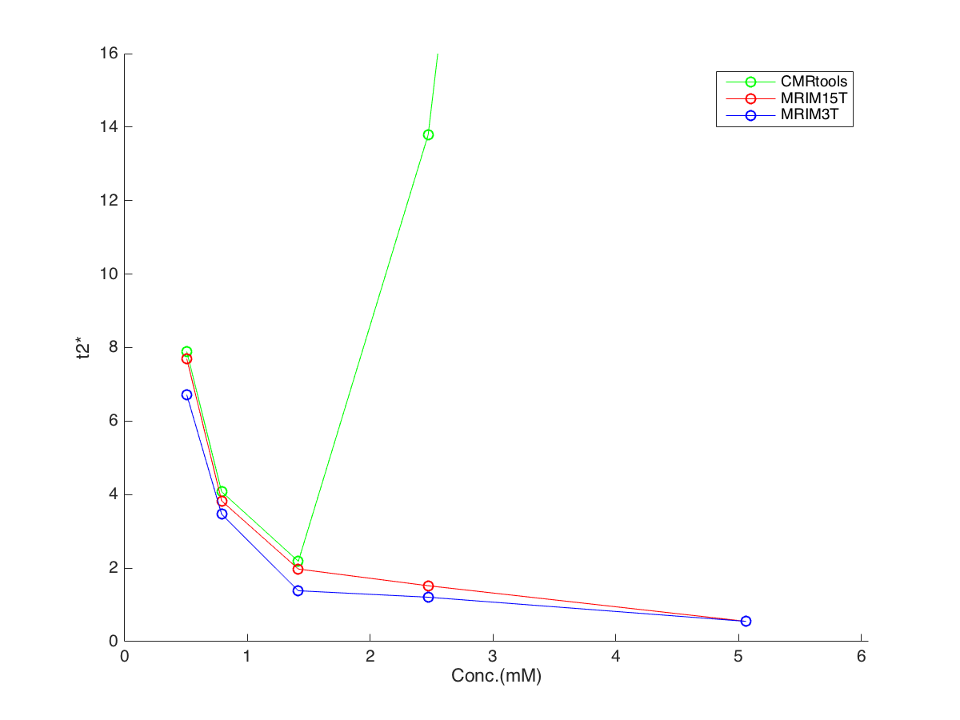
posi tion | T2* mean value |  |  | Conc.
 | CMRtools | 1.5T | 3T
1 | 7.891 | 7.695 | 6.714 | 0.505
2 | 4.077 | 3.827 | 3.461 | 0.789
3 | 2.182 | 1.973 | 1.382 | 1.413
4 | 13.791 | 1.518 | 1.206 | 2.470
5 | 87.078 | 0.549 | 0.549 | 5.059
6 | 10.179 | 9.854 | 9.423 | 0.871
7 | 4.727 | 4.500 | 3.889 | 1.761
8 | 2.487 | 2.380 | 1.887 | 3.584
9 | 1.633 | 1.223 | 1.058 | 6.387
10 | 50.522 | 0.736 | 0.570 | 12.421
11 | 15.017 | 14.832 | 12.076 | 1.060
12 | 7.997 | 7.628 | 6.243 | 1.682
13 | 4.142 | 3.844 | 3.558 | 3.375
14 | 2.256 | 2.137 | 1.501 | 6.956
15 | 2.205 | 1.505 | 1.258 | 9.698
set1 loading 20%

Slide 7
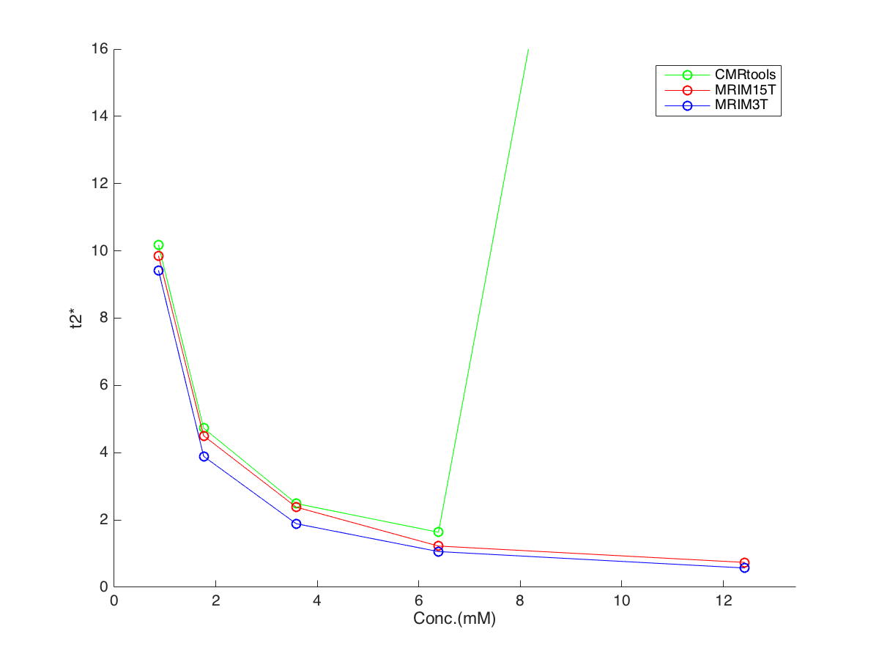
posi tion | T2* mean value |  |  | Conc.
 | CMRtools | 1.5T | 3T
1 | 7.891 | 7.695 | 6.714 | 0.505
2 | 4.077 | 3.827 | 3.461 | 0.789
3 | 2.182 | 1.973 | 1.382 | 1.413
4 | 13.791 | 1.518 | 1.206 | 2.470
5 | 87.078 | 0.549 | 0.549 | 5.059
6 | 10.179 | 9.854 | 9.423 | 0.871
7 | 4.727 | 4.500 | 3.889 | 1.761
8 | 2.487 | 2.380 | 1.887 | 3.584
9 | 1.633 | 1.223 | 1.058 | 6.387
10 | 50.522 | 0.736 | 0.570 | 12.421
11 | 15.017 | 14.832 | 12.076 | 1.060
12 | 7.997 | 7.628 | 6.243 | 1.682
13 | 4.142 | 3.844 | 3.558 | 3.375
14 | 2.256 | 2.137 | 1.501 | 6.956
15 | 2.205 | 1.505 | 1.258 | 9.698
set2 loading 10%

Slide 8
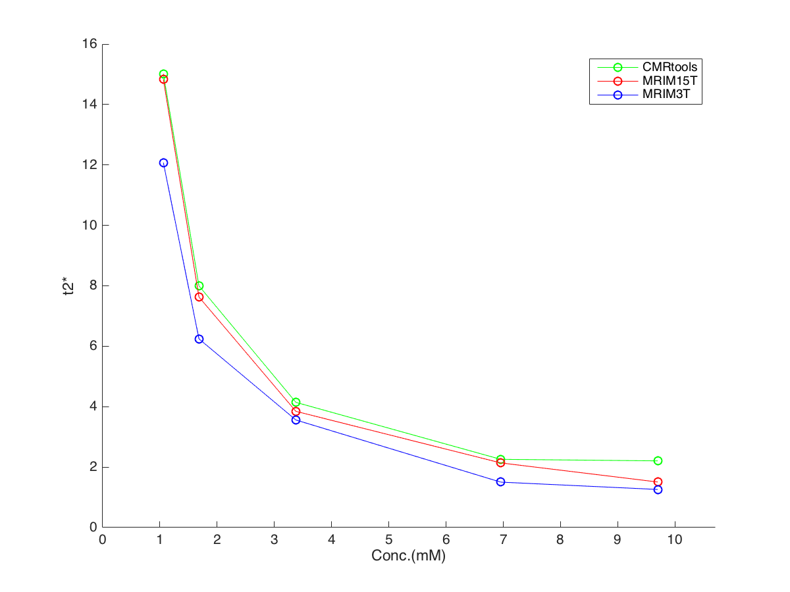
posi tion | T2* mean value |  |  | Conc.
 | CMRtools | 1.5T | 3T
1 | 7.891 | 7.695 | 6.714 | 0.505
2 | 4.077 | 3.827 | 3.461 | 0.789
3 | 2.182 | 1.973 | 1.382 | 1.413
4 | 13.791 | 1.518 | 1.206 | 2.470
5 | 87.078 | 0.549 | 0.549 | 5.059
6 | 10.179 | 9.854 | 9.423 | 0.871
7 | 4.727 | 4.500 | 3.889 | 1.761
8 | 2.487 | 2.380 | 1.887 | 3.584
9 | 1.633 | 1.223 | 1.058 | 6.387
10 | 50.522 | 0.736 | 0.570 | 12.421
11 | 15.017 | 14.832 | 12.076 | 1.060
12 | 7.997 | 7.628 | 6.243 | 1.682
13 | 4.142 | 3.844 | 3.558 | 3.375
14 | 2.256 | 2.137 | 1.501 | 6.956
15 | 2.205 | 1.505 | 1.258 | 9.698
set3 loading 5%

Slide 9
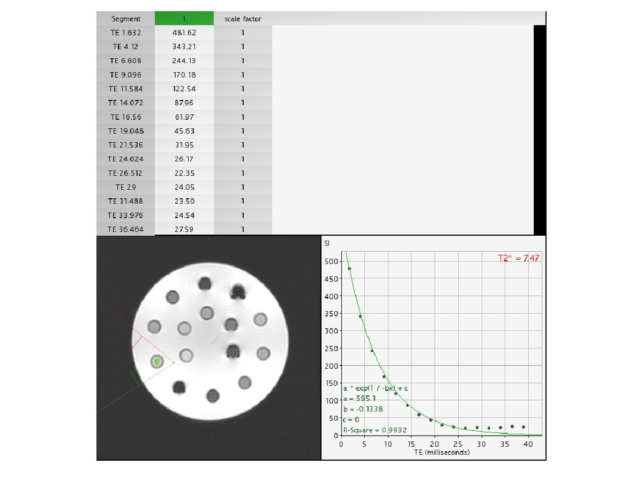
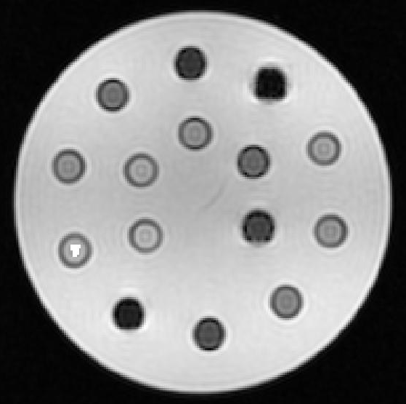
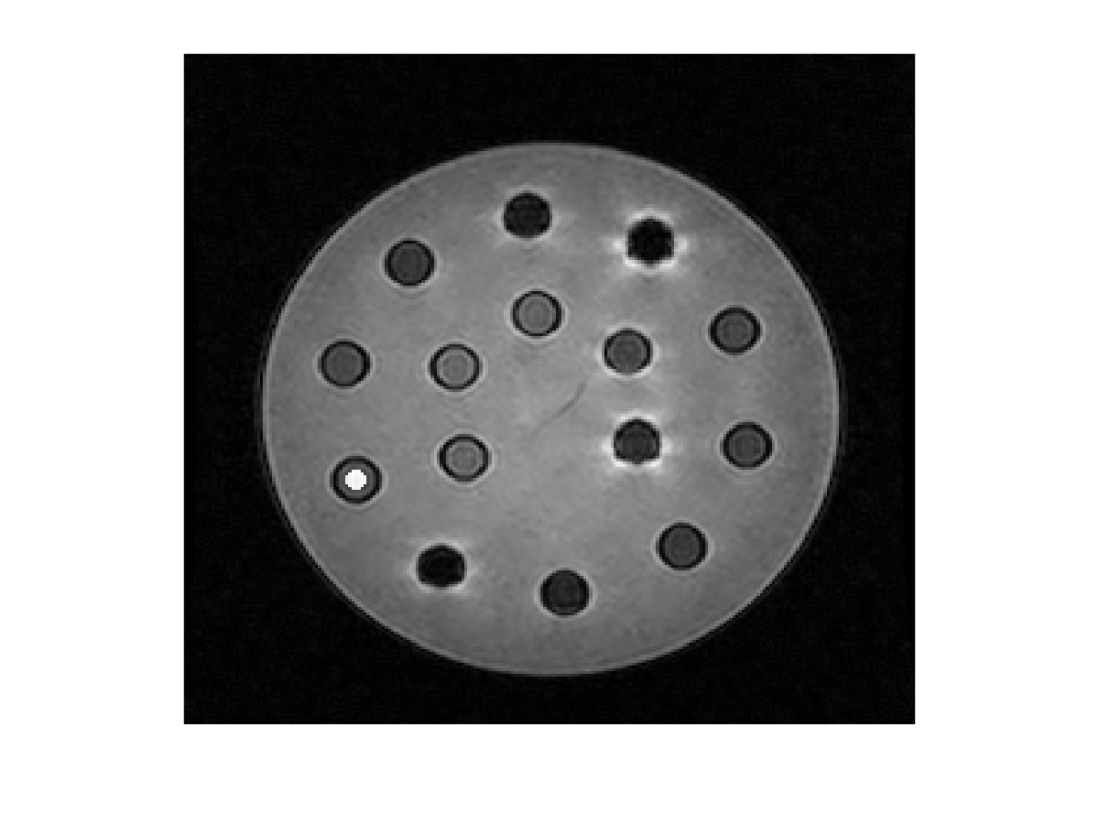
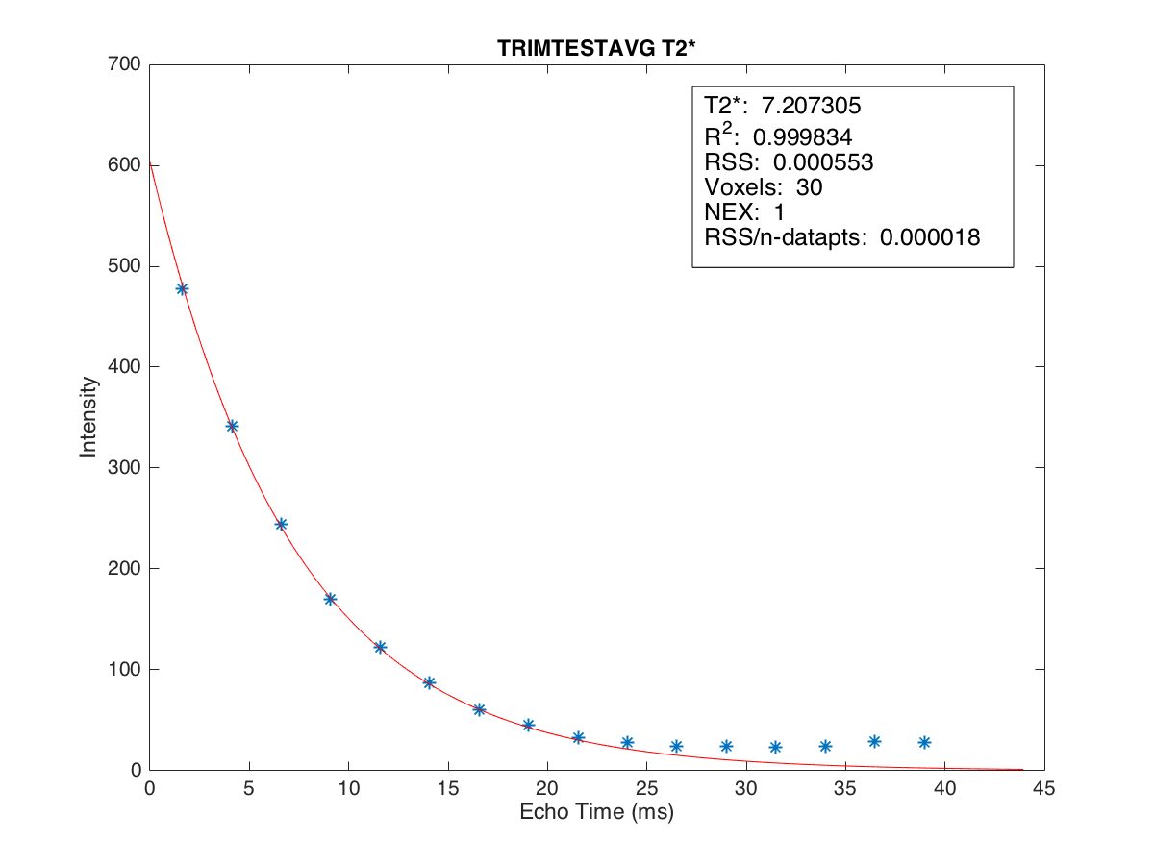
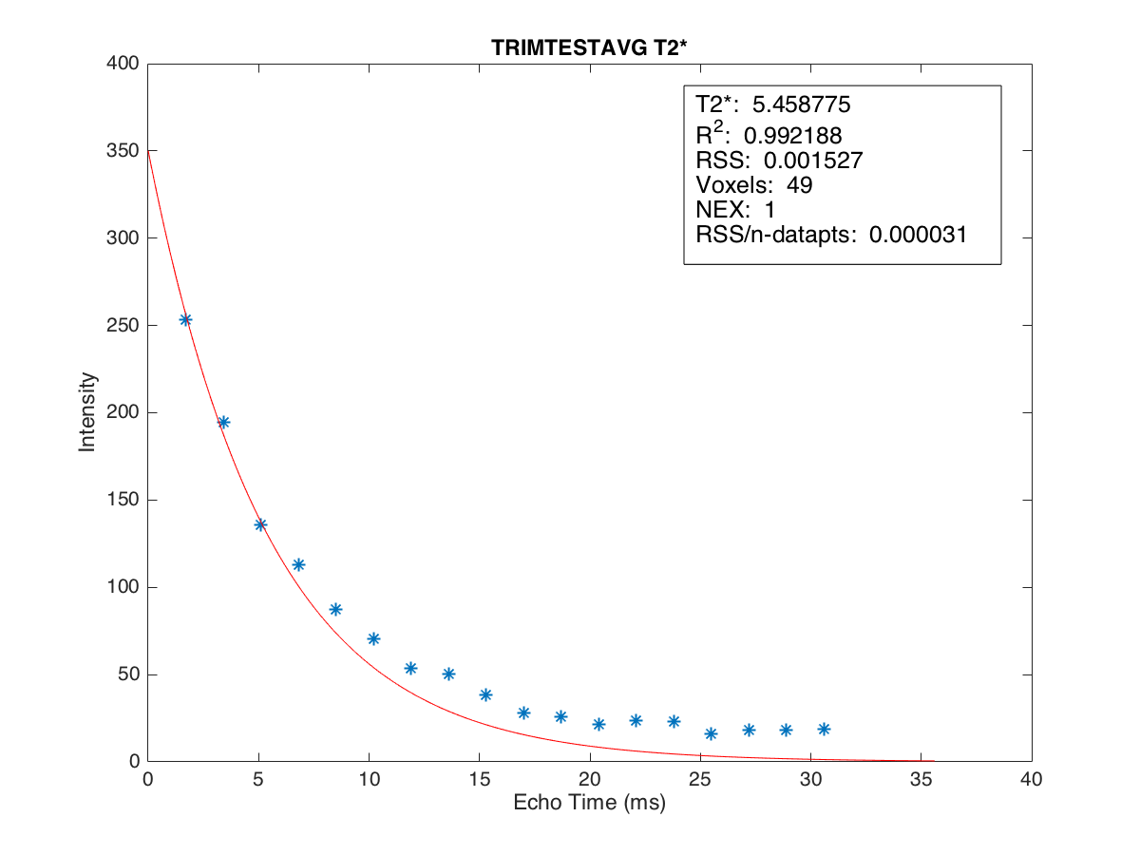

T2* = 7.207
T2* = 5.459
T2* = 7.47
MRIM 3T
CMRtools 1.5T
MRIM 1.5T
position 1 Conc. 0.505

Slide 10
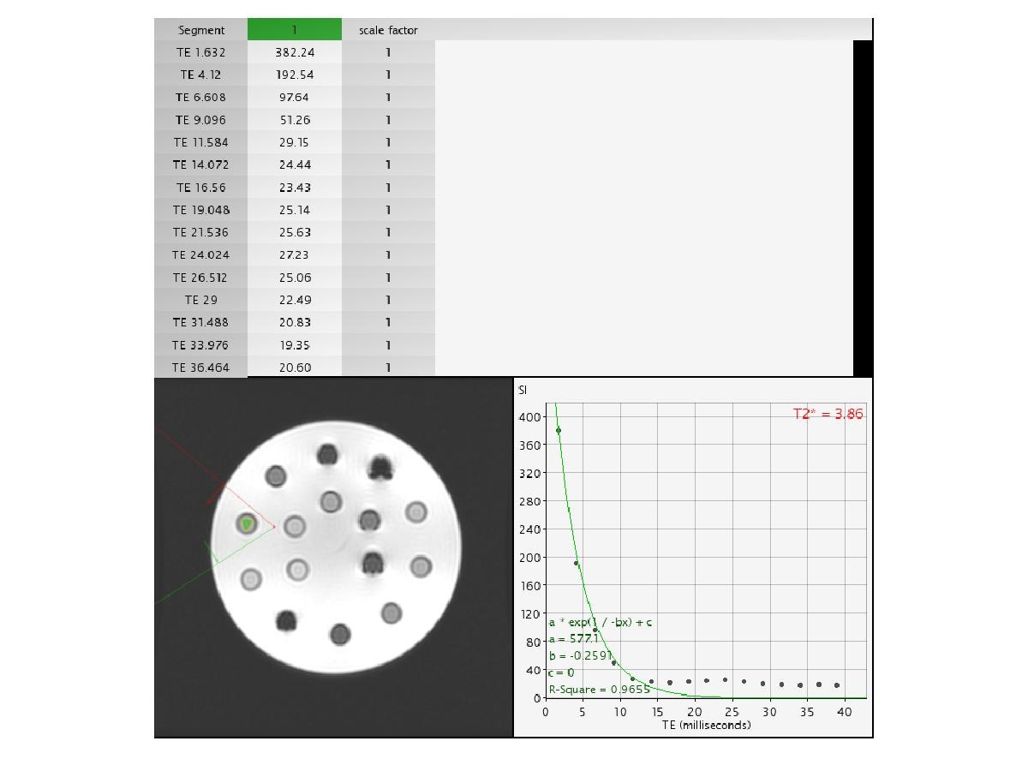
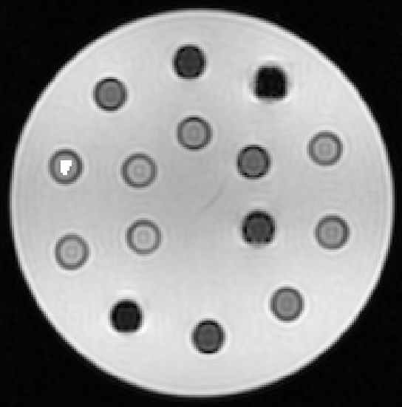
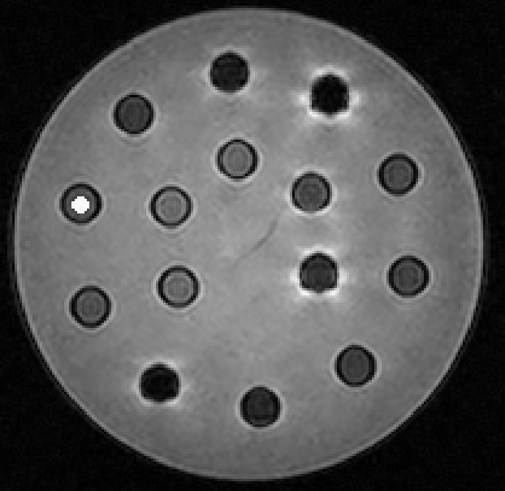
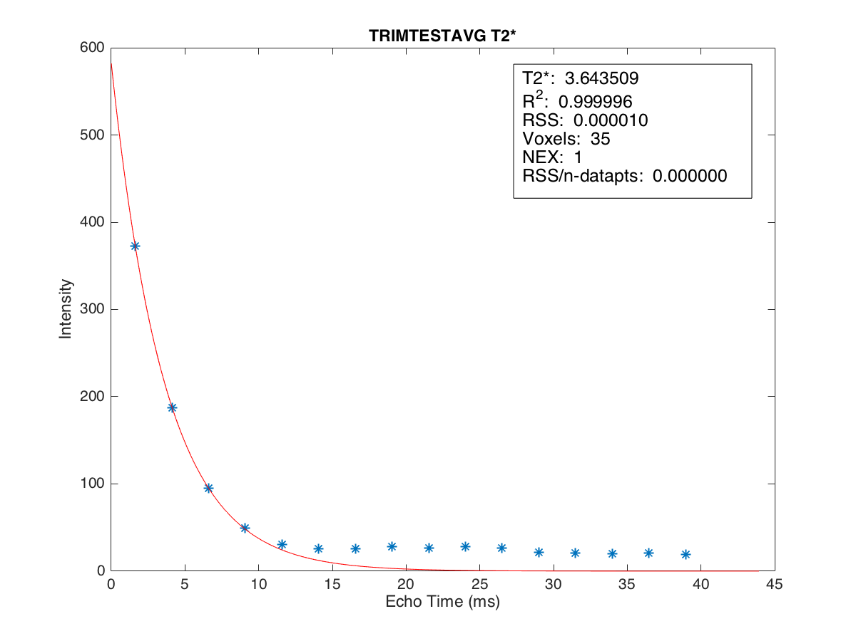
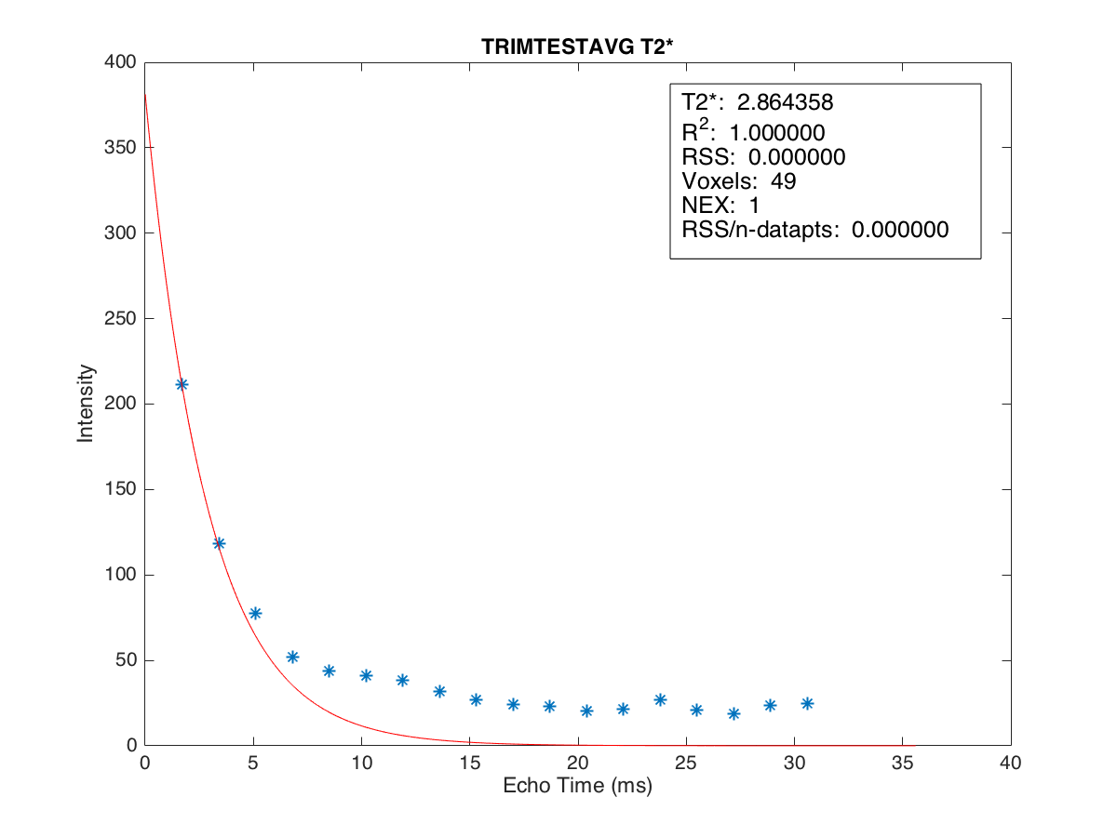
T2* = 3.644
T2* = 2.864
T2* = 3.86
MRIM 3T
CMRtools 1.5T
MRIM 1.5T
position 2 Conc. 0.789

Slide 11


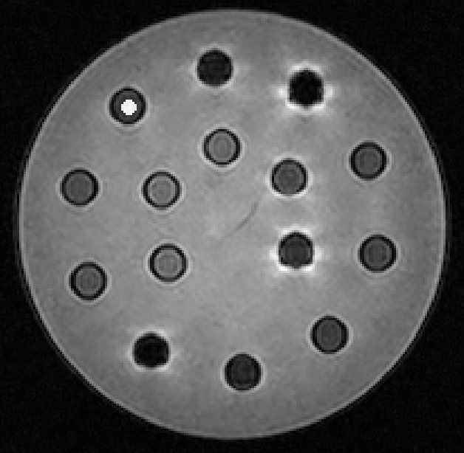
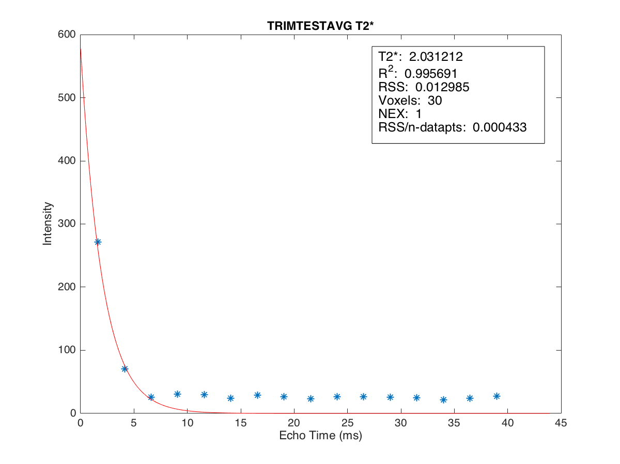
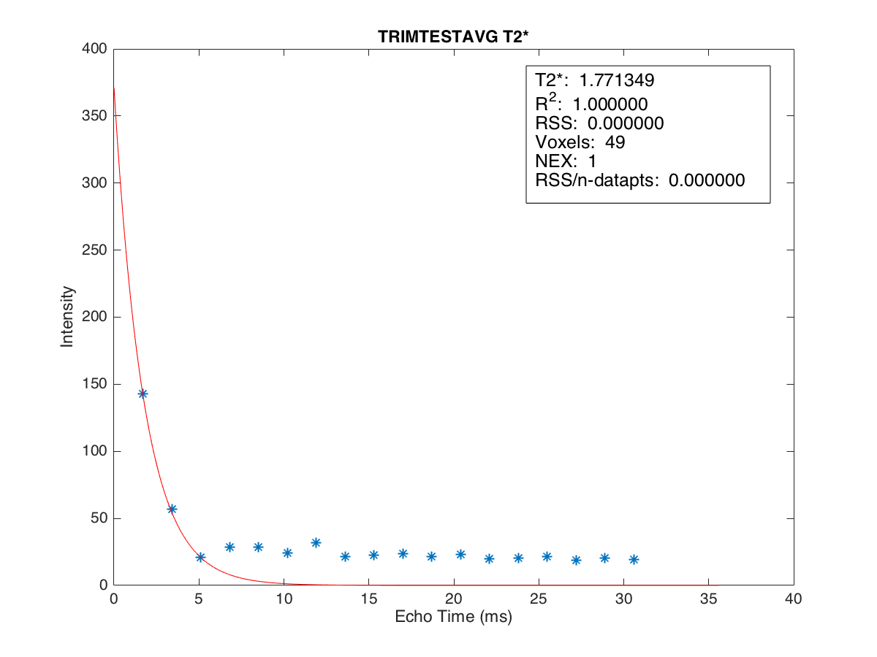
T2* = 2.031
T2* = 1.771
T2* = 2.09
MRIM 3T
CMRtools 1.5T
MRIM 1.5T
position 3 Conc. 1.413

Slide 12


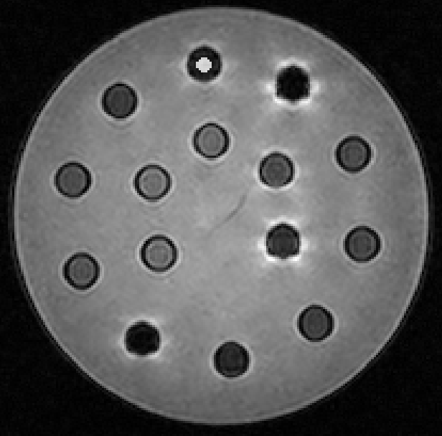
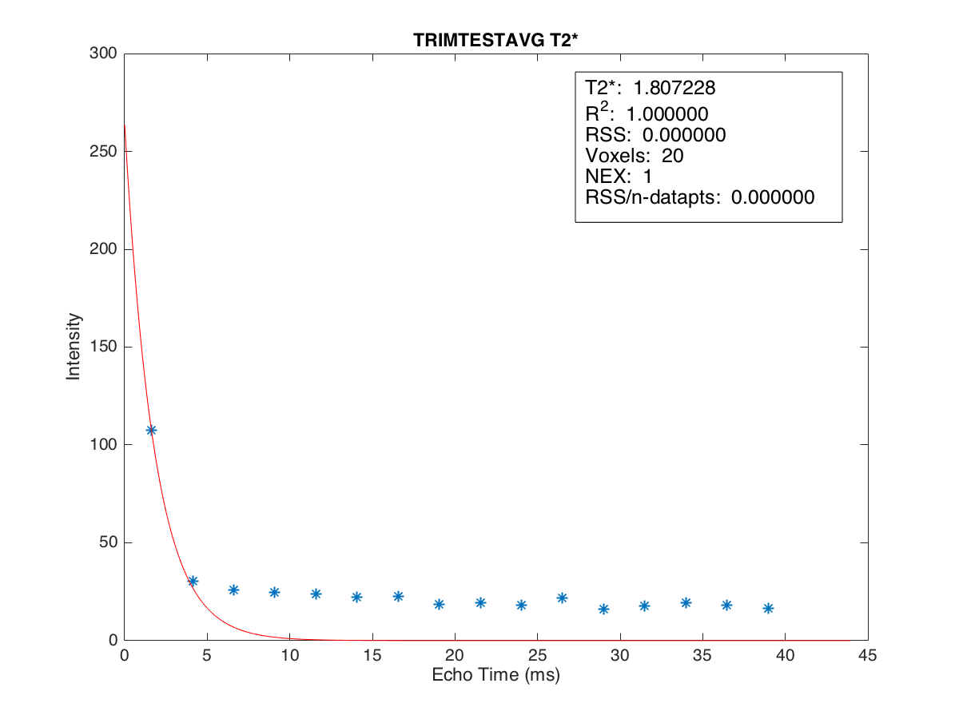
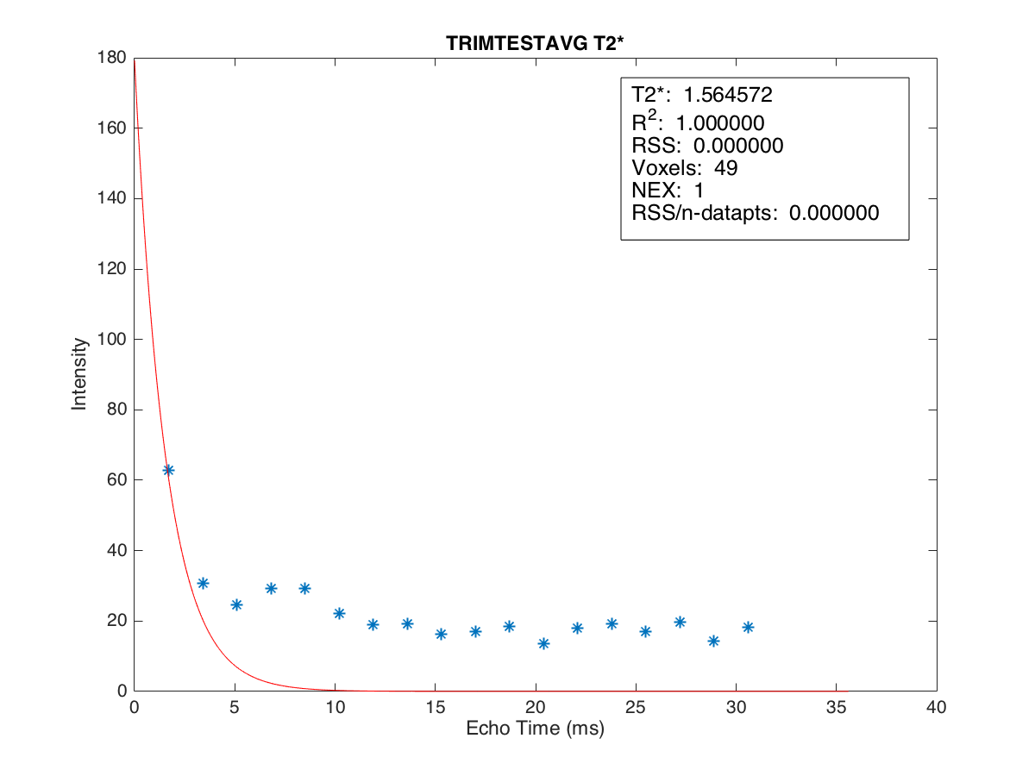
T2* = 1.807
T2* = 1.565
T2* = 12.32
MRIM 3T
CMRtools 1.5T
MRIM 1.5T
position 4 Conc. 2.470

Slide 13
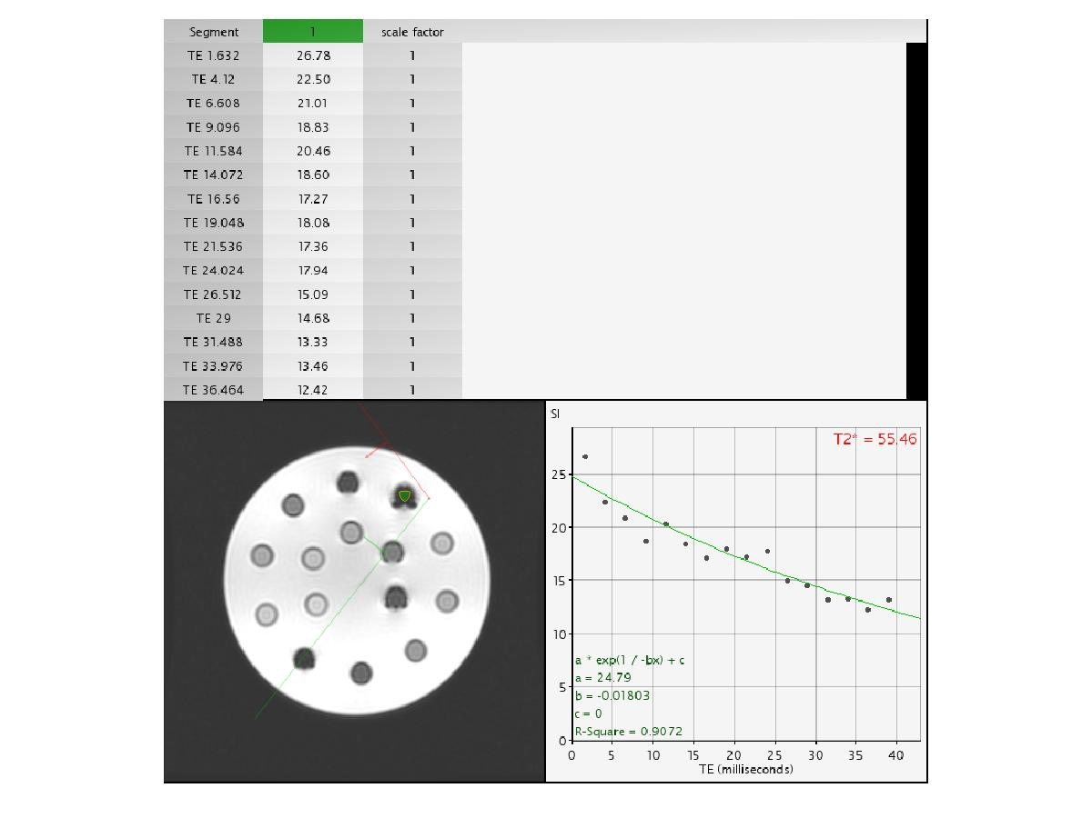

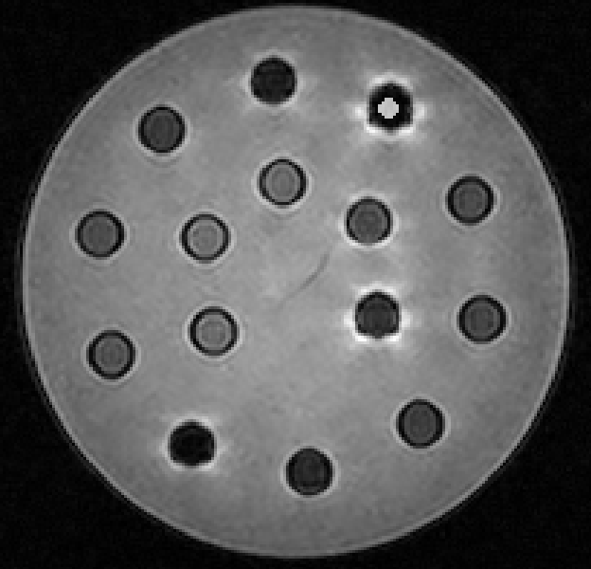
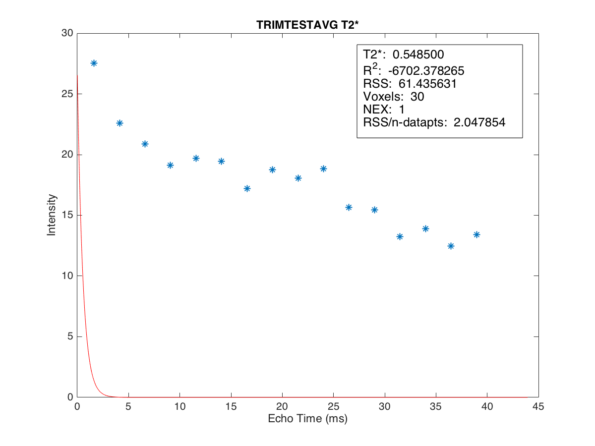
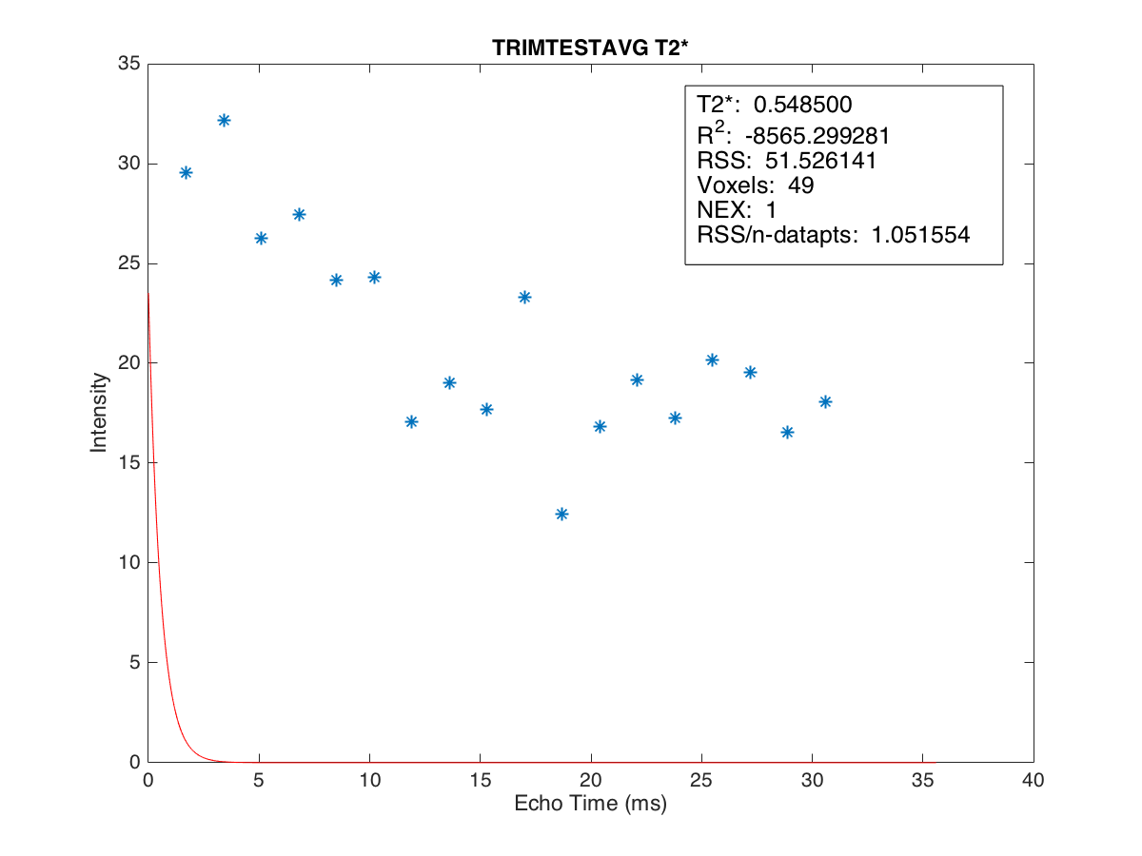
T2* = 0.549
T2* = 0.549
T2* = 55.46
MRIM 3T
CMRtools 1.5T
MRIM 1.5T
position 5 Conc. 5.059

Slide 14
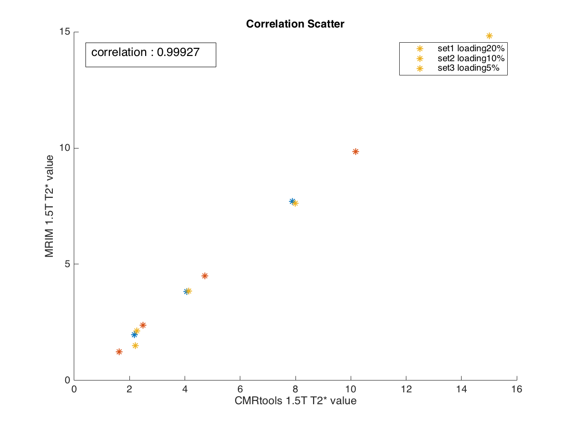
posi tion | T2* mean value |  | Conc.
 | CMRtools | 1.5T
1 | 7.891 | 7.695 | 0.505
2 | 4.077 | 3.827 | 0.789
3 | 2.182 | 1.973 | 1.413
4 | 13.791 | 1.518 | 2.470
5 | 87.078 | 0.549 | 5.059
6 | 10.179 | 9.854 | 0.871
7 | 4.727 | 4.500 | 1.761
8 | 2.487 | 2.380 | 3.584
9 | 1.633 | 1.223 | 6.387
10 | 50.522 | 0.736 | 12.421
11 | 15.017 | 14.832 | 1.060
12 | 7.997 | 7.628 | 1.682
13 | 4.142 | 3.844 | 3.375
14 | 2.256 | 2.137 | 6.956
15 | 2.205 | 1.505 | 9.698

Slide 15
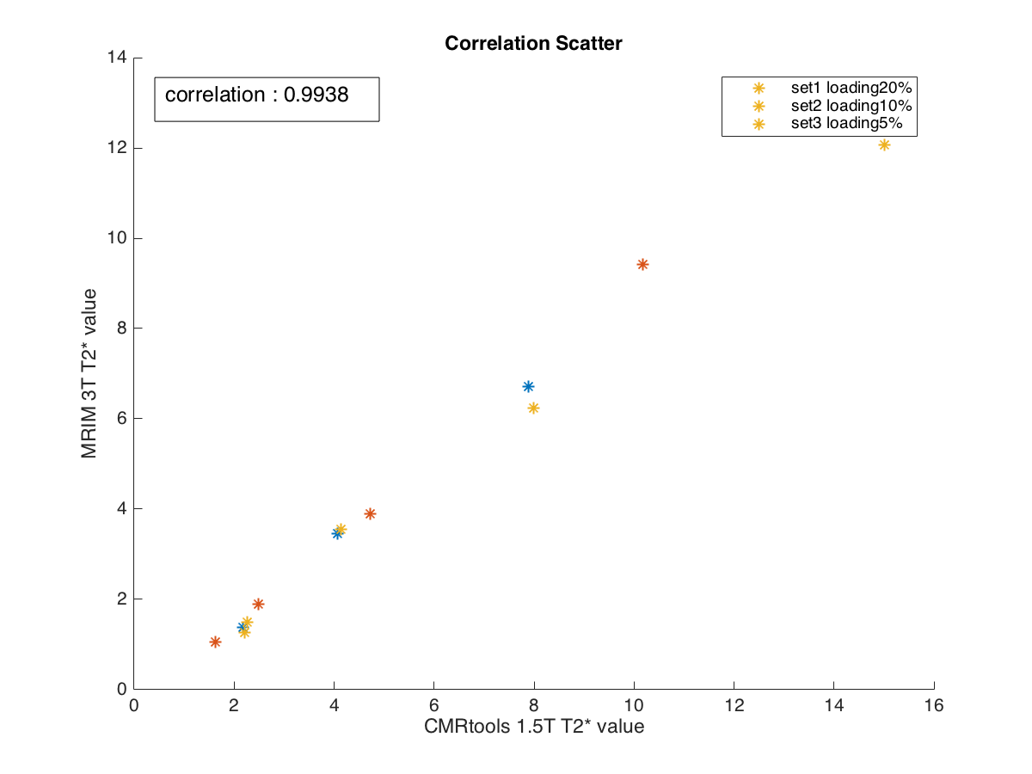
posi tion | T2* mean value |  | Conc.
 | CMRtools | 3T
1 | 7.891 | 6.714 | 0.505
2 | 4.077 | 3.461 | 0.789
3 | 2.182 | 1.382 | 1.413
4 | 13.791 | 1.206 | 2.470
5 | 87.078 | 0.549 | 5.059
6 | 10.179 | 9.423 | 0.871
7 | 4.727 | 3.889 | 1.761
8 | 2.487 | 1.887 | 3.584
9 | 1.633 | 1.058 | 6.387
10 | 50.522 | 0.570 | 12.421
11 | 15.017 | 12.076 | 1.060
12 | 7.997 | 6.243 | 1.682
13 | 4.142 | 3.558 | 3.375
14 | 2.256 | 1.501 | 6.956
15 | 2.205 | 1.258 | 9.698

Slide 16
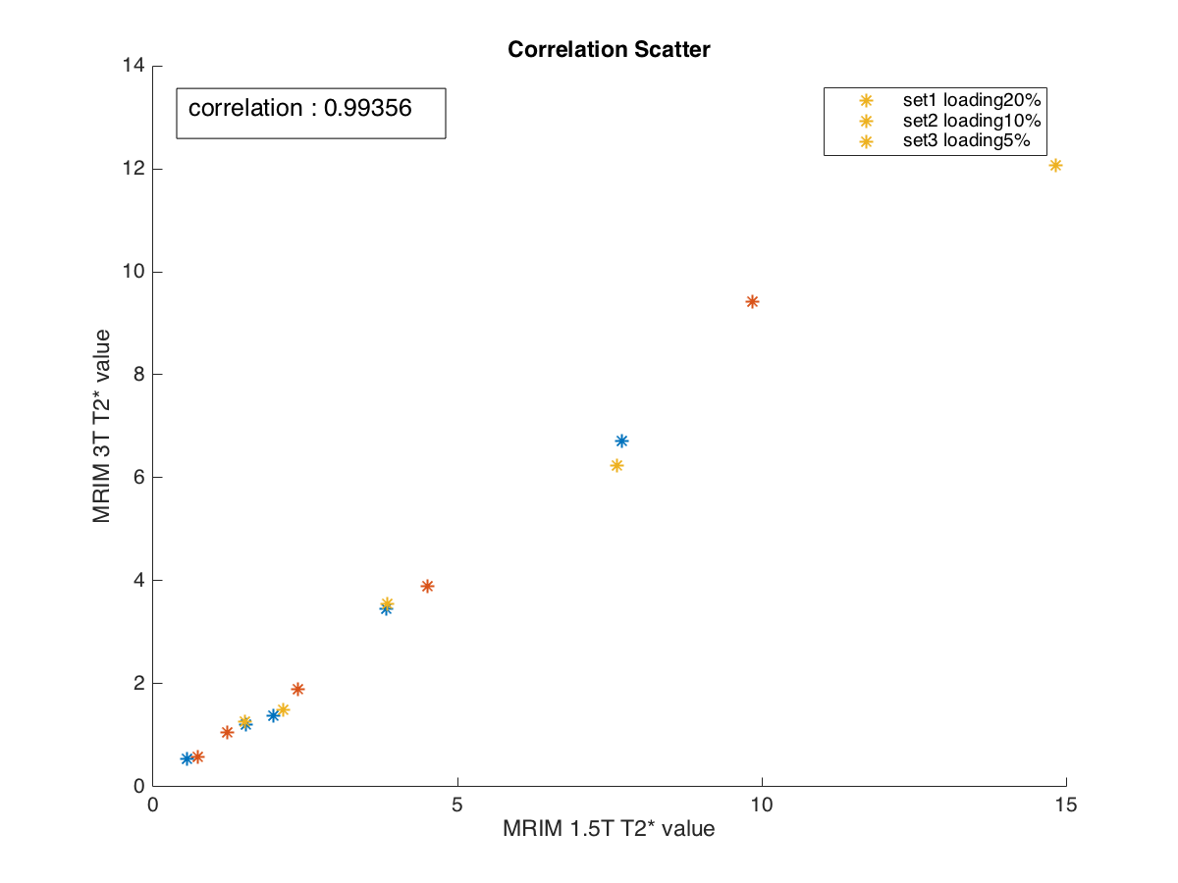

posi tion | T2* mean value |  | Conc.
 | 1.5T | 3T
1 | 7.695 | 6.714 | 0.505
2 | 3.827 | 3.461 | 0.789
3 | 1.973 | 1.382 | 1.413
4 | 1.518 | 1.206 | 2.470
5 | 0.549 | 0.549 | 5.059
6 | 9.854 | 9.423 | 0.871
7 | 4.500 | 3.889 | 1.761
8 | 2.380 | 1.887 | 3.584
9 | 1.223 | 1.058 | 6.387
10 | 0.736 | 0.570 | 12.421
11 | 14.832 | 12.076 | 1.060
12 | 7.628 | 6.243 | 1.682
13 | 3.844 | 3.558 | 3.375
14 | 2.137 | 1.501 | 6.956
15 | 1.505 | 1.258 | 9.698

Slide 17
Correlation Between |  | r | n
CMRtools | MRIM 1.5T | 0.9993 | 12
CMRtools | MRIM 3T | 0.9938 | 12
MRIM 1.5T | MRIM 3T | 0.9936 | 12*
MRIM 1.5T | MRIM 3T | 0.9947 | 15
*ตัด position ตาม CMRtool ที่ให้ผล error

Slide 18
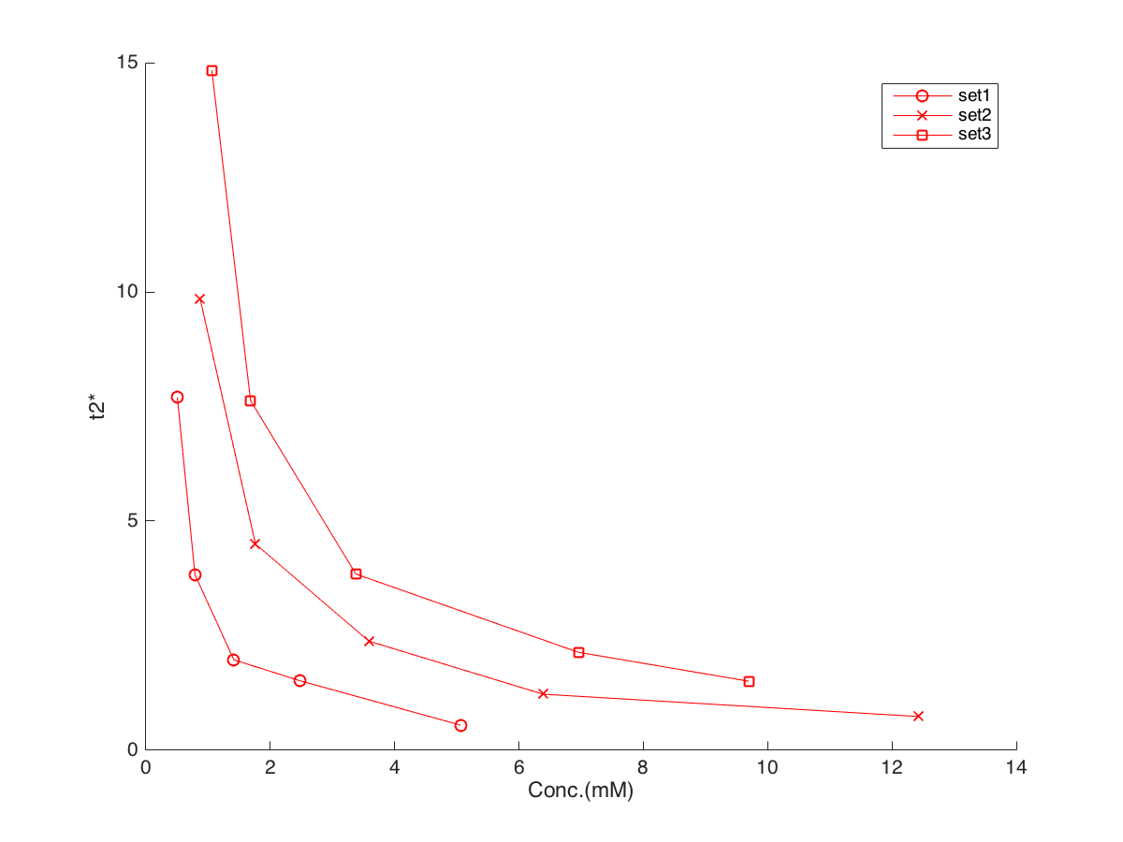
MRIM 1.5Tesla T2* Result
posi tion | T2* mean value | Conc. | loading
1 | 7.695 | 0.505 | 20%
2 | 3.827 | 0.789
3 | 1.973 | 1.413
4 | 1.518 | 2.470
5 | 0.549 | 5.059
6 | 9.854 | 0.871 | 10%
7 | 4.500 | 1.761
8 | 2.380 | 3.584
9 | 1.223 | 6.387
10 | 0.736 | 12.421
11 | 14.832 | 1.060 | 5%
12 | 7.628 | 1.682
13 | 3.844 | 3.375
14 | 2.137 | 6.956
15 | 1.505 | 9.698
loading 5%
loading 20%
loading 10%

Slide 19
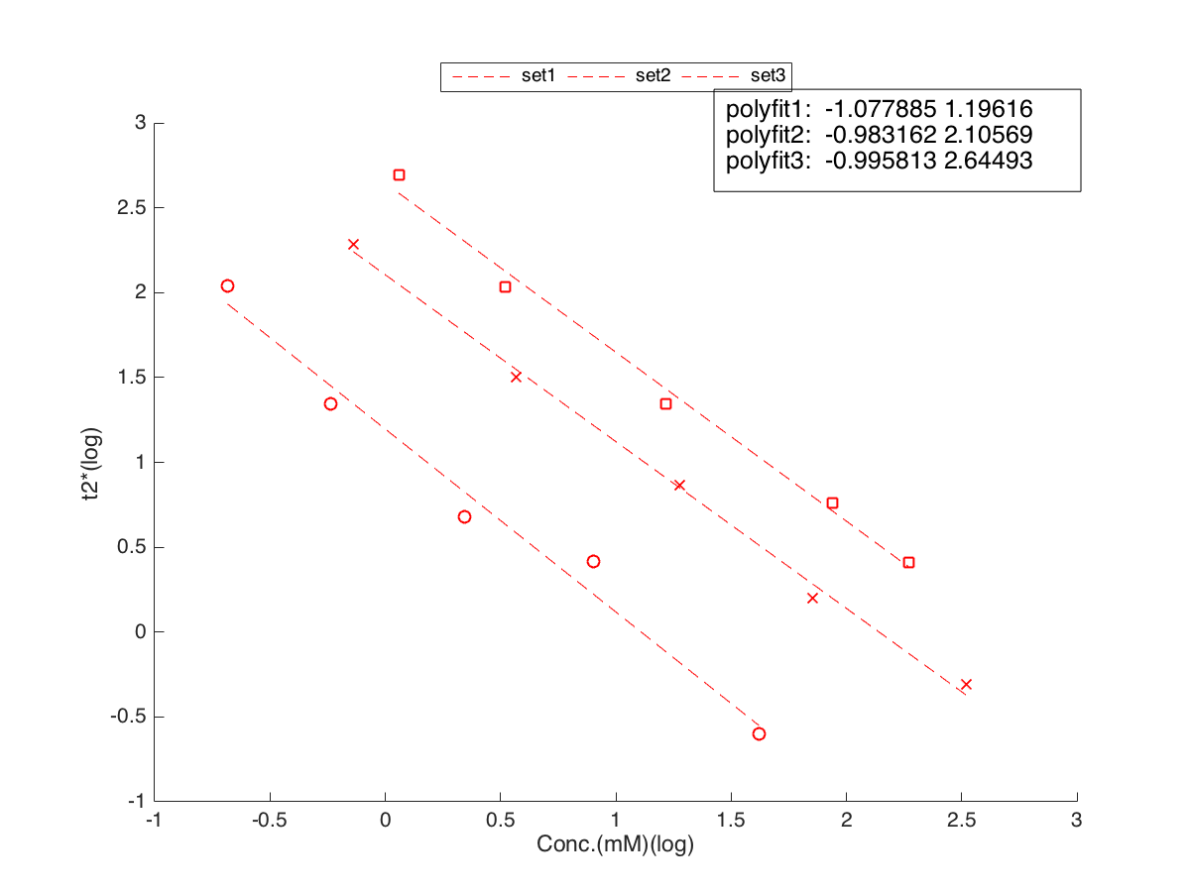
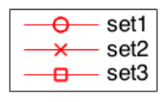
MRIM 1.5Tesla T2* Result
loading 5%
loading 20%
loading 10%

Slide 20
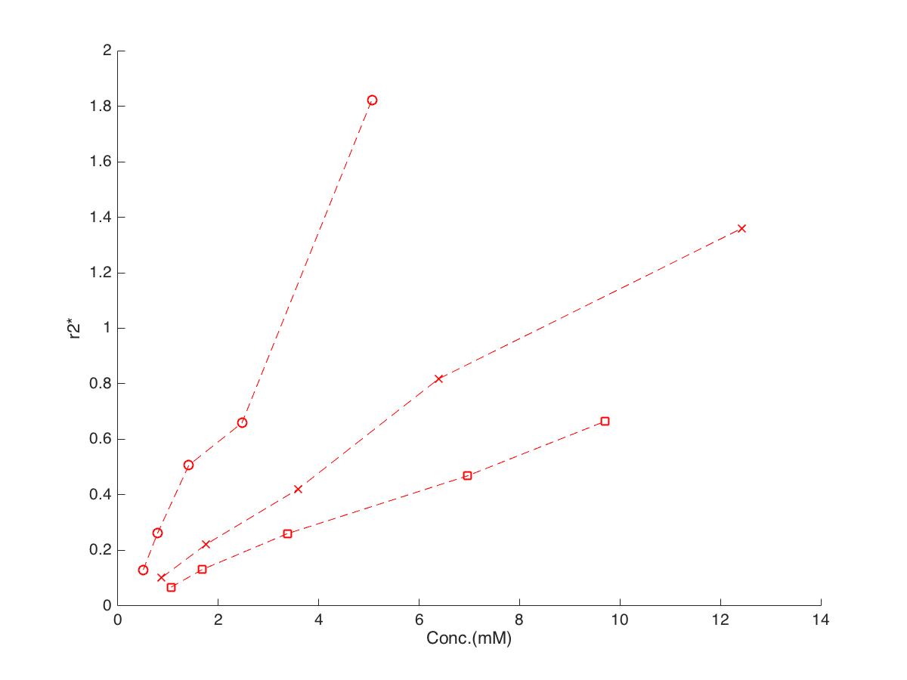
MRIM 1.5Tesla R2* Result
loading 20%
loading 10%
loading 5%

Slide 21
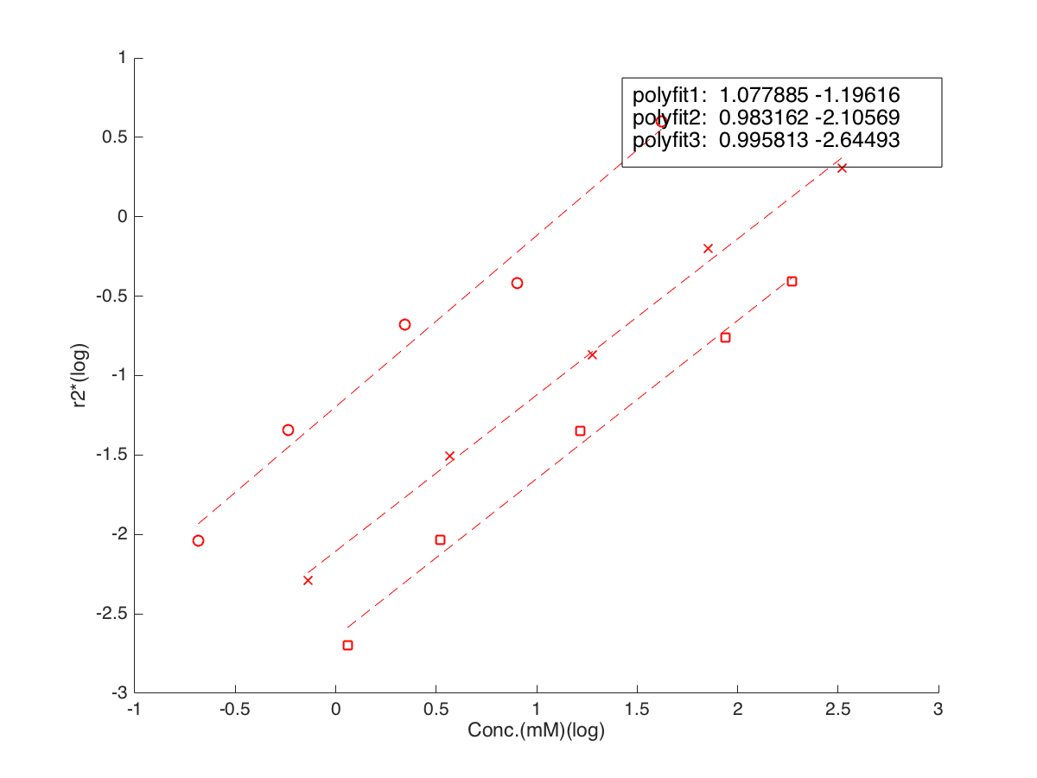
MRIM 1.5Tesla R2* Result
loading 20%
loading 10%
loading 5%

