Slide 1
Phantom
transfer function

Slide 2
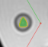
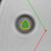
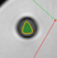
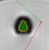
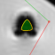
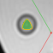


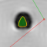
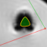
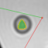
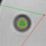
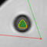
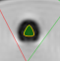
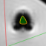
ตัวอย่างการวัดด้วยโปรแกรม CMRtools ของทั้ง 3 คน
Position1
Position2
Position3
Position4
Position5
User1
User2
User3

Slide 3
T2* CMRtools User1
position | 1 | 2 | 3 | 4 | 5 | 6 | 7 | 8 | 9 | 10 | 11 | 12 | 13 | 14 | 15
week1 | 7.47 | 3.86 | 2.11 | 13.25 | 54.44 | 8.99 | 4.29 | 2.39 | 1.69 | 47.03 | 14.16 | 7.83 | 4.08 | 2.18 | 2.20
week2 | 7.60 | 3.92 | 1.96 | 19.14 | 92.33 | 9.66 | 4.53 | 2.33 | 1.76 | 64.82 | 14.76 | 7.59 | 4.01 | 2.22 | 2.22
week3 | 7.99 | 3.99 | 2.07 | 18.61 | 80.75 | 10.20 | 4.76 | 2.39 | 1.70 | 54.69 | 15.15 | 7.95 | 4.17 | 2.28 | 2.80
week4 | 7.76 | 3.96 | 2.11 | 17.79 | 99.77 | 10.26 | 4.68 | 2.36 | 1.63 | 69.01 | 14.63 | 7.84 | 4.10 | 2.30 | 2.37
week5 | 7.71 | 3.96 | 2.23 | 18.55 | 90.83 | 9.99 | 4.62 | 2.39 | 1.67 | 64.20 | 14.95 | 7.92 | 4.15 | 2.45 | 2.43
week6 | 7.65 | 3.87 | 2.12 | 20.31 | 98.07 | 9.83 | 4.61 | 2.41 | 1.57 | 72.22 | 14.53 | 7.56 | 3.87 | 2.31 | 2.72
week7 | 8.03 | 4.10 | 2.20 | 15.74 | 83.79 | 10.18 | 4.77 | 2.45 | 1.64 | 69.06 | 15.18 | 8.23 | 4.26 | 2.42 | 2.10
week8 | 8.45 | 4.39 | 2.43 | 14.75 | 84.56 | 10.51 | 4.87 | 2.51 | 1.71 | 49.39 | 16.39 | 8.73 | 4.49 | 2.57 | 2.10
week9 | 8.53 | 4.44 | 2.44 | 11.79 | 87.89 | 10.27 | 4.99 | 2.55 | 1.61 | 55.73 | 16.39 | 8.84 | 4.60 | 2.61 | 1.97
week10 | 8.12 | 4.15 | 2.23 | 11.76 | 82.64 | 10.18 | 4.81 | 2.46 | 1.48 | 46.62 | 14.80 | 8.08 | 4.24 | 2.32 | 1.92
week11 | 7.98 | 4.05 | 2.18 | 2.67 | 78.90 | 10.08 | 4.63 | 2.42 | 1.45 | 40.70 | 14.82 | 8.00 | 4.20 | 2.34 | 1.95
week12 | 8.15 | 4.17 | 2.22 | 11.90 | 81.42 | 10.27 | 4.73 | 2.43 | 1.51 | 38.04 | 15.24 | 8.16 | 4.30 | 2.33 | 1.93
week13 | 7.87 | 4.14 | 2.24 | 11.95 | 60.04 | 10.41 | 4.78 | 2.63 | 1.56 | 28.21 | 15.07 | 8.07 | 4.26 | 2.37 | 2.08
week14 | 7.97 | 4.18 | 2.29 | 16.89 | 106.90 | 10.57 | 4.99 | 2.66 | 1.66 | 41.03 | 15.33 | 8.20 | 4.30 | 2.53 | 2.31
week15 | 7.42 | 3.86 | 2.16 | 19.12 | 90.14 | 10.17 | 4.66 | 2.57 | 1.48 | 49.62 | 14.01 | 7.41 | 3.85 | 2.30 | 2.60

Slide 4
T2* CMRtools User2
position | 1 | 2 | 3 | 4 | 5 | 6 | 7 | 8 | 9 | 10 | 11 | 12 | 13 | 14 | 15
week1 | 7.47 | 3.88 | 2.11 | 13.39 | 54.14 | 9.00 | 4.29 | 2.40 | 1.68 | 47.03 | 14.15 | 7.83 | 4.09 | 2.18 | 2.19
week2 | 7.58 | 3.95 | 1.96 | 18.88 | 79.90 | 9.81 | 4.50 | 2.33 | 1.76 | 64.15 | 14.91 | 7.61 | 7.61 | 2.18 | 2.78
week3 | 8.02 | 4.01 | 2.06 | 18.39 | 18.39 | 10.23 | 4.78 | 2.41 | 1.63 | 55.17 | 15.08 | 15.08 | 15.08 | 2.28 | 2.37
week4 | 7.73 | 3.95 | 2.10 | 17.99 | 89.95 | 10.31 | 4.67 | 2.34 | 1.67 | 63.10 | 14.56 | 7.78 | 4.07 | 2.32 | 2.89
week5 | 7.62 | 7.62 | 2.19 | 21.03 | 87.26 | 9.95 | 4.56 | 2.37 | 1.62 | 58.12 | 14.86 | 7.94 | 4.19 | 2.48 | 2.77
week6 | 7.62 | 3.94 | 2.13 | 20.54 | 96.02 | 9.85 | 4.55 | 2.42 | 1.51 | 67.46 | 14.49 | 7.50 | 3.89 | 2.46 | 3.19
week7 | 7.97 | 4.10 | 2.19 | 16.17 | 91.10 | 10.21 | 4.69 | 2.41 | 1.70 | 66.28 | 15.13 | 8.15 | 4.28 | 2.53 | 2.54
week8 | 8.47 | 4.34 | 2.35 | 14.43 | 86.91 | 10.56 | 4.81 | 2.49 | 1.59 | 50.29 | 16.33 | 8.65 | 4.49 | 2.60 | 2.17
week9 | 8.50 | 4.43 | 2.40 | 13.42 | 83.01 | 10.32 | 4.93 | 2.55 | 1.57 | 49.85 | 16.44 | 8.88 | 4.61 | 2.67 | 2.05
week10 | 8.05 | 4.12 | 2.21 | 12.63 | 73.54 | 10.16 | 4.76 | 2.44 | 1.47 | 43.27 | 14.75 | 8.04 | 4.27 | 2.40 | 2.05
week11 | 7.99 | 4.07 | 2.16 | 10.07 | 82.51 | 10.15 | 4.66 | 2.44 | 1.45 | 40.07 | 14.82 | 8.03 | 4.25 | 2.32 | 2.19
week12 | 8.12 | 4.17 | 2.17 | 13.54 | 79.36 | 10.29 | 4.65 | 2.41 | 1.45 | 40.25 | 15.16 | 8.17 | 4.32 | 2.39 | 2.13
week13 | 7.85 | 4.14 | 2.25 | 12.36 | 60.31 | 10.37 | 4.76 | 2.62 | 1.57 | 31.02 | 15.05 | 8.08 | 4.24 | 2.32 | 2.19
week14 | 7.97 | 4.16 | 2.28 | 16.03 | 101.04 | 10.57 | 4.99 | 2.64 | 1.62 | 39.54 | 15.33 | 8.21 | 4.29 | 2.55 | 2.32
week15 | 7.39 | 3.87 | 2.17 | 19.44 | 85.09 | 10.14 | 4.72 | 2.57 | 1.51 | 42.12 | 14.05 | 7.41 | 3.82 | 2.37 | 3.33

Slide 5
T2* CMRtools User3
position | 1 | 2 | 3 | 4 | 5 | 6 | 7 | 8 | 9 | 10 | 11 | 12 | 13 | 14 | 15
week1 | 7.55 | 3.87 | 2.09 | 12.48 | 52.14 | 9.00 | 4.29 | 2.38 | 1.67 | 50.80 | 14.17 | 7.85 | 4.06 | 2.20 | 2.20
week2 | 7.58 | 3.95 | 1.95 | 20.56 | 88.36 | 9.62 | 4.52 | 2.31 | 1.76 | 1.76 | 14.78 | 7.65 | 4.05 | 2.27 | 2.72
week3 | 8.04 | 4.00 | 2.07 | 19.96 | 70.49 | 10.21 | 4.77 | 2.40 | 1.61 | 55.99 | 15.23 | 8.00 | 4.21 | 2.29 | 3.08
week4 | 7.81 | 3.97 | 2.16 | 20.23 | 97.95 | 10.26 | 4.67 | 2.36 | 1.70 | 77.48 | 14.67 | 7.87 | 4.16 | 2.33 | 2.58
week5 | 7.72 | 3.94 | 2.24 | 19.66 | 118.88 | 9.93 | 4.59 | 2.38 | 11.97 | 72.10 | 14.97 | 7.97 | 4.16 | 2.48 | 2.30
week6 | 7.66 | 3.93 | 2.15 | 21.79 | 93.00 | 9.77 | 4.56 | 2.41 | 1.57 | 73.80 | 14.60 | 7.60 | 3.89 | 2.38 | 2.61
week7 | 8.04 | 4.14 | 2.20 | 15.91 | 87.09 | 10.15 | 4.76 | 2.43 | 1.74 | 74.78 | 15.31 | 8.24 | 4.29 | 2.49 | 2.10
week8 | 8.46 | 4.38 | 2.45 | 14.87 | 80.09 | 10.51 | 4.85 | 2.49 | 1.69 | 52.99 | 16.42 | 8.76 | 4.52 | 2.63 | 2.10
week9 | 8.55 | 4.46 | 2.46 | 12.41 | 83.58 | 10.29 | 5.03 | 2.56 | 1.59 | 55.75 | 16.42 | 8.93 | 4.61 | 2.64 | 1.80
week10 | 8.07 | 4.14 | 2.23 | 12.99 | 78.41 | 10.14 | 4.81 | 2.44 | 1.49 | 51.64 | 14.87 | 8.07 | 4.23 | 2.40 | 1.90
week11 | 8.01 | 4.06 | 2.19 | 10.69 | 82.37 | 10.05 | 4.63 | 2.41 | 1.43 | 45.44 | 14.86 | 8.02 | 4.26 | 2.42 | 1.81
week12 | 8.15 | 4.17 | 2.16 | 14.27 | 84.62 | 10.25 | 4.70 | 2.41 | 1.43 | 40.96 | 15.29 | 8.20 | 4.33 | 2.43 | 1.91
week13 | 7.86 | 4.15 | 2.27 | 13.94 | 55.89 | 10.34 | 4.74 | 2.61 | 1.55 | 28.80 | 15.14 | 8.07 | 4.26 | 2.49 | 2.10
week14 | 8.05 | 4.20 | 2.23 | 13.75 | 83.00 | 10.74 | 5.07 | 2.66 | 1.61 | 32.09 | 15.20 | 8.23 | 4.29 | 2.50 | 2.12
week15 | 7.40 | 3.89 | 2.16 | 17.49 | 85.42 | 10.07 | 4.67 | 2.57 | 1.53 | 51.52 | 14.12 | 7.48 | 3.90 | 2.29 | 2.60

Slide 6
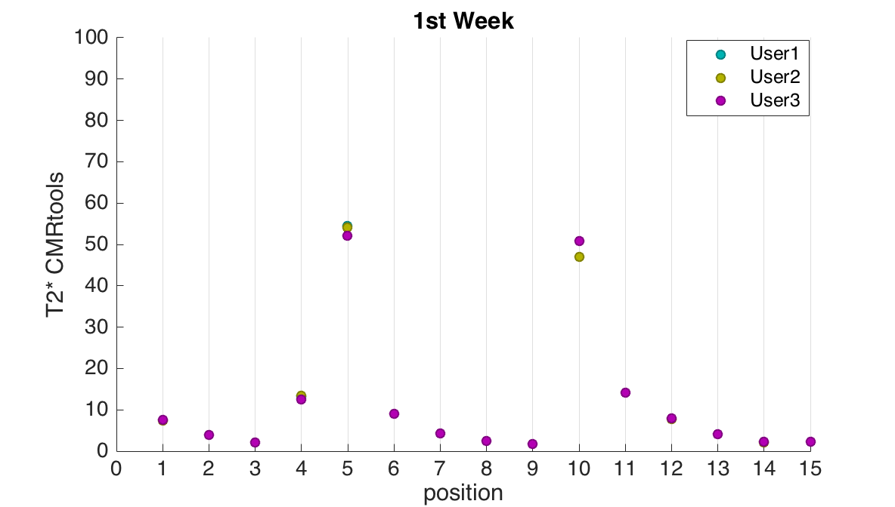

T2* Value
loading 5%
position | User1 | User2 | User3
1 | 7.47 | 7.47 | 7.55
2 | 3.86 | 3.88 | 3.87
3 | 2.11 | 2.11 | 2.09
4 | 13.25 | 13.39 | 12.48
5 | 54.44 | 54.14 | 52.14
6 | 8.99 | 9.00 | 9.00
7 | 4.29 | 4.29 | 4.29
8 | 2.39 | 2.40 | 2.38
9 | 1.69 | 1.68 | 1.67
10 | 47.03 | 47.03 | 50.80
11 | 14.16 | 14.15 | 14.17
12 | 7.83 | 7.83 | 7.85
13 | 4.08 | 4.09 | 4.06
14 | 2.18 | 2.18 | 2.20
15 | 2.20 | 2.19 | 2.20
loading 20%
loading 10%
position | 1 | 2 | 3 | 4 | 5 | 6 | 7 | 8 | 9 | 10 | 11 | 12 | 13 | 14 | 15
mean | 7.50 | 3.87 | 2.10 | 13.04 | 53.57 | 9.00 | 4.29 | 2.39 | 1.68 | 48.29 | 14.16 | 7.84 | 4.08 | 2.19 | 2.20
SD | 0.47 | 0.08 | 0.11 | 4.94 | 12.53 | 0.10 | 0.03 | 0.10 | 0.11 | 21.75 | 0.06 | 0.13 | 0.15 | 0.14 | 0.05

Slide 7
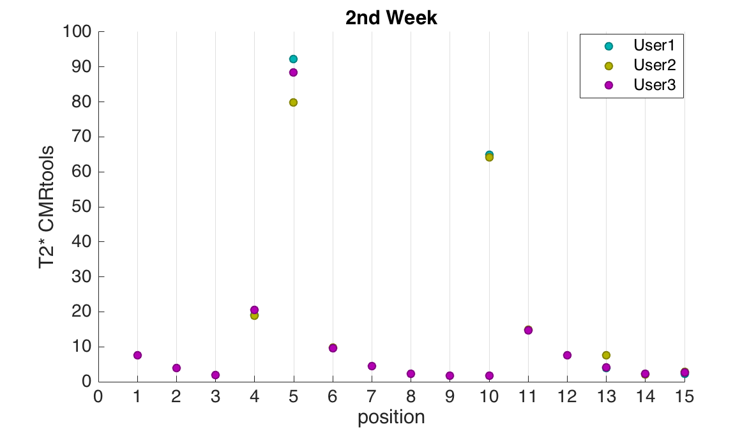
T2* Value
loading 5%
position | User1 | User2 | User3
1 | 7.60 | 7.58 | 7.58
2 | 3.92 | 3.95 | 3.95
3 | 1.96 | 1.96 | 1.95
4 | 19.14 | 18.88 | 20.56
5 | 92.33 | 79.90 | 88.36
6 | 9.66 | 9.81 | 9.62
7 | 4.53 | 4.50 | 4.52
8 | 2.33 | 2.33 | 2.31
9 | 1.76 | 1.76 | 1.76
10 | 64.82 | 64.15 | 1.76
11 | 14.76 | 14.91 | 14.78
12 | 7.59 | 7.61 | 7.65
13 | 4.01 | 7.61 | 4.05
14 | 2.22 | 2.18 | 2.27
15 | 2.22 | 2.78 | 2.72
loading 20%
loading 10%
position | 1 | 2 | 3 | 4 | 5 | 6 | 7 | 8 | 9 | 10 | 11 | 12 | 13 | 14 | 15
mean | 7.59 | 3.94 | 1.96 | 19.53 | 86.87 | 9.70 | 4.52 | 2.32 | 1.76 | 43.57 | 14.81 | 7.62 | 5.22 | 2.22 | 2.57
SD | 0.11 | 0.14 | 0.06 | 9.04 | 63.46 | 1.01 | 0.14 | 0.11 | 0.03 | 362.16 | 0.81 | 0.34 | 20.64 | 0.49 | 3.08

Slide 8
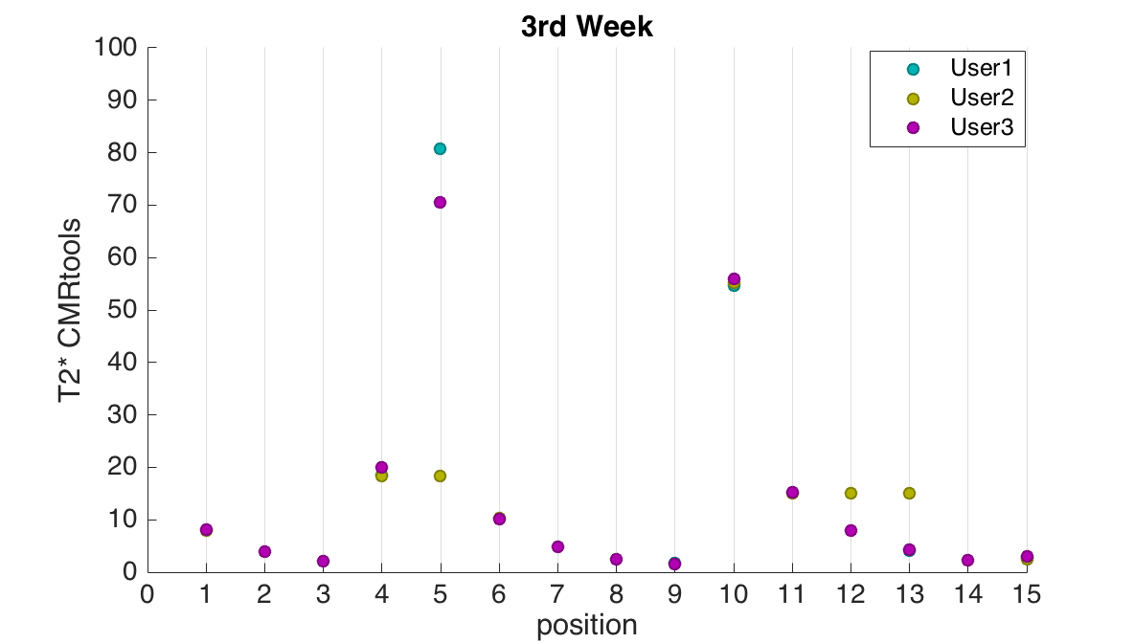
T2* Value
loading 5%
position | User1 | User2 | User3
1 | 7.99 | 8.02 | 8.04
2 | 3.99 | 4.01 | 4.00
3 | 2.07 | 2.06 | 2.07
4 | 18.61 | 18.39 | 19.96
5 | 80.75 | 18.39 | 70.49
6 | 10.20 | 10.23 | 10.21
7 | 4.76 | 4.78 | 4.77
8 | 2.39 | 2.41 | 2.40
9 | 1.70 | 1.63 | 1.61
10 | 54.69 | 55.17 | 55.99
11 | 15.15 | 15.08 | 15.23
12 | 7.95 | 15.08 | 8.00
13 | 4.17 | 15.08 | 4.21
14 | 2.28 | 2.28 | 2.29
15 | 2.80 | 2.37 | 3.08
loading 20%
loading 10%
position | 1 | 2 | 3 | 4 | 5 | 6 | 7 | 8 | 9 | 10 | 11 | 12 | 13 | 14 | 15
mean | 8.02 | 4.00 | 2.06 | 18.99 | 56.54 | 10.21 | 4.77 | 2.40 | 1.65 | 55.28 | 15.15 | 10.34 | 7.82 | 2.28 | 2.75
SD | 0.23 | 0.09 | 0.06 | 8.50 | 334.36 | 0.14 | 0.10 | 0.11 | 0.45 | 6.60 | 0.74 | 41.05 | 62.87 | 0.09 | 3.57

Slide 9
เพิ่มเงื่อนไขตรวจสอบค่า T2*
การตรวขสอบว่าค่า T2* ที่ได้ถูกต้องหรือไม่
1. ค่า ratio ต้องมีค่าต่ำกว่า 0.317
2. ค่า T2* ต้องไม่ติดลบ
ถ้าไม่ถูกต้องจะกำหนดให้ค่า T2* มีค่าต่ำกว่า 1.097 โดยกำหนดให้มีค่าเท่ากับ 0.549 เพื่อง่ายแก่การ plot chart

Slide 10
Result
1.5Tesla CMRtools Result
date | T2* value
 | position1 | position2 | position3 | position4 | position5 | position6 | position7 | position8 | position9 | position10 | position11 | position12 | position13 | position14 | position15
2014-09-30' | 7.472 | 3.860 | 2.094 | 12.325 | 55.463 | 8.954 | 4.320 | 2.377 | 1.683 | 51.289 | 14.185 | 7.781 | 4.056 | 2.160 | 2.079
2014-10-08' | 7.617 | 3.926 | 1.958 | 17.812 | 88.170 | 9.677 | 4.505 | 2.350 | 1.802 | 63.018 | 14.653 | 7.503 | 3.959 | 2.077 | 2.714
2014-10-15' | 8.033 | 4.015 | 2.069 | 17.659 | 82.364 | 10.235 | 4.758 | 2.418 | 1.638 | 55.377 | 15.233 | 7.933 | 4.152 | 2.170 | 2.612
2014-10-22' | 7.733 | 3.981 | 2.103 | 16.333 | 99.779 | 10.323 | 4.708 | 2.386 | 1.673 | 64.793 | 14.631 | 7.857 | 4.067 | 2.199 | 2.391
2014-11-05' | 7.672 | 3.933 | 2.198 | 19.128 | 98.721 | 10.082 | 4.626 | 2.408 | 1.727 | 58.036 | 14.813 | 7.833 | 4.088 | 2.328 | 2.294
2014-11-12' | 7.579 | 3.885 | 2.129 | 19.123 | 104.508 | 9.946 | 4.633 | 2.417 | 1.575 | 69.908 | 14.425 | 7.528 | 3.844 | 2.228 | 2.726
2014-11-19' | 7.957 | 4.128 | 2.162 | 14.417 | 90.513 | 10.242 | 4.753 | 2.462 | 1.727 | 62.562 | 15.178 | 8.150 | 4.178 | 2.299 | 2.309
2014-11-26' | 8.363 | 4.320 | 2.316 | 13.467 | 89.903 | 10.683 | 4.893 | 2.554 | 1.668 | 49.213 | 16.303 | 8.689 | 4.442 | 2.444 | 2.114
2014-12-03' | 8.453 | 4.375 | 2.384 | 11.064 | 83.863 | 10.372 | 5.004 | 2.571 | 1.617 | 49.300 | 16.338 | 8.792 | 4.517 | 2.456 | 1.910
2014-12-10' | 8.037 | 4.180 | 2.196 | 8.043 | 79.613 | 10.233 | 4.773 | 2.530 | 1.490 | 42.714 | 14.799 | 8.030 | 4.195 | 2.248 | 1.818
2014-12-17' | 7.981 | 4.110 | 2.192 | 2.392 | 88.821 | 10.259 | 4.673 | 2.466 | 1.487 | 40.002 | 14.936 | 8.020 | 4.148 | 2.187 | 1.769
2014-12-24' | 8.146 | 4.167 | 2.197 | 12.296 | 70.749 | 10.327 | 4.750 | 2.466 | 1.527 | 36.942 | 15.194 | 8.184 | 4.206 | 2.260 | 1.919
2015-01-21' | 7.914 | 4.166 | 2.260 | 9.619 | 60.496 | 10.507 | 4.804 | 2.636 | 1.609 | 27.603 | 15.063 | 8.042 | 4.184 | 2.257 | 1.819
2015-01-28' | 7.981 | 4.216 | 2.304 | 14.208 | 112.086 | 10.664 | 4.980 | 2.663 | 1.671 | 40.998 | 15.403 | 8.218 | 4.290 | 2.334 | 2.053
2015-02-04' | 7.421 | 3.892 | 2.169 | 18.980 | 101.124 | 10.182 | 4.718 | 2.596 | 1.597 | 46.076 | 14.100 | 7.394 | 3.805 | 2.185 | 2.540
mean | 7.891 | 4.077 | 2.182 | 13.791 | 87.078 | 10.179 | 4.727 | 2.487 | 1.633 | 50.522 | 15.017 | 7.997 | 4.142 | 2.256 | 2.205

Slide 11
Result
1.5Tesla MRIM Result
date | T2* value
 | position1 | position2 | position3 | position4 | position5 | position6 | position7 | position8 | position9 | position10 | position11 | position12 | position13 | position14 | position15
2014-09-30' | 7.207 | 3.644 | 2.031 | 1.807 | 0.549 | 8.906 | 4.248 | 2.207 | 1.316 | 0.549 | 13.905 | 7.425 | 3.701 | 1.891 | 1.487
2014-10-08' | 7.440 | 3.686 | 1.868 | 1.494 | 0.549 | 9.271 | 4.253 | 2.245 | 1.242 | 0.549 | 14.382 | 7.053 | 3.633 | 2.431 | 1.636
2014-10-15' | 7.741 | 3.705 | 1.826 | 1.620 | 0.549 | 10.015 | 4.431 | 2.333 | 1.209 | 0.549 | 15.131 | 7.572 | 3.778 | 2.394 | 1.628
2014-10-22' | 7.449 | 3.685 | 2.054 | 1.691 | 0.549 | 9.890 | 4.370 | 2.294 | 1.110 | 0.549 | 14.322 | 7.463 | 3.910 | 1.869 | 1.514
2014-11-05' | 7.494 | 3.679 | 1.936 | 1.637 | 0.549 | 9.629 | 4.454 | 2.337 | 1.158 | 0.549 | 14.522 | 7.408 | 3.651 | 1.896 | 1.580
2014-11-12' | 7.420 | 3.680 | 2.020 | 1.773 | 0.549 | 9.539 | 4.556 | 2.339 | 1.136 | 0.549 | 14.363 | 7.281 | 3.583 | 2.443 | 1.600
2014-11-19' | 7.795 | 3.904 | 1.906 | 1.564 | 0.549 | 9.954 | 4.456 | 2.297 | 1.212 | 0.549 | 14.953 | 7.803 | 3.924 | 1.975 | 1.536
2014-11-26' | 8.149 | 4.043 | 2.040 | 1.434 | 0.549 | 10.152 | 4.545 | 2.374 | 1.247 | 0.549 | 15.928 | 8.268 | 4.098 | 2.402 | 1.507
2014-12-03' | 8.297 | 4.070 | 2.028 | 1.422 | 0.549 | 10.086 | 4.861 | 2.437 | 1.205 | 0.549 | 16.331 | 8.506 | 4.224 | 2.376 | 1.407
2014-12-10' | 7.919 | 3.933 | 1.910 | 1.312 | 0.549 | 9.950 | 4.529 | 2.388 | 1.174 | 0.549 | 14.711 | 7.678 | 3.809 | 2.144 | 1.370
2014-12-17' | 7.670 | 3.858 | 1.889 | 1.332 | 0.549 | 9.997 | 4.486 | 2.430 | 1.184 | 0.549 | 14.873 | 7.730 | 3.954 | 2.128 | 1.395
2014-12-24' | 7.901 | 3.911 | 1.907 | 1.264 | 0.549 | 9.937 | 4.445 | 2.397 | 1.206 | 2.037 | 14.909 | 7.770 | 4.026 | 2.163 | 1.448
2015-01-21' | 7.647 | 3.970 | 2.091 | 1.286 | 0.549 | 10.280 | 4.693 | 2.647 | 1.332 | 1.867 | 14.823 | 7.585 | 3.968 | 2.198 | 1.396
2015-01-28' | 7.934 | 3.952 | 2.072 | 1.489 | 0.549 | 10.348 | 4.700 | 2.542 | 1.353 | 0.549 | 15.234 | 7.839 | 3.932 | 1.935 | 1.503
2015-02-04' | 7.360 | 3.680 | 2.011 | 1.643 | 0.549 | 9.854 | 4.478 | 2.440 | 1.258 | 0.549 | 14.090 | 7.040 | 3.472 | 1.807 | 1.568
mean | 7.695 | 3.827 | 1.973 | 1.518 | 0.549 | 9.854 | 4.500 | 2.380 | 1.223 | 0.736 | 14.832 | 7.628 | 3.844 | 2.137 | 1.505
T2* value on table = 0.549 mean T2* value less than 1.097

Slide 12
Result
3Tesla MRIM Result
date | T2* value
 | position1 | position2 | position3 | position4 | position5 | position6 | position7 | position8 | position9 | position10 | position11 | position12 | position13 | position14 | position15
2014-09-30' | 5.459 | 2.864 | 1.771 | 1.565 | 0.549 | 6.624 | 2.949 | 2.036 | 1.094 | 0.549 | 17.389 | 5.914 | 2.998 | 1.643 | 1.146
2014-10-08' | 6.507 | 3.523 | 1.473 | 1.668 | 0.549 | 9.287 | 3.907 | 2.196 | 0.549 | 0.549 | 11.171 | 6.314 | 3.987 | 1.089 | 1.140
2014-10-15' | 6.835 | 3.586 | 1.500 | 1.635 | 0.549 | 8.497 | 4.231 | 2.183 | 1.175 | 0.549 | 15.874 | 6.909 | 3.780 | 1.196 | 1.184
2014-10-22' | 6.872 | 3.590 | 1.692 | 1.606 | 0.549 | 8.660 | 3.623 | 2.074 | 1.128 | 0.549 | 12.666 | 6.640 | 3.965 | 1.421 | 0.967
2014-11-05' | 7.808 | 3.479 | 1.372 | 0.549 | 0.549 | 10.816 | 4.965 | 1.849 | 1.210 | 0.549 | 13.094 | 6.346 | 3.833 | 1.617 | 1.606
2014-11-12' | 6.508 | 3.240 | 0.992 | 0.549 | 0.549 | 8.857 | 5.048 | 1.926 | 1.262 | 0.549 | 9.919 | 5.560 | 3.227 | 1.476 | 1.542
2014-11-19' | 7.081 | 3.449 | 1.341 | 1.388 | 0.549 | 8.231 | 3.930 | 2.170 | 0.921 | 0.549 | 10.281 | 6.108 | 3.762 | 1.428 | 1.488
2014-11-26' | 8.647 | 3.762 | 1.487 | 1.051 | 0.549 | 11.591 | 4.985 | 1.600 | 1.139 | 0.549 | 17.732 | 6.961 | 3.986 | 1.752 | 1.064
2014-12-03' | 7.376 | 3.595 | 1.374 | 1.054 | 0.549 | 6.210 | 3.464 | 1.662 | 0.927 | 0.549 | 9.666 | 6.228 | 3.389 | 1.631 | 1.049
2014-12-10' | 5.453 | 3.291 | 1.083 | 2.139 | 0.549 | 8.525 | 3.233 | 1.549 | 1.175 | 0.549 | 7.174 | 5.065 | 2.655 | 1.741 | 1.792
2014-12-17' | 6.116 | 3.445 | 1.362 | 0.916 | 0.549 | 12.673 | 3.281 | 1.619 | 0.856 | 0.549 | 10.074 | 6.209 | 3.380 | 1.407 | 1.129
2014-12-24' | 6.615 | 3.417 | 1.217 | 1.280 | 0.549 | 10.846 | 4.021 | 1.917 | 1.173 | 0.549 | 10.913 | 6.507 | 3.741 | 1.446 | 1.434
2015-01-21' | 7.199 | 3.438 | 1.342 | 1.338 | 0.549 | 11.279 | 4.105 | 1.766 | 1.018 | 0.549 | 12.445 | 6.544 | 3.459 | 1.589 | 1.121
2015-01-28' | 6.797 | 3.418 | 1.250 | 0.801 | 0.549 | 8.200 | 3.441 | 1.702 | 1.065 | 0.868 | 12.581 | 6.258 | 3.443 | 1.745 | 0.913
2015-02-04' | 5.430 | 3.816 | 1.472 | 0.549 | 0.549 | 11.056 | 3.157 | 2.054 | 1.183 | 0.549 | 10.160 | 6.081 | 3.768 | 1.334 | 1.297
mean | 6.714 | 3.461 | 1.382 | 1.206 | 0.549 | 9.423 | 3.889 | 1.887 | 1.058 | 0.570 | 12.076 | 6.243 | 3.558 | 1.501 | 1.258
T2* value on table = 0.549 mean T2* value less than 1.097

Slide 13
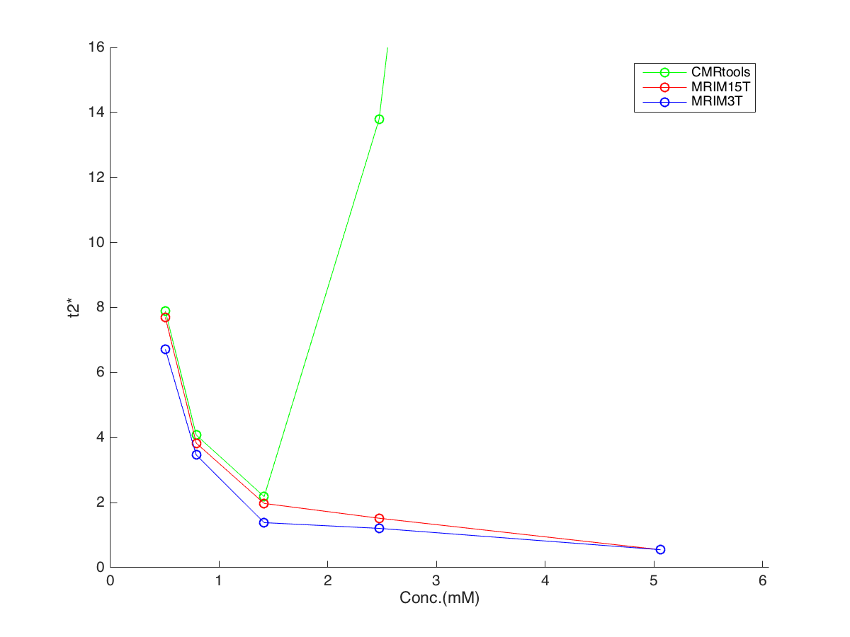
posi tion | T2* mean value |  |  | Conc.
 | CMRtools | 1.5T | 3T
1 | 7.891 | 7.695 | 6.714 | 0.505
2 | 4.077 | 3.827 | 3.461 | 0.789
3 | 2.182 | 1.973 | 1.382 | 1.413
4 | 13.791 | 1.518 | 1.206 | 2.470
5 | 87.078 | 0.549 | 0.549 | 5.059
6 | 10.179 | 9.854 | 9.423 | 0.871
7 | 4.727 | 4.500 | 3.889 | 1.761
8 | 2.487 | 2.380 | 1.887 | 3.584
9 | 1.633 | 1.223 | 1.058 | 6.387
10 | 50.522 | 0.736 | 0.570 | 12.421
11 | 15.017 | 14.832 | 12.076 | 1.060
12 | 7.997 | 7.628 | 6.243 | 1.682
13 | 4.142 | 3.844 | 3.558 | 3.375
14 | 2.256 | 2.137 | 1.501 | 6.956
15 | 2.205 | 1.505 | 1.258 | 9.698
set1 loading 20%

Slide 14
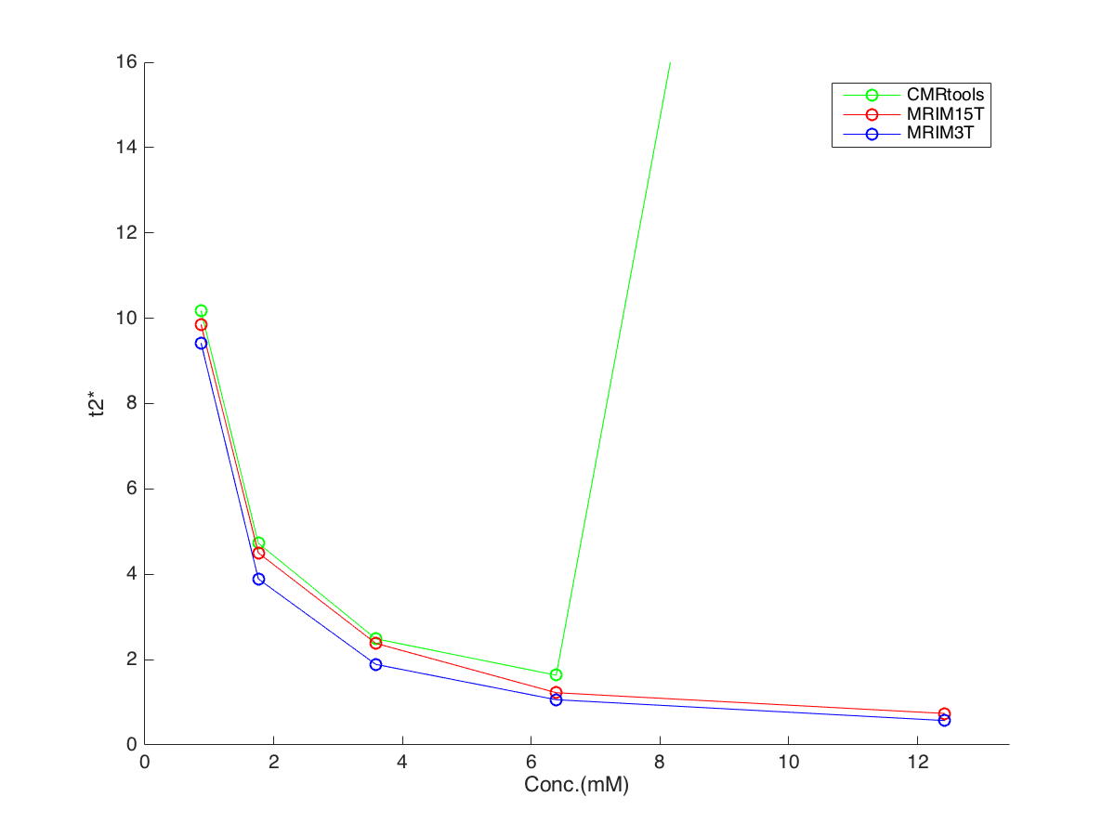
posi tion | T2* mean value |  |  | Conc.
 | CMRtools | 1.5T | 3T
1 | 7.891 | 7.695 | 6.714 | 0.505
2 | 4.077 | 3.827 | 3.461 | 0.789
3 | 2.182 | 1.973 | 1.382 | 1.413
4 | 13.791 | 1.518 | 1.206 | 2.470
5 | 87.078 | 0.549 | 0.549 | 5.059
6 | 10.179 | 9.854 | 9.423 | 0.871
7 | 4.727 | 4.500 | 3.889 | 1.761
8 | 2.487 | 2.380 | 1.887 | 3.584
9 | 1.633 | 1.223 | 1.058 | 6.387
10 | 50.522 | 0.736 | 0.570 | 12.421
11 | 15.017 | 14.832 | 12.076 | 1.060
12 | 7.997 | 7.628 | 6.243 | 1.682
13 | 4.142 | 3.844 | 3.558 | 3.375
14 | 2.256 | 2.137 | 1.501 | 6.956
15 | 2.205 | 1.505 | 1.258 | 9.698
set2 loading 10%

Slide 15
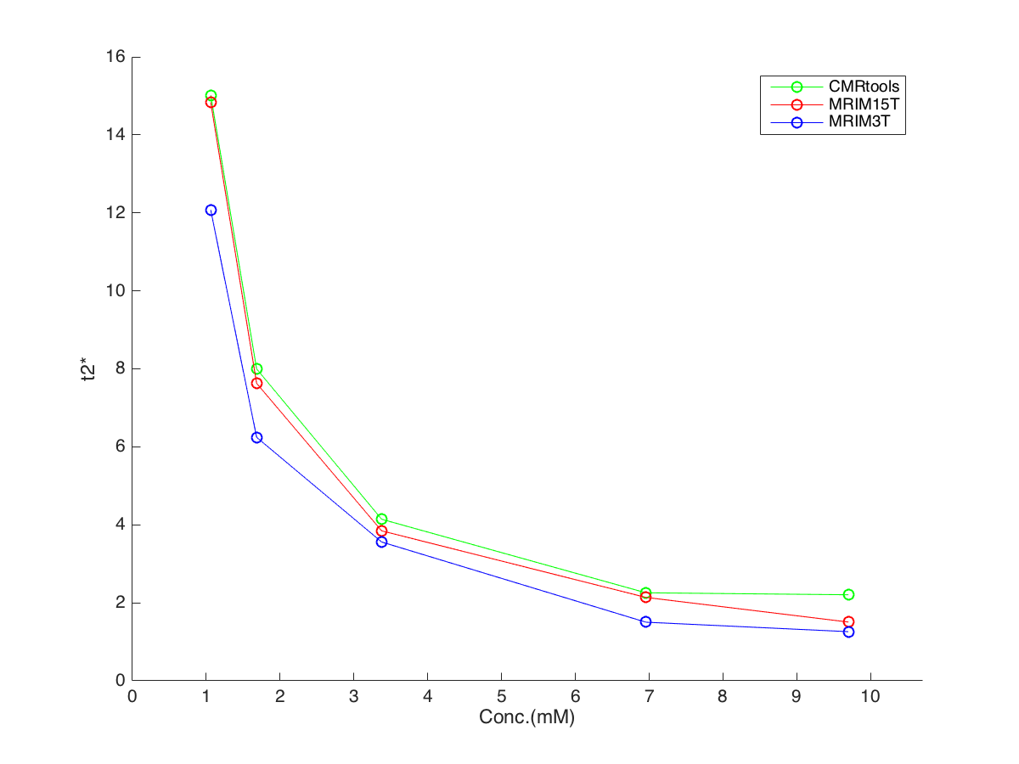
posi tion | T2* mean value |  |  | Conc.
 | CMRtools | 1.5T | 3T
1 | 7.891 | 7.695 | 6.714 | 0.505
2 | 4.077 | 3.827 | 3.461 | 0.789
3 | 2.182 | 1.973 | 1.382 | 1.413
4 | 13.791 | 1.518 | 1.206 | 2.470
5 | 87.078 | 0.549 | 0.549 | 5.059
6 | 10.179 | 9.854 | 9.423 | 0.871
7 | 4.727 | 4.500 | 3.889 | 1.761
8 | 2.487 | 2.380 | 1.887 | 3.584
9 | 1.633 | 1.223 | 1.058 | 6.387
10 | 50.522 | 0.736 | 0.570 | 12.421
11 | 15.017 | 14.832 | 12.076 | 1.060
12 | 7.997 | 7.628 | 6.243 | 1.682
13 | 4.142 | 3.844 | 3.558 | 3.375
14 | 2.256 | 2.137 | 1.501 | 6.956
15 | 2.205 | 1.505 | 1.258 | 9.698
set3 loading 5%

Slide 16
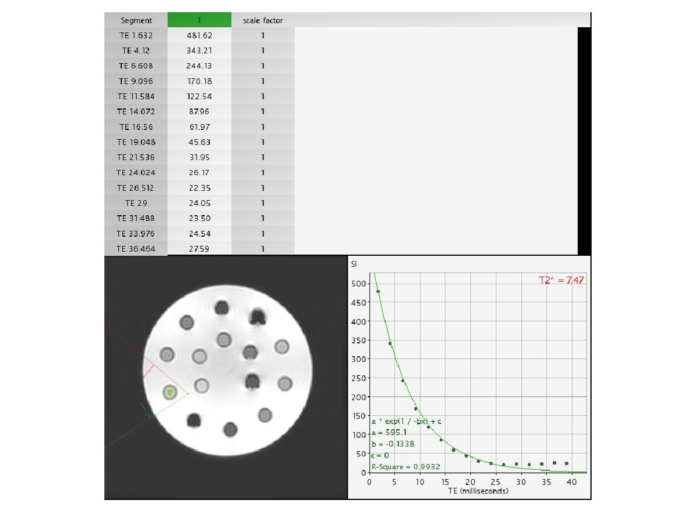
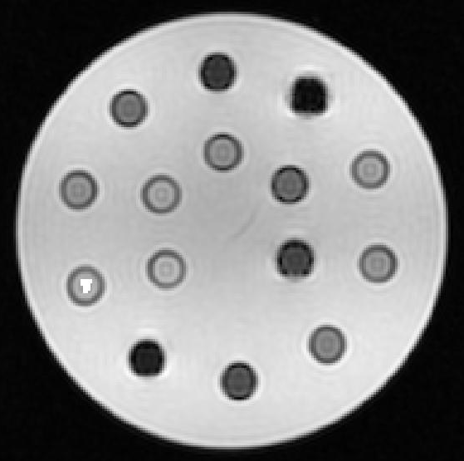
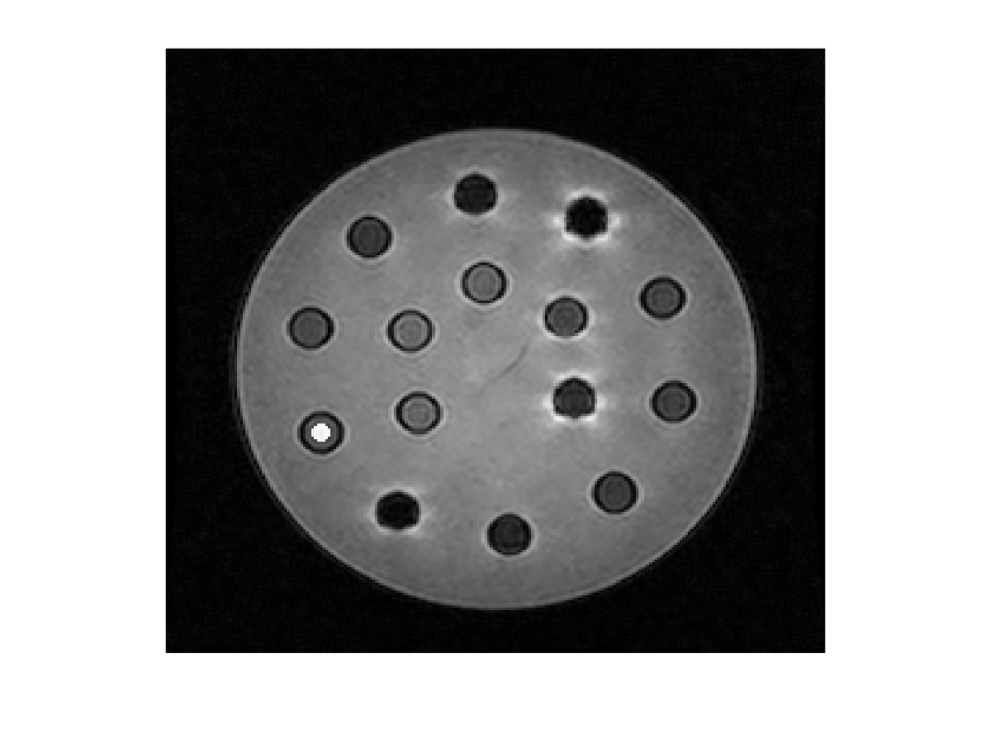
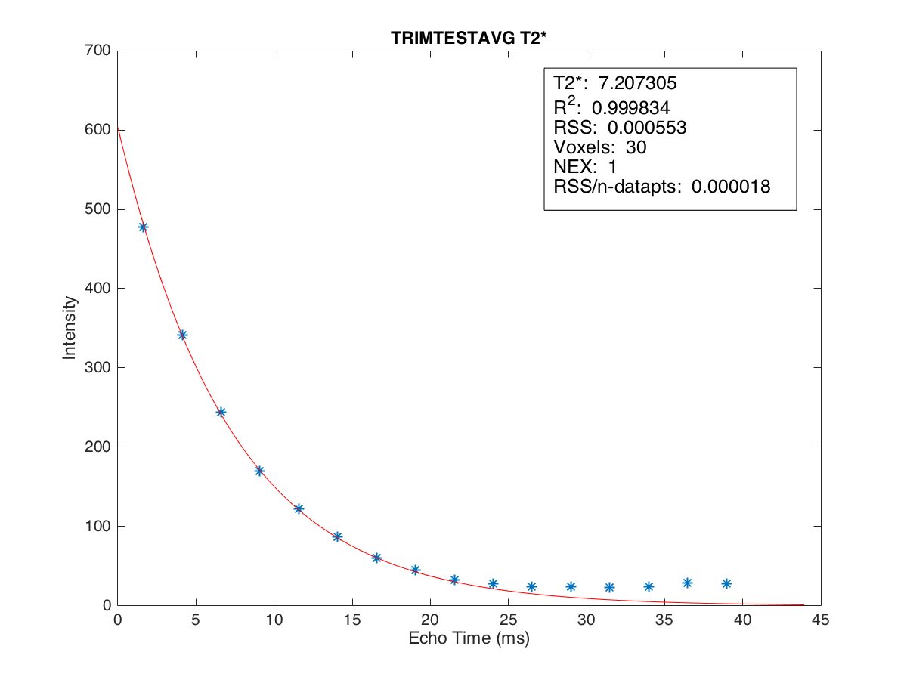
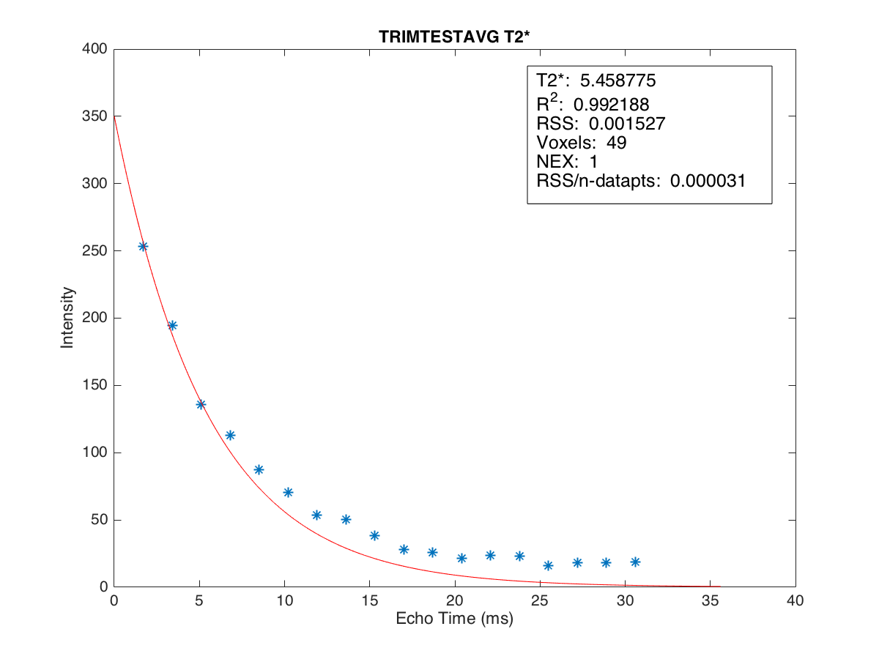
T2* = 7.207
T2* = 5.459
T2* = 7.47
MRIM 3T
CMRtools 1.5T
MRIM 1.5T
position 1 Conc. 0.505

Slide 17
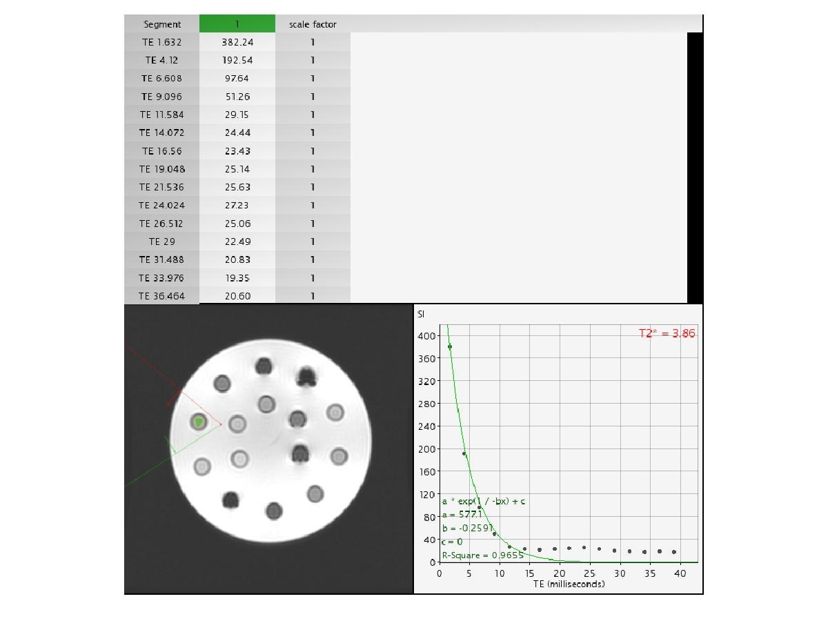
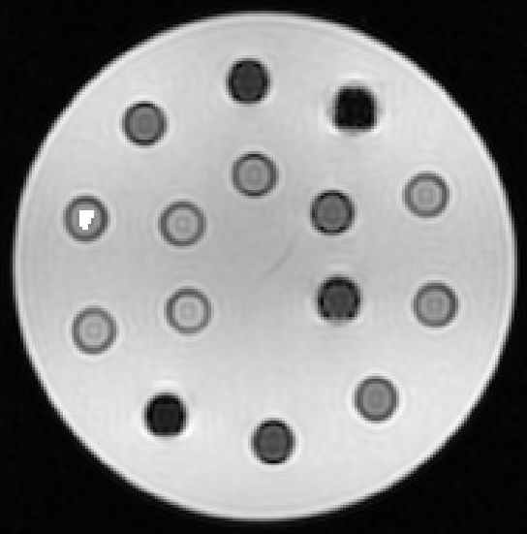
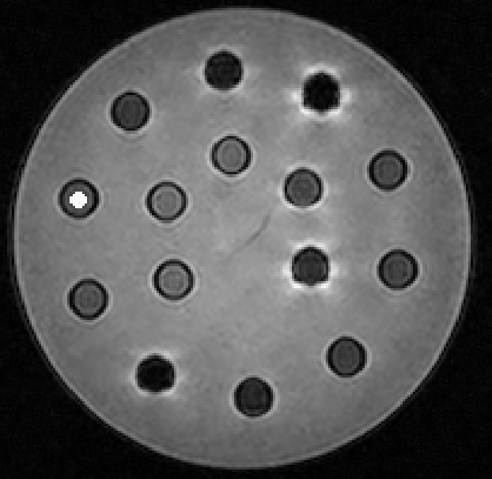
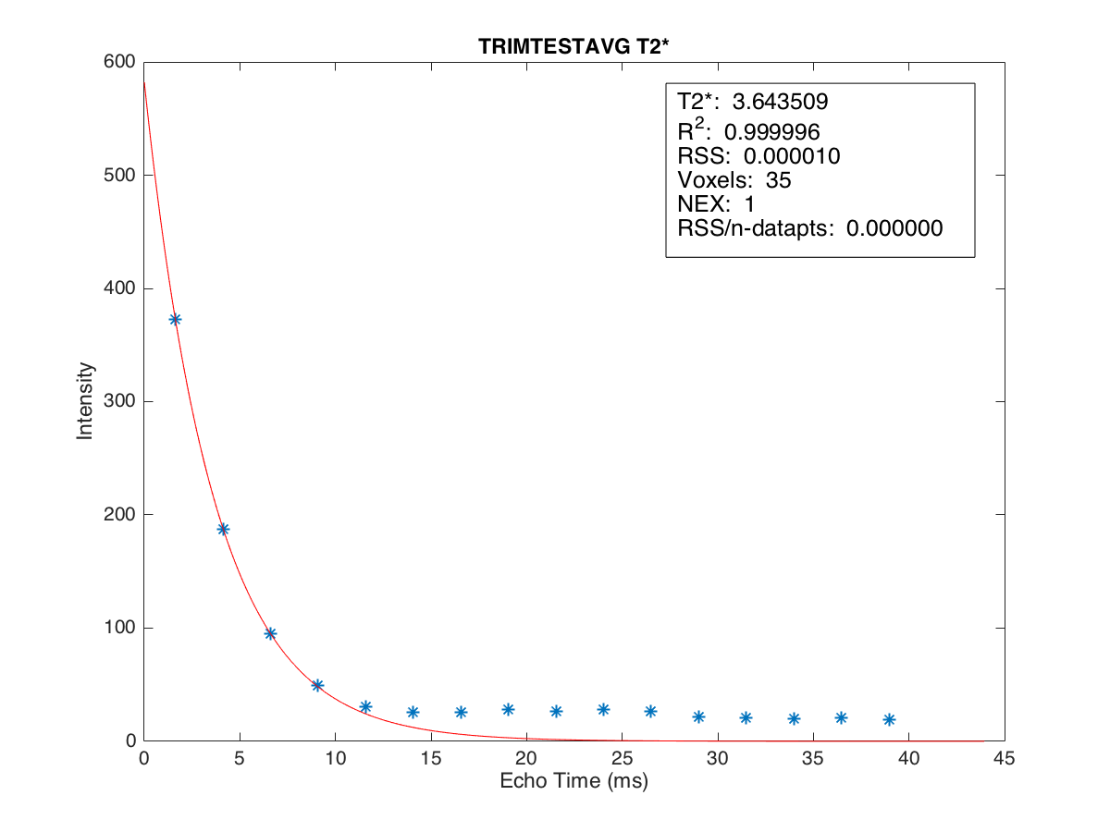
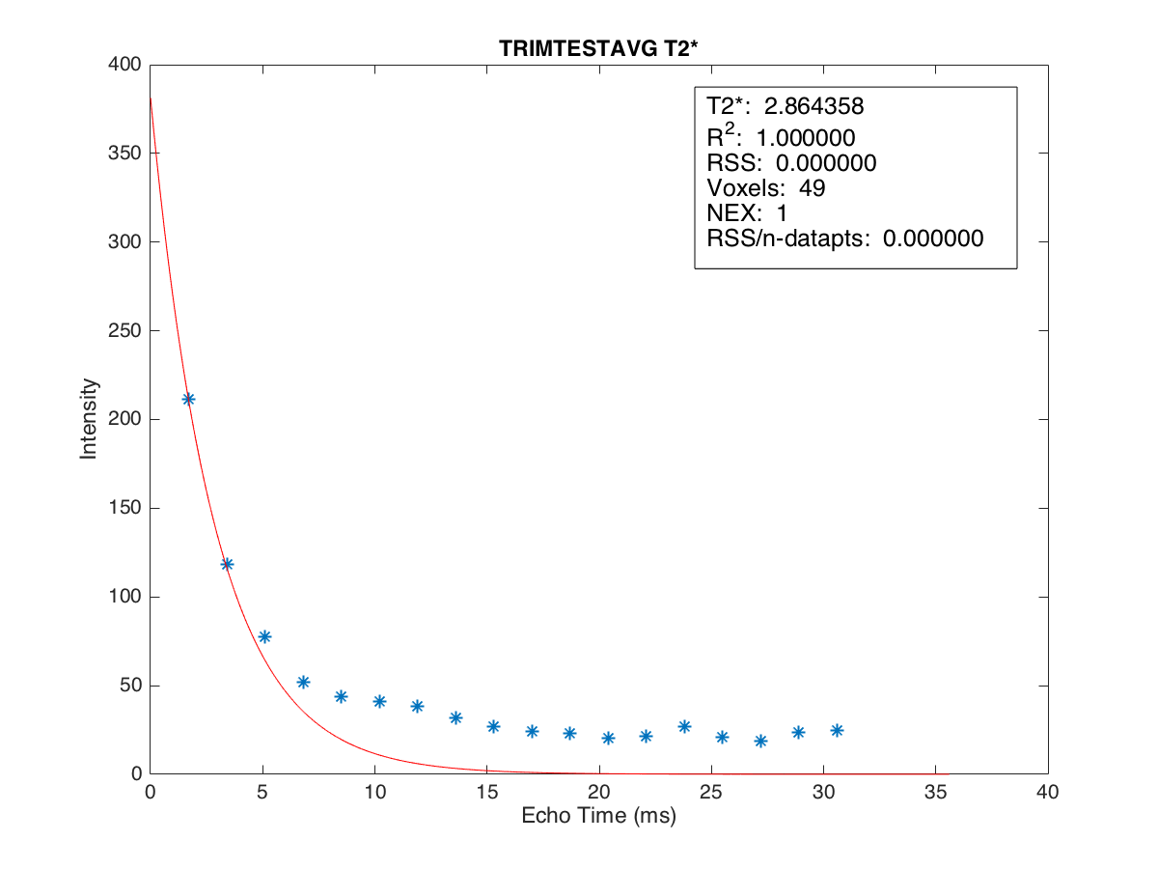
T2* = 3.644
T2* = 2.864
T2* = 3.86
MRIM 3T
CMRtools 1.5T
MRIM 1.5T
position 2 Conc. 0.789

Slide 18


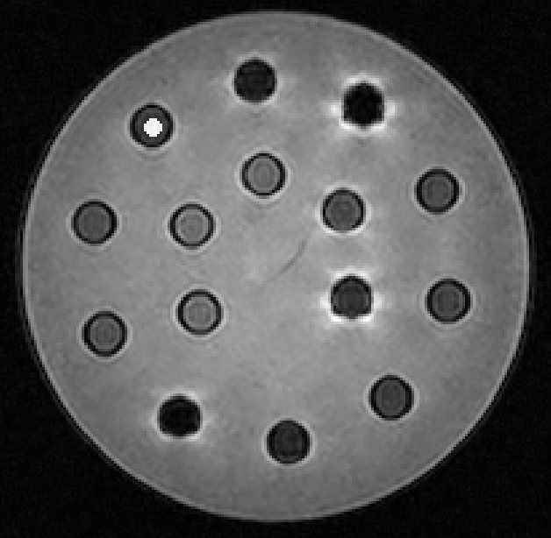
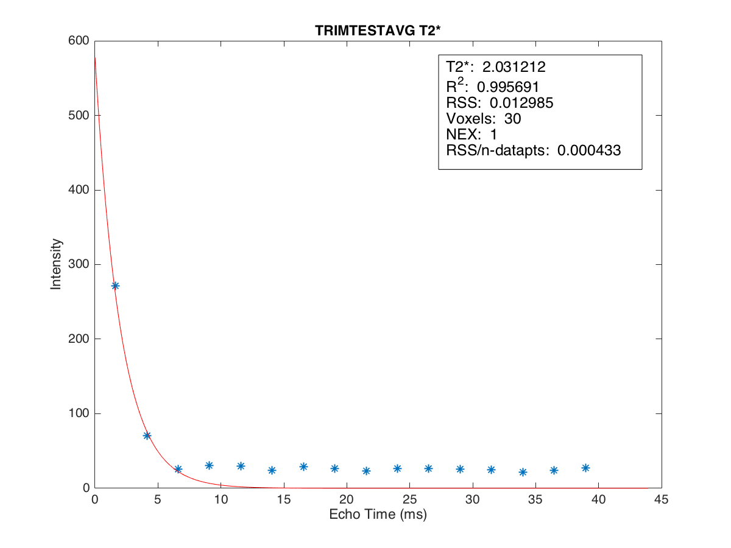
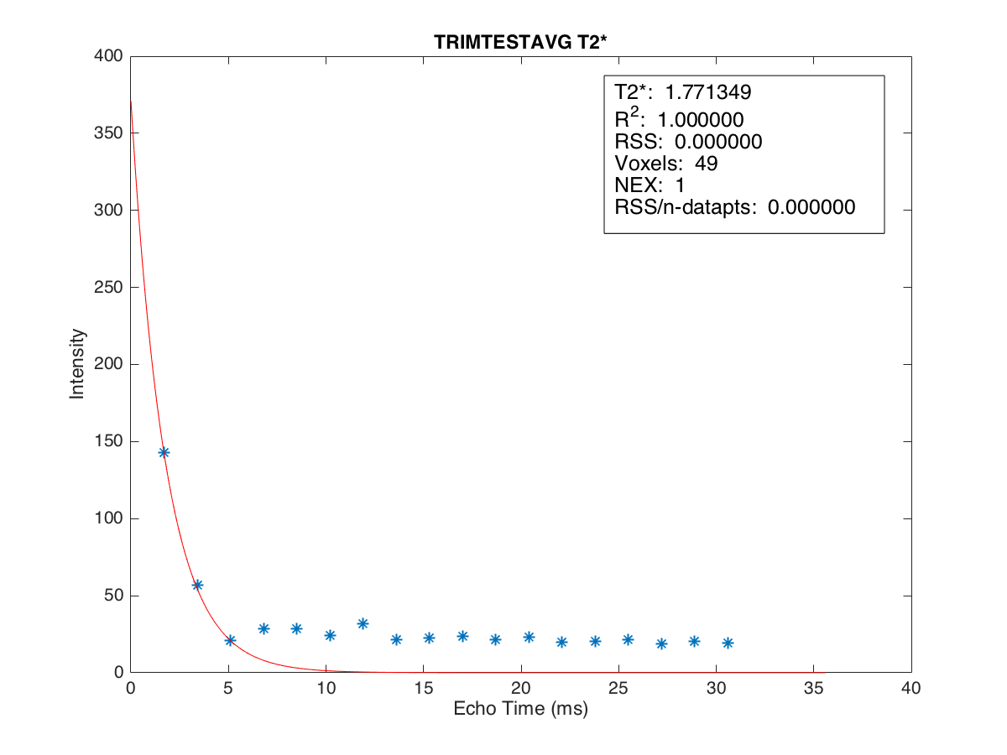
T2* = 2.031
T2* = 1.771
T2* = 2.09
MRIM 3T
CMRtools 1.5T
MRIM 1.5T
position 3 Conc. 1.413

Slide 19


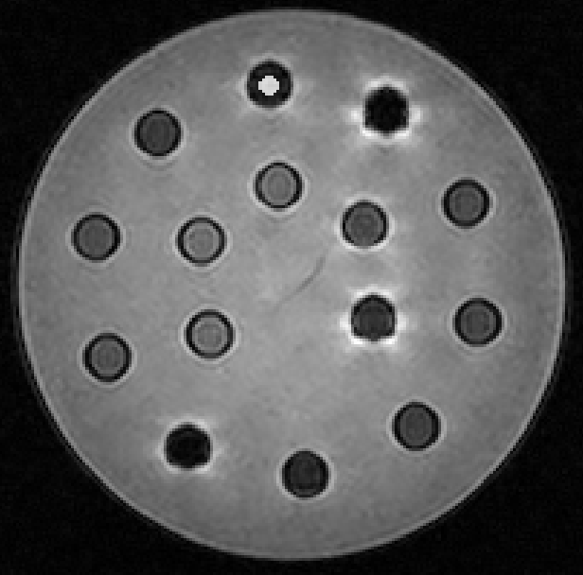
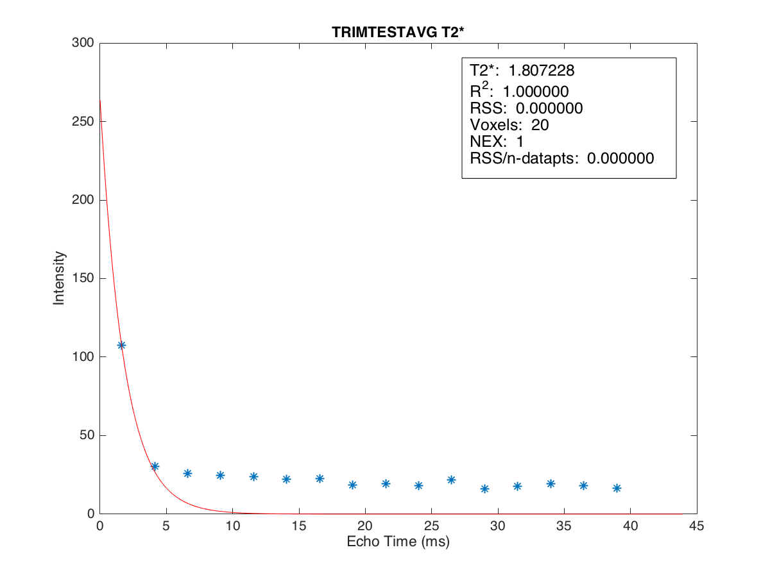
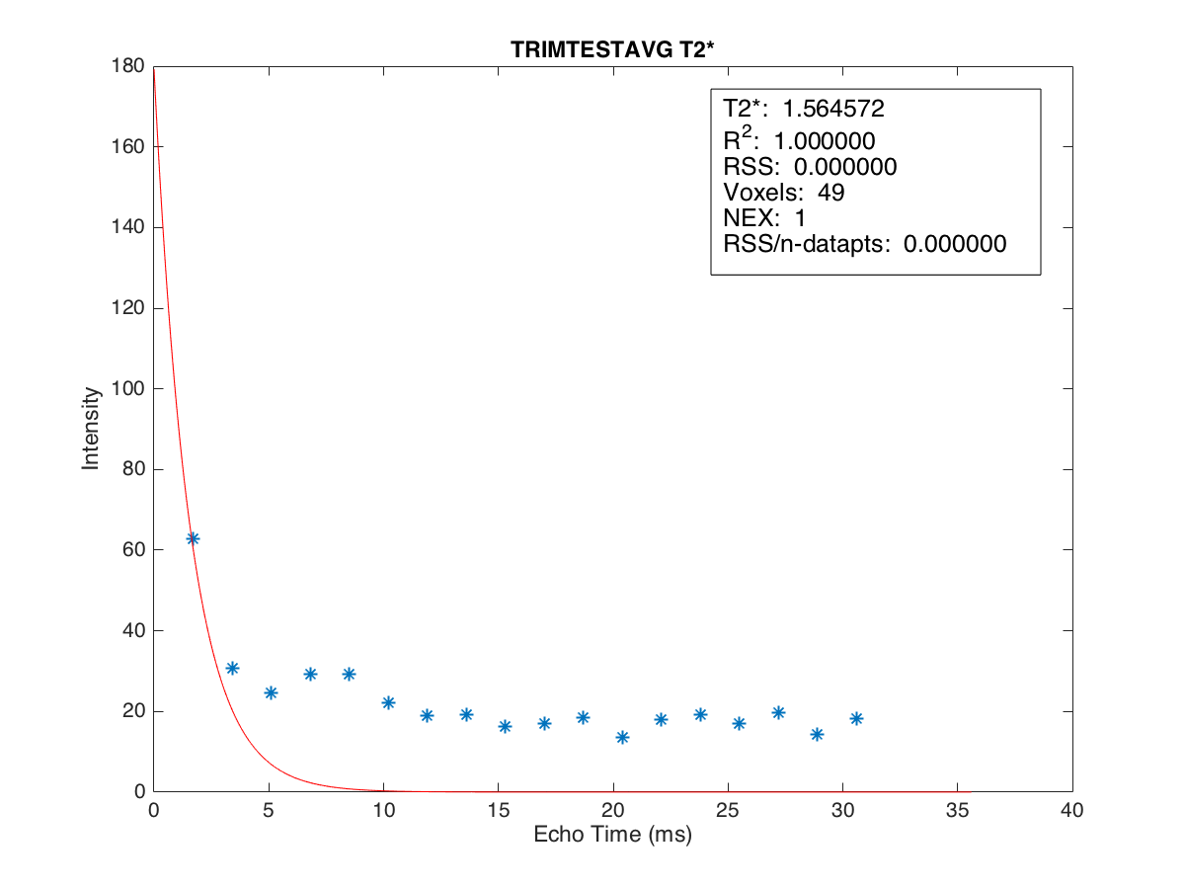
T2* = 1.807
T2* = 1.565
T2* = 12.32
MRIM 3T
CMRtools 1.5T
MRIM 1.5T
position 4 Conc. 2.470

Slide 20
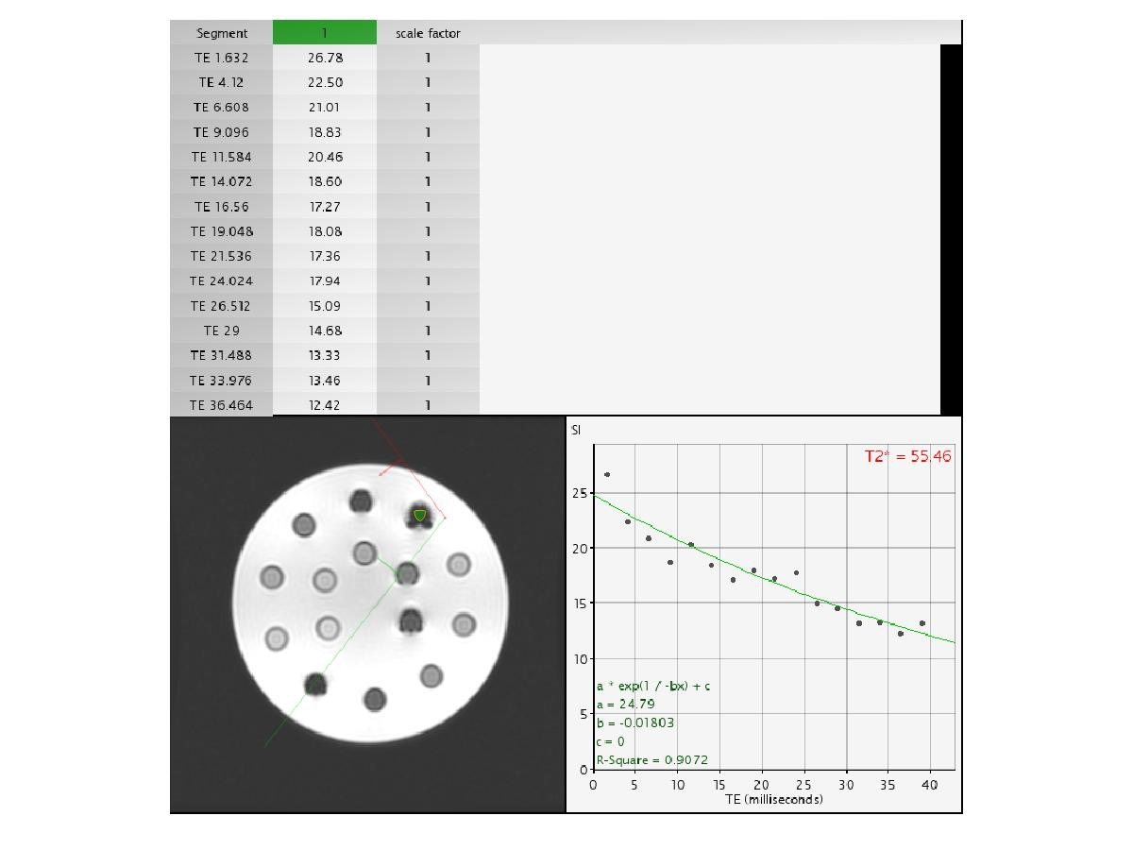

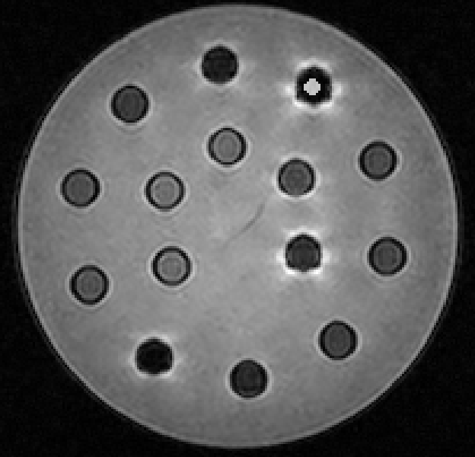
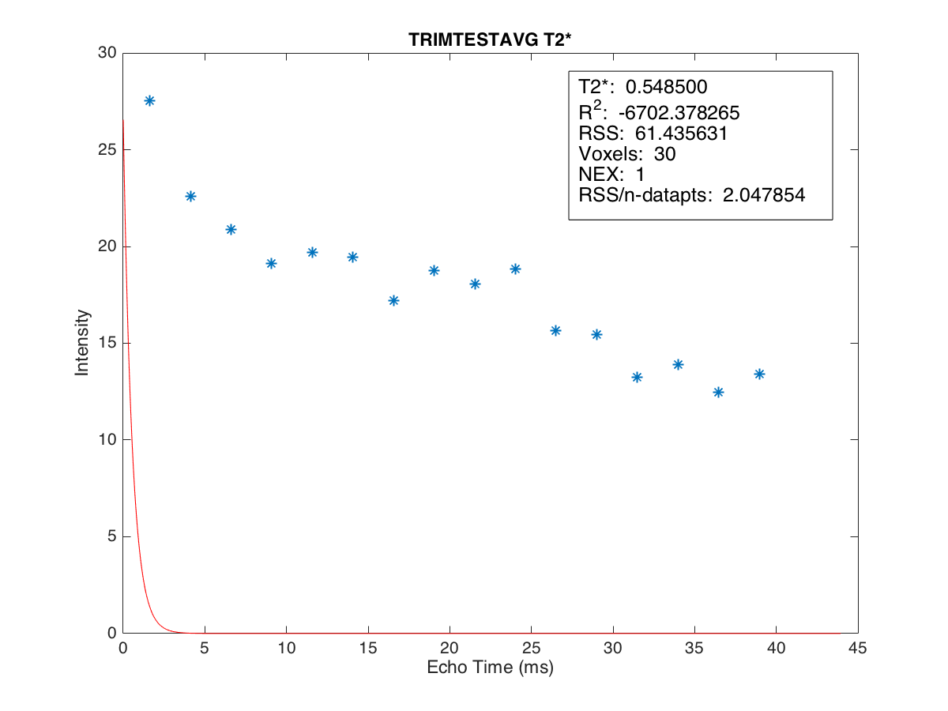
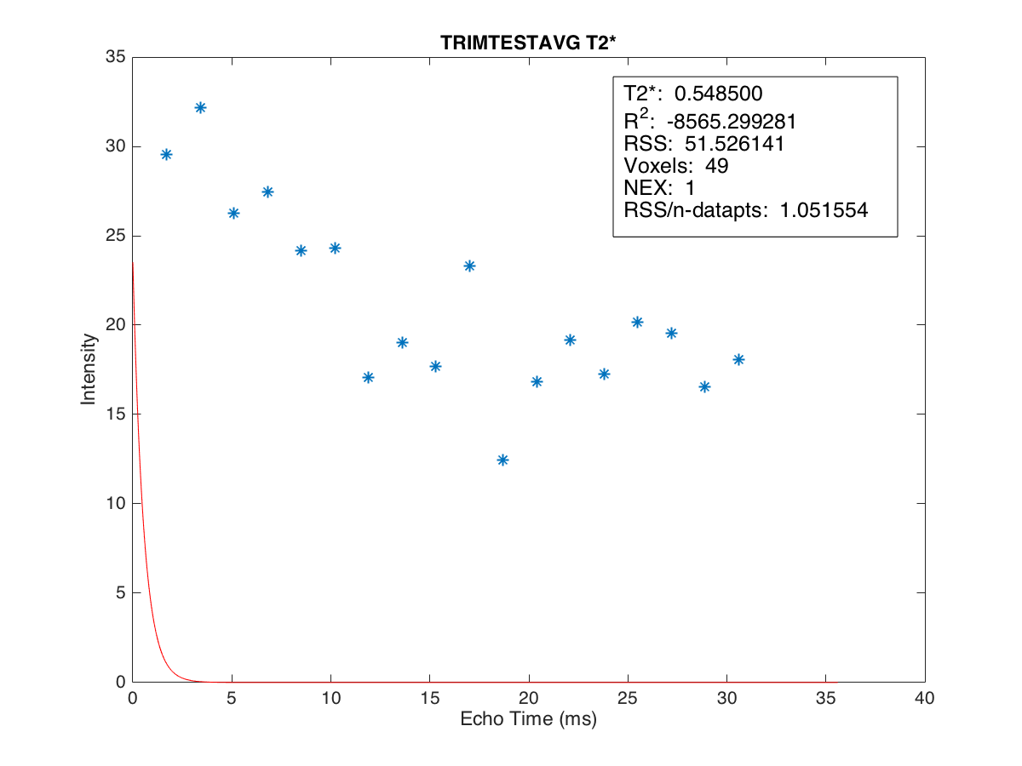
T2* = 0.549
T2* = 0.549
T2* = 55.46
MRIM 3T
CMRtools 1.5T
MRIM 1.5T
position 5 Conc. 5.059

Slide 21
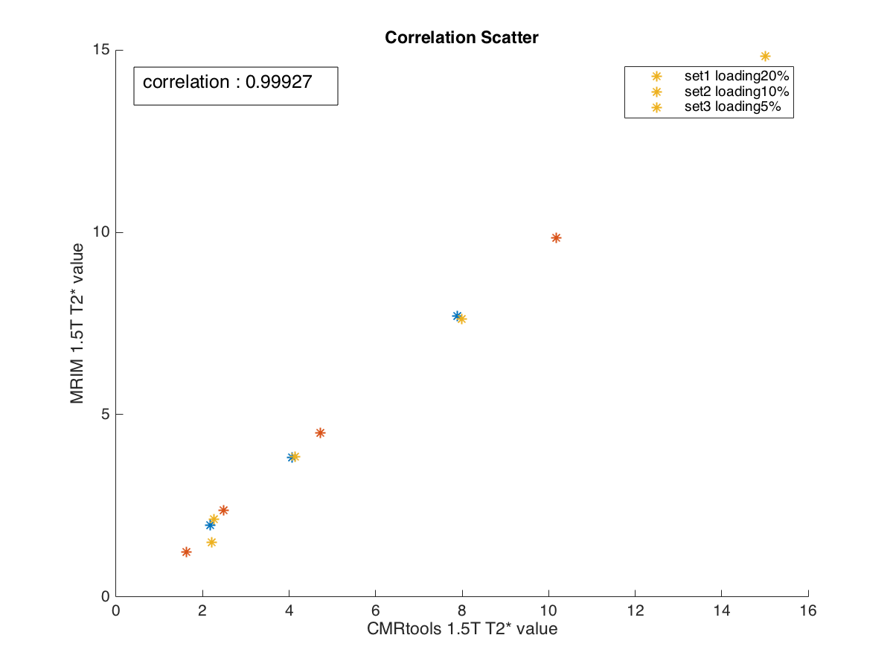
posi tion | T2* mean value |  | Conc.
 | CMRtools | 1.5T
1 | 7.891 | 7.695 | 0.505
2 | 4.077 | 3.827 | 0.789
3 | 2.182 | 1.973 | 1.413
4 | 13.791 | 1.518 | 2.470
5 | 87.078 | 0.549 | 5.059
6 | 10.179 | 9.854 | 0.871
7 | 4.727 | 4.500 | 1.761
8 | 2.487 | 2.380 | 3.584
9 | 1.633 | 1.223 | 6.387
10 | 50.522 | 0.736 | 12.421
11 | 15.017 | 14.832 | 1.060
12 | 7.997 | 7.628 | 1.682
13 | 4.142 | 3.844 | 3.375
14 | 2.256 | 2.137 | 6.956
15 | 2.205 | 1.505 | 9.698

Slide 22
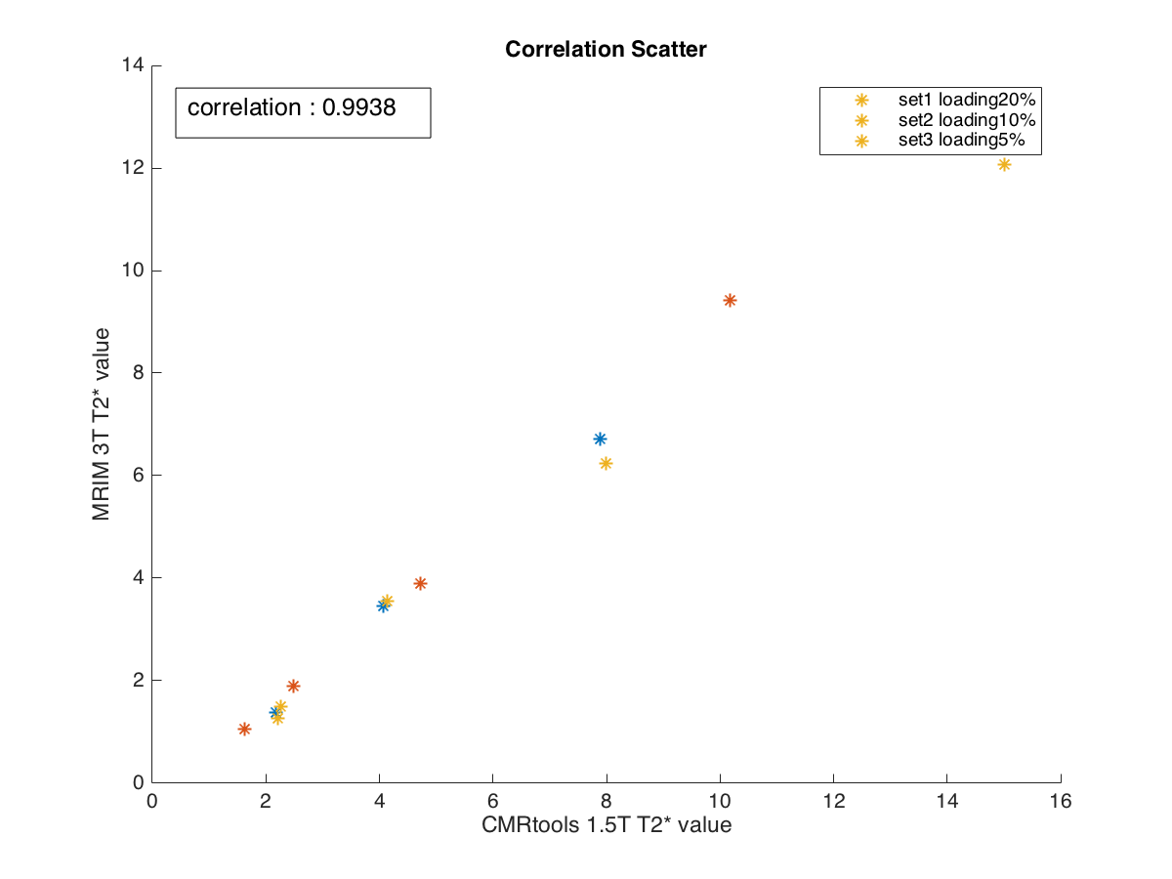
posi tion | T2* mean value |  | Conc.
 | CMRtools | 3T
1 | 7.891 | 6.714 | 0.505
2 | 4.077 | 3.461 | 0.789
3 | 2.182 | 1.382 | 1.413
4 | 13.791 | 1.206 | 2.470
5 | 87.078 | 0.549 | 5.059
6 | 10.179 | 9.423 | 0.871
7 | 4.727 | 3.889 | 1.761
8 | 2.487 | 1.887 | 3.584
9 | 1.633 | 1.058 | 6.387
10 | 50.522 | 0.570 | 12.421
11 | 15.017 | 12.076 | 1.060
12 | 7.997 | 6.243 | 1.682
13 | 4.142 | 3.558 | 3.375
14 | 2.256 | 1.501 | 6.956
15 | 2.205 | 1.258 | 9.698

Slide 23
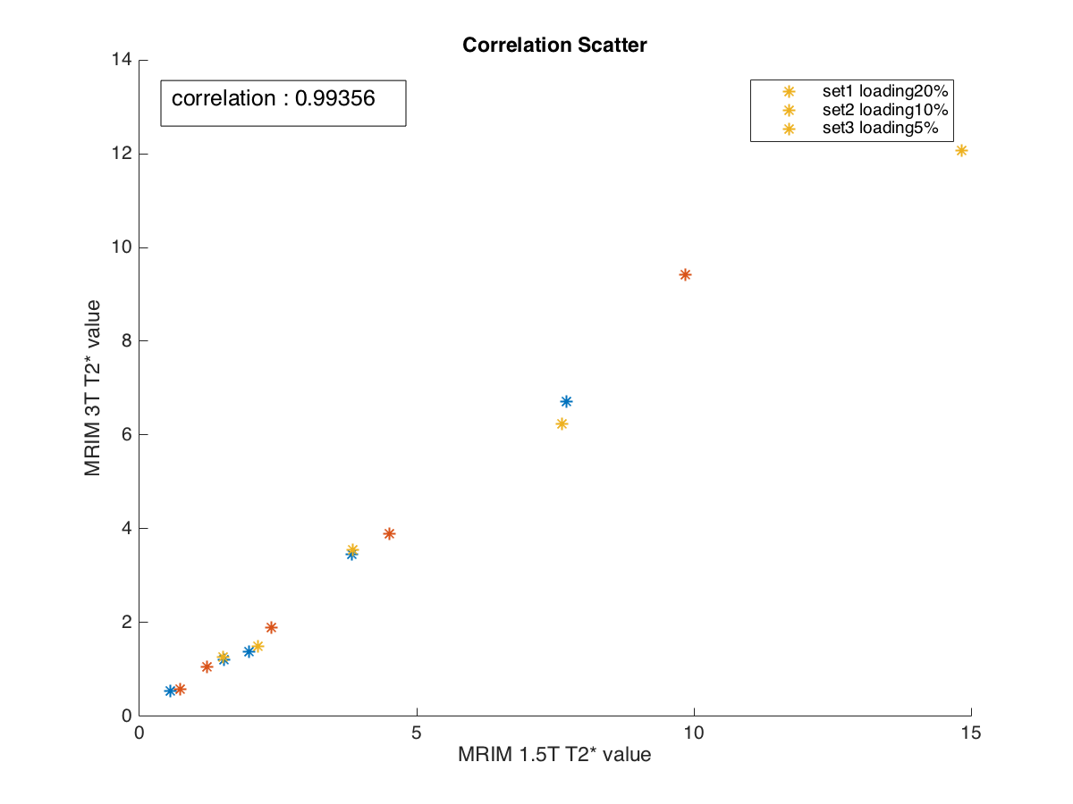

posi tion | T2* mean value |  | Conc.
 | 1.5T | 3T
1 | 7.695 | 6.714 | 0.505
2 | 3.827 | 3.461 | 0.789
3 | 1.973 | 1.382 | 1.413
4 | 1.518 | 1.206 | 2.470
5 | 0.549 | 0.549 | 5.059
6 | 9.854 | 9.423 | 0.871
7 | 4.500 | 3.889 | 1.761
8 | 2.380 | 1.887 | 3.584
9 | 1.223 | 1.058 | 6.387
10 | 0.736 | 0.570 | 12.421
11 | 14.832 | 12.076 | 1.060
12 | 7.628 | 6.243 | 1.682
13 | 3.844 | 3.558 | 3.375
14 | 2.137 | 1.501 | 6.956
15 | 1.505 | 1.258 | 9.698

Slide 24
Correlation Between |  | r | n
CMRtools | MRIM 1.5T | 0.9993 | 12
CMRtools | MRIM 3T | 0.9938 | 12
MRIM 1.5T | MRIM 3T | 0.9936 | 12*
MRIM 1.5T | MRIM 3T | 0.9947 | 15
*ตัด position ตาม CMRtool ที่ให้ผล error

Slide 25
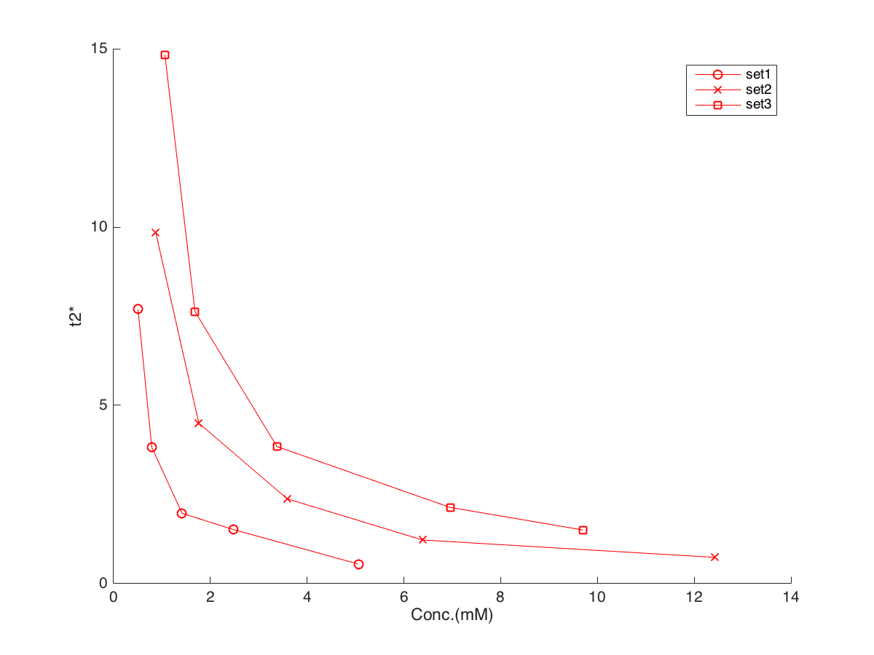
MRIM 1.5Tesla T2* Result
posi tion | T2* mean value | Conc. | loading
1 | 7.695 | 0.505 | 20%
2 | 3.827 | 0.789
3 | 1.973 | 1.413
4 | 1.518 | 2.470
5 | 0.549 | 5.059
6 | 9.854 | 0.871 | 10%
7 | 4.500 | 1.761
8 | 2.380 | 3.584
9 | 1.223 | 6.387
10 | 0.736 | 12.421
11 | 14.832 | 1.060 | 5%
12 | 7.628 | 1.682
13 | 3.844 | 3.375
14 | 2.137 | 6.956
15 | 1.505 | 9.698
loading 5%
loading 20%
loading 10%

Slide 26
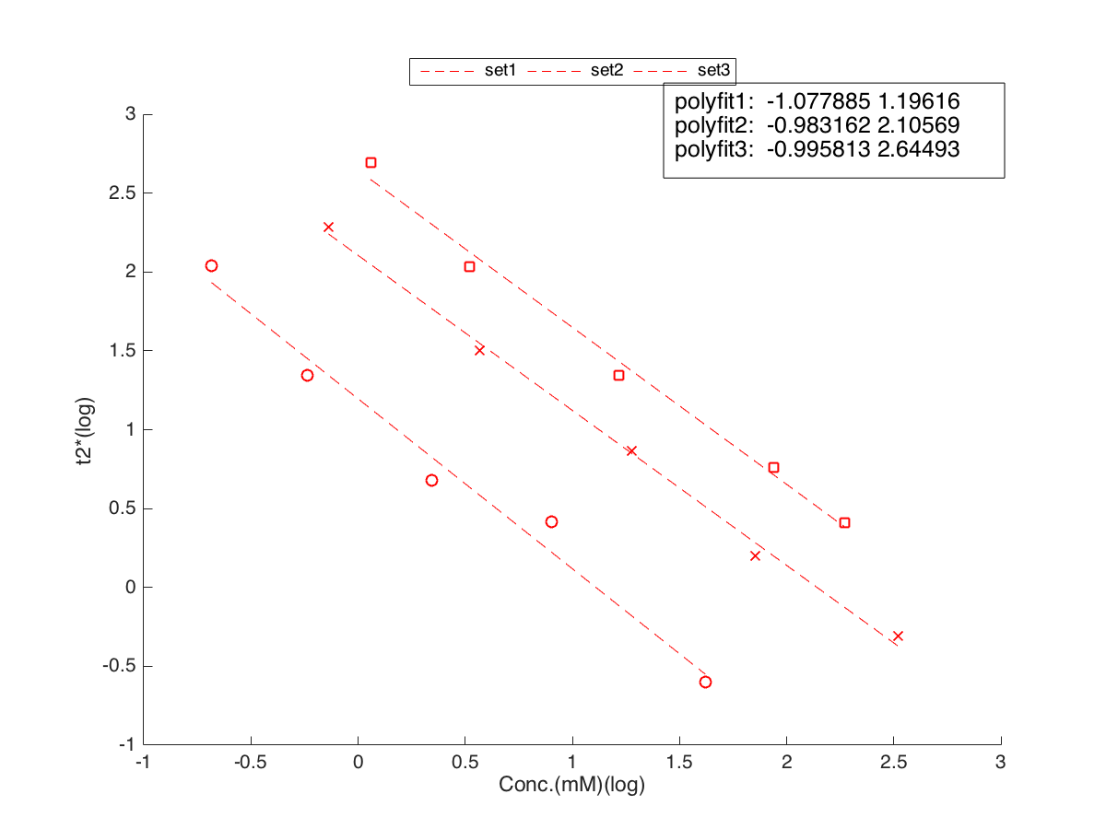
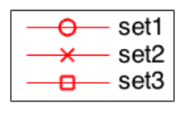
MRIM 1.5Tesla T2* Result
loading 5%
loading 20%
loading 10%

Slide 27
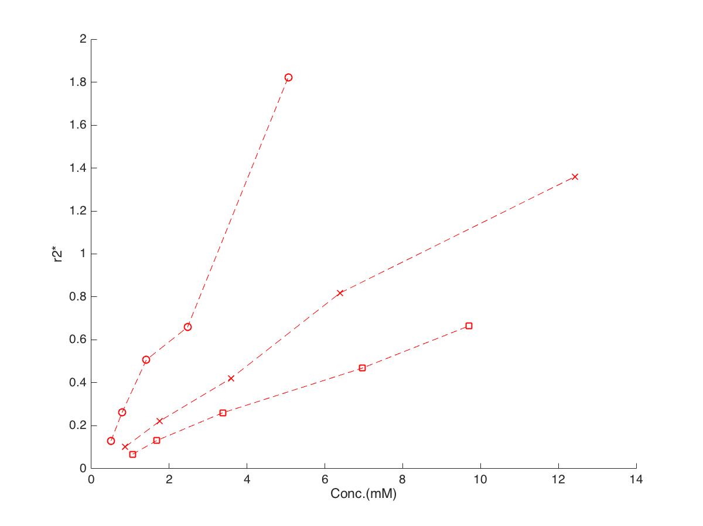
MRIM 1.5Tesla R2* Result
loading 20%
loading 10%
loading 5%

Slide 28
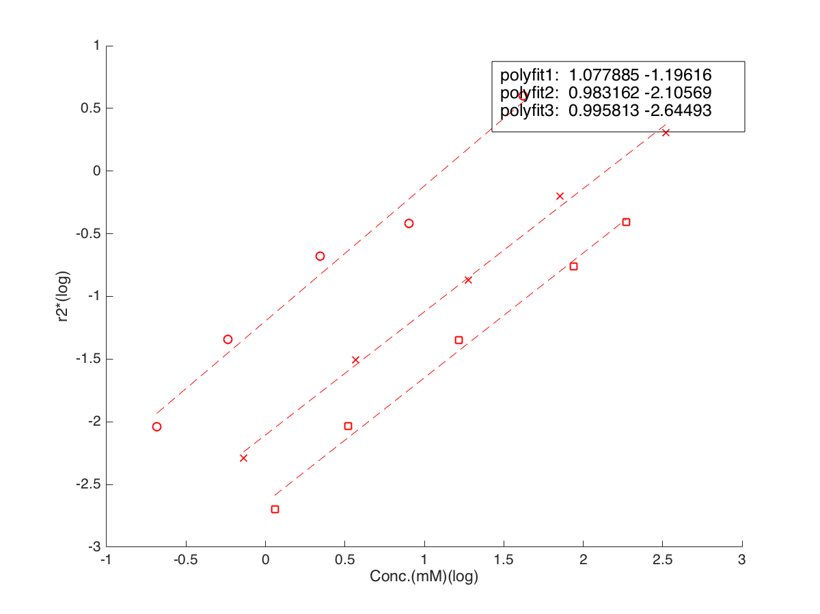
MRIM 1.5Tesla R2* Result
loading 20%
loading 10%
loading 5%

