Slide 1
Original Result
- CMRtools 1.5T
- MRIM 1.5T no 4 point Condition
- MRIM 1.5T + 4 point Condition
- MRIM 3T no 4 point Condition
- MRIM 3T + 4 point Condition

Slide 2
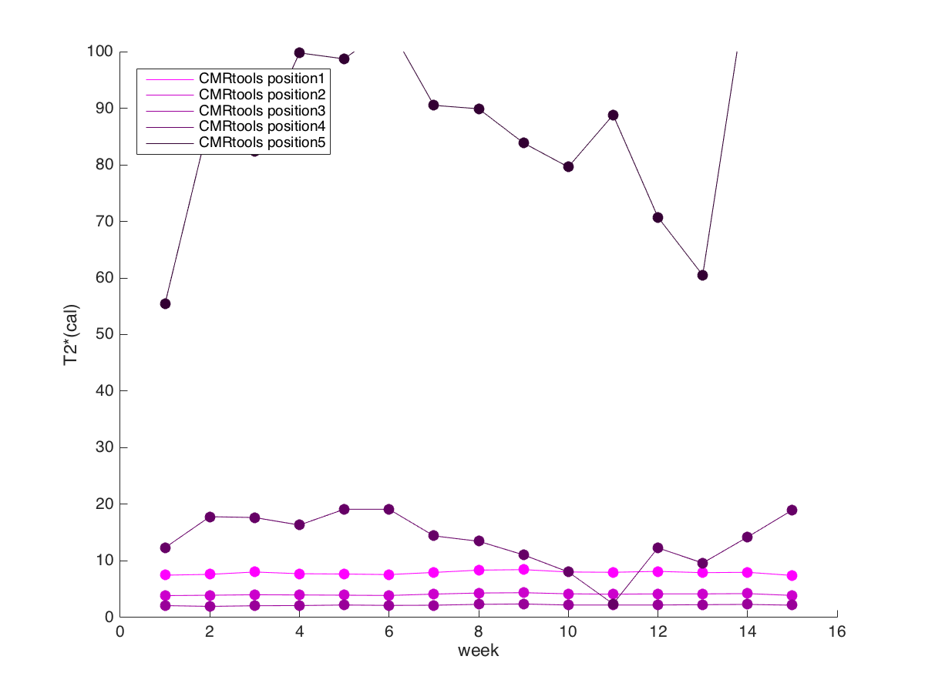
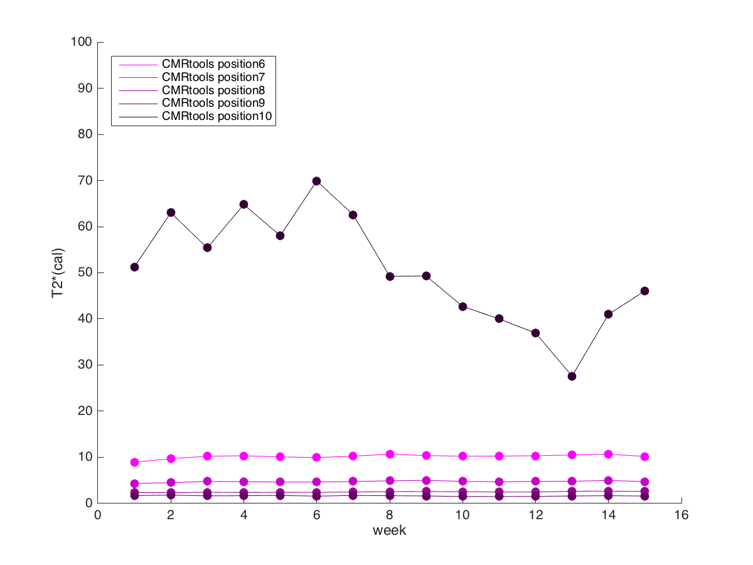
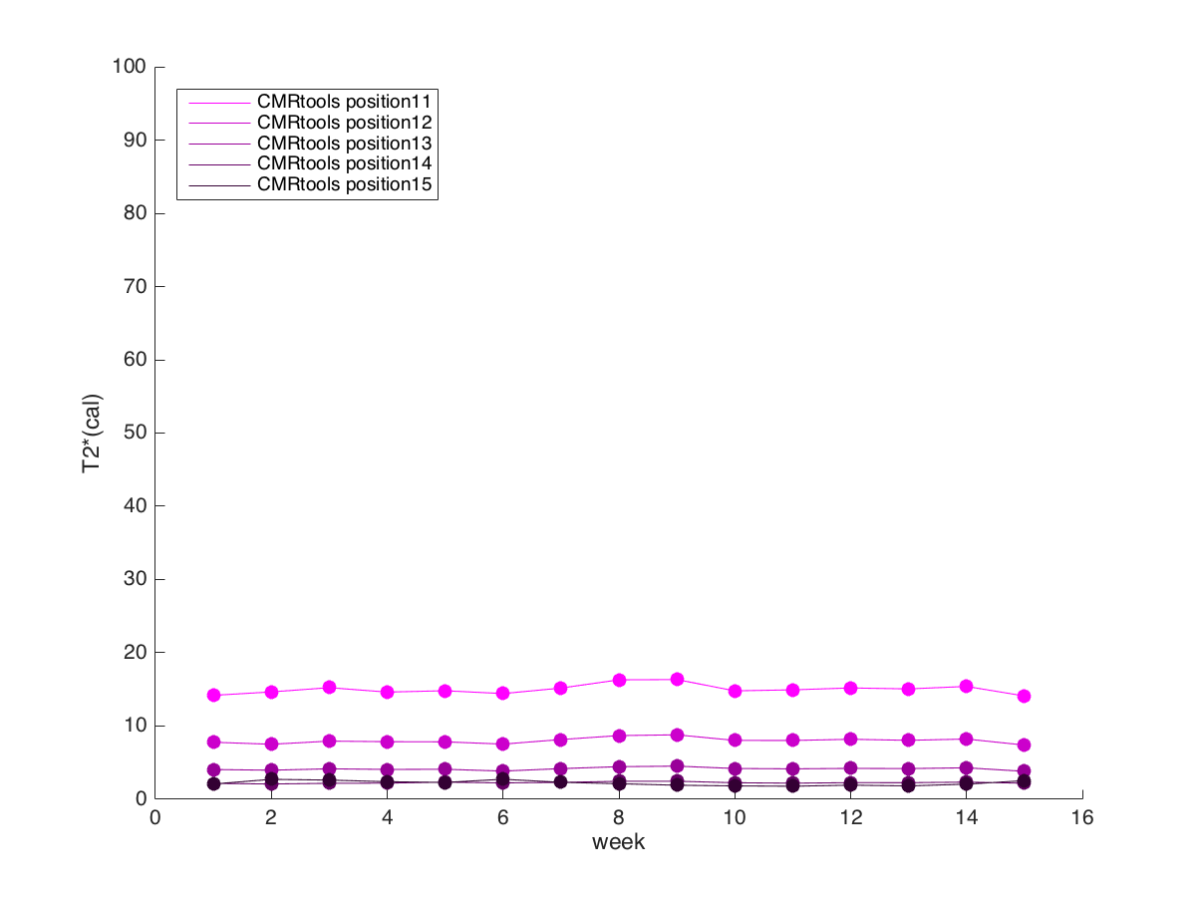
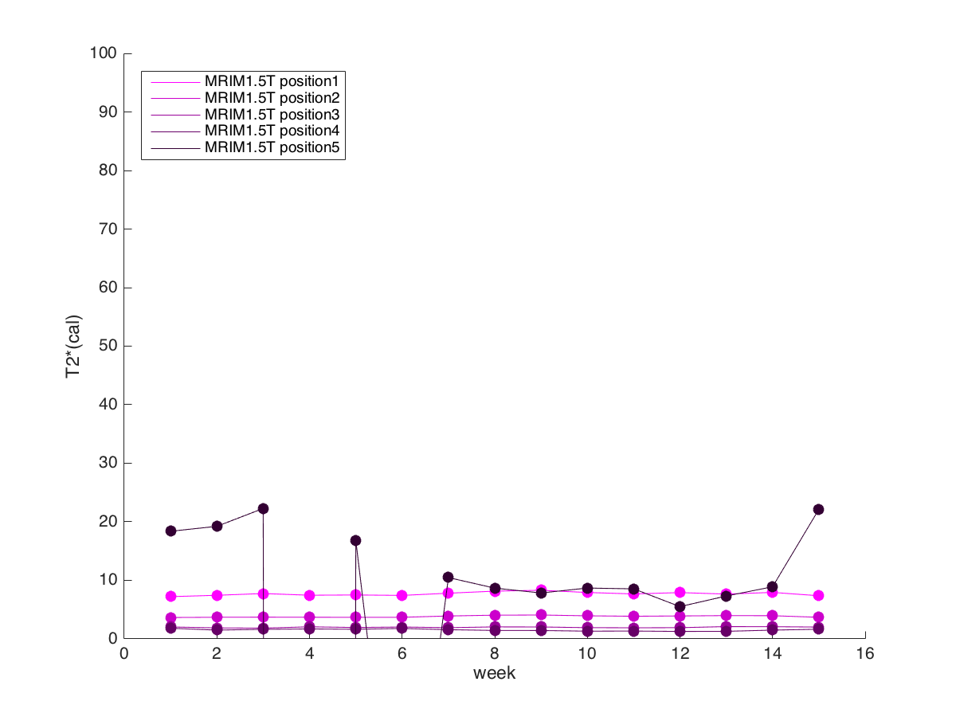
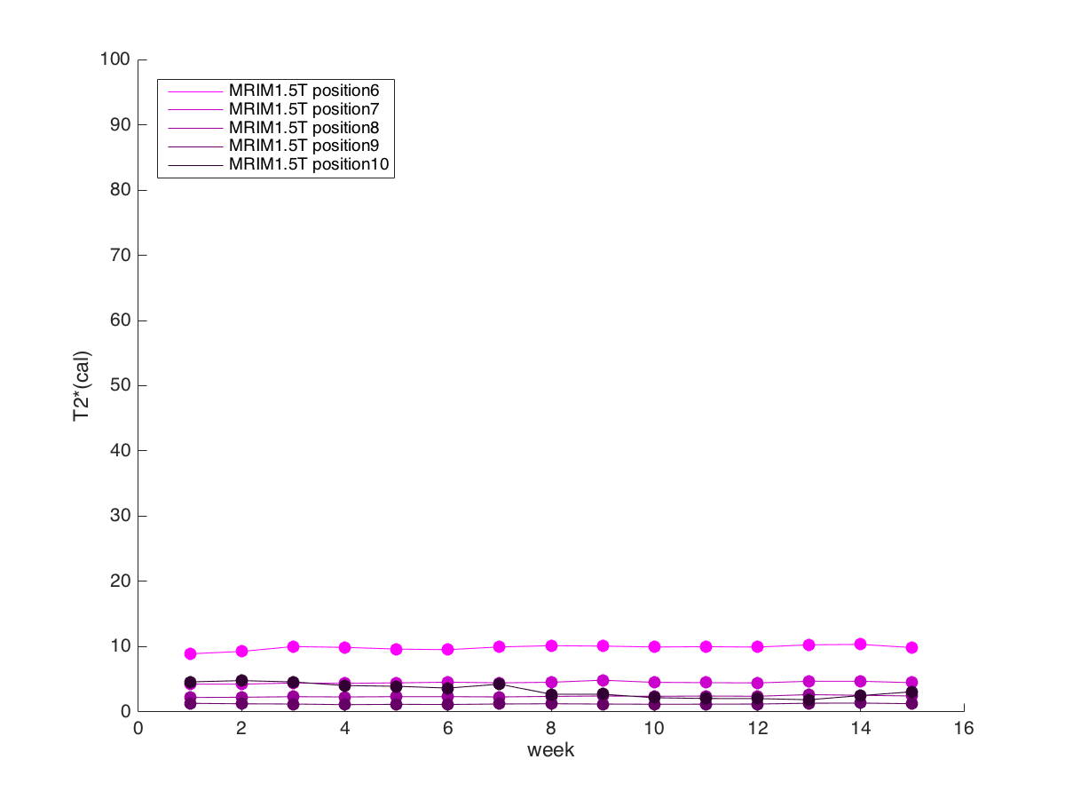
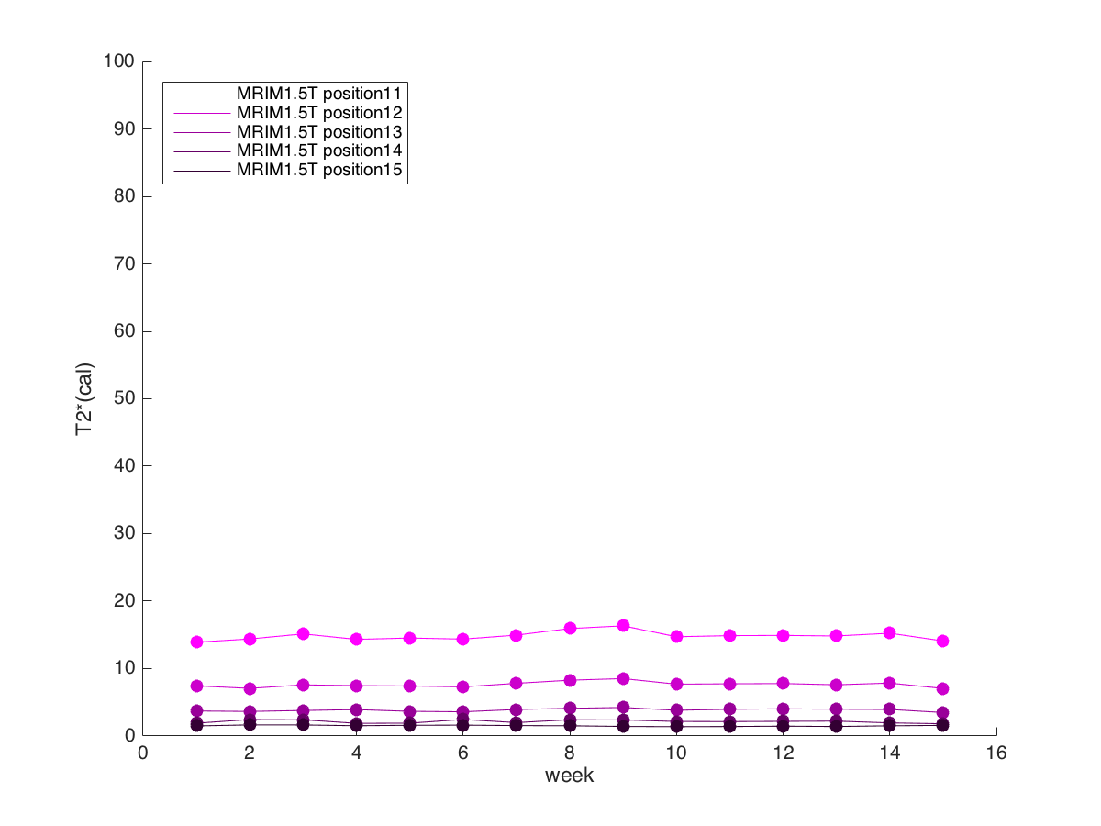
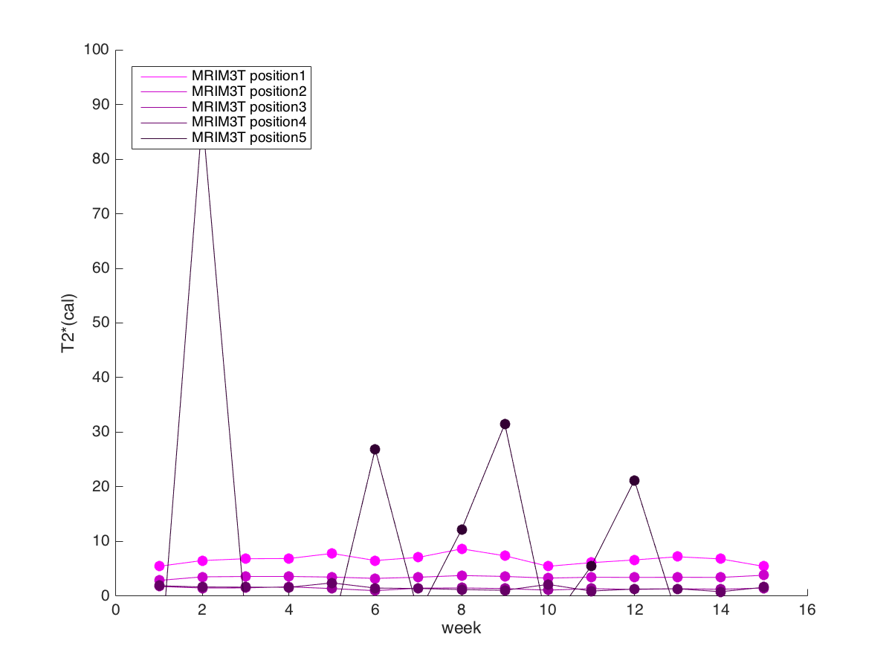
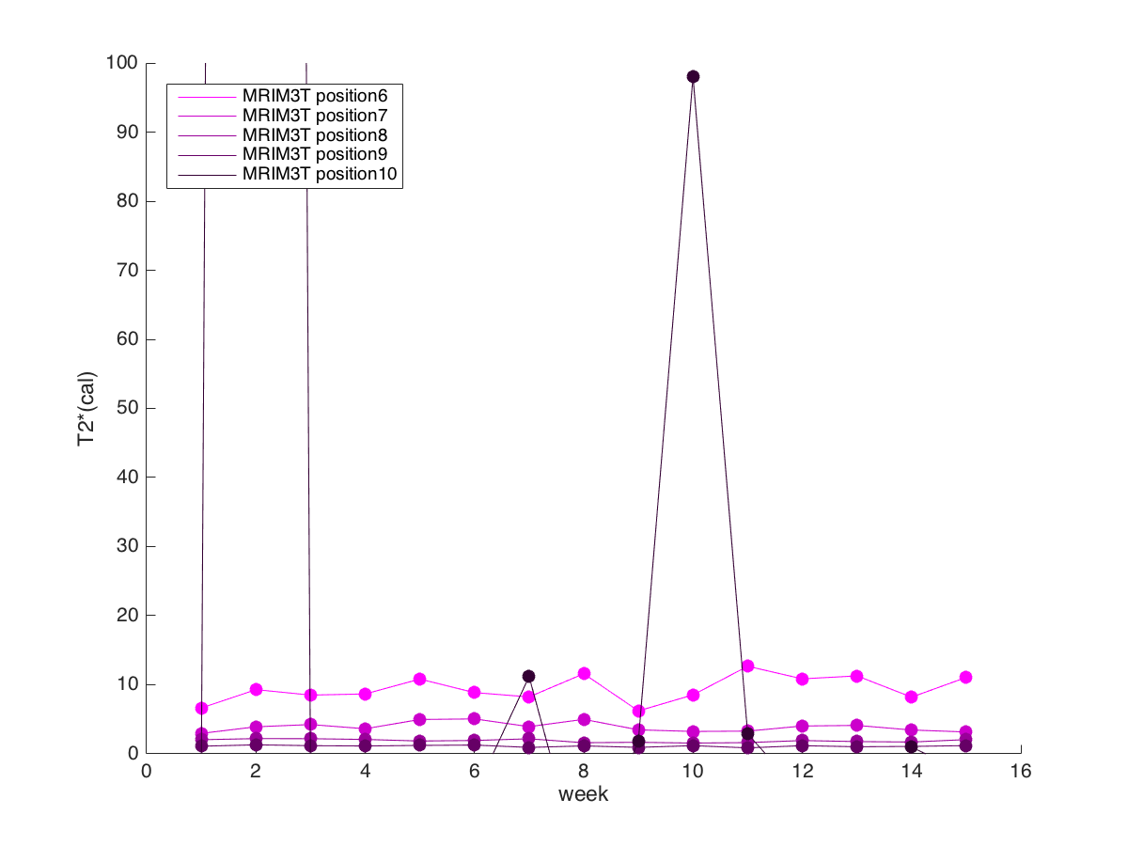
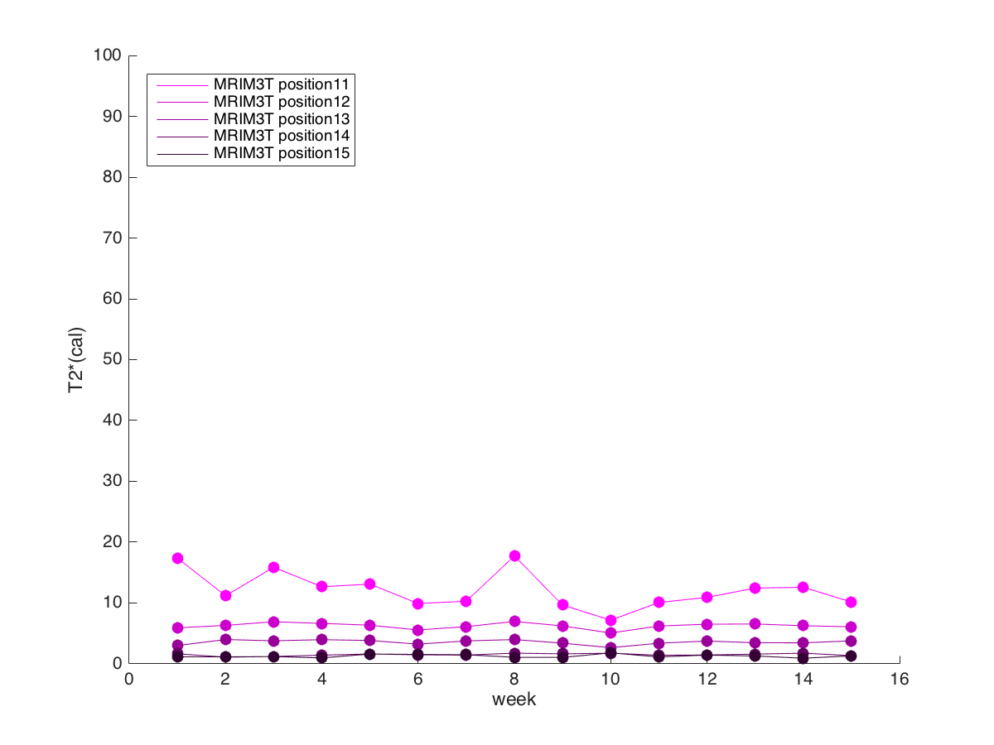

CMRtools
MIRM 1.5T
MIRM 1.5T
no 4 point
condition
Position 1-5
Position 6-10
Position 11-15

Slide 3
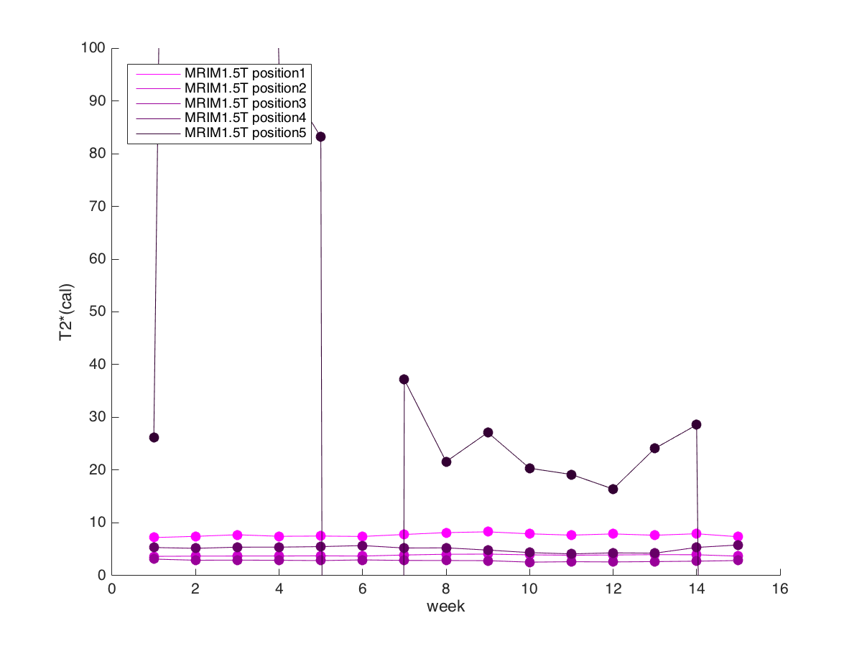
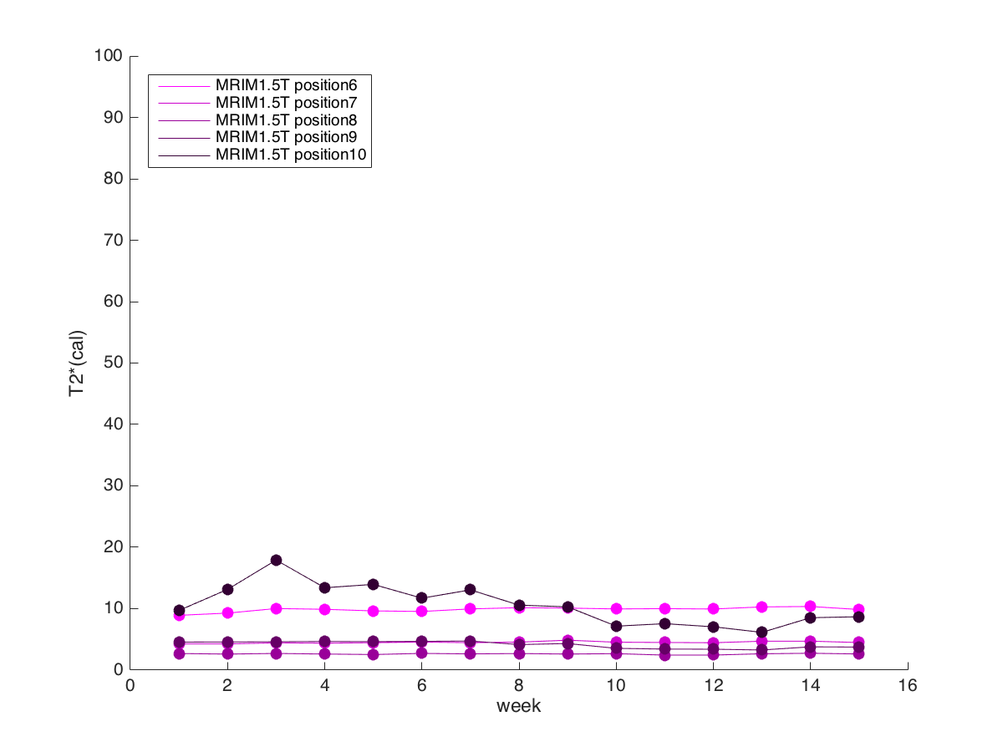
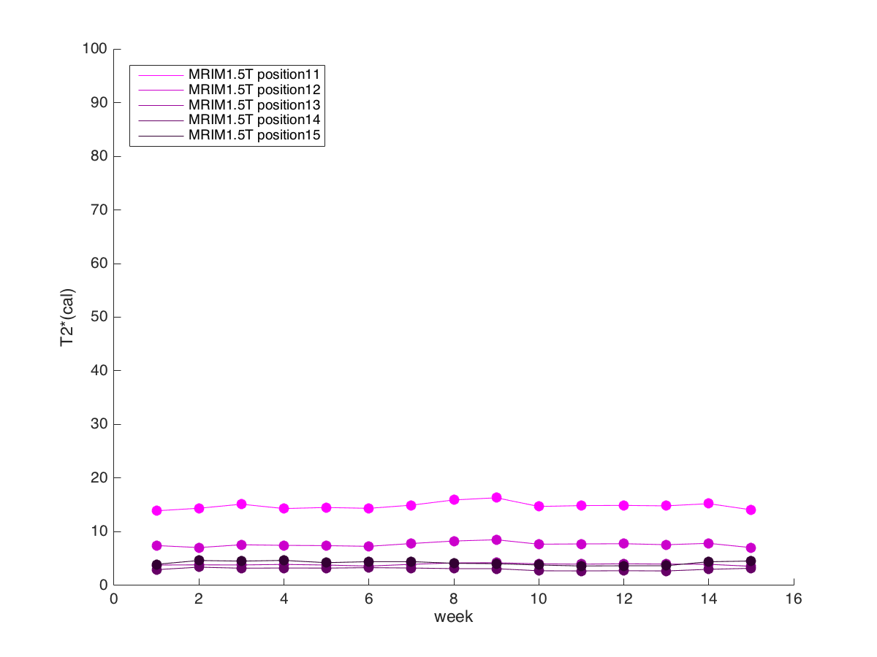
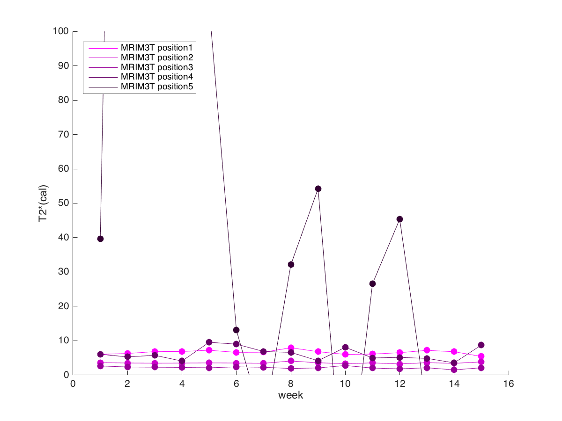
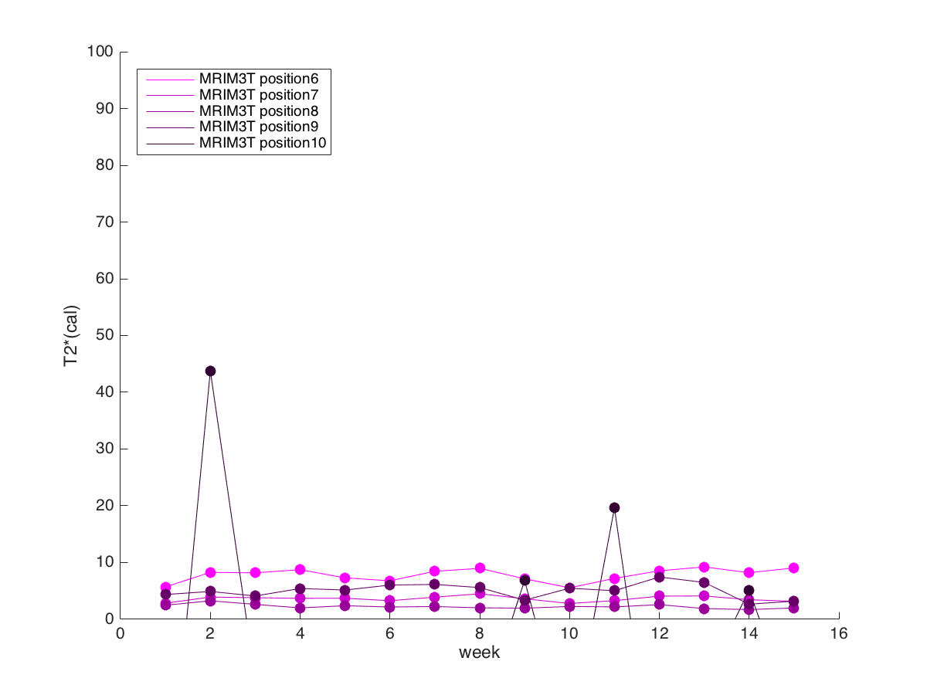
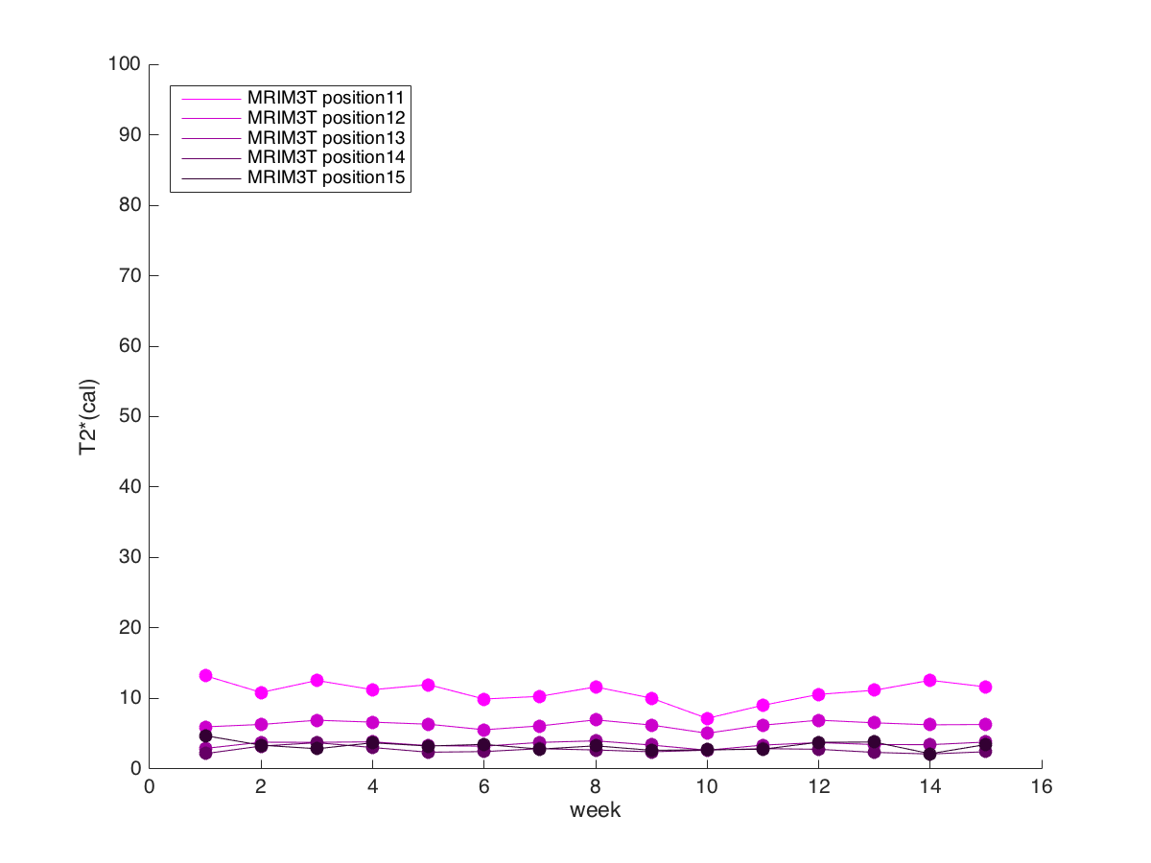
CMRtools
MIRM 1.5T
MIRM 1.5T
4 point
condition
Position 1-5
Position 6-10
Position 11-15

Slide 4
Normalize Result

Slide 5
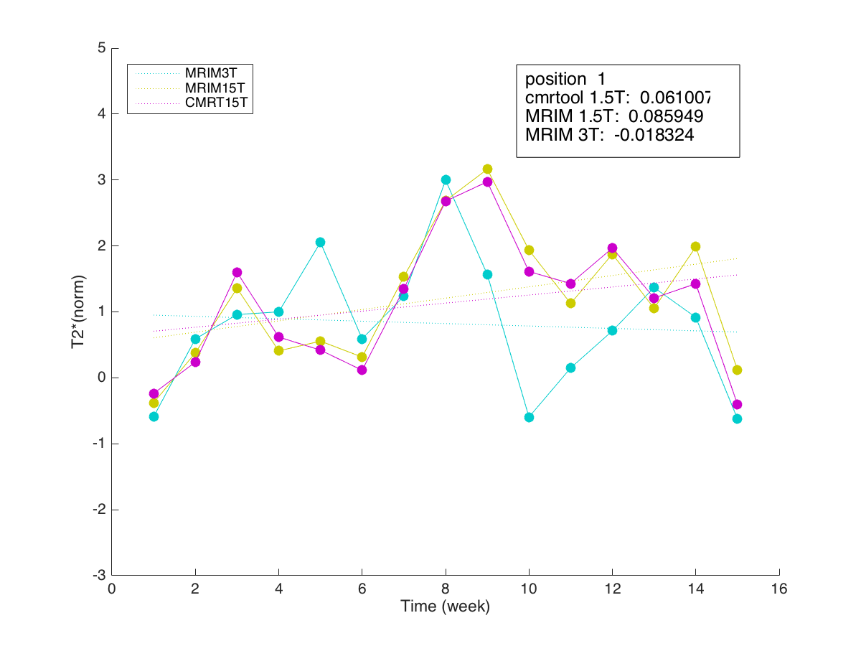
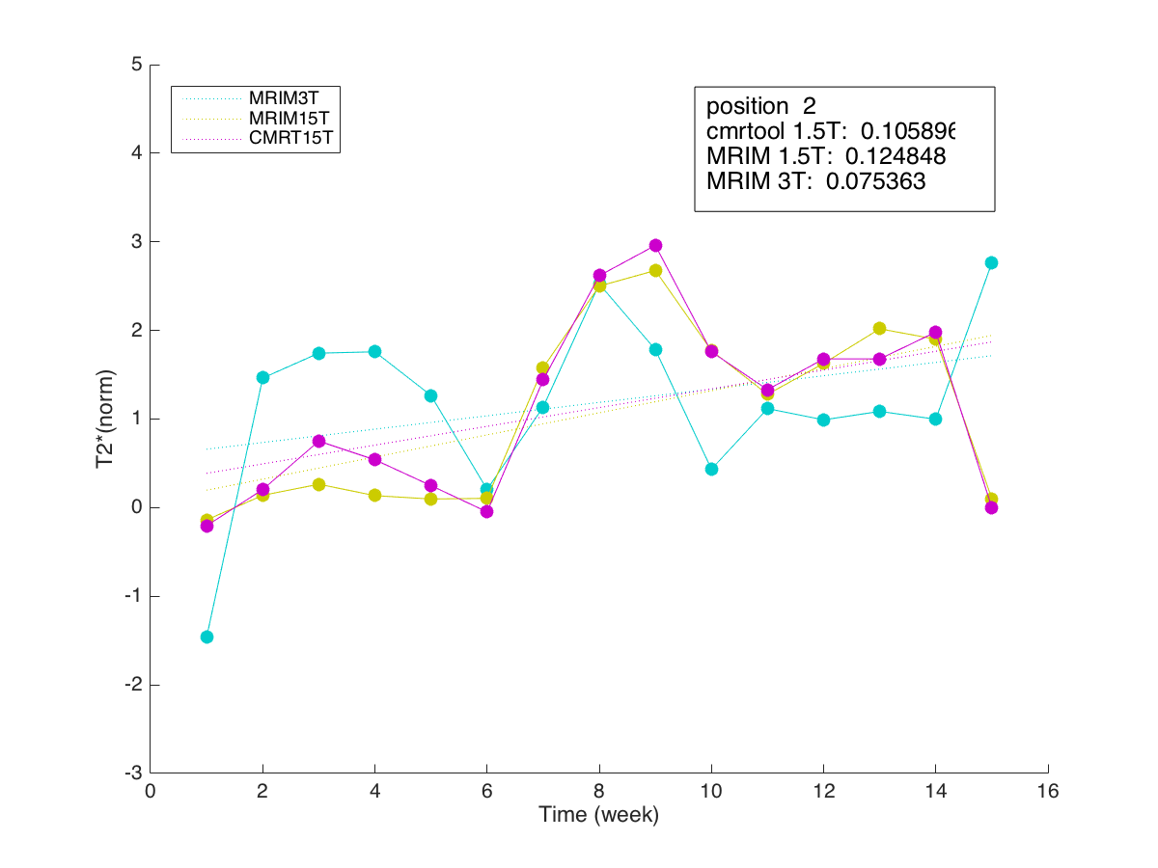
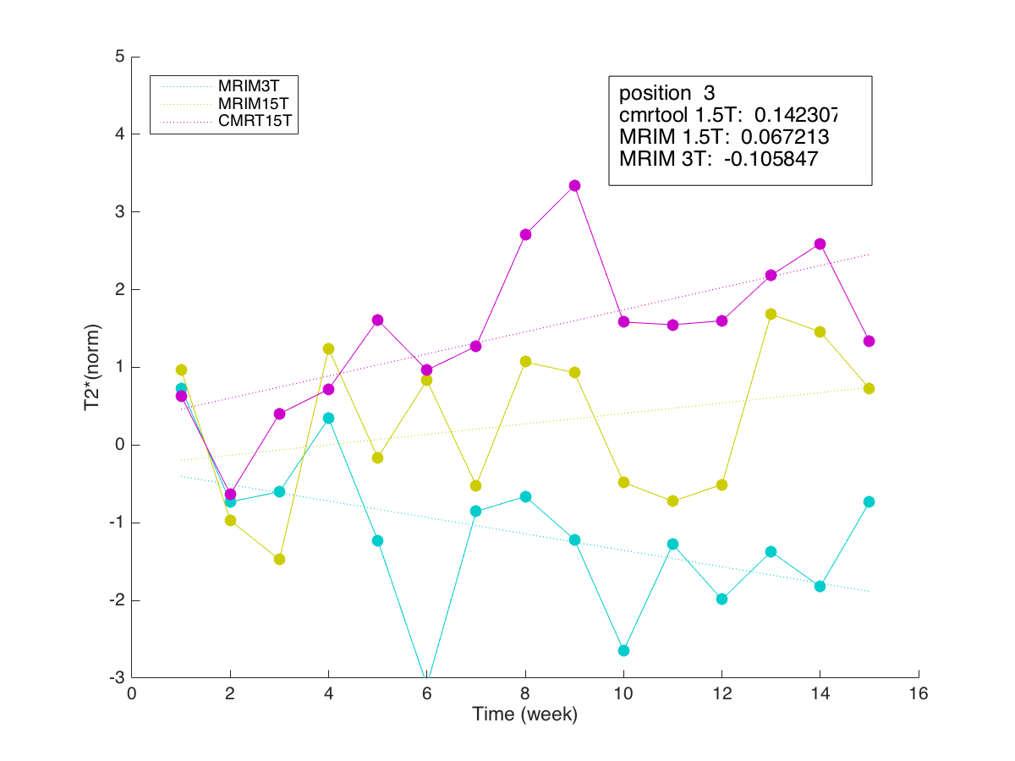
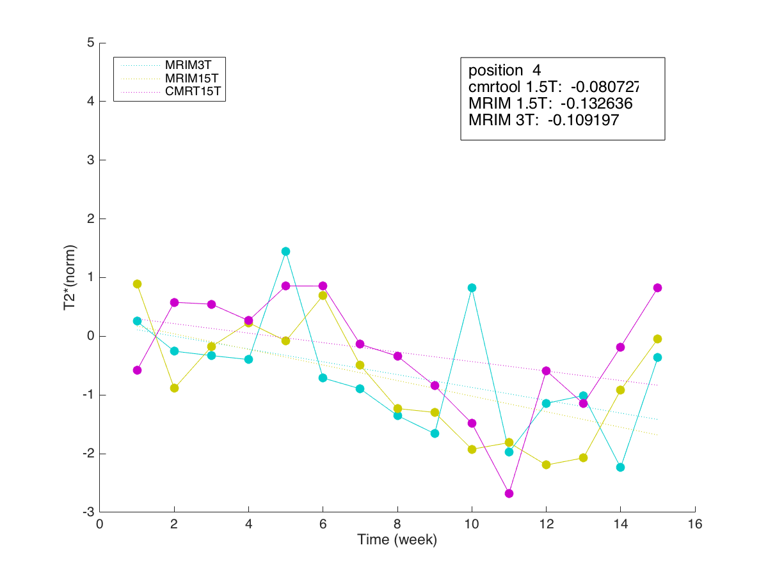
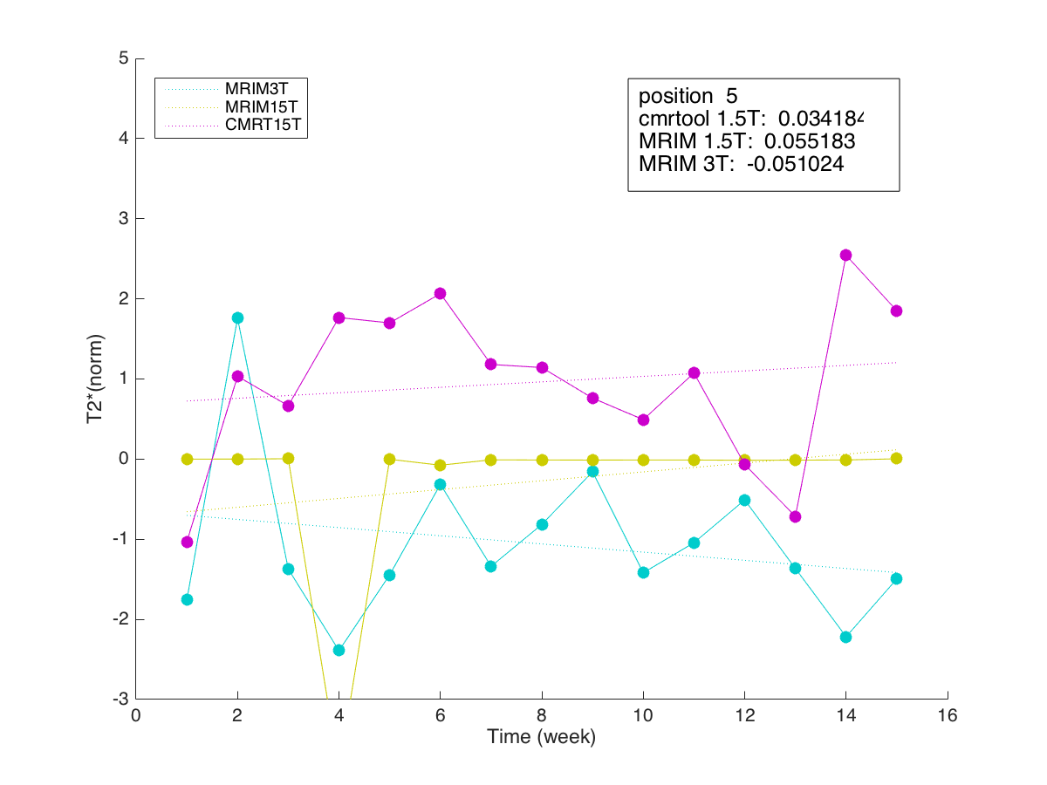
position 1-5
no 4 point condition

Slide 6
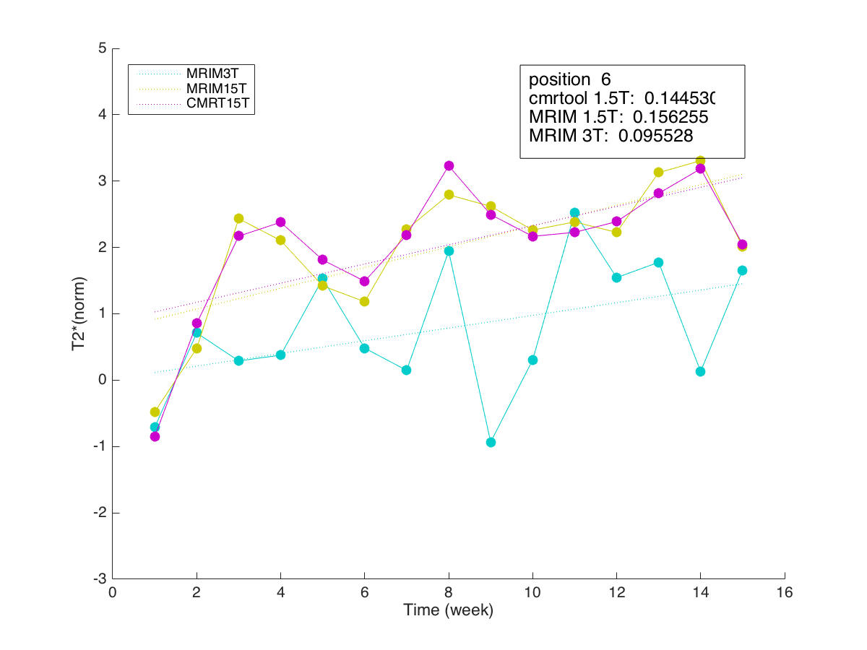
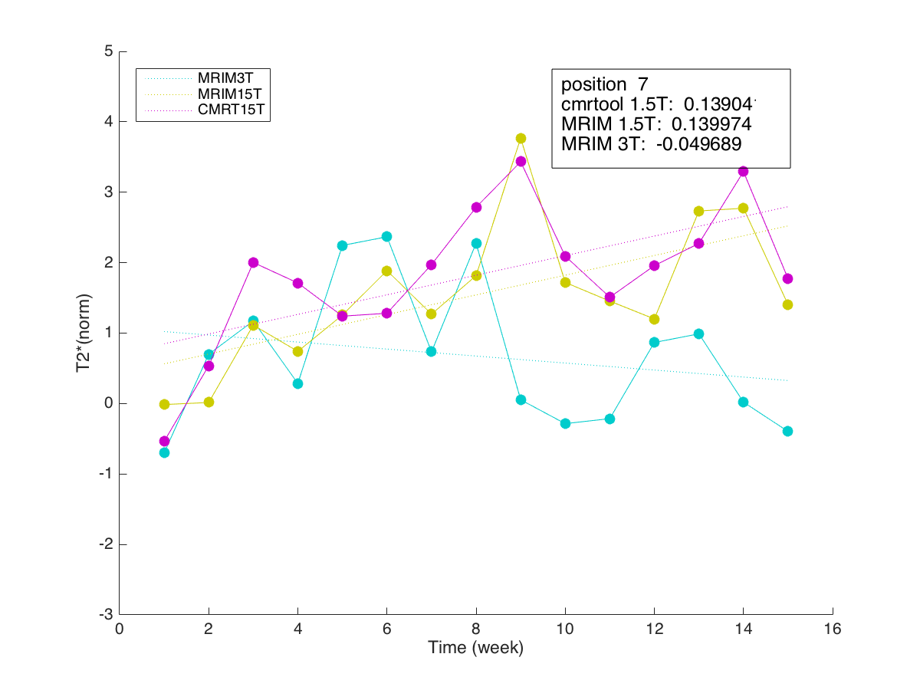
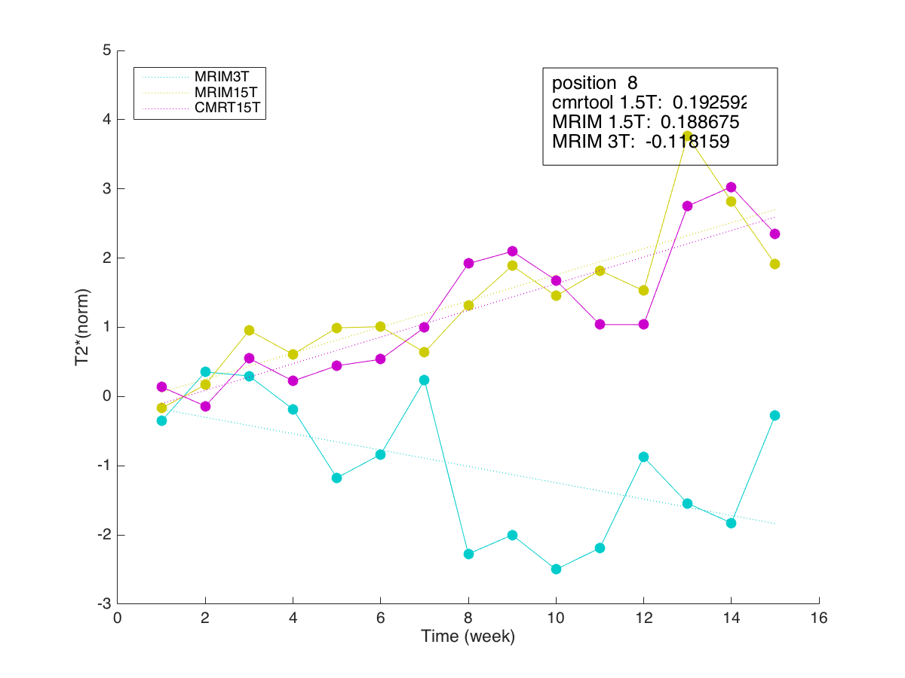
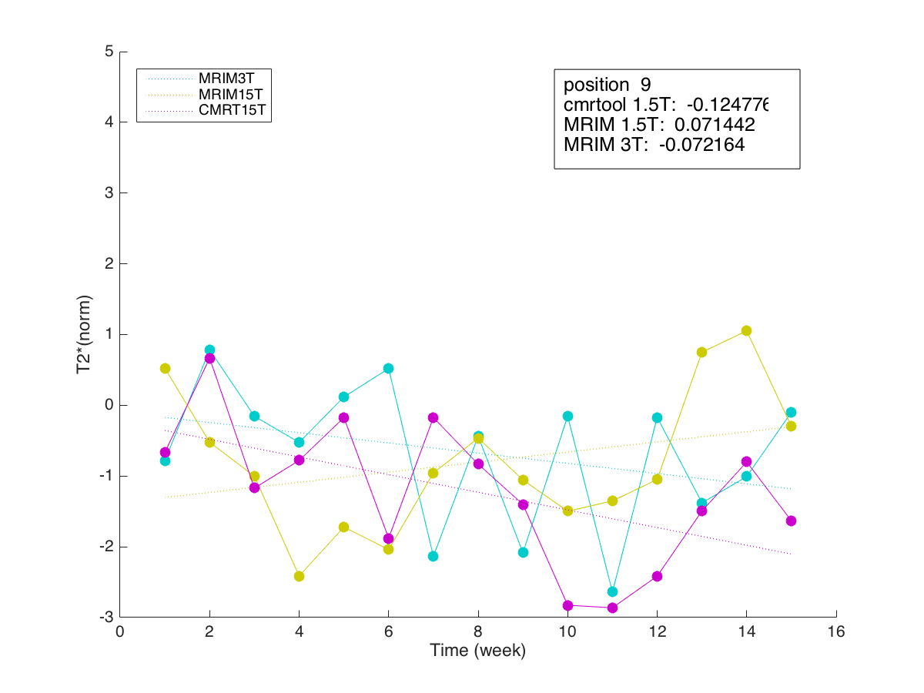
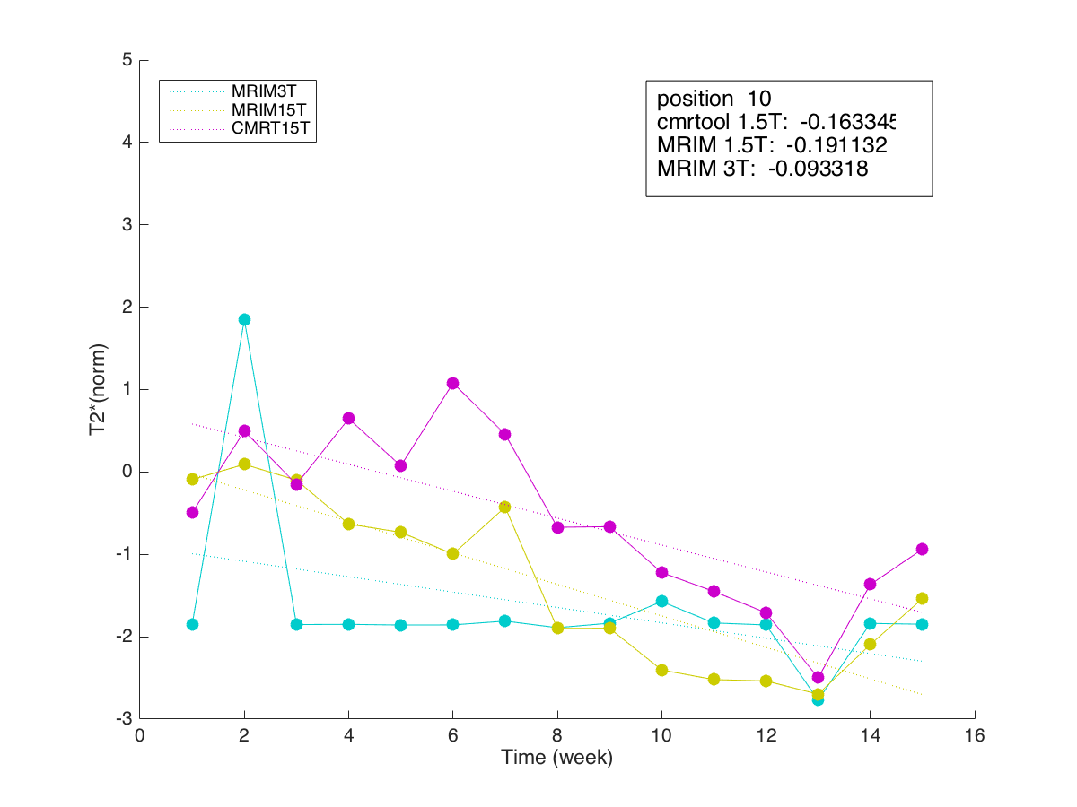
position 6-10
no 4 point condition

Slide 7
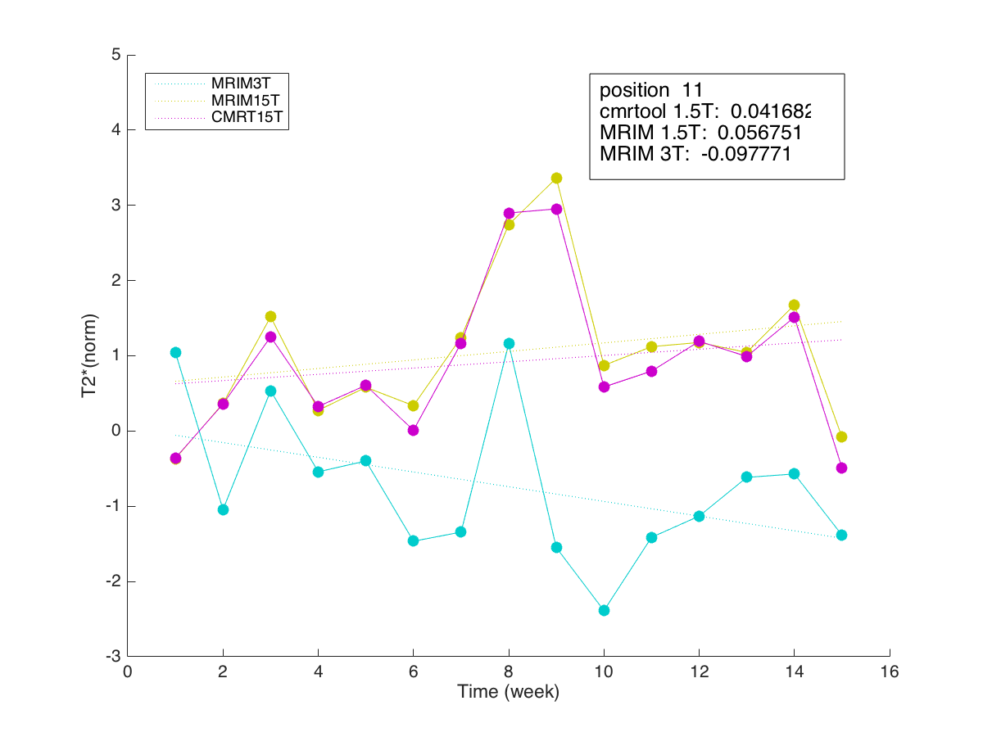
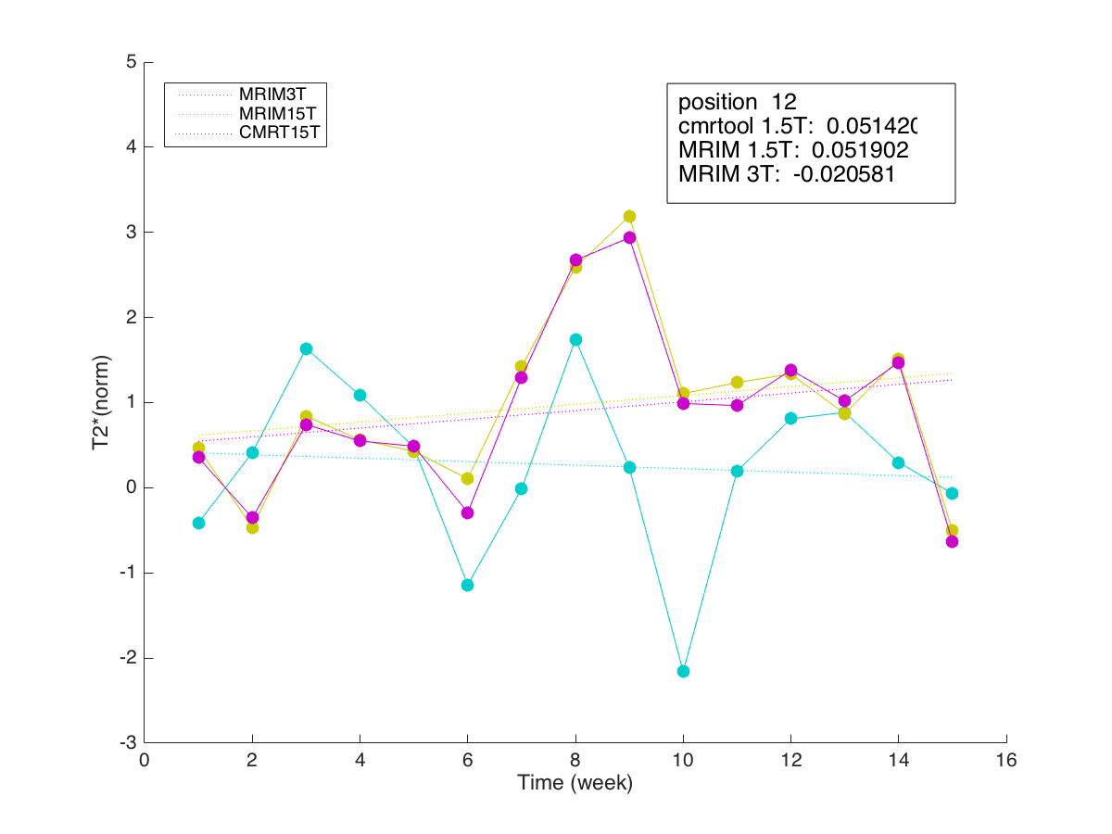
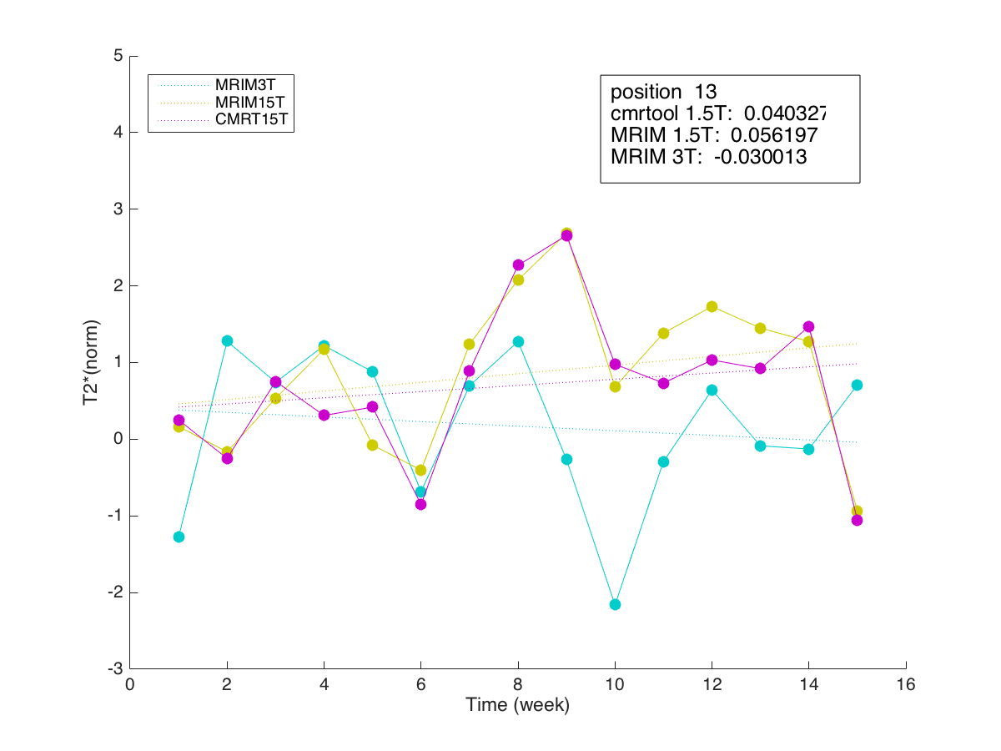
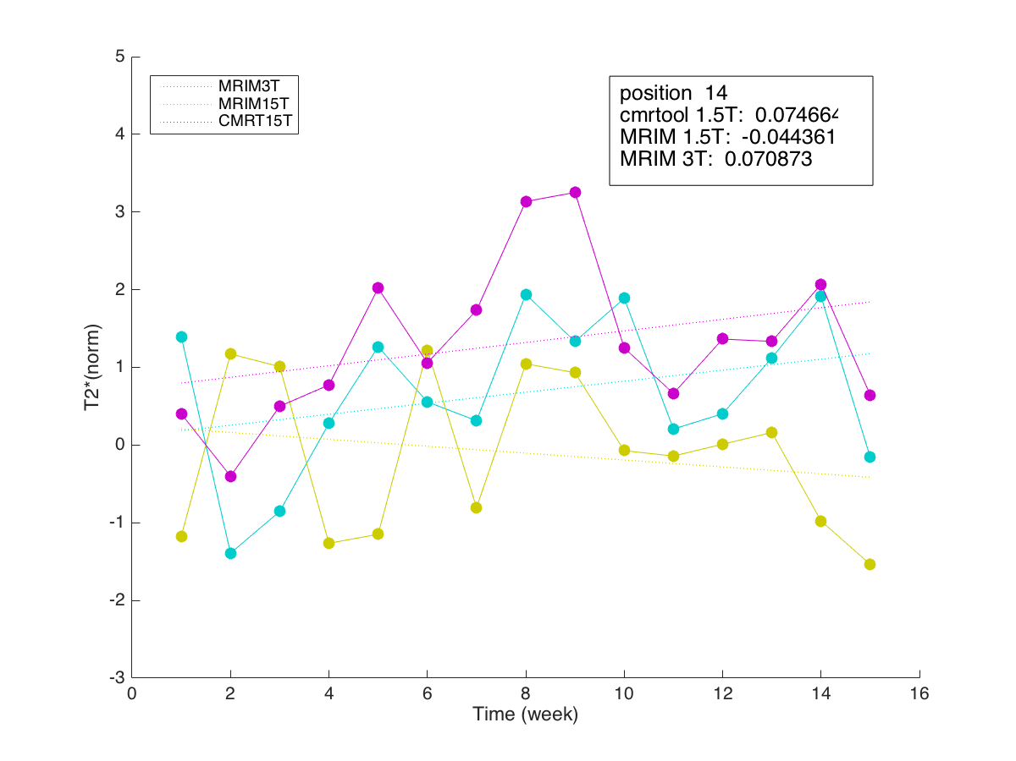
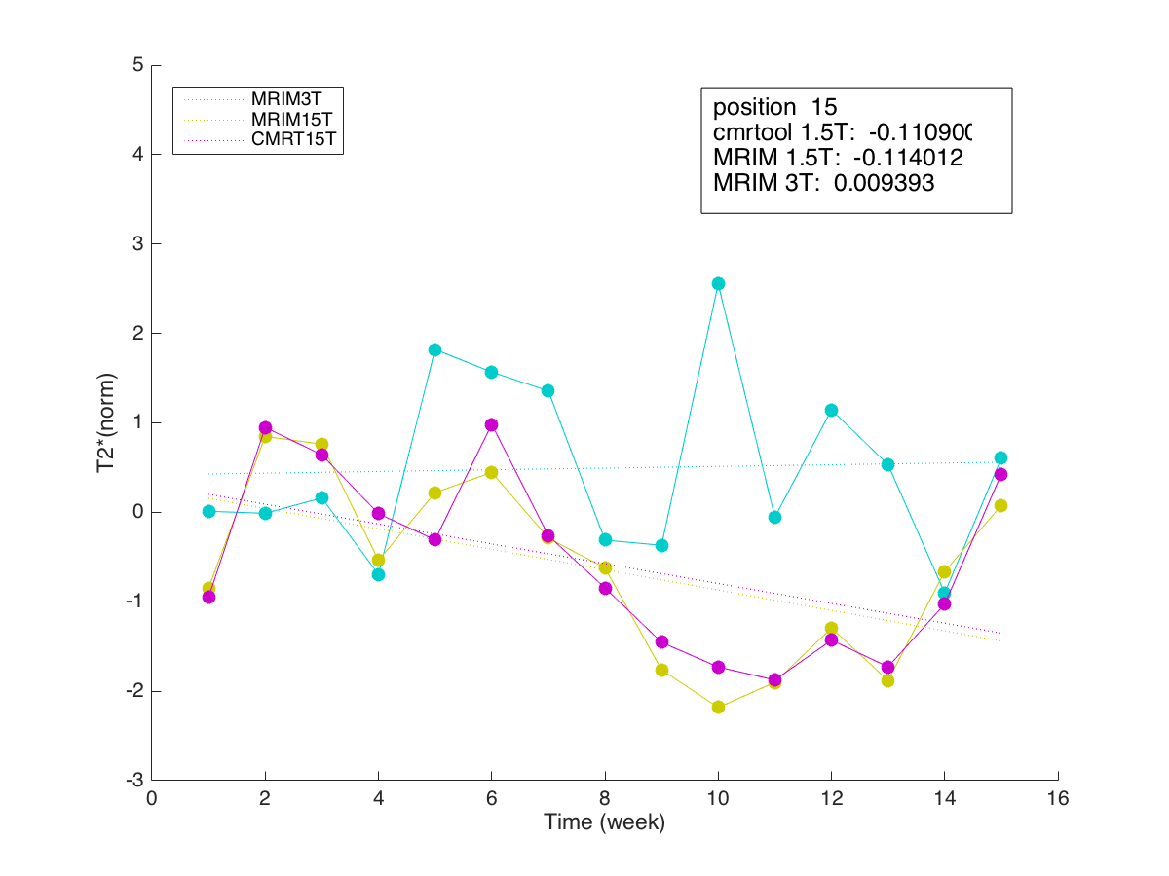
position 11-15
no 4 point condition

Slide 8
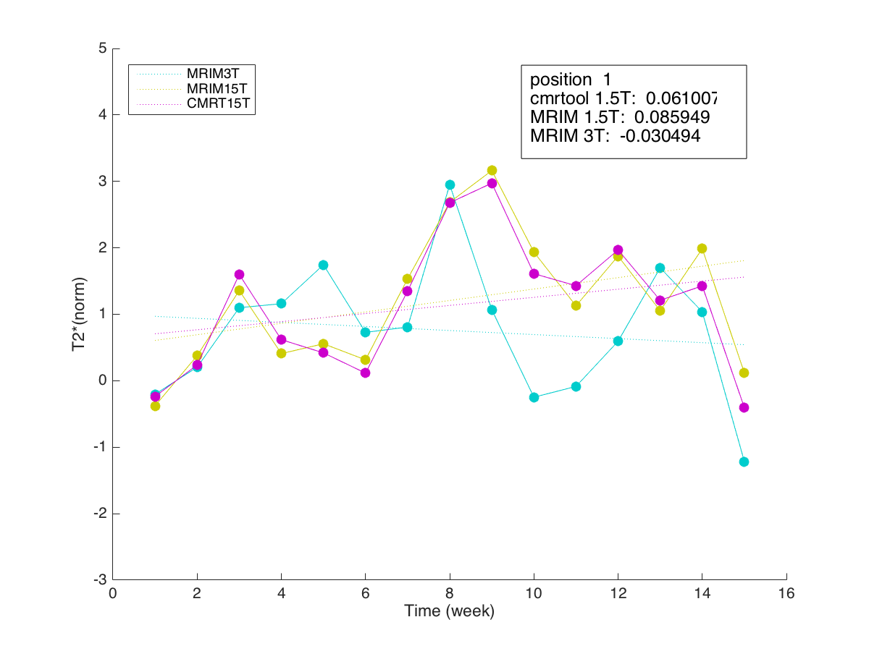
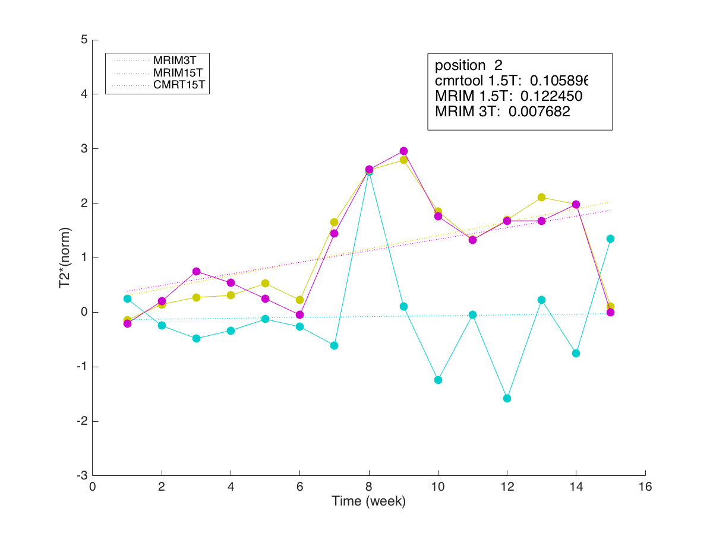
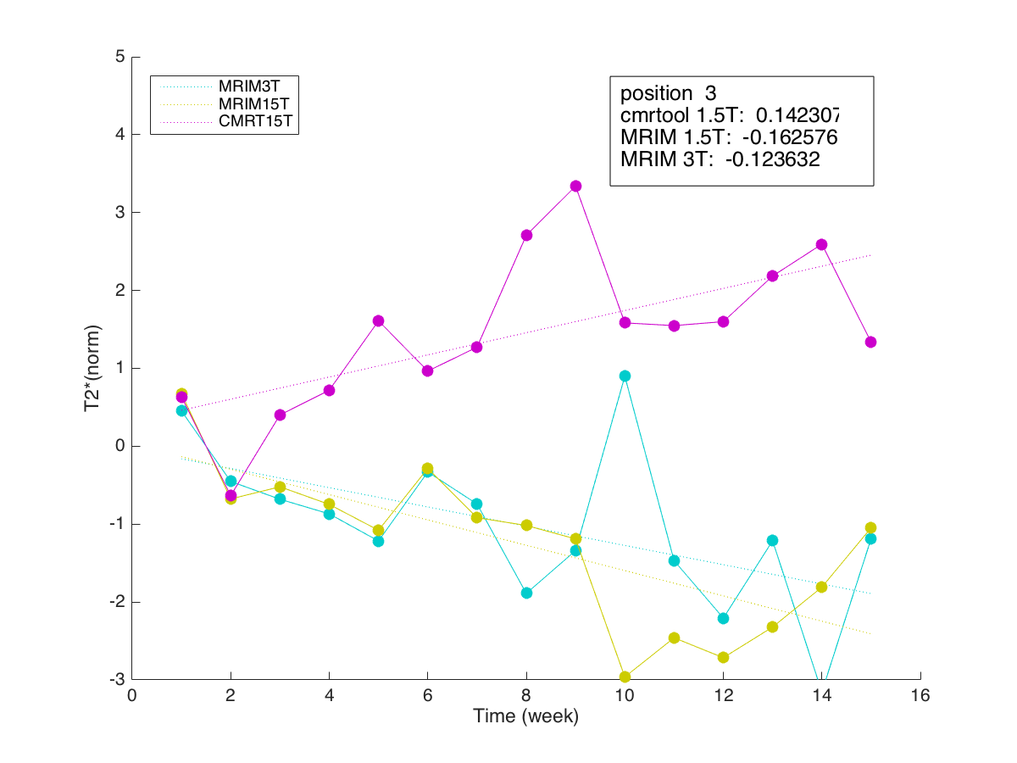
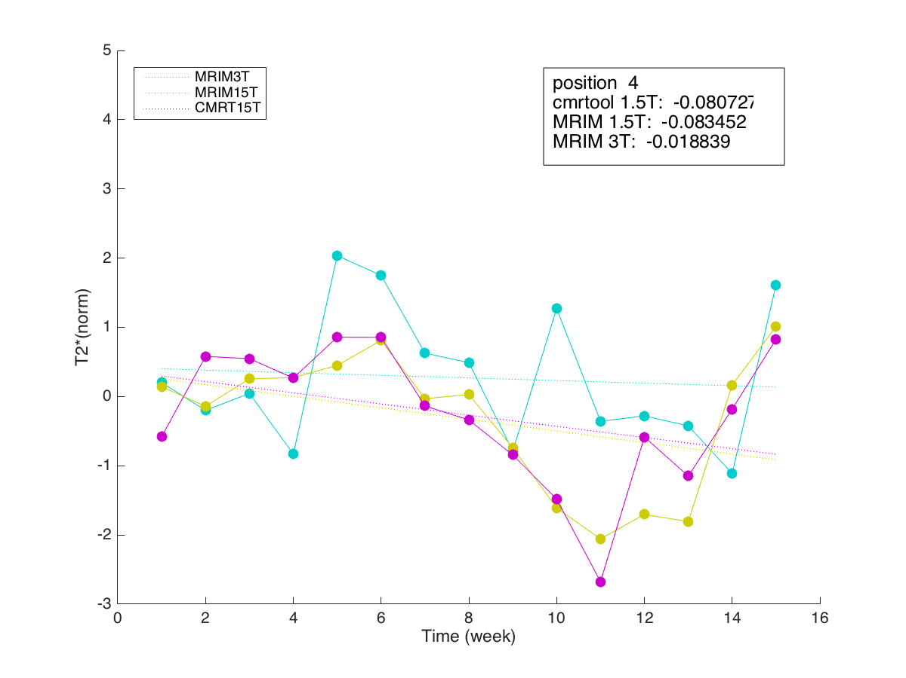
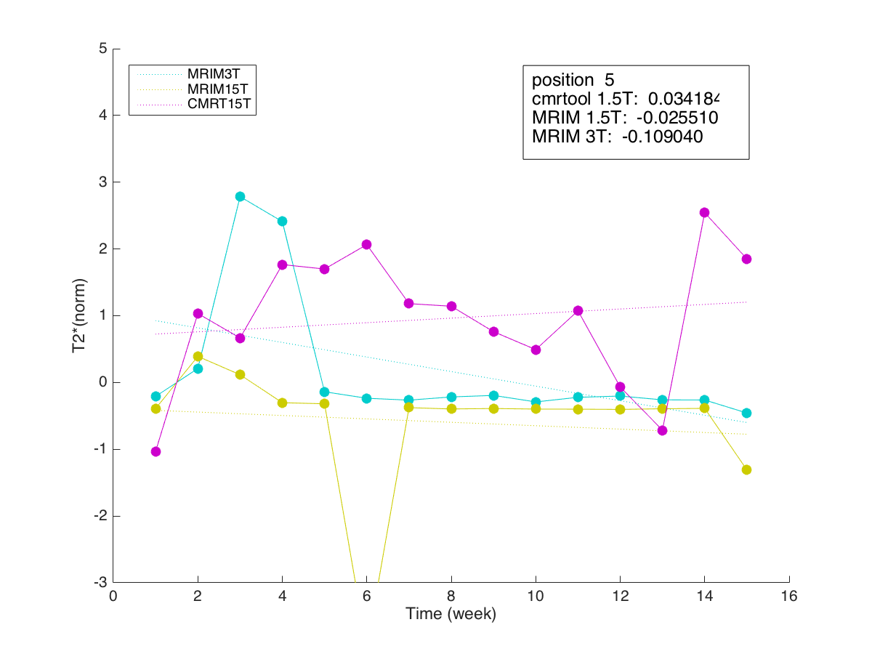
position 1-5
4 point condition

Slide 9
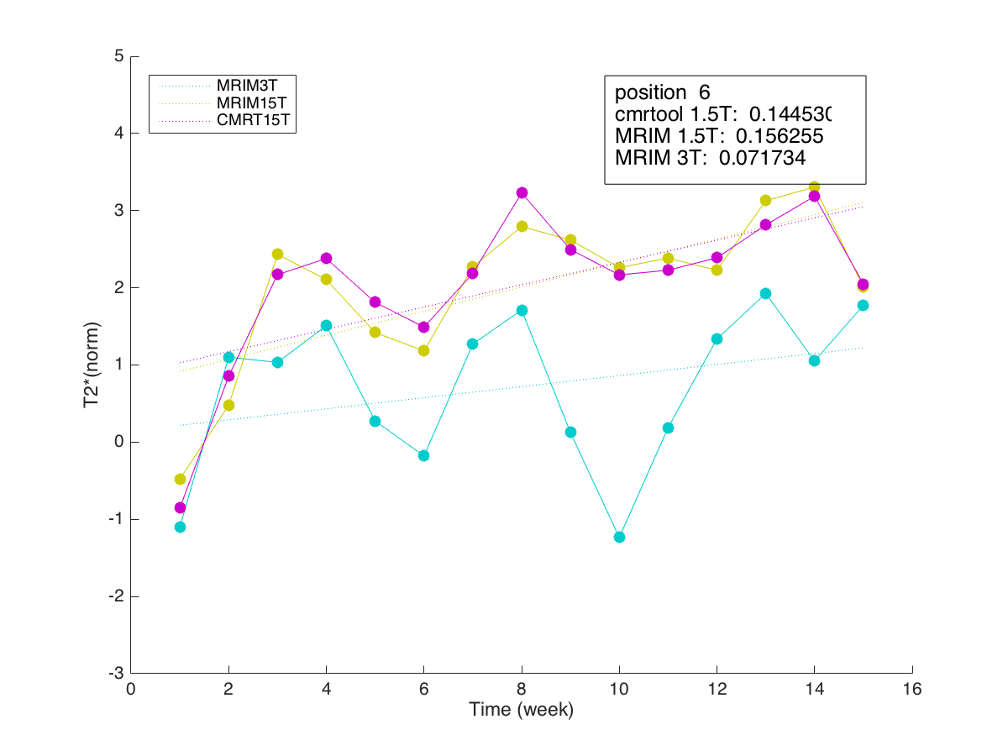
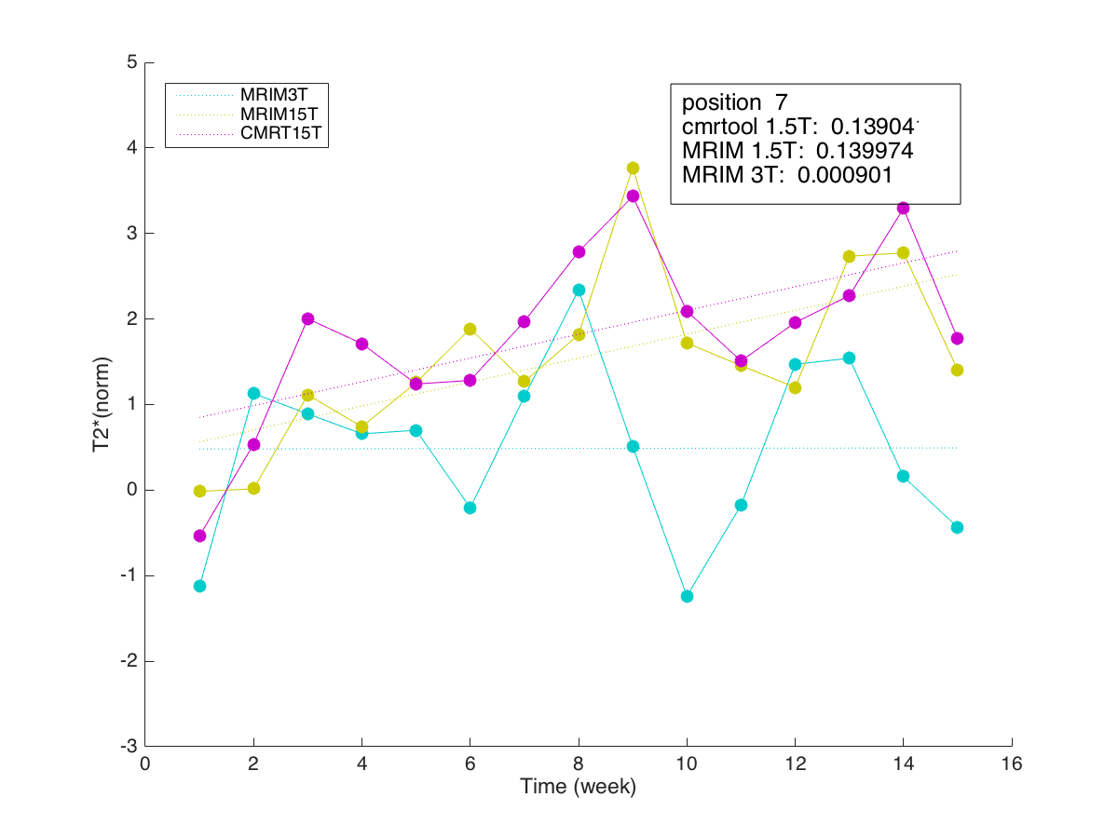
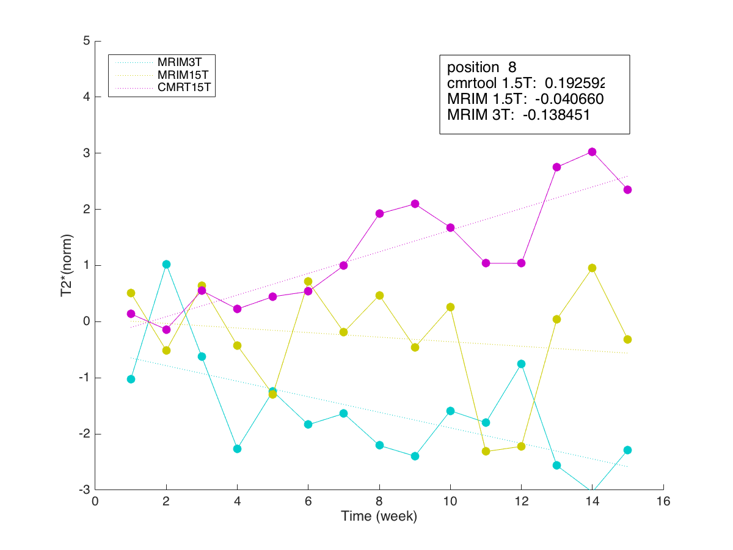
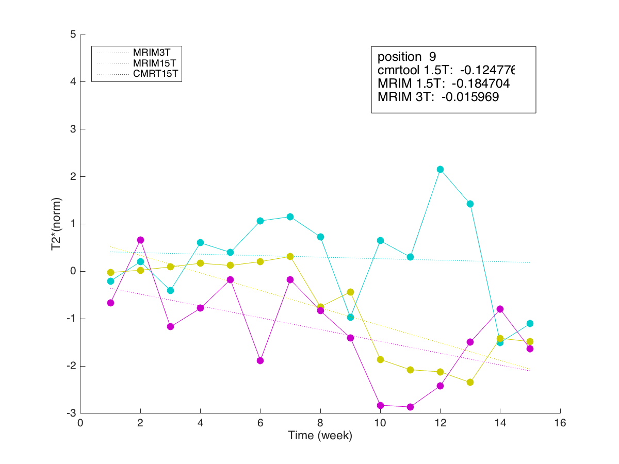
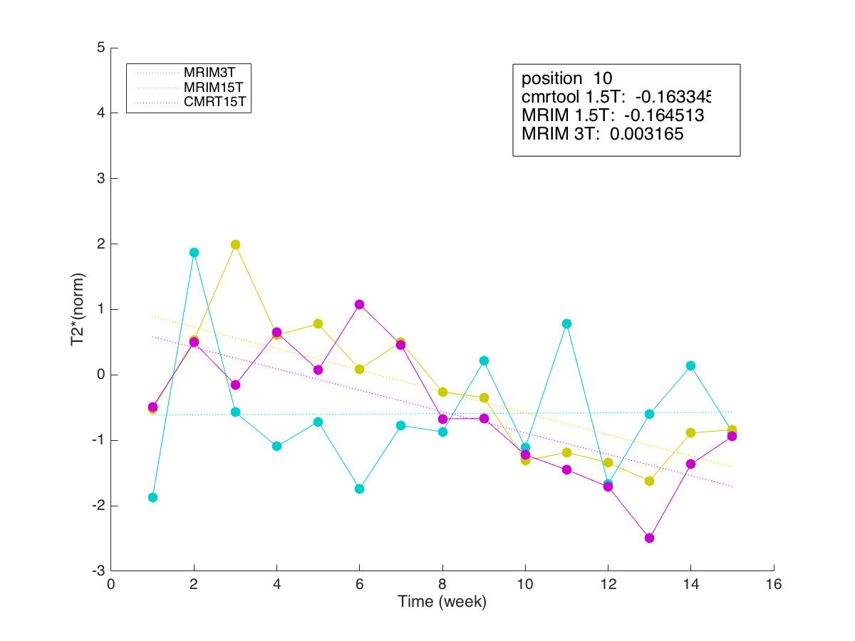
position 6-10
4 point condition

Slide 10
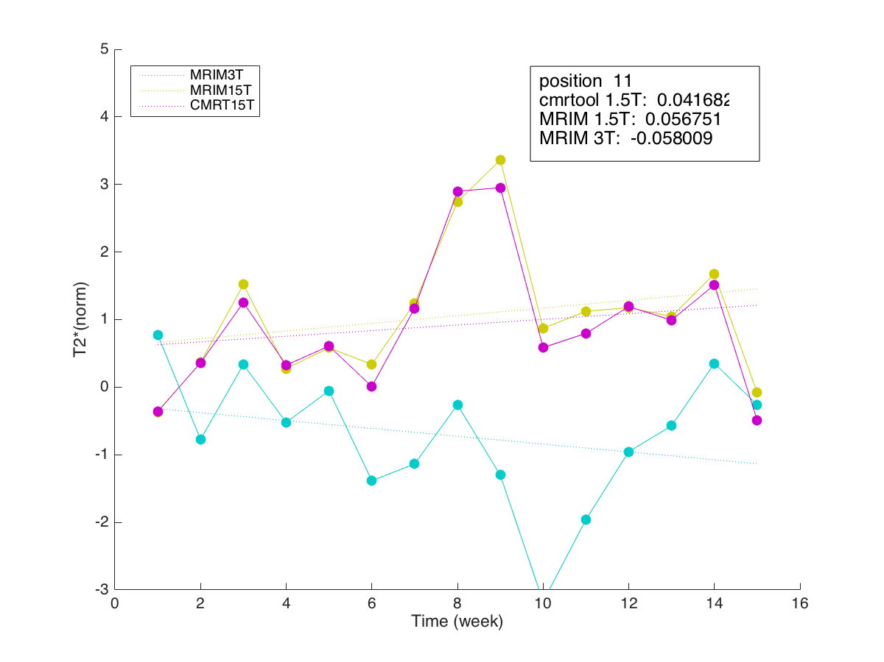

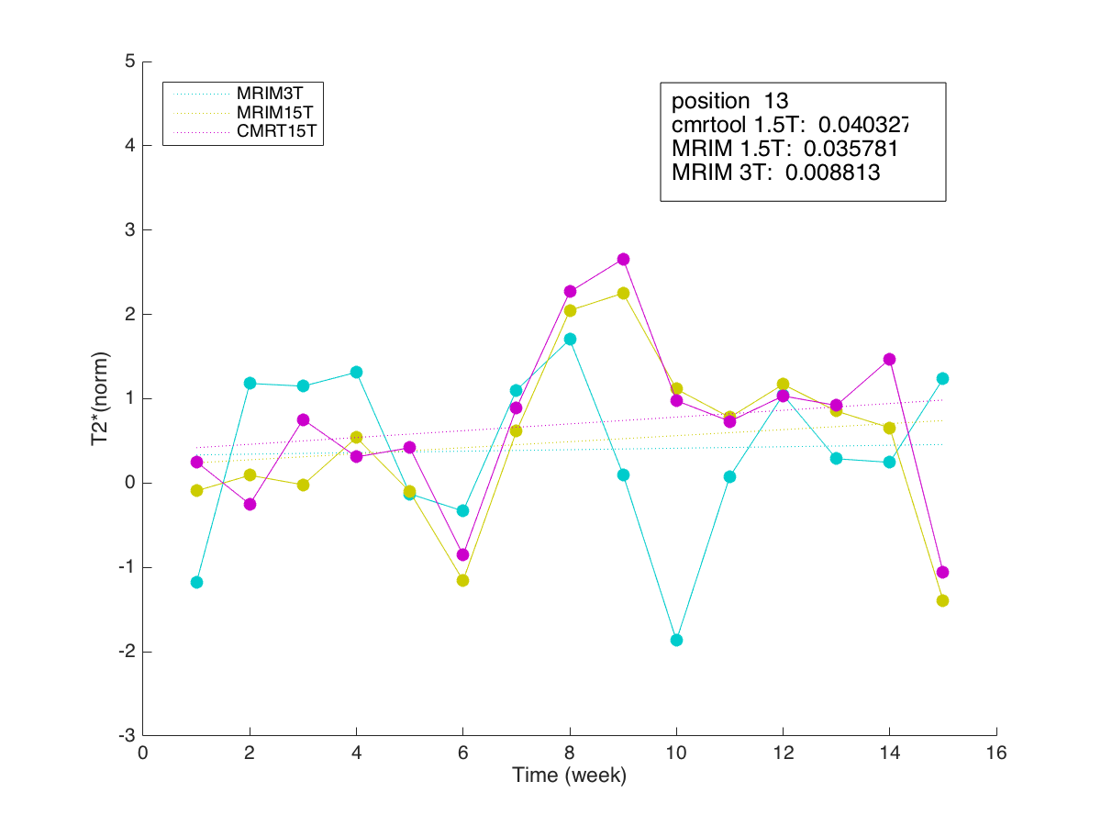
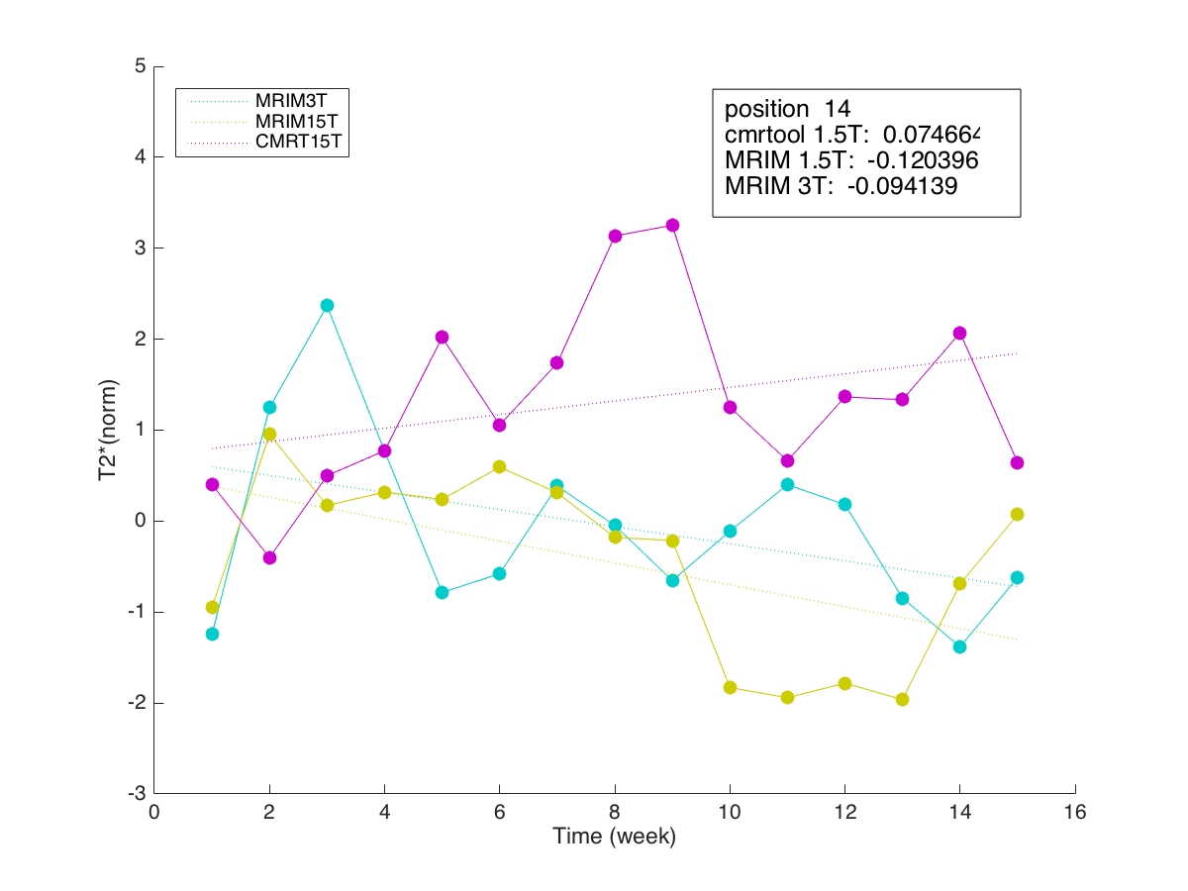
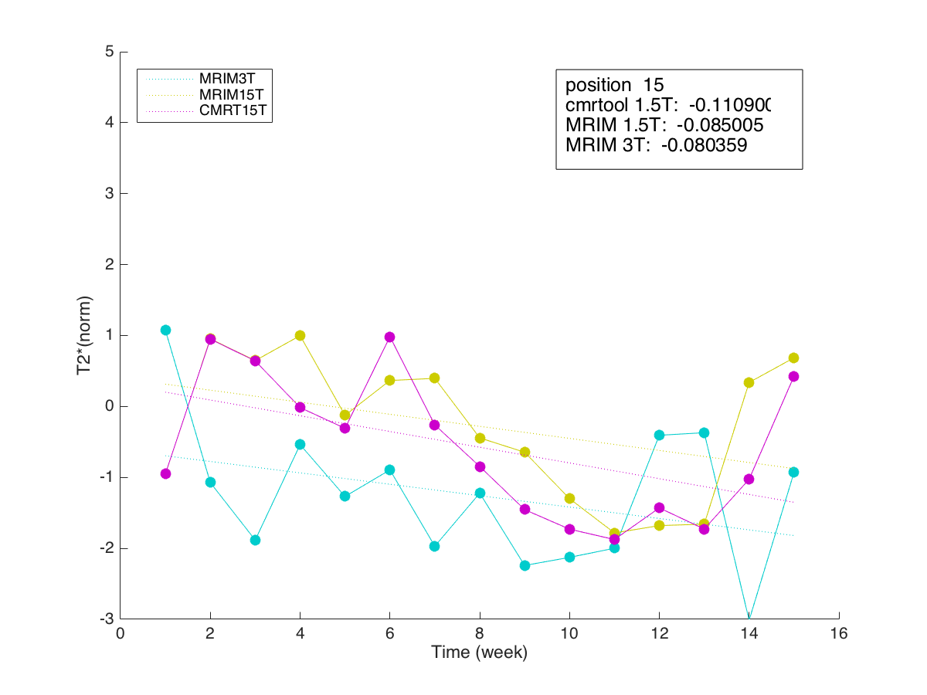
position 11-15
4 point condition

Slide 11
MEAN

Slide 12
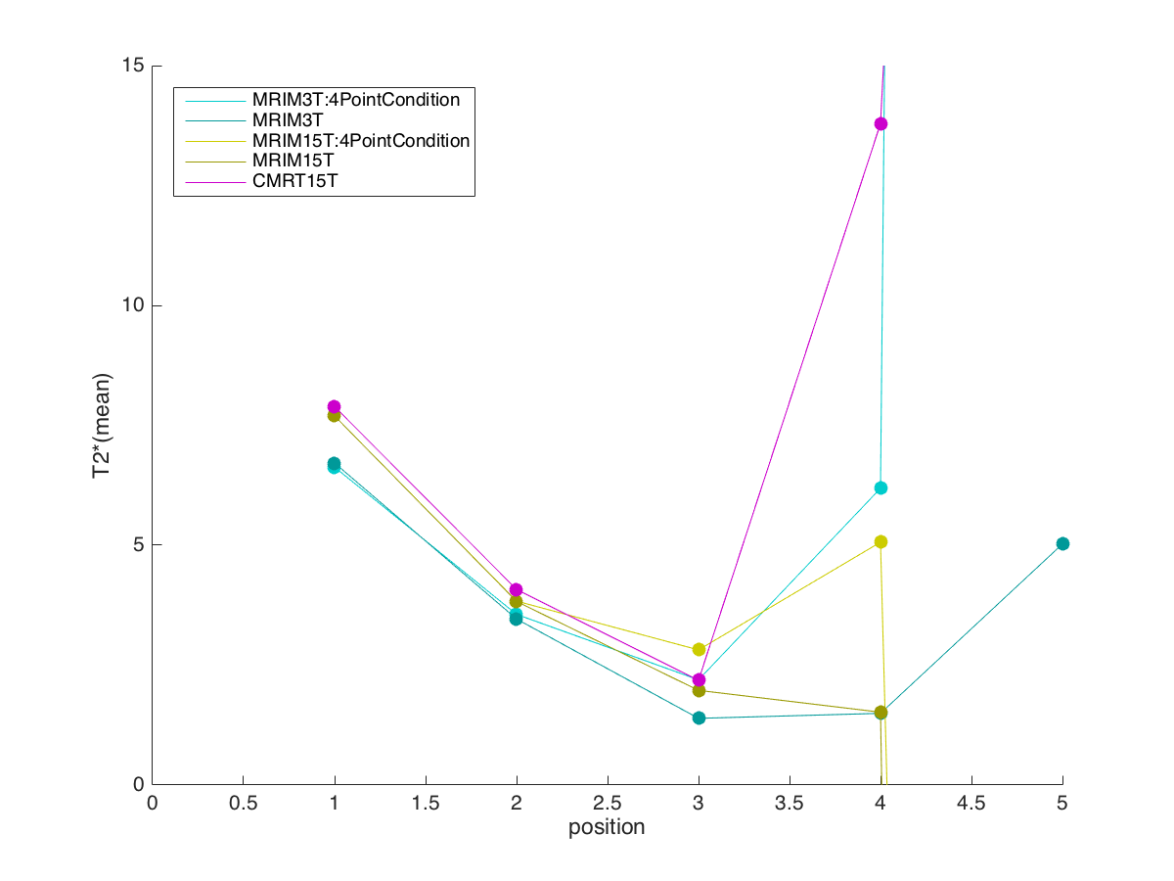
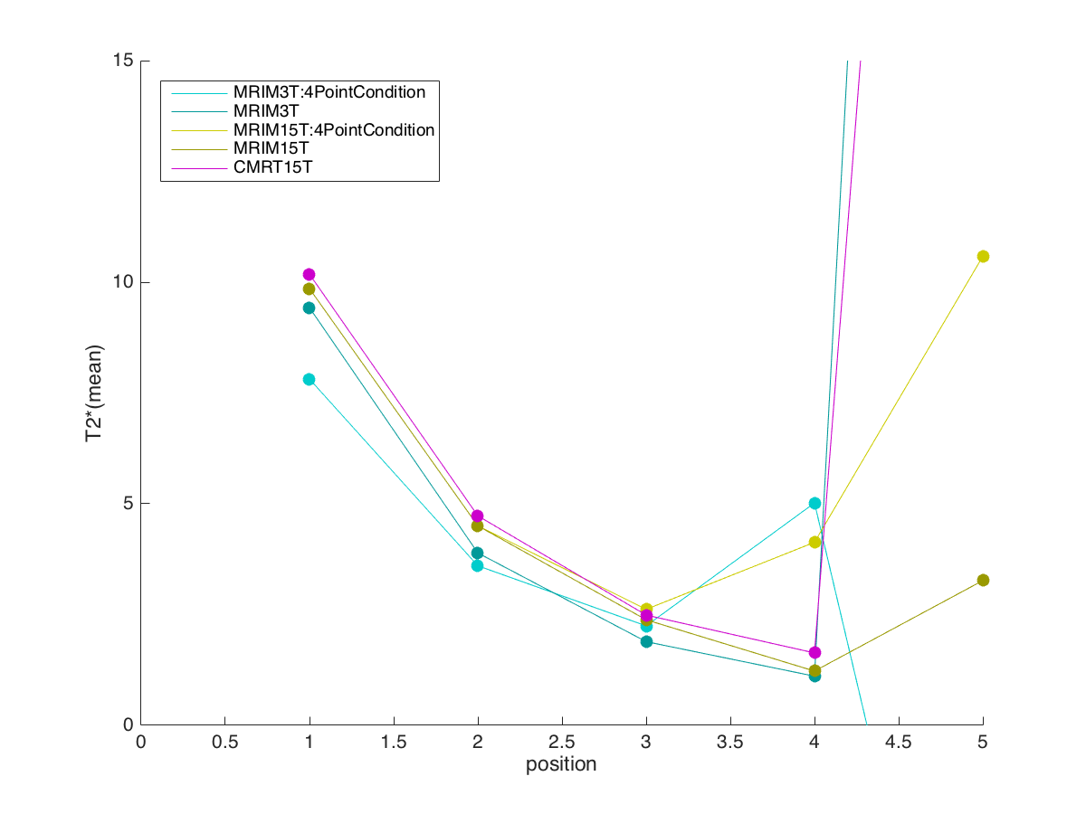
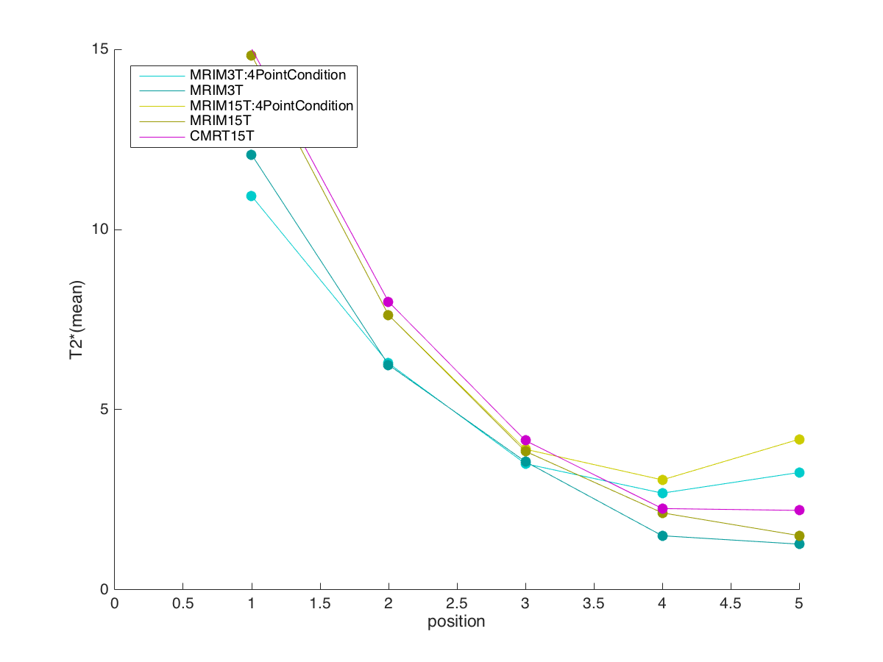
MEAN
Position 1-5
Position 6-10
Position 11-15

Slide 13
Table 1
position | CMRtools |  | 1.5T |  |  |  | 3T
 |  |  | MRIM |  | MRIM 4 point condition |  | MRIM |  | MRIM 4 point condition
 | mean | SD | mean | SD | mean | SD | mean | SD | mean | SD
1 | 7.891 | 0.306 | 7.695 | 0.308 | 7.695 | 0.308 | 6.714 | 0.889 | 6.627 | 0.607
2 | 4.077 | 0.163 | 3.827 | 0.151 | 3.834 | 0.145 | 3.461 | 0.225 | 3.557 | 0.204
3 | 2.182 | 0.107 | 1.973 | 0.084 | 2.817 | 0.159 | 1.389 | 0.204 | 2.193 | 0.312
4 | 13.791 | 4.738 | 1.518 | 0.176 | 5.063 | 0.550 | 1.494 | 0.437 | 6.187 | 1.903
5 | 87.078 | 15.830 | -220.396 | 885.739 | -136.752 | 793.372 | 5.026 | 29.404 | 401.455 | 972.472
6 | 10.179 | 0.423 | 9.854 | 0.381 | 9.854 | 0.381 | 9.423 | 1.871 | 7.813 | 1.163
7 | 4.727 | 0.172 | 4.500 | 0.162 | 4.500 | 0.162 | 3.889 | 0.684 | 3.599 | 0.480
8 | 2.487 | 0.099 | 2.380 | 0.112 | 2.617 | 0.092 | 1.887 | 0.227 | 2.243 | 0.381
9 | 1.633 | 0.089 | 1.223 | 0.070 | 4.130 | 0.550 | 1.108 | 0.128 | 5.018 | 1.310
10 | 50.522 | 11.821 | 3.266 | 1.049 | 10.585 | 3.261 | 71.781 | 366.119 | -11.071 | 22.250
11 | 15.017 | 0.650 | 14.832 | 0.651 | 14.832 | 0.651 | 12.076 | 2.976 | 10.928 | 1.533
12 | 7.997 | 0.392 | 7.628 | 0.397 | 7.628 | 0.397 | 6.243 | 0.486 | 6.289 | 0.507
13 | 4.142 | 0.192 | 3.844 | 0.207 | 3.902 | 0.183 | 3.558 | 0.387 | 3.499 | 0.373
14 | 2.256 | 0.104 | 2.137 | 0.231 | 3.052 | 0.241 | 1.501 | 0.199 | 2.684 | 0.428
15 | 2.205 | 0.334 | 1.505 | 0.088 | 4.178 | 0.373 | 1.269 | 0.254 | 3.257 | 0.626

Slide 14
Series & Echo Time

Slide 15
1.5T
series time | echo number
 | 1 | 2 | 3 | 4 | 5 | 6 | 7 | 8 | 9 | 10 | 11 | 12 | 13 | 14 | 15 | 16
220552 | 1.2400 | 3.2240 | 5.2080 | 7.1920 | 9.1760 | 11.1600 | 13.1440 | 15.1280 | 17.1120 | 19.0960 | 21.0800 | 23.0640 | 25.0480 | 27.0320 | 29.0160 | 31.0000
220648 | 1.2400 | 3.2240 | 5.2080 | 7.1920 | 9.1760 | 11.1600 | 13.1440 | 15.1280 | 17.1120 | 19.0960 | 21.0800 | 23.0640 | 25.0480 | 27.0320 | 29.0160 | 31.0000
220735 | 1.2400 | 3.2240 | 5.2080 | 7.1920 | 9.1760 | 11.1600 | 13.1440 | 15.1280 | 17.1120 | 19.0960 | 21.0800 | 23.0640 | 25.0480 | 27.0320 | 29.0160 | 31.0000
220821 | 1.2400 | 3.2240 | 5.2080 | 7.1920 | 9.1760 | 11.1600 | 13.1440 | 15.1280 | 17.1120 | 19.0960 | 21.0800 | 23.0640 | 25.0480 | 27.0320 | 29.0160 | 31.0000
220907 | 1.4760 | 3.7480 | 6.0200 | 8.2920 | 10.5640 | 12.8360 | 15.1080 | 17.3800 | 19.6520 | 21.9240 | 24.1960 | 26.4680 | 28.7400 | 31.0120 | 33.2840 | 35.5560
220953 | 1.6320 | 4.1200 | 6.6080 | 9.0960 | 11.5840 | 14.0720 | 16.5600 | 19.0480 | 21.5360 | 24.0240 | 26.5120 | 29.0000 | 31.4880 | 33.9760 | 36.4640 | 38.9520
221040 | 1.7680 | 4.4800 | 7.1920 | 9.9040 | 12.6160 | 15.3280 | 18.0400 | 20.7520 | 23.4640 | 26.1760 | 28.8880 | 31.6000 | 34.3120 | 37.0240 | 39.7360 | 42.4480
221126 | 2.0600 | 5.2520 | 8.4440 | 11.6360 | 14.8280 | 18.0200 | 21.2120 | 24.4040 | 27.5960 | 30.7880 | 33.9800 | 37.1720 | 40.3640 | 43.5560 | 46.7480 | 49.9400
221212 | 1.2400 | 3.2240 | 5.2080 | 7.1920 | 9.1760 | 11.1600 | 13.1440 | 15.1280 | 17.1120 | 19.0960 | 21.0800 | 23.0640 | 25.0480 | 27.0320 | 29.0160 | 31.0000
221258 | 1.2400 | 3.2240 | 5.2080 | 7.1920 | 9.1760 | 11.1600 | 13.1440 | 15.1280 | 17.1120 | 19.0960 | 21.0800 | 23.0640 | 25.0480 | 27.0320 | 29.0160 | 31.0000
221343 | 1.2400 | 3.2240 | 5.2080 | 7.1920 | 9.1760 | 11.1600 | 13.1440 | 15.1280 | 17.1120 | 19.0960 | 21.0800 | 23.0640 | 25.0480 | 27.0320 | 29.0160 | 31.0000
221430 | 1.2400 | 3.2240 | 5.2080 | 7.1920 | 9.1760 | 11.1600 | 13.1440 | 15.1280 | 17.1120 | 19.0960 | 21.0800 | 23.0640 | 25.0480 | 27.0320 | 29.0160 | 31.0000
221516 | 1.4760 | 3.7480 | 6.0200 | 8.2920 | 10.5640 | 12.8360 | 15.1080 | 17.3800 | 19.6520 | 21.9240 | 24.1960 | 26.4680 | 28.7400 | 31.0120 | 33.2840 | 35.5560
221602 | 1.6320 | 4.1200 | 6.6080 | 9.0960 | 11.5840 | 14.0720 | 16.5600 | 19.0480 | 21.5360 | 24.0240 | 26.5120 | 29.0000 | 31.4880 | 33.9760 | 36.4640 | 38.9520
221648 | 1.7680 | 4.4800 | 7.1920 | 9.9040 | 12.6160 | 15.3280 | 18.0400 | 20.7520 | 23.4640 | 26.1760 | 28.8880 | 31.6000 | 34.3120 | 37.0240 | 39.7360 | 42.4480
221734 | 2.0600 | 5.2520 | 8.4440 | 11.6360 | 14.8280 | 18.0200 | 21.2120 | 24.4040 | 27.5960 | 30.7880 | 33.9800 | 37.1720 | 40.3640 | 43.5560 | 46.7480 | 49.9400

Slide 16
3T
series time | echo number
 | 1 | 2 | 3 | 4 | 5 | 6 | 7 | 8 | 9 | 10 | 11 | 12 | 13 | 14 | 15 | 16 | 17 | 18
213352.7300 | 1.3010 | 3.0010 | 4.7010 | 6.4010 | 8.1010 | 9.8010 | 11.5010 | 13.2020 | 14.9020 | 16.6020 | 18.3020 | 20.0020 | 21.7020 | 23.4020 | 25.1020 | 26.8020 | 28.5020 | 30.2030
213537.4000 | 1.3010 | 3.0010 | 4.7010 | 6.4010 | 8.1010 | 9.8010 | 11.5010 | 13.2020 | 14.9020 | 16.6020 | 18.3020 | 20.0020 | 21.7020 | 23.4020 | 25.1020 | 26.8020 | 28.5020 | 30.2030
213708.6700 | 1.3010 | 3.0010 | 4.7010 | 6.4010 | 8.1010 | 9.8010 | 11.5010 | 13.2020 | 14.9020 | 16.6020 | 18.3020 | 20.0020 | 21.7020 | 23.4020 | 25.1020 | 26.8020 | 28.5020 | 30.2030
213840.0000 | 1.3010 | 3.0010 | 4.7010 | 6.4010 | 8.1010 | 9.8010 | 11.5010 | 13.2020 | 14.9020 | 16.6020 | 18.3020 | 20.0020 | 21.7020 | 23.4020 | 25.1020 | 26.8020 | 28.5020 | 30.2030
214017.8200 | 1.3010 | 3.0010 | 4.7010 | 6.4010 | 8.1010 | 9.8010 | 11.5010 | 13.2020 | 14.9020 | 16.6020 | 18.3020 | 20.0020 | 21.7020 | 23.4020 | 25.1020 | 26.8020 | 28.5020 | 30.2030
214149.0000 | 1.7010 | 3.4010 | 5.1010 | 6.8010 | 8.5010 | 10.2010 | 11.9010 | 13.6020 | 15.3020 | 17.0020 | 18.7020 | 20.4020 | 22.1020 | 23.8020 | 25.5020 | 27.2020 | 28.9020 | 30.6030
214320.4200 | 2.1010 | 3.8010 | 5.5010 | 7.2010 | 8.9010 | 10.6010 | 12.3010 | 14.0020 | 15.7020 | 17.4020 | 19.1020 | 20.8020 | 22.5020 | 24.2020 | 25.9020 | 27.6020 | 29.3020 | 31.0030
214458.2000 | 2.5010 | 4.2010 | 5.9010 | 7.6010 | 9.3010 | 11.0010 | 12.7010 | 14.4020 | 16.1020 | 17.8020 | 19.5020 | 21.2020 | 22.9020 | 24.6020 | 26.3020 | 28.0020 | 29.7020 | 31.4030
214629.3700 | 2.9010 | 4.6010 | 6.3010 | 8.0010 | 9.7010 | 11.4010 | 13.1010 | 14.8020 | 16.5020 | 18.2020 | 19.9020 | 21.6020 | 23.3020 | 25.0020 | 26.7020 | 28.4020 | 30.1020 | 31.8030

