Slide 1
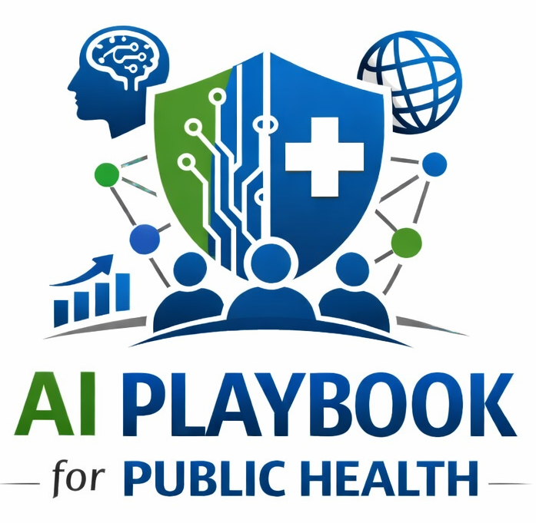
Lesson 1
Understanding Artificial Intelligence
Staff Training Module
AI Playbook and Toolkit for Public Health Departments
Generative and Agentic AI Implementation Playbook
Notes:
Welcome participants and explain that this is the first learning module in the AI Playbook and Toolkit for Public Health Departments.
Set expectations: this session is not about choosing a product or approving a pilot. It is about building shared language so staff, leaders, program teams, IT, privacy, legal, equity, procurement, and communications can participate in later decisions using the same vocabulary.
Emphasize that AI is already entering public health through vendor products, office productivity tools, analytics platforms, and informal staff experimentation. The department needs a common foundation before use cases move into readiness assessment, governance, procurement, or deployment.
Suggested opening question: When you hear the term AI, what kinds of tools or work activities come to mind?

Slide 2
AI PLAYBOOK AND TOOLKIT
Why this lesson comes first
Teams need a shared vocabulary before they can make responsible AI decisions.
Without shared language
With shared language
AI conversations can jump straight to vendors, tools, and pilots before staff agree on what the technology does, what risks it creates, and where humans remain accountable.
Public health teams can set guardrails, review use cases, ask better vendor questions, and explain AI-supported workflows to staff, partners, and communities.
Lesson 1: Understanding Artificial Intelligence
02
Notes:
Use this slide to explain why the learning section is intentionally placed early in the playbook. Public health departments should not begin with vendor demonstrations or tool selection. They should begin with shared understanding.
Without shared language, different teams may use the same words to mean different things. One person may think AI means a chatbot, another may think predictive analytics, and another may think automation across systems. That confusion can lead to weak governance, vague procurement requirements, or unmanaged staff use.
With shared language, the department can ask more precise questions: What data are involved? Is the system generating text, predicting risk, or taking workflow actions? Who reviews the output? What can the AI not do? What must be documented?
Facilitation prompt: Ask participants to name one AI-related term they have heard recently and whether everyone in the room would define it the same way.

Slide 3
AI PLAYBOOK AND TOOLKIT
Learning objectives
By the end of this lesson, staff should be able to:
• Define artificial intelligence in plain language.
• Distinguish generative AI, predictive AI, and agentic AI.
• Identify where AI can support public health work without replacing human judgment.
• Recognize why privacy, equity, transparency, validation, and monitoring must be planned early.
• Connect AI concepts to the playbook’s readiness, governance, and use case review steps.
Lesson 1: Understanding Artificial Intelligence
03
Notes:
Walk through the learning objectives and connect each objective to a later implementation decision.
The first objective is plain-language definition. Staff do not need to become data scientists, but they do need enough shared vocabulary to recognize different kinds of AI use.
The second objective distinguishes generative, predictive, and agentic AI because each category creates different operational and governance questions.
The third objective emphasizes support rather than replacement. In public health, AI should help staff organize, draft, detect, summarize, or route information while humans remain accountable for interpretation and consequential decisions.
The fourth objective introduces the safeguards that will recur across the playbook: privacy, equity, transparency, validation, monitoring, and accountability.
The fifth objective connects learning to action. This module should prepare participants for Play 1 Vision and Guardrails, Play 2 Readiness Assessment, and Play 3 Governance.

Slide 4
AI PLAYBOOK AND TOOLKIT
Module overview
Artificial intelligence is not one product or one capability.
AI is a family of methods that enable computer systems to learn from data, recognize patterns, generate new content, and support action toward defined goals. In public health, AI should be understood as an operational capability that needs governance, data safeguards, staff training, and monitoring.
Definition
Public health framing
Artificial intelligence enables systems to perform tasks that normally require human-like pattern recognition, language understanding, prediction, generation, or decision support.
AI should support public health professionals, not quietly replace accountability, community relationships, or final decisions in consequential workflows.
Lesson 1: Understanding Artificial Intelligence
04
Notes:
Use this slide as the central definition for the session. Keep the definition practical rather than technical.
Explain that AI includes multiple methods and capabilities. Some tools classify records, some forecast trends, some draft text, and some coordinate tasks across systems.
For public health, the key point is not whether a tool is impressive. The key point is whether it supports a legitimate public health purpose, uses appropriate data, can be reviewed by humans, and can be monitored for safety, equity, and performance.
Stress the public health framing: AI should not replace community trust, program expertise, epidemiologic judgment, legal accountability, or leadership responsibility.
Transition: Once the group has a working definition of AI, the next step is distinguishing major categories of AI use.

Slide 5
AI PLAYBOOK AND TOOLKIT
The most relevant AI categories are different
Generative AI
Predictive AI
Agentic AI
Produces new text, images, code, summaries, translations, or synthetic data from prompts and source material.
Uses patterns in data to estimate risk, classify records, forecast trends, or detect anomalies.
Coordinates multi-step workflows across systems under rules, approvals, and audit logs.
The category matters because each one creates different review questions, data needs, staffing requirements, and safeguards.
Lesson 1: Understanding Artificial Intelligence
05
Notes:
Explain that these categories are simplified for training. A real system may combine more than one category, but the distinctions help staff ask better questions.
Generative AI produces new content. In public health this may include drafts of health education materials, summaries of guidance, translations, grant narratives, or briefing language.
Predictive AI estimates, classifies, forecasts, or detects patterns. Examples might include anomaly detection in surveillance data, risk stratification, or forecasting service demand.
Agentic AI coordinates multi-step workflows. It may gather information, update a task queue, prepare a draft, or route an item to a team based on defined rules.
The governance implications are different. Generative AI needs source checking and content review. Predictive AI needs validation and subgroup monitoring. Agentic AI needs boundaries, audit logs, permissions, and escalation rules.
Ask participants: Which of these categories seems most likely to appear first in your own department?

Slide 6
AI PLAYBOOK AND TOOLKIT
Generative AI drafts, summarizes, and translates
Generative AI is useful when the task involves language, structure, synthesis, or first-draft support.
• Draft health education materials, FAQs, grant narratives, and internal briefings.
• Summarize long guidance, reports, policies, or literature for expert review.
• Translate technical findings into plain language for different audiences.
• Help staff organize evidence, but not certify that the evidence is correct.
Training point
Generated content can sound fluent while being incomplete, unsupported, or wrong. Public-facing and consequential outputs require source checking and subject matter review.
Lesson 1: Understanding Artificial Intelligence
06
Notes:
Use this slide to make generative AI concrete. Many staff will encounter generative AI first through office tools, search tools, chat interfaces, writing assistants, or vendor products.
Emphasize that drafting support can be useful when the task is bounded and reviewable. Examples include a first draft of an FAQ, a summary of internal notes, or plain-language translation of technical findings.
Then explain the risk: generative AI can produce fluent language without reliable grounding. It may invent citations, omit caveats, overstate certainty, or fail to reflect local context.
For public-facing materials, staff should verify source guidance, check accuracy, confirm literacy and language access needs, and route content through existing communications approval.
For sensitive materials, staff must know which tools are approved and which data are prohibited from use in public or unapproved AI systems.
Facilitation prompt: What kinds of documents or messages in your department might benefit from first-draft support, and which should never be released without expert review?

Slide 7
AI PLAYBOOK AND TOOLKIT
Agentic AI can act across workflow steps
Agentic AI can monitor inputs, gather information, prepare outputs, update task queues, and route work. That makes boundaries and oversight essential.
Appropriate support
Required controls
Assemble an evidence packet, draft a situation brief, flag a dashboard threshold, or route a task for human review.
Use role-based permissions, audit logs, approved data sources, escalation rules, and human approval before external communication or public health action.
Agentic systems should never quietly expand from support tasks into unapproved decisions.
Lesson 1: Understanding Artificial Intelligence
07
Notes:
Use this slide to explain why agentic AI is different from a drafting tool. Agentic systems may not only generate content; they may coordinate steps in a workflow.
Give a public health example: a system monitors incoming reports, identifies a possible signal, gathers related laboratory and syndromic data, creates a draft briefing note, and routes the packet to epidemiology staff.
That kind of support could save time, but it also increases risk because the AI is interacting with systems, data, queues, and workflows.
Required controls include role-based permissions, approved data sources, audit logs, human approval before external communication, and clear escalation rules.
Reinforce the bottom line: agentic systems should not quietly move from support to decision-making. If the system begins to change records, contact partners, prioritize people, trigger public alerts, or initiate action, governance approval and stronger controls are required.
Ask participants: What actions should AI never be allowed to take without human approval in your department?

Slide 8
AI PLAYBOOK AND TOOLKIT
Public health AI use should be bounded and reviewable
A good AI use case has a clear public health purpose, known data sources, named human owners, documented limits, and a monitoring plan.
Before use
During use
After use
Assess readiness, classify data, establish governance, and define what the AI may and may not do.
Require human review, document decisions, track concerns, and monitor performance across groups.
Review results, incidents, drift, equity impacts, and whether the system should be changed, scaled, paused, or retired.
Lesson 1: Understanding Artificial Intelligence
08
Notes:
This slide connects the lesson to implementation discipline. AI should be bounded, reviewable, and monitored across the lifecycle.
Before use, the department should assess readiness, classify data, establish governance, define the use case, and decide what the AI may and may not do.
During use, humans need review points, documentation expectations, and escalation pathways. Staff should know how to report unsafe outputs, privacy concerns, equity concerns, or workflow problems.
After use, the department should monitor whether the system continues to perform as expected. This includes technical performance, public health value, equity, staff adoption, data quality, and incident history.
Use this slide to preview the playbook sequence: readiness, governance, use case prioritization, deployment support, monitoring, and oversight.
Transition: The next slide turns the concepts into a short training exercise.

Slide 9
AI PLAYBOOK AND TOOLKIT
Training exercise
Apply the lesson to one workflow in your department.
• Choose one workflow where staff are curious about AI support.
• Identify whether the idea is generative, predictive, agentic, or a combination.
• Write what AI may support and what humans must still decide.
• List the data involved, review steps, and likely risks.
• Name the playbook play or tool that should be completed next.
Expected output
A short AI concept note that can feed into readiness assessment, governance review, or use case prioritization.
Lesson 1: Understanding Artificial Intelligence
09
Notes:
Use this slide as an individual or small-group exercise. Give participants 10 to 15 minutes if this is a facilitated session.
Ask each group to choose one workflow, not one tool. Examples could include drafting public messages, summarizing inspection findings, monitoring surveillance signals, routing partner requests, or preparing grant narratives.
Have groups identify whether the idea is primarily generative, predictive, agentic, or a combination. The goal is not perfect categorization; the goal is learning to ask better governance questions.
Then ask groups to define what AI may support and what humans must still decide. This is the start of a human-centered decision rule.
Groups should list the data involved and any obvious risks, such as PHI exposure, inaccurate outputs, bias, language access, public trust, or staff workload.
The expected output should be a short AI concept note that could later feed into the readiness assessment, governance intake, or use case prioritization process.

Slide 10
AI PLAYBOOK AND TOOLKIT
What staff should take away
AI can support public health work, but responsible use starts with shared understanding.
1
2
3
AI is a family of capabilities, not one tool.
Different AI categories need different safeguards.
Governance, readiness, and human accountability come before deployment.
Next step: use this lesson before Play 1, Play 2, and Play 3 discussions so staff share a practical vocabulary for AI decisions.
Lesson 1: Understanding Artificial Intelligence
10
Notes:
Use this slide to close the instructional part of the deck. Reinforce three takeaways.
First, AI is a family of capabilities. Staff should not assume all AI uses carry the same risks or require the same controls.
Second, different categories of AI need different safeguards. Generative AI requires content review and source checking; predictive AI requires validation and subgroup monitoring; agentic AI requires workflow boundaries and auditability.
Third, governance, readiness, and human accountability come before deployment. This is the reason the playbook begins with vision, readiness assessment, and governance before tool selection or pilot approval.
Recommended close: Ask participants to name one thing they would now ask before approving or using an AI-enabled tool.
Transition to resources or to the next live activity, such as completing the readiness assessment or drafting an AI concept note.

Slide 11
AI PLAYBOOK AND TOOLKIT
References and resources
Use these resources to support staff learning and governance conversations.
• NIST AI Risk Management Framework: risk, governance, mapping, measurement, and management.
• World Health Organization guidance on ethics and governance of AI for health.
• HHS resources on civil rights, privacy, and responsible AI use in health contexts.
• AI Playbook and Toolkit pages for Readiness Assessment, Governance, and Use Case Prioritization.
For training use: adapt discussion questions and exercises to local policies, data systems, community context, and approved AI tools.
Lesson 1: Understanding Artificial Intelligence
11
Notes:
Close by pointing participants to resources that can support deeper learning and governance work.
NIST AI RMF is useful for risk framing, governance, mapping, measurement, and management. It can help structure conversations about what needs to be documented and monitored.
WHO guidance is useful for ethics and governance concepts in health contexts, especially transparency, accountability, human oversight, and safety.
HHS resources can support civil rights, privacy, and responsible AI considerations in health settings.
Remind participants that the AI Playbook and Toolkit translate these broader frameworks into practical public health plays and tools.
If using this deck in a live session, end by identifying the next action: complete the readiness assessment, convene a governance discussion, draft an AI vision statement, or submit a candidate use case for review.

