Slide 1
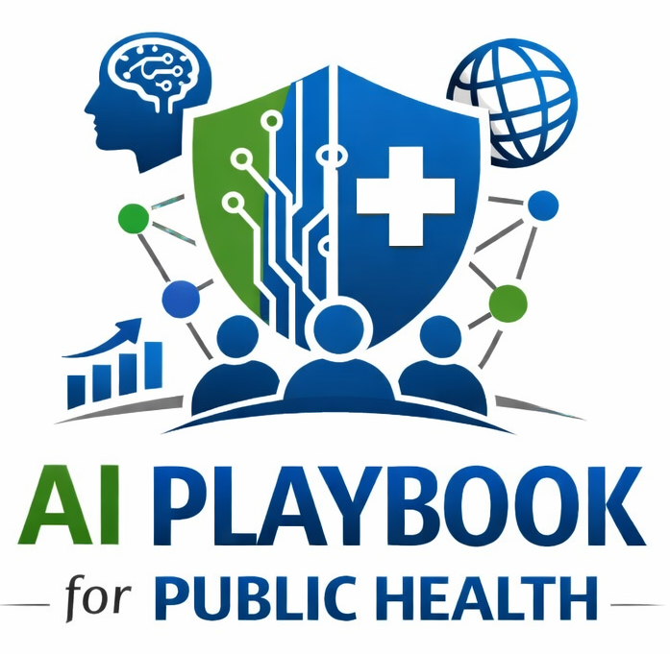
Understanding Artificial Intelligence
A staff training module for public health departments
Use this lesson to build a shared vocabulary before teams select tools, approve pilots, review vendors, or use AI in public health workflows.
AI Playbook and Toolkit for Public Health Departments

Slide 2
AI PLAYBOOK AND TOOLKIT
Why this lesson comes first
Teams need a shared vocabulary before they can make responsible AI decisions.
Without shared language
With shared language
AI conversations can jump straight to vendors, tools, and pilots before staff agree on what the technology does, what risks it creates, and where humans remain accountable.
Public health teams can set guardrails, review use cases, ask better vendor questions, and explain AI-supported workflows to staff, partners, and communities.
Lesson 1: Understanding Artificial Intelligence
02

Slide 3
AI PLAYBOOK AND TOOLKIT
Learning objectives
By the end of this lesson, staff should be able to:
• Define artificial intelligence in plain language.
• Distinguish generative AI, predictive AI, and agentic AI.
• Identify where AI can support public health work without replacing human judgment.
• Recognize why privacy, equity, transparency, validation, and monitoring must be planned early.
• Connect AI concepts to the playbook’s readiness, governance, and use case review steps.
Lesson 1: Understanding Artificial Intelligence
03

Slide 4
AI PLAYBOOK AND TOOLKIT
Module overview
Artificial intelligence is not one product or one capability.
AI is a family of methods that enable computer systems to learn from data, recognize patterns, generate new content, and support action toward defined goals. In public health, AI should be understood as an operational capability that needs governance, data safeguards, staff training, and monitoring.
Definition
Public health framing
Artificial intelligence enables systems to perform tasks that normally require human-like pattern recognition, language understanding, prediction, generation, or decision support.
AI should support public health professionals, not quietly replace accountability, community relationships, or final decisions in consequential workflows.
Lesson 1: Understanding Artificial Intelligence
04

Slide 5
AI PLAYBOOK AND TOOLKIT
The most relevant AI categories are different
Generative AI
Predictive AI
Agentic AI
Produces new text, images, code, summaries, translations, or synthetic data from prompts and source material.
Uses patterns in data to estimate risk, classify records, forecast trends, or detect anomalies.
Coordinates multi-step workflows across systems under rules, approvals, and audit logs.
The category matters because each one creates different review questions, data needs, staffing requirements, and safeguards.
Lesson 1: Understanding Artificial Intelligence
05

Slide 6
AI PLAYBOOK AND TOOLKIT
Generative AI drafts, summarizes, and translates
Generative AI is useful when the task involves language, structure, synthesis, or first-draft support.
• Draft health education materials, FAQs, grant narratives, and internal briefings.
• Summarize long guidance, reports, policies, or literature for expert review.
• Translate technical findings into plain language for different audiences.
• Help staff organize evidence, but not certify that the evidence is correct.
Training point
Generated content can sound fluent while being incomplete, unsupported, or wrong. Public-facing and consequential outputs require source checking and subject matter review.
Lesson 1: Understanding Artificial Intelligence
06

Slide 7
AI PLAYBOOK AND TOOLKIT
Agentic AI can act across workflow steps
Agentic AI can monitor inputs, gather information, prepare outputs, update task queues, and route work. That makes boundaries and oversight essential.
Appropriate support
Required controls
Assemble an evidence packet, draft a situation brief, flag a dashboard threshold, or route a task for human review.
Use role-based permissions, audit logs, approved data sources, escalation rules, and human approval before external communication or public health action.
Agentic systems should never quietly expand from support tasks into unapproved decisions.
Lesson 1: Understanding Artificial Intelligence
07

Slide 8
AI PLAYBOOK AND TOOLKIT
Public health AI use should be bounded and reviewable
A good AI use case has a clear public health purpose, known data sources, named human owners, documented limits, and a monitoring plan.
Before use
During use
After use
Assess readiness, classify data, establish governance, and define what the AI may and may not do.
Require human review, document decisions, track concerns, and monitor performance across groups.
Review results, incidents, drift, equity impacts, and whether the system should be changed, scaled, paused, or retired.
Lesson 1: Understanding Artificial Intelligence
08

Slide 9
AI PLAYBOOK AND TOOLKIT
Training exercise
Apply the lesson to one workflow in your department.
• Choose one workflow where staff are curious about AI support.
• Identify whether the idea is generative, predictive, agentic, or a combination.
• Write what AI may support and what humans must still decide.
• List the data involved, review steps, and likely risks.
• Name the playbook play or tool that should be completed next.
Expected output
A short AI concept note that can feed into readiness assessment, governance review, or use case prioritization.
Lesson 1: Understanding Artificial Intelligence
09

Slide 10
AI PLAYBOOK AND TOOLKIT
What staff should take away
AI can support public health work, but responsible use starts with shared understanding.
1
2
3
AI is a family of capabilities, not one tool.
Different AI categories need different safeguards.
Governance, readiness, and human accountability come before deployment.
Next step: use this lesson before Play 1, Play 2, and Play 3 discussions so staff share a practical vocabulary for AI decisions.
Lesson 1: Understanding Artificial Intelligence
10

Slide 11
AI PLAYBOOK AND TOOLKIT
References and resources
Use these resources to support staff learning and governance conversations.
• NIST AI Risk Management Framework: risk, governance, mapping, measurement, and management.
• World Health Organization guidance on ethics and governance of AI for health.
• HHS resources on civil rights, privacy, and responsible AI use in health contexts.
• AI Playbook and Toolkit pages for Readiness Assessment, Governance, and Use Case Prioritization.
For training use: adapt discussion questions and exercises to local policies, data systems, community context, and approved AI tools.
Lesson 1: Understanding Artificial Intelligence
11

