Slide 1
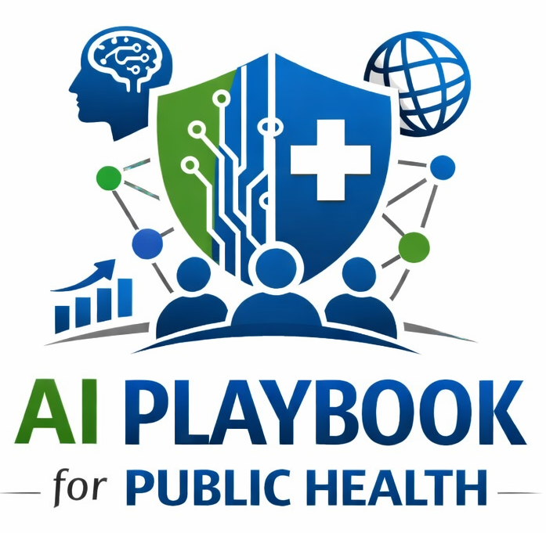
Lesson 5
AI-Supported Public Health Workflows
Staff Training Module
AI Playbook and Toolkit for Public Health Departments
Notes:
Welcome participants to the AI-Supported Public Health Workflows lesson.
Explain that this deck is designed for staff training, leadership orientation, governance preparation, or cross-program discussion.
Frame the topic in plain language: AI can support signal detection, evidence gathering, analysis, synthesis, briefing, communication, and decision support.
Invite participants to think about where this topic already appears in their department's workflows, vendor tools, data systems, communications, or planning conversations.

Slide 2
AI PLAYBOOK AND TOOLKIT
Why this topic matters
AI can support signal detection, evidence gathering, analysis, synthesis, briefing, communication, and decision support.
Public health value
Guardrail
AI projects often fail when they are not anchored in a real workflow. Public health work includes handoffs, legal authorities, partner relationships, community trust, and time-sensitive decisions. Workflow mapping helps agencies find where AI.
Match the tool to workflow stage and keep humans responsible for decisions.
AI-Supported Public Health Workflows
02
Notes:
Use this slide in the AI-Supported Public Health Workflows training module.
Use this slide to explain the practical public health reason for learning this topic before AI tools are approved or deployed.
Connect the discussion back to the playbook: this topic supports Plays 7, 10, 11 and Tools 31, 29, 41.
Emphasize the core guardrail: Match the tool to workflow stage and keep humans responsible for decisions.
Ask participants how this topic could affect their own program area, staff roles, community relationships, data, or public communications.

Slide 3
AI PLAYBOOK AND TOOLKIT
Learning objectives
By the end of this lesson, staff should be able to:
• Explain AI-Supported Public Health Workflows in plain language.
• Identify appropriate public health uses and limits.
• Describe human review, governance, equity, privacy, and monitoring expectations.
• Connect the topic to the related plays and tools.
AI-Supported Public Health Workflows
03
Notes:
Use this slide in the AI-Supported Public Health Workflows training module.
Walk through the objectives and connect each one to a practical implementation decision.
Connect the discussion back to the playbook: this topic supports Plays 7, 10, 11 and Tools 31, 29, 41.
Explain that participants do not need technical expertise to use this material. The goal is enough shared understanding to participate in governance, readiness assessment, use case review, procurement, deployment, or monitoring.

Slide 4
AI PLAYBOOK AND TOOLKIT
Module overview
AI is most useful when it is tied to a specific public health workflow rather than introduced as a general productivity tool. Workflow mapping helps teams identify where AI could support signal detection, evidence gathering, analysis, synthesis, communication, decision support, documentation, monitoring, or service delivery without displacing accountability.
Working definition
AI can support signal detection, evidence gathering, analysis, synthesis, briefing, communication, and decision support.
AI-Supported Public Health Workflows
04
Notes:
Use this slide in the AI-Supported Public Health Workflows training module.
Use this slide to provide the narrative overview and definition before moving into detailed application.
Connect the discussion back to the playbook: this topic supports Plays 7, 10, 11 and Tools 31, 29, 41.
Ask the group to restate the topic in their own words.

Slide 5
AI PLAYBOOK AND TOOLKIT
What this means in practice
Workflow Mapping Questions
Potential AI Support
Design Safeguards
What event starts the workflow, and what output ends it? Where do staff spend time searching, summarizing, routing, checking, rewriting, or reconciling information? Which steps require judgment, legal authority, community relationship,.
Detect unusual patterns and prepare alerts for human review. Summarize reports, partner updates, inspection notes, or case records into structured fields. Draft situation reports, FAQs, or internal updates from approved source material. Track.
Keep AI support close to the staff workflow and test whether it actually saves time or improves quality. Measure false positives, false negatives, staff burden, equity effects, and downstream operational impact. Make handoffs explicit so staff.
AI-Supported Public Health Workflows
05
Notes:
Use this slide in the AI-Supported Public Health Workflows training module.
Use this slide to turn the concept into practical behaviors, decisions, and safeguards.
Connect the discussion back to the playbook: this topic supports Plays 7, 10, 11 and Tools 31, 29, 41.
Invite participants to identify where these practices would need to be documented in their own department.
Start with Workflow Mapping Questions, then compare it with the other practice areas on the slide.

Slide 6
AI PLAYBOOK AND TOOLKIT
Public health application
Use the topic to examine real workflows, not abstract technology.
Detect anomalies
Synthesize outbreak updates
Draft situation reports
Flag unusual changes in surveillance, laboratory, syndromic, environmental, or service-utilization data for staff investigation.
Combine situation reports, surveillance data, partner updates, and public communications into a concise operational update.
Create an initial SitRep structure with current status, risks, actions taken, resource needs, and next operational decisions.
AI-Supported Public Health Workflows
06
Notes:
Use this slide in the AI-Supported Public Health Workflows training module.
Use this slide to make the topic concrete through public health workflow examples.
Connect the discussion back to the playbook: this topic supports Plays 7, 10, 11 and Tools 31, 29, 41.
For each example, ask: What problem is being solved? What data would be used? Who reviews the AI output? What decision remains human? What could go wrong?

Slide 7
AI PLAYBOOK AND TOOLKIT
Facilitated discussion and exercise
Discussion questions
Training exercise
What problem in the workflow is AI expected to solve? Where does the workflow require professional judgment, legal authority, or community knowledge? How will staff know whether AI improves timeliness, quality, consistency, equity, or workload?
Choose one workflow and map the trigger, inputs, staff roles, decisions, outputs, handoffs, risks, and performance measures. Identify one AI support point and one step that should remain fully human-controlled.
AI-Supported Public Health Workflows
07
Notes:
Use this slide in the AI-Supported Public Health Workflows training module.
Use this slide for a facilitated activity near the end of the lesson.
Connect the discussion back to the playbook: this topic supports Plays 7, 10, 11 and Tools 31, 29, 41.
Give participants time to work individually or in small groups. Ask them to produce a practical artifact that can feed into readiness assessment, governance review, use case prioritization, or implementation planning.
Expected takeaways include: AI workflow map, Workflow risk and control table, Pilot success measures.

Slide 8
AI PLAYBOOK AND TOOLKIT
Next steps and resources
Apply the lesson
References and resources
Use this topic with Plays 7, 10, 11 and Tools 31, 29, 41. Turn the discussion into a documented question, decision, gap, or implementation artifact.
CDC Data Modernization Initiative: Context for modern public health data flows and AI-ready infrastructure. CDC STLT Data Connection: Peer-learning resource for public health data modernization and workflow improvement. NIST AI Risk Management.
AI-Supported Public Health Workflows
08
Notes:
Use this slide in the AI-Supported Public Health Workflows training module.
Close by connecting the lesson to next actions and resources.
Connect the discussion back to the playbook: this topic supports Plays 7, 10, 11 and Tools 31, 29, 41.
Point participants to the first resource: CDC Data Modernization Initiative.
End by asking each participant or team to name one follow-up action they will take after the session.

