Slide 1
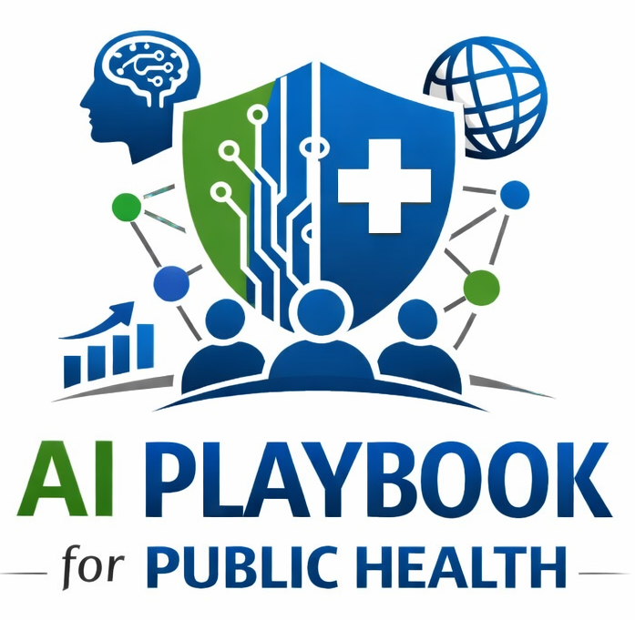
Lesson 6
Risks, Limitations, and Guardrails
Staff Training Module
AI Playbook and Toolkit for Public Health Departments
Notes:
Welcome participants to the Risks, Limitations, and Guardrails lesson.
Explain that this deck is designed for staff training, leadership orientation, governance preparation, or cross-program discussion.
Frame the topic in plain language: Public health AI risks include hallucination, bias, privacy exposure, automation bias, model drift, and performance loss on complex tasks.
Invite participants to think about where this topic already appears in their department's workflows, vendor tools, data systems, communications, or planning conversations.

Slide 2
AI PLAYBOOK AND TOOLKIT
Why this topic matters
Public health AI risks include hallucination, bias, privacy exposure, automation bias, model drift, and performance loss on complex tasks.
Public health value
Guardrail
Responsible AI risk management is not a one-time checklist. Public health risks change as data, models, vendors, disease patterns, staff behavior, and community needs change. Agencies need repeatable risk review methods that can be used before.
Governance, documentation, validation, and monitoring are mandatory, not optional.
Risks, Limitations, and Guardrails
02
Notes:
Use this slide in the Risks, Limitations, and Guardrails training module.
Use this slide to explain the practical public health reason for learning this topic before AI tools are approved or deployed.
Connect the discussion back to the playbook: this topic supports Plays 3, 11, 12, 13 and Tools 3, 16, 14, 47, 17.
Emphasize the core guardrail: Governance, documentation, validation, and monitoring are mandatory, not optional.
Ask participants how this topic could affect their own program area, staff roles, community relationships, data, or public communications.

Slide 3
AI PLAYBOOK AND TOOLKIT
Learning objectives
By the end of this lesson, staff should be able to:
• Explain Risks, Limitations, and Guardrails in plain language.
• Identify appropriate public health uses and limits.
• Describe human review, governance, equity, privacy, and monitoring expectations.
• Connect the topic to the related plays and tools.
Risks, Limitations, and Guardrails
03
Notes:
Use this slide in the Risks, Limitations, and Guardrails training module.
Walk through the objectives and connect each one to a practical implementation decision.
Connect the discussion back to the playbook: this topic supports Plays 3, 11, 12, 13 and Tools 3, 16, 14, 47, 17.
Explain that participants do not need technical expertise to use this material. The goal is enough shared understanding to participate in governance, readiness assessment, use case review, procurement, deployment, or monitoring.

Slide 4
AI PLAYBOOK AND TOOLKIT
Module overview
AI risks in public health are not limited to technical errors. They include privacy exposure, hallucinated guidance, biased prioritization, automation bias, model drift, vendor opacity, accessibility barriers, environmental burden, and loss of public trust. Risk management should begin before tool selection and continue through deployment and monitoring.
Working definition
Public health AI risks include hallucination, bias, privacy exposure, automation bias, model drift, and performance loss on complex tasks.
Risks, Limitations, and Guardrails
04
Notes:
Use this slide in the Risks, Limitations, and Guardrails training module.
Use this slide to provide the narrative overview and definition before moving into detailed application.
Connect the discussion back to the playbook: this topic supports Plays 3, 11, 12, 13 and Tools 3, 16, 14, 47, 17.
Ask the group to restate the topic in their own words.

Slide 5
AI PLAYBOOK AND TOOLKIT
What this means in practice
Common Risk Categories
Mitigation Practices
Governance Triggers
Accuracy risk: the output is wrong, incomplete, out of date, or unsupported by evidence. Equity risk: the system performs worse for a subgroup, language community, rural area, disability group, Tribal community, or. Privacy and security risk:.
Use risk tiers so higher-impact systems receive deeper review, documentation, validation, and monitoring. Require human review, source verification, and documented decision ownership. Test outputs with realistic public health examples before.
Escalate to governance when AI affects public communication, eligibility, enforcement, surveillance prioritization, resource. Pause or retire systems when risk controls fail, performance changes, or the use no longer aligns with agency.
Risks, Limitations, and Guardrails
05
Notes:
Use this slide in the Risks, Limitations, and Guardrails training module.
Use this slide to turn the concept into practical behaviors, decisions, and safeguards.
Connect the discussion back to the playbook: this topic supports Plays 3, 11, 12, 13 and Tools 3, 16, 14, 47, 17.
Invite participants to identify where these practices would need to be documented in their own department.
Start with Common Risk Categories, then compare it with the other practice areas on the slide.

Slide 6
AI PLAYBOOK AND TOOLKIT
Public health application
Use the topic to examine real workflows, not abstract technology.
Equity audit before scale
Hallucination audit for public-facing products
Incident response for unsafe outputs
Review subgroup performance, access barriers, language needs, and potential disparate impacts before a pilot expands.
Test generated content against authoritative sources and require correction before public release.
Document unsafe, biased, private, or inaccurate outputs and route them through escalation, containment, and corrective action.
Risks, Limitations, and Guardrails
06
Notes:
Use this slide in the Risks, Limitations, and Guardrails training module.
Use this slide to make the topic concrete through public health workflow examples.
Connect the discussion back to the playbook: this topic supports Plays 3, 11, 12, 13 and Tools 3, 16, 14, 47, 17.
For each example, ask: What problem is being solved? What data would be used? Who reviews the AI output? What decision remains human? What could go wrong?

Slide 7
AI PLAYBOOK AND TOOLKIT
Facilitated discussion and exercise
Discussion questions
Training exercise
What harms could occur if the AI output is wrong, biased, delayed, misunderstood, or over-trusted? What data, populations, or workflows are most vulnerable to error? What conditions should trigger pause, review, correction, or retirement?
Select a proposed AI use case and identify risks across accuracy, privacy, security, equity, transparency, workforce burden, legal authority, and public trust. Define one mitigation for each risk.
Risks, Limitations, and Guardrails
07
Notes:
Use this slide in the Risks, Limitations, and Guardrails training module.
Use this slide for a facilitated activity near the end of the lesson.
Connect the discussion back to the playbook: this topic supports Plays 3, 11, 12, 13 and Tools 3, 16, 14, 47, 17.
Give participants time to work individually or in small groups. Ask them to produce a practical artifact that can feed into readiness assessment, governance review, use case prioritization, or implementation planning.
Expected takeaways include: Risk register, Mitigation plan, Incident escalation criteria.

Slide 8
AI PLAYBOOK AND TOOLKIT
Next steps and resources
Apply the lesson
References and resources
Use this topic with Plays 3, 11, 12, 13 and Tools 3, 16, 14, 47, 17. Turn the discussion into a documented question, decision, gap, or implementation artifact.
NIST AI Risk Management Framework: Core framework for identifying, measuring, managing, and governing AI risk. HHS Civil Rights and AI: Civil rights and nondiscrimination considerations for AI in health and human services. WHO: Ethics and.
Risks, Limitations, and Guardrails
08
Notes:
Use this slide in the Risks, Limitations, and Guardrails training module.
Close by connecting the lesson to next actions and resources.
Connect the discussion back to the playbook: this topic supports Plays 3, 11, 12, 13 and Tools 3, 16, 14, 47, 17.
Point participants to the first resource: NIST AI Risk Management Framework.
End by asking each participant or team to name one follow-up action they will take after the session.

